Slide 1
How Variables Are Stored
Variables are nothing more than reserved memory locations to store values.

Slide 2
How Variables Are Stored
At least we choose to think of it this way.
If we looked at the technical details,
we might find that the interpreter
saves time by reusing the memory
space that a variable previously had.
Variables are nothing more than reserved memory locations to store values.
In languages that use declarations (eg, C++):
  Declaring a variable reserves a space in memory.
  The declared data type of the variable determines how much memory will be allocated.
In languages without declarations (eg, Python):
  Assigning to a variable reserves its space in memory.
  What is being assigned determines its type and size.

Slide 3
How Variables Are Stored
At least we choose to think of it this way.
If we looked at the technical details,
we might find that the interpreter
saves time by reusing the memory
space that a variable previously had.
Variables are nothing more than reserved memory locations to store values.
In languages that use declarations (eg, C++):
  Declaring a variable reserves a space in memory.
  The declared data type of the variable determines how much memory will be allocated.
In languages without declarations (eg, Python):
  Assigning to a variable reserves its space in memory.
  What is being assigned determines its type and size.
Maybe the interpreter saves time this way.
But we choose to think of each assignment
as reserving a new space in memory.

Slide 4
How Variables Are Stored
Variables are nothing more than reserved memory locations to store values.
In languages that use declarations (eg, C++):
  Declaring a variable reserves a space in memory.
  The declared data type of the variable determines how much memory will be allocated.
In languages without declarations (eg, Python):
  Assigning to a variable reserves its space in memory.
  What’s being assigned determines its type and thus, size.

Slide 5
How Variables Are Stored
Variables are nothing more than reserved memory locations to store values.
In languages that use declarations (eg, C++):
  Declaring a variable reserves a space in memory.
  The declared data type of the variable determines how much memory will be allocated.
In languages without declarations (eg, Python):
  Assigning to a variable reserves its space in memory.
  What’s being assigned determines its type and thus, size.
    This means the interpreter analyzes the right-hand side (RHS) of the equals sign to determine the type.

Slide 6
Assigning Values to Variables
Python variables do not have to be explicitly declared to reserve memory space.
The declaration happens automatically when you assign a value to a variable.
The equal sign (=) is used to assign values to variables:
  counter = 100 # An integer assignment
  miles = 1000.0 # A floating point
  name = "John" # A string
  print (counter)
  print (miles)
  print (name)

Slide 7
Updating the Values of Variables
Assigning a new value to an existing variable does not update it, instead it creates a new variable.
  Even if it is the same type, it is a new variable.
But, for multi-value variables, assigning to one value is different than assigning to the whole variable.
Python divides its types into two categories:
  Numbers, strings, and tuples are immutable.

Slide 8
Updating the Values of Variables
Assigning a new value to an existing variable does not update it, instead it creates a new variable.
  Even if it is the same type, it is a new variable.
But, for multi-value variables, assigning to one value is different than assigning to the whole variable.
Python divides its types into two categories:
  Numbers, strings, and tuples are immutable.
  Lists, sets, and dictionaries are mutable.
not • change • able: “cannot be changed”
im: a prefix meaning “not”
mute: a root meaning “change”
able: a suffix meaning “able”

Slide 9
Data Types:
Python has six standard data types:
Number (integer/float/complex/bool)
String
List
Tuple
Set
Dictionary
. . .
frozenset, byte sequence, byte array, range types, etc.
will be covered later…

Slide 10
Data Types:
Python has six standard data types:
Number (integer/float/complex/bool)
String
List
Tuple
Set
Dictionary
. . .
frozenset, byte sequence, byte array, range types, etc.
will be covered later…

Slide 11
1. Numbers
Numbers are immutable, which means that changing the value results in the allocation of a new object.
Number objects are created when they are assigned:
>>> var1 = 1
>>> var2 = 10.5
>>> var1 = 5+3j
You can also delete the reference to a number object or objects by using the del statement:
>>> del var1
>>> del var_a, var_b

Slide 12
Number Examples:
strikethrough indicates a Python 2.x-only topic.
(Python 3 no longer has the “long” type, since integers are now unbounded in size!)
(Python3整數不會有溢位的問題)
Python supports four (five) kinds of numbers:
int (signed integers)
bool (a binary number)
long (long integers)
float (floating point real values)
complex (complex numbers)
int | bool | long | float | complex
0 | False | 51924361L | .0 | 3.14j
100 | True | -0x19323L | 15.2 | 45.j
-786 |  | 0122L | -21.9 | 9.322e-36j
80 |  | 0xDEFABCECBDAECBFBAEl | 32.3e+18 | 0.876j
-490 |  | 535633629843L | +90.0 | -.6545+0J
-0x260 |  | -052318172735L | -3.25E101 | 3e+26J
0x69 |  | -4721885298529L | 70.2E-12 | 4.53e-7j

Slide 13
Python Arithmetic Operators:
Operator | Description | Example
+ add | Adds the two operands | 10 + 20 ⇒ 30
- subtract | Subtracts the right-hand operand from left-hand one | 10 - 20 ⇒ -10
* multiply | Multiplies the two operands | 10 * 20 ⇒ 200
/ divide | Divides the first operand by the second one, with the result being a float (or, possibly, complex) | 10 / 20 ⇒ 0.5
% modulus | Yields the remainder resulting from dividing the first operand by the second one | 10 % 20 ⇒ 10
** exponent | Raises the first operand to the power of the second one | 9**.5 ⇒ 3.0
// floor divide | Yields the whole-number portion of the result of dividing the first operand by the second one | 9//2 ⇒ 4 9.0//2.0 ⇒ 4.0

Slide 14
Python Arithmetic Operators:
Operator | Description | Example
+ add | Adds the two operands | 10 + 20 ⇒ 30
- subtract | Subtracts the right-hand operand from left-hand one | 10 - 20 ⇒ -10
* multiply | Multiplies the two operands | 10 * 20 ⇒ 200
/ divide | Divides the first operand by the second one, with the result being a float (or, possibly, complex) | 10 / 20 ⇒ 0.5
% modulus | Yields the remainder resulting from dividing the first operand by the second one | 10 % 20 ⇒ 10
** exponent | Raises the first operand to the power of the second one | 9**.5 ⇒ 3.0
// floor divide | Yields the whole-number portion of the result of dividing the first operand by the second one | 9//2 ⇒ 4 9.0//2.0 ⇒ 4.0
Present in C++, but behaves differently
Not in C++
Not in C++

Slide 15
Python Arithmetic Operators:
Operator | Description | Example
== | Yields True if the value of two operands are equal | (10 == 20) ⇒ False
!= | Yields True if the value of two operands are not equal | (10 != 20) ⇒ True
. <> . (Python2) | Yields True if the value of two operands are not equal | (10 <> 20) ⇒ True
> | Yields True if the left operand’s value is greater than the right operand’s value | (10 > 20) ⇒ False
< | Yields True if the left operand’s value is less than the right operand’s value | (10 < 20) ⇒ True
>= | Yields True if the left operand’s value is ≥ the right operand’s value | (10 >= 20) ⇒ False
<= | Yields True if the left operand’s value is ≤ the right operand’s value | (10 <= 20) ⇒ True
strikethrough indicates a Python 2.x-only topic.

Slide 16
Python Arithmetic Operators:
Operator | Description | Example
== | Yields True if the value of two operands are equal | (10 == 20) ⇒ False
!= | Yields True if the value of two operands are not equal | (10 != 20) ⇒ True
> | Yields True if the left operand’s value is greater than the right operand’s value | (10 > 20) ⇒ False
< | Yields True if the left operand’s value is less than the right operand’s value | (10 < 20) ⇒ True
>= | Yields True if the left operand’s value is ≥ the right operand’s value | (10 >= 20) ⇒ False
<= | Yields True if the left operand’s value is ≤ the right operand’s value | (10 <= 20) ⇒ True
strikethrough indicates a Python 2.x-only topic.
Conclusion: Python3’s comparison operators are the same as C++’s.

Slide 17
Python Arithmetic Operators:
Operator | Description | Example
== | Yields True if the value of two operands are equal | (10 == 20) ⇒ False
!= | Yields True if the value of two operands are not equal | (10 != 20) ⇒ True
> | Yields True if the left operand’s value is greater than the right operand’s value | (10 > 20) ⇒ False
< | Yields True if the left operand’s value is less than the right operand’s value | (10 < 20) ⇒ True
>= | Yields True if the left operand’s value is ≥ the right operand’s value | (10 >= 20) ⇒ False
<= | Yields True if the left operand’s value is ≤ the right operand’s value | (10 <= 20) ⇒ True
“False” and “True” are aliases for the integers “0” and “1”, respectively.
>>> print(True,False,True+0,False+0)
True False 1 0
>>> print(true)
Traceback (most recent call last):
File "<stdin>", line 1, in <module>
NameError: name 'true' is not defined
>>>
>>> print(True,False,True+0,False+0)
True False 1 0
>>> print(true)
Traceback (most recent call last):
File "<stdin>", line 1, in <module>
NameError: name 'true' is not defined
>>>
>>> print(True,False,True+0,False+0)
True False 1 0
>>> print(true)
Traceback (most recent call last):
File "<stdin>", line 1, in <module>
NameError: name 'true' is not defined
>>>

Slide 18
Python Arithmetic Operators:
Operator | Description | Example
= | Assigns the value(s) from right side operand(s) to left side operand(s) | c = a + b
+= | Adds the right operand to the left operand and assigns the result to left operand | c+=a ⇒ c=c+a
-= | Subtracts the right operand from the left operand and assigns the result to left operand | c-=a ⇒ c=c-a
*= | Multiplies the right operand with the left operand and assigns the result to left operand | c*=a ⇒ c=c*a
/= | Divides the left operand with the right operand and assigns the result to left operand | c/=a ⇒ c=c/a
%= | Performs a modulus using the two operands and assigns the result to the left operand | c%=a ⇒ c=c%a
**= | Raises the left operand with the right operand and assigns the result to left operand | c**=a ⇒ c=c**a
//= | Divides the left operand with the right operand and assigns the result to left operand | c//=a ⇒ c=c//a

Slide 19
Python Arithmetic Operators:
Operator | Description | Example
= | Assigns the value(s) from right side operand(s) to left side operand(s) | c = a + b
+= | Adds the right operand to the left operand and assigns the result to left operand | c+=a ⇒ c=c+a
-= | Subtracts the right operand from the left operand and assigns the result to left operand | c-=a ⇒ c=c-a
*= | Multiplies the right operand with the left operand and assigns the result to left operand | c*=a ⇒ c=c*a
/= | Divides the left operand with the right operand and assigns the result to left operand | c/=a ⇒ c=c/a
%= | Performs a modulus using the two operands and assigns the result to the left operand | c%=a ⇒ c=c%a
**= | Raises the left operand with the right operand and assigns the result to left operand | c**=a ⇒ c=c**a
//= | Divides the left operand with the right operand and assigns the result to left operand | c//=a ⇒ c=c//a
There is no difference to C++, except for those new or modified operators (**, //, and /): these new/modified operators will, of course, have corresponding new assignment operators.

Slide 20
Python Bitwise Logic Operators:
Operator | Description | Example
& binary AND | Places a bit in the result if it exists in both operands | (60 & 13) → 12 which is 0000 1100
| binary OR | Places a bit in the result if it exists in either operand | (60 | 13) → 61 which is 0011 1101
^ binary XOR | Places a bit in the result if it is set in one operand but not both | (60 ^ 13) → 49 which is 0011 0001
~ binary FLIP | Places a bit in the result if it is not set in the operand (on the right-hand) | (~60 ) → -61 which is …1100 0011
<< left shift | The left operand’s value moves left by the number of bits indicated by the right operand | 60 << 2 → 240 which is 1111 0000
>> right shift | The left operand’s value moves right by the number of bits indicated by the right operand | 60 >> 2 → 15 which is 0000 1111

Slide 21
Python Bitwise Logic Operators:
Operator | Description | Example
& binary AND | Places a bit in the result if it exists in both operands | (60 & 13) → 12 which is 0000 1100
| binary OR | Places a bit in the result if it exists in either operand | (60 | 13) → 61 which is 0011 1101
^ binary XOR | Places a bit in the result if it is set in one operand but not both | (60 ^ 13) → 49 which is 0011 0001
~ binary FLIP | Places a bit in the result if it is not set in the operand (on the right-hand) | (~60 ) → -61 which is …1100 0011
<< left shift | The left operand’s value moves left by the number of bits indicated by the right operand | 60 << 2 → 240 which is 1111 0000
>> right shift | The left operand’s value moves right by the number of bits indicated by the right operand | 60 >> 2 → 15 which is 0000 1111
These are all identical to C++

Slide 22
Python Logic Operators:
Operator | Description | Example
and | If both the operands are nonzero then then condition becomes True. | (True and 0) → False
or | If either of the two operands are non zero then then condition becomes True. | (True or 0) → True
not | If the operand is nonzero, then the condition becomes False. Otherwise, it becomes True. | not 7 → False not 0 → True not "hello" → False not False → True

Slide 23
Python Logic Operators:
Operator | Description | Example
and | If both the operands are nonzero then then condition becomes True. | (True and 0) → False
or | If either of the two operands are non zero then then condition becomes True. | (True or 0) → True
not | If the operand is nonzero, then the condition becomes False. Otherwise, it becomes True. | not 7 → False not 0 → True not "hello" → False not False → True
These operations are identical to C++, but Python uses words, rather than the
&&, ||, ! symbols.

Slide 24
Python Operator Precedence (优先权)
Operator | Description
** | Exponentiation
~ + - | Bitwise NOT, Positive (unary +), Negative (unary -)
* / % // | Multiply and divide-based operations
+ - | Addition and subtraction
>> << | Shifts
& | Bitwise AND
^ | Bitwise XOR
| | Bitwise OR
<= < > >= == != in, not in, is, is not | Comparison tests, including tests for membership and identity
not | Boolean NOT
and | Boolean AND
or | Boolean OR

Slide 25
Python Operator Precedence (优先权)
Operator | Description
** | Exponentiation
~ + - | Bitwise NOT, Positive (unary +), Negative (unary -)
* / % // | Multiply and divide-based operations
+ - | Addition and subtraction
>> << | Shifts
& | Bitwise AND
^ | Bitwise XOR
| | Bitwise OR
<= < > >= == != in, not in, is, is not | Comparison tests, including tests for membership and identity
not | Boolean NOT
and | Boolean AND
or | Boolean OR
We’ll talk about these later. But
not yet, because they’re not applicable to the “number” data-type (which is the only type we’ve been talking about since slide #10)

Slide 26
Data Types:
Python has six standard data types:
Number
String
List
Tuple
Set
Dictionary

Slide 27
2. Strings:
Python Strings are immutable.
  In C++, this is legal: string S="Hello"; S[0]='J';
  In Python, it is illegal.
The characters in Python3 strings are unicode.
There is no separate data type for character.
  To get a character, just make a string of length 1.
Strings are defined by putting quotes around a string of characters.
  You can use single quotes ('…'), double quotes ("…"), or triple quotes ('''…''' or """…""")
  The single & double quote are each 1 keyboard character.
  The triple quote is 3 keyboard characters (either 3 " or 3 ' ).

Slide 28
2. Strings:
In providing many types of quotes, Python
lets you include quotes inside of your string,
by defining that string with a different quote:
>>> x="There's no problem here."
>>> y='And I said, "I agree."'
>>> z='''She said, "He said, 'OK'"'''
Triple quotes can make multi-line strings without \n.
>>> x="""Quotes("/') work. Line endings are remembered ->
... Escape codes like newline (\n) & tab (\t) also work"""
>>>
>>>

Slide 29
2. Strings:
In providing many types of quotes, Python
lets you include quotes inside of your string,
by defining that string with a different quote:
>>> x="There's no problem here."
>>> y='And I said, "I agree."'
>>> z='''She said, "He said, 'OK'"'''
Triple quotes can make multi-line strings without \n.
>>> x="""Quotes("/') work. Line endings are remembered ->
... Escape codes like newline (\n) & tab (\t) also work"""
>>> print(x)
Quotes("/') work. Line endings are remembered ->
Escape codes like newline (
) & tab ( ) also work
>>>
>>>

Slide 30
String Operators:
Operator | Description | Example Assume a='Python':
+ Concatenation | Creates a new string of the left-side string followed by the right-side one | "Hi" + a → 'HiPython'
* Repetition | Creates new strings, concatenating multiple copies of the same string | a*2 → 'PythonPython'
[] Slice | Gives the character at the given index (Numbering starts at 0) | a[1] → 'y'
[ : ] Range Slice | Gives the characters in the given range (inclusive of 1st number but not last) | a[1:4] → 'yth'
[ : : ] Range Step Slice | Gives the characters in the given range with a step size given by the 3rd number | a[4:0:-1] → 'ohty'
in Membership | Returns True if the left-side string is a substring of the right-side string | "P" in a → True
not in Nonmembership | Returns True if the left-side string is not found in the right-side string | "M" not in a → True
r/R Raw String | Suppress actual meaning of escape characters (such as "\n" or "\t") | r"\n\t" → '\n\t'
Operator | Description | Example Let a='Hello' and b='Python':
+ Concatenation | Creates a new string of the left-side string followed by the right-side one | a + b → HelloPython
* Repetition | Creates new strings, concatenating multiple copies of the same string | a*2 → HelloHello
[] Slice | Gives the character at the given index | a[1] → e
[ : ] Range Slice | Gives the characters in the given range | a[1:4] → ell
in Membership | Returns True if a character exists in the given string | H in a → True
not in Nonmembership | Membership - Returns True if a character is not in the given string | M not in a → True
% Formatted String | Uses printf-style string formatting | "<%d>"%(2) → '<2>'

Slide 31
String Operators:
Operator | Description | Example Assume a='Python':
+ Concatenation | Creates a new string of the left-side string followed by the right-side one | "Hi" + a → 'HiPython'
* Repetition | Creates new strings, concatenating multiple copies of the same string | a*2 → 'PythonPython'
[] Slice | Gives the character at the given index (Numbering starts at 0) | a[1] → 'y'
[ : ] Range Slice | Gives the characters in the given range (inclusive of 1st number but not last) | a[1:4] → 'yth'
[ : : ] Range Step Slice | Gives the characters in the given range with a step size given by the 3rd number | a[4:0:-1] → 'ohty'
in Membership | Returns True if the left-side string is a substring of the right-side string | "P" in a → True
not in Nonmembership | Returns True if the left-side string is not found in the right-side string | "M" not in a → True
r/R Raw String | Suppress actual meaning of escape characters (such as "\n" or "\t") | r"\n\t" → '\n\t'
Operator | Description | Example Let a='Hello' and b='Python':
+ Concatenation | Creates a new string of the left-side string followed by the right-side one | a + b → HelloPython
* Repetition | Creates new strings, concatenating multiple copies of the same string | a*2 → HelloHello
[] Slice | Gives the character at the given index | a[1] → e
[ : ] Range Slice | Gives the characters in the given range | a[1:4] → ell
in Membership | Returns True if a character exists in the given string | H in a → True
not in Nonmembership | Membership - Returns True if a character is not in the given string | M not in a → True
% Formatted String | Uses printf-style string formatting | "<%d>"%(2) → '<2>'

Slide 32
Example (+, *, [], [:]) :
% cat test.py
str = 'Hello World!'
print (str) # Prints complete string
print (str[0]) # Prints 1st character of the string
print (str[1:4]) # Prints characters from the 2nd to the 4th
print (str[1:-1]) # Prints characters from the 2nd up to 2nd-to-last
print (str * 2) # Prints string two times
print (str + "TEST") # Prints concatenated string
% python3 test.py
Hello World!
H
ell
ello World
Hello World!Hello World!
Hello World!TEST
%

Slide 33
String Operators:
Operator | Description | Example Assume a='Python':
+ Concatenation | Creates a new string of the left-side string followed by the right-side one | "Hi" + a → 'HiPython'
* Repetition | Creates new strings, concatenating multiple copies of the same string | a*2 → 'PythonPython'
[] Slice | Gives the character at the given index (Numbering starts at 0) | a[1] → 'y'
[ : ] Range Slice | Gives the characters in the given range (inclusive of 1st number but not last) | a[1:4] → 'yth'
[ : : ] Range Step Slice | Gives the characters in the given range with a step size given by the 3rd number | a[4:0:-1] → 'ohty'
in Membership | Returns True if the left-side string is a substring of the right-side string | "P" in a → True
not in Nonmembership | Returns True if the left-side string is not found in the right-side string | "M" not in a → True
r/R Raw String | Suppress actual meaning of escape characters (such as "\n" or "\t") | r"\n\t" → '\n\t'
Operator | Description | Example Let a='Hello' and b='Python':
+ Concatenation | Creates a new string of the left-side string followed by the right-side one | a + b → HelloPython
* Repetition | Creates new strings, concatenating multiple copies of the same string | a*2 → HelloHello
[] Slice | Gives the character at the given index | a[1] → e
[ : ] Range Slice | Gives the characters in the given range | a[1:4] → ell
in Membership | Returns True if a character exists in the given string | H in a → True
not in Nonmembership | Membership - Returns True if a character is not in the given string | M not in a → True
% Formatted String | Uses printf-style string formatting | "<%d>"%(2) → '<2>'

Slide 34
Example ([:], [::]) :
% cat test.py
str = 'Hello World!'
print (str[0:]) # Zero to the default ending means: everything
print (str[:-1]) # Default beginning to the last means: everything
print (str[8:2:-1]) # From the 8th down to the 3rd
print (str[::-1]) # From default (last) down to default (1st)
print (str[::2]) # From default to default, stepping by 2
print (str[::]) # From default to default, stepping by default
% python3 test.py
Hello World!
Hello World
roW ol
!dlroW olleH
HloWrd
Hello World!
%

Slide 35
String Operators:
Operator | Description | Example Assume a='Python':
+ Concatenation | Creates a new string of the left-side string followed by the right-side one | "Hi" + a → 'HiPython'
* Repetition | Creates new strings, concatenating multiple copies of the same string | a*2 → 'PythonPython'
[] Slice | Gives the character at the given index (Numbering starts at 0) | a[1] → 'y'
[ : ] Range Slice | Gives the characters in the given range (inclusive of 1st number but not last) | a[1:4] → 'yth'
[ : : ] Range Step Slice | Gives the characters in the given range with a step size given by the 3rd number | a[4:0:-1] → 'ohty'
in Membership | Returns True if the left-side string is a substring of the right-side string | "P" in a → True
not in Nonmembership | Returns True if the left-side string is not found in the right-side string | "M" not in a → True
r/R Raw String | Suppress actual meaning of escape characters (such as "\n" or "\t") | r"\n\t" → '\n\t'
Operator | Description | Example Let a='Hello' and b='Python':
+ Concatenation | Creates a new string of the left-side string followed by the right-side one | a + b → HelloPython
* Repetition | Creates new strings, concatenating multiple copies of the same string | a*2 → HelloHello
[] Slice | Gives the character at the given index | a[1] → e
[ : ] Range Slice | Gives the characters in the given range | a[1:4] → ell
in Membership | Returns True if a character exists in the given string | H in a → True
not in Nonmembership | Membership - Returns True if a character is not in the given string | M not in a → True
% Formatted String | Uses printf-style string formatting | "<%d>"%(2) → '<2>'

Slide 36
String Operators: in & not in:
You can search for substrings (including single characters) in strings:
>>> print("I" not in "team")
True
>>> print("me" in "team")
False
>>> print("table" in "immutable")
True
>>> print("mule" in "immutable")
False
>>>

Slide 37
String Operators:
Operator | Description | Example Assume a='Python':
+ Concatenation | Creates a new string of the left-side string followed by the right-side one | "Hi" + a → 'HiPython'
* Repetition | Creates new strings, concatenating multiple copies of the same string | a*2 → 'PythonPython'
[] Slice | Gives the character at the given index (Numbering starts at 0) | a[1] → 'y'
[ : ] Range Slice | Gives the characters in the given range (inclusive of 1st number but not last) | a[1:4] → 'yth'
[ : : ] Range Step Slice | Gives the characters in the given range with a step size given by the 3rd number | a[4:0:-1] → 'ohty'
in Membership | Returns True if the left-side string is a substring of the right-side string | "P" in a → True
not in Nonmembership | Returns True if the left-side string is not found in the right-side string | "M" not in a → True
r/R Raw String | Suppress actual meaning of escape characters (such as "\n" or "\t") | r"\n\t" → '\n\t'
Operator | Description | Example Let a='Hello' and b='Python':
+ Concatenation | Creates a new string of the left-side string followed by the right-side one | a + b → HelloPython
* Repetition | Creates new strings, concatenating multiple copies of the same string | a*2 → HelloHello
[] Slice | Gives the character at the given index | a[1] → e
[ : ] Range Slice | Gives the characters in the given range | a[1:4] → ell
in Membership | Returns True if a character exists in the given string | H in a → True
not in Nonmembership | Membership - Returns True if a character is not in the given string | M not in a → True
% Formatted String | Uses printf-style string formatting | "<%d>"%(2) → '<2>'

Slide 38
Raw Strings
Raw strings don't treat the backslash as a special character. Every character in the string stays the way you wrote it:
>>> print ('C:\\Users\\Me\n')
C:\Users\Me
>>> print (r'C:\\Users\\Me\n')
C:\\Users\\Me\n
>>>

Slide 39
String Operators:
Operator | Description | Example Assume a='Python':
+ Concatenation | Creates a new string of the left-side string followed by the right-side one | "Hi" + a → 'HiPython'
* Repetition | Creates new strings, concatenating multiple copies of the same string | a*2 → 'PythonPython'
[] Slice | Gives the character at the given index (Numbering starts at 0) | a[1] → 'y'
[ : ] Range Slice | Gives the characters in the given range (inclusive of 1st number but not last) | a[1:4] → 'yth'
[ : : ] Range Step Slice | Gives the characters in the given range with a step size given by the 3rd number | a[4:0:-1] → 'ohty'
in Membership | Returns True if the left-side string is a substring of the right-side string | "P" in a → True
not in Nonmembership | Returns True if the left-side string is not found in the right-side string | "M" not in a → True
r/R Raw String | Suppress actual meaning of escape characters (such as "\n" or "\t") | r"\n\t" → '\n\t'
Operator | Description | Example Let a='Hello' and b='Python':
+ Concatenation | Creates a new string of the left-side string followed by the right-side one | a + b → HelloPython
* Repetition | Creates new strings, concatenating multiple copies of the same string | a*2 → HelloHello
[] Slice | Gives the character at the given index | a[1] → e
[ : ] Range Slice | Gives the characters in the given range | a[1:4] → ell
in Membership | Returns True if a character exists in the given string | H in a → True
not in Nonmembership | Membership - Returns True if a character is not in the given string | M not in a → True
% Formatted String | Uses printf-style string formatting | "<%d>"%(2) → '<2>'

Slide 40
Formatted Strings:
Python lets you do C-style formatted prints.
  The syntax is:
  "format string"%(argument list)

Slide 41
Formatted Strings:
Python lets you do C-style formatted prints.
  The syntax is:
  "format string"%(argument list)
The “%” is the key part of this syntax.

Slide 42
Formatted Strings:
Python lets you do C-style formatted prints.
  The syntax is:
  "format string"%(argument list)
The “%” is the key part of this syntax.
Note the argument list is inside of parentheses.
  (As you’ll see in a moment, that means it is a tuple)

Slide 43
Formatted Strings:
Python lets you do C-style formatted prints.
  The syntax is:
  "format string"%(argument list)
The “%” is the key part of this syntax.
Note the argument list is inside of parentheses.
  (As you’ll see in a moment, that means it is a tuple)
Here are examples:
>>> print ("***%s there %d***"%("Hi",4))
***Hi there 4***
>>> print ("%d hours at $%.2f an hour = $%.2f"%\
... (8,10.5,8*10.5))
8 hours at $10.50 an hour = $84.00
>>>
>>>

Slide 44
String Formatting Symbols:
Format Symbol | Conversion
%c | character
%s | string conversion via str() prior to formatting
%i | signed decimal integer
%d | signed decimal integer
%u | unsigned decimal integer
%o | octal integer
%x | hexadecimal integer (lowercase letters)
%X | hexadecimal integer (UPPERcase letters)
%e | exponential notation (with lowercase 'e')
%E | exponential notation (with UPPERcase 'E')
%f | floating point real number
%g | the shorter of %f and %e
%G | the shorter of %f and %E

Slide 45
Data Types:
Python has six standard data types:
Number
String
List
Tuple
Set
Dictionary

Slide 46
Python Lists:
A list contains items separated by commas and enclosed within square brackets, [ ].
Lists are similar to arrays in C.
But items in a list can be different data types.
The stored values are accessed by the slice operators ( [ ] and [ : ] ) . Indices count from 0:
  First (1st) element L[0]
  Second (2nd) element L[1]
  Third (3rd) element L[2]
  Fourth (4th) element L[3]
  ...
  Last element L[-1]

Slide 47
Python Lists:
A list contains items separated by commas and enclosed within square brackets, [ ].
Lists are similar to arrays in C.
But items in a list can be different data types.
The stored values are accessed by the slice operators ( [ ] and [ : ] ) . Indices count from 0:
  First (1st) element L[0]
  Second (2nd) element L[1]
  Third (3rd) element L[2]
  Fourth (4th) element L[3]
  ...
  Last element L[-1]
To fix this, I have invented my own words, which I will use in class.
It’s confusing that
you write a “1”
in order to get
the 2nd element.

Slide 48
Python Lists:
A list contains items separated by commas and enclosed within square brackets, [ ].
Lists are similar to arrays in C.
But items in a list can be different data types.
The stored values are accessed by the slice operators ( [ ] and [ : ] ) . Indices count from 0:
  First (1st) element L[0] Zeroth (0th) element
  Second (2nd) element L[1] Oneth (1th) element
  Third (3rd) element L[2] Twoth (2th) element
  Fourth (4th) element L[3] Threeth (3th) element
  ... ...
  Last element L[-1] Back-first element
To fix this, I have invented my own words, which I will use in class.

Slide 49
Accessing Values in Lists:
Use the square brackets for slicing along with the index or indices to obtain the value (or values) at that index (or index range):
This feature
lets us say:
since 5-1=4, the answer will have 4 elements.
Ranges are left-inclusive, but
not right inclusive.
  >>> list1 = [1, 2, 3, 4, 5, 6, 7];
  >>> list2 = ['phys', 'chem', 2017, 2019];
  >>> print ("list2[0]: ", list2[0])
  list2[0]: phys
  >>> print ("list1[1:5]: ", list1[1:5])
  list1[1:5]: [2, 3, 4, 5]
  >>>
  >>>
  >>>
  >>>
On the
left-side,
I say “oneth”
(not second)
But on the
right-side,
I say “fifth”
(not fiveth)

Slide 50
List Operators:
(Let a = [1,"Hello!",6,4,5,7])
Operator | Description | Example
[] / [ : ] | Slices (with indices starting from 0) | a[4] → 5 a[3:] → [4,5,7] a[:1] → [1]
+ | Concatenation | a+["x"] → [1,'Hello!',6,4,5,7,'x']
* | Repetition | a*2 → [1,'Hello!',6,4,5,7,1, 'Hello!',6,4,5,7]
in | True if it finds a value in the list. | print("ell" in a) → False
not in | True if it doesn’t find a value in the list. | print("Hello!" not in a) → False

Slide 51
Python Lists
% cat test.py
list = [ 'abcd', 786, 2.23, 'john', 70.2 ]
tlist = [123, 'john']
print (list) # Prints complete list
print (list[-2]) # Prints the second-from-back element
print (list[1:4]) # Prints elements from 2nd(ie 1th) to 4th
print (list[2:]) # Prints elements starting at 3rd(ie 2th)
print (tlist * 2) # Prints the list two times
print (list + tlist) # Prints concatenated lists
% python3 test.py
['abcd', 786, 2.23, 'john', 70.2]
'john'
[786, 2.23, 'john']
[2.23, 'john', 70.2]
[123, 'john', 123, 'john']
['abcd', 786, 2.23, 'john', 70.2, 123, 'john']
%

Slide 52
Updating List Elements
You update elements of lists by giving the indexed element on the left-hand side of the “=” sign:
  % cat test.py
  list1 = ['phys', 'chem', 2017, 2019]
  print("Value available at index 2: ")
  print(list1[2])
  list1[2] = 2020
  print("New value available at index 2: ")
  print(list1)
  % python3 test.py
  Value available at index 2:
  2017
  "New value available at index 2: "
  ['phys', 'chem', 2020, 2019]
  %
2017

Slide 53
Updating List Elements
You update elements of lists by giving the indexed element on the left-hand side of the “=” sign.
You can also assign to larger slice:
  >>> L=[1,2,3,4,5,6,7,8,9]
  >>> L[2:6]
  [3, 4, 5, 6]
  >>> L[2:6]=['a','b','c', 'd']
  >>> L
  [1, 2, 'a', 'b', 'c', 'd', 7, 8, 9]
  >>> L[2:6]=['x','y']
  >>> L
  [1, 2, 'x', 'y', 7, 8, 9]
  >>> L[2:6]=[]
  >>> L
  [1, 2, 9]
  >>>
  >>>
  >>>
  >>>
  >>>
  >>>
  >>>
  >>>
  >>>
  >>>

Slide 54
Updating List Elements
% cat test.py
list = [ 'abcd', 786, 2.23, 'john', 70.2 ]
print (list[2]); list[2] = 2001; print (list[2])
list[1:3]=[9,9,9,9,9] #Replace a range, sizes needn’t match
print (list)
list[6:1:-2]=[111,222,333] # Backwards assignment
print (list)
list[1:7:2]=[1,2,3,4] #If using a step, sizes must match
% python3 test.py
2.23
2001
['abcd', 9, 9, 9, 9, 9, 'john', 70.2]
['abcd', 9, 333, 9, 222, 9, 111, 70.2]
Traceback (most recent call last):
File "<stdin>", line 1, in <module>
ValueError: attempt to assign sequence of size 4 to extended slice of size 3
%

Slide 55
Deleting List Elements
You remove a list element with the del statement:
  % cat test.py
  list1 = ['phys', 'chem', 2017, 2019]
  print(list1)
  del list1[2]
  print("After deleting value at index 2: ")
  print(list1)
  % python3 test.py
  ['phys', 'chem', 2017, 2019]
  After deleting value at index 2:
  ['phys', 'chem', 2019]
  %
2017
2017

Slide 56
Deleting List Elements
You remove a list element with the del statement.
You can also delete all of a slice:
  >>> L=[1,2,3,4,5,6,7,8,9]
  >>> del L[2:7]
  >>> L
  [1, 2, 8, 9]
  >>> L=[1,2,3,4,5,6,7,8,9]
  >>> del L[2:7:2]
  >>> L
  [1, 2, 4, 6, 8, 9]
  >>> L=[1,2,3,4,5,6,7,8,9]
  >>> del L[7:2:-1]
  >>> L
  [1, 2, 3, 9]
  >>>
  >>>
  >>>
  >>>
  >>>
  >>>
  >>>
  >>>
  >>>
  >>>

Slide 57
Deleting List Elements
% cat test.py
L = [ 'abcd', 786, 2.23, 'john', 70.2, 1, 2, 3, 4, 5, 6]
print (L[2]);
del L[2]; print (L[2]) #L[3] is now in the L[2] spot
print (L) # See that L[3:] have now all shifted down
del L[2:7:2]; print (L)#This deletes 3rd,5th,and 7th
del L #This deletes the entire list
print (L) #What prints if there is no list?
% python3 test.py
2.23
john
['abcd', 786, 'john', 70.2, 1, 2, 3, 4, 5, 6]
['abcd', 786, 70.2, 2, 4, 5, 6]
Traceback (most recent call last):
File "<stdin>", line 1, in <module>
NameError: name 'L' is not defined
%

Slide 58
Sidebar: About Garbage Collection
A question arises regarding how “del” is handled by the Python programming environment.
The answer is that it relates to how Python uses garbage collection.
  But this concept needs to be clarified, as we’ll see in the following slides…

Slide 59
In C, you manage your own garbage
% cat prog.c
#include "stuff.h"
int main() {
A=(coord*)malloc
(sizeof(coord));
A->x=1;
B=A; C=B;
A->y=2; C->z=3;
A=NULL; B=NULL;
print(C);
C=NULL;
print(C);
}
% ./prog.x
(1,2,3)
Error:Segmentation Fault
% cat stuff.h
#include <stdio.h>
#include <stdlib.h>
typedef struct {
int x,y,z;
} coord;
coord *A, *B, *C;
void print(coord *P){
printf("%d,%d,%d\n",
P->x,P->y,P->z);
}
%
% cat prog.c
#include "stuff.h"
int main() {
A=(coord*)malloc
(sizeof(coord));
A->x=1;
% cat stuff.h
#include <stdio.h>
#include <stdlib.h>
typedef struct {
int x,y,z;
} coord;
coord *A, *B, *C;
void print(coord *P){
printf("%d,%d,%d\n",
P->x,P->y,P->z);
}
%
x=?, y=?, z=?
undef
that
memory
undef
undef
*A
*A
*B
*C

Slide 60
In C, you manage your own garbage
% cat prog.c
#include "stuff.h"
int main() {
A=(coord*)malloc
(sizeof(coord));
A->x=1;
B=A; C=B;
A->y=2; C->z=3;
A=NULL; B=NULL;
print(C);
C=NULL;
print(C);
}
% ./prog.x
(1,2,3)
Error:Segmentation Fault
% cat prog.c
#include "stuff.h"
int main() {
A=(coord*)malloc
(sizeof(coord));
A->x=1;
B=A; C=B;
x=1, y=?, z=?
that
memory
undef
that memory
undef
that
memory
*A
*B
*B
*C
*C

Slide 61
In C, you manage your own garbage
% cat prog.c
#include "stuff.h"
int main() {
A=(coord*)malloc
(sizeof(coord));
A->x=1;
B=A; C=B;
A->y=2; C->z=3;
A=NULL; B=NULL;
print(C);
C=NULL;
print(C);
}
% ./prog.x
(1,2,3)
Error:Segmentation Fault
% cat prog.c
#include "stuff.h"
int main() {
A=(coord*)malloc
(sizeof(coord));
A->y=2; C->z=3;
x=1, y=?, z=?
that
memory
that memory
that
memory
*A
*B
*C

Slide 62
In C, you manage your own garbage
In languages with garbage collection (Java, Python,etc) this error cannot happen.
% cat prog.c
#include "stuff.h"
int main() {
A=(coord*)malloc
(sizeof(coord));
A->x=1;
B=A; C=B;
A->y=2; C->z=3;
A=NULL; B=NULL;
print(C);
C=NULL;
print(C);
}
% ./prog.x
(1,2,3)
Error:Segmentation Fault
% cat prog.c
#include "stuff.h"
int main() {
A=(coord*)malloc
(sizeof(coord));
A->x=1;
B=A; C=B;
A->y=2; C->z=3;
A=NULL; B=NULL;
print(C);
C=NULL;
print(C);
% ./prog.x
(1,2,3)
Error:Segmentation Fault
At this point, you have no
way to free() this memory.
It’s stuck in memory forever.
x=1, y=2, z=3
that
memory
NULL
that memory
NULL
that
memory
NULL
*A
*A
*B
*B
*C
*C

Slide 63
In C, you manage your own garbage
% cat prog2.c
#include "stuff.h"
int main() {
A=(coord*)malloc
(sizeof(coord));
A->x=1;
B=A; C=B;
A->y=2; C->z=3;
A=NULL;
print(C);
free(B);
print(C);
}
% ./prog.x
(1,2,3)
(garbage,garbage,garbage)
But what if we ran this program instead?
Now B get’s freed…

Slide 64
In C, you manage your own garbage
% cat prog2.c
#include "stuff.h"
int main() {
A=(coord*)malloc
(sizeof(coord));
A->x=1;
B=A; C=B;
A->y=2; C->z=3;
A=NULL;
print(C);
free(B);
print(C);
}
% ./prog.x
(1,2,3)
(garbage,garbage,garbage)
% cat prog2.c
#include "stuff.h"
int main() {
A=(coord*)malloc
(sizeof(coord));
A->x=1;
B=A; C=B;
A->y=2; C->z=3;
A=NULL;
x=1, y=2, z=3
Up to this point,
everything is the same…
that
memory
NULL
that memory
that
memory
*A
*A
*B
*C

Slide 65
In C, you manage your own garbage
% cat prog2.c
#include "stuff.h"
int main() {
A=(coord*)malloc
(sizeof(coord));
A->x=1;
B=A; C=B;
A->y=2; C->z=3;
A=NULL;
print(C);
free(B);
print(C);
}
% ./prog.x
(1,2,3)
(garbage,garbage,garbage)
% cat prog2.c
#include "stuff.h"
int main() {
A=(coord*)malloc
(sizeof(coord));
A->x=1;
B=A; C=B;
A->y=2; C->z=3;
A=NULL;
print(C);
free(B);
% ./prog2.x
(1,2,3)
x=1, y=2, z=3
NULL
that memory
that
memory
*A
*B
*C

Slide 66
In C, you manage your own garbage
% cat prog2.c
#include "stuff.h"
int main() {
A=(coord*)malloc
(sizeof(coord));
A->x=1;
B=A; C=B;
A->y=2; C->z=3;
A=NULL;
print(C);
free(B);
print(C);
}
% ./prog.x
(1,2,3)
(garbage,garbage,garbage)
% cat prog2.c
#include "stuff.h"
int main() {
A=(coord*)malloc
(sizeof(coord));
A->x=1;
B=A; C=B;
A->y=2; C->z=3;
A=NULL;
print(C);
free(B);
print(C);
% ./prog2.x
(1,2,3)
This output is unpredictable
NULL
that memory
that
memory
*A
*B
*C

Slide 67
In C, you manage your own garbage
Now note: del automatically
happens when a variable is
reassigned. So using del on a
whole variable isn’t so useful.
(Using it on individual elements,
however, is quite common.)
Well, not quite:
Yes, we can use del. But No, we
don’t have to.
See: whereas not using free() in C is a bug, in Python there
is garbage collection.
% cat prog2.c
#include "stuff.h"
int main() {
A=(coord*)malloc
(sizeof(coord));
A->x=1;
B=A; C=B;
A->y=2; C->z=3;
A=NULL;
print(C);
free(B);
print(C);
}
% ./prog.x
(1,2,3)
(garbage,garbage,garbage)
% cat prog2.c
#include "stuff.h"
int main() {
A=(coord*)malloc
(sizeof(coord));
A->x=1;
B=A; C=B;
A->y=2; C->z=3;
A=NULL;
print(C);
free(B);
print(C);
}
% ./prog2.x
(1,2,3)
This output is unpredictable
In Python, we use del instead of free.
So, we only use del if we want to let Python know that it can reclaim the memory.

Slide 68
In C, you manage your own garbage
Now note: del automatically
happens when a variable is
reassigned. So using del on a
whole variable isn’t so useful.
(Using it on individual elements,
however, is quite common.)
% cat prog2.c
#include "stuff.h"
int main() {
A=(coord*)malloc
(sizeof(coord));
A->x=1;
B=A; C=B;
A->y=2; C->z=3;
A=NULL;
print(C);
free(B);
print(C);
}
% ./prog.x
(1,2,3)
(garbage,garbage,garbage)
>>> A=[1]
>>> B=A; C=B
>>> A+=[2];C+=[3]
print(A)
[1, 2, 3]
>>> A=0
>>> print(C)
[1, 2, 3]
>>> del B
>>>t(C)
[1, 2, 3]
print(B)
[1, 2, 3]
% cat prog2.c
#include "stuff.h"
int main() {
A=(coord*)malloc
(sizeof(coord));
A->x=1;
B=A; C=B;
A->y=2; C->z=3;
A=NULL;
print(C);
free(B);
print(C);
% ./prog2.x
(1,2,3)
This output is unpredictable
In Python, we use del instead of free.

Slide 69
In C, you manage your own garbage
% cat prog2.c
#include "stuff.h"
int main() {
A=(coord*)malloc
(sizeof(coord));
A->x=1;
B=A; C=B;
A->y=2; C->z=3;
A=NULL;
print(C);
free(B);
print(C);
}
% ./prog.x
(1,2,3)
(garbage,garbage,garbage)
>>> A=[1]
>>> B=A; C=B
>>> A+=[2];C+=[3]
print(A)
[1, 2, 3]
>>> A=0
>>> print(C)
[1, 2, 3]
>>> del B
>>> print(C)
[1, 2, 3]
>>>print(B)
[1, 2, 3]
% cat prog2.c
#include "stuff.h"
int main() {
A=(coord*)malloc
(sizeof(coord));
A->x=1;
B=A; C=B;
A->y=2; C->z=3;
A=NULL;
print(C);
free(B);
print(C);
% ./prog2.x
(1,2,3)
This output is unpredictable
See the difference?
Del is smarter than free(). It frees the space only if nothing else points to it.
(And, either way, it deletes the variable.)
See the difference?
Del is smarter than free. It frees the object’s space only if nothing else points to it. (And, either way, it deletes the variable.)

Slide 70
In C, you manage your own garbage
% cat prog2.c
#include "stuff.h"
int main() {
A=(coord*)malloc
(sizeof(coord));
A->x=1;
B=A; C=B;
A->y=2; C->z=3;
A=NULL;
print(C);
free(B);
print(C);
}
% ./prog.x
(1,2,3)
(garbage,garbage,garbage)
>>> A=[1]
>>> B=A; C=B
>>> A+=[2];C+=[3]
print(A)
[1, 2, 3]
>>> A=0
>>> print(C)
[1, 2, 3]
>>> del B
>>> print(C)
[1, 2, 3]
>>> print(B)rint(B)
NameError: name 'B' is not defined
% cat prog2.c
#include "stuff.h"
int main() {
A=(coord*)malloc
(sizeof(coord));
A->x=1;
B=A; C=B;
A->y=2; C->z=3;
A=NULL;
print(C);
free(B);
print(C);
% ./prog2.x
(1,2,3)
This output is unpredictable
See the difference?
Del is smarter than free(). It frees the space only if nothing else points to it.
(And, either way, it deletes the variable.)
See the difference?
Del is smarter than free. It frees the space only if nothing else points to it.
(And, either way, it deletes the variable.)

Slide 71
Data Types:
Python has six standard data types:
Number
String
List
Tuple
Set
Dictionary

Slide 72
Python Tuples:
A tuple is similar to a list.
But whereas lists are enclosed in brackets [ ], tuples are enclosed in parentheses ( ) .
Also tuples are immutable (cannot update).
  So tuples can be thought of as read-only lists.
    And, for that matter, strings can be thought of as tuples of characters.

Slide 73
Python Tuples:
% cat test.py
tuple = ('abcd', 786, 2.23, 'john', 70.2)
ttup = (123, 'john')
print (tuple) # Prints complete tuple
print (tuple[-2]) # Prints the second-from-back element
print (tuple[1:4]) # Prints elements from 2nd(ie 1th) to 4th
print (tuple[2:]) # Prints elements starting at 3rd(ie 2th)
print (ttuple * 2) # Prints the tuple two times
print (tuple+ttup) # Prints concatenated tuples
% python3 test.py
('abcd', 786, 2.23, 'john', 70.2)
'john'
(786, 2.23, 'john')
(2.23, 'john', 70.2)
(123, 'john', 123, 'john')
('abcd', 786, 2.23, 'john', 70.2, 123, 'john')
%

Slide 74
Creating Singleton Tuples
You can create a tuple with any number of entries, including zero:
  tup1=('phys','chem',2017,2019); tup2=()

Slide 75
Creating Singleton Tuples
You can create a tuple with any number of entries, including zero:
  tup1=('phys','chem',2017,2019); tup2=()
But a tuple with one value (mathematically, this is called a singleton) has a problem, because numerical expressions use parentheses too:
  x = (2+3*(4+1))

Slide 76
Creating Singleton Tuples
You can create a tuple with any number of entries, including zero:
  tup1=('phys','chem',2017,2019); tup2=()
But a tuple with one value (mathematically, this is called a singleton) has a problem, because numerical expressions use parentheses too:
  x = (2+3*(4+1))
    But an expression can be as simple as just a number:
      >>> x = (50); print (x*2)
      100
      >>> # (50)*2 == 100 tells us (50) is a number

Slide 77
Creating Singleton Tuples
You can create a tuple with any number of entries, including zero:
  tup1=('phys','chem',2017,2019); tup2=()
But a tuple with one value (mathematically, this is called a singleton) has a problem, because numerical expressions use parentheses too:
  x = (2+3*(4+1))
    But an expression can be as simple as just a number:
      >>> x = (50); print (x*2)
      100
      >>> # (50)*2 == 100 tells us (50) is a number
    The solution is for tuple singletons to use a comma at the end:
      >>> x = (50,); print (x*2)
      (50, 50)
      >>> # Clearly (50,) was treated like a tuple

Slide 78
Creating Singleton Tuples
You can create a tuple with any number of entries, including zero:
  tup1=('phys','chem',2017,2019); tup2=()
But a tuple with one value (mathematically, this is called a singleton) has a problem, because numerical expressions use parentheses too:
  x = (2+3*(4+1))
    But an expression can be as simple as just a number:
      >>> x = (50); print (x*2)
      100
      >>> # (50)*2 == 100 tells us (50) is a number
    The solution is for tuple singletons to use a comma at the end:
      >>> x = (50,); print (x*2)
      (50, 50)
      >>> # Clearly (50,) was treated like a tuple
  Non-singletons have no problem, because “,” isn’t used in expressions.
  List singletons have no problem, because “[” isn’t used in expressions.

Slide 79
If There’s No Enclosing [ ]
or ( ) Symbol
Any set of comma-separated objects, written without identifying symbols, defaults to a tuple:
  >>> X = 'ab', -4.24e93, 7+6.6j, 'xyz'
  >>> print ("X => ", X)
  X => ('ab', -4.24e93, 7+6.6j, 'xyz')
  >>>
(Of course, if there is also no comma or quote, then it defaults to a number):
  >>> X = 1; Y = 1,
  >>> print ("X => ", X, "; Y => ", Y)
  X => 1 ; Y => (1,)
  >>>

Slide 80
Tuple Operators
Tuples are similar to lists, so we won’t talk
about their operators (which are the same).
Well, yes, the operators are the same, but…
you cannot update or delete tuple elements.

Slide 81
Updating Tuples
Tuples are immutable so you can’t modify them.
But you can create a new tuple from a modified existing tuple:
  >>> tup1 = ('abc', 'xyz', 12, 34.56, 7j)
  >>> tup2 = tup1[:2]; print(tup2)
  ('abc', 'xyz')
  >>> tup3 = tup1[-1:]*3 + tup2;
  >>> print(tup3)
  (7j, 7j, 7j, 'abc', 'xyz')
  >>>

Slide 82
Updating Tuples
Tuples are immutable so you can’t modify them.
But you can create a new tuple from a modified existing tuple:
  >>> tup1 = ('abc', 'xyz', 12, 34.56, 7j)
  >>> tup2 = tup1[:2]; print(tup2)
  ('abc', 'xyz')
  >>> tup3 = tup1[-1:]*3 + tup2;
  >>> print(tup3)
  (7j, 7j, 7j, 'abc', 'xyz')
  >>>

Slide 83
Updating Tuples
Tuples are immutable so you can’t modify them.
But you can create a new tuple from a modified existing tuple:
  >>> tup1 = ('abc', 'xyz', 12, 34.56, 7j)
  >>> tup2 = tup1[:2]; print(tup2)
  ('abc', 'xyz')
  >>> tup3 = tup1[-1:]*3 + tup2;
  >>> print(tup3)
  (7j, 7j, 7j, 'abc', 'xyz')
  >>>

Slide 84
Updating Tuples
Tuples are immutable so you can’t modify them.
But you can create a new tuple from a modified existing tuple:
  >>> tup1 = ('abc', 'xyz', 12, 34.56, 7j)
  >>> tup2 = tup1[:2]; print(tup2)
  ('abc', 'xyz')
  >>> tup3 = tup1[-1:]*3 + tup2; print(tup3)
  (7j, 7j, 7j, 'abc', 'xyz')
  >>> tupX = tup1[-1]*3 + tup2;
  Traceback (most recent call last):
  File "<stdin>", line 1, in <module>
  TypeError: unsupported operand type(s) for +: 'complex' and 'tuple'

Slide 85
Updating Tuples
Tuples are immutable so you can’t modify them.
But you can create a new tuple from a modified existing tuple:
  >>> tup1 = ('abc', 'xyz', 12, 34.56, 7j)
  >>> tup2 = tup1[:2]; print(tup2)
  ('abc', 'xyz')
  >>> tup3 = tup1[-1:]*3 + tup2; print(tup3)
  (7j, 7j, 7j, 'abc', 'xyz')
  >>> tupX = tup1[-1]*3 + tup2;
  Traceback (most recent call last):
  File "<stdin>", line 1, in <module>
  TypeError: unsupported operand type(s) for +: 'complex' and 'tuple'

Slide 86
Updating Tuples
Tuples are immutable so you can’t modify them.
But you can create a new tuple from a modified existing tuple:
  >>> tup1 = ('abc', 'xyz', 12, 34.56, 7j)
  >>> tup2 = tup1[:2]; print(tup2)
  ('abc', 'xyz')
  >>> tup3 = tup1[-1:]*3 + tup2; print(tup3)
  (7j, 7j, 7j, 'abc', 'xyz')
  >>> tupX = tup1[-1]*3 + tup2;
  Traceback (most recent call last):
  File "<stdin>", line 1, in <module>
  TypeError: unsupported operand type(s) for +: 'complex' and 'tuple'

Slide 87
Updating Tuples
Tuples are immutable so you can’t modify them.
But you can create a new tuple from a modified existing tuple:
  >>> tup1 = ('abc', 'xyz', 12, 34.56, 7j)
  >>> tup2 = tup1[:2]; print(tup2)
  ('abc', 'xyz')
  >>> tup3 = tup1[-1:]*3 + tup2; print(tup3)
  (7j, 7j, 7j, 'abc', 'xyz')
  >>> tupX = tup1[-1]*3 + tup2;
  Traceback (most recent call last):
  File "<stdin>", line 1, in <module>
  TypeError: unsupported operand type(s) for +: 'complex' and 'tuple'

Slide 88
Updating Tuples
But this one wasn’t complex. It was a one-element tuple (and that element was complex).
Tuples are immutable so you can’t modify them.
But you can create a new tuple from a modified existing tuple:
  >>> tup1 = ('abc', 'xyz', 12, 34.56, 7j)
  >>> tup2 = tup1[:2]; print(tup2)
  ('abc', 'xyz')
  >>> tup3 = tup1[-1:]*3 + tup2; print(tup3)
  (7j, 7j, 7j, 'abc', 'xyz')
  >>> tupX = tup1[-1]*3 + tup2;
  Traceback (most recent call last):
  File "<stdin>", line 1, in <module>
  TypeError: unsupported operand type(s) for +: 'complex' and 'tuple'
If we had said
“(tup1[-1],)*3 + tup2”
it would’ve worked.

Slide 89
Updating Tuples
But this one wasn’t complex. It was a one-element tuple (and that element was complex).
Tuples are immutable so you can’t modify them.
But you can create a new tuple from a modified existing tuple.
  By the way, that new tuple could even have the same name (and it would still be new):
  >>> tup1 = ('abc', 'xyz', 12, 34.56, 7j)
  >>> tup1 = ('ABC',)+tup1[1:]
  >>> print(tup1)
  ('ABC', 'xyz', 12, 34.56, 7j)
  >>>
If we had said
“(tup1[-1],)*3 + tup2”
it would’ve worked.

Slide 90
Updating Tuples
Tuples are immutable so you can’t modify them.
But you can create a new tuple from a modified existing tuple.
  By the way, that new tuple could even have the same name (and it would still be new).
By the additional way, the same thing can be said for strings (which are also immutable):
  >>> S = "Hello"; print(S)
  Hello
  >>> S = "J" + S[1:]; print(S)
  Jello
  >>>

Slide 91
Deleting Tuple Elements
You can’t remove individual tuple elements.
  But you can put together a new tuple, while
  choosing to leave out the undesired elements:
  >>> tup = ('phys', 'chem', 2017, 2019)
  >>> tup = tup[:1]+tup[-1:]#can even reuse name
  >>> tup
  ('phys', 2019)
  >>>
  >>>

Slide 92
Deleting Tuple Elements
You can’t remove individual tuple elements.
  But you can put together a new tuple, while
  choosing to leave out the undesired elements:
  >>> tup = ('phys', 'chem', 2017, 2019)
  >>> tup = tup[:1]+tup[-1:]#can even reuse name
  >>> tup
  ('phys', 2019)
  >>>
You can delete the entire tuple, however:
  >>> del tup;
  >>> print (tup)
  Traceback (most recent call last):
  File "<stdin>", line 1, in <module>
  NameError: name 'tup' is not defined
  >>>
>>>

Slide 93
Lists Can Combine Together
>>> L=[1,2,3,4]
>>> print (L+L)
[1, 2, 3, 4, 1, 2, 3, 4]
>>>

Slide 94
Tuples Can Combine Together
>>> L=[1,2,3,4]
>>> print (L+L)
[1, 2, 3, 4, 1, 2, 3, 4]
>>> T=(5,6,7,8)
>>> print (T+T)
(5, 6, 7, 8, 5, 6, 7, 8)
>>>

Slide 95
Lists and Tuples Can’t Combine
>>> L=[1,2,3,4]
>>> print (L+L)
[1, 2, 3, 4, 1, 2, 3, 4]
>>> T=(5,6,7,8)
>>> print (T+T)
(5, 6, 7, 8, 5, 6, 7, 8)
>>> print (L+T)
Traceback (most recent call last):
File "<stdin>", line 1, in <module>
TypeError: can only concatenate list (not "tuple") to list
>>>

Slide 96
To Combine, First Type Cast:
>>> L=[1,2,3,4]
>>> print (L+L)
[1, 2, 3, 4, 1, 2, 3, 4]
>>> T=(5,6,7,8)
>>> print (T+T)
(5, 6, 7, 8, 5, 6, 7, 8)
>>> print (L+T)
Traceback (most recent call last):
File "<stdin>", line 1, in <module>
TypeError: can only concatenate list (not "tuple") to list
>>> print (L+list(T))
[1, 2, 3, 4, 5, 6, 7, 8]
>>>

Slide 97
Lists Can Be Written To
>>> L=L+['5','6']
>>> print(L)
[1, 2, 3, 4, '5', '6']
>>>]='X'
>>> print(L)
[1, 'X', 3, 4, '5', '6']
>>> T[1]='X'
'tuple' object does not support item assignment

Slide 98
Can Tuples Be Written to?
>>> L=L+['5','6']
>>> print(L)
[1, 2, 3, 4, '5', '6']
>>> T=T+('5','6')
>>> print(T)
(5, 6, 7, 8, '5', '6')
>>> L[1]='X'
>>> print(L)
[1, 'X', 3, 4, '5', '6']
>>> T[1]='X'
'tuple' object does not support item assignment

Slide 99
Q: Didn’t we say, just a few slides back, that tuples are read-only?
>>> L=L+['5','6']
>>> print(L)
[1, 2, 3, 4, '5', '6']
>>> T=T+('5','6')
>>> print(T)
(5, 6, 7, 8, '5', '6')
>>> L[1]='X'
>>> print(L)
[1, 'X', 3, 4, '5', '6']
>>> T[1]='X'
'tuple' object does not support item assignment
Actually, T is not being updated – it is being overwritten. I mean: Python dynamically creates variables when they are first assigned, right? So the old T was read from and was used to create a brand-new, read-only variable (which just-so-happens to also be named T (and therefore kills the old T)).

Slide 100
Tuples Cannot Be Written to
>>> L=L+['5','6']
>>> print(L)
[1, 2, 3, 4, '5', '6']
>>> T=T+('5','6')
>>> print(T)
(5, 6, 7, 8, '5', '6')
>>> T[1]='X'
Traceback (most recent call last):
File "<stdin>", line 1, in <module>
TypeError: 'tuple' object does not support item assignment
>>> L[1]='X'
>>> print(L)
[1, 'X', 3, 4, '5', '6']
If we try changing what
is truly the existing T, we will find that we cannot.

Slide 101
But Lists Can Be Written To
>>> L=L+['5','6']
>>> print(L)
[1, 2, 3, 4, '5', '6']
>>> T=T+('5','6')
>>> print(T)
(5, 6, 7, 8, '5', '6')
>>> T[1]='X'
Traceback (most recent call last):
File "<stdin>", line 1, in <module>
TypeError: 'tuple' object does not support item assignment
>>> L[1]='X'
>>> print(L)
[1, 'X', 3, 4, '5', '6']
>>>

Slide 102
Sidebar: Consider the following program…
% cat check.cpp
#include <iostream>
#include <string>
using namespace std;
void changer(int a, int &b, int *c, string d, char *e) {
a=1;b=1;c[0]=1;d="one";e[0]='o';e[1]='n';e[2]='e';e[3]='\0';
}
main() {
int a=0, b=0, c[100]={0};
string d="zero";
char e[]="zero";
cout<<"a="<<a<<",b="<<b<<",c="<<c[0]<<",d="<<d<<",e="<<e<<"\n";
changer(a,b,c,d,e);
cout<<"a="<<a<<",b="<<b<<",c="<<c[0]<<",d="<<d<<",e="<<e<<"\n";
}
% ./check.x
a=0, b=0, c=0, d=zero, e=zero
a=0, b=1, c=1, d=zero, e=one
%

Slide 103
Sidebar: Consider the following program…
Call by value only changes a copy
Call by reference changes the original
% cat check.cpp
#include <iostream>
#include <string>
using namespace std;
void changer(int a, int &b, int *c, string d, char *e) {
a=1;b=1;c[0]=1;d="one";e[0]='o';e[1]='n';e[2]='e';e[3]='\0';
}
main() {
int a=0, b=0, c[100]={0};
string d="zero";
char e[]="zero";
cout<<"a="<<a<<",b="<<b<<",c="<<c[0]<<",d="<<d<<",e="<<e<<"\n";
changer(a,b,c,d,e);
cout<<"a="<<a<<",b="<<b<<",c="<<c[0]<<",d="<<d<<",e="<<e<<"\n";
}
% ./check.x
a=0, b=0, c=0, d=zero, e=zero
a=0, b=1, c=1, d=zero, e=one
%

Slide 104
Sidebar: Consider the following program…
% cat test.py
a=0
b="zero"
c=[0]
d=(0,)
print(a,b,c,d)
w=a;x=b;y=c;z=d
w=1;x="one ";y[0]=1;z=(1,)#can’t do w[0], y[0] or z[0]
print(w,x,y,z)
print(a,b,c,d)
% python3 test.py
0 zero [0] (0,)
1 one [1] (1,)
0 zero [1] (0,)
%

Slide 105
Sidebar: Consider the following program…
% cat test.py
a=0
b="zero"
c=[0]
d=(0,)
print(a,b,c,d)
w=a;x=b;y=c;z=d
w=1;x="one ";y[0]=1;z=(1,)#can’t do w[0], y[0] or z[0]
print(w,x,y,z)
print(a,b,c,d)
% python3 test.py
0 zero [0] (0,)
1 one [1] (1,)
0 zero [1] (0,)
%

Slide 106
But, of course, the process of total overwriting is not the same process as that of updating, so it doesn’t affect the original variable.
% cat test.py
a=0
b="zero"
c=[0]
d=(0,)
print(a,b,c,d)
w=a;x=b;y=c;z=d
w=1;x="one ";y[=[1];z=(1,)#can’t do w[0], y[0] or z[0]
print(w,x,y,z)
print(a,b,c,d)
% python3 test.py
0 zero [0] (0,)
1 one [1] (1,)
0 zero [0] (0,)
%
Can you see why the value of c remained as [0]?

Slide 107
Updating the Values of Variables
Assigning a value to a variable does not update it, instead it creates a new variable.
  If it is the same type (or even if not) it might possibly end up in the same memory location. Nonetheless, it is a new variable.
But there are multi-value variables. For these, assigning to one value is different than assigning to the variable.
Python divides its types into two categories:
  Numbers, strings, and tuples are immutable.
  Lists, sets, and dictionaries are mutable.
Assigning a value to a variable does not update it, instead it creates a new variable.
  If it is the same type (or even if not) it might possibly end up in the same memory location. Nonetheless, it is a new variable.
But there are multi-value variables. For these, assigning to one value is different than assigning to the variable.
Python divides its types into two categories:
  Numbers, strings, and tuples are immutable.
  Lists, sets, and dictionaries are mutable.

Slide 108
Updating the Values of Variables
Assigning a value to a variable does not update it, instead it creates a new variable.
  If it is the same type (or even if not) it might possibly end up in the same memory location. Nonetheless, it is a new variable.
But there are multi-value variables. For these, assigning
to one value is different than assigning to the variable.
Python divides its types into two categories:
  Numbers, strings, and tuples are immutable.
  Lists, sets, and dictionaries are mutable.
    But, the set and dictionary elements must be immutable.
    As for sets, this restriction lets elements always be unique.
    As for dictionaries, this restriction (on its keys) is necessary to not lose track of elements.

Slide 109
Data Types:
Python has six standard data types:
Number
String
List
Tuple
Set
Dictionary

Slide 110
The Notation (符號) for Sets
Defining a set
In Math (數學), you use the {…} symbols for a set.
  Python uses the same notation:
  >>> S = {1, 2, 3}
Operating on a set
Python uses keyboard equivalents to the math symbols:
Math: Union (∪), Intersection (∩), Xor (⊕), Remove subset (-)
Python: Union (|), Intersection (&), Xor (^), Remove subset (-)
Comparing a set
Again, Python uses keyboard equivalents:
Math: Equals (=), Contains (⊆), Is contained (⊇)
Python: Equals (==), Contains (>=), Is contained (<=, for 1 element: in)

Slide 111
Python Sets
Python sets are unordered.
  One implication (其中一個意義) of this is that you cannot use order-based syntax:
  >>> a={1,5,3}; print(a[1]) #an error
  Another implication is comparisons ignore order:
>>> {1, 2, 3} == {3, 2, 1}
True
  Another implication is elements don’t repeat:
>>> {1, 5, 3, 2, 1, 5, 3, 4, 1, 1, 1}
{1, 2, 3, 4, 5}
But lists are ordered, and can repeat:
>>> [1, 5, 3, 2, 1, 5, 3, 4, 1, 1, 1]
[1, 5, 3, 2, 1, 5, 3, 4, 1, 1, 1]

Slide 112
Set Elements
Python set elements must be immutable.
  Even though the set, itself, is mutable.
This limitation exists as a consequence of the requirement that set elements must be unique:
  If you were to allow those elements to be changed after they’ve been added, like so:
  >>> L=[1,2];S={[ ],L};L.clear();len(S)#Is len=1 or 2?

Slide 113
Set Elements
Python set elements must be immutable.
  Even though the set, itself, is mutable.
This limitation exists as a consequence of the requirement that set elements must be unique:
  If you were to allow those elements to be changed after they’ve been added, like so:
  >>> L=[1,2];S={[ ],L};L.clear();len(S)#Is len=1 or 2?
  then you’d need checks whenever mutables change,
  or you’d just tell programmers to not change them.
      But this is unsafe, so its not the way of Python.

Slide 114
Set Elements
Python set elements must be immutable.
  Even though the set, itself, is mutable.
This limitation exists as a consequence of the requirement that set elements must be unique:
  If you were to allow those elements to be changed after they’ve been added, like so:
  >>> L=[1,2];S={[ ],L};L.clear();len(S)#Is len=1 or 2?
  then you’d need checks whenever mutables change,
  or you’d just tell programmers to not change them.
      But this is unsafe, so its not the way of Python.
It follows that you can’t “cheat”, wrapping a mutable element in an immutable one (eg, a tuple), like so:
  >>> L=[1,2];S={(L,)} # This won’t work

Slide 115
Union with |
>>> {1,5,4,3} | {2,5}
{1, 2, 3, 4, 5}
>>> {"cat"} | {"bat"}
{'bat', 'cat'}
>>> set("cat") | set("bat")
{'a', 'b', 'c', 't'}
This converts the argument to a set.
Actually each type has a converter function:
>>> set('5.0')
{'.', '0', '5'}
>>> str(5.0)
'5.0'
>>> int('5.0')
5
>>> list('5.0')
['5', '.', '0']
>>> sorted('5.0')#makes a sorted list
['.', '0', '5']
>>> #This last one is sorted by ASCII value

Slide 116
Union with |
>>> {1,5,4,3} | {2,5}
{1, 2, 3, 4, 5}
>>> {"cat"} | {"bat"}
{'bat', 'cat'}
>>> set("cat") | set("bat")
{'a', 'b', 'c', 't'}
>>> set("cat") | {"b","a","t"}
{'a', 'b', 'c', 't'}
>>> set("cat") | {"bat"}
{'c', 'bat', 't', 'a'}
>>> set("cat").union (set("bat"))
{'a', 'b', 'c', 't'}
>>> set("cat").union ("bat")
{'c', 'b', 't', 'a'}
>>> # The last 2 results have the same 4 items,
>>> # but they've printed in a different order.
>>> # It doesn’t matter, as sets are unordered.
This is a method. We haven’t talked about methods yet. For now, we’ll just say that it is another way to run the | operator.
Here we see an interesting detail. It didn’t give the same output as the | operator gave.

Slide 117
Intersection with &
>>> {1,5,4,3} & {2,5}
{5}
>>> {"cat"} & {"bat"}
set( )
>>> set("cat") & set("bat")
{'t', 'a'}
>>> set("cat") & {"b","a","t"}
{'t', 'a'}
>>> set("cat") & {"bat"}
set( )
>>> set("cat").intersection(set("bat"))
{'t', 'a'}
>>> set("cat").intersection("bat")
{'t', 'a'}
>>>
These indicate empty sets. (The reason they're not written as “{ }” will be explained in Lecture #3.)

Slide 118
Remove shared items, with -
>>> {1,5,4,3} - {2,5}
{1, 3, 4}
>>> {"cat"} - {"bat"}
{'cat'}
>>> set("cat") - set("bat")
{'c'}
>>> set("cat") - {"b","a","t"}
{'c'}
>>> set("cat") - {"bat"}
{'c', 't', 'a'}
>>> set("cat").difference (set("bat"))
{'c'}
>>> set("cat").difference ("bat")
{'c'}
>>>

Slide 119
Exclusively in just one set, with ^
>>> {1,5,4,3} ^ {2,5}
{1, 2, 3, 4}
>>> {"cat"} ^ {"bat"}
{'bat', 'cat'}
>>> set("cat") ^ set("bat")
{'c', 'b'}
>>> set("cat") ^ {"b","a","t"}
{'c', 'b'}
>>> set("cat") ^ {"bat"}
{'c', 'bat', 't', 'a'}
>>> set("cat").symmetric_difference(set("bat"))
{'c', 'b'}
>>> set("cat").symmetric_difference("bat")
{'c', 'b'}
>>>

Slide 120
Sets
The methods are not identical to their symbol-based versions. The methods allow the t object to be various types (such as a list), but the symbol-based versions require t to be a set.
This restriction prevents error-prone constructions like set('abc') & 'cbs'. Instead you have to use the more readable set('abc').intersection('cbs').
Method Symbol Result
 | len(s) | Returns the number of elements in set s
 | x in s | Test x for membership in s
x not in s |  | Test if x in s is not true
 | s == t | Test if s and t have exactly the same elements
 | s != t | Test if x == s is not true
s.issubset(t) | s <= t | Test if every element in s is in t
 | s < t | Test if s <= t and s != t
s.issuperset(t) | s >= t | Test if every element in t is in s
s.issuperset(t) | s > t | Test if s >= t and s != t
s.union(t) | s | t | Returns a new set with elements from either s or t
s.intersection(t) | s & t | Returns a new set with elements common to s and t
s.difference(t) | s - t | Returns a new set with elements in s but not in t
s.symmetric_difference(t)s ^ t |  | Returns a new set with elements in s or t but not both
s.copy() |  | Returns a new set with a shallow copy of s
Notice also that there is neither a repetition operator, *, nor a
slice operator, [ ].
Notice that there is a - operation, but there is no + operation.

Slide 121
Mathematical (數學) Sets
Mathematics (數學) defines two types of sets:
  1. Ordered Sets
    If you want to visit all elements of an ordered set, then they must be visited in a specific order.
      Eg: Dealing a stack of cards off the top of the deck.
        The cards always come out the same, regardless of who deals the deck.
  2. Unordered Sets
    If you want to visit all elements of an unordered set, then the order is unimportant.
      Eg: Pulling balls out of a bag.
        The balls could come out different each time.

Slide 122
Sets in Computer Languages
  1. Ordered Sets
    If you want to visit all elements of an ordered set, then they must be visited in a specific order.
      Eg: Dealing a stack of cards off the top of the deck.
        The cards always come out the same, regardless of who deals the deck.
  2. Unordered Sets
    If you want to visit all elements of an unordered set, then the order is unimportant.
      Eg: Pulling balls out of a bag.
        The balls could come out different each time.
        Python-style:
          Lists, Tuples (immutable lists), Strings (tuples of
          characters)
    C-style:
      Arrays, Strings (arrays of characters), Linked lists,etc.
        Python-style:
          Sets, Dictionaries
    C-style: Nothing (speaking strictly of built-in types)
            Q: But wait! We know that, mathematically, unordered sets
            do exist, so how can they be modeled in C?
            A: Well, a full-order can be imposed upon a partial order.
            So a set can be stored into an array or linked list or table.

Slide 123
Homework Assignment
Submit on Cyber University by March 16th at 11:59 pm
Here are some hints for the following assignment:
It uses one of the functions given back on slide #115.
It uses the slicing methods given on slides 31-34.
Solve the assignment by experimenting in interactive mode, before filling in the file.
If you get stuck on the 1st cmd string, try the 2nd one. The two answers are independent.
If you only get one of the two to work, comment out the other line when submitting your answer.
The assignment is to fill in 5 blanks in a python program that I am giving you, named PyHW.py. Those blanks to fill in are on these lines:
Line 4: # Fill in this blank with your student ID number: ___________
Line 31: cmd="p=_____;print(s,t,_____)"
Line 52: cmd="p=_____;print(s,t,_____)"
Read the PyHW.py file that is posted to the cyberuniversity for the assignment details. (I've also reproduced it here, on the next two slides...)

Slide 124
% cat PyHW.py
# Python Programming Assignment #1
# Due: March 16th, at 11:59 pm
# Submission method -> Post to the cyberuniversity (see Lecture 2 for details).
# Fill in this blank with your student ID number: ___________
# An anagram is created by rearranging the letters of a word or phrase to form
# a different word or phrase. Sometimes the anagram can seem related to the
# original phrase as: "Debit card" => "Bad credit", "Classroom" => "School
# master", or "Snooze alarms" => "Alas! No more Zs".
# In this homework we will create an anagram for "dormitory", by using the
# slicing, concatenation, and sorting operations and functions that we have
# covered in Lecture 2.
# You will create the anagram by filling in the blanks in the program below.
# Your solution must use exactly the set of letters that I've indicated, below.
# The code below uses the exec command. This command simply lets a string get
# executed as a command. For example: >>> s="print('Hi');print('Bye')"; exec(s)
# will print the same output as if you had typed: >>> print('Hi');print('Bye')
# The reason we use the exec command is so that your answer will be a string,
# named cmd. This lets us print the letters that you used with: print(set(cmd))
# (Confused? See slide #115 of Lecture 2, where set('5.0') -> {'.', '0', '5'}).
# So with all of that out of the way, here is the program:
print()
...

Slide 125
s="dormitory"; t=" => "
cmd="p=_____;print(s,t,_____)"
# In the above, you need to fill in the 2 blanks. Once that's done, execute it:
exec(cmd)
# Expected output of the previous line: dormitory => ['d', 'i', 'r', 't', 'y', 'r', 'o', 'o', 'm']
# But what commands must you use to make to work? You'll only use commands that
# are covered in Lecture 2. It is helpful to see the letters in the solution:
print(set(cmd))
# Expected output of the previous line: ['(', ')', '+', ',', '-', '1', '2', '3', '4', ':', ';', '=', '[', ']', 'd', 'e', 'i', 'n', 'o', 'p', 'r', 's', 't']
# (If your output is different, then you'll need to try again. Now, what
# commands will you use? Well, clearly you only use commands that can be
# spelled with the letters d, e, i, n, o, p, r, s, and t. Moreover, we
# already know that p, r, i, n, and t are used, since we see those letters
# already, in the part of the cmd string that is already given to you.)
print()
# In the second part, we'll do the reverse, creating an anagram for dirty room:
s="dirty room"
cmd="p=_____;print(s,t,_____)"
# In the above, you again fill in 2 blanks. Once that's done, you execute it:
exec(cmd)
# Expected output of the previous line: dirty room => dormitory
print(set(cmd))
# Expected output of the previous line: ['(', ')', '+', ',', '-', '1', '2', '9', ':', ';', '=', '[', ']', 'i', 'n', 'p', 'r', 's', 't']
print()

Slide 126
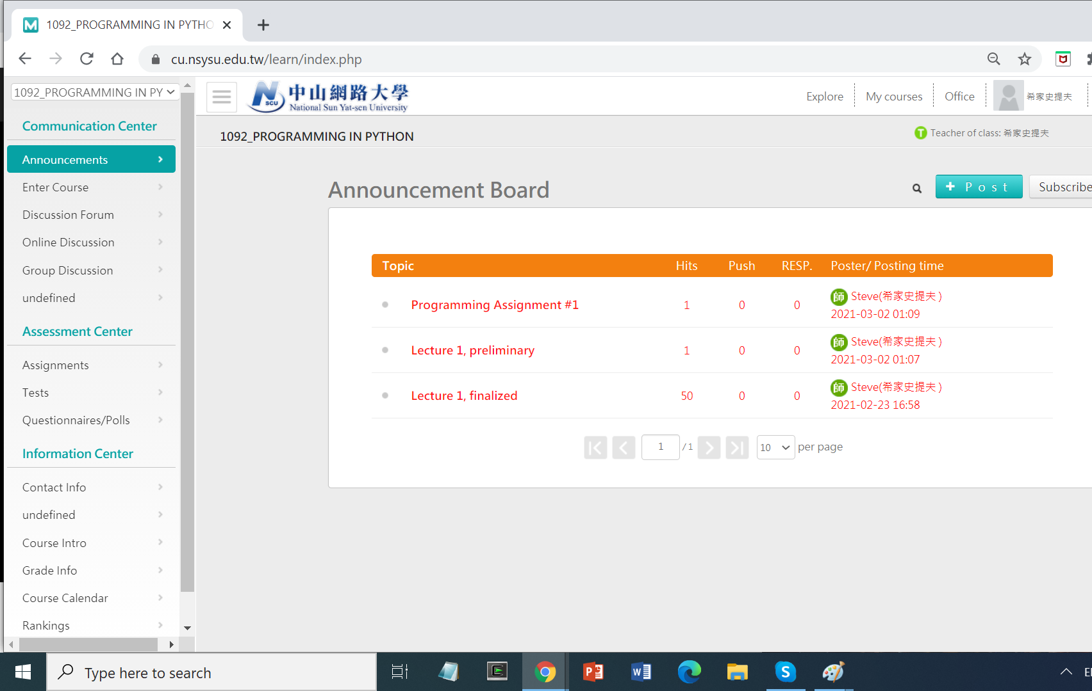
This is the cyberuniversity.
This is our course website.
This is the page where I post.
Here are the files I've posted:
The lecture notes you're viewing now.
The first assignment. Download
the file attached to this post.
When you finish the assignment,
this where you go to upload it.

Slide 127

This is the cyberuniversity.
This is our course website.
This is the page where I post.
Here are the files I've posted:
The lecture notes you're viewing now.
The first assignment. Download
the file attached to this post.
When you finish the assignment,
this where you go to upload it.

Slide 128
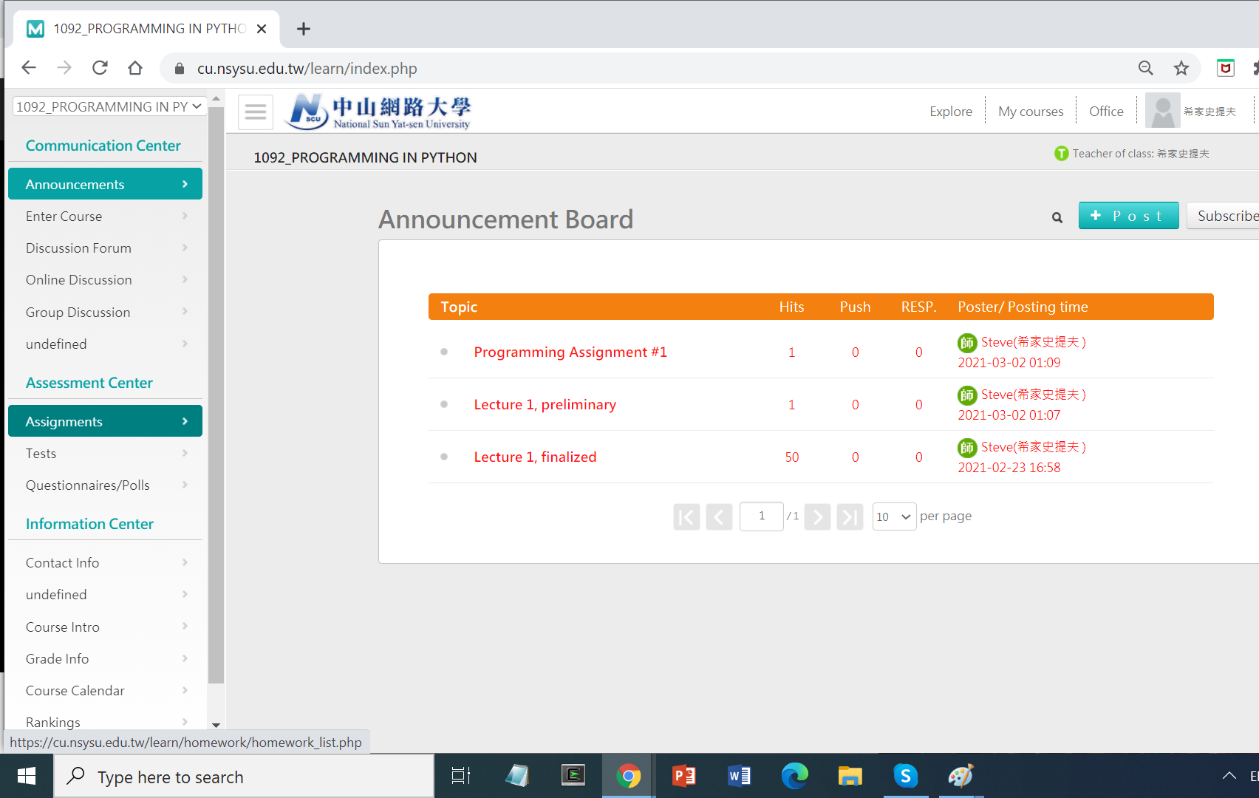

Slide 129
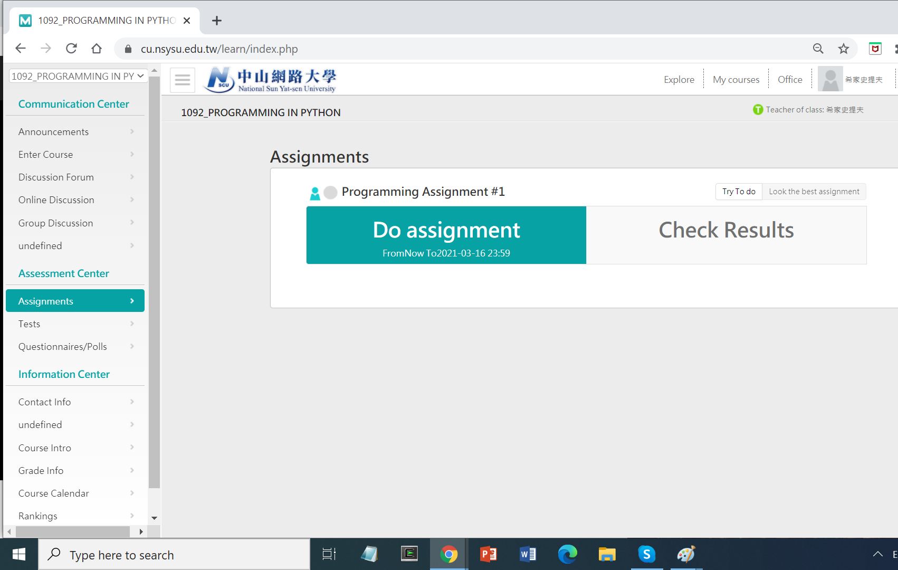
Click here to
submit the assignment.
Notice the due date. This button
won't work after the due date.

Slide 130
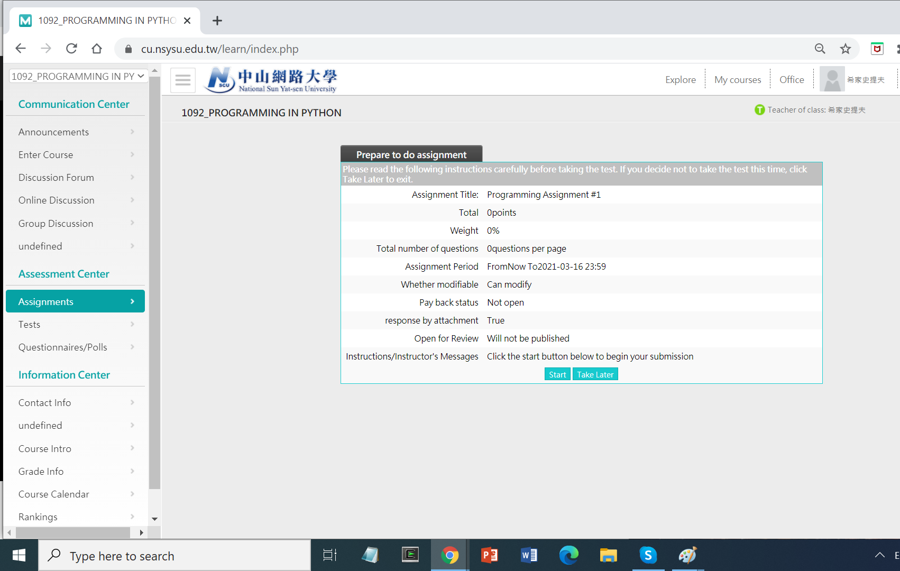
Incorrect. It is worth points.
You can re-upload.
You attach your answer.
Click here to
submit the assignment.

Slide 131
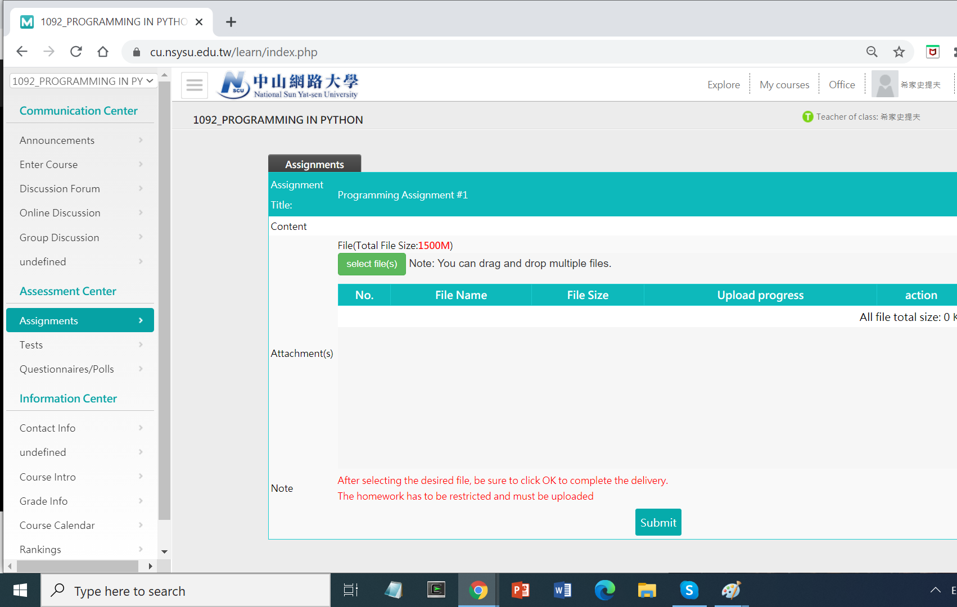
Click here to
select your python file.
Click here to
actually submit it.

