Slide 1
Evaluating eFlx
CS637 · RESEARCH PAPER EVALUATION
Energy flexibility provisioning for e-taxi fleets: re-implemented, reproduced, critiqued and extended
TEAM
Ghada Suleiman · 261330004
Rishikesh Sawant · 261110052
Suraj Singh Raman · 261110067
PAPER
L. Zhou, Y. Zhao, Y. Yuan, C. Xu, S. Lin · ICCPS 2025
IIT Kanpur
Notes:
Ghada: Hello, we are Ghada, Rishikesh and Suraj, and we evaluate the ICCPS 2025 paper eFlx. No code was released, so we rebuilt the method from the paper alone, reproduced its experiments on real New York taxi data, critiqued it, and extended it with new ideas.

Slide 2
First the paper, then our work
OUTLINE
Part | Slides | Presented by
Introduction and outline | 1–2 | Ghada Suleiman
The paper: demand response and the problem | 3–6 | Ghada Suleiman
The paper: the model and the eFlx solution | 7–9 | Ghada Suleiman
Evaluating the paper: its claims and our critique | 10–11 | Suraj Singh Raman
Implementing the technical idea | 12–16 | Suraj Singh Raman
Reproducing the paper’s results | 17–21 | Suraj (17), Rishikesh (18–21)
New use cases and examples | 22–23 | Rishikesh Sawant
New ideas and extended implementation | 24–25 | Rishikesh Sawant
Conclusion and contributions | 26–27 | All three
FROM THE PAPER
what the authors did
OUR WORK
what we did ourselves
Evaluating eFlx · 2
Notes:
Ghada: First I summarise the paper: demand response, the problem, and the eFlx solution. Then Suraj and Rishikesh present our own work: our evaluation, implementation, reproduction, and new use cases and ideas. A navy badge marks the paper’s content; orange marks our own work.

Slide 3
A taxi fleet as a power plant on wheels
FROM THE PAPER
1 · INTRODUCTION
Demand response (DR)
50+ kWh
When the grid is short of power (a generator fails, a heat wave), it pays large consumers to cut their demand for a while.
used by one e-taxi per day
Why a taxi fleet is special
~100 MW
charging load of a 13,000-taxi Manhattan fleet
A factory must stop working to cut load. A fleet has batteries, and one coordinator can move when and where thousands of taxis charge, without passengers noticing.
10 min
to start cutting after an emergency call (NYISO DSASP)
Evaluating eFlx · 3
Notes:
Ghada: An electric taxi uses more than 50 kWh a day, so a 13,000-taxi Manhattan fleet charges at around 100 megawatts. In an emergency, grids pay large customers to cut demand, often within 10 minutes; this is demand response. A factory has to stop working to do that. A taxi fleet doesn’t: it has batteries, and a coordinator can shift when and where taxis charge without passengers noticing. A power plant on wheels.

Slide 4
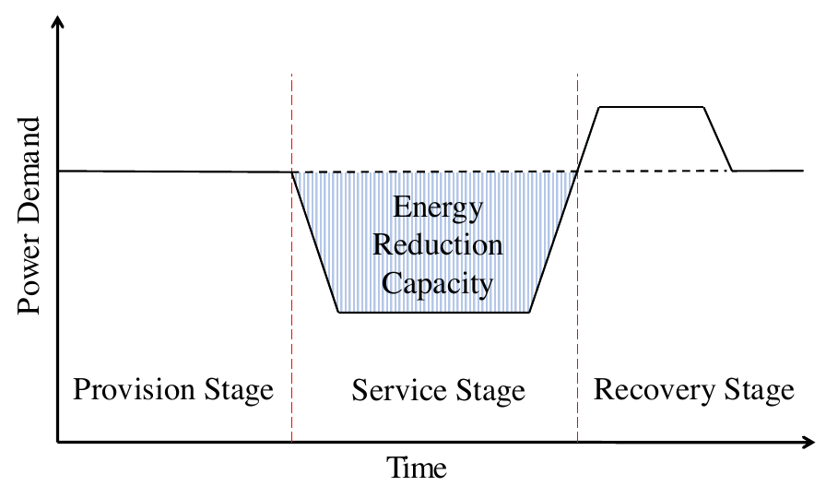
A DR program has three stages
FROM THE PAPER
1 · INTRODUCTION
1 · Provision
The fleet has a DR contract but no call yet: keep serving, no extra charging, get ready
2 · Service (2 hours)
The call comes: cut charging, live on stored energy, still serve passengers
3 · Recovery
Recharge and return to normal
Key point: the call can come at any time, so the fleet must stay ready in every 20-minute slot.
Evaluating eFlx · 4 · figure: paper Fig. 1
Notes:
Ghada: A DR program has three stages, the paper’s Figure 1. In provision, the fleet has a contract but no call yet: it keeps serving passengers and may not charge extra, but it can get ready. In service, it cuts charging for two hours, the shaded area, and lives on stored energy. In recovery, it recharges. Because the call can come at any moment, staying ready is a continuous job.

Slide 5
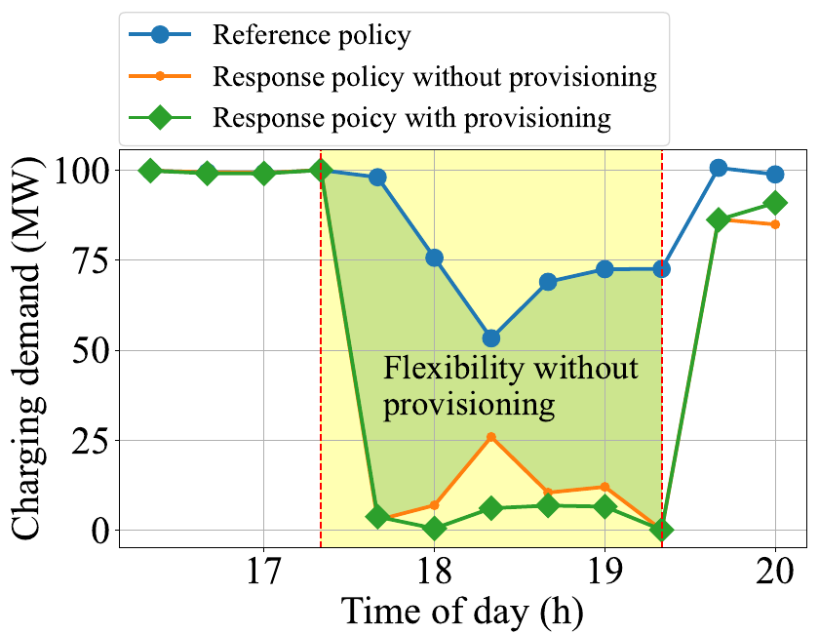
Reacting helps; preparing helps more
FROM THE PAPER
1 · INTRODUCTION
127.86 MWh
cut in 2 hours by a fleet that only reacts when called
139.37 MWh
cut by a fleet that prepared in advance: +11.5 MWh, +9%
Same passengers served in all cases. The paper is about how to prepare as well as possible.
Evaluating eFlx · 5 · figure and numbers: paper Fig. 2, Sec. 2.2
Notes:
Ghada: The paper’s motivating example, Figure 2. A fleet that only reacts when called already cuts 127.86 megawatt-hours over the two hours. A fleet that prepared in advance cuts 139.37, about 9% more, while serving the same passengers. So preparation, called provisioning, is worth something, and the paper asks how to do it best.

Slide 6
Be ready for a call that can come any time
FROM THE PAPER
2 · PROBLEM STATEMENT
RULES
THE QUESTION
How should the fleet dispatch and charge taxis now, before any call, so that whenever a call arrives it can cut as much charging as possible, without losing passengers?
1 · Call time unknown
Be ready in every 20-min slot
2 · No extra charging first
Never above normal service (Eq. 8d)
3 · No worse service
FLEXIBILITY (EQ. 6)
Serve as many passengers as normal
charging if no call came − charging when responding
over the 2-hour window, in MWh. It comes from spare taxis and stored battery energy.
Hard case studied: the evening peak, DR window 17:20–19:20, when passenger and grid demand are both highest.
Evaluating eFlx · 6
Notes:
Ghada: The question: how should the fleet dispatch and charge taxis now, before any call, so that whenever a call comes it can cut as much charging as possible without losing passengers? Flexibility, Equation 6, is the charging with no call minus the charging when responding. It comes from spare taxis and stored battery energy. Three rules keep it fair: the call time is unknown, no extra charging before the call, and no worse service. The paper studies the hardest case, the evening peak.

Slide 7
The model: counting taxis, not tracking them
FROM THE PAPER
3 · THE PAPER’S SOLUTION
SPACE
TIME
ENERGY
City split into regions
20-minute slots
15 battery levels
Vacant
Occupied
Charging
Waiting
Cruising, can pick up or be sent elsewhere
Carrying a passenger
+3 levels per slot at a station
Parked at a station, using no energy
Decisions each slot: send vacant taxis to regions or chargers, and choose how many charge.
Dynamics (Eq. 1–4) are linear in these counts, so every plan is a linear program.
Evaluating eFlx · 7
Notes:
Ghada: The model counts taxis instead of tracking each one: how many are vacant, occupied, charging or waiting, per region and battery level, in 20-minute slots. A driving taxi loses one battery level per slot; a charging taxi gains three. Each slot the operator decides where vacant taxis go and how many charge. All equations are linear, so every plan is a linear program that solves quickly.

Slide 8
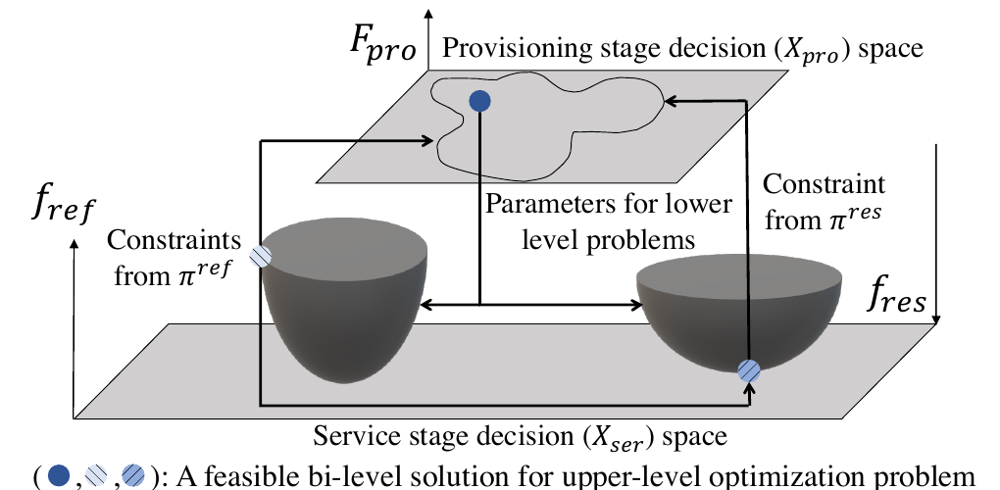
Why it is hard: the yardstick moves
FROM THE PAPER
3 · THE PAPER’S SOLUTION
Flexibility = baseline − response. But the baseline is “what the fleet would do with no call”, which is the very policy being optimised. Its baseline needs a baseline, and so on.
Problem 2: infinite-level
Baseline = the policy itself; cannot be solved
Problem 4: bi-level
Baseline = normal service; exact MILP has 1,482,570 variables
Problem 5: one LP
Predict normal service’s numbers, so both levels merge
Evaluating eFlx · 8 · figure: paper Fig. 5, Sec. 4.5
Notes:
Ghada: The hard part. Flexibility is baseline minus response, but the baseline, what the fleet does with no call, is the very policy being optimised. The yardstick moves with the thing it measures: an infinite-level problem. The paper first fixes the baseline to normal service, giving the bi-level problem in Figure 5. Solved exactly, that has about 1.5 million variables, far too slow for every 20 minutes. So it predicts normal service instead, and the two levels merge into one linear program, Problem 5.

Slide 9
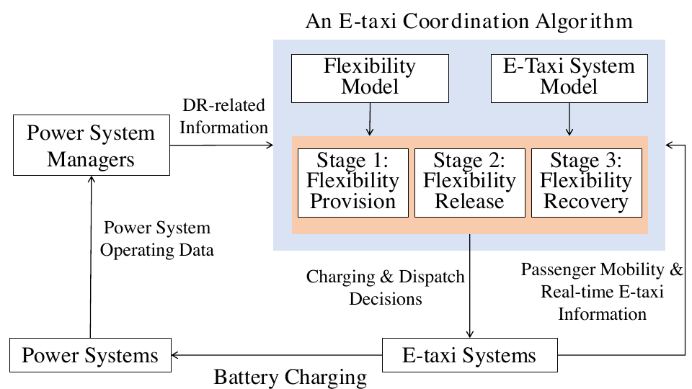
eFlx: a closed-loop fleet controller
FROM THE PAPER
3 · THE PAPER’S SOLUTION
Algorithm 1: provisioning
Solve the LP, re-predict normal service, solve again, until the plan settles (~3–4 rounds)
Algorithm 2: MPC loop
Every 20 min: read the fleet, provision, respond or serve normally, apply only this slot’s orders
Always assumes
the call may come in the next slot (τ = 1)
Evaluating eFlx · 9 · figure: paper Fig. 4
Notes:
Ghada: eFlx sits between the grid and the fleet, as in Figure 4: it receives DR signals and live taxi data, and sends back charging and dispatch orders. Algorithm 1 solves the linear program, re-predicts normal service, and repeats until the plan settles, usually in three or four rounds. Algorithm 2 runs this every 20 minutes and applies only the current slot’s orders. Importantly, eFlx always assumes the call may come in the very next slot. That is the paper’s method; Suraj now evaluates it.

Slide 10
What the paper claims
FROM THE PAPER
4 · EVALUATING THE PAPER
−19.98%
+5.52%
0.52%
~2%
charging during the DR window, vs TRC
flexibility vs TRC
from an Oracle that knows when DR starts
extra idle driving and waiting; service unchanged
SETUP
BASELINES
~13,000 Manhattan e-taxis, real NYC trip data, DR window 17:20–19:20
TRC (normal), R2I (park idle taxis at stations), TES, Oracle
Evaluating eFlx · 10 · numbers from the paper’s Sec. 7
Notes:
Suraj: To evaluate the paper, we start from what it claims. On about 13,000 Manhattan taxis, with the DR window at 17:20, eFlx charges 20% less during the window than normal operation, called TRC, and offers 5.5% more flexibility. It comes within half a percent of an Oracle that knows the start time, at only about 2% overhead. These are the claims we set out to test.

Slide 11
Our critical reading: strengths and gaps
OUR WORK
4 · EVALUATING THE PAPER
Strengths
Gaps we found → what we did
Important, under-studied problem: fleets as grid helpers
Elegant escape from the infinite-level loop
Fast: one LP, real time on a PC
Fair tests: same response policy, cap and service level
Flexibility is measured against each policy’s own baseline | shown, slide 20
Always assumes DR in the next slot | P-eFlx, slide 24
“Controlled service compromise” never measured | measured, slide 25
Only cuts load; grids also need extra charging | tested, slide 23
Missing parameters (β, η, battery, ports, days) | chosen, NOTES.md
Battery lasts ~4.7 h: 3–4× the paper’s 50 kWh/day | noted
Fixed trip probabilities; the “Oracle” is not a bound | noted
Qv/Qo text swapped vs Eq. 2b–2c; free index in Eq. 6 | noted
Evaluating eFlx · 11 · details in NOTES.md and REPORT.md, Section 1
Notes:
Suraj: Next, our critical reading. The paper’s strengths: an important new problem, an elegant escape from the infinite loop, real-time speed, and fair comparisons. But we found gaps, and for most of them we did something. Flexibility is measured against each policy’s own baseline, so it can be gamed; Rishikesh shows this on Manhattan. eFlx always assumes DR comes next slot; our P-eFlx plans for when DR is likely. The service compromise is mentioned but never measured; we measure it. Only load cuts are studied; we test absorbing surplus power. Key parameters are missing, energy use is unrealistically high, trip probabilities are fixed, the Oracle isn’t a true bound, and the Qv and Qo descriptions are swapped. To test the claims, we rebuilt the system.

Slide 12
Rebuilding eFlx with no code released
OUR WORK
5 · IMPLEMENTATION
Paper | Our code | In plain words
Eq. 1–4, 5e–5g | eflx/model.py | The city’s rules: how taxis move
Problems 1, 3, 5 · Alg. 1 · baselines | eflx/policies.py | The strategies, eFlx included
Alg. 2 (MPC) · Eq. 6 | eflx/sim.py | Plan, act, repeat; score flexibility
Same LPs at Manhattan scale | eflx/fastplan.py | Fast engine, ~20× faster
NYC trips → model inputs | scripts/get_nyc_data.py | Real demand and trip patterns
EQ. (1) AS CODE
STACK
# every available taxi gets exactly one decision
Python · cvxpy · HiGHS LP solver · pandas · matplotlib, on a laptop
sum(x[l], axis=1) + sum(y[l], axis=1) == V[k][l]
Evaluating eFlx · 12 · every assumption is listed in NOTES.md
Notes:
Suraj: With no code released, the paper became our specification, one part per file. model.py holds the city’s rules, Equations 1 to 4; policies.py the strategies, including eFlx and the baselines; sim.py the plan-act loop and the flexibility score. For Manhattan, fastplan.py builds the same linear programs about 20 times faster. Here is Equation 1 as code: every available taxi gets exactly one decision. Where the paper leaves numbers out, like battery size or charger counts, we chose values and documented each one in NOTES.md.

Slide 13
How we know our code is right
OUR WORK
5 · IMPLEMENTATION
100 / 100
4 / 4
~20×
taxis conserved in every slot (checked by the simulator)
test states: readable and fast LPs reach identical optima
faster with the sparse builder
$ python tests/test_fastplan.py
case 0: reference obj 233.2720, response obj 0.0000 -> identical
case 1: reference obj 258.8344, response obj 30.6614 -> identical
case 2: reference obj 267.7137, response obj 49.2266 -> identical
case 3: reference obj 258.5566, response obj 40.1378 -> identical
FastPlan matches the cvxpy spec
Evaluating eFlx · 13
Notes:
Suraj: How do we know the code is right? The simulator checks every slot that no taxi is created or lost. And we have two independent builders of the same linear programs: a readable one that mirrors the paper’s equations, and the fast one we use at scale. On four test cases they reach exactly the same optimal values.

Slide 14
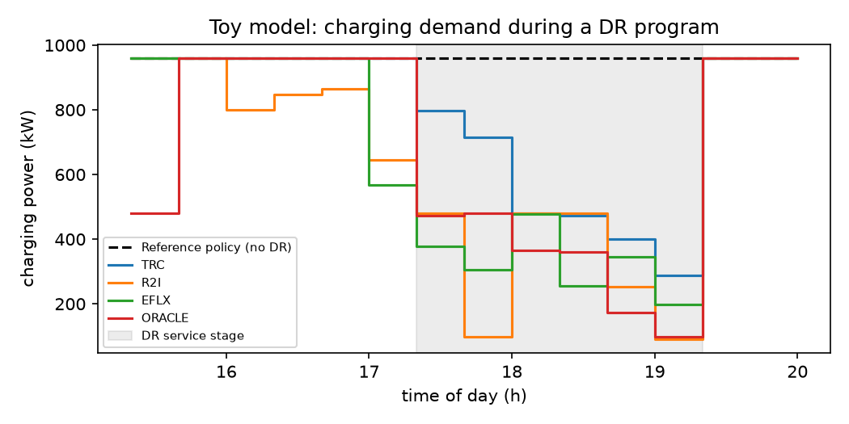
Toy model: the core idea reproduces
OUR WORK
5 · TOY MODEL
2 regions · 2 stations · 100 taxis · DR 17:20–19:20 · with charging limit
Policy | Flexibility | DR charging
TRC | 870 kWh | 1050 kWh
R2I | 1256 kWh | 628 kWh
eFlx | 1267 kWh | 653 kWh
Oracle | 1270 kWh | 650 kWh
eFlx: −38% DR charging vs TRC, at 100% service
Evaluating eFlx · 14 · results/toy_results.txt, results/toy_fig8.png
Notes:
Suraj: First, a toy city small enough to check by hand: 2 regions and 100 taxis. The core idea reproduces: eFlx raises flexibility from 870 to about 1270 kWh and cuts charging during DR by 38%, serving every passenger, close to the Oracle. Notice the jump back to full charging at 19:20; Rishikesh returns to that rebound.

Slide 15
Same optimum, different answers
OUR WORK
5 · FINDING
Toy DR-window charging from our two LP builders: each reaches the same optimal objective at every step
Why
The LPs have many tied optimal solutions; the solver picks one
Policy | Fast builder | cvxpy builder | Change
TRC | 1050 kWh | 1083 kWh | +3%
R2I | 628 kWh | 668 kWh | +6%
eFlx | 653 kWh | 712 kWh | +9%
Oracle | 650 kWh | 561 kWh | −14%
So what
A “0.52% from Oracle” gap can sit inside solver noise
Also found
The Oracle must see the whole DR window, or it loses to eFlx
Evaluating eFlx · 15 · results/toy_results.txt vs results/toy_results_cvxpy_builder.txt
Notes:
Suraj: A reproducibility finding. Our two builders always reach the same optimal value, but often pick different optimal solutions, because these programs have many ties. Over a full run that changes results by up to 14%: the Oracle charges 650 or 561 kWh depending on the builder. So a gap like “0.52% from the Oracle” can sit inside solver noise; papers should state their tie-breaking. Next, a quick demo.

Slide 16
Demo: anyone can rerun it
OUR WORK
5 · DEMO
STEP 1
STEP 2 · ~4 s
STEP 3 · ~7 s
Open the GitHub repo and its README
Run the validation test
Run the toy experiment, open its figure
$ git clone https://github.com/ascyrax/cs637-eflx && cd cs637-eflx
$ python tests/test_fastplan.py
FastPlan matches the cvxpy spec
$ python toy_demo.py
sanity OK: 100 taxis conserved over 15 slots
eflx flex 1266.9 kWh DR charge 653.1 kWh served 100.00%
plot saved to results/toy_fig8.png
Evaluating eFlx · 16 · in the video, replace this slide with a pre-recorded screen capture (~45 s)
Notes:
Suraj (over the screen recording): Here is our repository; the README explains how to run everything. The validation test takes four seconds, and the toy experiment seven, printing the table you just saw and regenerating its figure. The Manhattan runs use the same code but take hours, so we show their saved results.

Slide 17
Real data: NYC taxi trips, March 2024
OUR WORK
6 · REPRODUCTION
2.01 M
12
~2,430
84%
weekday Manhattan trips over 21 days
regions, clustered from 62 taxi zones
trips per 20-min slot at the evening peak
of trips finish within one slot
FROM THE PAPER
OUR CHOICES
15 battery levels · −1 level per slot driving · +3 per slot charging · DR 17:20–19:20
4,000 ports · 3 kWh per level · 12 regions instead of the paper’s 38
Evaluating eFlx · 17 · source: NYC Taxi & Limousine Commission trip records
Notes:
Suraj: For the real experiment we used New York’s taxi trip records for March 2024: about two million weekday trips in Manhattan, about 2,400 per 20-minute slot at the evening peak. The paper’s 38 grid regions aren’t public, so we clustered taxi zones into 12 regions. We kept the paper’s battery and timing values and chose the rest, such as the number of chargers. Rishikesh now presents the results.

Slide 18
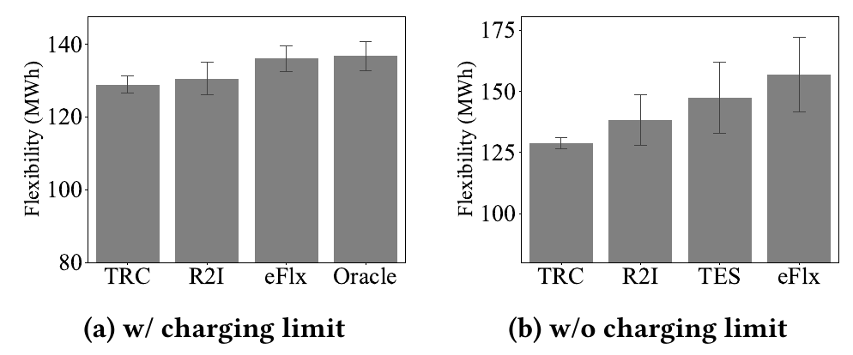
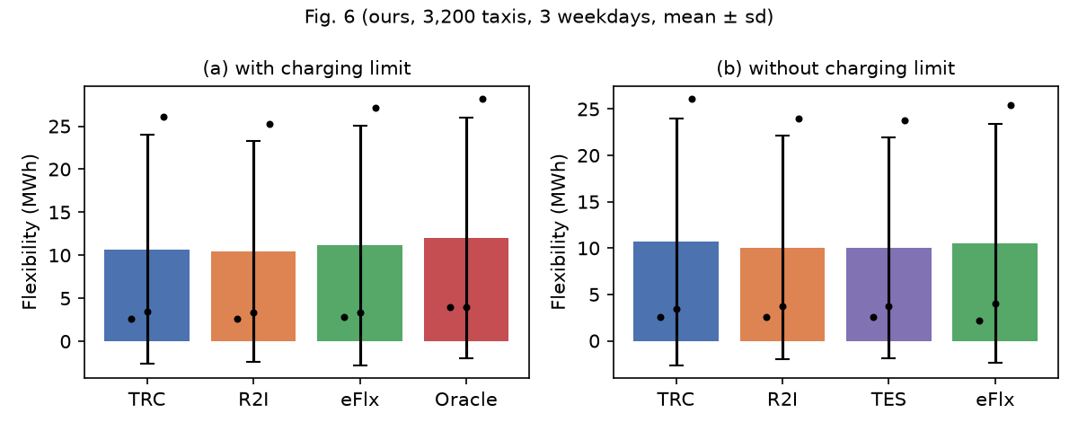
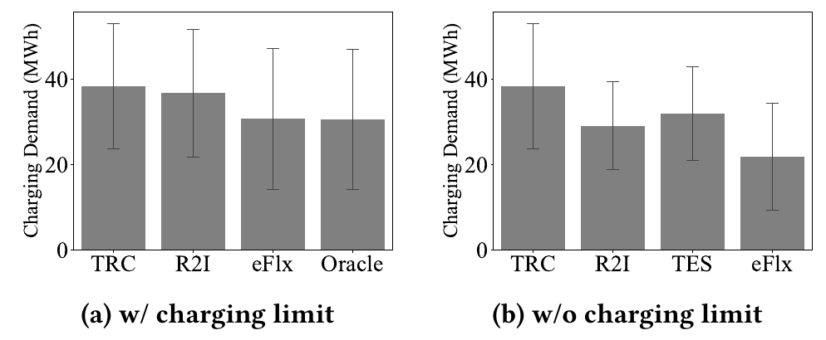
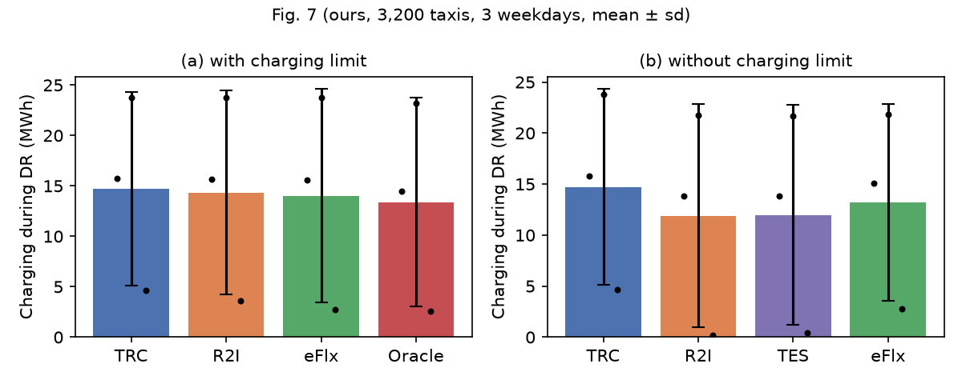
Figs. 6 and 7: paper vs ours (3,200 taxis)
OUR WORK
6 · REPRODUCTION
Evaluating eFlx · 18 · left: paper · right: ours, mean ± sd over 3 weekdays
Notes:
Rishikesh: The paper’s Figures 6 and 7 beside ours: flexibility on top, DR charging below. A first surprise: at the paper’s own fleet size of 13,000 taxis, every policy cuts DR charging to zero, so nothing can be compared. So we use a tighter fleet of 3,200 taxis. There the ordering holds in direction, eFlx charging least, then R2I, then normal operation, but the error bars across days are large.

Slide 19
Claim by claim: direction holds, size doesn’t
OUR WORK
6 · REPRODUCTION
Claim (eFlx vs …) | Paper | Ours | Verdict
Flexibility vs TRC | +5.52% | +3.95% | Partly holds
DR charging vs TRC | −19.98% | −4.81% | Direction only
DR charging vs R2I | −16.36% | −2.27% | Direction only
DR charging, gap to Oracle | +0.51% | +4.61% | Does not hold
DR charging vs R2I, no limit | −24.73% | +11.05% | Reversed
DR charging vs TES, no limit | −31.37% | +10.37% | Reversed
Idle driving vs TRC | +2.06% | +9.66% | Higher cost
Waiting at stations vs TRC | +2.12% | +44.14% | Higher cost
Manhattan, 3,200 taxis, totals over 3 weekdays, with the charging limit unless noted. Gains come almost entirely from one day: −1.4%, 0%, −41% vs TRC.
Evaluating eFlx · 19 · results/manhattan_3200_claims.md
Notes:
Rishikesh: Claim by claim, totals over three weekdays. eFlx cuts DR charging by 4.8%, not 20%, and ends 4.6% from the Oracle, not half a percent. Flexibility, plus 4% against 5.5%, is the closest match. Without the charging limit, eFlx is actually worse than R2I and TES. Service stays the same, but nearly all the gain comes from one of the three days. The likely causes: unpublished parameters, the fleet size, and solver ties.

Slide 20
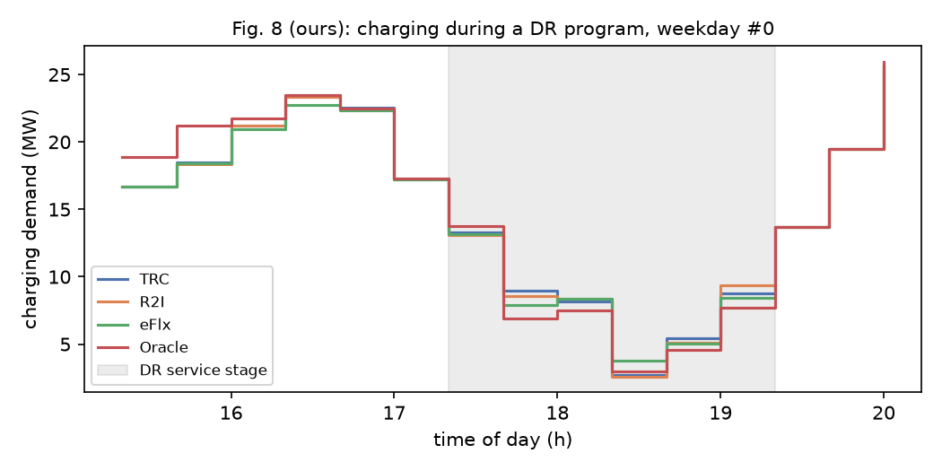
Overheads, and what the experiments miss
OUR WORK
6 · REPRODUCTION
Overhead vs TRC
Idle driving +9.7%, waiting +44% (paper: ~2% each)
Runtime
236 s per slot (paper 254.7 s); 3.9 iterations of Alg. 1
Rebound
Charging jumps back after 19:20: a new peak, never measured
Design gaps: one DR window only · number of days not stated · same model plans and simulates · robustness noise model not given
Evaluating eFlx · 20 · results/manhattan_3200_fig8.png, fig9–10
Notes:
Rishikesh: Overheads are higher than claimed: 10% more idle driving and 44% more waiting, against about 2%. Runtime matches, about four minutes per slot. Look at the right edge: after 19:20 charging shoots up to 26 megawatts, a new peak for the grid that the paper never measures. And at 13,000 taxis eFlx scores 40% more flexibility while every policy charges zero: the metric problem from slide 11, in action.

Slide 21
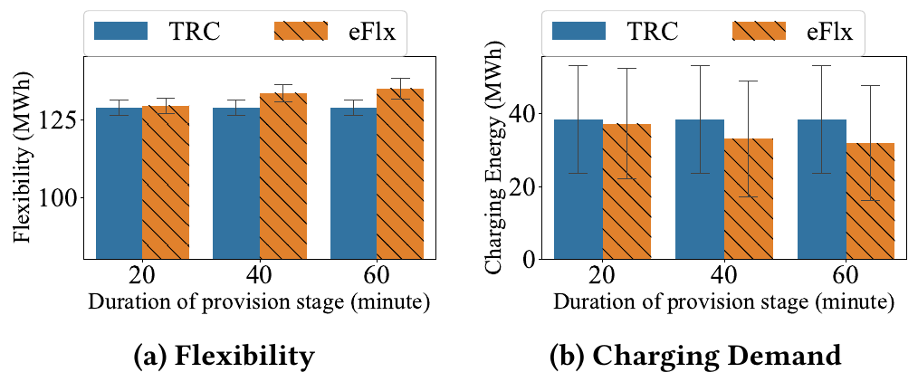
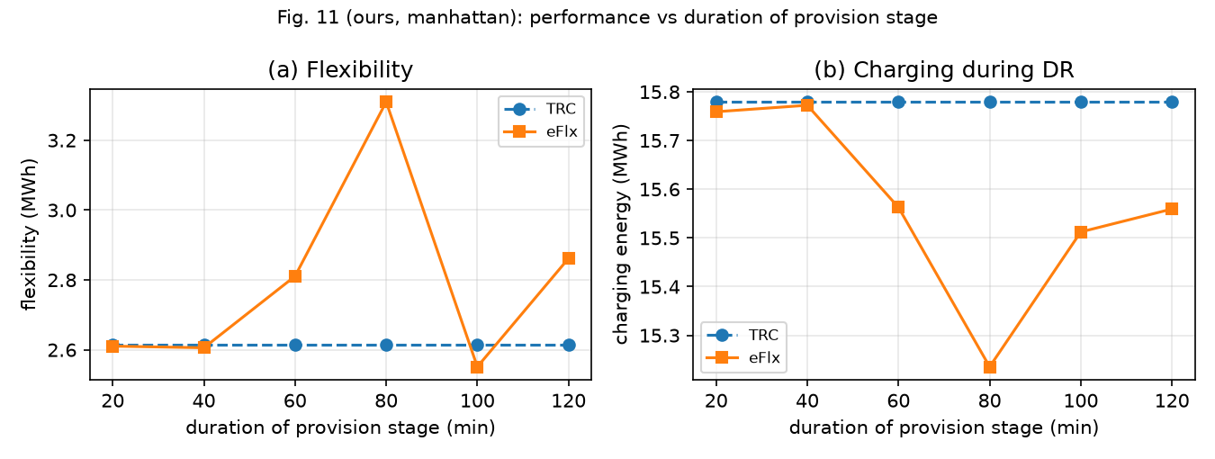
Fig. 11 and Table 1: lead time and forecast error
OUR WORK
6 · REPRODUCTION
Fig. 11: partly holds
Toy: steady rise, 884 → 1267 kWh. Manhattan: no gain at 20–40 min, peak at 80 min (3.31 vs 2.61 MWh), not monotonic.
Table 1: 10% forecast error
eFlx change | Flexibility | DR charging | Served
Paper | −1.33% | +7.69% | not given
Ours, toy | +3.6% | −7.0% | 95.4%
Ours, Manhattan | −6.8% | −3.4% | 93.9%
~5% of passengers are missed, and on Manhattan eFlx’s edge over TRC almost vanishes (2.67 vs 2.63 MWh).
Evaluating eFlx · 21 · left: paper (top), ours on Manhattan (bottom) · paper_extras.py
Notes:
Rishikesh: Two more paper experiments. Figure 11 varies how early provisioning starts. On the toy city, longer preparation steadily helps. On Manhattan it only partly holds: no gain at 20 to 40 minutes, a peak at 80, then a dip. Table 1 adds a 10% error to the demand forecast. The paper reports flexibility down 1.3%; we see 6.8%, with about 5% of passengers missed, which the paper doesn’t report. And eFlx’s edge over normal operation almost vanishes: 2.67 against 2.63 megawatt-hours.

Slide 22
New use cases: when does eFlx help?
OUR WORK
7 · NEW USE CASES
Fleet-size sweep (Manhattan, DR 17:20–19:20)
DR at other times
Fleet | TRC DR charging | Best possible
13,000 (paper) | — | 0 MWh
8,000 | 100.6 MWh | 0 MWh
6,000 | 66.2 MWh | 0 MWh
5,000 | 59.0 MWh | 0 MWh
4,000 | 35.0 MWh | 0 MWh
3,200 (ours) | 12.5 MWh | 6.6 MWh
Start at 16:40, 17:20 or 18:00
Several weekdays
Error bars instead of one scenario
Toy city + rebound
Checkable by hand; peak after DR
The paper’s fleet sits in the “easy” corner of its own Fig. 3
Evaluating eFlx · 22 · results/regime.json, NOTES.md · open-loop check from the 15:20 fleet state
Notes:
Rishikesh: Now new use cases. The most revealing is a fleet-size sweep: what is the least charging possible during DR while serving everyone? From 13,000 taxis down to 4,000 the answer is zero; there are so many spare, charged taxis that any policy can stop charging. Only at 3,200 does some charging remain. So the paper’s fleet sits in the easy corner of its own problem. We also varied the DR start time and used several weekdays.

Slide 23
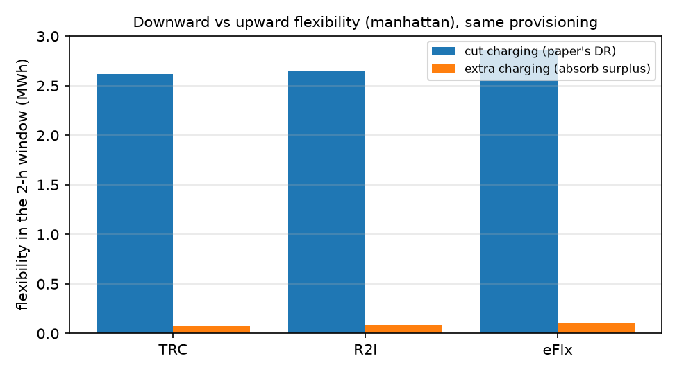
Absorbing surplus solar and wind power
OUR WORK
7 · NEW USE CASE
Sometimes the grid has too much power (sunny noon, windy night) and wants fleets to charge more. We reverse the response: maximise charging in the window, same service rules.
0.1 MWh
extra charging possible, vs 2.6–2.9 MWh of cut (Manhattan)
Why: normal operation already charges at every free port; on the toy city there is no room at all.
A fleet selling both directions must deliberately hold charging back: a two-sided plan the paper doesn’t consider.
Evaluating eFlx · 23 · Manhattan, 3,200 taxis, weekday 0 · new_ideas.py, results/upward_*.png
Notes:
Rishikesh: A second use case. Grids with lots of solar and wind sometimes have too much power and want fleets to charge more. We reversed the response to maximise charging instead. On Manhattan the fleet can absorb only 0.1 megawatt-hours extra, against 2.6 to 2.9 of cut, because normal operation already uses every free charger. To offer both directions, a fleet must hold some charging back in advance: a two-sided plan the paper doesn’t consider.

Slide 24
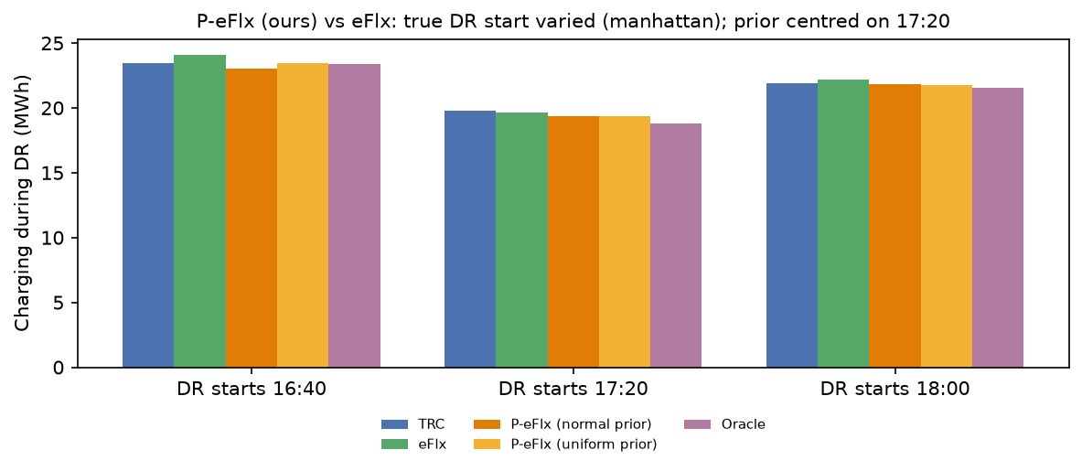
P-eFlx: plan for when DR is likely
OUR WORK
7 · NEW IDEA 1
eFlx assumes “DR next slot”. P-eFlx uses a prior over start times and minimises expected DR charging, at the same LP size.
−32%
DR charging vs eFlx, toy model
−2.6%
DR charging vs eFlx, Manhattan
~75%
of the eFlx–Oracle gap closed, without knowing the start
Caveat: one Manhattan day shows no difference; part of another day’s gain comes with ~1 pp lower service.
Evaluating eFlx · 24 · improvement.py, results/improvement_*.png
Notes:
Rishikesh: Our first new idea, P-eFlx. eFlx always assumes DR comes in the next slot, which is pessimistic; the Oracle knows exactly when, which is unrealistic. P-eFlx uses a probability distribution over start times and minimises the expected DR charging, with the same problem size. It cuts DR charging by 32% versus eFlx on the toy city and by 2.6% on Manhattan, closing three quarters of the gap to the Oracle without knowing the start time.

Slide 25
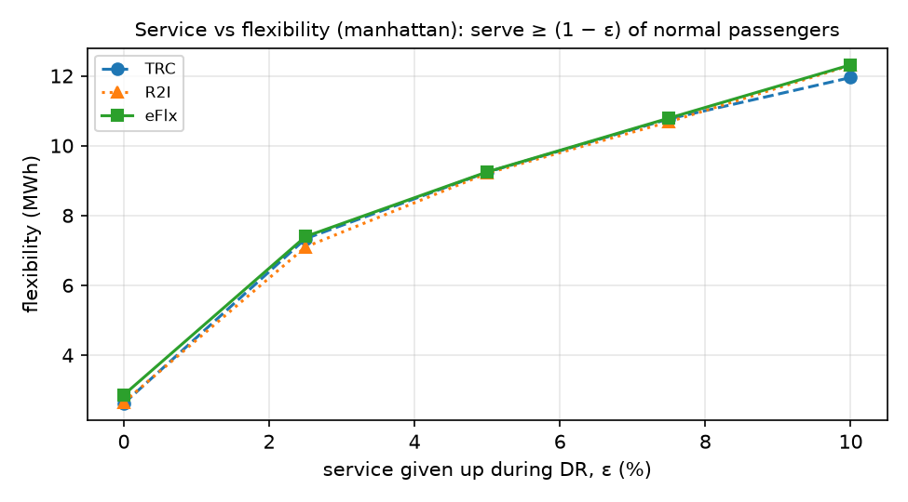
How much flexibility does a little service buy?
OUR WORK
7 · NEW IDEA 2
The paper mentions a “controlled service compromise” but never measures it. We let the fleet serve only (1 − ε) of normal passengers during DR, ε = 0–10%.
2.6×
flexibility when 4% of passengers are missed (eFlx 2.86 → 7.40 MWh, Manhattan)
< 1%
of service: what eFlx’s provisioning is worth on Manhattan (toy city: ≈ 9%)
For a tight fleet, a small service compromise is a far bigger lever than smarter provisioning, and this curve prices it.
Evaluating eFlx · 25 · Manhattan, 3,200 taxis, weekday 0 · new_ideas.py, results/tradeoff_*.png
Notes:
Rishikesh: Our second idea measures the service compromise the paper mentions but never quantifies: during DR, the fleet may serve slightly fewer passengers. On Manhattan, missing about 4% of passengers gives two and a half times the flexibility, from 2.86 to 7.4 megawatt-hours, while eFlx’s provisioning is worth less than 1% of service. This curve is exactly what a grid operator and a taxi company would need to price a DR contract.

Slide 26
What the paper did, and what we did
8 · CONCLUSION
THE PAPER
WE
Defined the energy flexibility of an e-taxi fleet
Bi-level provisioning problem, reduced to one LP
Claimed −19.98% DR charging, 0.52% from Oracle
Re-implemented it from scratch, on real NYC data
Reproduced every figure: idea holds, gains shrink (−4.8% vs −19.98%)
Found gaps; added P-eFlx, service trade-off, surplus absorption
Limits: our parameter choices · 12 regions, not 38 · fluid simulator · few weekdays. Next: per-taxi simulator, LP tie-breaking, two-sided DR plans.
Evaluating eFlx · 26
Notes:
All three, split. Ghada: The paper defined fleet flexibility and turned a hard bi-level problem into one fast linear program, claiming 20% less charging in an emergency. Suraj: We rebuilt it from scratch and validated it; our limits are chosen parameters, 12 regions instead of 38, and a fluid simulator. Rishikesh: On real data the idea holds, but the gain shrinks to about 5%. We added P-eFlx, the service trade-off and the surplus-power test; next would be a per-taxi simulator and two-sided plans.

Slide 27
Contribution
TEAM
Member | Share | Work
Ghada Suleiman 261330004 | 33.3% | Paper study: DR, problem, model, eFlx; extension ideas; slides 1–9
Suraj Singh Raman 261110067 | 33.3% | Claims and critique, implementation, validation, toy experiments, demo, NYC data setup; slides 10–17
Rishikesh Sawant 261110052 | 33.3% | Manhattan reproduction, new use cases and ideas; slides 18–25
Thank you
Code, data and results: github.com/ascyrax/cs637-eflx
Evaluating eFlx · 27
Notes:
All three, split. Ghada: Thank you for watching our evaluation of eFlx. Suraj: Everything you saw today, the code, the data, the results and the full report, is in our GitHub repository, so you can rerun any experiment yourself. Rishikesh: We look forward to your questions. Thank you!

