Slide 1
Efficient Estimation of
Word Representations in
Vector Space
Tomas Mikolov, Kai Chen, Greg Corrado, Jeffrey Dean
Google Inc., Mountain View, CA
組長：黃宗德 406410091 資工四
組員：林于恩 406410050 資工四，王至弘 406410009 資工四，
吳啟民 609211014 應用數學，鄭策丰 609211003 應用數學，
陳威樺 406410061 資工四

Slide 2
Goal of the Paper
Maximize the accuracy of these vector operations by developing new model architectures that preserve the linear regularities among words.
Word Vectors: vector(“King”) - vector(”Man”) + vector(”Woman”) = vector(“Queen”)
To find a word that is similar to “small” in the same sense as “biggest” is similar to “big”, we can simply compute vector X = vector("biggest") - vector("big") + vector(“small”).

Slide 3
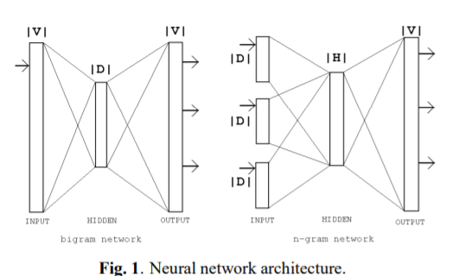
Previous Work
Represent every word as a vector.
Neural Network Language Model (NNLM):
The word vectors are first learned using neural network with a single hidden layer.
The word vectors are then used to train the NNLM.

Slide 4
Previous Work
The computational complexity of model architectures is:
O = E x T x Q
E: number of the training epochs, usually between 3 and 50
T: number of the words in the training set, 1.6 billion
Q: defined further for each model architecture
Generally speaking, most models are trained using stochastic gradient descent and backpropagation.

Slide 5
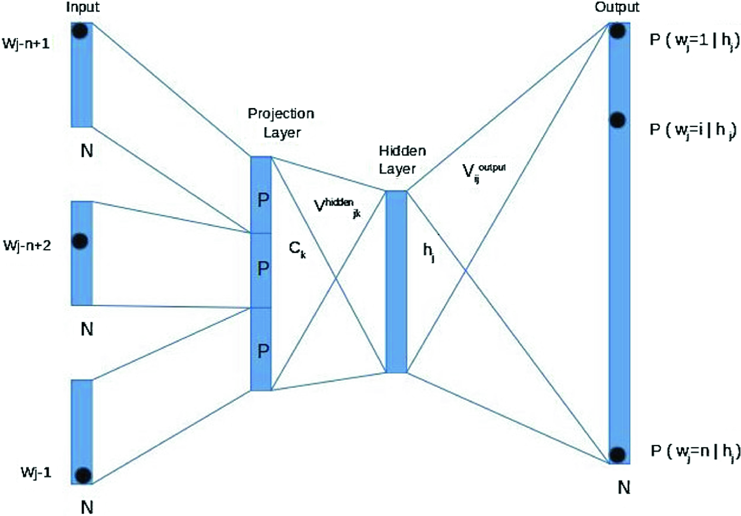
Feedforward Neural Net Language Model (NNLM)

Slide 6
Feedforward Neural Net Language Model (NNLM)
Q = N × D + N × D × H + H × V
input layer :
N previous words are encoded using 1-of-V coding (one hot coding) where V is size of the vocabulary.
projection layer P :
has dimensionality N × D(after word embedding)
hidden layer : size H
ouput layer : dimensionality V

Slide 7
Feedforward Neural Net Language Model (NNLM)
The dominating term is H × V :
with binary tree representations of the vocabulary, the number of output units goes down to log2(V )
In our models we represented the vocabulary as a Huffman binary tree (log2(Unigram perplexity(V)))
This is not crucialneural network LMs as the computational bottleneck is in the N ×D×H term, we will later propose architectures that do not have hidden layers and thus depend heavily on the efficiency of the softmax normalization.

Slide 8
Recurrent Neural Net Language Model (RNNLM)
There are 3 layers in RNNLM model.
input layer
hidden layer
output layer
What is special for this type of model is the recurrent matrix that connects hidden layer to itself, using time-delayed connections.
Training complexity: Q = H × H + H × V

Slide 9
New Log-linear Models
Continuous Bag-of-Words(CBOW) Model
Continuous Skip-gram Model

Slide 10
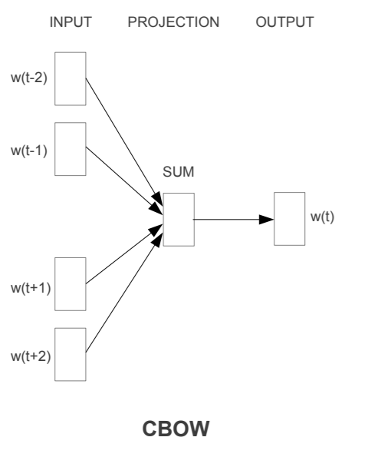
Continuous Bag-of-Words(CBOW) Model
There are 4 layers in CBOW model.
Input layer
Projection layer
Hidden layer
Output Layer
COBW model predicts the words by
the context.
Training complexity: Q = N × D + D × log2(V)

Slide 11
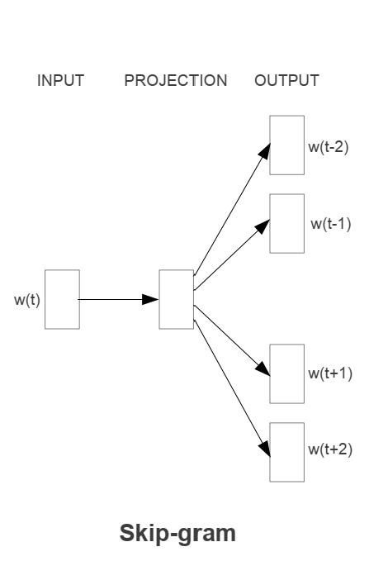
Continuous Skip-gram Model
Skip-gram Model tries to maximize
classification of a word based on
another word in the same sentence

Slide 12
Continuous Skip-gram Model
The quick brown fox jumps over the lazy dog
(fox , quick) (fox brown) (fox jump) (fox over)
Compared with (fox, NLP), there may be more phrases such as (fox quick) or (fox jump). Therefore, when the neural network is trained, given an input word "fox", compared to " NLP", "quick" or "jump" may have a higher probability of appearing near it.

Slide 13
Continuous Skip-gram Model
increasing the range
improves quality of the resulting word vectors
increases the computational complexity.
more distant words usually less related to the current word than those close to it
give less weight to the distant words : sampling less from those words in our training examples.

Slide 14
EX.
C is the maximum distance of the words.
if C = 5
for each training word we will select randomly a number R in range < 1; C> and then use R words from history and R words from the future of the current word as correct labels.
This will require us to do R × 2 word classifications, with the current word as input, and each of the R + R words as output.
Training complexity: Q = C × D + C × D × log2(V )
In the following experiments, we use C = 10.

Slide 15
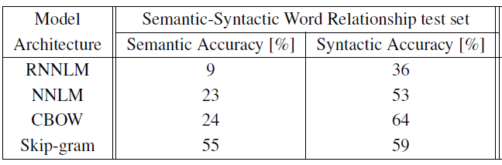
Results and Conclusions
We search in the vector space for the word closest to X measured by “cosine distance”, and use it as the answer to the question.
Comparison of architectures using models trained on the same data

Slide 16
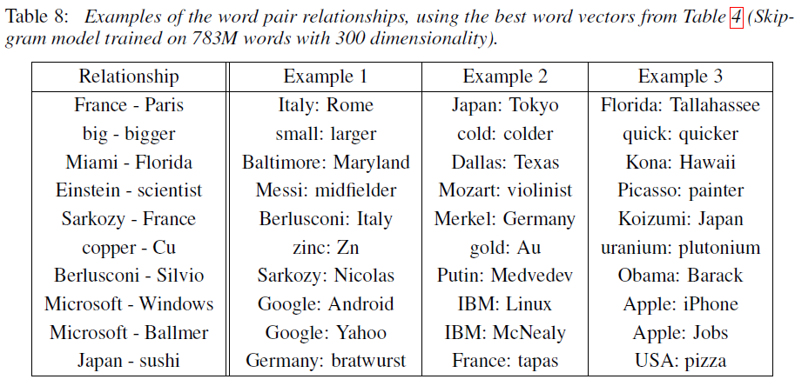
Results and Conclusions
Word vectors can be used to improve many NLP applications, such as machine translation, information retrieval and question answering systems.

Slide 17
References
〈NEURAL NETWORK BASED LANGUAGE MODELS FOR HIGHLY INFLECTIVE LANGUAGES〉
〈Word2vec from scratch (Skip-gram & CBOW)〉
對數線性模式log linear model 課程1

Slide 18
THANK YOU

