Slide 1
個人專案提案-skike
主題:
1.機票比價
2.飯店比價
3.地圖價格
4.推薦地點(optional)

Slide 2
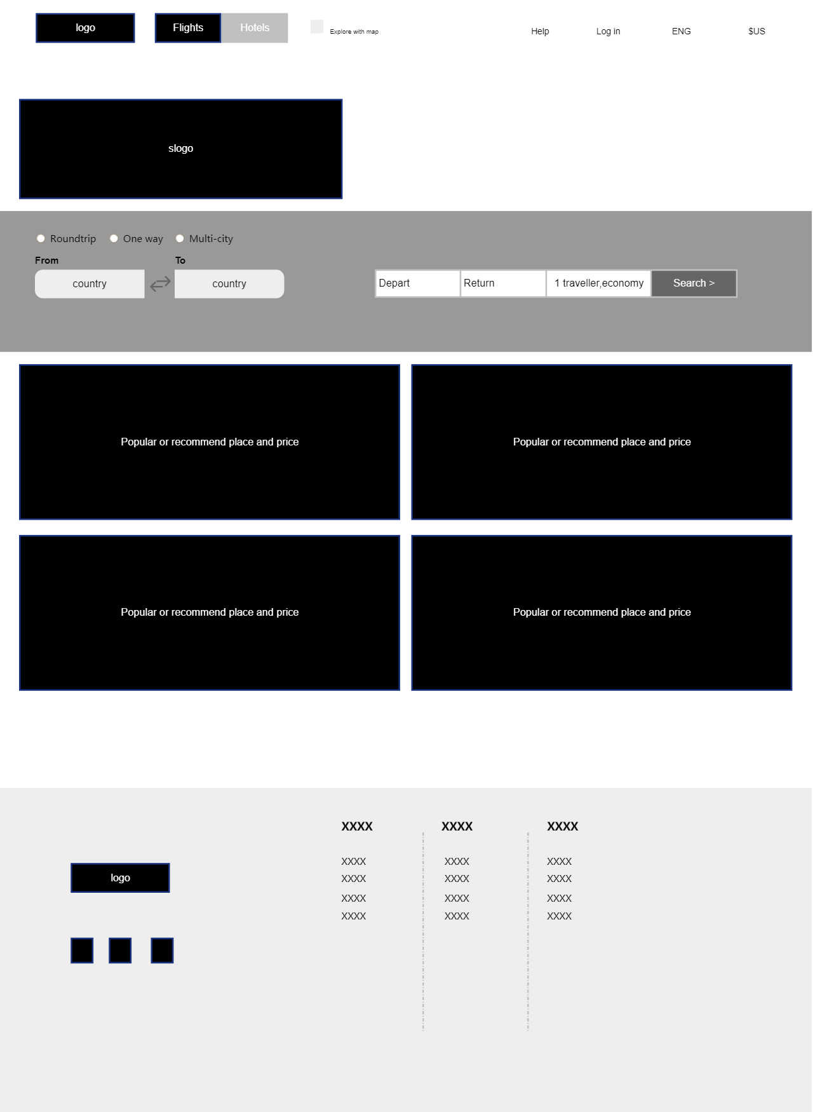
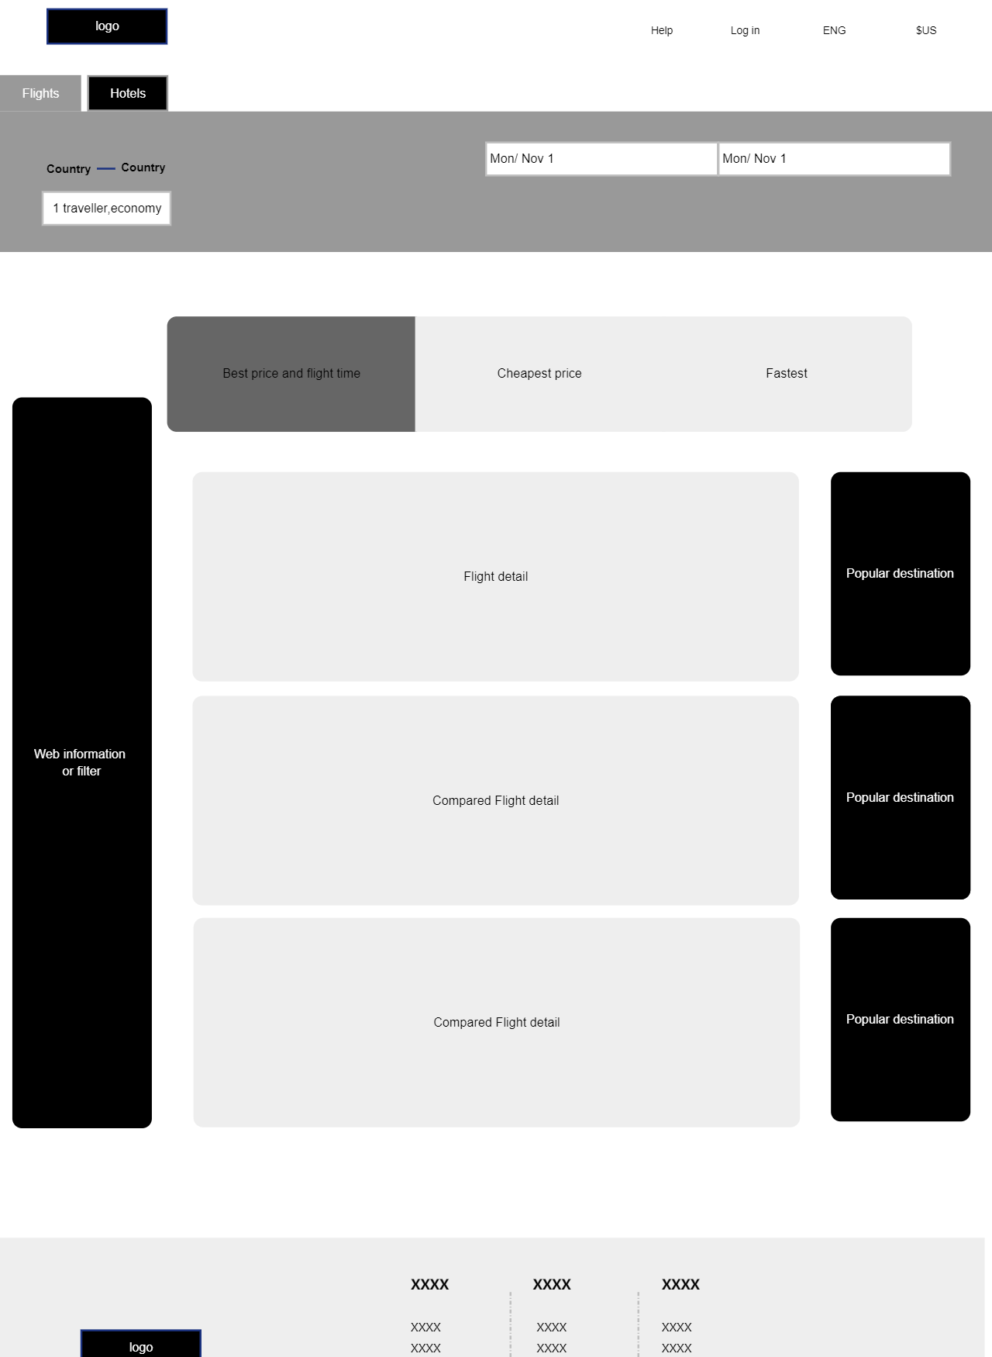
Flight booking

Slide 3
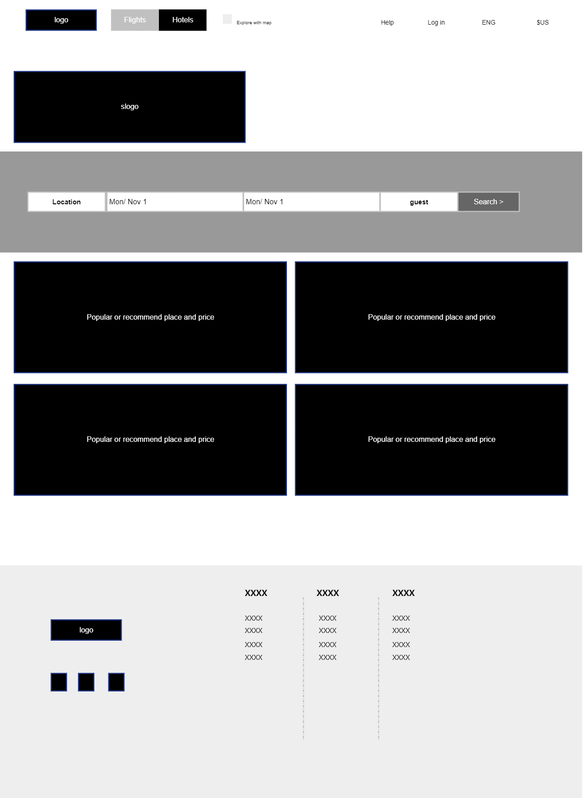
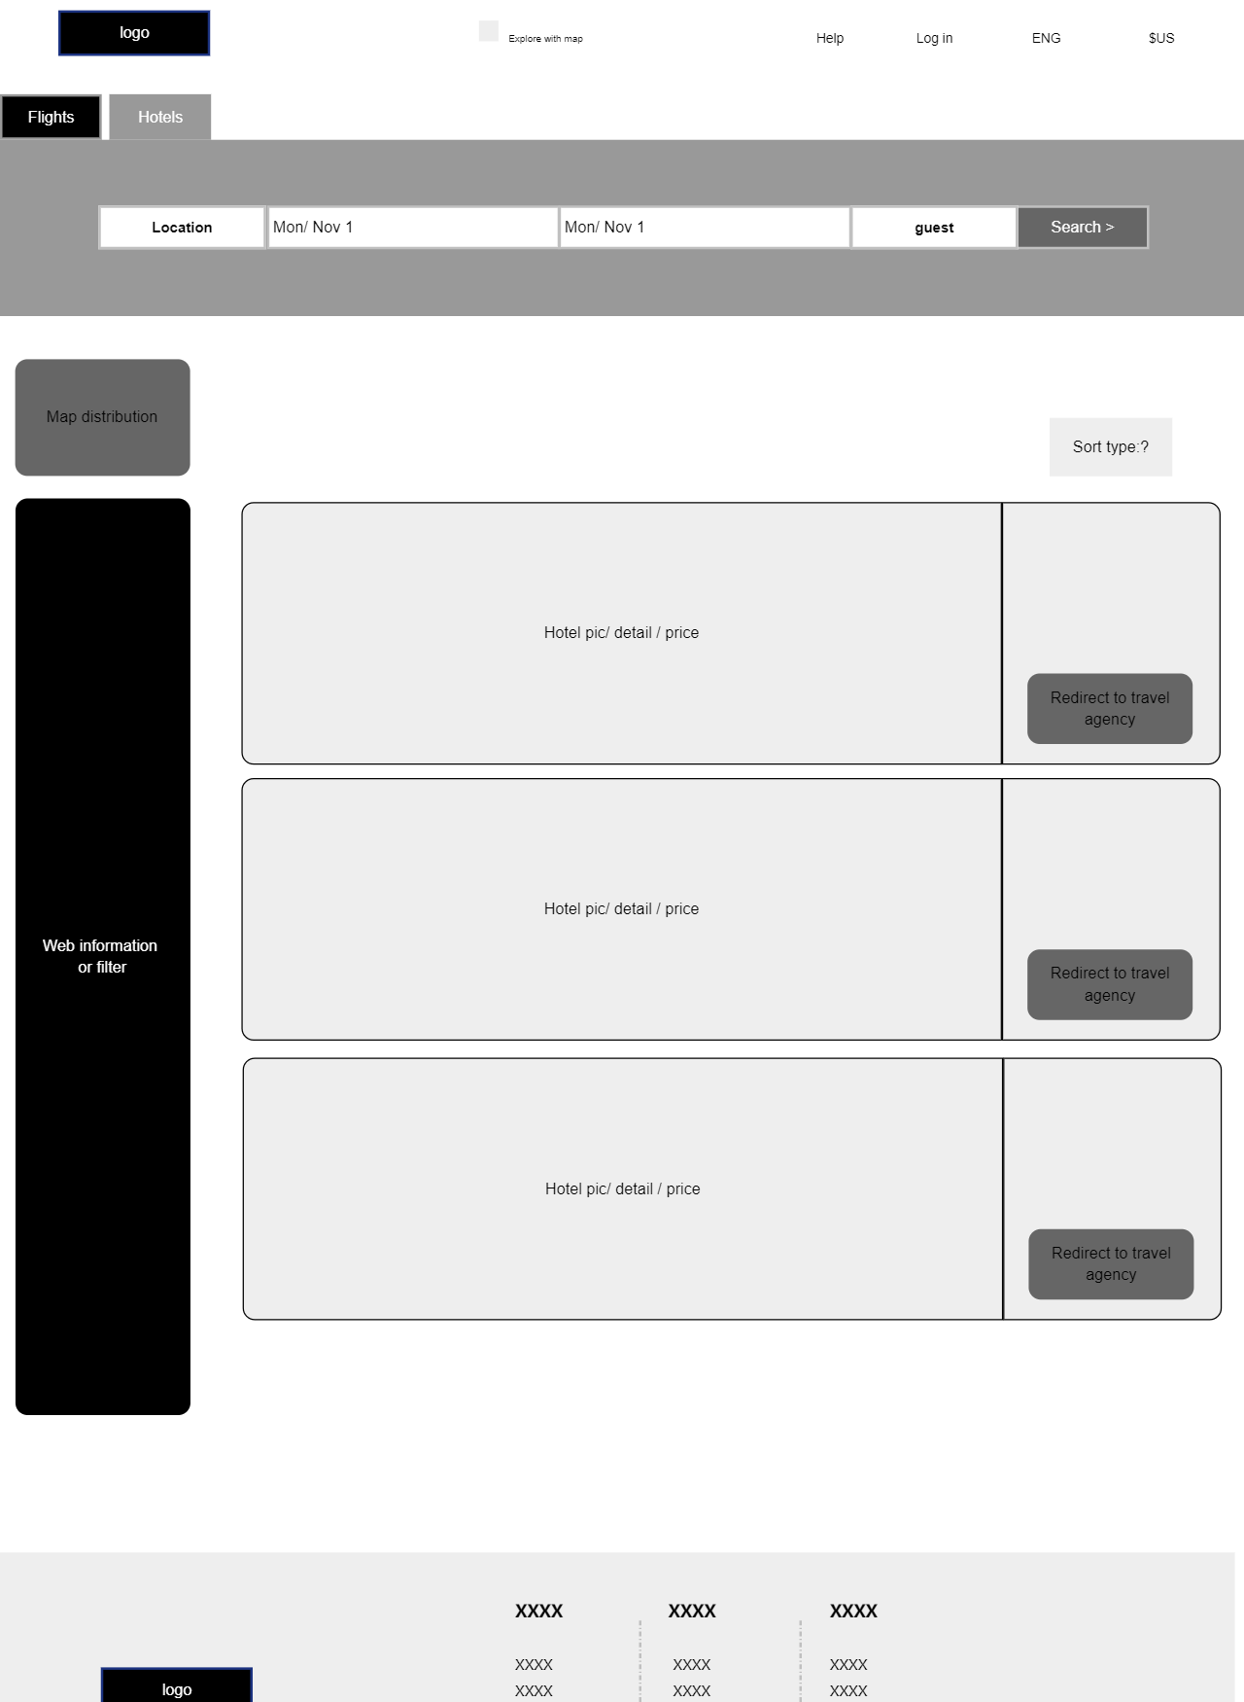
hotel booking
Redirect to travel agency

Slide 4
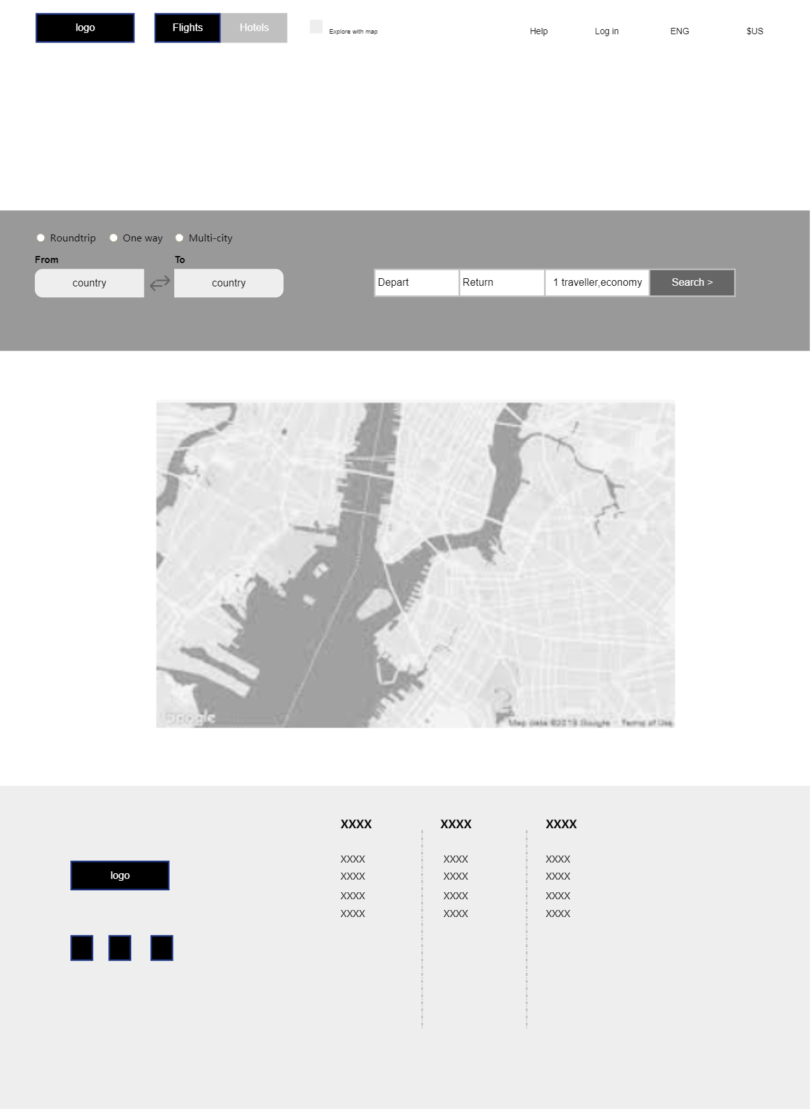
Map compare

Slide 5
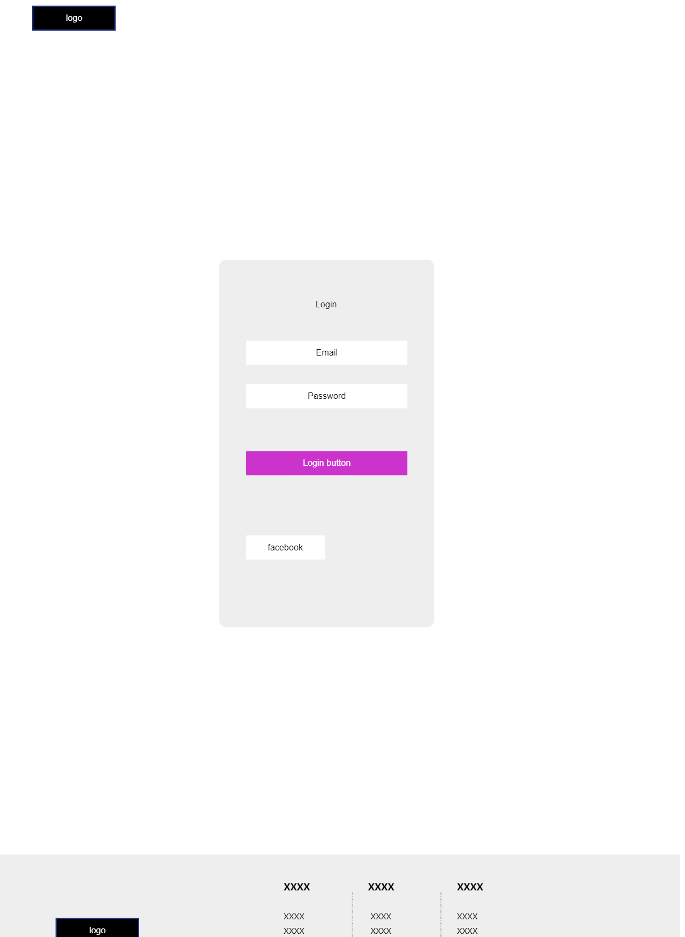
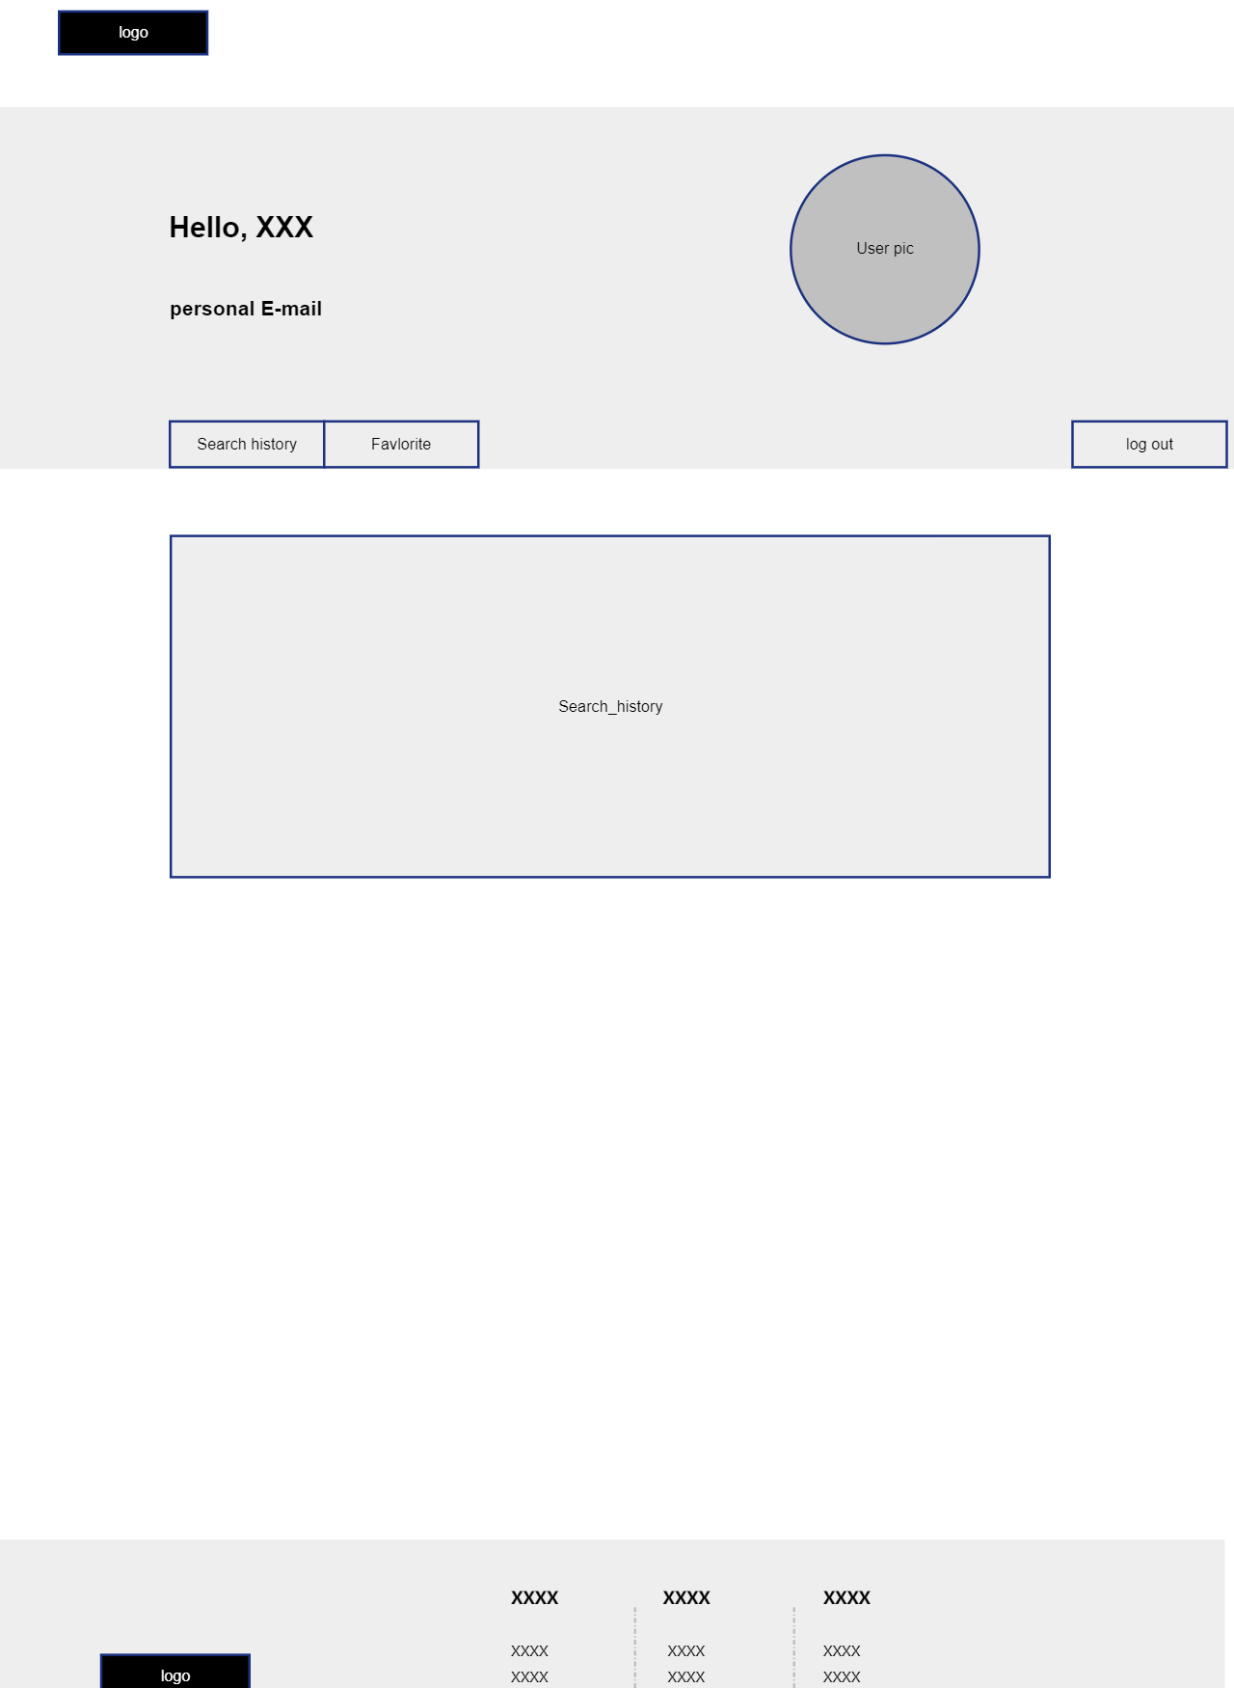
User

Slide 6
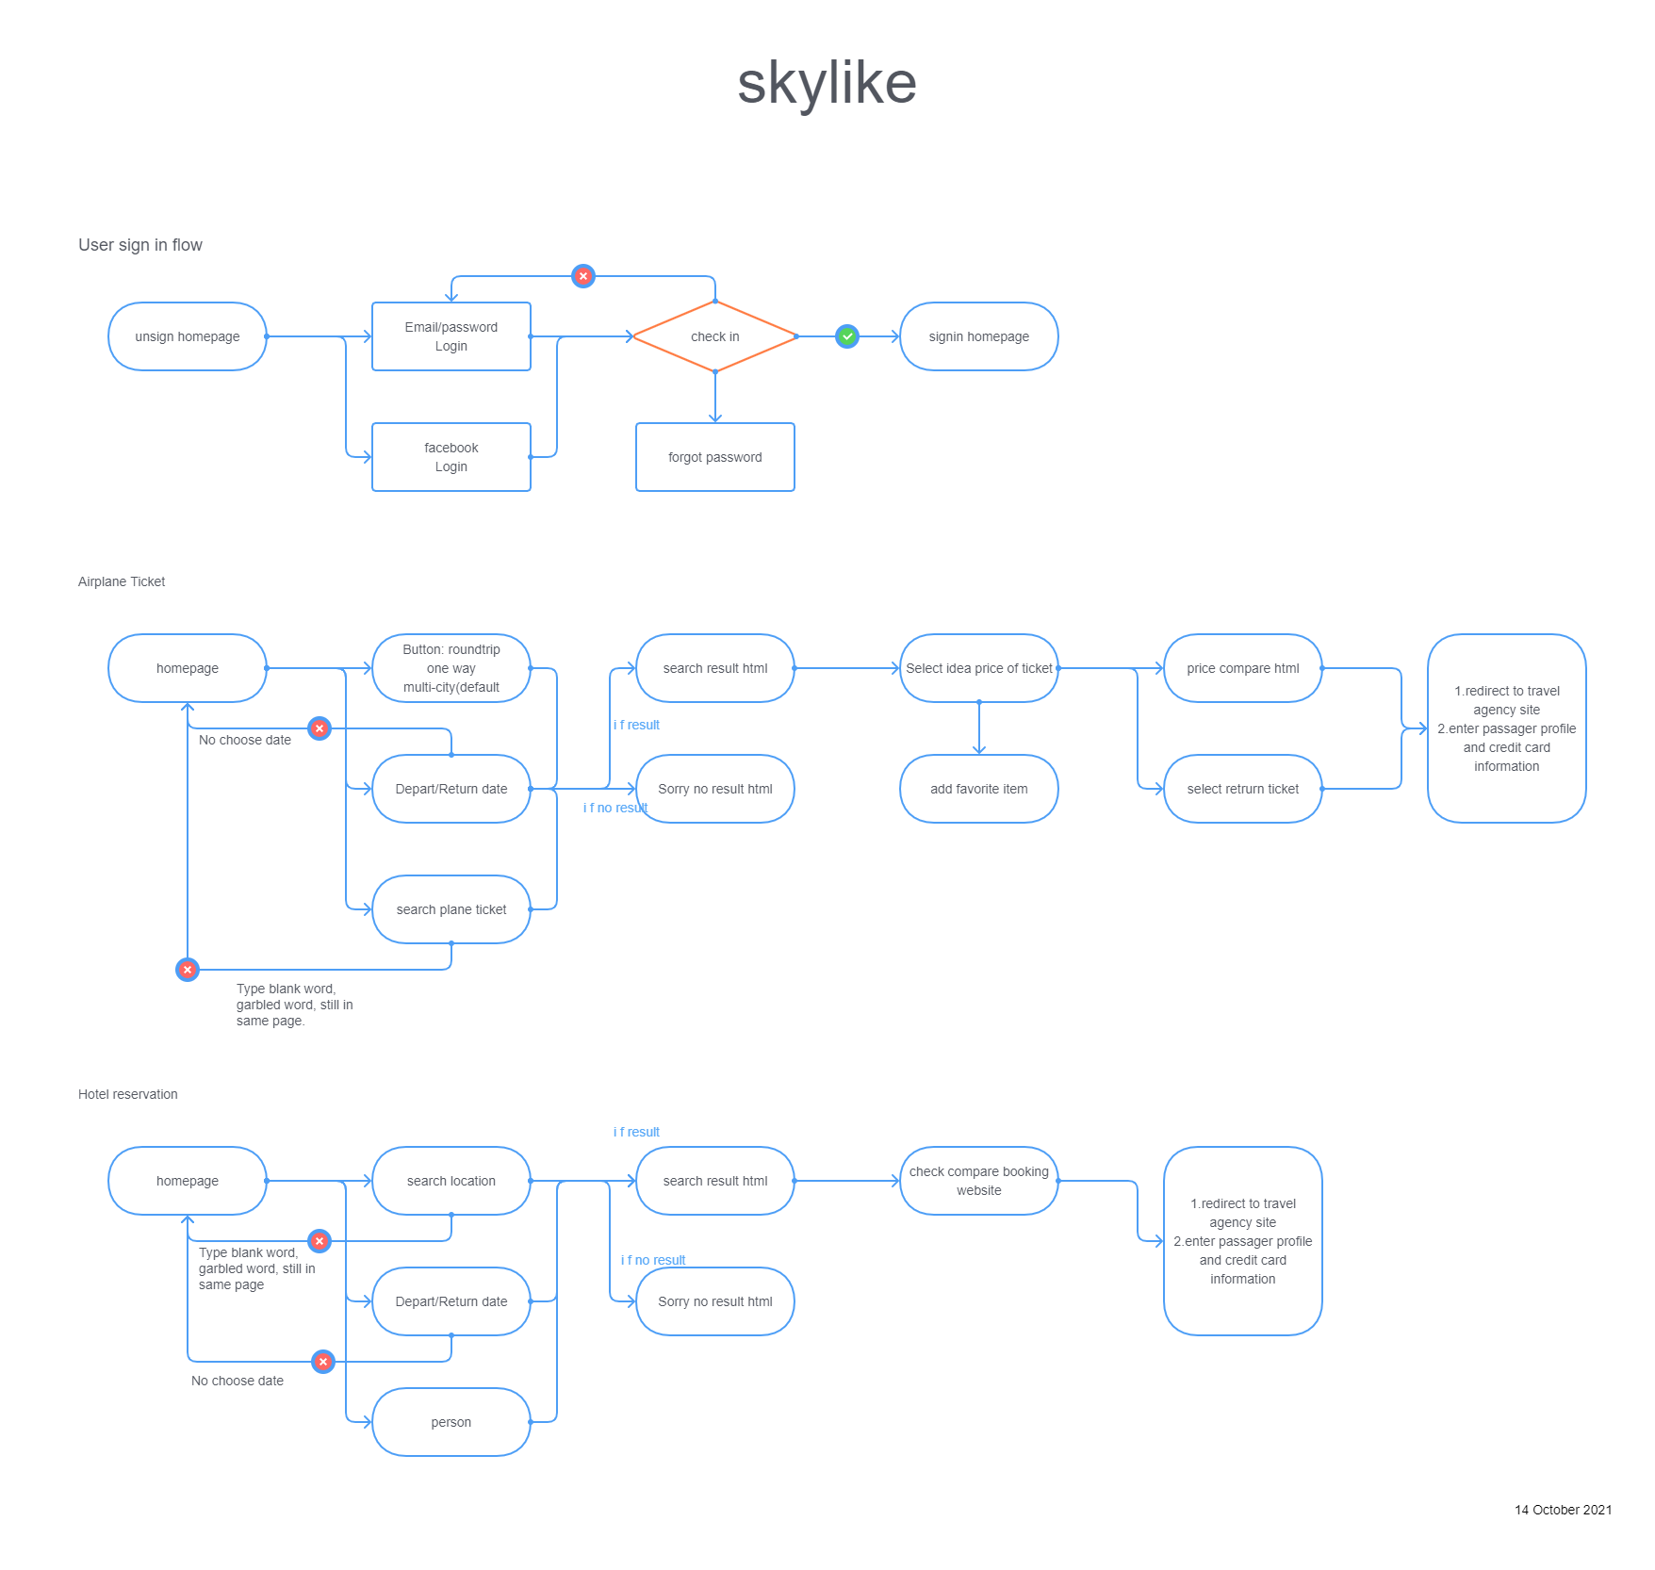

Slide 7







Slide 8
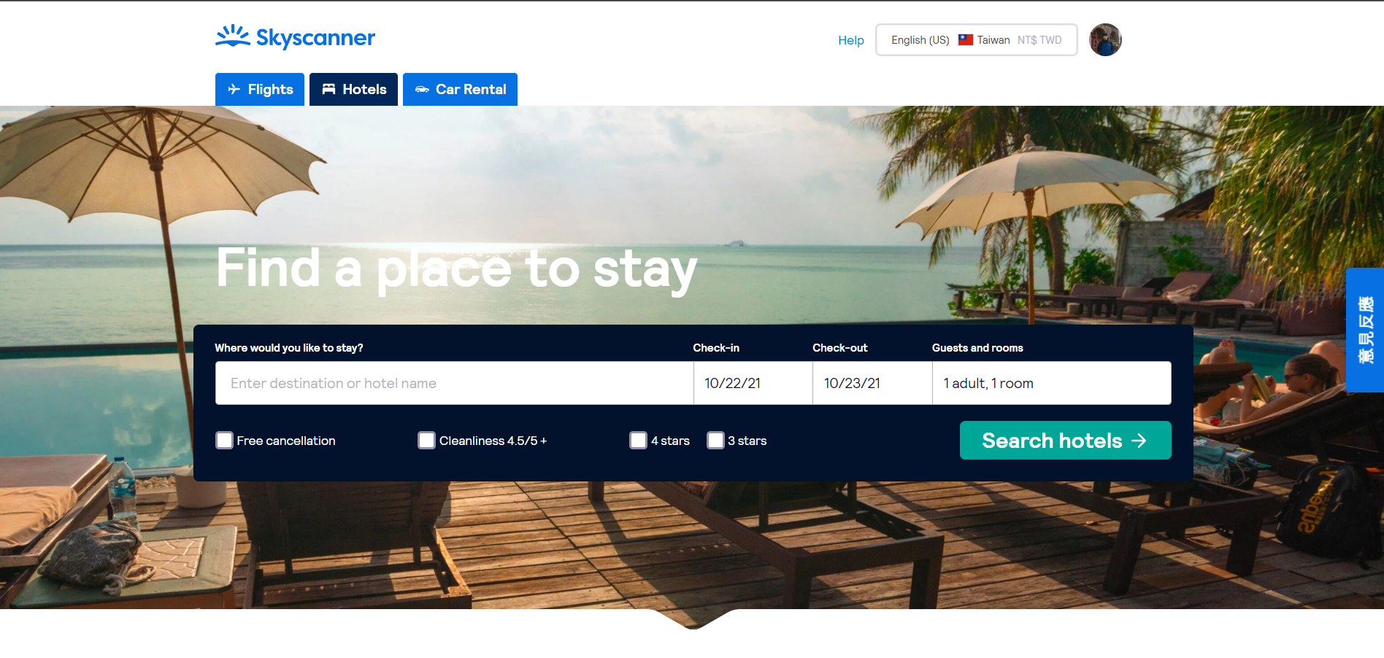

Slide 9
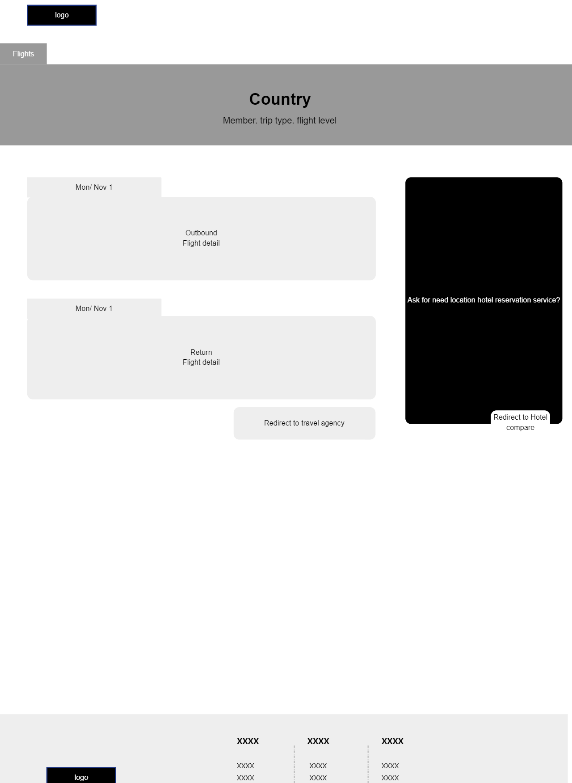
Redirect to travel agency
Redirect to travel agency

