Slide 1
如何讓自建的 Framework 跟 Spring Boot 一樣潮
David Hsu（松凌科技）

Slide 2
About me
徐永維(David Hsu)
david.hsu.sl@gmail.com
https://github.com/davidhsusl
松凌科技
http://www.softleader.com.tw

Slide 3
大綱
Spring Framework – Softleader Framework
XML Configuration
Java Configuration
Spring Boot – Softleader Microservices
Annotation Configuration
Spring Boot Starter – Softleader Boot Starter
Starter Configuration

Slide 4
Spring Framework – Softleader Framework
XML Configuration
<jpa:repositories base-package="tw.com.softleader.core.**.dao"
entity-manager-factory-ref="entityManagerFactory"
transaction-manager-ref="transactionManager"
base-class="tw.com.softleader.data.dao.GenericCrudDaoImpl">
</jpa:repositories>

Slide 5
Spring Framework – Softleader Framework
XML Configuration
缺點:
不易修改、重構
無法透過繼承來 Override 部份設定，專案每次都必須重寫相同設定

Slide 6
Spring Framework – Softleader Framework
Extends Java Configuration
@Configuration @EnableTransactionManagement @EnableJpaRepositories( basePackages = "tw.com.softleader.data.core.**.dao", repositoryBaseClass = GenericCrudDaoImpl.class ) public class DataSourceConfiguration {
protected Collection<String> entityPackagesToScan() { return new ArrayList<>(); } @Bean public LocalContainerEntityManagerFactoryBean entityManagerFactory( @Qualifier("dataSource") DataSource dataSource, @Qualifier("jpaVendorAdapter") JpaVendorAdapter jpaVendorAdapter) { final LocalContainerEntityManagerFactoryBean factory = new LocalContainerEntityManagerFactoryBean(); factory.setJpaVendorAdapter(jpaVendorAdapter); Collection<String> packages = Lists.newArrayList("tw.com.softleader.data.core.**.entity", "org.springframework.data.jpa.convert.threeten"); Optional.ofNullable(entityPackagesToScan()).ifPresent(packages::addAll); factory.setPackagesToScan(packages.stream().toArray(String[]::new)); factory.setDataSource(dataSource); return factory; }

Slide 7
Spring Framework – Softleader Framework
Extends Java Configuration
@Configuration @EnableJpaRepositories( basePackages = "tw.com.softleader.data.mypackage.**.dao", repositoryBaseClass = GenericCrudDaoImpl.class ) public class MyDataSourceConfiguration extends DataSourceConfiguration { @Override public Collection<String> entityPackagesToScan() { return Collections.singletonList("tw.com.softleader.data.mypackage.**.entity"); } }

Slide 8
Spring Framework – Softleader Framework
Extends Java Configuration
缺點:
有多個 Module 的專案同時都 extends Configuration 並啟動將會產生 recursion 的問題

Slide 9
Spring Framework – Softleader Framework
Import Java Configuration
@Configuration @EnableTransactionManagement @EnableJpaRepositories(
basePackages = "tw.com.softleader.data.core.**.dao", repositoryBaseClass = GenericCrudDaoImpl.class) public class DataSourceConfiguration { @Autowired(required = false) private EntityPackageDefinition[] entityPackageDefinitions; @Bean public LocalContainerEntityManagerFactoryBean entityManagerFactory( @Qualifier("dataSource") DataSource dataSource, @Qualifier("jpaVendorAdapter") JpaVendorAdapter jpaVendorAdapter) { final LocalContainerEntityManagerFactoryBean factory = new LocalContainerEntityManagerFactoryBean(); factory.setJpaVendorAdapter(jpaVendorAdapter); Collection<String> packages = Lists.newArrayList("tw.com.softleader.data.core.**.entity", "org.springframework.data.jpa.convert.threeten"); Optional.ofNullable(entityPackageDefinitions) .ifPresent(e -> Stream.of(e).forEach(packages::addAll)); factory.setPackagesToScan(packages.stream().toArray(String[]::new)); ... return factory; }

Slide 10
Spring Framework – Softleader Framework
Import Java Configuration
@Import(DataSourceConfiguration.class) @Configuration @EnableJpaRepositories( basePackages = "tw.com.softleader.data.mypackage.**.dao", repositoryBaseClass = GenericCrudDaoImpl.class ) public class MyDataSourceConfiguration { @Bean public EntityPackageDefinition entityPackagesToScan() { EntityPackageDefinition packageDefinition = new EntityPackageDefinition(); packageDefinition.add("tw.com.softleader.data.mypackage.**.entity"); return packageDefinition; } }

Slide 11
Spring Framework – Softleader Framework
Import Java Configuration
缺點:
無法直接透過 @Override 取代部份 code，但若 @Bean 的 method name 相同，Spring 依然會視為 override，可以透過此方法取代 Java override，只是必須先知道 Configuration 裡的 method name
需要 return 特定的 Bean，讓底層去 autowire，設定冗長
當 import 的 Configuration 很多時，若沒有完整的文件說明，使用者難以了解到底哪些設定是我可以修改的

Slide 12
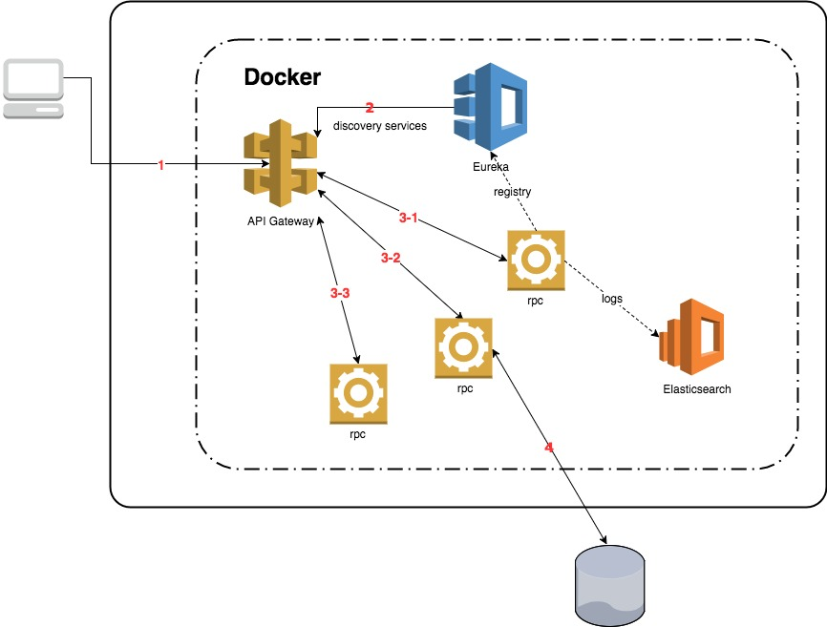
Spring Boot – Softleader Microservices

Slide 13
Spring Boot – Softleader Microservices
Annotation Configuration
@EnableCoreFormula @EnableCoreDomainRule @EnableCoreDataSource( entityPackagesToScan = "tw.com.softleader.data.mypackage.**.entity", idStrategies = "tw.com.softleader.data.mypackage.**.entity=AUTO" ) @EnableJpaRepositories( basePackages = "tw.com.softleader.data.mypackage.**.dao", repositoryBaseClass = GenericCrudDaoImpl.class ) @SpringBootApplication public class MyApplication {}

Slide 14
Spring Boot – Softleader Microservices
Annotation Configuration
如何寫 Annotation Configuration ?
@Import 接受三種類型的 class
@Configuration
implements ImportSelector
implements ImportBeanDefinitionRegistrar
@Import({DataSourceConfiguration.class, DataSourceRegistrar.class}) public @interface EnableCoreDataSource {

Slide 15
Spring Boot – Softleader Microservices
Annotation Configuration
ImportSelector
public interface ImportSelector { /** * Select and return the names of which class(es) should be imported based on * the {@link AnnotationMetadata} of the importing @{@link Configuration} class. */ String[] selectImports(AnnotationMetadata importingClassMetadata); }

Slide 16
Spring Boot – Softleader Microservices
Annotation Configuration
public class MyDatasourceImportSelector implements ImportSelector { @Override public String[] selectImports(AnnotationMetadata importingClassMetadata) { AnnotationAttributes attributes = AnnotationAttributes.fromMap( importingClassMetadata.getAnnotationAttributes( EnableCoreDataSource.class.getName(), false)); String idStrategies = attributes.getString("idStrategies"); if(idStrategies.contains("AUTO")) { return new String[]{DatasourceAutoConfiguration.class.getName()}; } else { return new String[]{DatasourceOtherConfiguration.class.getName()}; } } }

Slide 17
Spring Boot – Softleader Microservices
Annotation Configuration
ImportBeanDefinitionRegistrar
public interface ImportBeanDefinitionRegistrar { /** * Register bean definitions as necessary based on the given annotation metadata of * the importing {@code @Configuration} class. * <p>Note that {@link BeanDefinitionRegistryPostProcessor} types may <em>not</em> be * registered here, due to lifecycle constraints related to {@code @Configuration} * class processing. * @param importingClassMetadata annotation metadata of the importing class * @param registry current bean definition registry */ public void registerBeanDefinitions( AnnotationMetadata importingClassMetadata, BeanDefinitionRegistry registry); }

Slide 18
Spring Boot – Softleader Microservices
Annotation Configuration
public class MyDatasourceRegistrar implements ImportBeanDefinitionRegistrar { @Override public void registerBeanDefinitions( AnnotationMetadata importingClassMetadata, BeanDefinitionRegistry registry) { AnnotationAttributes attributes = AnnotationAttributes.fromMap( importingClassMetadata.getAnnotationAttributes( EnableCoreDataSource.class.getName(), false)); boolean generateDdl = attributes.getBoolean("generateDdl"); BeanDefinition beanDefinition = BeanDefinitionBuilder.rootBeanDefinition(HibernateJpaVendorAdapter.class) .addPropertyValue("generateDdl", generateDdl) .getBeanDefinition(); beanDefinition.setPrimary(false); registry.registerBeanDefinition("jpaVendorAdapter", beanDefinition); } }

Slide 19
Spring Boot – Softleader Microservices
Annotation Configuration
在 ImportSelector 與 ImportBeanDefinitionRegistrar 中不可以 autowire 其他 Spring 的 bean，但可以透過 implements 以下四種 interface 來取得 Spring 的 bean
EnvironmentAware
BeanFactoryAware
BeanClassLoaderAware
ResourceLoaderAware

Slide 20
Spring Boot – Softleader Microservices
Annotation Configuration
public class MyDatasourceRegistrar implements ImportBeanDefinitionRegistrar, BeanFactoryAware { private BeanFactory beanFactory; @Override public void registerBeanDefinitions( AnnotationMetadata importingClassMetadata, BeanDefinitionRegistry registry) { MyBean myBean = beanFactory.getBean(MyBean.class); ... } @Override public void setBeanFactory(BeanFactory beanFactory) throws BeansException { this.beanFactory = beanFactory; } }

Slide 21
Spring Boot – Softleader Microservices
Annotation Configuration 使用時機
@Configuration
不需要讓使用者客製化任何參數時，最簡單使用的設定
implements ImportSelector
依據 Annotation 的 attribute 決定要啟動的 Configuration，因為沒有提供 BeanDefinitionRegistry，所以須搭配回傳 Configuration 來註冊 Bean
implements ImportBeanDefinitionRegistrar
有提供 BeanDefinitionRegistry，適用 Bean 多且複雜的條件使用
@Import({DataSourceConfiguration.class, DataSourceRegistrar.class}) public @interface EnableCoreDataSource {

Slide 22

Spring Boot – Softleader Microservices
Annotation Configuration Sample
https://github.com/davidhsusl/JCConf2017
boot-web
random-port-sample

Slide 23
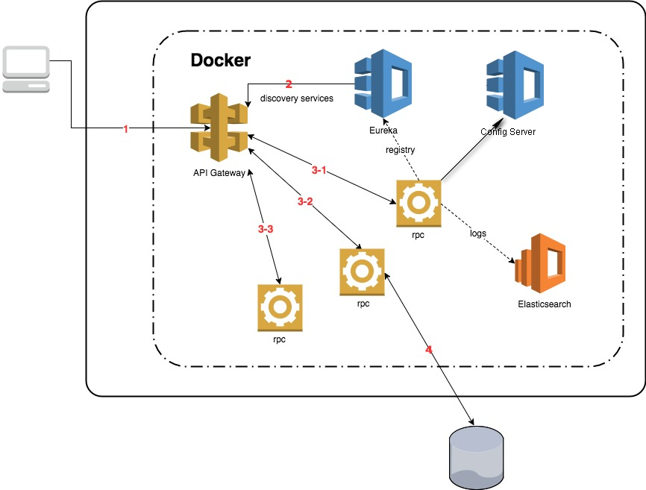
Spring Boot Starter – Softleader Boot Starter

Slide 24
Spring Boot Starter – Softleader Boot Starter
Starter Configuration
使用 Starter 前
pom.xml
Configuration
<dependency> <groupId>tw.com.softleader</groupId> <artifactId>softleader-web</artifactId> </dependency>
@EnableRandomPort(minPort = 60000, maxPort = 62000)
@EnableDiscoveryClient @SpringBootApplication public class ScheduleApplication { public static void main(String[] args) { SpringApplication.run(ScheduleApplication.class, args); } }

Slide 25
Spring Boot Starter – Softleader Boot Starter
Starter Configuration
使用 Starter 後
pom.xml
Configuration
application.properties
<dependency> <groupId>tw.com.softleader</groupId> <artifactId>softleader-boot-starter-web</artifactId> </dependency>
@EnableDiscoveryClient @SpringBootApplication public class ScheduleApplication { public static void main(String[] args) { SpringApplication.run(ScheduleApplication.class, args); } }
server.port.random.enable=true server.port.random.min=60000 server.port.random.max=62000

Slide 26
Spring Boot Starter – Softleader Boot Starter
Starter Configuration
如何寫一個 Starter ?
pom.xml
Classpath:/META-INF/spring.factories
<dependency> <groupId>org.springframework.boot</groupId> <artifactId>spring-boot-autoconfigure</artifactId> </dependency>
org.springframework.boot.autoconfigure.EnableAutoConfiguration=tw.com.softleader.boot.web.WebAutoConfiguration

Slide 27
Spring Boot Starter – Softleader Boot Starter
Starter Configuration
如何寫一個 Starter ?
定義 properties 的參數
@Getter @Setter @ConfigurationProperties("server.port.random") public class ServerProperties { private boolean enable = false; private int min = 1; private int max = 65535; }

Slide 28
Spring Boot Starter – Softleader Boot Starter
Starter Configuration
如何寫一個 Starter ?
寫 AutoConfiguration
@EnableConfigurationProperties(ServerProperties.class) @Configuration public class WebAutoConfiguration { @Autowired private ServerProperties properties; @ConditionalOnProperty(name = "server.port.random.enable", havingValue = "true") @Bean public EmbeddedServletContainerCustomizer containerCustomizer() { return container -> { ... }; } }

Slide 29
Spring Boot Starter – Softleader Boot Starter
Starter Configuration
於專案的 pom.xml 加入我們寫好的 starter dependency，在 Application 啟動時 Spring 會自動尋找 Classpath:/META-INF/spring.factories 的設定來執行我們寫的 AutoConfiguration
pom.xml
<dependency> <groupId>tw.com.softleader</groupId> <artifactId>softleader-boot-starter-web</artifactId> </dependency>

Slide 30
Spring Boot Starter – Softleader Boot Starter
Starter Configuration Sample
https://github.com/davidhsusl/JCConf2017
boot-starter-web
random-port-starter-sample

Slide 31
總結
Spring 原本提供的 Configuration 絕大部分已經符合我們的需求，但當我們有需要客製一些額外的功能時，Spring 也提供了我們使用與 Spring 相同的模式進行開發給予他人使用的 Configuration，如果要朝 Spring Cloud 的方向前進，學會開發自己的 Starter 就相對重要。
david.hsu.sl@gmail.com
https://github.com/davidhsusl/JCConf2017

