Slide 1
成績分佈
Avg: 49.65
Max: 89

Slide 2
a
1. As we increase the complexity of a model, which statement is true?
(a) Bias will decrease and variance will increase.
(b) Both bias and variance will increase.
(c) Both bias and variance will decrease.
(d) Bias will increase and variance will decrease.
d
2. For a centered dataset X, what does the value in the matrix X^{T}X represent? (5%)
(a) Similarity between data instances (b) Distance between data points © Dissimilarity between variables (d) Covariance between variables.
a,d
3. Which statements are true regarding the objective function of LDA? (5%)
(a) The means in the projection space shall be as far apart as possible.
(b) The distances in the original space shall be preserved in the projection space.
(c) The variances of the data shall be kept as much as possible in the new space.
(d) The examples of classes shall be scattered in as small a region as possible in the new space.
c,d
4. Which of the following methods are non-linear dimensionality reduction techniques? (5%)
(a) PCA (b) Factor Analysis (c) Isomap (d) LLE.

Slide 3
5. Linear Discriminant Analysis (LDA) is a supervised method for dimensionality reduction for classification problems. Please describe the idea of LDA, i.e., the goal that LDA tries to optimize. (5%)
Find a low-dimensional space such that when x is projected, classes are well-separated.
The means to be as far apart as possible
The examples of classes be scattered in as small a region as possible
Find the direction, as defined by a vector w, that maximizes

Slide 4
6. Among model selection procedures, please explain the following two methods.
Cross-validation, (5%)
Regularization. (5%)
7. (a) Please describe the idea of dimensionality reduction technique, Principle Component Analysis. (5%)
(b) Please explain how to use Proportion of Variance (PoV) and eigenvalues (λs) to determine the value k, i.e., the dimensionality of the reduced space. Assume the dimensionality of the original space is d. (5%)

Slide 5
Model Selection Procedure
Cross-validation:
Measure generalization accuracy by testing on data unused during training.
If there is a large enough dataset, it is the best approach.
Regularization:
Penalize complex models
E’ = error on data + λ ⋅ model complexity
Akaike’s information criterion (AIC), Bayesian information criterion (BIC)

Slide 6
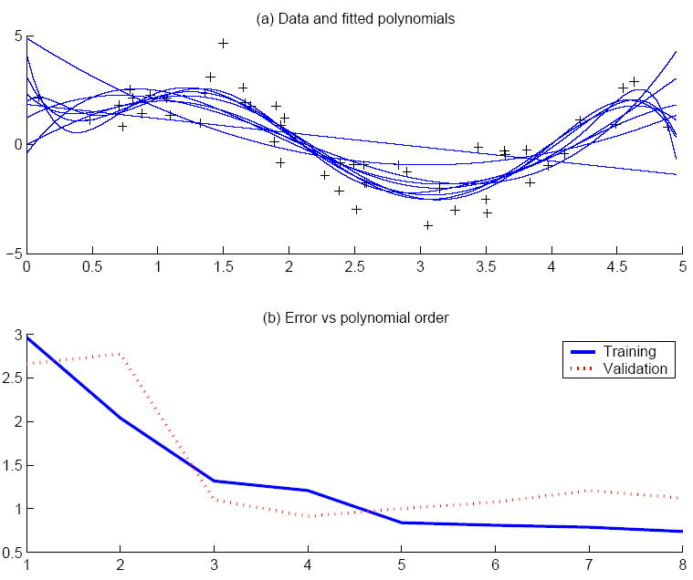
Cross Validation
Data
Training
dataset
Validation
dataset
Best fit, “elbow”
f(x) = 2sin(1.5x), and one noisy (N(0,1)) dataset sampled from the function. Training and validation sets (each containing 50 instances) are generated. (a) Training data and fitted polynomials of order from 1 to 8. (b) Training and validation errors as a function of the polynomial order. The “elbow” is at 3.

Slide 7
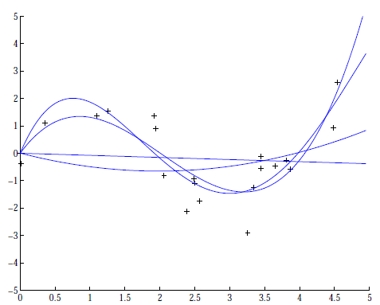
Regularization: Regression example
4: [-0.1093, 1.4356, -5.5007, 6.0454, -0.0019]
3: [0.4238, -2.5778, 3.4675, -0.0002
2: [0.1682, -0.6657, 0.0080]
1: [-0.0769, 0.0016]
Coefficients increase in magnitude as order increases.
Regularization (L2):
Force w_{i} to be small.

Slide 8
Principal Component Analysis (PCA)
Given N data vectors from d-dimensions, find k (≤ d) orthogonal vectors that can be best used to represent data
The original data set is reduced to one consisting of N data vectors on k principal components (reduced dimensions)
Goal is to find a projection that captures the largest amount of variation in data
Each data vector is a linear combination of the k principal component vectors
Works for numeric data only
[x₁ x₂ x₃ x₄ x₅ x₆] → [z₁ z₂ z₃]
z₁ = w₁₁x₁+w₁₂x₂+w₁₃x₃+w₁₄x₄+w₁₅x₅+w₁₆x₆
z₂ = w₂₁x₁+w₂₂x₂+w₂₃x₃+w₂₄x₄+w₂₅x₅+w₂₆x₆
z₃ = w₃₁x₁+w₃₂x₂+w₃₃x₃+w₃₄x₄+w₃₅x₅+w₃₆x₆
z₄ = w₄₁x₁+w₄₂x₂+w₄₃x₃+w₄₄x₄+w₄₅x₅+w₄₆x₆
…

Slide 9
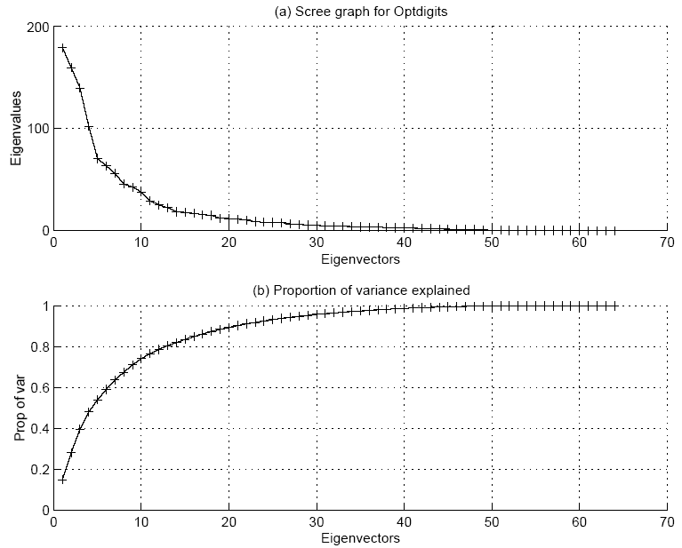

How to choose k ?
Proportion of Variance (PoV) explained. Typically, stop at PoV > 0.9
Scree graph plots of PoV vs k, stop at “elbow”
λ_{i} are sorted in descending order

Slide 10
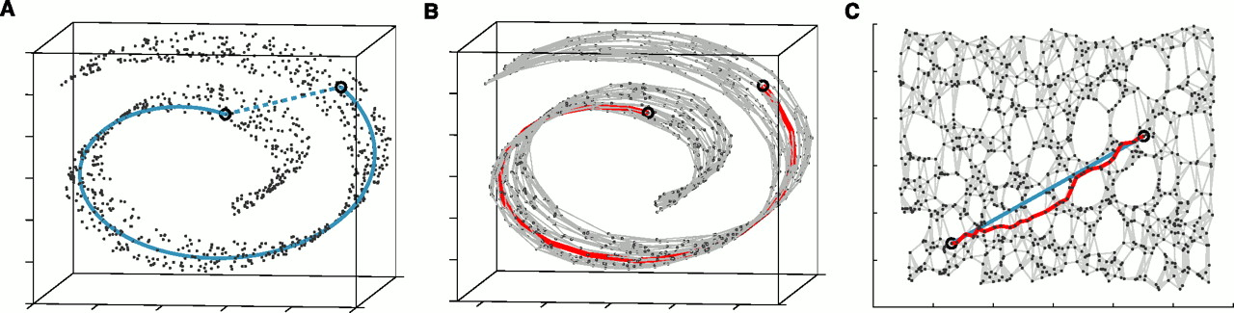
8. In Isomap, the geodesic distance is used and not the Euclidean distance. Please describe an approach to measuring the geodesic distance between two data points. (10%)
Determine the neighbors.
All points in a fixed radius, or
K nearest neighbors
Construct a neighborhood graph.
Each point is connected to the other if it is a K nearest neighbor.
Edge Length equals the Euclidean distance
Compute the shortest paths between two nodes
Floyd’s Algorithm
Djkastra’s ALgorithm

Slide 11
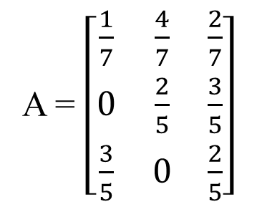
9. Assume a set of observations {O₁, …, O₅} as shown below and states S₁ = red, S₂ = green and S₃ = blue, please answer the following questions.
Find the Markov model M = {Π, A} which is most likely to generate the set, i.e., to estimate the model’s parameters Π and A. (10%)
Write the formula for estimating π_{i .} (5%)
Write the formula for estimating the probabilities of state transition, a_{ij.} (5%)
O₁: “red red green green”
O₂: “red green blue blue”
O₃: “green green blue red blue”
O₄: “blue blue red green”
O₅: “red blue red green blue”
Π = [0.6 0.2 0.2]
A = $\left[\begin{matrix}\frac{1}{7} & \frac{4}{7} & \frac{2}{7} \\ 0 & \frac{2}{5} & \frac{3}{5} \\ \frac{3}{5} & 0 & \frac{2}{5}\end{matrix}\right]$

Slide 12
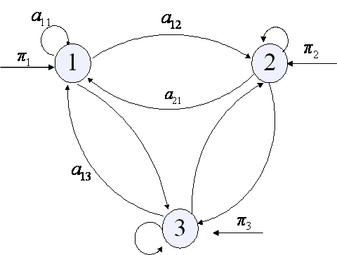
13.2 Model’s Parameters Estimation
O₁: “red red green green”
O₂: “red green blue blue”
O₃: “green green blue red blue”
O₄: “blue blue red green”
…
O_{K}: “blue red blue red”
modeling
M = {Π, A}

Slide 13

10. Given a Markov model M as follows and S₁ = Rainy, S₂ = Cloudy, and S₃ = Sunny, what is the probability of observing O = “Rainy Cloudy Cloudy Sunny Sunny Cloudy Rainy” given that today is Rainy. (10%)
Rainy Cloudy Sunny
$$Π=\left[\begin{matrix}0.6 \\ 0.3 \\ 0.1\end{matrix}\right] A=\left[\begin{matrix}0.4 & 0.3 & 0.3 \\ 0.3 & 0.6 & 0.1 \\ 0.2 & 0.1 & 0.7\end{matrix}\right]$$
R
C
S
Prob(O) = 0.3*0.6*0.1*0.7*0.1*0.3

Slide 14
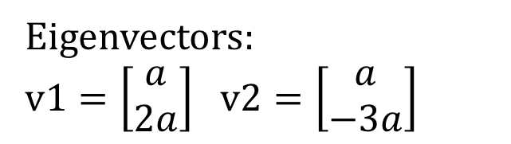
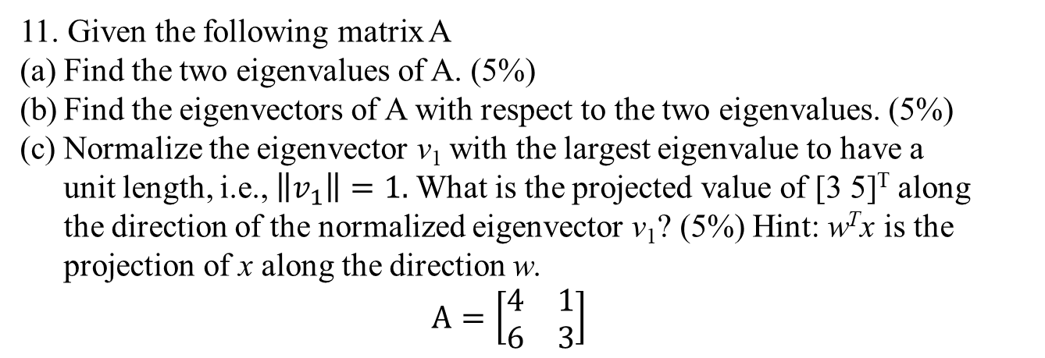
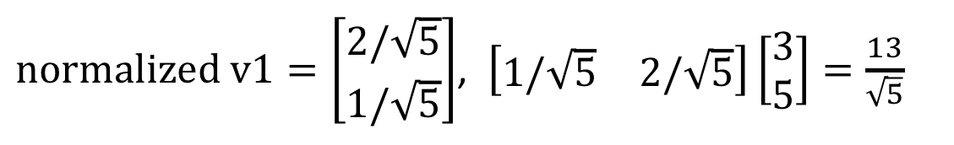
11. Given the following matrix A
Find the two eigenvalues of A. (5%)
Find the eigenvectors of A with respect to the two eigenvalues. (5%)
Normalize the eigenvector v₁ with the largest eigenvalue to have a unit length, i.e., $\left\|v_{1}\right\|=1.$What is the projected value of [3 5]^{T} along the direction of the normalized eigenvector v₁? (5%) Hint: w^{T}x is the projection of x along the direction w.
$$A=\left[\begin{matrix}4 & 1 \\ 6 & 3\end{matrix}\right]$$
(a)
(6 – 7λ + λ²) = 0
Eigenvalues = 6, 1
Eigenvectors:
$v1=\left[\begin{aligned}a \\ 2a\end{aligned}\right]$ $v2=\left[\begin{aligned}a \\ −3a\end{aligned}\right]$
(b)
(c)
$normalized v1=\left[\begin{aligned}2/\sqrt{5} \\ 1/\sqrt{5}\end{aligned}\right]$, $\left[\begin{matrix}1/\sqrt{5} & 2/\sqrt{5}\end{matrix}\right]\left[\begin{aligned}3 \\ 5\end{aligned}\right]=\frac{13}{\sqrt{5}}$

