Slide 1
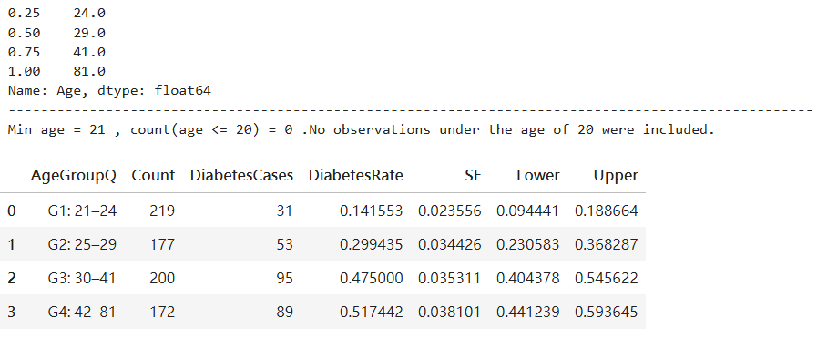
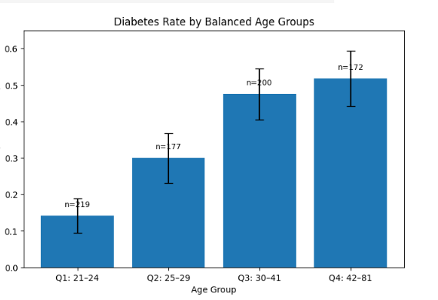
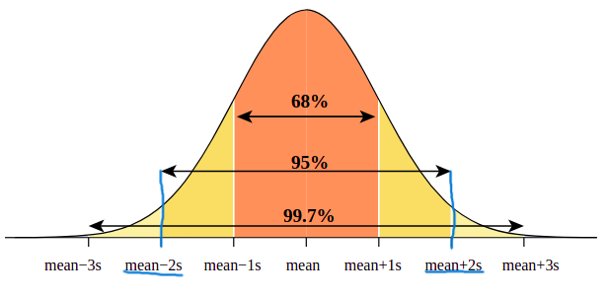
Age and Diabetes Prevalence in Balanced Age Groups
Table 1. Balanced age-group summary
Design
Age was divided into four quantile-based groups so that each group contained a similar sample size. Younger observations were more concentrated, whereas older observations were more dispersed.
Computation
For each group, the mean of Outcome was interpreted as the diabetes rate. Standard errors were computed for each proportion, and approximate bounds were displayed using plus or minus two standard errors. No observations were recorded below age 20.
Figure 1. Diabetes rate by balanced age groups
Key result
14.2% → 29.9% → 47.5% → 51.7%
The increasing pattern suggests that diabetes prevalence tends to rise with age in this dataset.
Interpretation
Because the group sizes were relatively balanced and the standard errors were fairly small, the upward pattern is unlikely to be explained only by unstable grouping. Within the observed sample, Age appears to be an informative variable for understanding diabetes prevalence.
Error bars(Lower/Upper Bound)
represent approximate ±2 standard errors.

