Slide 1
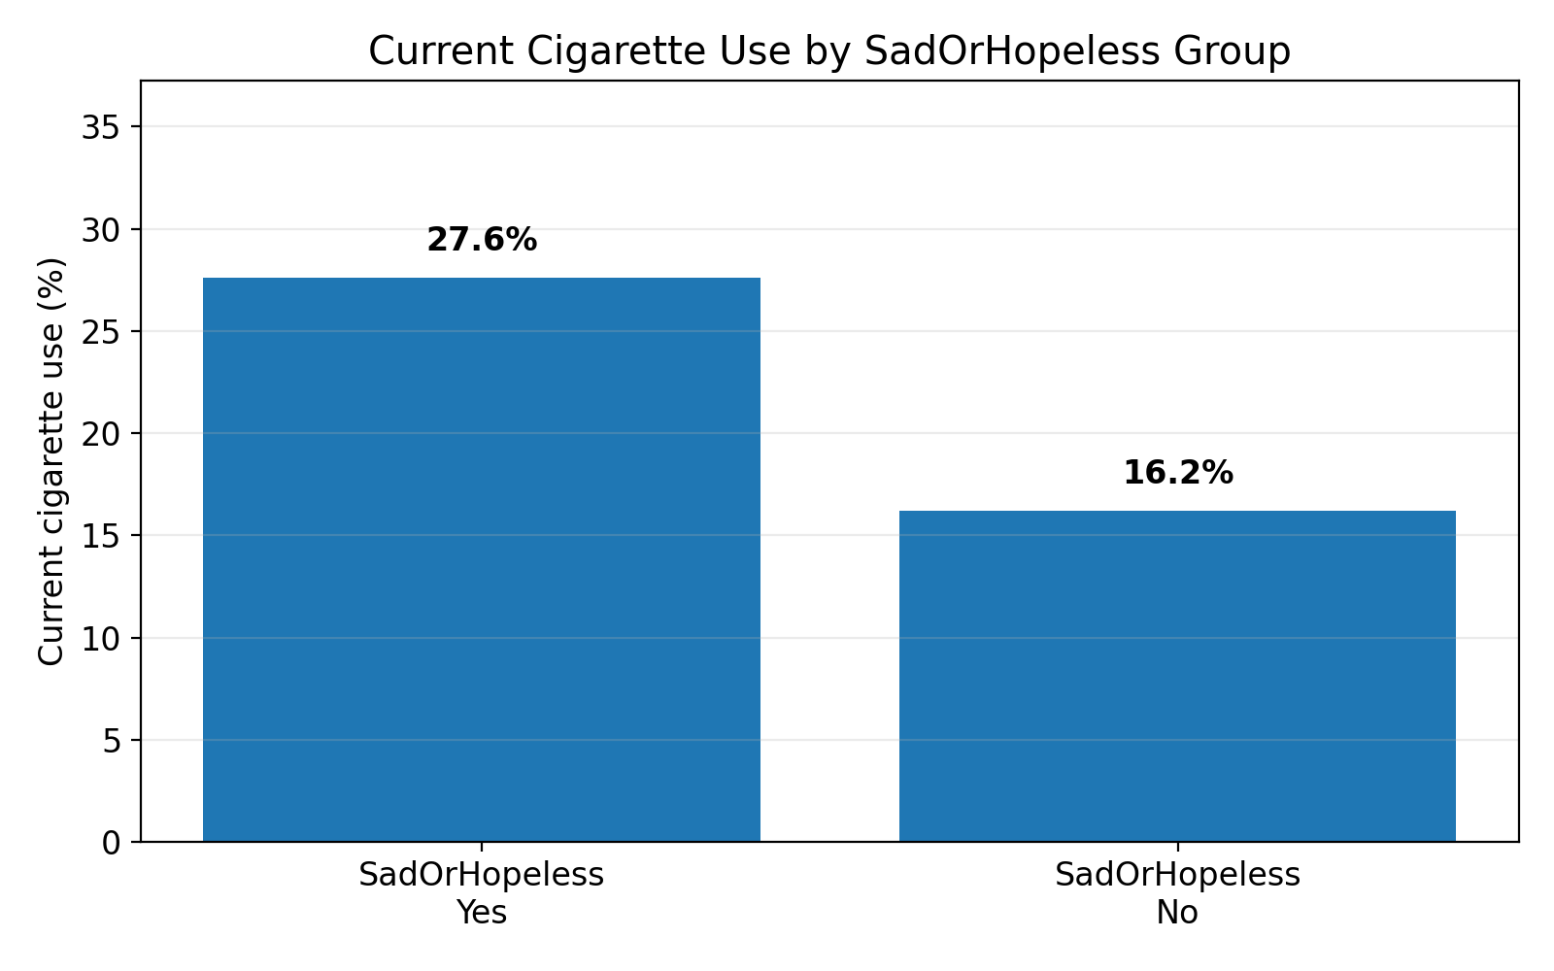
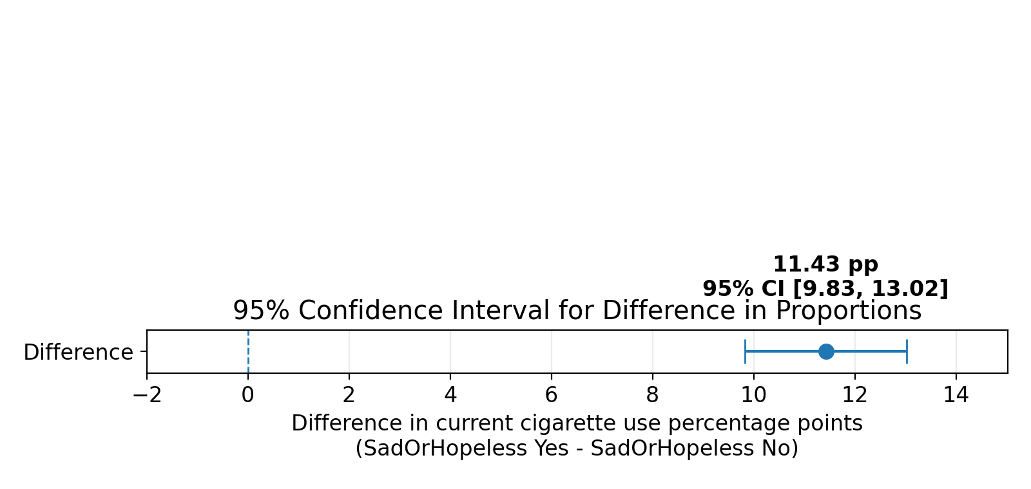
Cycle 3 - Two-Sample Inference
Q8: SadOrHopeless Feeling and Current Cigarette Use
Research Question
Is the proportion of current cigarette use different between students who felt sad or hopeless and those who did not?
11.43 pp
higher current cigarette use in the SadOrHopeless group
Key statistical result
Method: two-proportion z-test 95% CI: [9.83, 13.02] pp z: 15.0536 p-value: < 0.0001 Decision: Reject H0 at α = 0.05
Conclusion
Students who felt sad or hopeless had a higher observed proportion of current cigarette use (27.6% vs 16.2%). The result is statistically significant, but it shows association, not causation.
Valid N = 13,174 | Difference = SadOrHopeless Yes - No

