Slide 1
CMPT 310 Group #10
Kaggle Comp. : H&M
Perapat Arerassadorn
Tsai Chang Hsiu
Li Zidai
Japneet Singh
Brandon Zhang

Slide 2

Introduction and Background
Extensive product selections
Potential Problem:
  Loss of customer interests
  Environmental damages
Solution:
  Product recommendations
Notes:
Intro: (~60 secs) ZEE
H&M Group is a multinational clothing brand that is known for its extensive selection of products. However, this large product choice potentially brings a problem that people may give up before finding the ideal items, after a long time of searching, because they face too many choices when shopping online. In addition, it is important to the business that their customers purchase suitable items, because it could potentially decrease product waste, which leads to sustainability and less emission from transportations. Therefore, to enhance the customer shopping experience and minimize environmental damages, our team is aiming to develop product recommendations based on data from previous transactions, as well as from customer and product meta data.

Slide 3
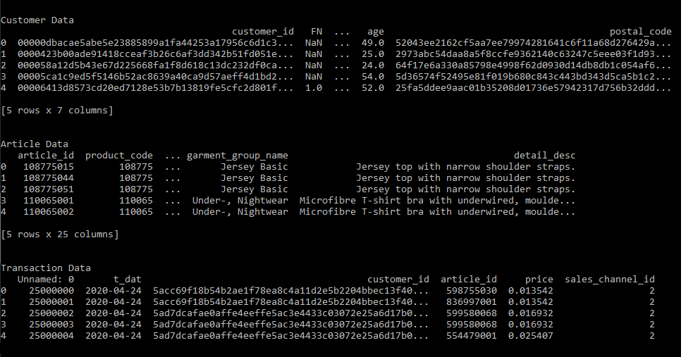
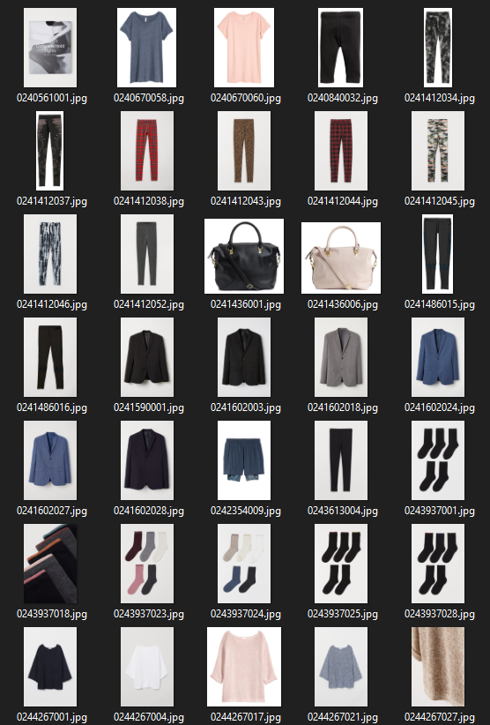
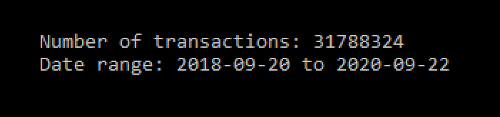
The Data
Notes:
information and data
the available meta data span from simple data such as garment type and customer age to product description as well as garment images
the source of data are provided by H&M group with over 31 million transactions over 2 years period
the size of data are over 34 gb which are mostly images but we will use a much smaller size of data and we will not use the images

Slide 4
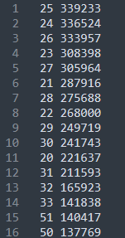

Reducing the Data
Transactions by age group in descending order
Notes:
we reduce the data size to work on a much smaller scale as we are working only on 25 years old buyers and also in the last 5 months
by filtering out other age group we chose to work on the 25 year old customer group because they have the largest total number of transactions
we hope this will give us better training data as it reduces the variation due to demographic and time factors

Slide 5
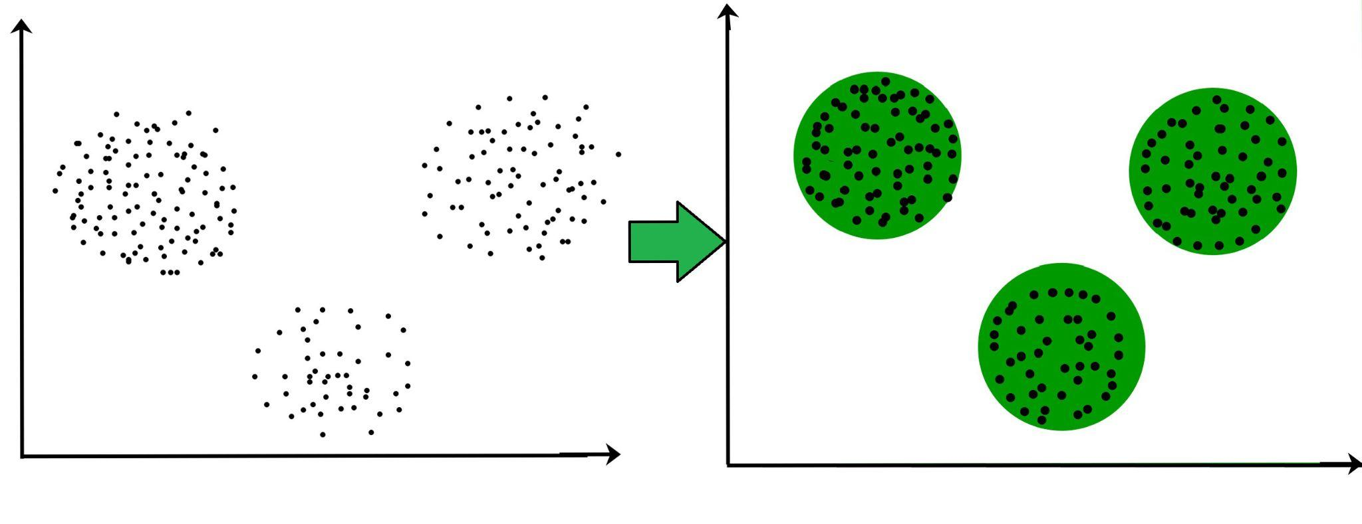
Clustering
Notes:
Recommendation systems commonly use clustering algorithms, which is an unsupervised learning method that adapts to patterns inherent in the data. The basic idea is to track which values tend to occur together so that when one of those values happens, we can infer the occurrence of the others as well.

Slide 6
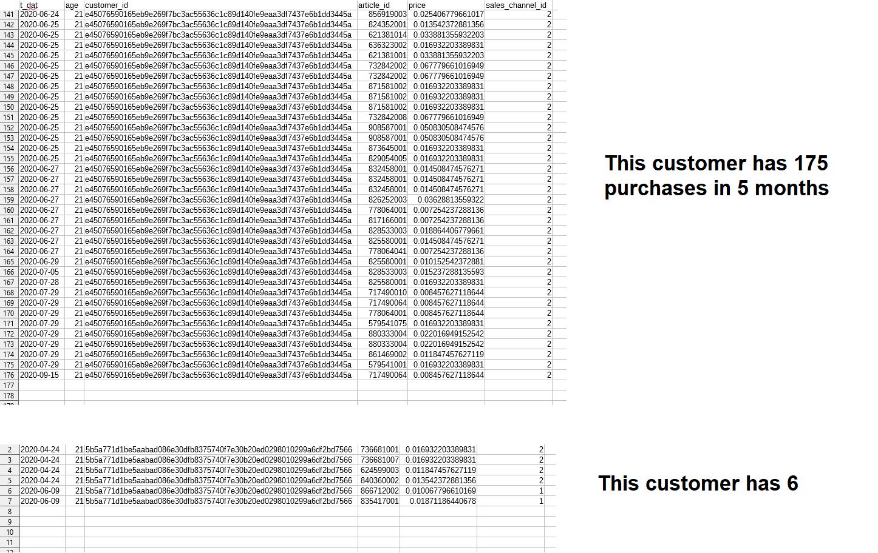
Notes:
Given the complexity of figuring out what someone will purchase and in what order, this method is well suited for recommendation problems. In our data set, purchases by an individual customer work as a natural clustering group and will be used in variations in the algorithms we implement.

Slide 7
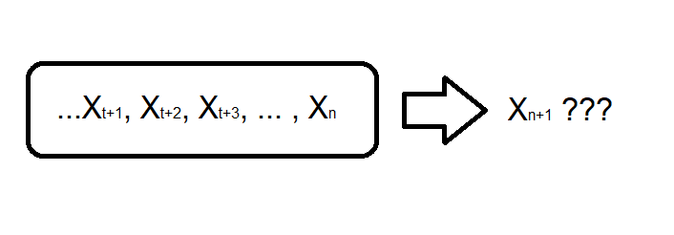
Sequence Prediction
Notes:
Additionally, the sequence of a customer’s purchases might also infer what they are likely to purchase next. This class of problem is called sequence prediction, and the simplest machine learning algorithm that solves this is the Markov process.

Slide 8
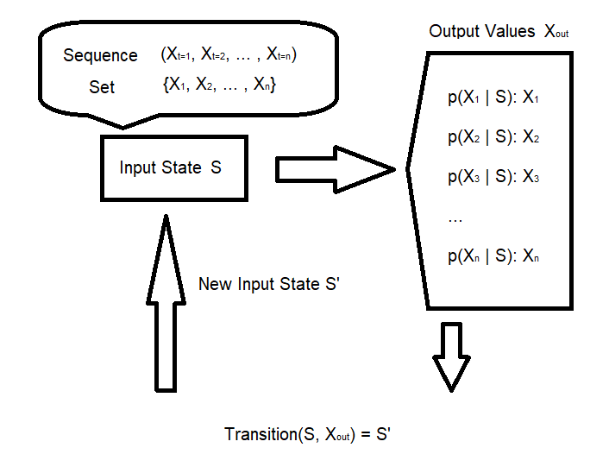
Sequence Prediction
Markov Process:
Notes:
Expressed simply, we track the number of times each output X happens after each state S so that for any input S, we have a probability distribution of possible X's that we can choose from. We can consider variations on the structure of input states, i.e. the number of transactions, and whether it’s an ordered sequence or an unordered set and we will implement a few of these to observe which variations perform better.

Slide 9
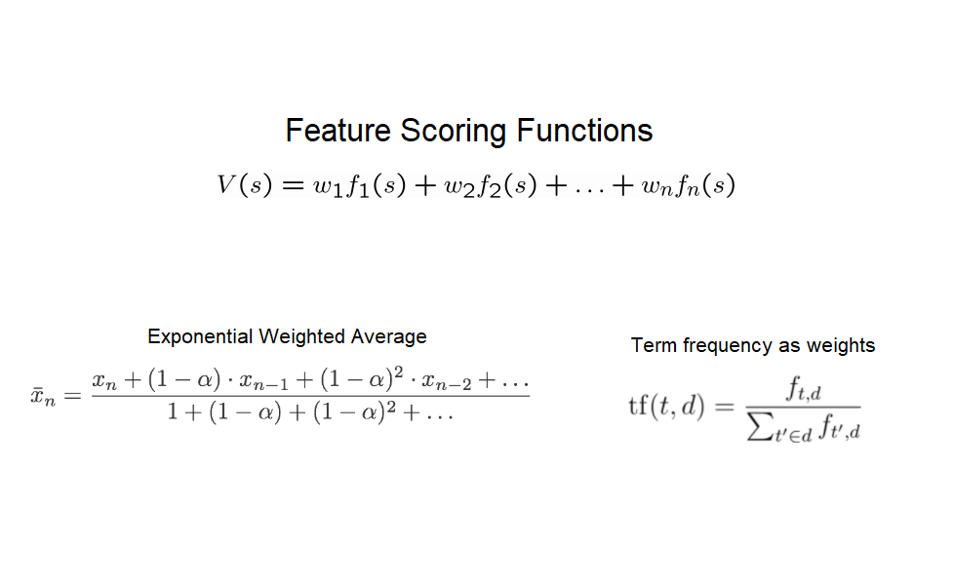
Notes:
We will also compare the results of a number of custom feature-scoring algorithms leveraging the clustered structure of the data. The features will be built based on common heuristics including common techniques such as exponential time-weighting, term frequency/inverse document frequency, etc.

Slide 10
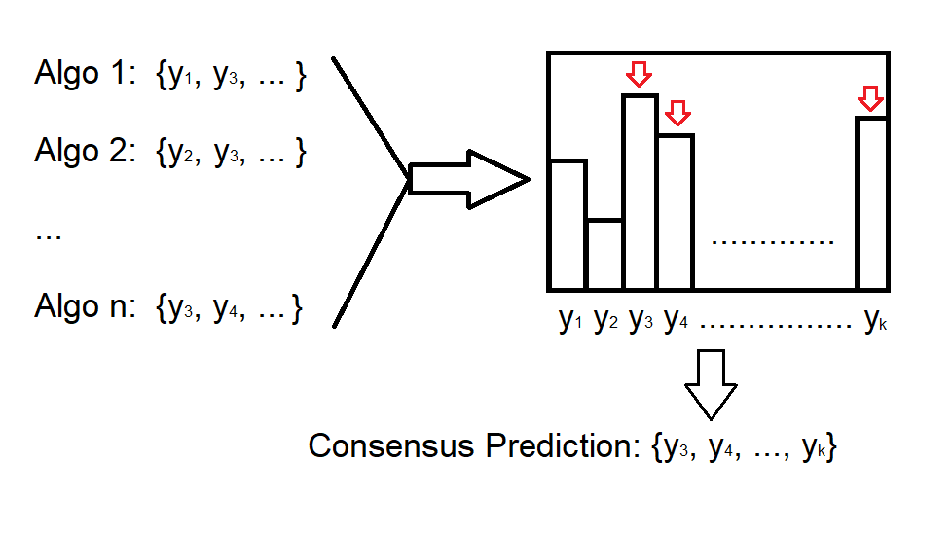
Ensemble Modeling
Notes:
Lastly, we will evaluate an ensemble model of our algorithms by pooling their results to vote on predictions to try and reduce each individual algorithm’s biases.

Slide 11
Potential Challenges and Lessons Learned
Difficulties with comparing different algorithm
What are the metrics of evaluation algorithm
Coordination, cooperation and communication between team member is vital.
Learn about new algorithms, NIPS file format, google Colab.
Notes:
Challenges and lessons learned:(Matt) #5
Initially, we planned to use some basic classifications (KNN, Bayes, Random Forest) to be the model in the recommendation, like finding a customer’s major purchase category, based on that, giving the best sellers from that category.
After a week, we found some notebooks in Kaggle, which got the best score. They use the more complicated matrix to make the recommendation(LSTM, PCA, e.t.c). We will look into those algorithms deeper to support our project in the next several weeks. We also discussed TF-IDF can be a possible solution, but more focus on the TF.
We also learned that coordination, cooperation and communication are vital for progress. Especially communication, it’s best for the team to communicate promptly for the project's progress to flow smoothly.
In the further weeks, we still need to learn about new algorithms, NIPS file format, google Colab.

Slide 12
Conclusion
Kaggle competition:
  Apply theoretical algorithms
  Bring positive impact
Boosted team morale:
  Collaboration
  Communication
Our approach:
  N-depth markov processes
  Custom feature-scoring algorithms
Continued learning:
  Potential to discover more suitable algorithms with better score
Notes:
Conclusion: (~40 secs) JAPNEET
In conclusion, this project is providing us with an opportunity to apply algorithms to real world problems and make a positive impact on H&M’s business model. In addition, our team has been brought closer throughout the consistent improvements on our collaborations and communications. After extensive discussions and researches, we decided to explore the follow algorithms: n-depth markov processes, and custom feature-scoring algorithms. As the project being perfected throughout the process, we will be keeping learning and polishing our choice of algorithms to achieve better results. Thank you very much for watching our presentation.

