Slide 1
Code-record

Slide 2
Data processing
pre_customizedData_
InternalBaseLineTest
Pre_czb
Pre_customizedData
format
Shape file
json
json
Build mygraph
new_import
GraphFromJSON_Customized
GraphFromJSON_Customized_IgnoreShortCut
define_roads
define_roads_FirstTime
define_roads_FirstTime
define_interior_parcels
define_interior_parcels
define_interior_parcels
AddShortCutInGraph
Info of mygraph
Missing myG.td_dict_init()
feature_init
myG.td_dict_init()
myG.feature_init()
myG.td_dict_POI_Related_init()
myG.feature_init()
myG.td_dict_POI_Related_init()
Run roadfinding
build_all_roads
Save
"/Users/chenzebin/Documents/GitHub/road-planning-for-slums/data"

Slide 3
Important variable changes – constraint and objective
file
function
envs/road.py
reward_info_function
finalReward
Reward
weight
class RoadEnv:
__init__
build_ration
Stop
condition
envs/road.py
class RoadEnv:
def step(
envs/road.py
_get_obs
Embedding
_get_obs_stage2_culdesac
Pretreatment
/myGraph.py
get_obs_stage2_culdesac
Selection
Policy
Pretreatment
/myGraph.py
_get_edge_mask
_get_edge_mask_stage2_culdesac
Feature dimension
Pretreatment
/myGraph.py
get_numerical_feature_size
original is 4, change it to 5 becasue of cul-de-sac num
_get_numerical
[0.5, stage1_ration, stage2_ration, interior_ration,culdesacNum]

Slide 4
Computation control
file
function
Sample num
khrylib/rl/agents/agent.py
sample
Control update
road_planning/agents/
road_planning_agent.py
update_policy
optim_batch_num
= int(math.floor(num_state / self.mini_batch_size))
.yaml
max_num_iterations
Save model
khrylib/rl/core/logger_rl.py
def end_episode(self, info):
Control when to say the model
Road.py
def reward_info_function
record
Return {}
'f2POI_dis_avg’:
mg.f2POI_avg, (old: taking the edge)
'f2POI_avg_EachCat_mean':mg.f2POI_avg_EachCat_mean

Slide 5
self.stats_loggers['episode_reward_avg'].log(-0.9*info['f2f_dis_avg'] - 0.1*info['total_road_cost'])
eval_R_eps

Slide 6
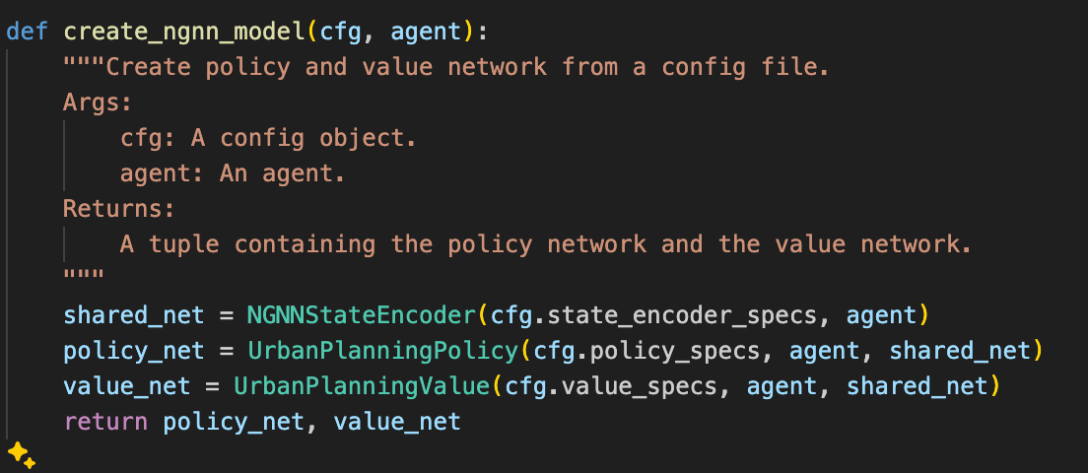

Slide 7
恢复模型状态：
self.actor_critic_net.load_state_dict(model_cp['actor_critic_dict'])：加载模型的状态字典。
self.loss_iter = model_cp['loss_iter']：恢复损失迭代器。

Slide 8
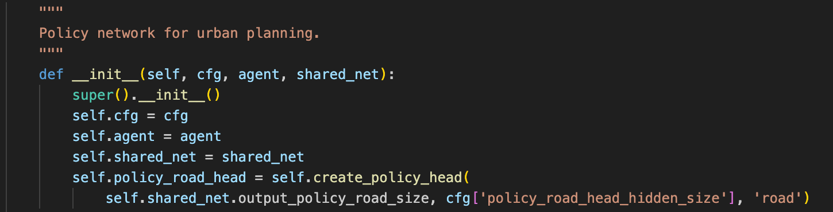

Slide 9
Lr =4
loss.item() 0.1527809053659439 value_loss.item() 0.03901302441954613 surr_loss.item() 0.1616269052028656 entropy_loss.item() -2.8352513313293457
loss.item() 109.96417236328125 value_loss.item() 219.66030883789062 surr_loss.item() 0.1623990386724472 entropy_loss.item() -2.838313341140747
loss.item() 3475.370849609375 value_loss.item() 6950.4736328125 surr_loss.item() 0.16225853562355042 entropy_loss.item() -2.837226390838623
loss.item() 92.9514389038086 value_loss.item() 185.63577270507812 surr_loss.item() 0.16193367540836334 entropy_loss.item() -2.8384971618652344

Slide 10
Lr =0.0004
loss.item() 0.1527809053659439 value_loss.item() 0.03901302069425583 surr_loss.item() 0.1616269052028656 entropy_loss.item() -2.8352513313293457
loss.item() 0.14847075939178467 value_loss.item() 0.028909724205732346 surr_loss.item() 0.1623990386724472 entropy_loss.item() -2.838313341140747
loss.item() 0.1448313146829605 value_loss.item() 0.0218900665640831 surr_loss.item() 0.16225853562355042 entropy_loss.item() -2.837226390838623
loss.item() 0.14198118448257446 value_loss.item() 0.016864998266100883 surr_loss.item() 0.16193366050720215 entropy_loss.item() -2.8384971618652344

Slide 11
optimize_policy_ start update_params
loss.item() 0.1527809053659439 value_loss.item() 0.03901302441954613 surr_loss.item() 0.1616269052028656 entropy_loss.item() -2.8352513313293457
loss.item() 0.1533508598804474 value_loss.item() 0.03866995871067047 surr_loss.item() 0.162399023771286 entropy_loss.item() -2.838313341140747
loss.item() 0.1534225046634674 value_loss.item() 0.039072442799806595 surr_loss.item() 0.16225853562355042 entropy_loss.item() -2.837226390838623
loss.item() 0.1531032770872116 value_loss.item() 0.03910915553569794 surr_loss.item() 0.16193366050720215 entropy_loss.item() -2.8384971618652344

Slide 12
Lr = 4的时候
500条边的图
weight
gradient
Actor 网络（policy）
0.00x
X *10 负7次方
更新了
critic 网络（value）
也变成几十了
0。或者 几十

Slide 13
Lr = 0.004的时候
250条边的图
500条边的图
weight
gradient
weight
gradient
Actor 网络（policy）
0.00x
0.00x
0.00x
X *10 负8，负9次方
太小 所以不更新了
critic 网络（value）
0.00x
0.00x
0.00x
0.00x

Slide 14
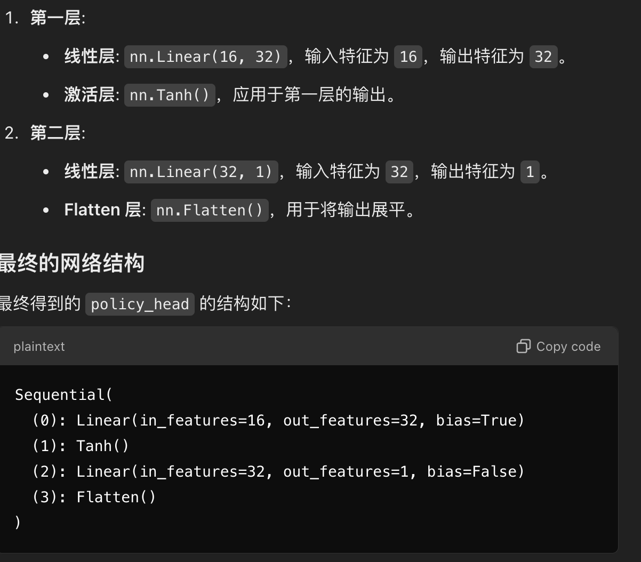
Policy network

Slide 15
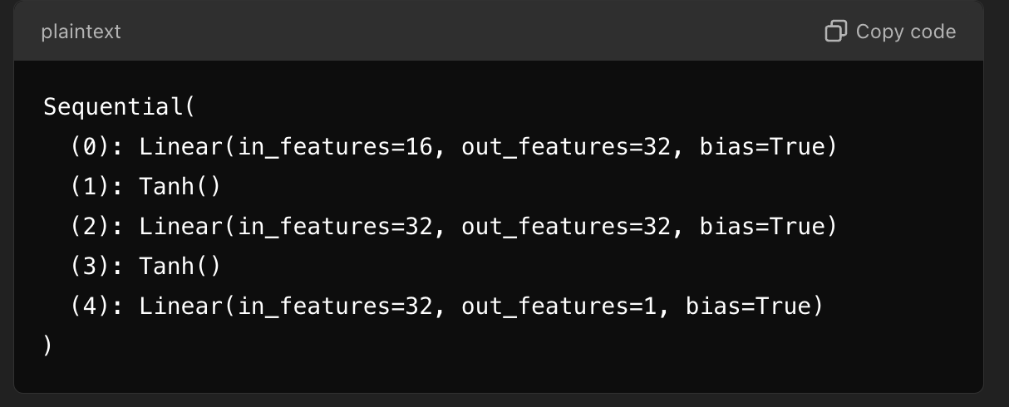
value network

Slide 16
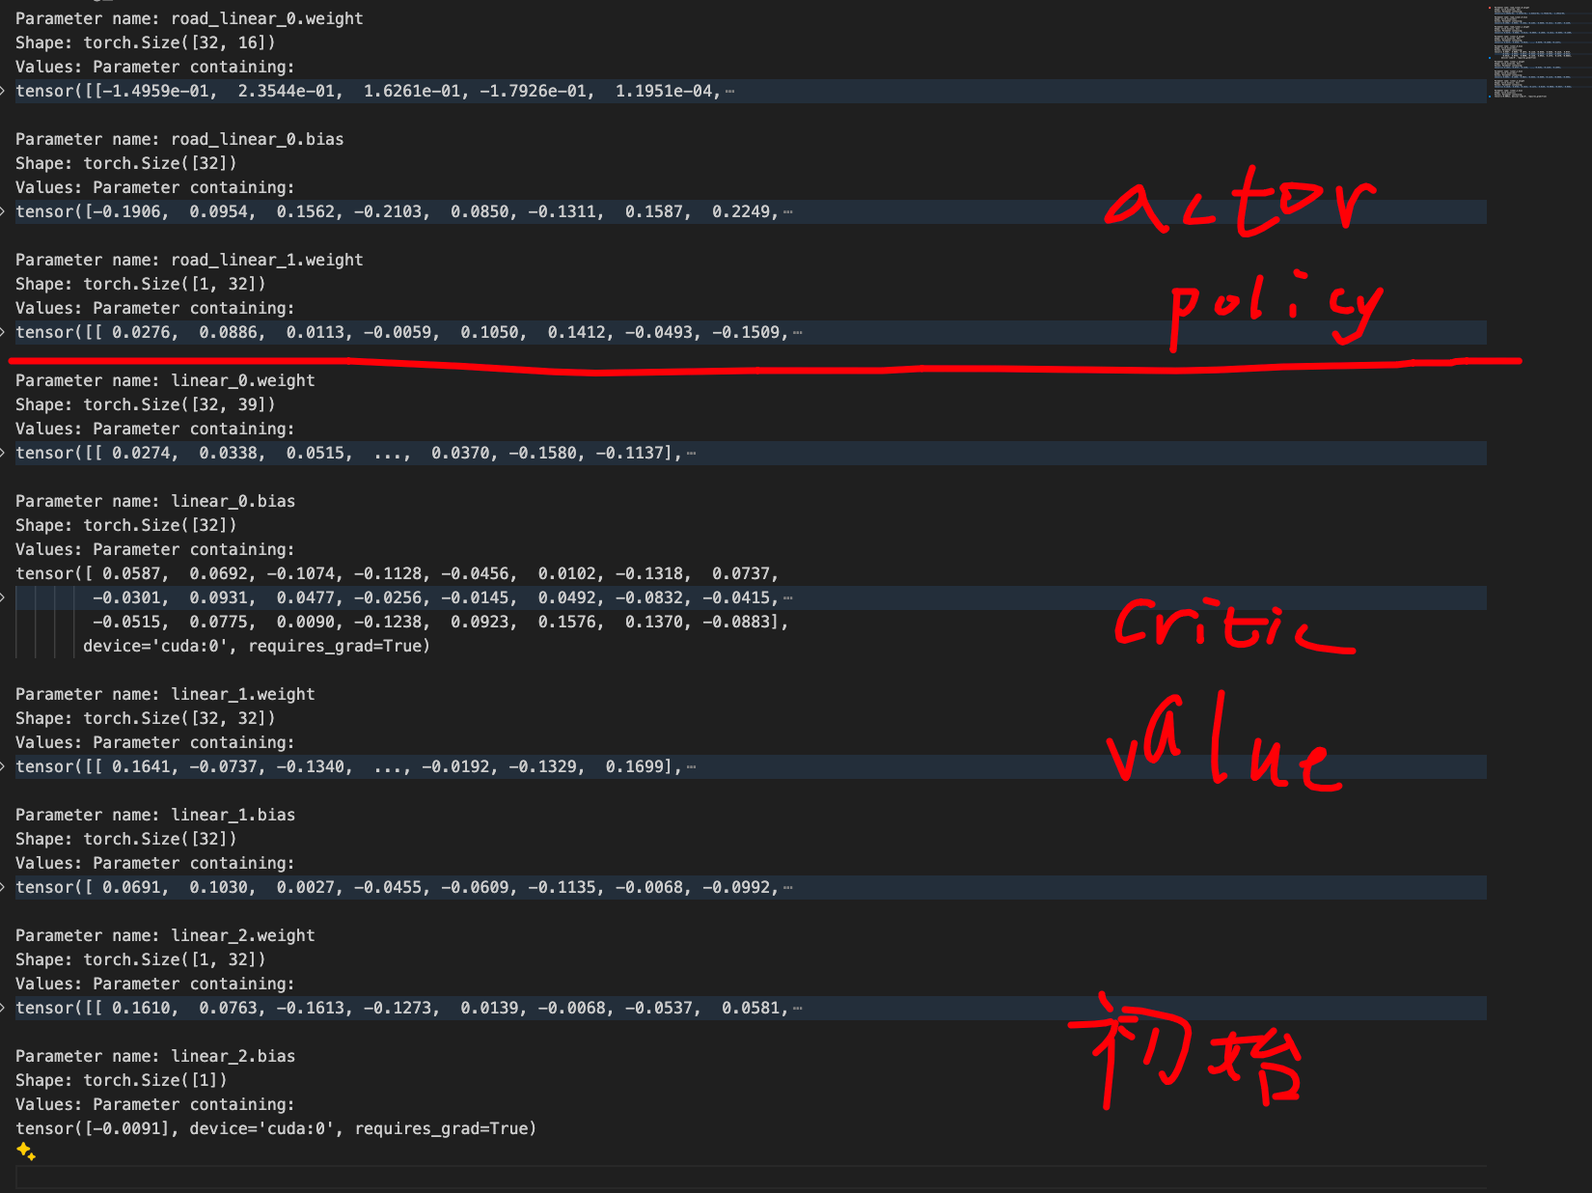
初始，还没梯度

Slide 17
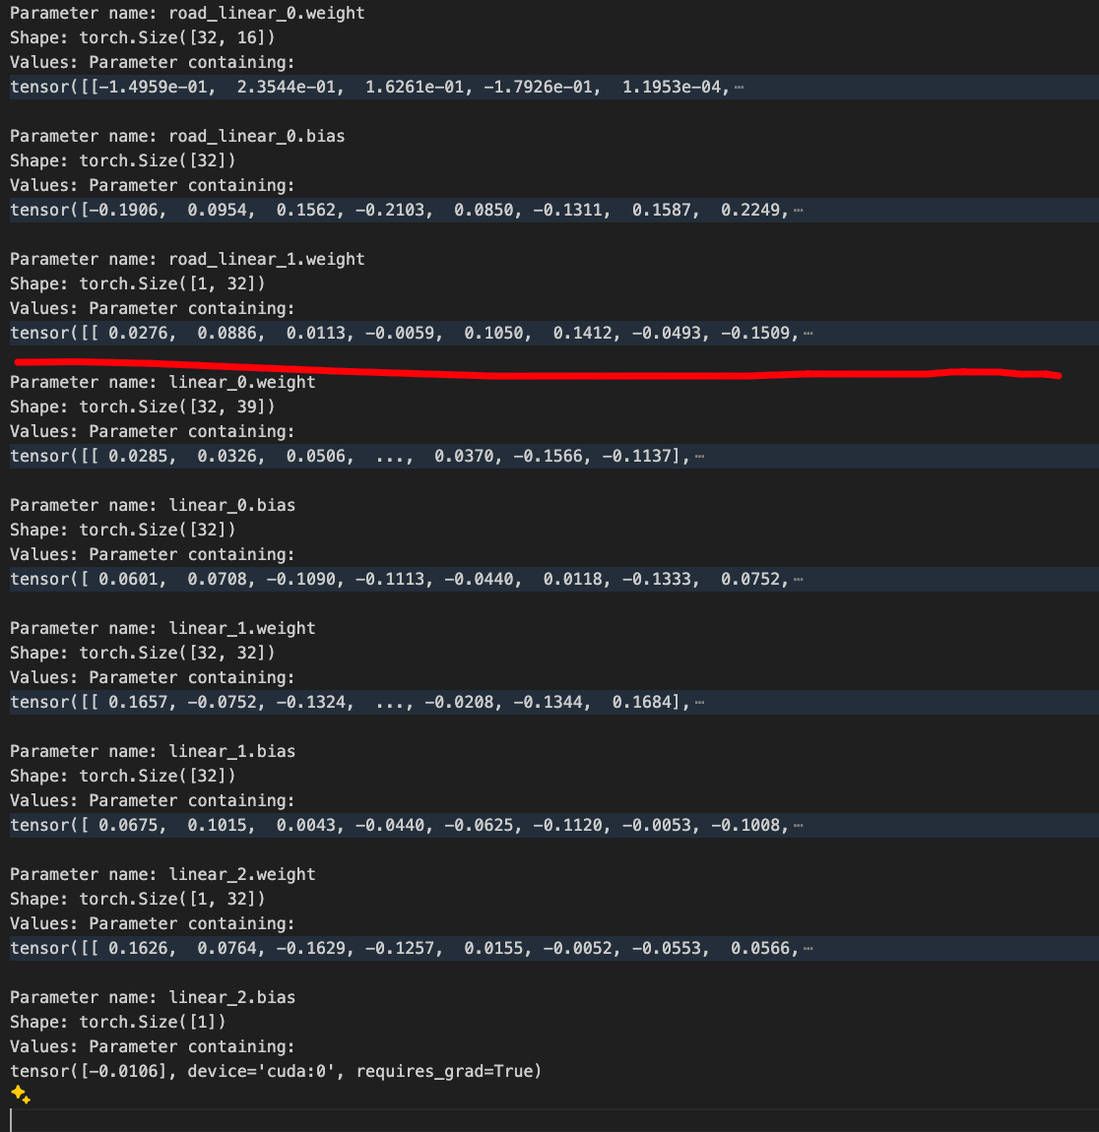
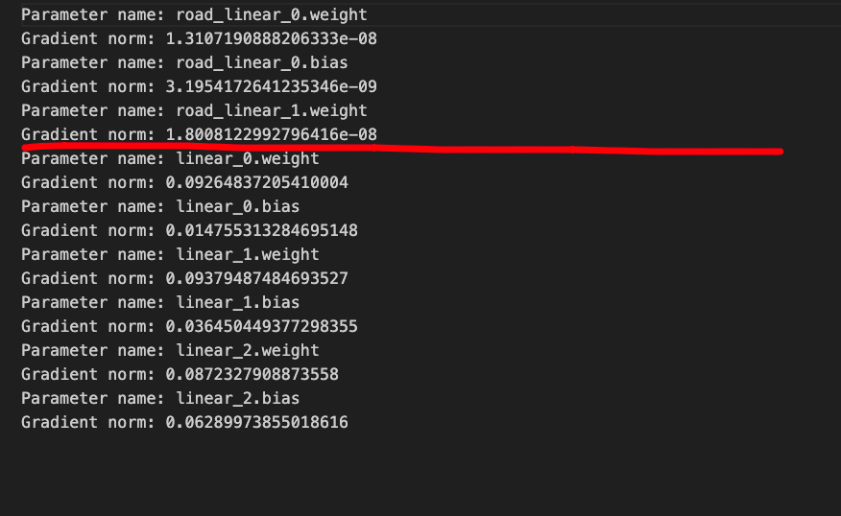
第一次

Slide 18
