Slide 1
STAC51 TUT02
Week 12: Apr 01, 2021

Slide 2
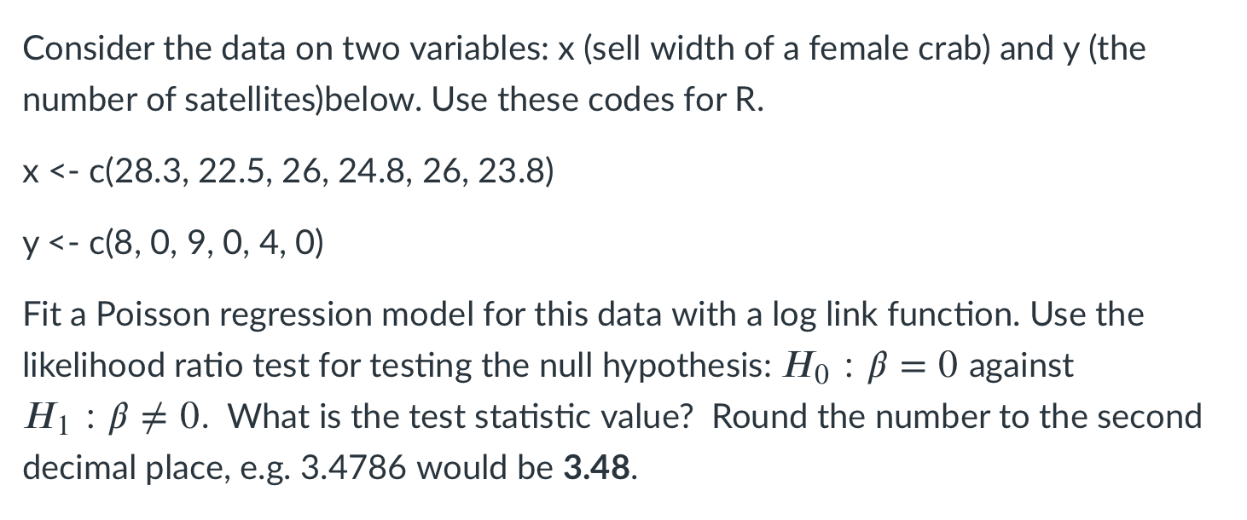

Slide 3
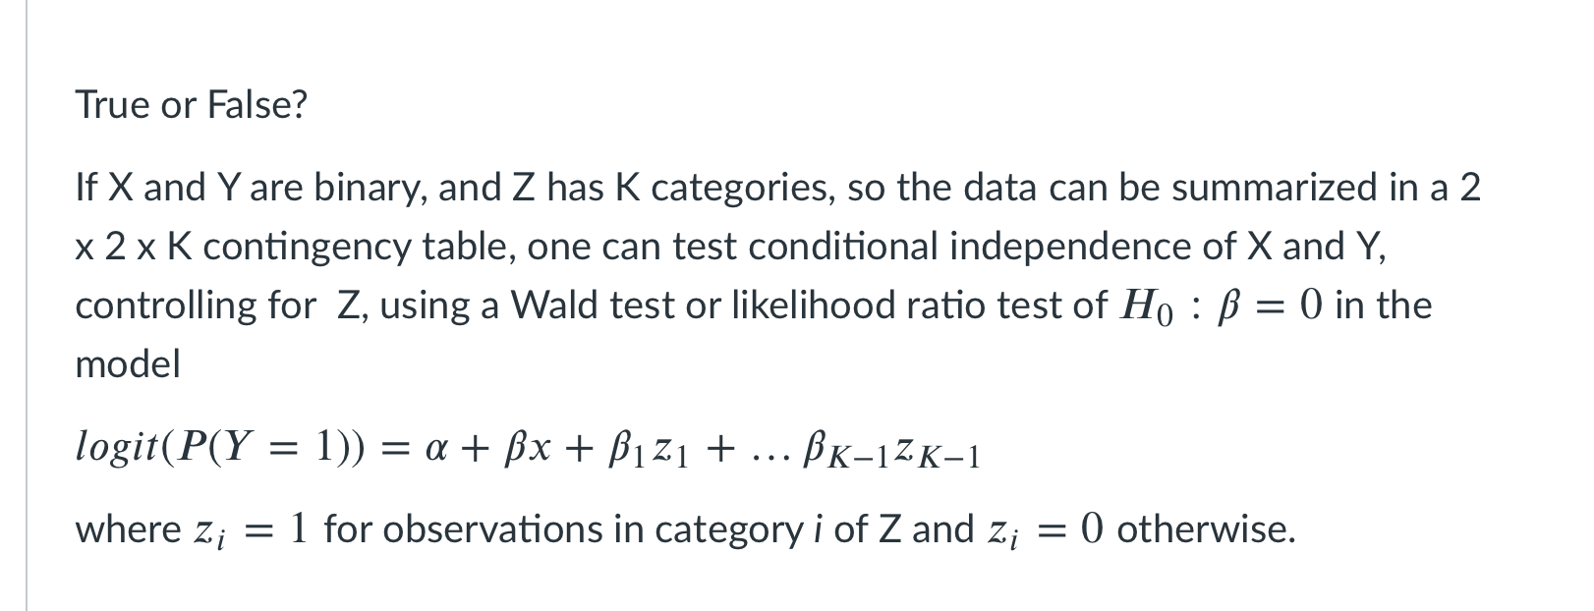

Slide 4
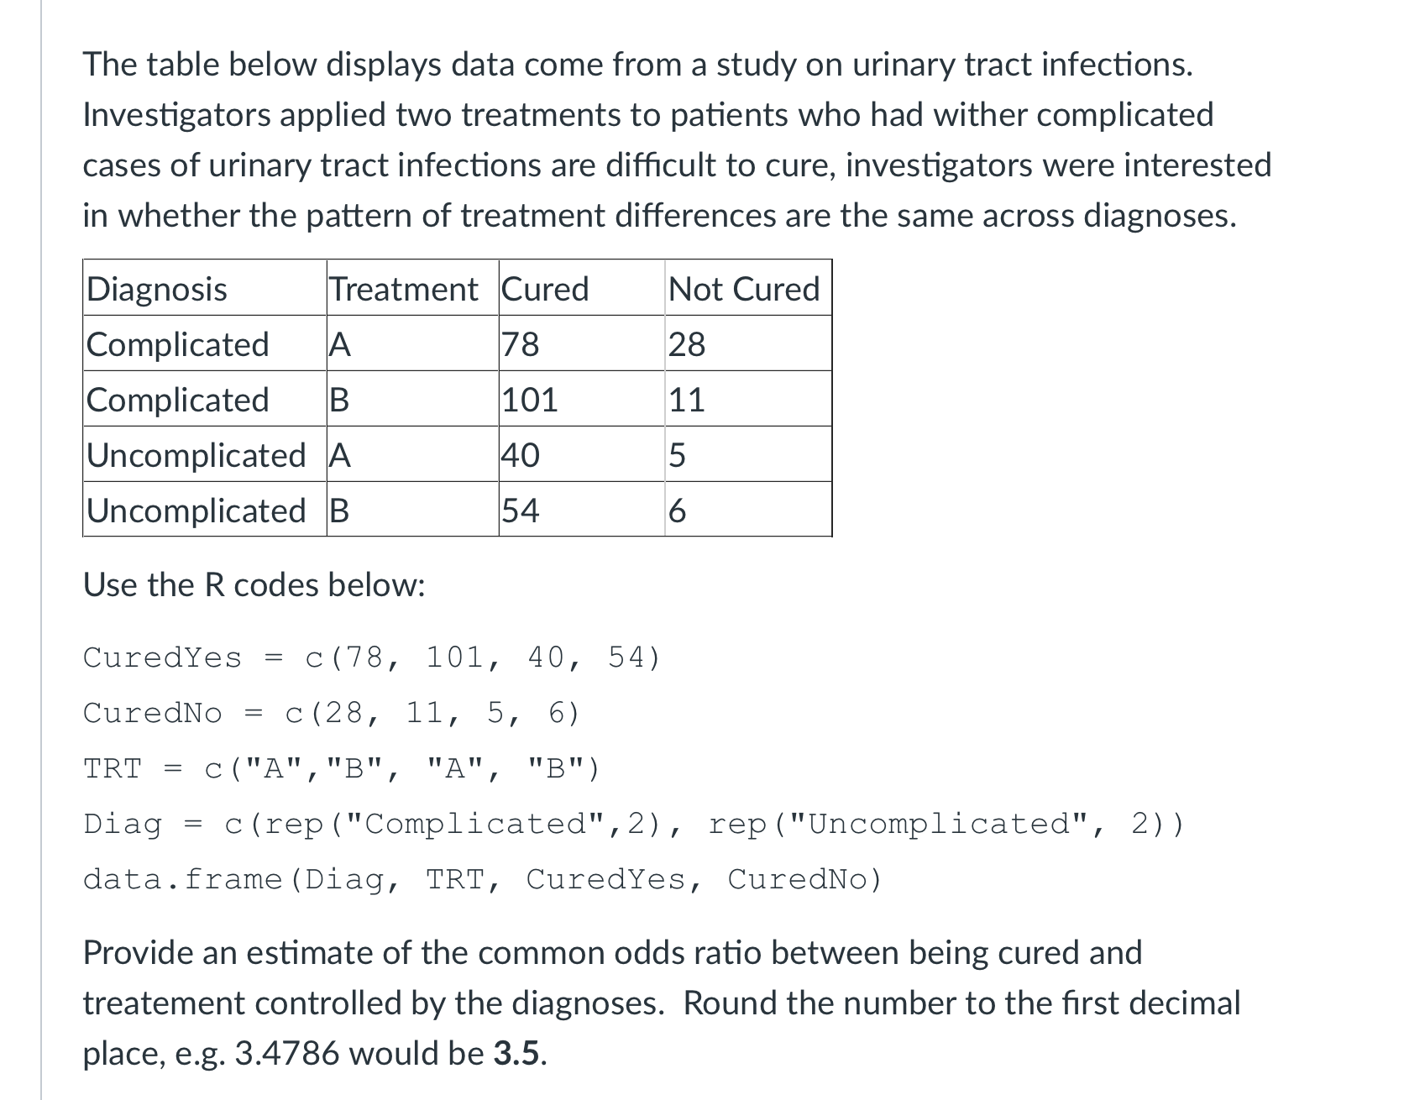

Slide 5
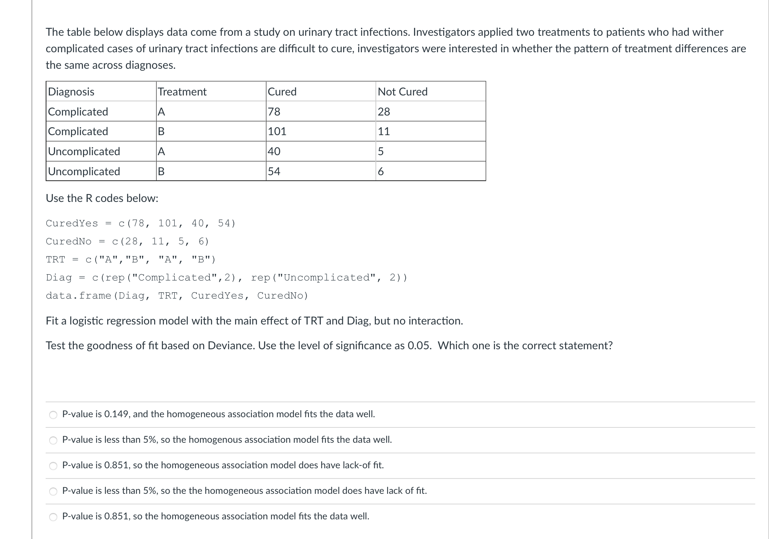

Slide 6
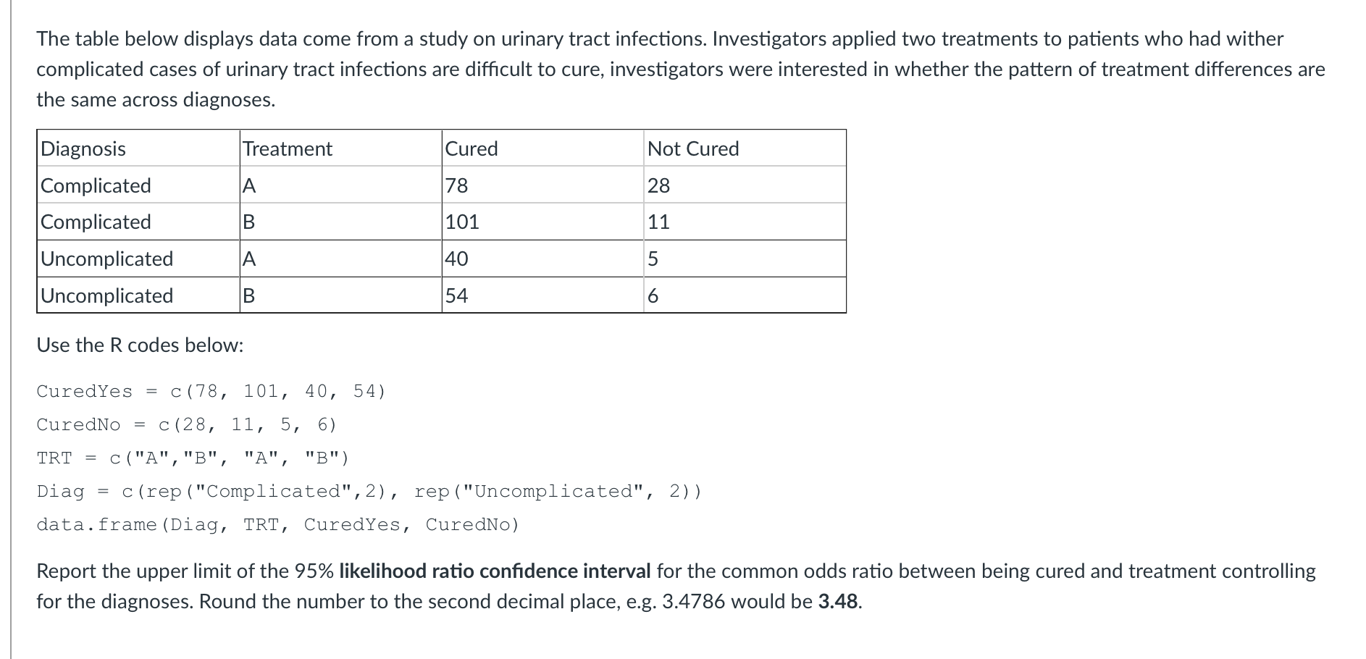

Slide 7
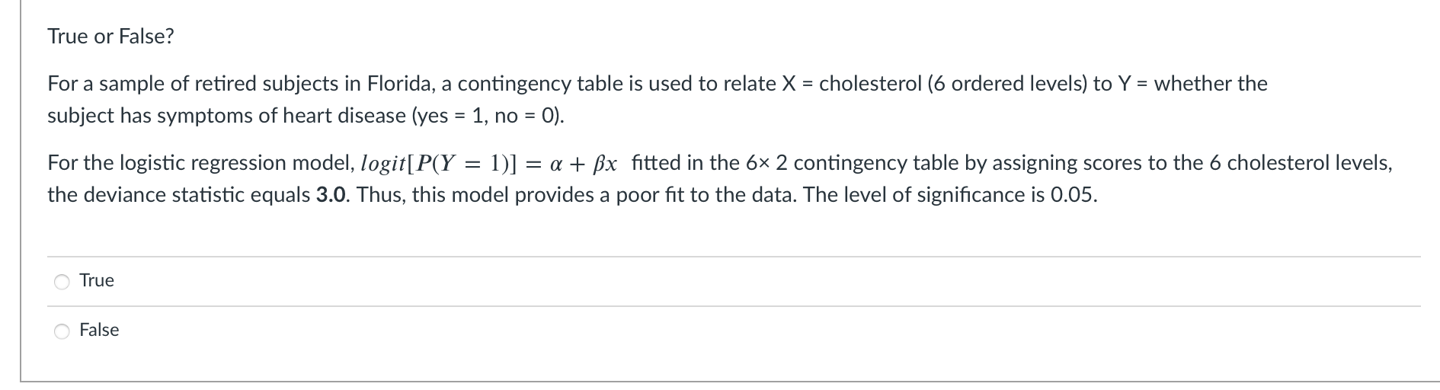

Slide 8
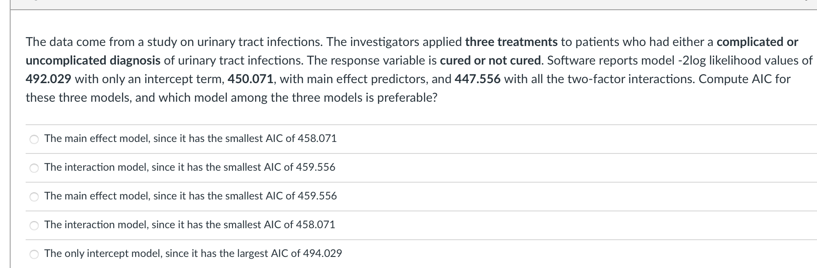

Slide 9
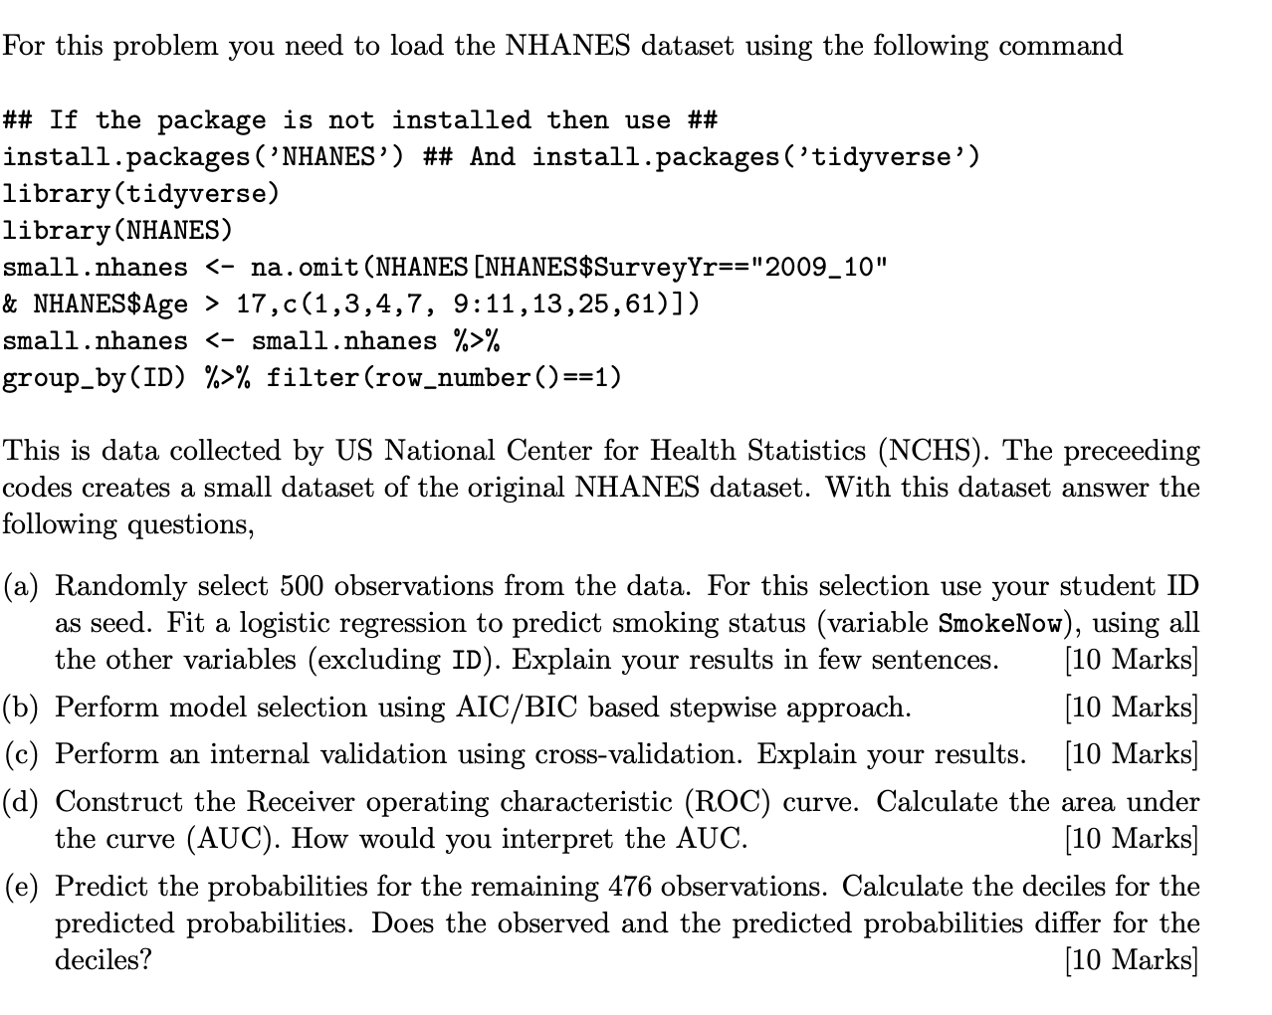

Slide 10
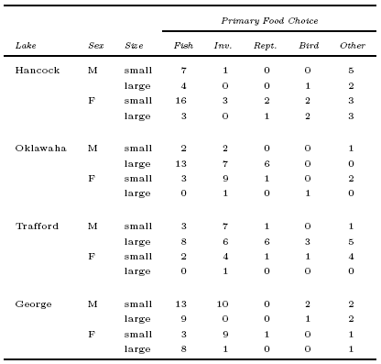
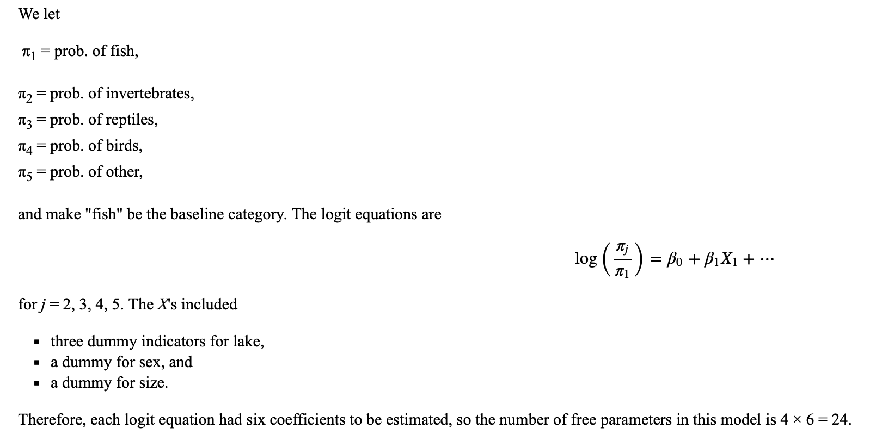
the usual primary food choice of alligators appears to be fish, we'll use fish as the baseline category

Slide 11
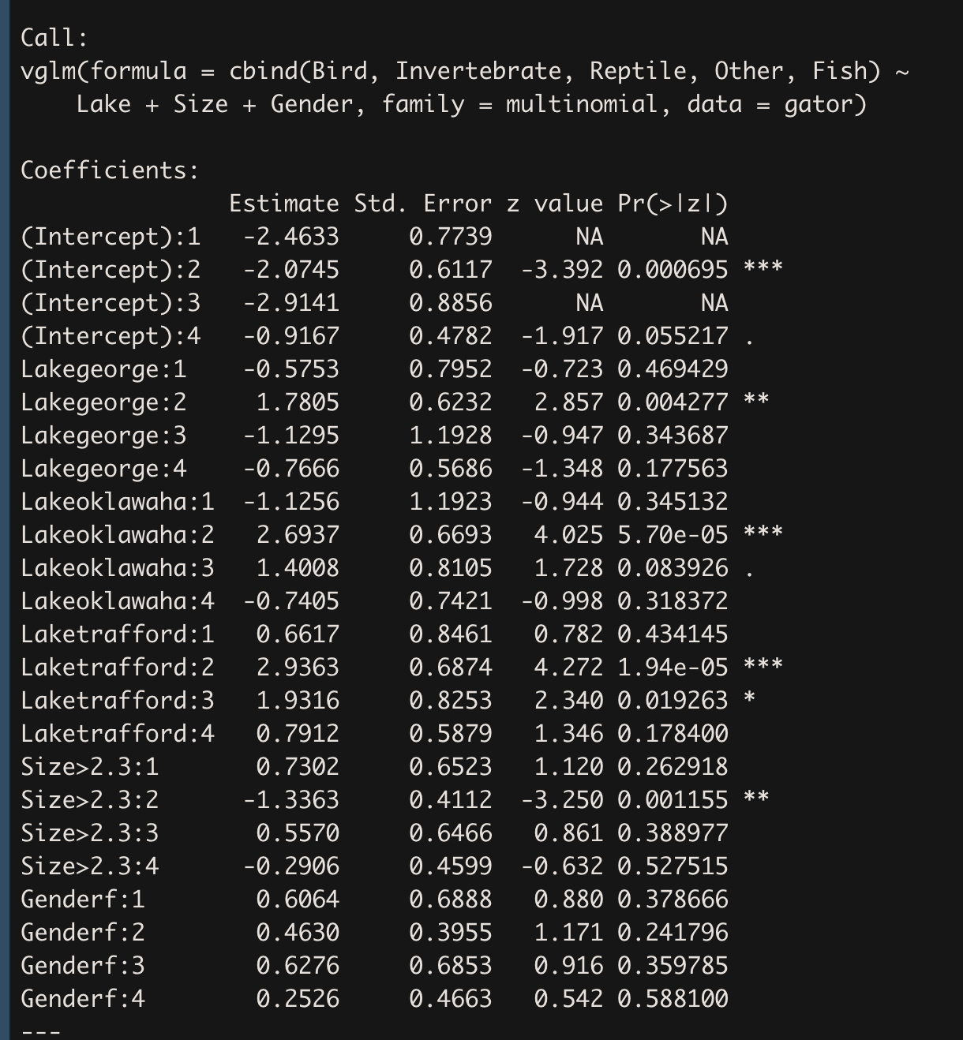
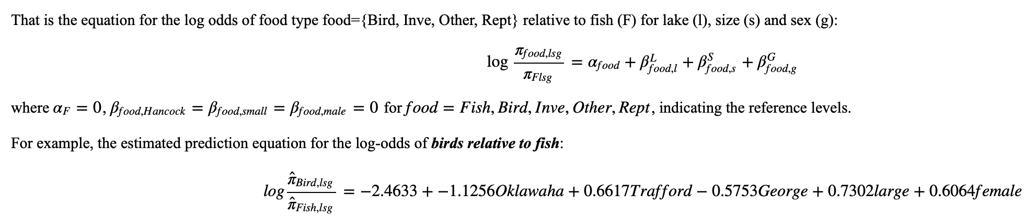
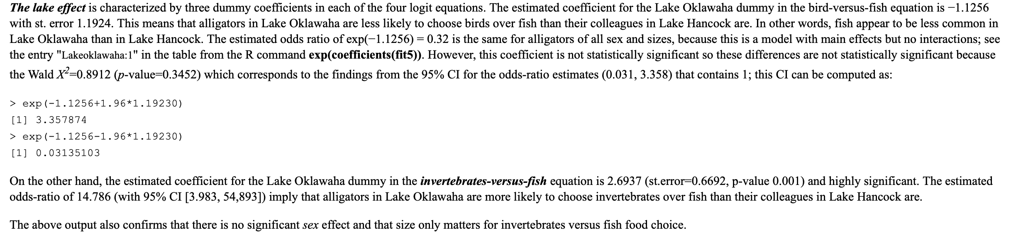
The intercepts give the estimated log-odds for the reference group lake = Hancock, size = small, sex = male. For example, the estimated log-odds of birds versus fish in this group is −2.4633; the estimated log-odds of invertebrates versus fish is −2.0744; and so on.

Slide 12
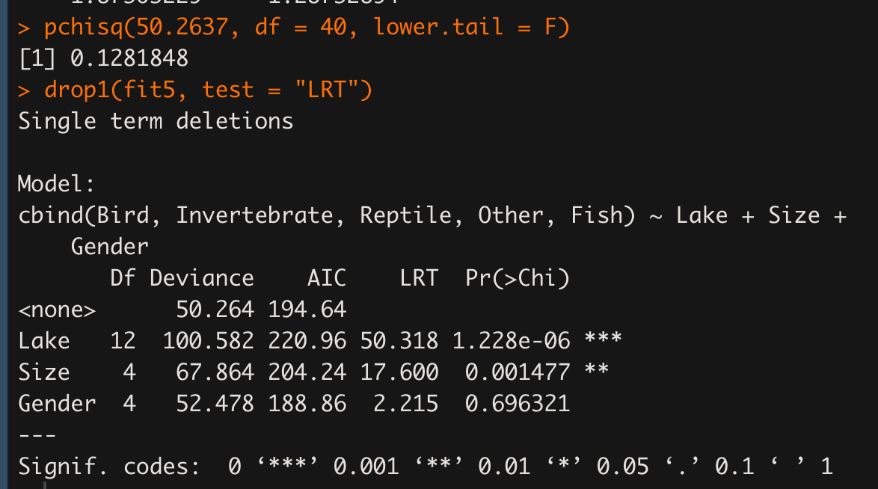
## Goodness of fit
# There are N = 16 profiles (unique combinations of lake, sex and size) in this dataset.
# Recall that Residual deviance tests the fit of the current model versus the saturated model.
# The saturated model, which fits a separate multinomial distribution to each profile, has 16 × 4 = 64 parameters.
# The current model has an intercept, three lake coefficients, one sex coefficient and one size coefficient for each of the four logit equations, for a total of 24 parameters.
# Therefore, the overall fit statistics have 64 − 24 = 40 degrees of freedom.
Does the model fit well?
The model fits OK but not great. The Residual Deviance of 50.26 with 40 df from the table above output is reasonable, with p-value of 0.1282 and the statistics/df is close to 1 that is 1.256. We will see that in terms of G^2/df and p-value, we can actually improve the fit by removing the gender covariate.

Slide 13
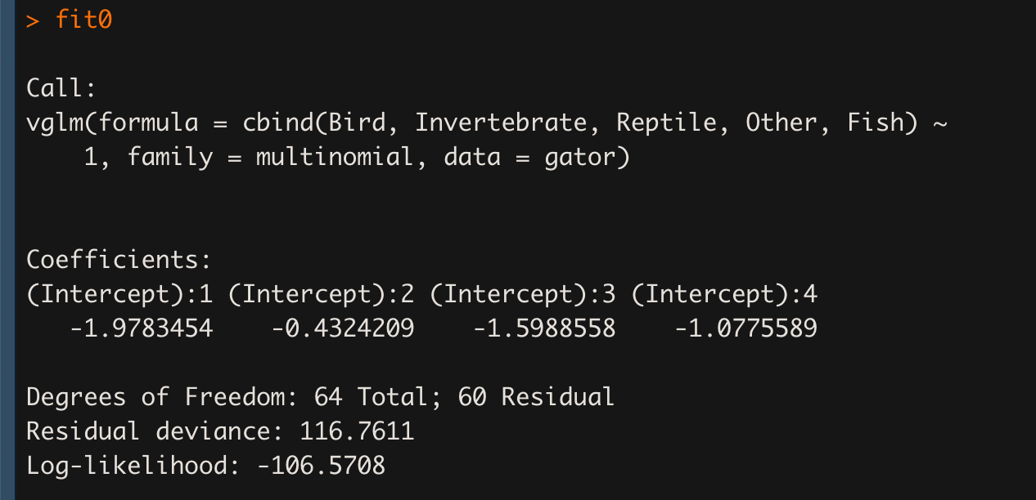
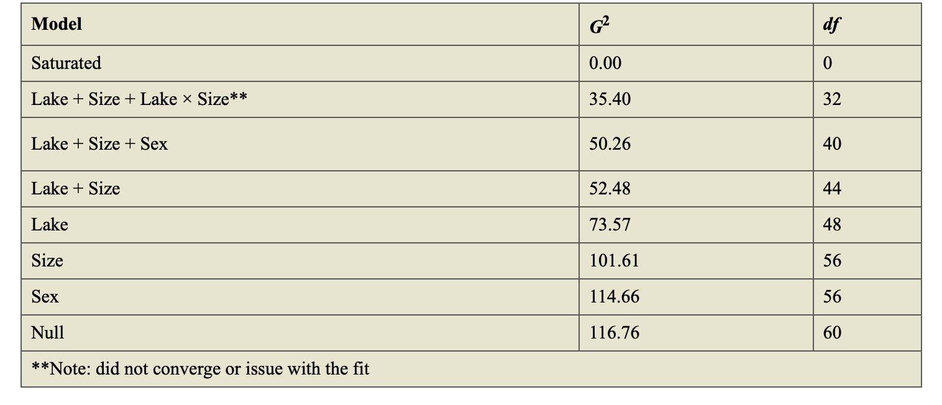
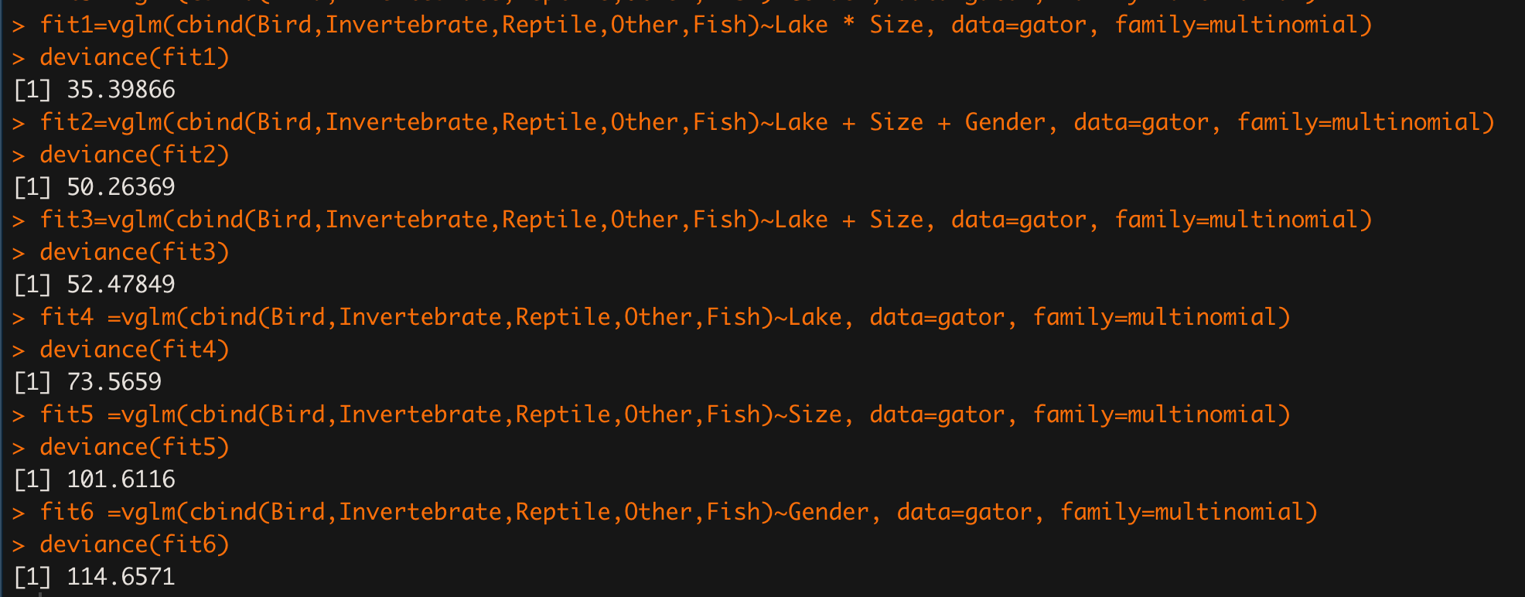
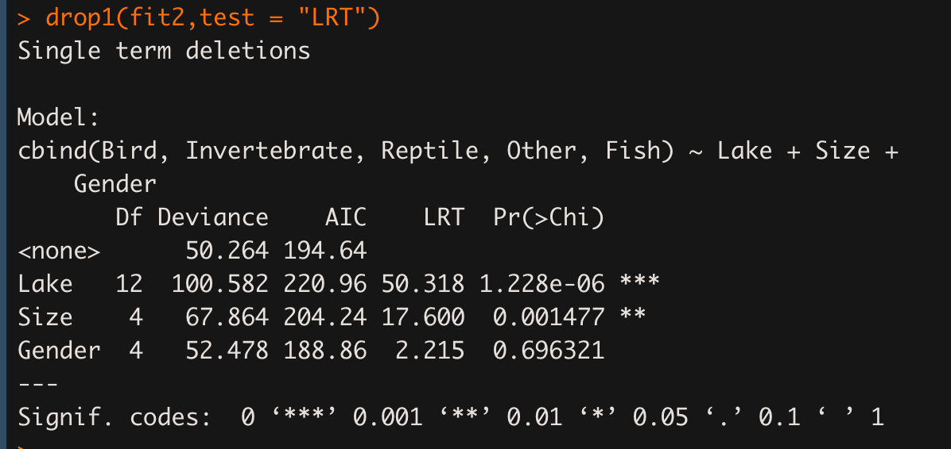
Model Selection
First, let's find the deviance G² for the null (intercept-only) model, a model with just four parameters. Because there are N = 4 × 2 × 2 = 16 unique covariate patterns, the saturated model will have 16 × (5 − 1) = 64 parameters, so the G² statistic for the null model should have 64 − 4 = 60 degrees of freedom.
we can use the table above for model selection by comparing the models via calculation of ΔG², and Δdf. Our "final" model will have main effects for lake and size but no effect for sex (because "Lake+Size" - "Lake + Size +Sex" = 52.48 - 50.26 = 2.22 with 44 - 40 = 4 df which is not significant)

Slide 14
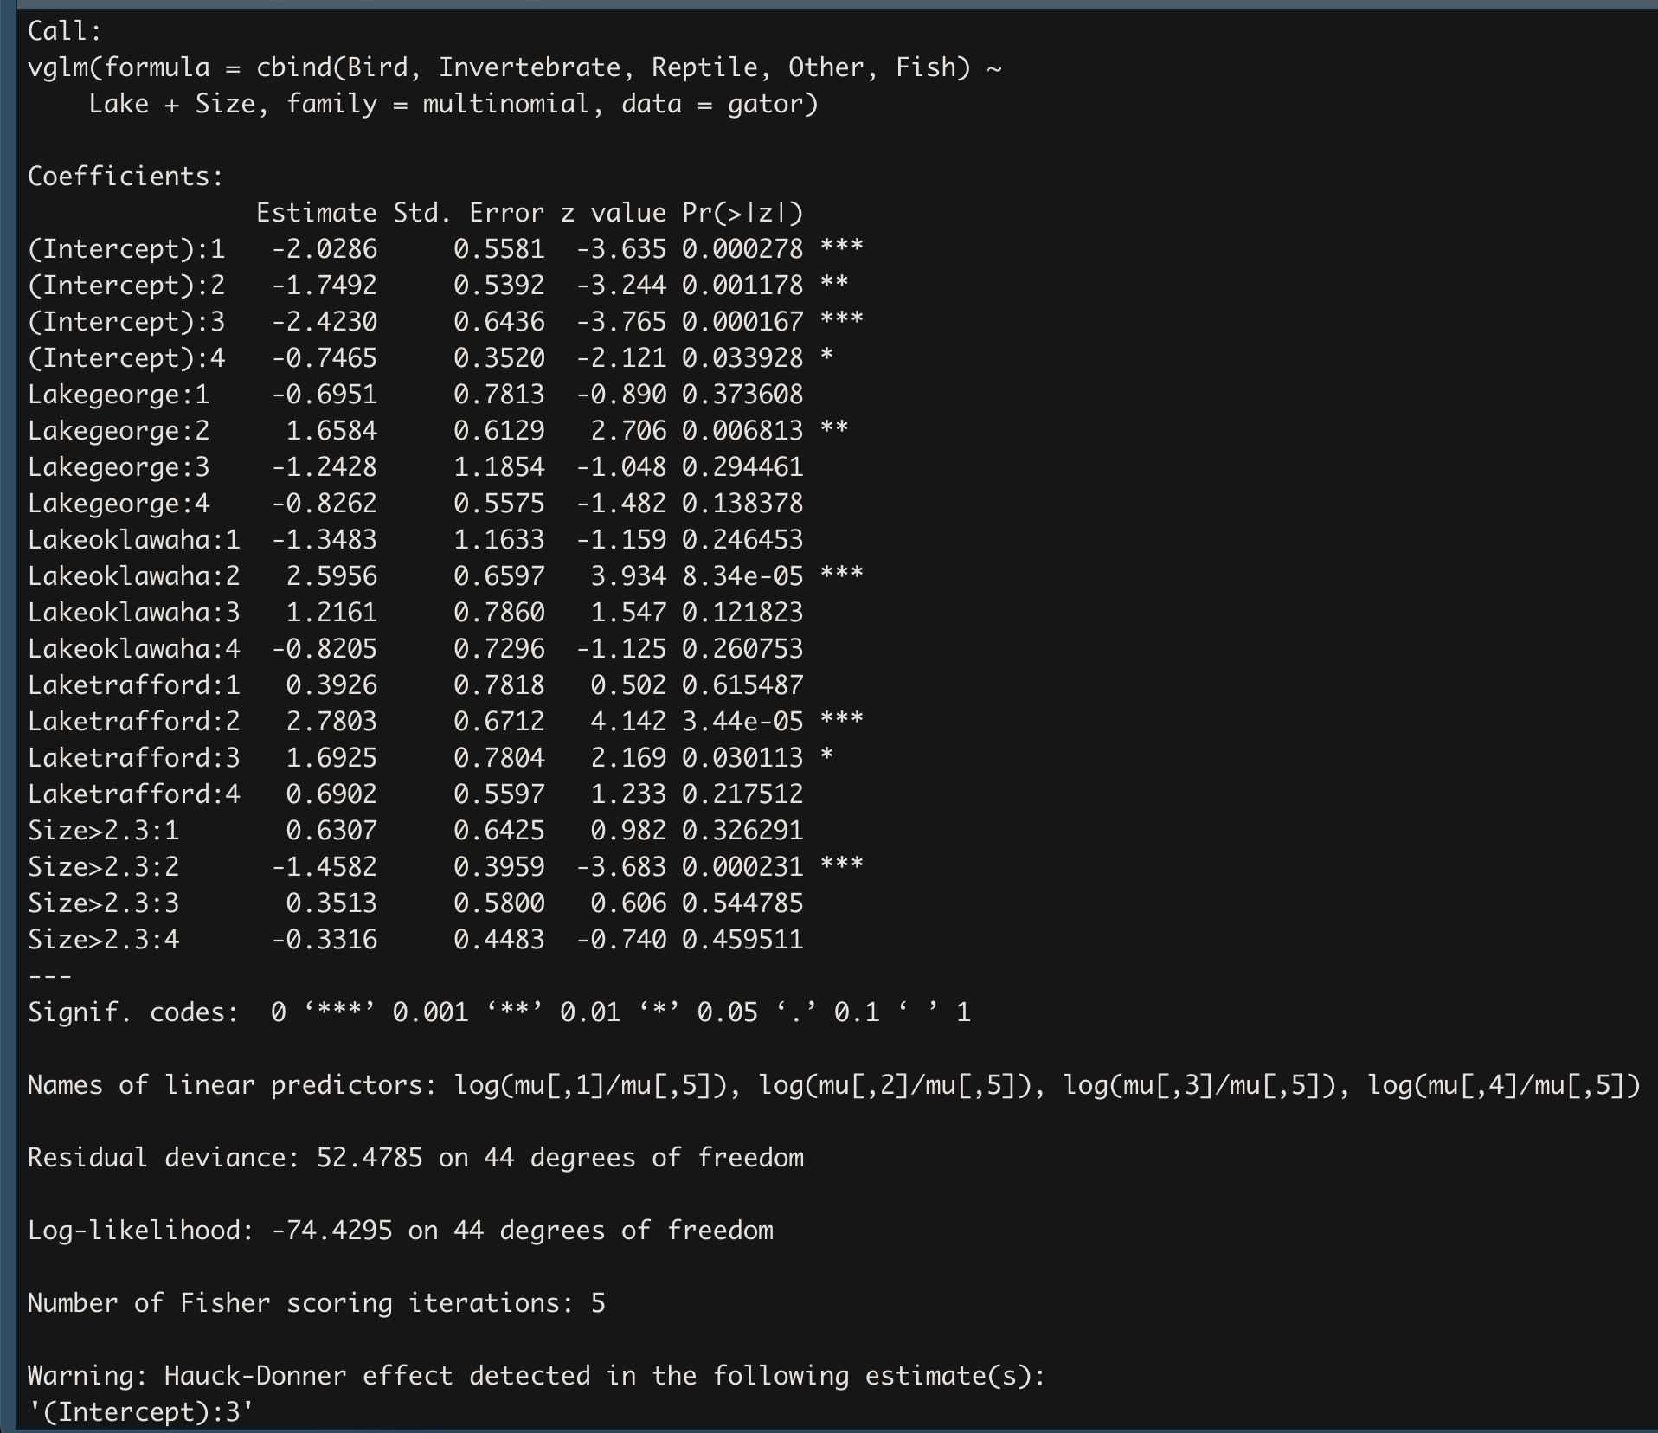
Based on the analysis-of-deviance table, our "final" model will have main effects for lake and size but no effect for sex

