Slide 1
STAC51 TUT02
Week 13: Dec 3, 2020

Slide 2
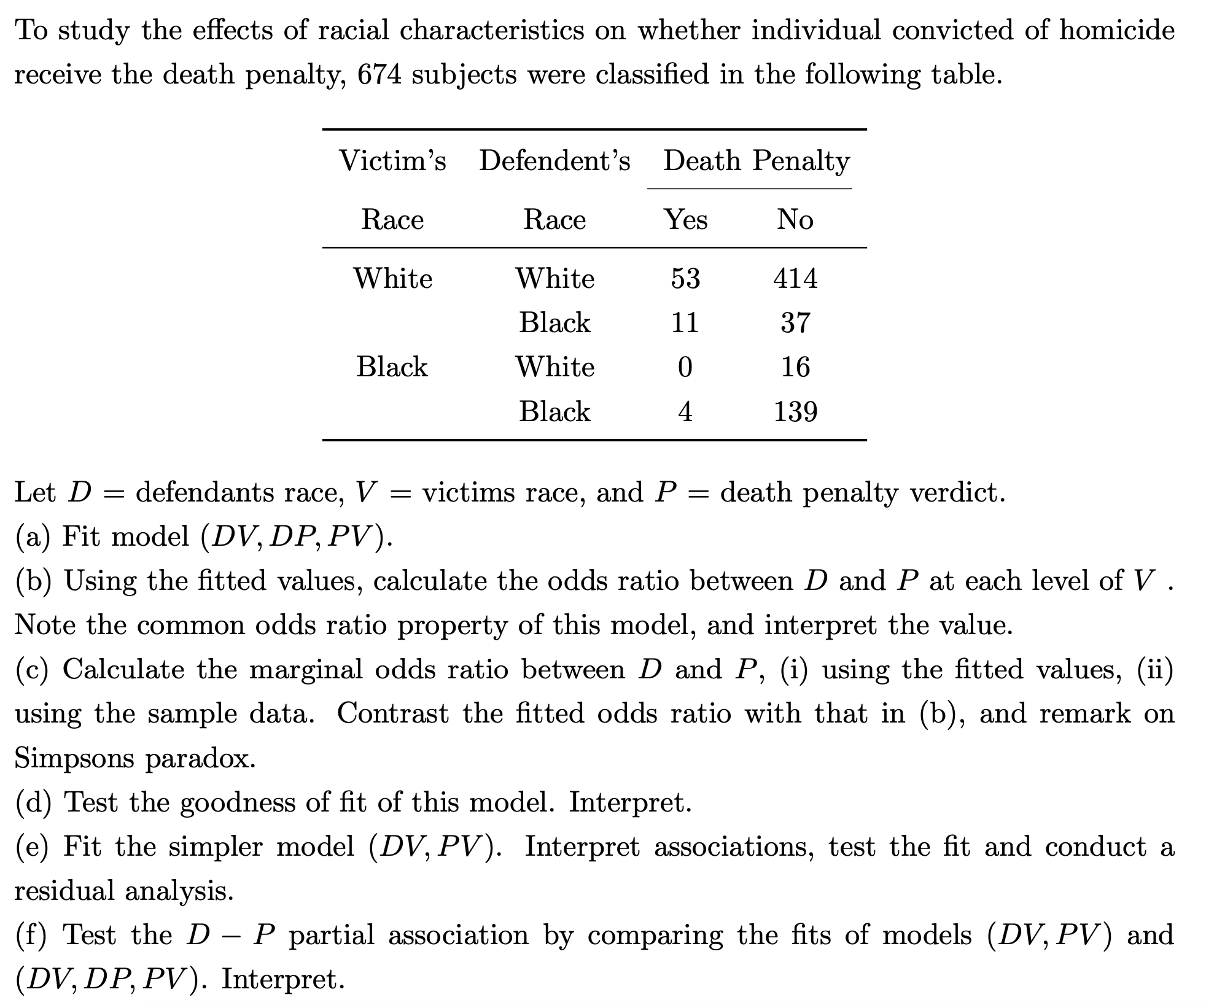

Slide 3
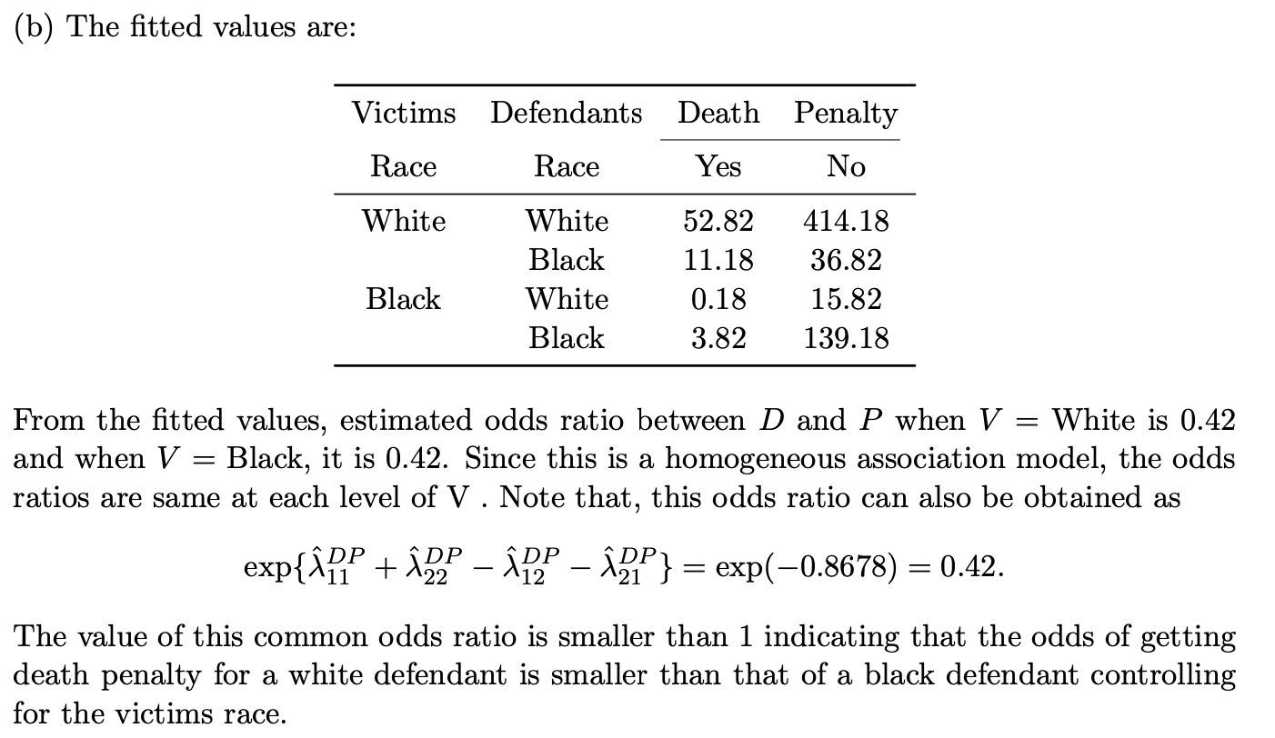

Slide 4


Slide 5


Slide 6
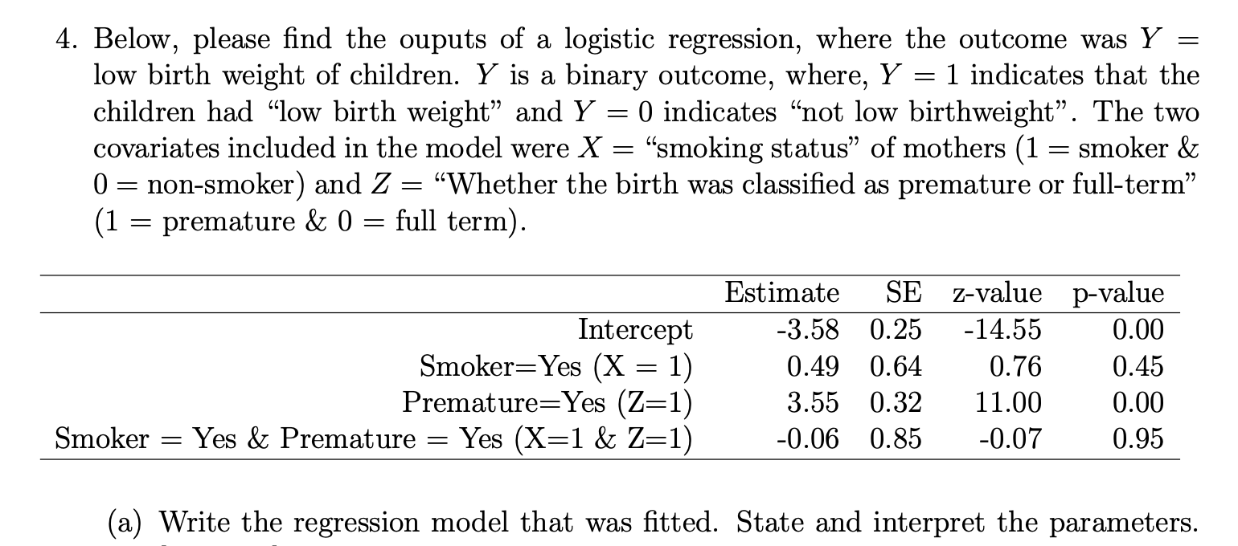


Slide 8
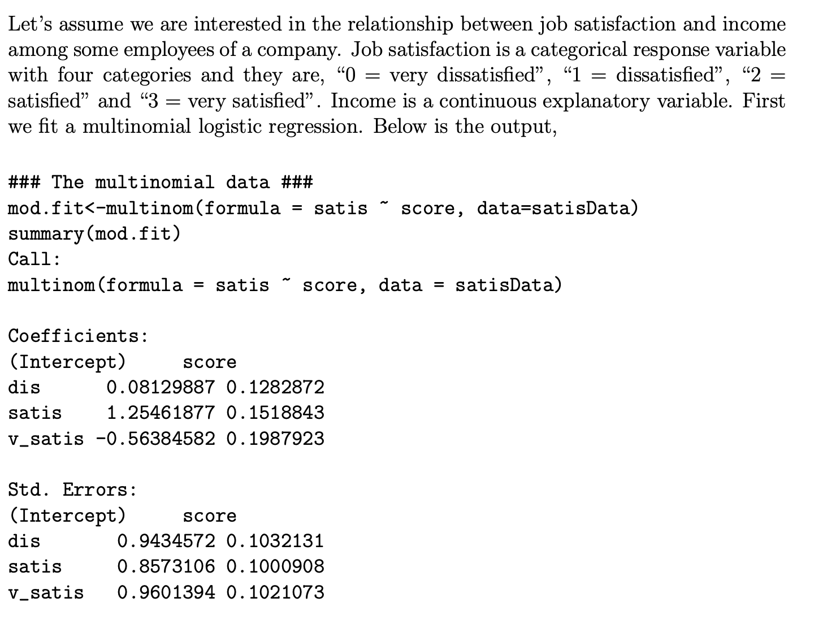



Slide 10


Slide 11


