Slide 1
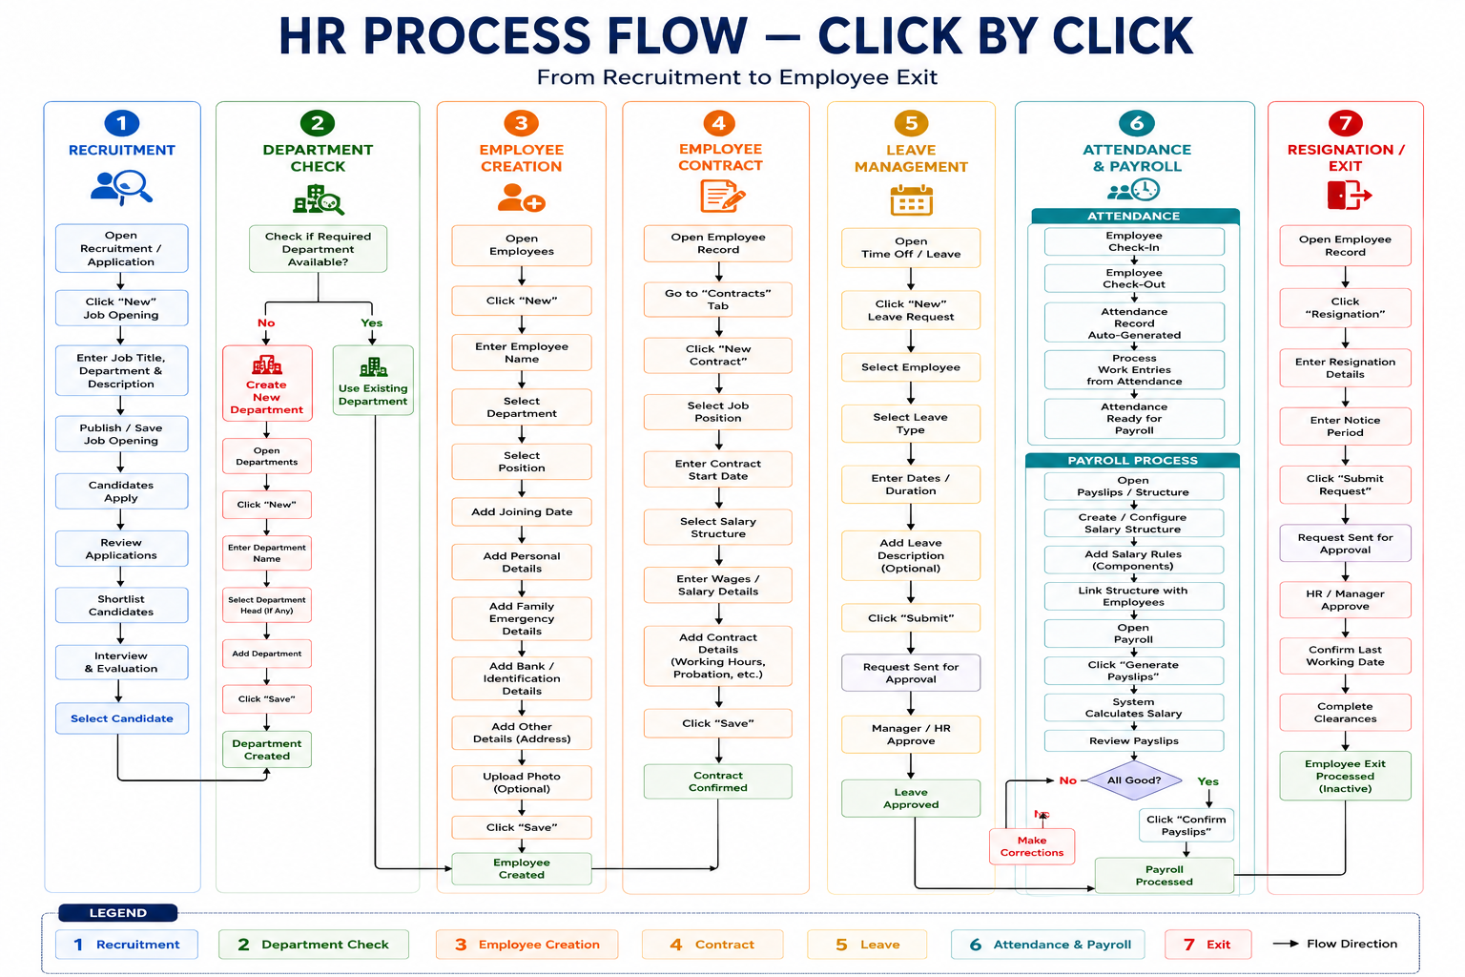
HR PROCESS FLOW
HR Process • 1

Slide 2
1. Complete HR Process
Recruitment
Job → Candidate
Department
Create or use existing
Employee
Create record
Contract
Salary + terms
Leave
Request → approval
Attendance
Check-in → work entry
Payroll
Salary → payslip
Exit
Resignation → closure
Department Decision
Existing → select it
Missing → create department
Then create employee
Employee Lifecycle
Employee master
Contract
Daily HR
Payroll
Resignation
HR Process • 2

Slide 3
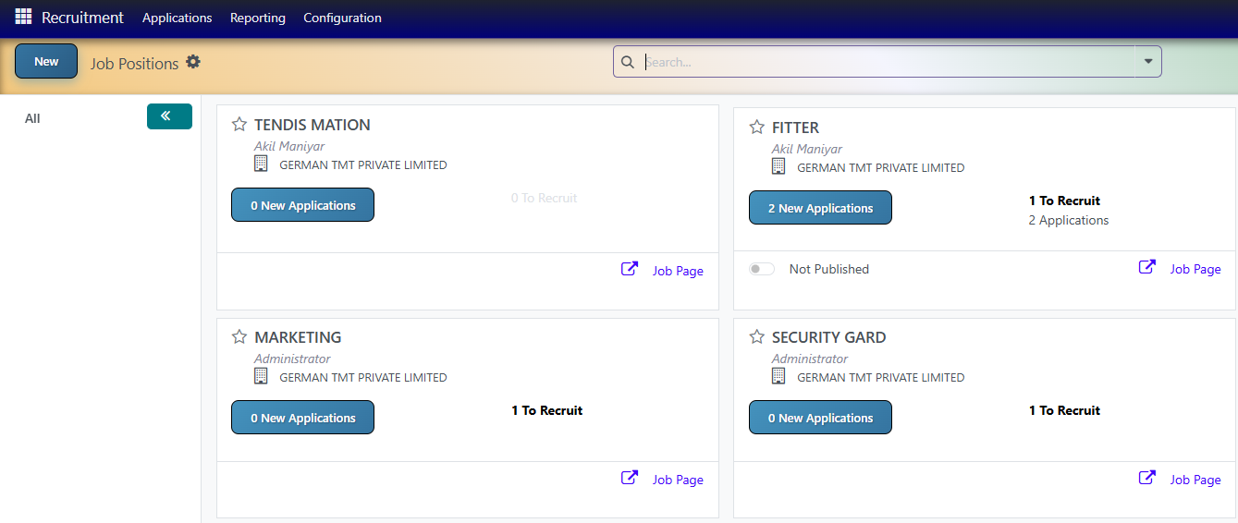
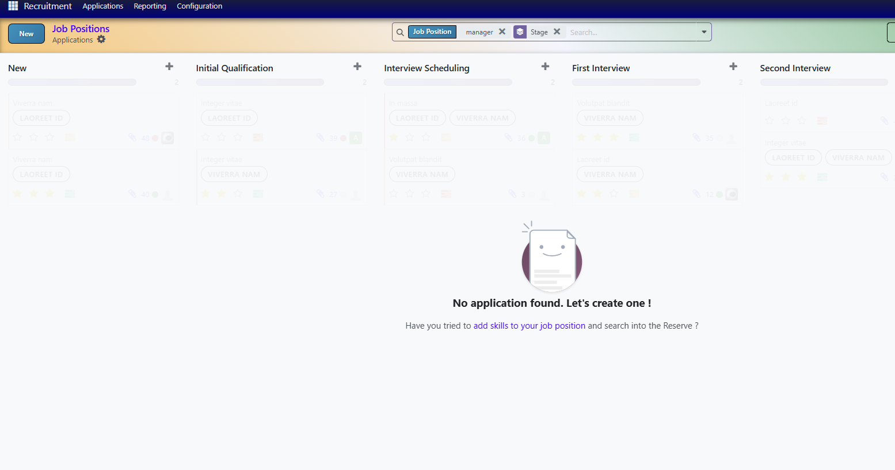
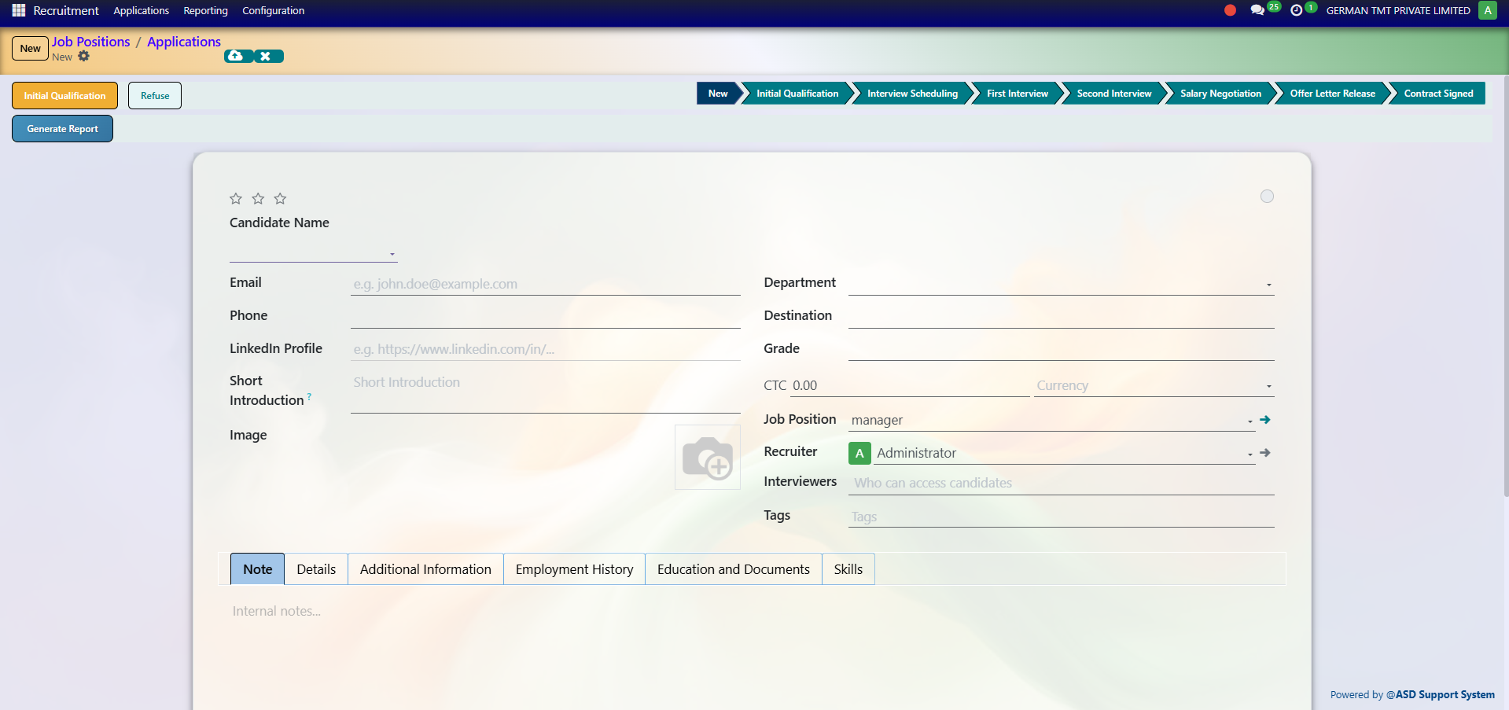
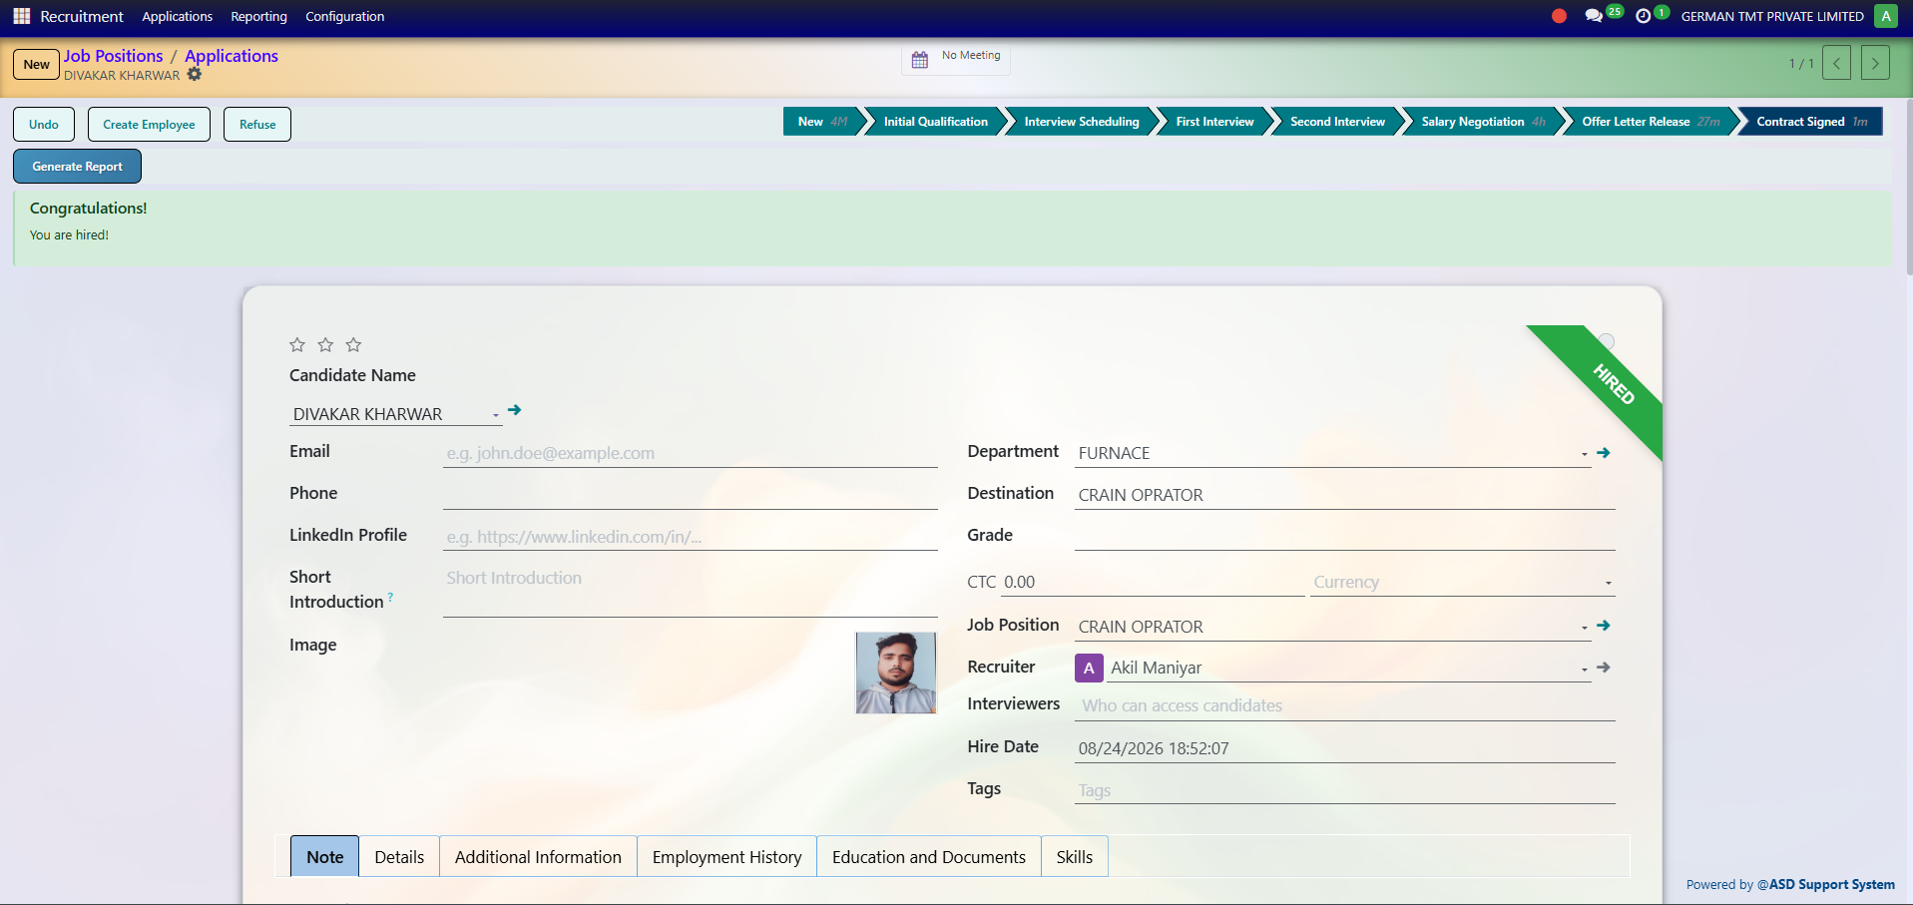
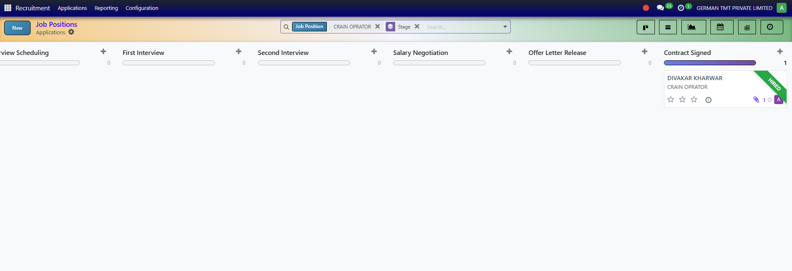
2. Recruitment
Open Recruitment
Applicants / Jobs
New Job
Create opening
Job Details
Title / department / description
Publish / Save
Opening ready
Candidates
Applications
Review
Shortlist
Interview
Evaluation
Select
Candidate selected
Department raises a job requisition; once approved it is published to the careers website / job boards.
Applications land as candidate cards in the Recruitment pipeline against that position.
Recruiter and interviewers move each candidate through the stages, logging interview evaluations and scorecards.
An offer / contract proposal is prepared and sent for the candidate's signature.
On signature, the candidate is marked Hired — we can create Employee record, carrying over CV, skills and contact details.
HOW IT WORKS
HR Process • 3

Slide 4
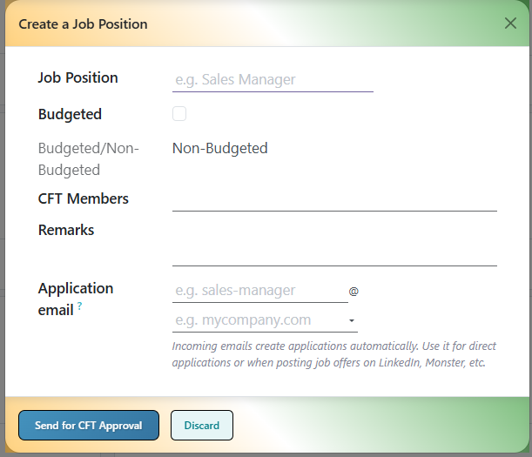
3. Department Check
Check Department
Is required department available?
YES
Use existing department,
Follow the Recruitment step
NO
Create department
Save
Department ready
Next
Create employee and follow Recruitment steps
If Existing
Select department
Continue directly
If Missing
Departments → New
Name / manager / details
Save
HR Process • 4

Slide 5
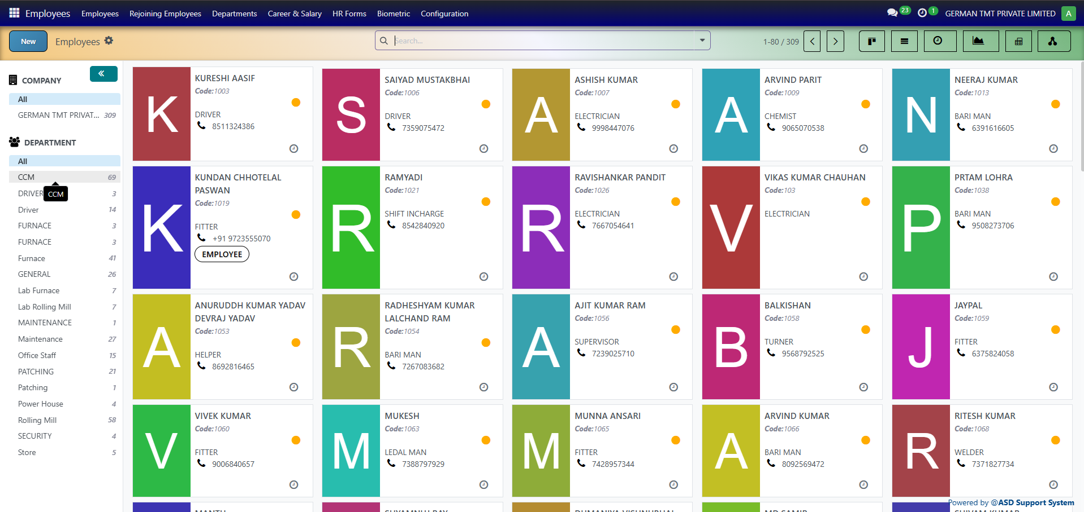
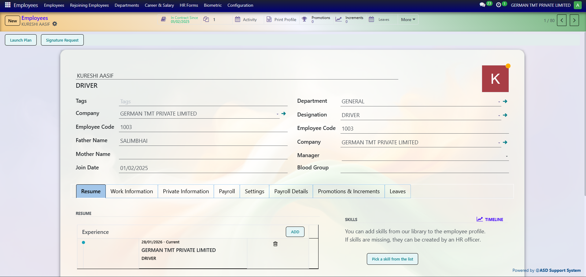
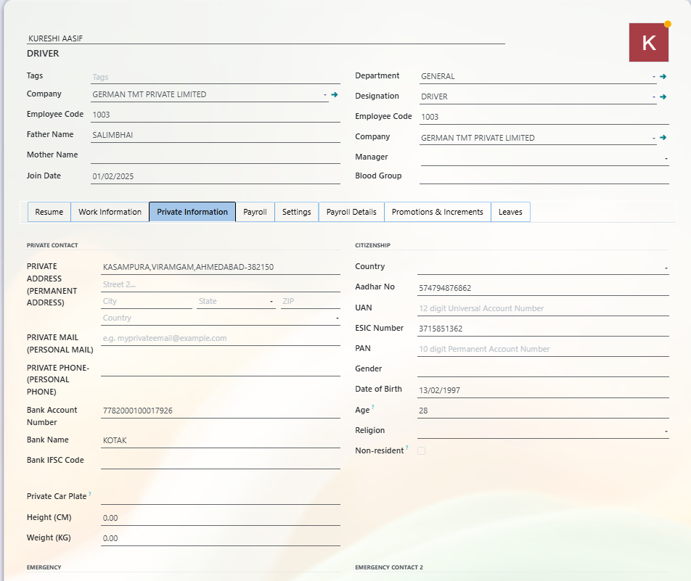
4. Employee Creation
Employees
Open Employees
New
Create record
Name
Employee name
Department
Select department
Job
Select position
Joining Date
Enter date
Save
Employee created
Personal
Basic details
Family / emergency
Education / other
Bank / ID
Bank account
IFSC
Identification
Attachments
Result
Employee ready for contract
HR operations can start
HR Process • 5

Slide 6
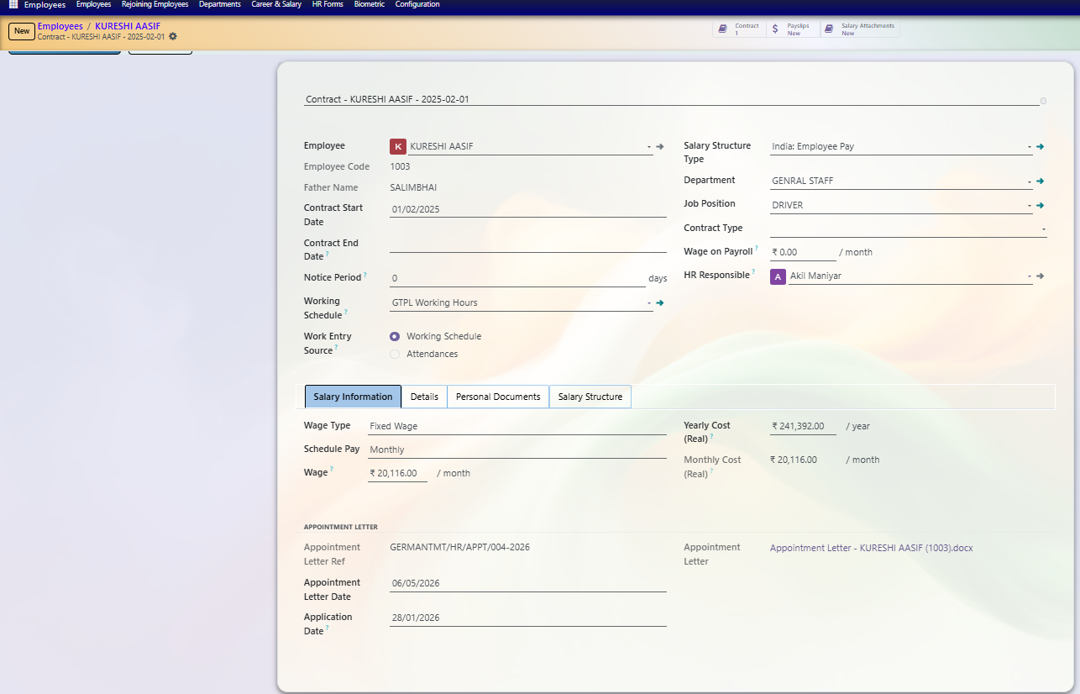
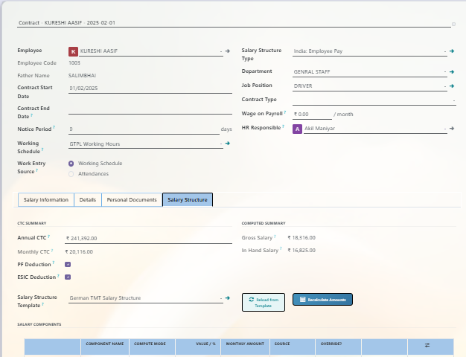
5. Employee Contract
Employee
Open record
Contracts
Open tab
New
Create contract
Job
Select position
Start Date
Set date
Salary Structure
Select
Wage
Enter salary
Terms
Working hours / terms
Save
Save
Confirm
Contract confirmed
Contract
Employee
Job
Start date
Salary structure
Wage
Working hours
Payroll Link
Salary structure
Salary rules
Attendance / leave inputs
HR Process • 6

Slide 7
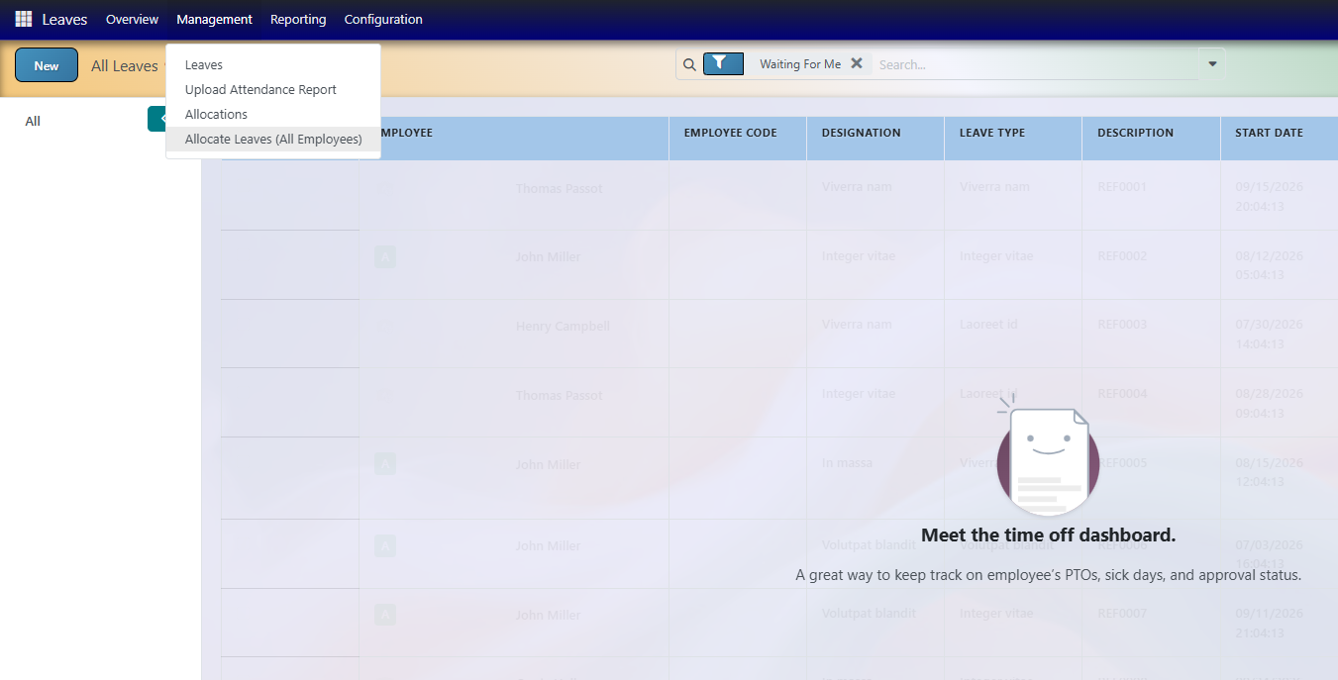
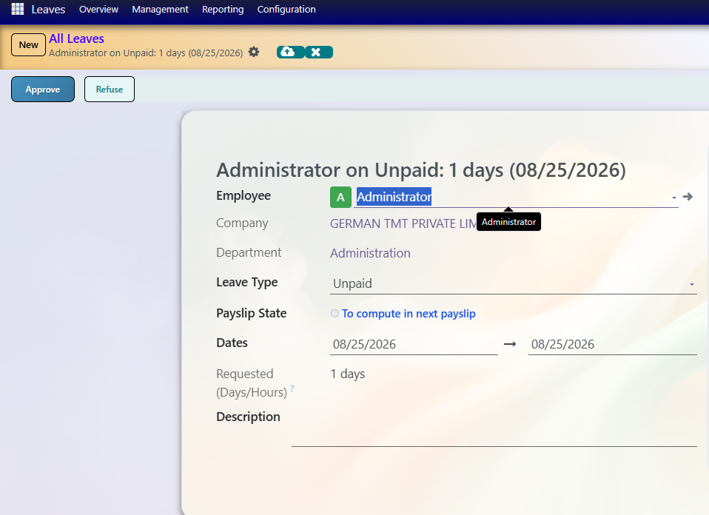
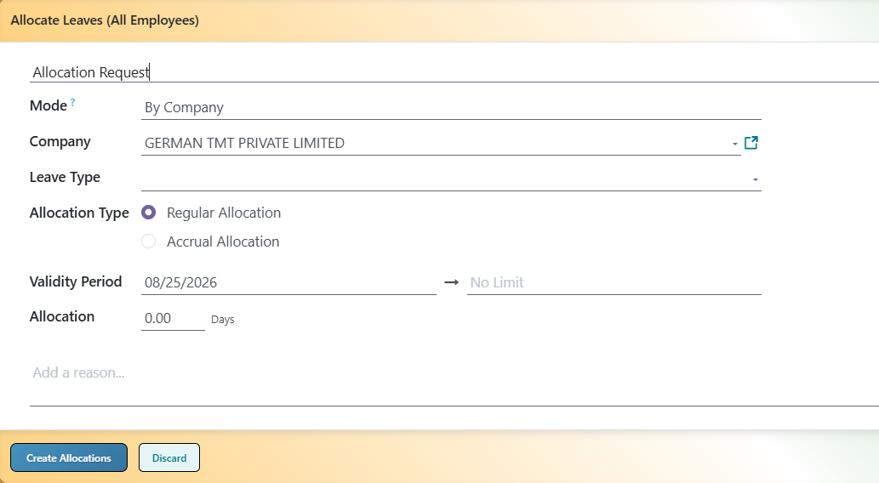
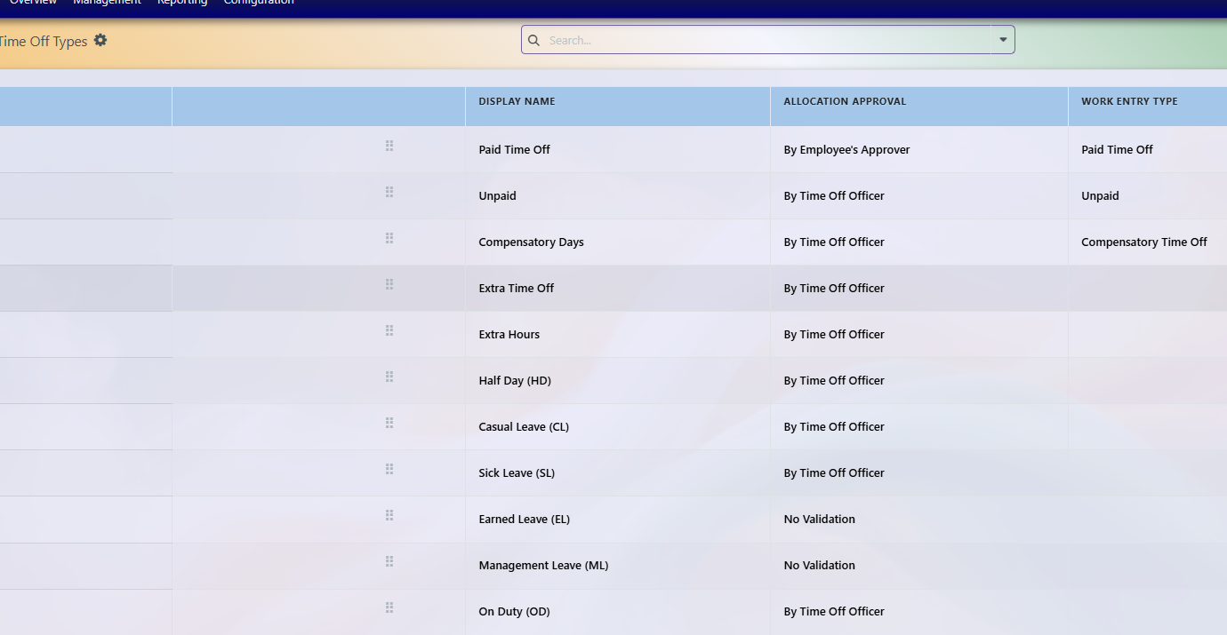
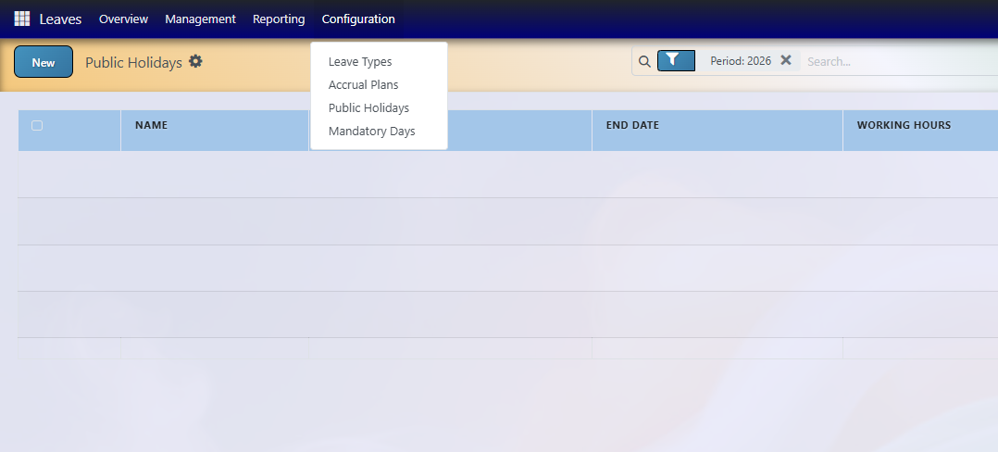
6. Leave Management
LEAVES
Open leave go to management then leaves
New Request
Create
Employee
Select
Leave Type
Select
Dates
Enter duration
Submit
Send
Approval
Manager / HR
Approved
Leave recorded
Configuration
Open leave
Leaves Types
We can set the types of leaves
Public holiday
Here we can set the public holidays
Leave
Allocate Leaves
Leave Types
Public Holidays
Allocate Leaves
Allocate Leaves (All Employees) is used when the company wants to grant a specific leave balance to multiple employees at once. Instead of creating a separate allocation for each employee, HR can select the company, choose the required leave type (such as Casual Leave or Sick Leave), specify the number of days/hours and validity period, and create the allocation. The system will then automatically allocate the selected leave balance to all eligible employees of that company.
Leave Types
Leave Types allow the company to define and configure different types of leaves such as Casual Leave (CL), Sick Leave (SL), Earned Leave (EL), Paid Time Off, Management Leave, and On Duty. Each leave type can have its own approval and allocation rules.
Public Holidays
Public Holidays allow the company to define holidays that apply to employees, such as national holidays, festivals, or company-declared holidays. The holiday can be configured with a start date, end date, working hours, and company so that it is considered when calculating employee working and leave schedules.

Slide 8
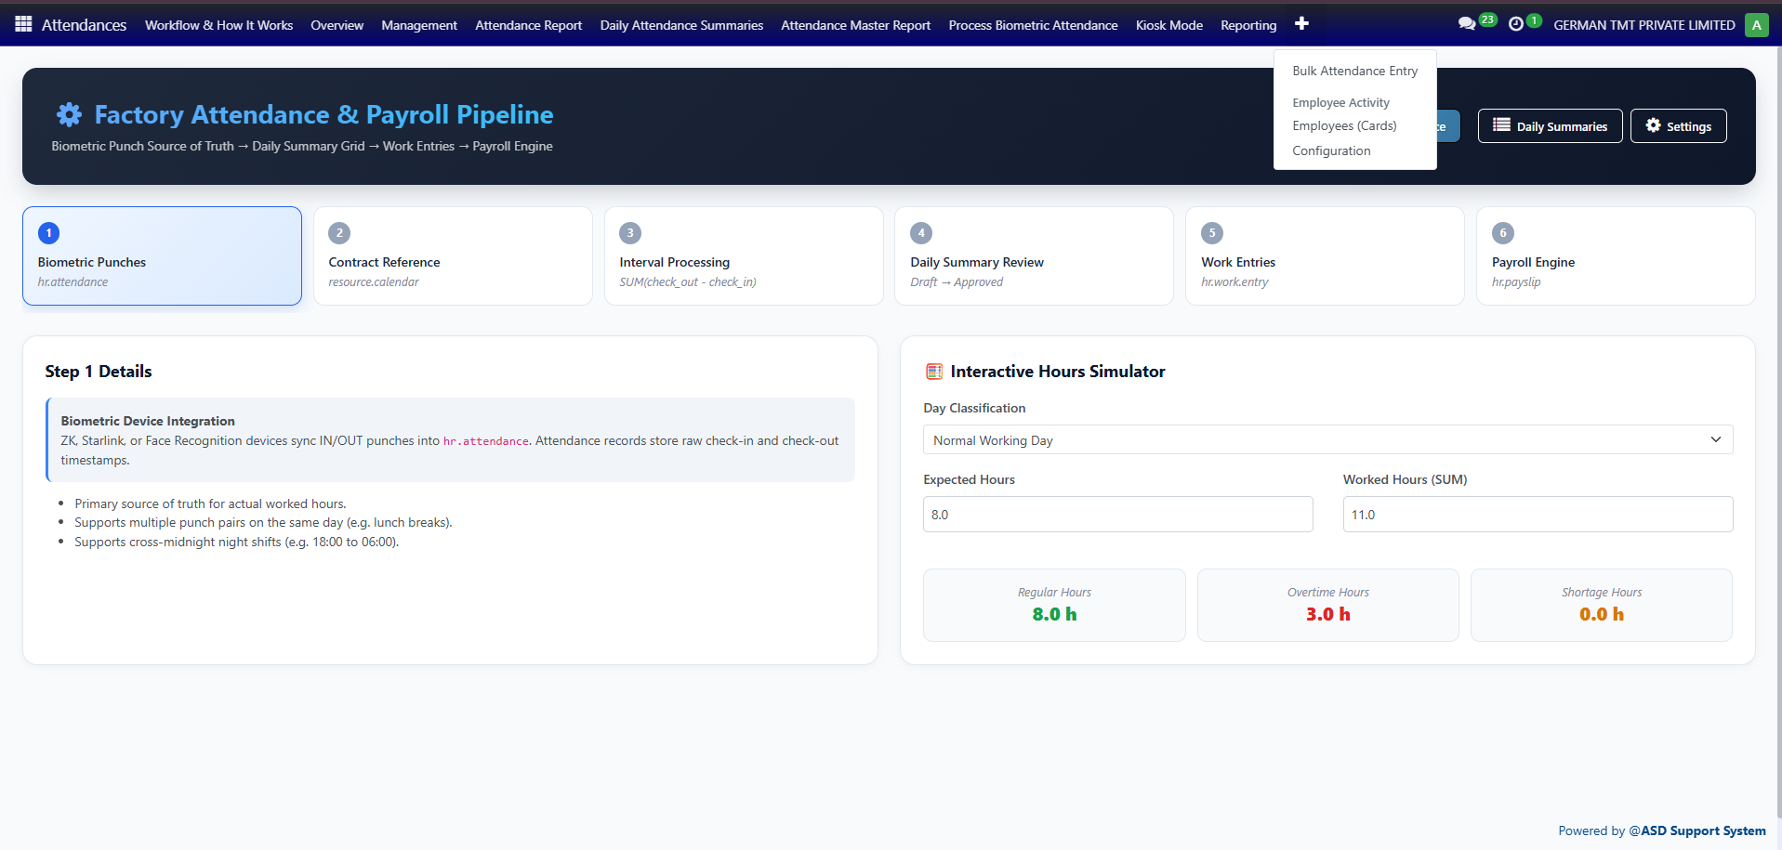
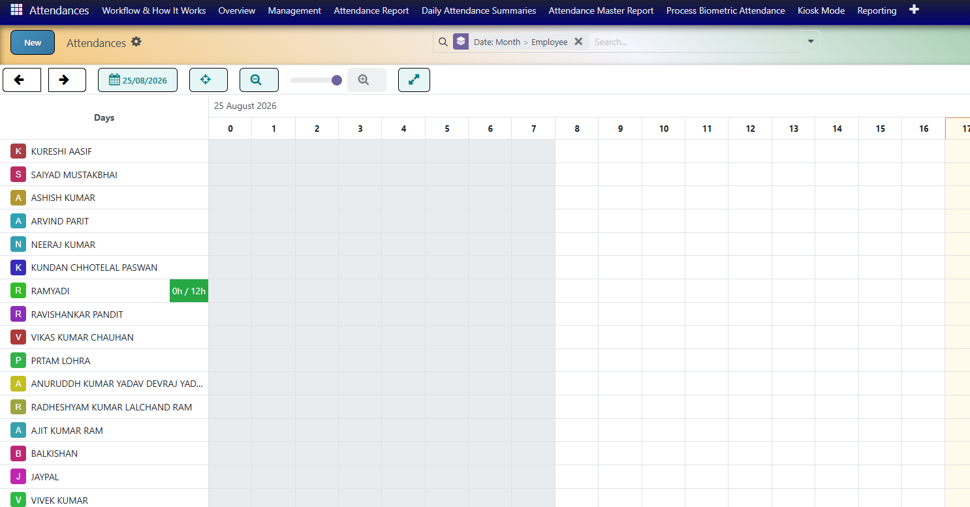
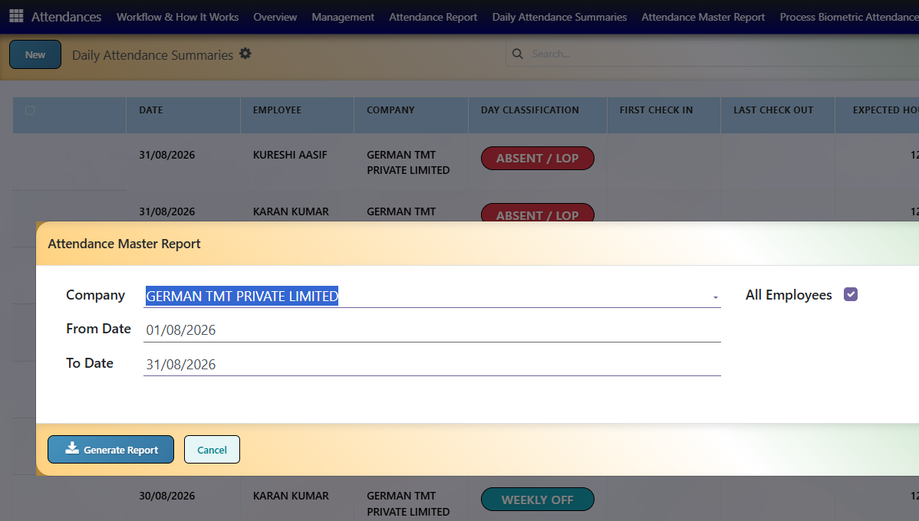
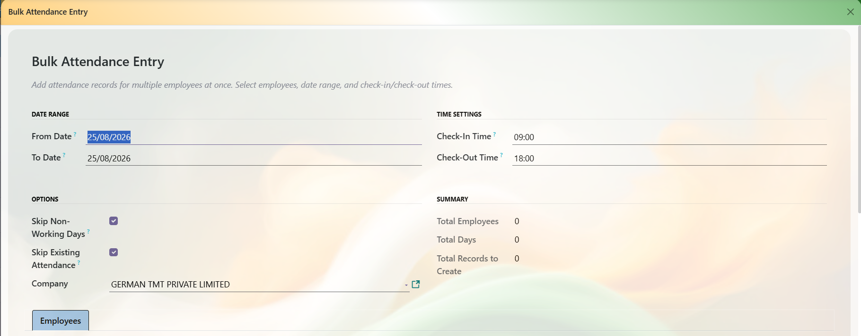
7. Attendance
Check-In
Start work
Check-Out
End work
Attendance
Record punches in overview
Attendance Report
Here we can generate an attendance report for a particular employee by selecting the required month. The report shows the employee’s attendance details for the selected month
Dily Attendance Summary
Here we can view the daily attendance details of employees, including who is present, absent, on leave, or has incomplete attendance.
Attendance Master Report
Here we can generate the attendance report for all employees at once. The report provides a complete overview of employee attendance
Bulk Attendance Entry
Here we can enter attendance for multiple employees at once instead of updating each employee individually. HR can select the required date and enter the attendance details for all selected employees in a single operation.
Sources
Biometric / Time Office
Configured attendance systems
Check-in / check-out
Processing
Shift handling
Overtime
Late / early exceptions
Missing attendance
Payroll Link
Workday information
Work entries
Validate before payroll

Slide 9
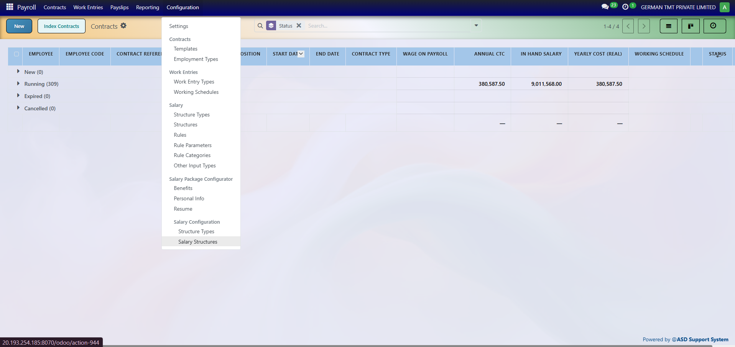
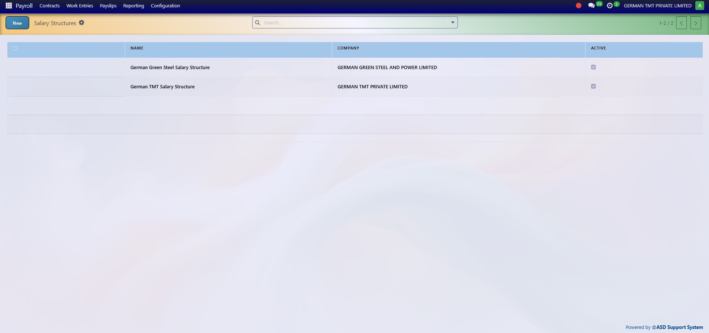
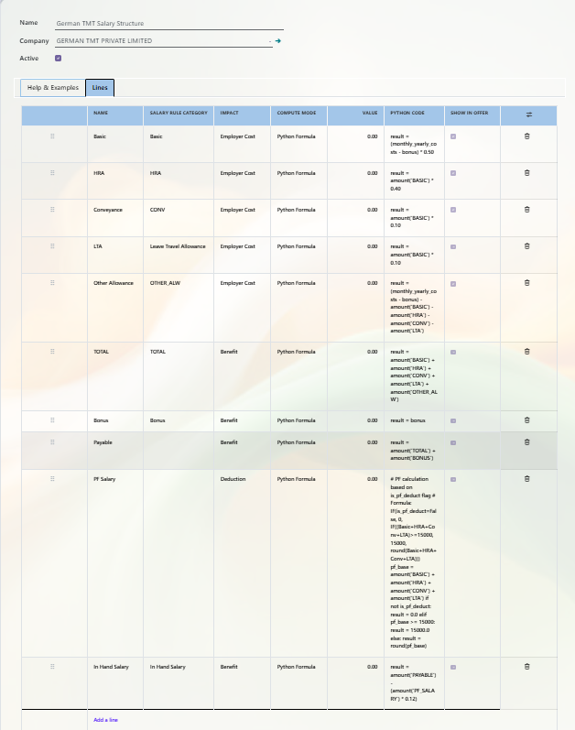
8. Salary Structure
Payroll
Configuration
Salary Structure
Open configuration
Create
Configure structure
Salary Rules
Add components
Components
Fixed / percentage
Save
Structure ready
Setup
Structure name
Basic / allowances
Deductions
Salary rules
Salary Structure
Here we can define the salary structure for employees, including different salary components such as Basic Salary, HRA, Allowances, PF, ESIC, deductions, and other components. The configured structure is then used to calculate the employee’s salary during payroll processing.

Slide 10
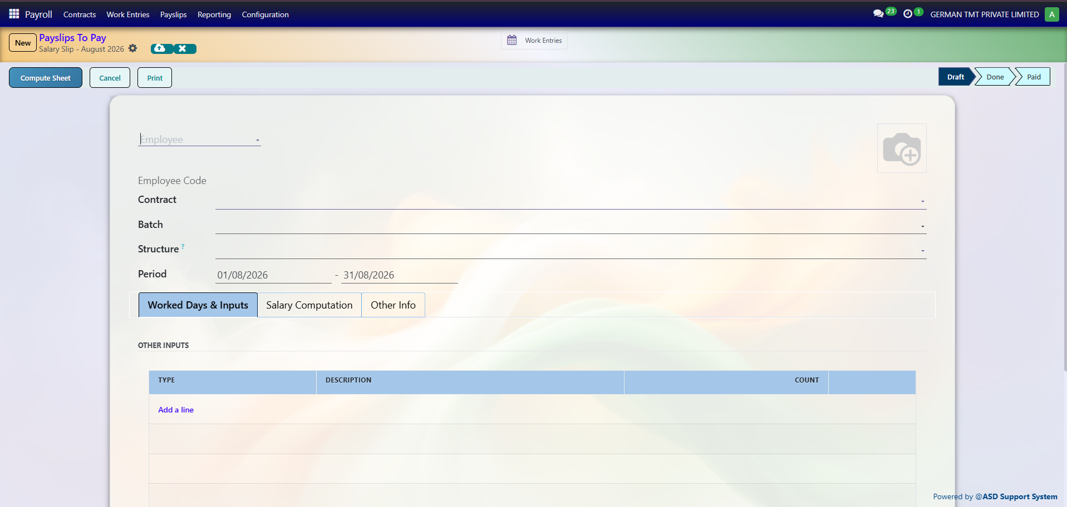
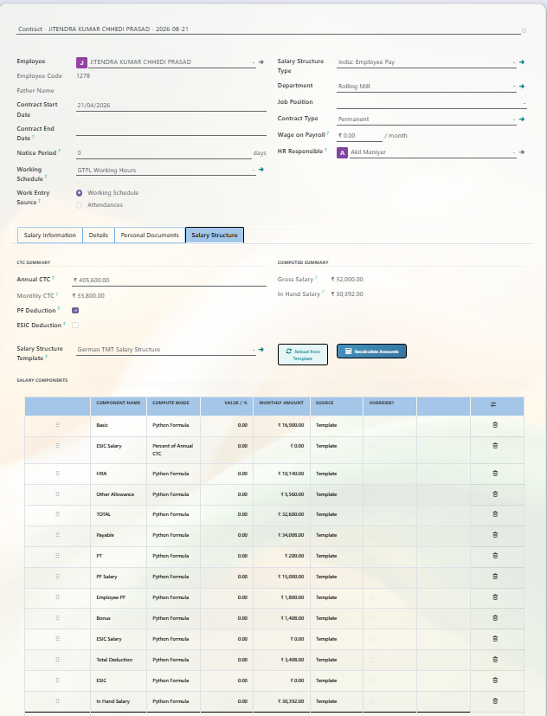
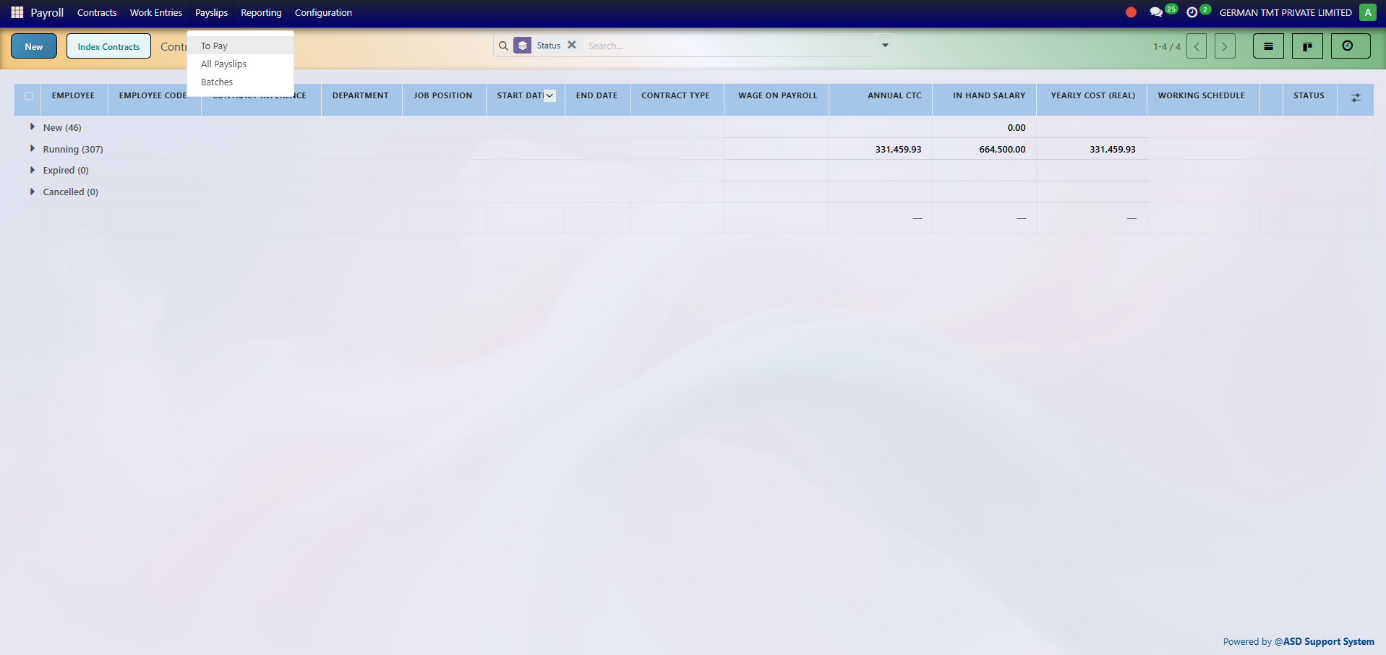
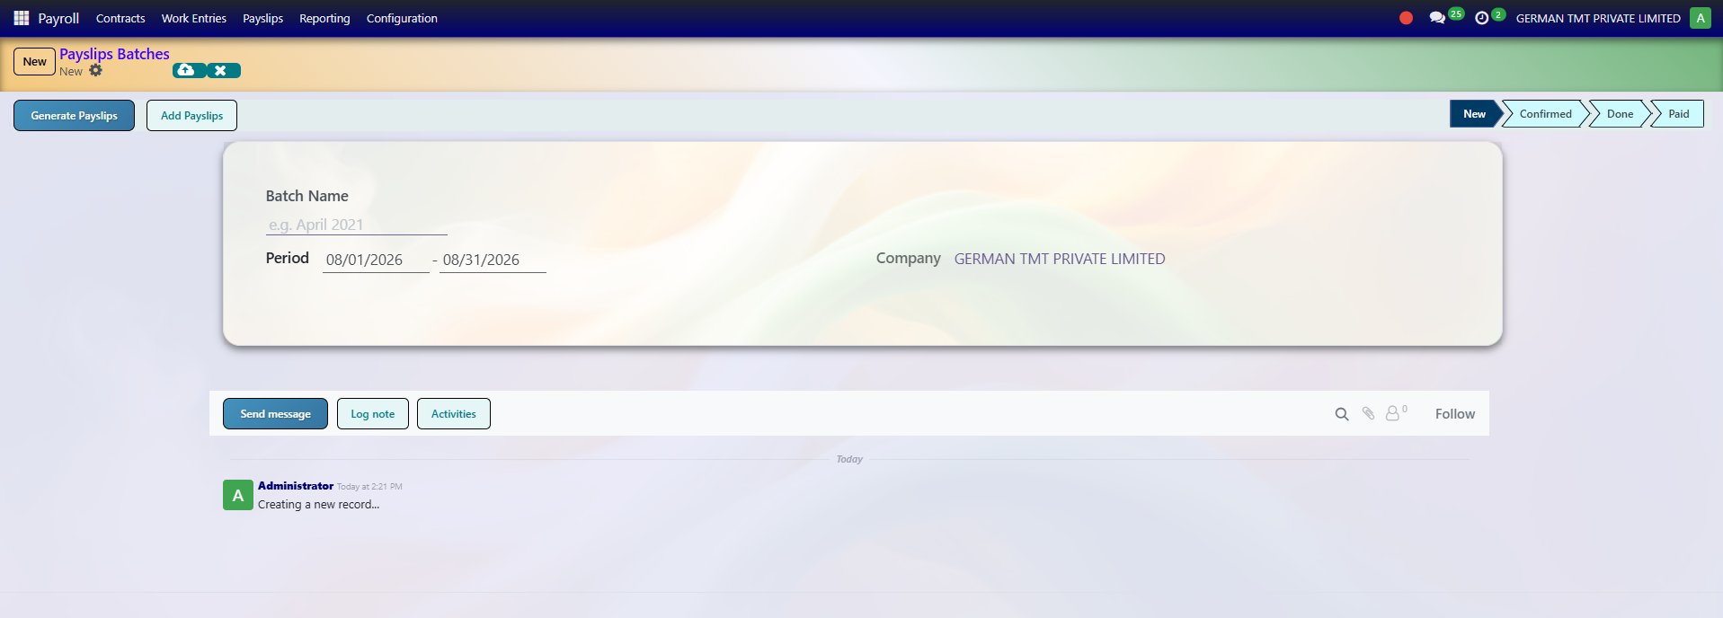
Payslip
Here we can generate a payslip for a particular employee by selecting the employee and required payroll period. The payslip shows the employee’s salary details, earnings, deductions, and net salary.
9. Payroll
Payroll
Open
Salary Structure
Set the structure
Contract
Employe visible which are in contract only get payslips
Calculation
System calculates
Review
Check payslip
Decision
All good?
Confirm
Finalise
Processed
Payroll complete
Payslip Batch
Here we can generate payslips for multiple employees at once. Instead of creating each payslip individually, HR can select a group of employees or the required batch and generate all their payslips together.
Review
Working days
Components
Deductions
Correct before confirmation
Inputs
Contract
Salary structure
Salary rules
Attendance
Leave / work entries
To Payslip
Salary Structure
Here we can define the salary structure for employees, including different salary components such as Basic Salary, HRA, Allowances, PF, ESIC, deductions, and other components. The configured structure is then used to calculate the employee’s salary during payroll processing.
Payslip Batch

Slide 11
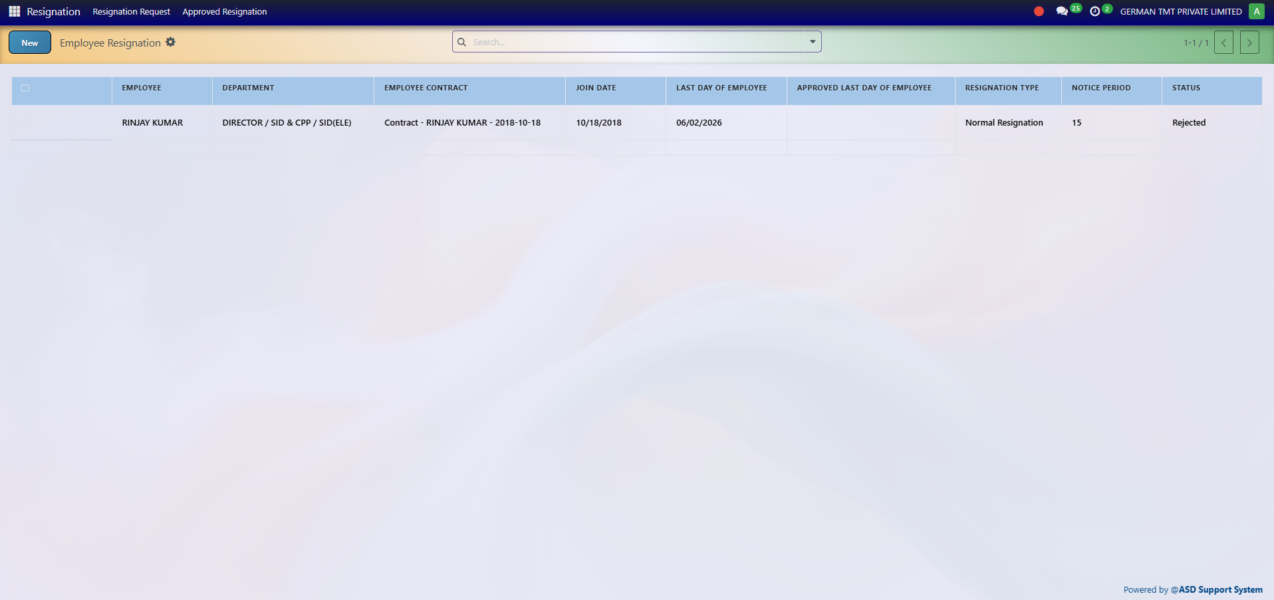
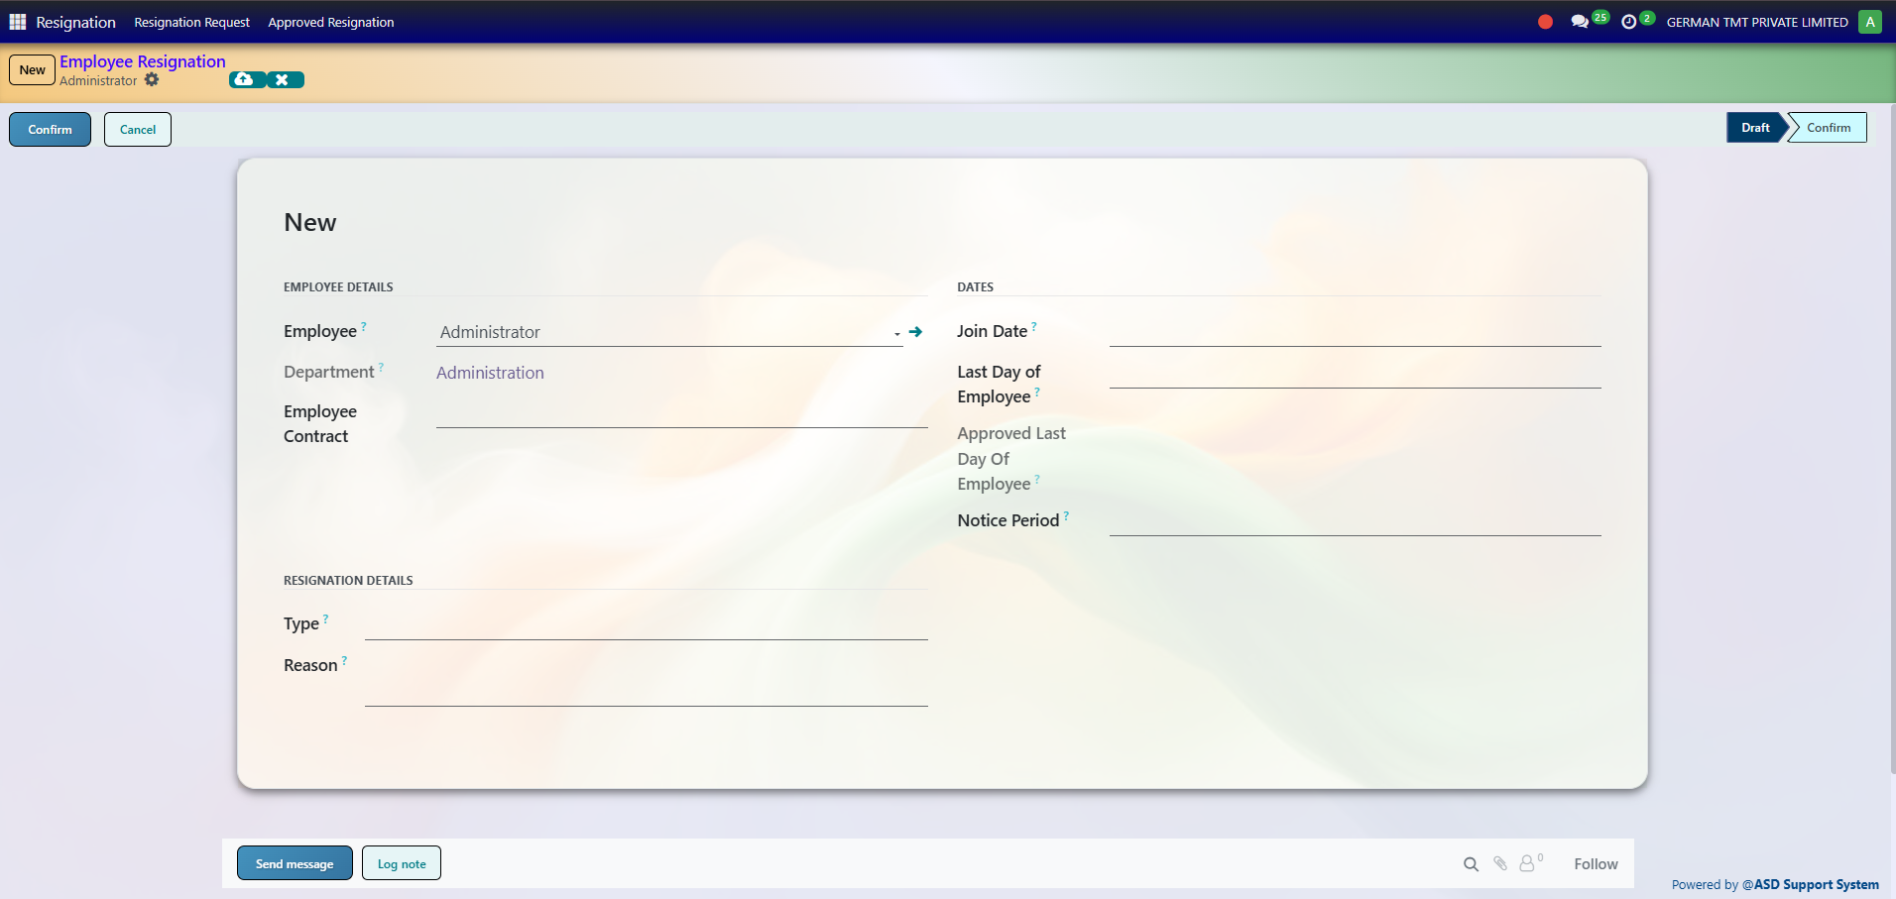
10. Resignation / Exit
Resignation
Create request
Details
Reason / dates
Notice
Notice period
Submit
Send
Approval
HR / Manager
Last Working Date
Confirm
Clearance
Complete
Exit
Employee inactive
Details
Type / reason
Contract
Notice period
Relieving date
Approval
Submit
Review
Approve / reject
Confirm last working date
HR Process • 11

Slide 12
11. Complete Click-by-Click Summary
Recruitment
Job
Candidates
Interview
Selection
Department
Check existing
Create if missing
Save
Employee
New
Department
Job
Joining date
Details
Save
Contract
New
Job
Salary structure
Wage
Terms
Confirm
Leave
Request
Type
Dates
Submit
Approve
Attendance
Check-in
Check-out
Process
Work entries
Salary / Payroll
Structure
Rules
Contract
Payslip
Review
Confirm
Resignation
Details
Notice
Approval
Last day
Clearance
Exit
HR Process • 12

Slide 13
12. Full Visual Reference

Slide 14
13. Process Notes
Department Rule
Recruitment identifies department
Existing → use it
Missing → create it
Then employee
Employee Rule
Create after department ready
Complete details
Create contract
Connect salary structure
Payroll Rule
Configure salary structure
Attendance + leave feed payroll
Review before confirmation
Daily HR
Leave request → approval
Check-in / check-out
Attendance processing
Work entries
Exit Rule
Resignation
Notice period
Approval
Last working date
Clearance
Overall
Recruitment
Department
Employee
Contract
Leave / Attendance
Salary / Payroll
Exit
HR Process • 14

