Slide 1
CALLBACK OBJECTS
Everything you didn’t know you wanted to hook in the kernel
Yarden Shafir

Slide 2

ABOUT ME
Circus artist and aerial instructor
Software engineer @Crowdstrike
Windows Internals instructor @Winsider
Former pastry chef
Taught mom how to unmute zoom
Almost succeeded at training a cat
Usually found upside down

Slide 3
ANOTHER KERNEL COMMUNICATION MECHANISM
Named Objects
Can be created by any driver with ExCreateCallback
Other drivers can register with ExRegisterCallback
Get a handle with ExCreateCallback
Can be configured on only allow one registered function
Any driver can notify with ExNotifyCallback
All registered drivers need to know what types to expect in both arguments

Slide 4
Notify
Driver A
Register
Driver B
Callback
Object
Driver C
Create
Register
Notify

Slide 5
PCALLBACK_OBJECT CallbackObject;
PCALLBACK_REGISTRATION CallbackHandle;
OBJECT_ATTRIBUTES ObjectAttributes;
UNICODE_STRING CallbackName;
RtlInitUnicodeString(&CallbackName, L"\\Callback\\SeImageVerificationDriverInfo");
InitializeObjectAttributes( &ObjectAttributes, &CallbackName, OBJ_KERNEL_HANDLE | OBJ_CASE_INSENSITIVE | OBJ_PERMANENT, nullptr, nullptr);
status = ExCreateCallback(&CallbackObject, &ObjectAttributes, 0, 1);
CallbackHandle = (PCALLBACK_REGISTRATION)ExRegisterCallback( CallbackObject, (PCALLBACK_FUNCTION)ImageVerificationCallbackFunction, nullptr);

Slide 6
STRUCTURES AND FIELDS
typedef struct _CALLBACK_REGISTRATION
{
LIST_ENTRY Link;
PCALLBACK_OBJECT CallbackObject;
PCALLBACK_FUNCTION CallbackFunction;
PVOID CallbackContext;
ULONG Busy;
BOOLEAN UnregisterWaiting;
} CALLBACK_REGISTRATION, *PCALLBACK_REGISTRATION;
typedef struct _CALLBACK_OBJECT
{
ULONG Signature;
KSPIN_LOCK Lock;
LIST_ENTRY RegisteredCallbacks;
BOOLEAN AllowMultipleCallbacks;
UCHAR reserved[3];
LIST_ENTRY CallbackList;
} CALLBACK_OBJECT, *PCALLBACK_OBJECT;

Slide 7
CALLBACKS ARE LINKED IN A LIST
So are the registered functions
Get a pointer to one, you get them all
CALLBACK_OBJECT
CALLBACK_OBJECT
CALLBACK_OBJECT
CALLBACK_OBJECT
CALLBACK_REGISTRATION
CALLBACK_REGISTRATION
CALLBACK_REGISTRATION
CALLBACK_REGISTRATION
CALLBACK_REGISTRATION
CALLBACK_REGISTRATION
CALLBACK_REGISTRATION
CALLBACK_REGISTRATION

Slide 8
WHO USES CALLBACKS?
The kernel notifies drivers about OS events with callbacks
Win32k uses anonymous callbacks
Security products use them for internal communication
PatchGuard has a callback used to trigger checks

Slide 9
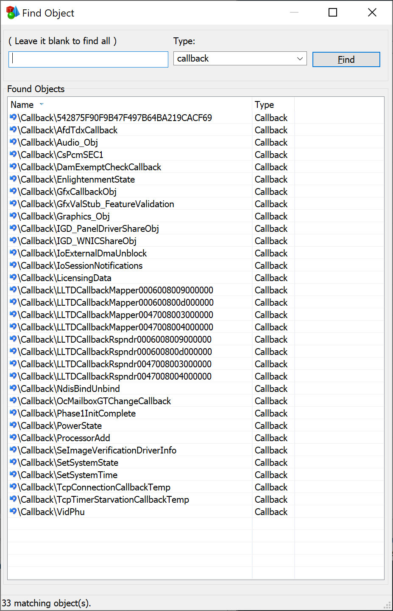
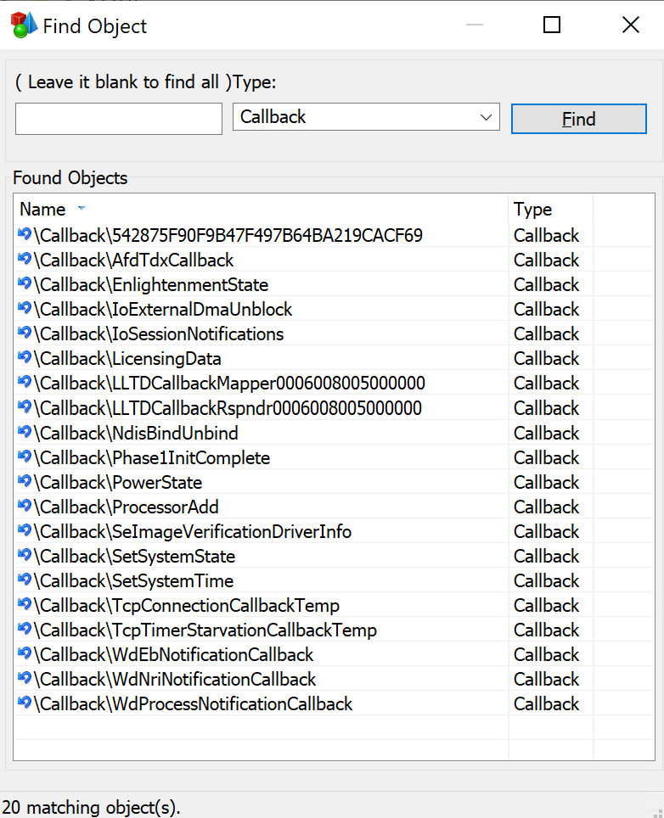
A FEW EXAMPLES…
Graphics callbacks
Power State
SeImageVerificationDriverInfo
Windows Defender Callbacks
There are also unnamed callbacks that don’t appear here
Those are harder to find and use because you can’t open them by name
Can still find them by iterating over the callbacks list

Slide 10
HOW CAN WE ABUSE THIS?
Listen to private driver communication
Hook callbacks to get interesting data without officially “registering”
Notify callbacks with false data and “lie” to products
Find interesting pointers and structures in callback contexts

Slide 11
WINDOWS DEFENDER CALLBACKS
Process notification – A way to get process information without using the well-known callbacks
Nri service – called when the network service starts to receive process information
Boot driver callback (ELAM) – Called by the ELAM driver with information about early loaded drivers

Slide 12
PATCH GUARD CALLBACK
Callback Name: 542875F90F9B47F497B64BA219CACF69
MsSecFlt.sys registers function SecKernelIntegrityCallback
Notified once when PG is initialized
Sets a pointer to a function that will be called for periodic PG checks
Nothing checks if the pointer is already set
Pointer can be replaced after being set the first time

