Slide 1
DATABASE SYSTEM CONCEPTS
第十九章 恢复系统
Chapter19 Recovery System

Slide 2
提纲
故障分类
存储器
恢复与原子性性
恢复算法
缓冲区管理
非易失性存储器上数据丢失的故障
使用远程备份系统的高可用性
锁的提前释放与逻辑撤销操作
ARIES
主存数据库的恢复

Slide 3
故障分类
事务故障
-逻辑故障
事务由于某些内部条件而无法继续正常执行，这样的内部条件包括非法输入、溢出等
-系统错误
系统进入一种不良状态，比如死锁
系统崩溃
硬件故障、DBMS故障或者OS故障
磁盘故障

Slide 4
存储器
易失性存储器(Volatile storage)
Does not survive system crashes
Examples: main memory, cache memory
非易失性存储器(Nonvolatile storage)
Survives system crashes
Examples: disk, tape, flash memory, non-volatile RAM
But may still fail, losing data
稳定存储器(Stable storage)
A mythical form of storage that survives all failures
Approximated by maintaining multiple copies on distinct nonvolatile media
See book for more details on how to implement stable storage

Slide 5
稳定存储器的实现
Maintain multiple copies of each block on separate disks
copies can be at remote sites to protect against disasters such as fire or flooding.
Failure during data transfer can still result in inconsistent copies: Block transfer can result in
Successful completion
Partial failure: destination block has incorrect information
Total failure: destination block was never updated
Protecting storage media from failure during data transfer (one solution):
Execute output operation as follows (assuming two copies of each block):
Write the information onto the first physical block.
When the first write successfully completes, write the same information onto the second physical block.
The output is completed only after the second write successfully completes.

Slide 6
防止存储介质发生故障
Copies of a block may differ due to failure during output operation.
To recover from failure:
1. First find inconsistent blocks:
Expensive solution: Compare the two copies of every disk block.
Better solution:
Record in-progress disk writes on non-volatile storage (Flash, Non-volatile RAM or special area of disk).
Use this information during recovery to find blocks that may be inconsistent, and only compare copies of these.
Used in hardware RAID systems
2. If either copy of an inconsistent block is detected to have an error (bad checksum), overwrite it by the other copy. If both have no error, but are different, overwrite the second block by the first block.

Slide 7
数据访问
Physical blocks are those blocks residing on the disk.
Buffer blocks are the blocks residing temporarily in main memory.
Block movements between disk and main memory are initiated through the following two operations:
input (B) transfers the physical block B to main memory.
output (B) transfers the buffer block B to the disk, and replaces the appropriate physical block there.
We assume, for simplicity, that each data item fits in, and is stored inside, a single block.

Slide 8
数据访问
Each transaction T_{i} has its private work-area in which local copies of all data items accessed and updated by it are kept.
T_{i} 's local copy of a data item X is called x_{i}.
Transferring data items between system buffer blocks and its private work-area done by:
read(X) assigns the value of data item X to the local variable x_{i}.
write(X) assigns the value of local variable x_{i} to data item {X} in the buffer block.
Note: output(B_{X}) need not immediately follow write(X). System can perform the output operation when it deems fit.
Transactions
Must perform read(X) before accessing X for the first time (subsequent reads can be from local copy)
write(X) can be executed at any time before the transaction commits

Slide 9
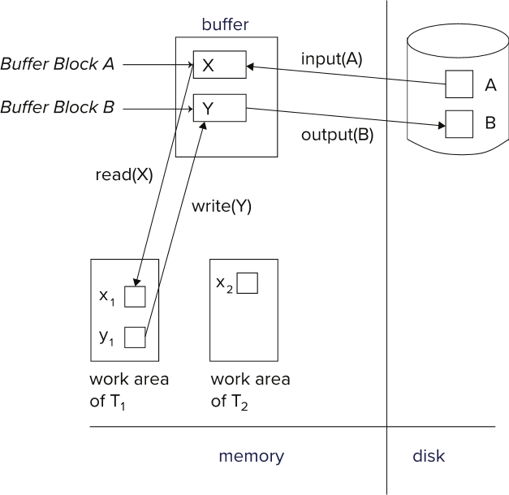
数据访问

Slide 10
恢复与原子性性
开始状态：
A=1000元
B=2000元
A+B=3000元
T1
read(A);
A := A − 50;
write(A);
read(B);
B := B + 50;
write(B);
重新执行还是不重新执行？

Slide 11
恢复与原子性
日志是日志记录的序列,记录数据库中所有的更新活动
先写日志，后写数据库
日志的组成：
-事务标识符
-数据项标识符
-旧值
-新值

Slide 12
恢复与原子性
日志记录
<T_{i} start>
<T_{i}, X_{j}, V₁,V₂>
<T_{i}, commit>
<T_{i}, abort>

Slide 13
Oracle Redo日志
system change number，是Oracle中的时间号
timestmap=2016-06-22 09:25:58.0,
scn=10920473921993,seq_owner=QMCB,seg_Name=AC43,
sql=insert into "QMCB"."AC43"("PID","AAC001","AAC002","AAC003","AAE140","AAE002","AAB301","AAB191") values ('11516030110177226253201512','000101001024001629','370104196109192950','****','21','201512','379900',TO_DATE('29-12月-15', 'DD-MON-RR'));

Slide 14
恢复与原子性
延迟的数据库修改(deferred-modification technique)，事务中所有的write操作，在事务部分提交时才修改数据库的执行，日志中只记录新值
结束状态：
A=950元
B=2050元
A+B=3000元
结束状态：
C=600元

Slide 15
恢复与原子性
延迟的数据库修改的恢复机制:
Redo(T_{i}): 将事务T_{i}更新的所有数据项的值设为新值
Redo操作必须是幂等的
事务T_{i}需要Redo操作，当且仅当日志中既包含记录<T_{i}, start>又包含记录<T_{i}, commit>

Slide 16
恢复与原子性

Slide 17
恢复与原子性
立即的数据库修改：允许数据库修改在事务处于活动状态时就输出到数据库中
结束状态：
A=950元
B=2050元
A+B=3000元
结束状态：
C=600元

Slide 18
恢复与原子性
立即的数据库修改的恢复机制:
Undo(Ti)：将事务Ti所有更新的所有数据项的值恢复成旧值
Redo(Ti)：将事务Ti所有更新的所有数据项的值置为新值
事务Ti需要Redo操作，当且仅当日志中既包含记录<Ti, start>又包含记录<Ti, commit>
事务Ti需要Undo操作，当且仅当日志中既包含记录<Ti, start>不包含记录<Ti, commit>

Slide 19
恢复与原子性

Slide 20
恢复与原子性
系统发生故障时，检查日志，决定哪些事务需要Redo，哪些事务需要Undo，原则上需要搜索整个日志，但是有下列问题：
搜索过程太耗时
大多数需要Redo的事务已经写入了数据库，此时Redo不会产生不良后果，但是会使得恢复过程太长

Slide 21
恢复与原子性
检查点：由系统周期性地执行检查点，需要执行下列操作：
-1、将当前位于主存的所有日志记录输出到稳定存储器上
-2、将所有修改了的缓冲块输出到磁盘上
-3、将一个日志记录<checkpoint>输出到稳定存储器

Slide 22
恢复与原子性
检查点执行过程中，不允许事务执行更新操作
在检查点之前提交的事务，不予考虑
因为记录<Ti,commit>在日志中，出现在<checkpoint>之前
确定最近的检查点发生前开始执行的最近的一个事务T_{i}， 对于T_{i}和T_{i}之后的开始执行的事务T_{j}执行redo和undo操作

Slide 23
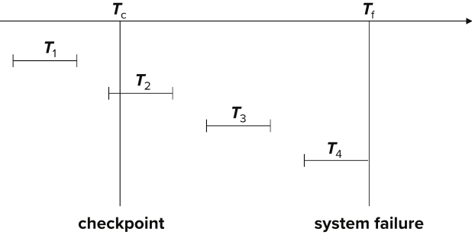
恢复与原子性
T₁ can be ignored (updates already output to disk due to checkpoint)
T₂ and T₃ redone.
T₄ undone

Slide 24
并发事务的恢复
使用严格两阶段封锁(事务持有的所有排他锁必须在事务结束后，方可释放)
从后向前扫描日志(为什么？)
因为一个事务可能多次更新一个数据项

Slide 25
并发事务的恢复
系统由后向前扫描日志，直至发现第一个<checkpoint>：
-Redo-list：对每一个形如<T_{i} commit>的记录，将T_{i}加入Redo-list
-Undo-list：对每一个形如<T_{i} start>的记录，如果T_{i}不属于Redo-list，将T_{i}加入undo-list

Slide 26
并发事务的恢复
Redo-list和undo-list构造完毕后，恢复过程如下：
-从最后一个记录开始由后至前从新扫描日志，并且对undo-list中的每一个日志记录执行Undo操作。忽略redo-list中的事务。
-找到最近一条<checkpoint>记录。
-系统由最近一条<checkpoint>记录由前向后扫描日志，并且对redo-list中事务T_{i}的每一个日志记录执行redo操作。

Slide 27
并发事务的恢复
问题：为什么要先进行Undo操作，后进行Redo操作？
假设日志：<Ti,A,10,20>,<Tj,A,10,30>,<Tj,commit>，此时如果先Redo再Undo的话，数据项A会出现问题，因此要先进行Undo操作，后进行Redo操作

Slide 28
恢复算法
要确定系统如何从故障中恢复，首先需要确定用于存储数据库设备的故障状态，其次考虑这些故障状态对数据库内容有什么影响。然后设计在故障发生后仍保障数据库一致性以及事务原子性的算法，这些算法称为恢复算法，包括：
在正常事务处理时采取措施，保证有足够的信息用于故障恢复
故障发生后采取措施，将数据库内容恢复到某个保证数据库一致性、事务原子性及持久性的状态

Slide 29
恢复算法
Logging (during normal operation):
<T_{i} start> at transaction start
<T_{i}, X_{j}, V₁, V₂> for each update, and
<T_{i} commit> at transaction end
Transaction rollback (during normal operation)
Let T_{i} be the transaction to be rolled back
Scan log backwards from the end, and for each log record of T_{i} of the form <T_{i}, X_{j}, V₁, V₂>
Perform the undo by writing V₁ to X_{j},
Write a log record <T_{i} , X_{j}, V₁>
such log records are called compensation log records
Once the record <T_{i} start> is found stop the scan and write the log record <T_{i} abort>

Slide 30
恢复算法
Recovery from failure: Two phases
Redo phase: replay updates of all transactions, whether they committed, aborted, or are incomplete
Undo phase: undo all incomplete transactions
Redo phase:
1. Find last <checkpoint L> record, and set undo-list to L.
2. Scan forward from above <checkpoint L> record
Whenever a record <T_{i}, X_{j}, V₁, V₂> or <T_{i}, X_{j}, V₂> is found, redo it by writing V₂ to X_{j}
Whenever a log record <T_{i} start> is found, add T_{i} to undo-list
Whenever a log record <T_{i} commit> or <T_{i} abort> is found, remove T_{i} from undo-list

Slide 31
恢复算法
Undo phase:
1. Scan log backwards from end
Whenever a log record <T_{i}, X_{j}, V₁, V₂> is found where T_{i} is in undo-list perform same actions as for transaction rollback:
perform undo by writing V₁ to X_{j}.
write a log record <T_{i} , X_{j}, V₁>
Whenever a log record <T_{i} start> is found where T_{i} is in undo-list,
Write a log record <T_{i} abort>
Remove T_{i} from undo-list
Stop when undo-list is empty
1. i.e., <T_{i} start> has been found for every transaction in undo-list
After undo phase completes, normal transaction processing can commence

Slide 32
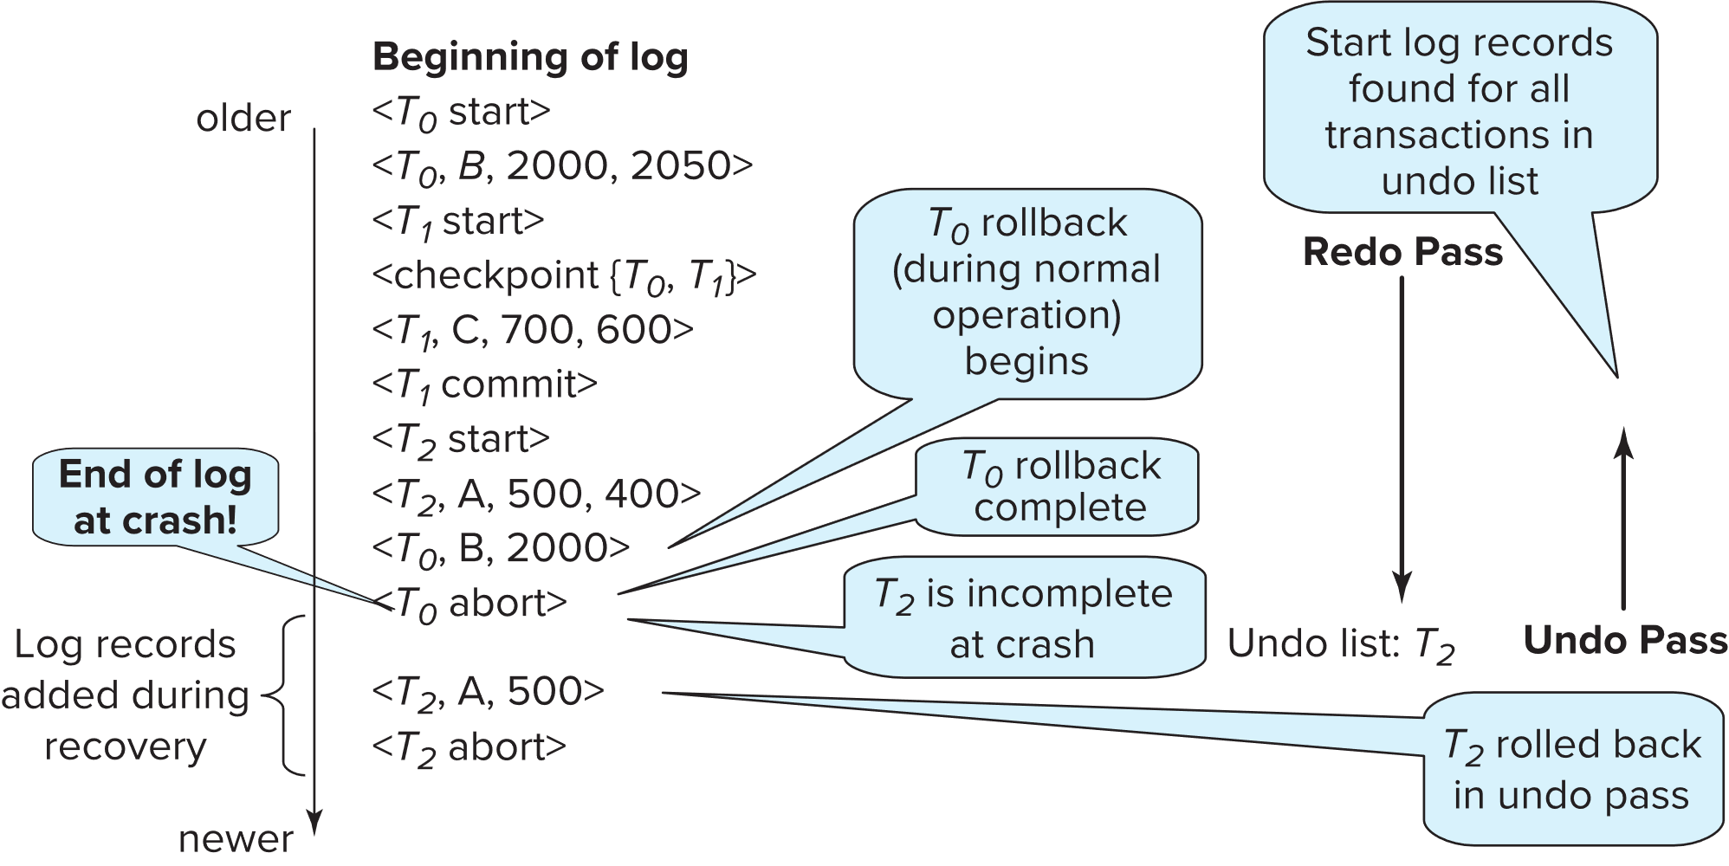
恢复算法

Slide 33
缓冲区管理
Log record buffering: log records are buffered in main memory, instead of being output directly to stable storage.
Log records are output to stable storage when a block of log records in the buffer is full, or a log force operation is executed.
Log force is performed to commit a transaction by forcing all its log records (including the commit record) to stable storage.
Several log records can thus be output using a single output operation, reducing the I/O cost.

Slide 34
缓冲区管理
The rules below must be followed if log records are buffered:
Log records are output to stable storage in the order in which they are created.
Transaction T_{i} enters the commit state only when the log record <T_{i} commit> has been output to stable storage.
Before a block of data in main memory is output to the database, all log records pertaining to data in that block must have been output to stable storage.
This rule is called the write-ahead logging or WAL rule
Strictly speaking, WAL only requires undo information to be output

Slide 35
数据库缓冲
Database maintains an in-memory buffer of data blocks
When a new block is needed, if buffer is full an existing block needs to be removed from buffer
If the block chosen for removal has been updated, it must be output to disk
The recovery algorithm supports the no-force policy: i.e., updated blocks need not be written to disk when transaction commits
force policy: requires updated blocks to be written at commit
More expensive commit
The recovery algorithm supports the steal policy: i.e., blocks containing updates of uncommitted transactions can be written to disk, even before the transaction commits

Slide 36
缓冲区管理
If a block with uncommitted updates is output to disk, log records with undo information for the updates are output to the log on stable storage first
(Write ahead logging)
No updates should be in progress on a block when it is output to disk. Can be ensured as follows.
Before writing a data item, transaction acquires exclusive lock on block containing the data item
Lock can be released once the write is completed.
Such locks held for short duration are called latches.
To output a block to disk
1. First acquire an exclusive latch on the block
Ensures no update can be in progress on the block
2. Then perform a log flush
3. Then output the block to disk
4. Finally release the latch on the block

Slide 37
缓冲区管理
Database buffer can be implemented either
In an area of real main-memory reserved for the database, or
In virtual memory
Implementing buffer in reserved main-memory has drawbacks:
Memory is partitioned before-hand between database buffer and applications, limiting flexibility.
Needs may change, and although operating system knows best how memory should be divided up at any time, it cannot change the partitioning of memory.

Slide 38
缓冲区管理
Database buffers are generally implemented in virtual memory in spite of some drawbacks:
When operating system needs to evict a page that has been modified, the page is written to swap space on disk.
When database decides to write buffer page to disk, buffer page may be in swap space, and may have to be read from swap space on disk and output to the database on disk, resulting in extra I/O!
Known as dual paging problem.
Ideally when OS needs to evict a page from the buffer, it should pass control to database, which in turn should
Output the page to database instead of to swap space (making sure to output log records first), if it is modified
Release the page from the buffer, for the OS to use
Dual paging can thus be avoided, but common operating systems do not support such functionality.

Slide 39
模糊检查点
To avoid long interruption of normal processing during checkpointing, allow updates to happen during checkpointing
Fuzzy checkpointing is done as follows:
1. Temporarily stop all updates by transactions
2. Write a <checkpoint L> log record and force log to stable storage
3. Note list M of modified buffer blocks
4. Now permit transactions to proceed with their actions
5. Output to disk all modified buffer blocks in list M
blocks should not be updated while being output
Follow WAL: all log records pertaining to a block must be output before the block is output
6. Store a pointer to the checkpoint record in a fixed position
last_checkpoint on disk

Slide 40
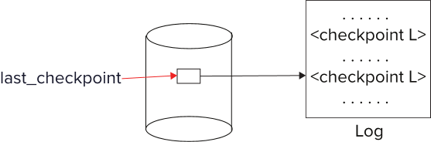
模糊检查点
When recovering using a fuzzy checkpoint, start scan from the checkpoint record pointed to by last_checkpoint
Log records before last_checkpoint have their updates reflected in database on disk, and need not be redone.
Incomplete checkpoints, where system had crashed while performing checkpoint, are handled safely

Slide 41
非易失性存储器上数据丢失的故障
So far we assumed no loss of non-volatile storage
Technique similar to checkpointing used to deal with loss of non-volatile storage
Periodically dump the entire content of the database to stable storage
No transaction may be active during the dump procedure; a procedure similar to checkpointing must take place
Output all log records currently residing in main memory onto stable storage.
Output all buffer blocks onto the disk.
Copy the contents of the database to stable storage.
Output a record <dump> to log on stable storage.

Slide 42
非易失性存储器上数据丢失的故障
To recover from disk failure
restore database from most recent dump.
Consult the log and redo all transactions that committed after the dump
Can be extended to allow transactions to be active during dump; known as fuzzy dump or online dump
Similar to fuzzy checkpointing

Slide 43
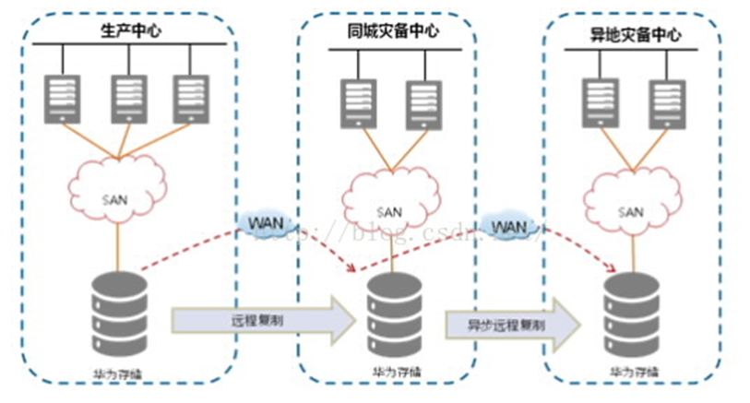
两地三中心容灾

