Slide 1
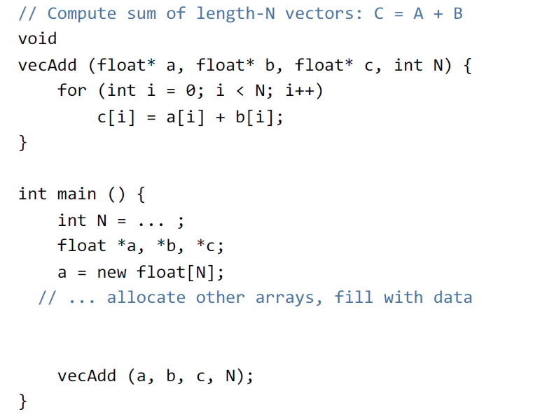
Hello World: Vector Addition

Slide 2
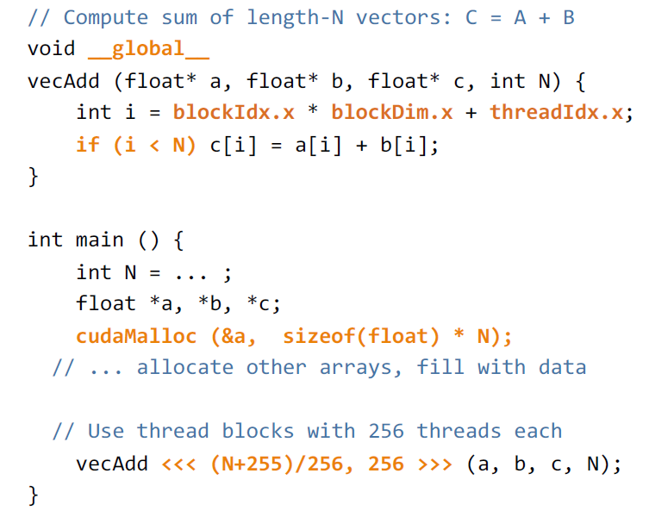
Hello World: Vector Addition

Slide 3
IDs and Dimensions
Threads:
3D IDs, unique within a block
Blocks:
3D IDs, unique within a grid
Built-in variables:
threadIdx: idx within a block
blockIdx: idx within the grid
blockDim: block dimension
gridDim: grid dimension
Device
Grid 1
Block
(0, 0)
Block
(1, 0)
Block
(2, 0)
Block
(0, 1)
Block
(1, 1)
Block
(2, 1)
Block (1, 1)
Thread
(0, 0)
Thread
(1, 0)
Thread
(2, 0)
Thread
(3, 0)
Thread
(4, 0)
Thread
(0, 1)
Thread
(1, 1)
Thread
(2, 1)
Thread
(3, 1)
Thread
(4, 1)
Thread
(0, 2)
Thread
(1, 2)
Thread
(2, 2)
Thread
(3, 2)
Thread
(4, 2)
Notes:
!

Slide 4
Which thread do I belong to?
blockDim.x = 4, gridDim.x = 4
threadIdx.x:
0
1
2
3
0
1
2
3
0
1
2
3
0
1
2
3
blockIdx.x:
0
0
0
0
1
1
1
1
2
2
2
2
3
3
3
3
idx = blockIdx.x*blockDim.x + threadIdx.x:
0
1
2
3
4
5
6
7
8
9
10
11
12
13
14
15

Slide 5
Hello World: Vector Addition

Slide 6
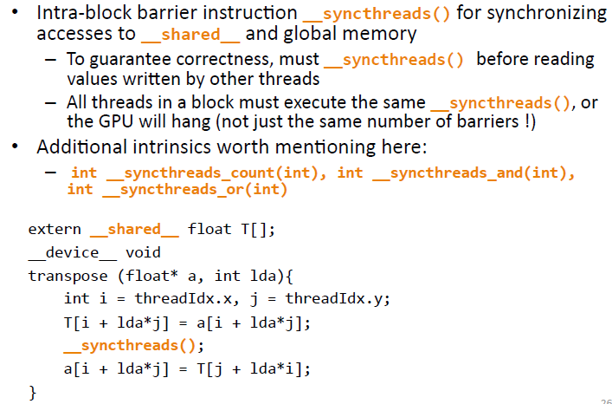
Thread-Block Synchronization

