Slide 1
Intro
Project outlines
Introduce project Function 1
Function 1.testing & results
Introduce project Function 2
Function 2.testing & results
Overall

Slide 2

Project outlines
Project name : Rich (URL : https://github.com/asdnng/rich)
Number of lines of Code : 34128. Measured by Lizard
3) Language : Python

Slide 3
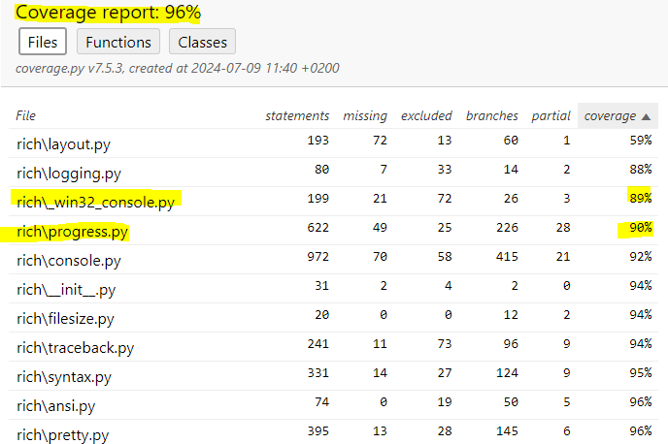
Project outlines
Coverage measurement with existing tool
By using Pytest : pytest --cov=rich --cov-branch tests/

Slide 4
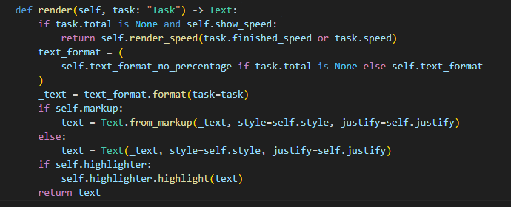
Function 1 : TaskProgressColumn.render (rich\console.py)
The render function takes a task object, converts it to text format, and returns it. This function is used to visually represent a task in progress. It renders text differently depending on the task's completion status, speed, format, and whether it is highlighted.

Slide 5
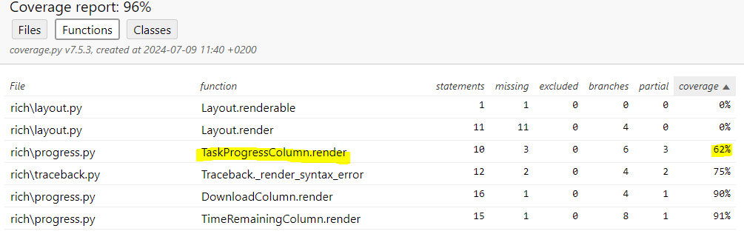
Function 1 : TaskProgressColumn.render (rich\console.py)
1) Old coverage

Slide 6
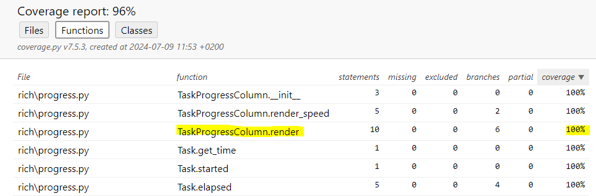
Function 1 : TaskProgressColumn.render (rich\console.py)
2) New coverage (Enhanced new test code : Commit-1)

Slide 7
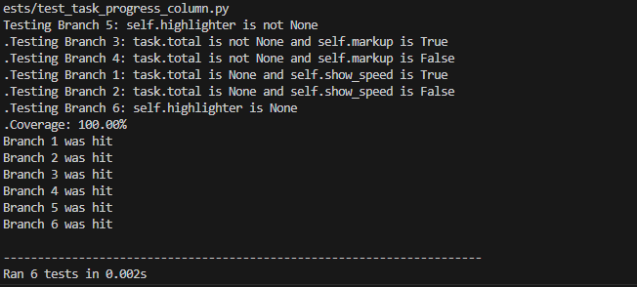
Function 1 : TaskProgressColumn.render (rich\console.py)
The main reason for the improved coverage is that I added test cases and improved existing test cases to extend them to test all conditional branches. Previously, only some branches were tested, but I added test cases that could handle all input conditions so that each branch could be executed. So, coverage of the previous version was approximately 60%, after enhancement, I got 100% test coverage

Slide 8
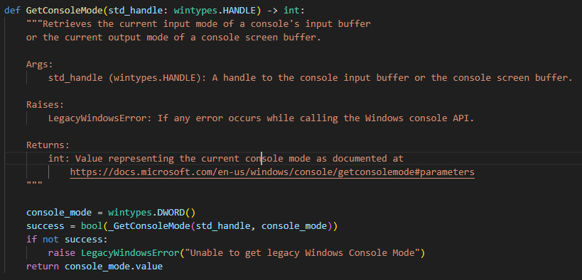
Function 2 : GetConsoleMode(rich\_win32_console.py)
The GetConsoleMode function returns the current mode of the Windows console. This function is used to get the mode of the console's input buffer or output screen buffer.

Slide 9
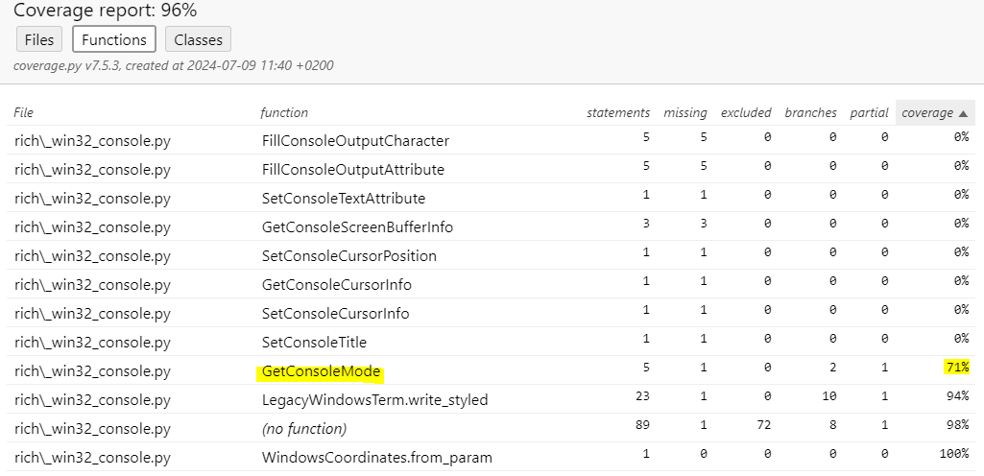
Function 2 : GetConsoleMode(rich\_win32_console.py)
1) Old coverage

Slide 10
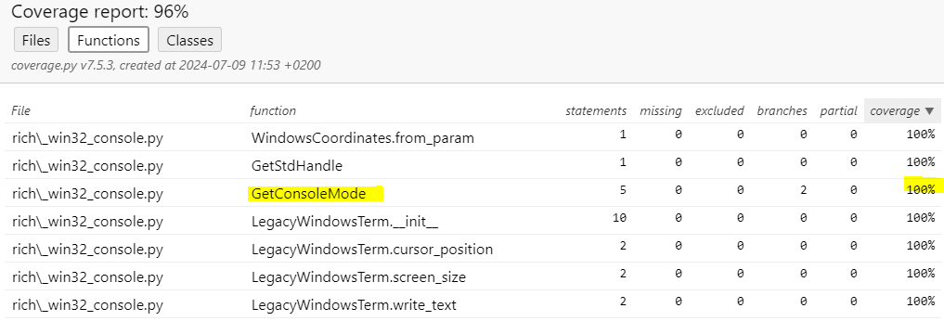
Function 2 : GetConsoleMode(rich\_win32_console.py)
2) New coverage (Enhanced new test code : Commit-2)

Slide 11
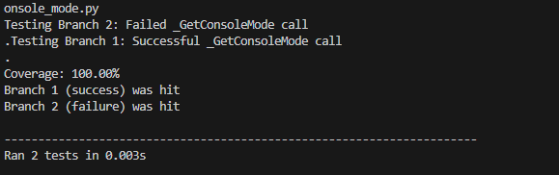
Function 2 : GetConsoleMode(rich\_win32_console.py)
This function also has 100% test coverage after enhancement after I added some additional test cases like the first one. Before the improvement, coverage of this function was 71%

Slide 12
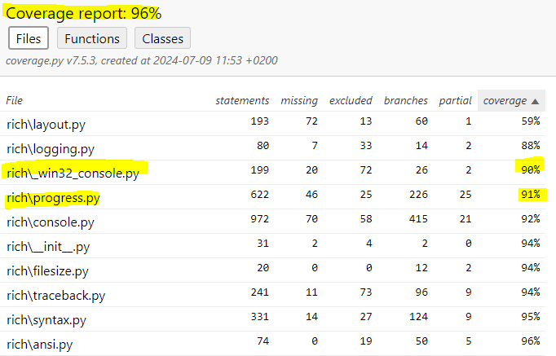
Overall
1) Old coverage
2) New coverage
The overall overage percentage has not changed but the coverage of each file has increased by 1 %

