Slide 1
Library Management System
Work by Group 6

Slide 2
Group Members
Emmanuel Cadet (ecades@mum.edu)
Musiliu Adeniyi Bolaji (mabolaji@mum.edu)
Aaron Gezai (agezai@mum.edu)

Slide 3
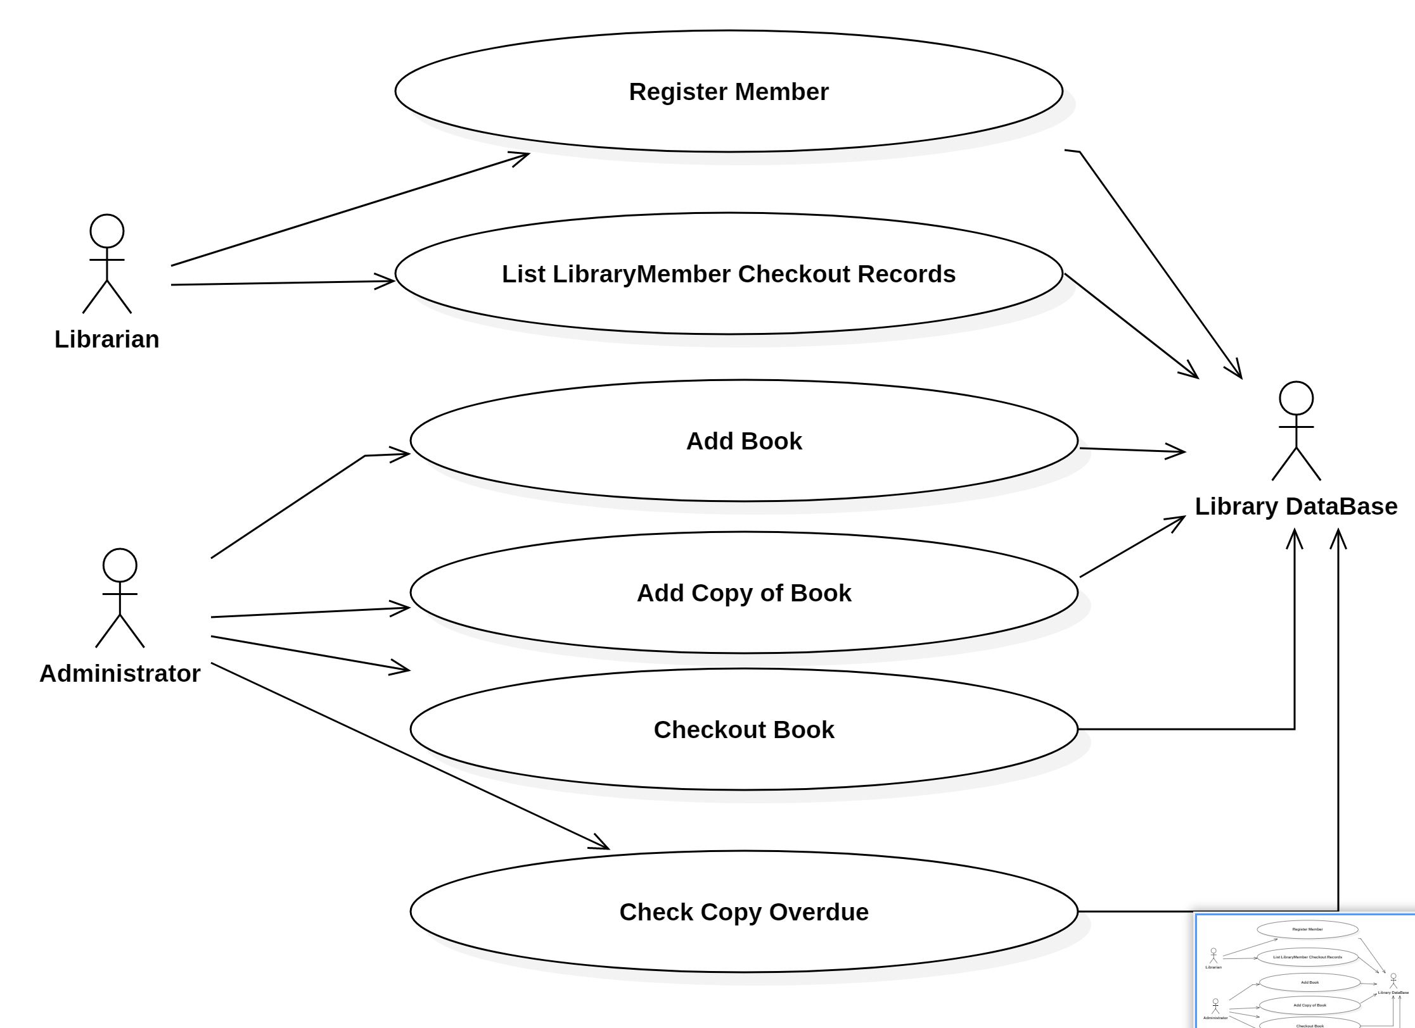
Library System
Use Case Diagram

Slide 4
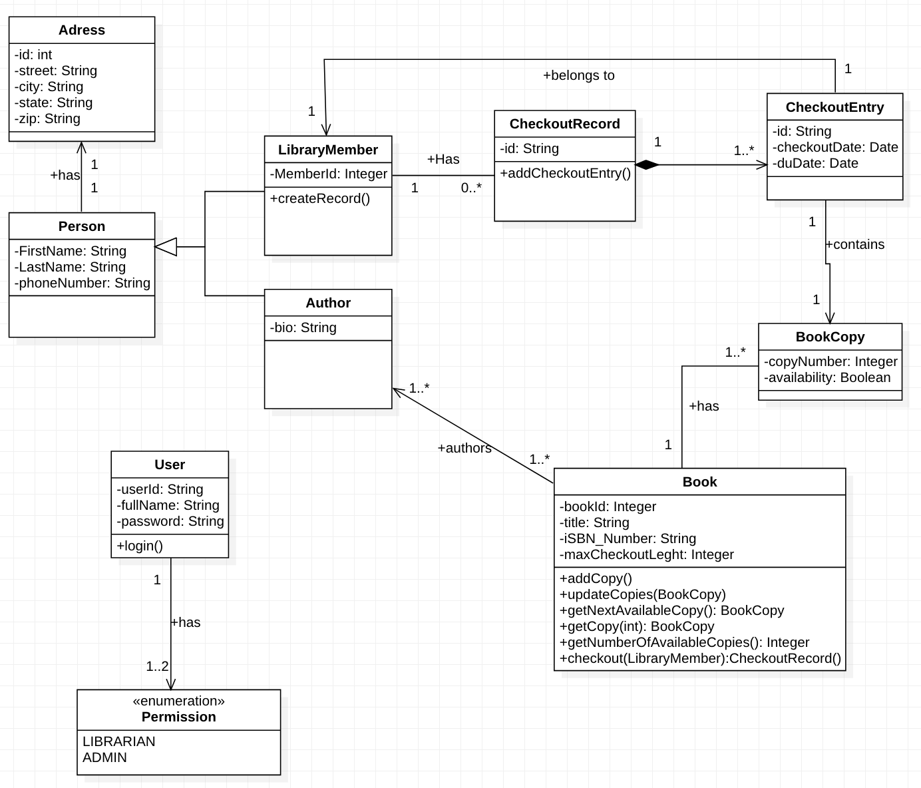
Library System
Class Diagram

Slide 5
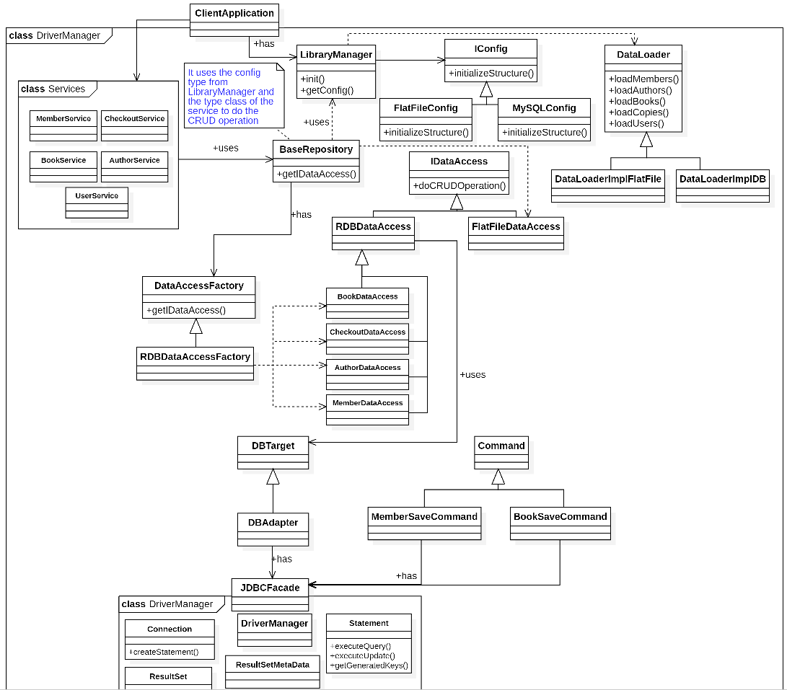
Library Framewor
Class Diagram
Framwork design

Slide 6
Key point
Whatever need to be explain here
Title

