Slide 1
Library Management Framework
By Group 1

Slide 2
Group Members
Emmanuel Cadet (ecades@mum.edu)
Musiliu Adeniyi Bolaji (mabolaji@mum.edu)
Aaron Gezai (agezai@mum.edu)

Slide 3
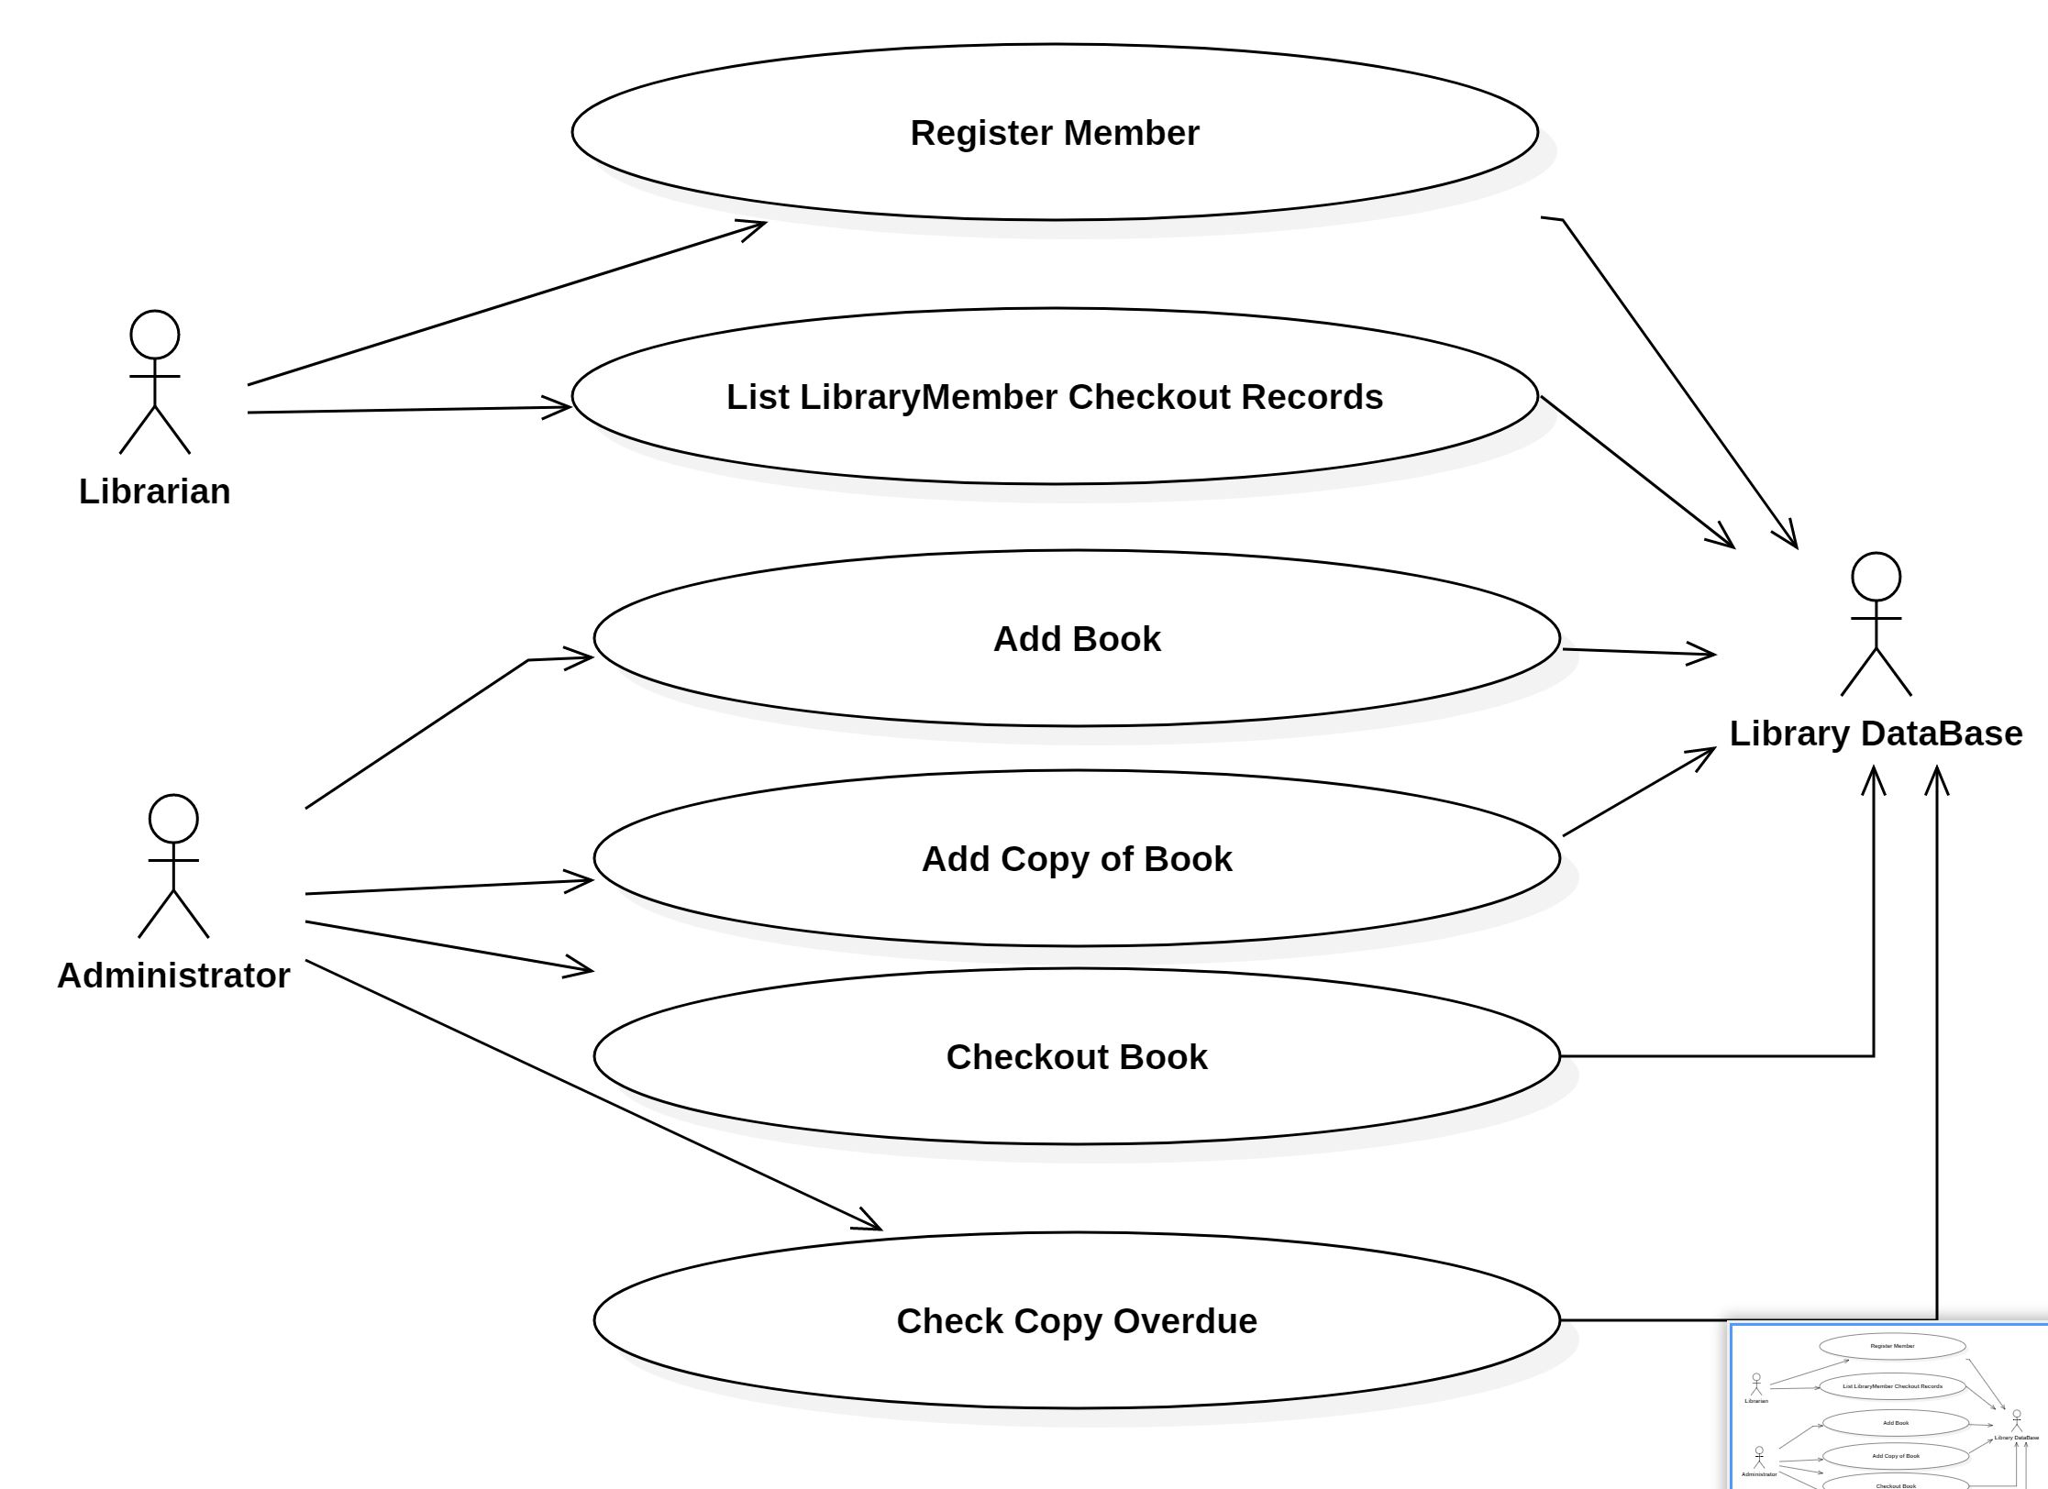
Library System
Use Case Diagram

Slide 4
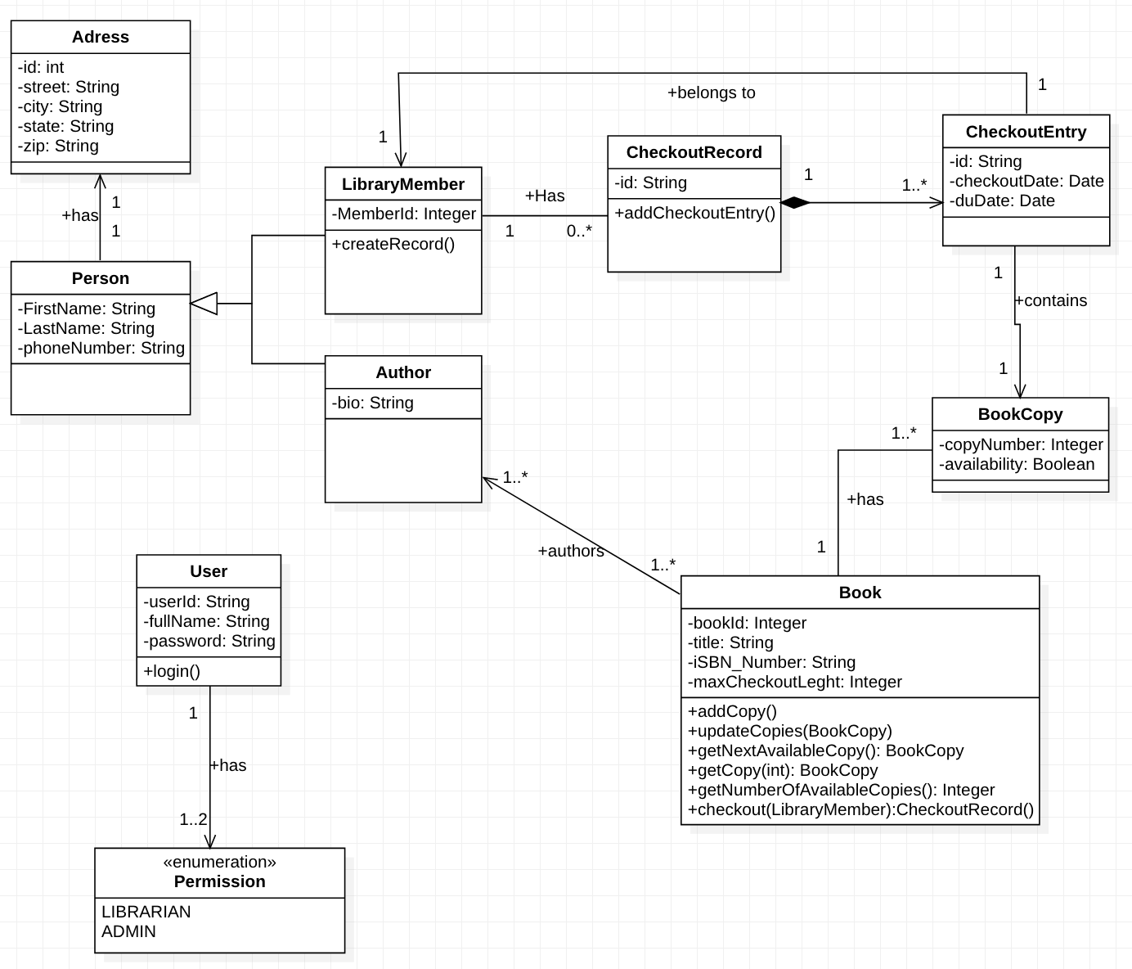
Library System
Class Diagram

Slide 5
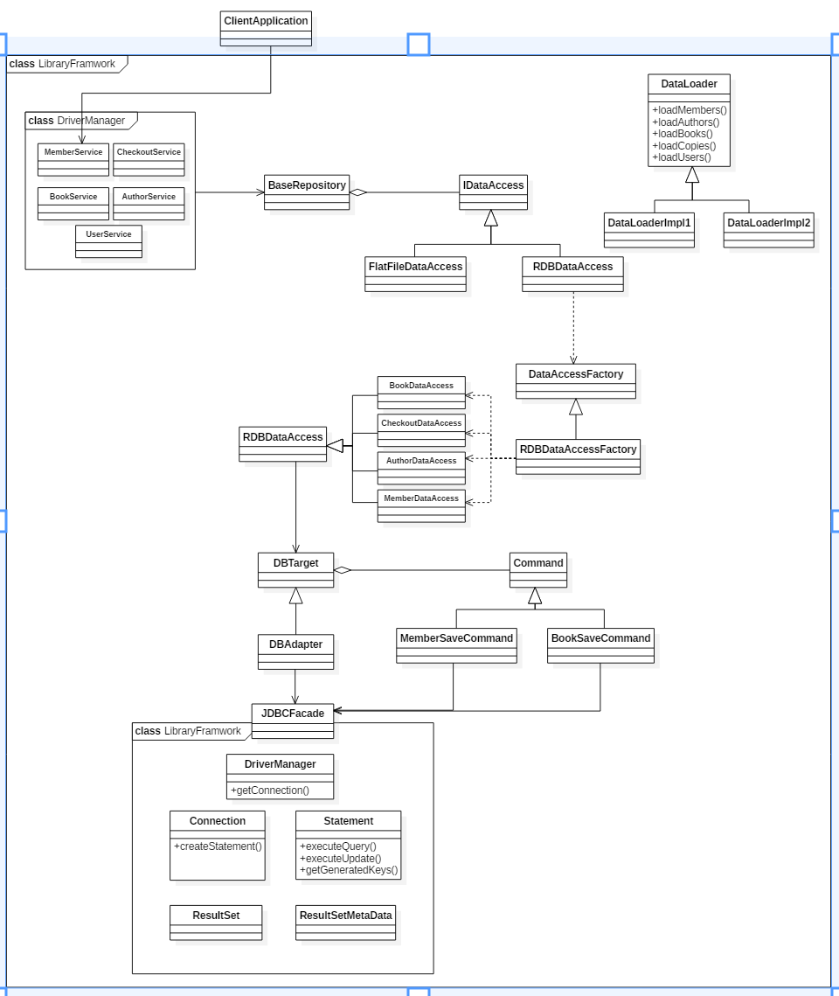
Library Framewor
Class Diagram
Use Case Diagram
Framework design

Slide 6
Key point
The framework is developed to make Library Application development easy for application developers across different platforms.
The framework exposes four major APIs/services:
UserService – to manager users
BookService – to manage books
AuthorService – to manage authors
CheckOutService – to manage book checkouts
The developer can specify which and where to save records : Flat File or Relational Database
The framework makes use of design patterns : Command, Factory Method, Singleton, Façade, Adapter, Strategy and Template patterns

