Slide 1
GROUP ONE
LIBRARY FRAMEWORK
Emmanuel Cadet 610163 ecades@mum.edu
Musiliu Adeniyi Bolaji 610130 mabolaji@mum.edu
Aaron Gezai 109660 agezai@mum.edu

Slide 2

GROUP ONE
Application design
Emmanuel Cadet
Musiliu Adeniyi Bolaji
Aaron Gezai
Framework design
Emmanuel Cadet
Musiliu Adeniyi Bolaji
Aaron Gezai
Coding
Emmanuel Cadet
Musiliu Adenyi Bolaji
Presentation document
Emmanuel Cadet
Musiliu Adeni Bolaji
Aaron Gezai
Tasks assignment

Slide 3

Introduction
In our previous MPP course we have developed a Library Management System and have chosen two client applications to study in order to find duplication areas so that we can put them into a common area which will be core Library Framework services.
We have used several design patterns to abstract all areas that can have general reusable solution and which can have an occurring problem

Slide 4

LIBRARY FRAMEWORK
The framework is developed to make Library Application development easy for application developers across different platforms.
The framework exposes four major APIs/services:
UserService – to manager users
BookService – to manage books
AuthorService – to manage authors
CheckOutService – to manage book checkouts
The developer can specify which and where to save records : Flat File or Relational Database using LibraryManager

Slide 5
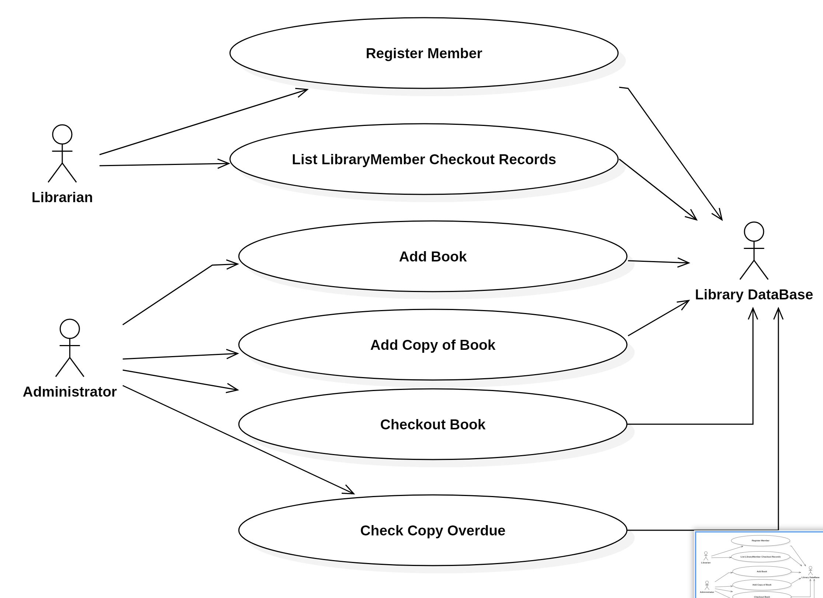
Library Management System Use Case Diagram

Slide 6
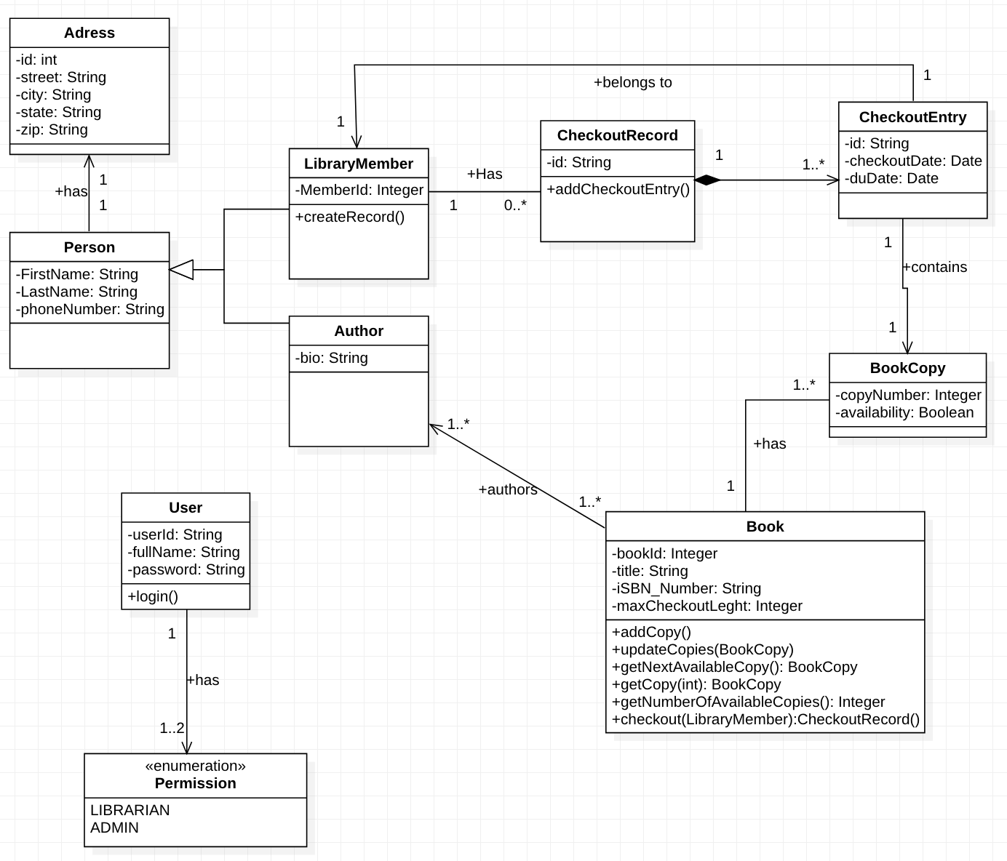
Library Management System Class Diagram
Class Diagram

Slide 7
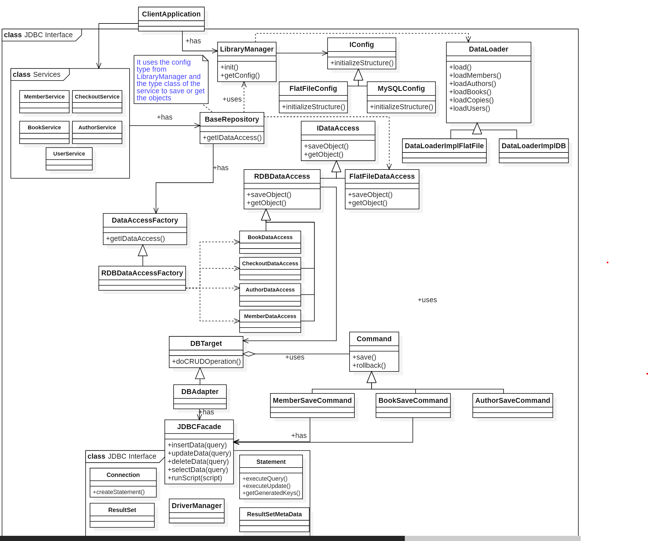
Library Framework Class Diagram
Notes:
THE FRAMEWOR DESIGN PATTERN

Slide 8
PATTERNS USED
Factory Method pattern
Strategy pattern
Façade pattern
Adapter pattern
Command pattern
Template Method Pattern
Singleton pattern

Slide 9
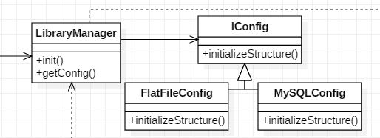
The Strategy Design Pattern
Client applications can use LibraryManager interface to choose either to use Flat file or a MySQL database to store data
We implemented Strategy Pattern to handle the variation of the storage type the client want to use so that it can vary independently

Slide 10
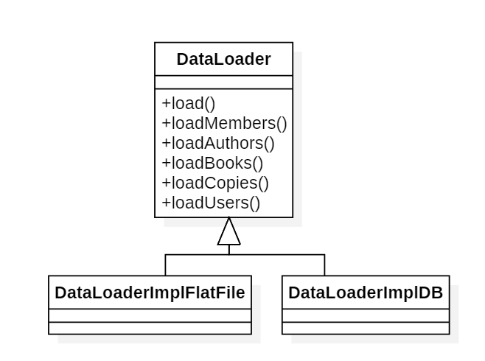
Template Method Design Pattern
We use the load template method to offer the client the possibility to load his personal data by implementing the abstract methods in DataLoader.

Slide 11
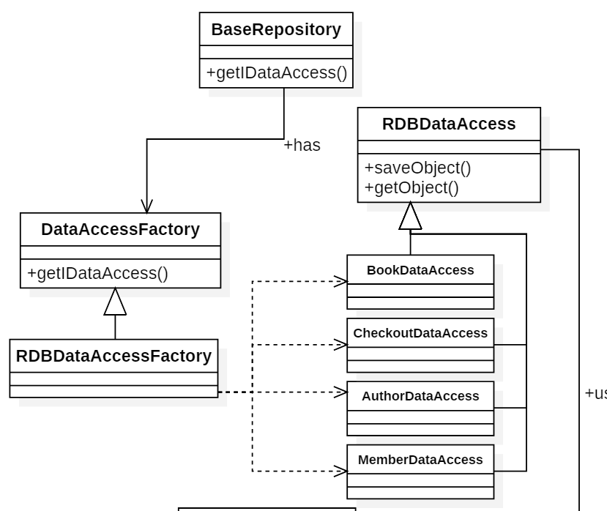
The Factory Design Pattern
We use Factory pattern to create a data access object which may vary dependently on the type of service the BaseRepository interface need to store or get. The subclass RDBDataAccessFactory will decide which Data Access to create base on the type of the object that need to be stored. This solution is both reusable and easy to maintain.

Slide 12
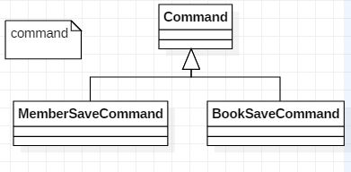
The Command Design pattern.
In our framework, we use this design pattern to handle save request for Members and Books. In fact, when we save a member, we have to save first his address in a separate table and after his information as a person and finally his information as a library member, if one fails at some point, we rollback and eventually log them. Similar process for book.

Slide 13
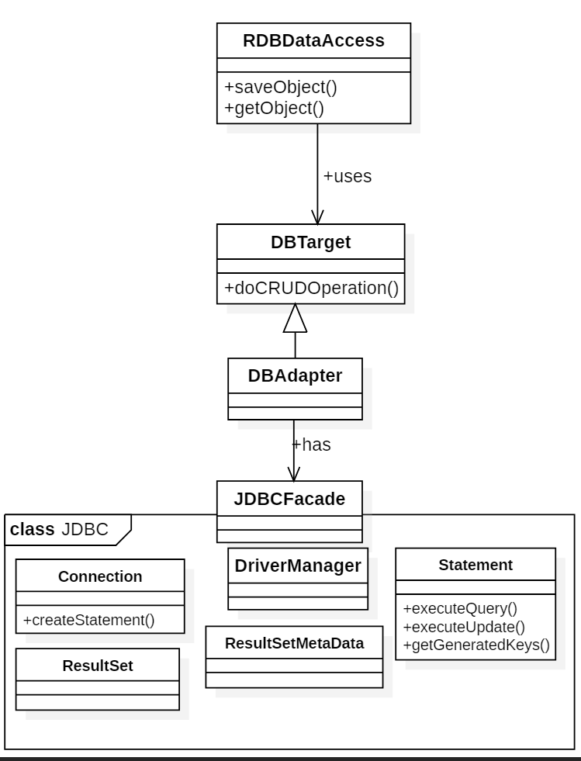
The Adapter Design Pattern
In this area, we use adapter to provide a compatible interface to the RDBDataAccess concreate objects so that it can save the objects in the database properly.
Th adapter is needed here because the JDBCFacade interface only provide interface to send queries to the JDBC system. The Adapter takes the objects and convert the requested operation into a query and use the Façade interface to send it to the database.

Slide 14
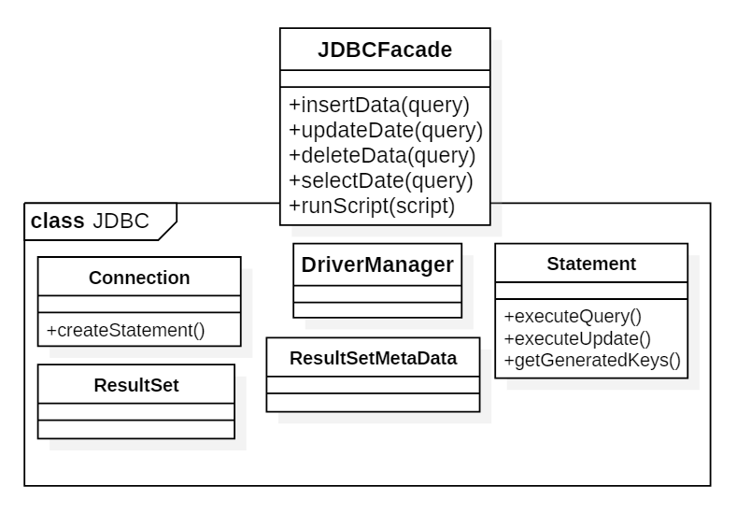
The Façade Design Pattern
The Façade pattern is used to hide all implementation needed to use the JDBC interface. It provides all necessary method to send a query to the database.

Slide 15
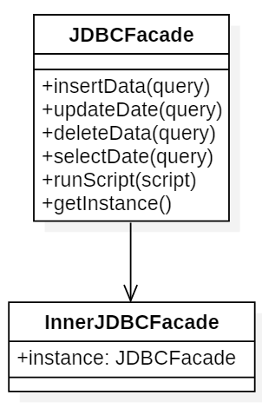
Singleton Design pattern
We use the singleton patter in the JDBCFace to provide a lazy instantiation and thread safe instance of it.
In this solution, the singleton instance is created inside an inner class and the inner class will be loaded only when the first call of the getInstance is made. This guaranty that the instance will be created when needed and as it is a private static instance which is initialized when it was declared it also guaranty thread safety. Also used in two other places.

Slide 16


