Slide 1
width
 |  |  |  | x | x | x | x | x
 |  |  |  | x | x | x | x | x
 |  |  |  | x | x | x | x | x
 |  |  |  | x | x | x | x | x
 |  |  |  | x | x | x | x | x
 | c | s | s | s | s | s | s | s
nr_args
max_sum_size

Slide 2
utež( ang. weight)
 | 7 | 6 | 5 | 4 | 3 | 2 | 1 | 0 |  | h
 |  |  |  | x | x | x | x | x |  | 5
 |  |  |  | x | x | x | x | x
0 |  |  |  | x | x | x | x | x
 |  |  |  | x | x | x | x | x
 |  |  |  | x | x | x | x | x
 |  |  |  | s | s | s | s | s |  | 4
1 |  |  | c | c | c | c | c
 |  |  |  | s | s | s | s | s
 |  |  | c | c | c | c | c
 |  |  | s | s | s | s | s | s |  | 3
2 |  | c | c | c | c | c | c
 |  |  |  | c | c | c | c
3 |  | c | s | s | s | s | s | s |  | 2
 |  | c | c | c | c | c
4 | c | s | s | s | s | s | s | s
stopnja redukcije
višina drevesa
vsota

Slide 3
this_weight
 | 7 | 6 | 5 | 4 | 3 | 2 | 1 | 0
 |  |  |  | x | x | x | x | x
 |  |  |  | x | x | x | x | x
0 |  |  |  | x | x | x | x | x | 5
 |  |  |  | x | x | x | x | x
 |  |  |  | x | x | x | x | x
 |  |  |  | s | s | s | s | s
1 |  |  | c | c | c | c | c |  | 4
 |  |  |  | s | s | s | s | s
 |  |  | c | c | c | c | c
 |  |  | s | s | s | s | s | s
2 |  | c | c | c | c | c | c |  | 3
 |  |  |  | c | c | c | c
3 |  | c | s | s | s | s | s | s
 |  | c | c | c | c | c |  |  | 2
 | c | s | s | s | s | s | s | s
this_lvl
height

Slide 4
 | 7 | 6 | 5 | 4 | 3 | 2 | 1 | 0
 |  |  |  | x | x | x | x | x |  | 5
 |  |  |  | x | x | x | x | x
 |  |  |  | x | x | x | x | x
 |  |  |  | x | x | x | x | x
 |  |  |  | x | x | x | x | x
 |  |  |  | s | s | s | s | s |  | 4
 |  |  | c | c | c | c | c
 |  |  |  | s | s | s | s | s
 |  |  | c | c | c | c | c
 |  |  | s | s | s | s | s | s |  | 3
 |  | c | c | c | c | c | c
 |  |  |  | c | c | c | c
 |  | c | s | s | s | s | s | s |  | 2
 |  | c | c | c | c | c
 | c | s | s | s | s | s | s | s
 | 7 | 6 | 5 | 4 | 3 | 2 | 1 | 0
 | 0 | 0 | 0 | 0 | 0 | 0 | 0 | 0 |  | 5
 |  |  | 2 | 2 | 2 | 2 | 2 | 0 |  | 4
 |  | 1 | 1 | 1 | 1 | 1 | 1 | 0 |  | 3
 |  |  |  |  |  |  |  |  |  | 2

Slide 5
this_weight
5 | 4 | 3 | 2 | 1 | 0
 | x | x | x | x | x
 | x | x | x | x | x
 | x | x | x | x | x
 | x | x | x | x | x
 | x | x | x | x | x
 | s | s | s | s | s
c | c | c | c | c
 | s | s | s | s | s
c | c | c | c | c
this_lvl = 0
this_num_bits = 5 = height
this_lvl = 1
this_weight = 0
prev_lvl_bits = 5
full_adder_sum_bits = 1
half_adder_sum_bits = 1
prev_lvl_carry_rect =0
this_num_bits = 5-1*3-1*2+1+1+0 = 2
this_lvl = 1
this_weight = 1
this_num_bits =
prev_lvl_bits
- 3* full_adder_sum_bits
- 2* half_adder_sum_bits
+ full_adder_sum_bits
+ half_adder_sum_bits
+ prev_lvl_carry_rect
prev_lvl_bits = 5
full_adder_sum_bits = 1
half_adder_sum_bits = 1
prev_lvl_carry_rect =2
this_num_bits = 5-1*3-1*2+1+1+2 = 4

Slide 6
 | 7 | 6 | 5 | 4 | 3 | 2 | 1 | 0
 |  |  |  | x | x | x | x | x |  | 5
 |  |  |  | x | x | x | x | x
 |  |  |  | x | x | x | x | x
 |  |  |  | x | x | x | x | x
 |  |  |  | x | x | x | x | x
 |  |  |  | s | s | s | s | s |  | 4
 |  |  | c | c | c | c | c
 |  |  |  | s | s | s | s | s
 |  |  | c | c | c | c | c
 |  |  | s | s | s | s | s | s |  | 3
 |  | c | c | c | c | c | c
 |  |  |  | c | c | c | c
 |  | c | s | s | s | s | s | s |  | 2
 |  | c | c | c | c | c
 | c | s | s | s | s | s | s | s
stopnja redukcije
(višina drevesa)
vsota

Slide 7
arg_width
 |  |  |  | x | x | x | x | x
 |  |  |  | x | x | x | x | x
 |  |  |  | x | x | x | x | x
 |  |  |  | x | x | x | x | x
 |  |  |  | x | x | x | x | x
 | c | s | s | s | s | s | s | s
0 | 0 | 0 | 0 | x | x | x | x | x
0 | 0 | 0 | 0 | x | x | x | x | x
0 | 0 | 0 | 0 | x | x | x | x | x
0 | 0 | 0 | 0 | x | x | x | x | x
0 | 0 | 0 | 0 | x | x | x | x | x
 | c | s | s | s | s | s | s | s

Slide 8
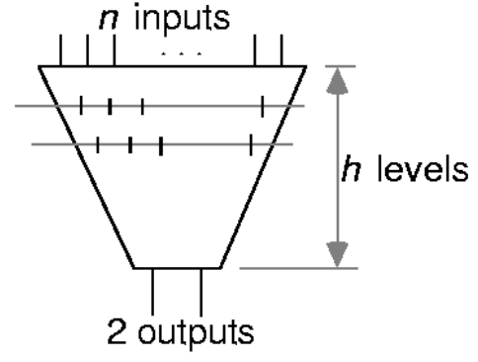
Wallace Tree
h(n) = 1 + h(⎡2n/3⎤)
Ignoring Ceiling Operator Write as: h(n) = 1 + h(2n/3)
Can Get Lower Bound on Tree Height: h(n) ≥ log_{1.5}(n/2)
Equality for n = 2, 3 only

Slide 9
Wallace Tree Height
Can Also Consider n(h)
– Number of Inputs for a Tree of Height h
Recurrence is: n(h) = ⎣3n(h-1)/2⎦
Ignoring Floor Operator Can get Bounds
Lower Bound: n(h) > 2(3/2)^{h-1}
Upper Bound: n(h) < 2(3/2)^{h}
Exact Values for 0 ≤ h ≤ 20 in Table

Slide 10
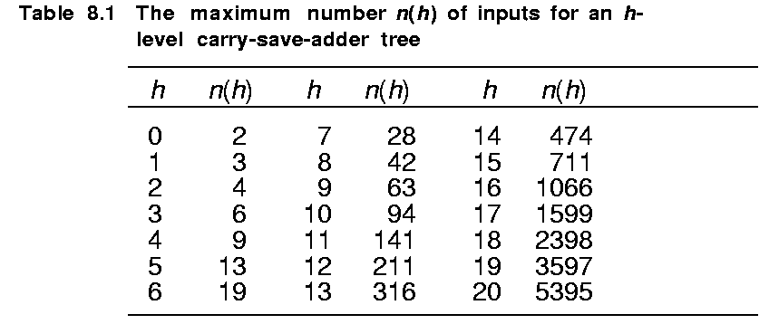
Tree Levels

Slide 11
Wallace Tree Height
Can Also Consider n(h)
– Number of Inputs for a Tree of Height h
Recurrence is: n(h) = ⎣3n(h-1)/2⎦
Ignoring Floor Operator Can get Bounds
Lower Bound: n(h) > 2(3/2)^{h-1}
Upper Bound: n(h) < 2(3/2)^{h}
Exact Values for 0 ≤ h ≤ 20 in Table

Slide 12
10 | 9 |  | 8 | 7 | 6 | 5 | 4 | 3 | 2 | 1 | 0
 |  |  |  | x | x | x | x | x | x | x | x
 |  |  |  | x | x | x | x | x | x | x | x
 |  |  |  | x | x | x | x | x | x | x | x
 |  |  |  | x | x | x | x | x | x | x | x
 |  |  |  | x | x | x | x | x | x | x | x
 |  |  |  | x | x | x | x | x | x | x | x
 |  |  |  | x | x | x | x | x | x | x | x
 |  |  |  | x | x | x | x | x | x | x | x
 |  |  | c | s | s | s | s | s | s | s | s
 |  |  | c | s | s | s | s | s | s | s | s
 |  |  | c | s | s | s | s | s | s | s | s
 |  |  |  | c | c | c | c | c | c | c
 |  |  |  | c | c | c | c | c | c | c
 |  |  |  | c | c | c | c | c | c | c
h=8
h=6

Slide 13
10 | 9 | 8 | 7 | 6 | 5 | 4 | 3 | 2 | 1 | 0
 |  | x | x | x | x | x | x | x | x | x
 |  | x | x | x | x | x | x | x | x | x
 |  | x | x | x | x | x | x | x | x | x
 |  |  | x | x | x | x | x | x | x
 |  |  | x | x | x | x | x | x | x
 |  |  | x | x | x | x | x | x | x
 | c | s | s | s | s | s | s | s | s | s
 |  | c | s | s | s | s | s | s | s
 |  | c | c | c | c | c | c | c | c
 |  |  | c | c | c | c | c | c
h=6
h=4

Slide 14
10 | 9 | 8 | 7 | 6 | 5 | 4 | 3 | 2 | 1 | 0
 | x | x | x | x | x | x | x | x | x | x
 |  | x | x | x | x | x | x | x | x
 |  | x | x | x | x | x | x | x | x
 |  |  | x | x | x | x | x | x
 | x | s | s | s | s | s | s | s | s | s
 | c | c | c | c | c | c | c | c
 |  | x | x | x | x | x | x | x
 | s | s | s | s | s | s | s | s | s | s
c | c | c | c | c | c | c | c
h=4
h=3
h=2

