Slide 1
Genetic Algorithms A Tool for Image Segmentation
報告組員 110321015 陳奕羱
110321018 張簡雲翔

Slide 2
Outline
Introduction
GA Based Algorithm
Experiment & Result

Slide 3
Introduction

Slide 4
Introduction
Task : Image Segmentation
No general methods
High complexity problem
Technique : Genetic Algorithms
Dealing with complex search spaces
Minimum available knowledge

Slide 5
GA Based Algorithm

Slide 6
Flow Chart of GAs
Initial
Population
New
Population
Crossover & Mutation
Image Segmentation
Current
Population
By
Machine
By
Human
Results
Terminate ?
Evaluation
Fitness
of
Population
Segmented
Image

Slide 7
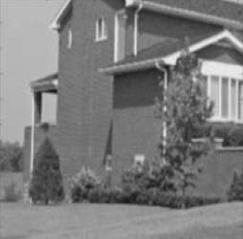
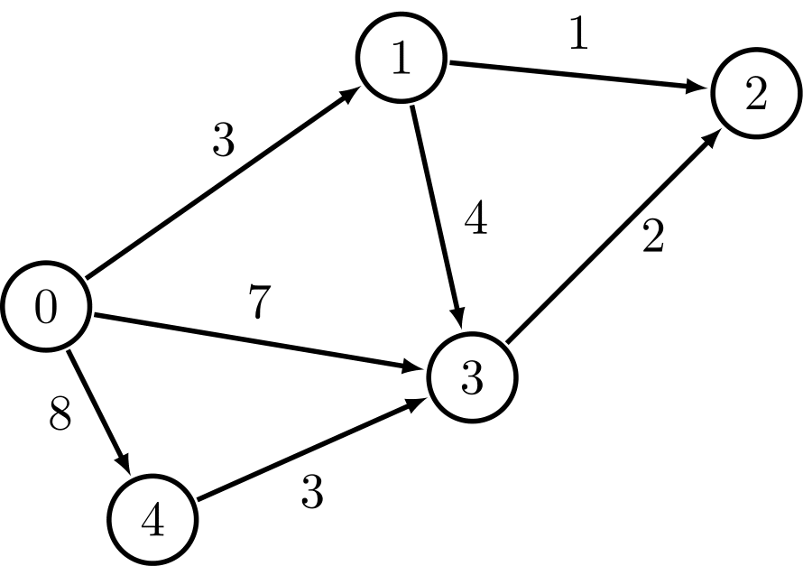
Image Segmentation by Human
Normalization
Distance Function
Grayscale Picture ( M * N * 1 )
Normalized Picture
Weighted Graph

Slide 8
Image Segmentation by Human
S₀
…
S_{K}
Partition
Weighted Graph
Partition

Slide 9
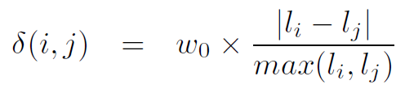
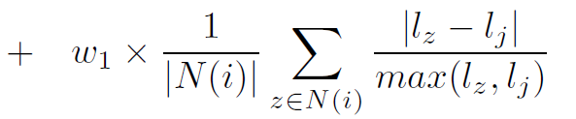
Distance Function
0 <= w₀ , w₁ <= 1
l_{i} is the gray level of pixel i
N(i ) is the neighborhood of pixel i
Similarity between Pixel i, and j
Similarity between Neighborhoods of Pixel i, and j

Slide 10

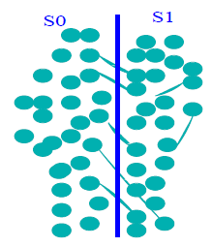
Distance Function
Minimize the distance function

Slide 11

Chromosome Representation
32 Bit Binary String
24 MSB identifies pixel position
8 LSB identifies the pixel label of the cluster to which the pixel belongs
Pixel Position
Pixel Label

Slide 12
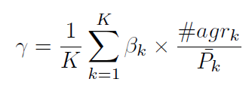

Fitness Function
#agrk is the largest pixel intersection between Seg_{k} and S
Seg_{k} denotes the k ^{th} segment retrieved by human
S denotes the k ^{th} segment retrieved by machine

Slide 13
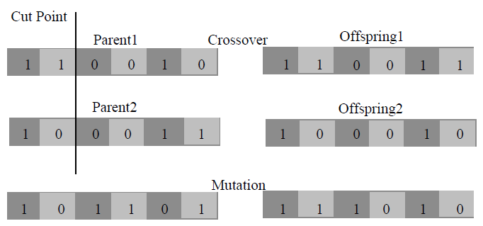
Crossover & Mutation
Single point crossover with probability P_{c}
Bit mutation with probability P_{m}

Slide 14
Selection Process
GAs population with M * N numbers of chromosomes
P(0) is initialized with random number
New population P(t + 1) is determined with better fitness
t is the iteration number

Slide 15
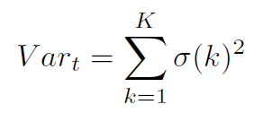

Termination Condition
σ(k )² is the grey-level variance of region k
ε is the small defined value

Slide 16
GA Based Image Segmentation Algorithm
∀ f ∈ F , if δ( f , l_{Sk} ) = min{ δ( f , g_{Si} ), i = 1 , 2 , . . . , K_{max} }
then
Crossover & Mutation
Generate P(t + 1)
assign ( f , S_{k} )
update ({ μ_{k} , σ_{k} })
end
Increase iteration
repeat until ( | Var_{t + 1} − Var_{t} | <= ε )

Slide 17
Experiment & Result

Slide 18
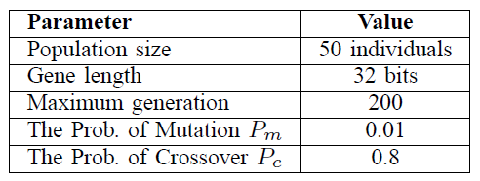
Tuning Parameter

Slide 19
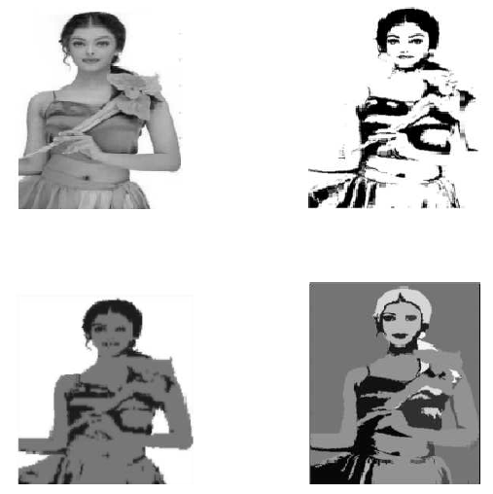
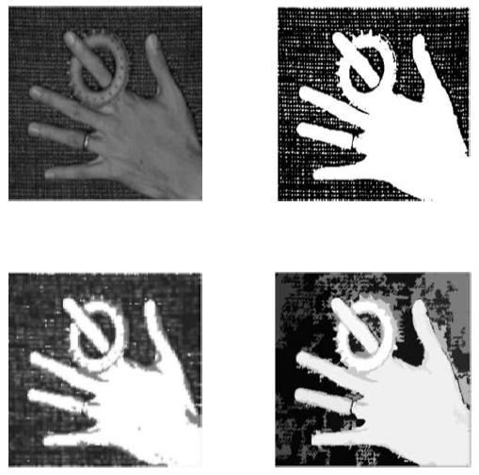
Result
Origin
Global
Threshold
Origin
Global
Threshold
K-Means
GAs
K-Means
GAs
Aish
Hand

Slide 20
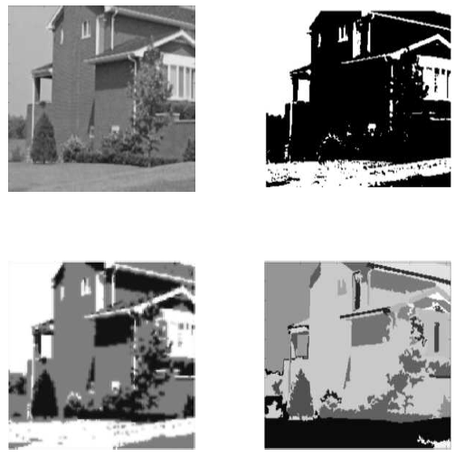
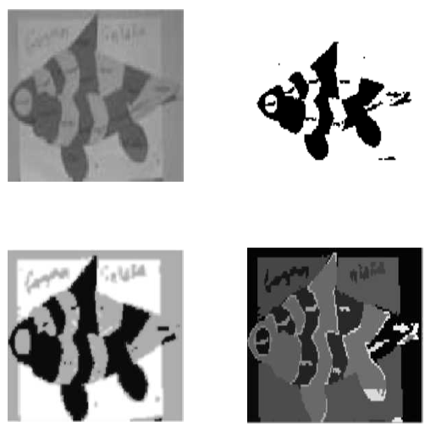
Result
Origin
Global
Threshold
Origin
Global
Threshold
K-Means
GAs
K-Means
GAs
House
Fish

Slide 21
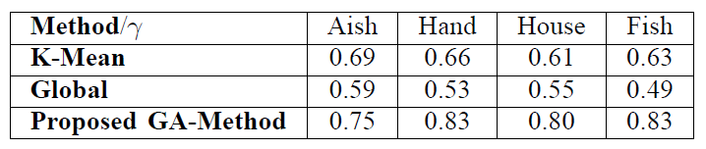
Result

Slide 22
Thanks

