Slide 1
Quantum Computing and U.S. Cybersecurity: A Case Study of the Breaking of RSA and Plan for Cryptographic Algorithm Transition
Helena Holland
Undergraduate Thesis Defense
University of Nebraska-Lincoln
Department of Mathematics
February 29, 2024

Slide 2
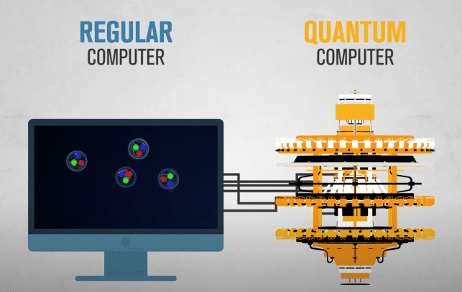

Slide 3
Overview
Research Question: How might quantum computing technology impact American cybersecurity?
Background
Research Methodology
Case Study: RSA, Shor’s algorithm, American Intelligence Community’s response & plan for algorithm transition
Discussion of Results & Conclusion
Q&A

Slide 4
Background
Quantum Computing
Public-key Cryptography
The Quantum Threat to Cybersecurity

Slide 5
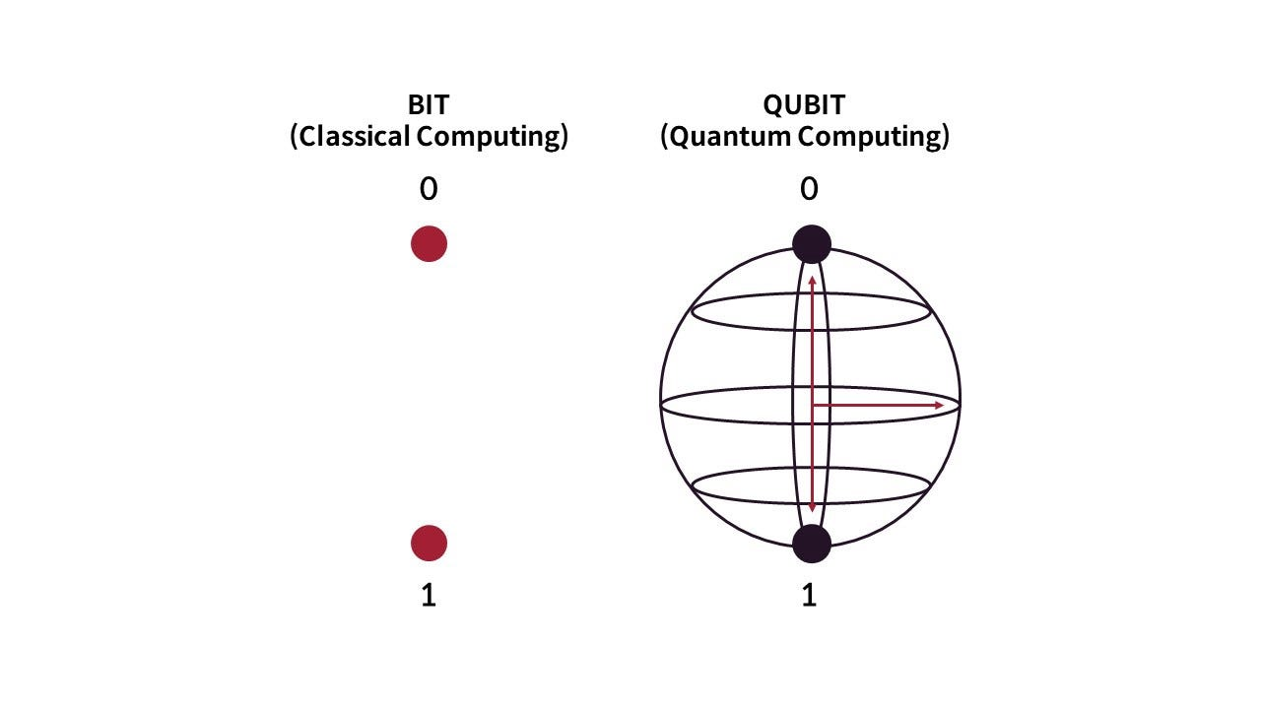

How Does a Quantum Computer Work?
Computation: input information $→$ manipulate information $→$ output result
Quantum computation: a paradigm shift, but a purely theoretical device
Classical Bits vs Quantum Bits (Qubits)
Key quantum mechanical concepts:
superposition
encoding $2^{n}$ vs n states in an n-qubit system
measurement
entanglement
N = 3
100
110
111
101
001
011
010
000

Slide 6

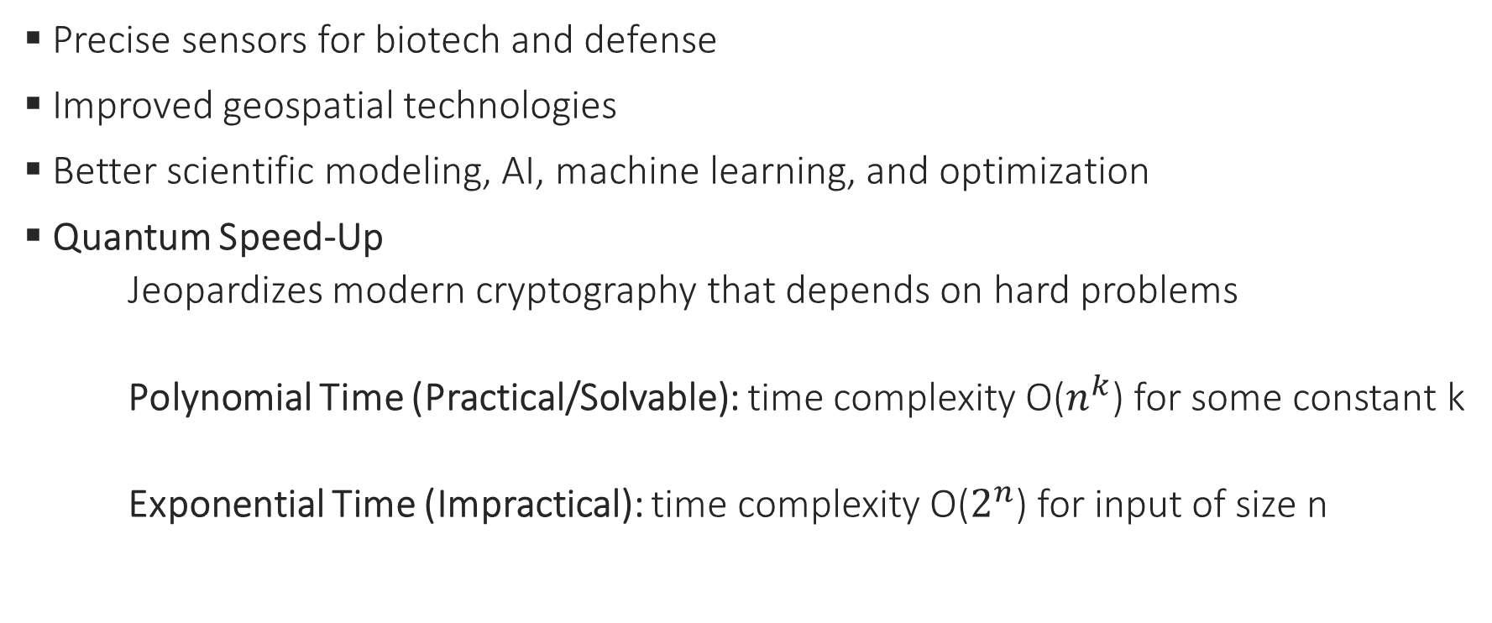
Quantum Possibilities
Precise sensors for biotech and defense
Improved geospatial technologies
Better scientific modeling, AI, machine learning, and optimization
Quantum Speed-Up
Jeopardizes modern cryptography that depends on hard problems
Polynomial Time (Practical/Solvable): time complexity O($n^{k}$) for some constant k
Exponential Time (Impractical): time complexity O($2^{n}$) for input of size n

Slide 7
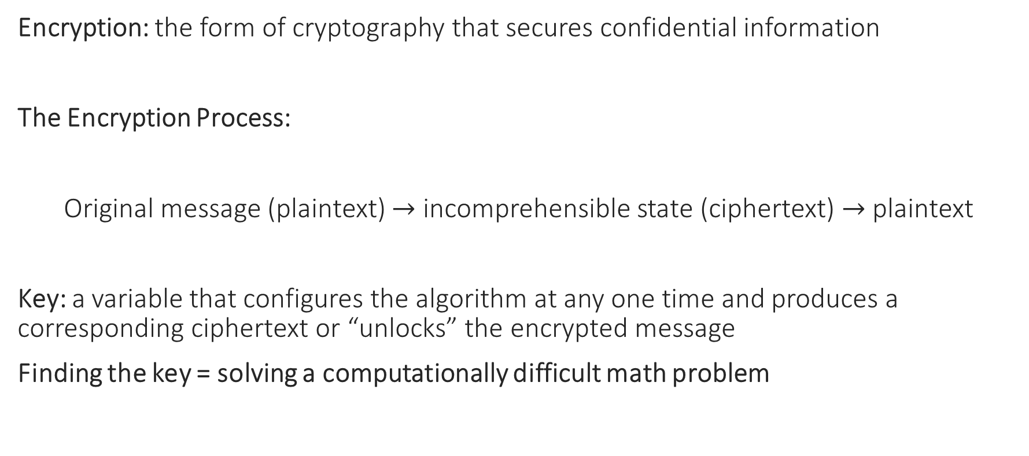
Modern Cryptography - Encryption
Encryption: the form of cryptography that secures confidential information
The Encryption Process:
Original message (plaintext) $→$ incomprehensible state (ciphertext) $→$ plaintext
Key: a variable that configures the algorithm at any one time and produces a corresponding ciphertext or “unlocks” the encrypted message
Finding the key = solving a computationally difficult math problem
Encryption key
Decryption key

Slide 8

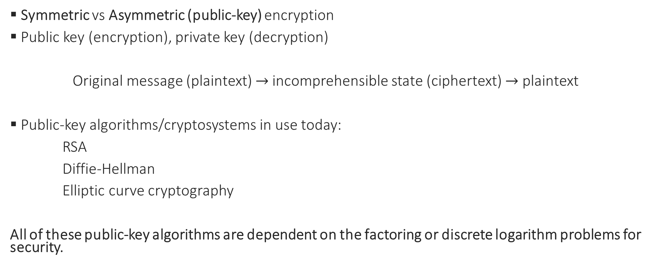
Public-key Cryptography
Symmetric vs Asymmetric (public-key) encryption
Public key (encryption), private key (decryption)
Original message (plaintext) $→$ incomprehensible state (ciphertext) $→$ plaintext
Public-key algorithms/cryptosystems in use today:
RSA
Diffie-Hellman
Elliptic curve cryptography
All of these public-key algorithms are dependent on the factoring or discrete logarithm problems for security.
Public key
Private key

Slide 9

The Quantum Threat to Cybersecurity
A quantum computer can solve both the factoring and discrete logarithm problems in polynomial time using Shor’s algorithm (1994), rendering all forms of public-key cryptography vulnerable as soon as a quantum computer is built.

Slide 10
Research Methodology
Research Question: How might quantum computing technology impact American cybersecurity?
Case Study Method:
RSA & Shor’s Algorithm
The plan for migration to post-quantum cryptography
- Quantum-Resistant Algorithm Standardization Process
- National Security Memorandum 10 (NSM – 10)
- SWOT Analysis of Algorithm Transition Plan

Slide 11
Case Study
RSA and Shor’s Algorithm
The American Intelligence Community’s Response

Slide 12
RSA
Developed in 1977 by cryptologists Rivest, Shamir, and Adleman (RSA)
Secures online financial transactions, web browsers, email services, VPNs
RSA relies on the factoring problem
Find odd prime numbers p and q such that a large number n = pq
Cracking RSA = factoring a large number n into two primes (possible for a quantum computer)

Slide 13
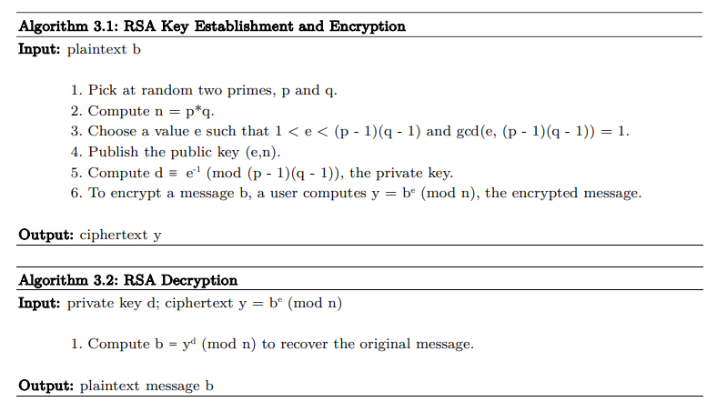
RSA

Slide 14
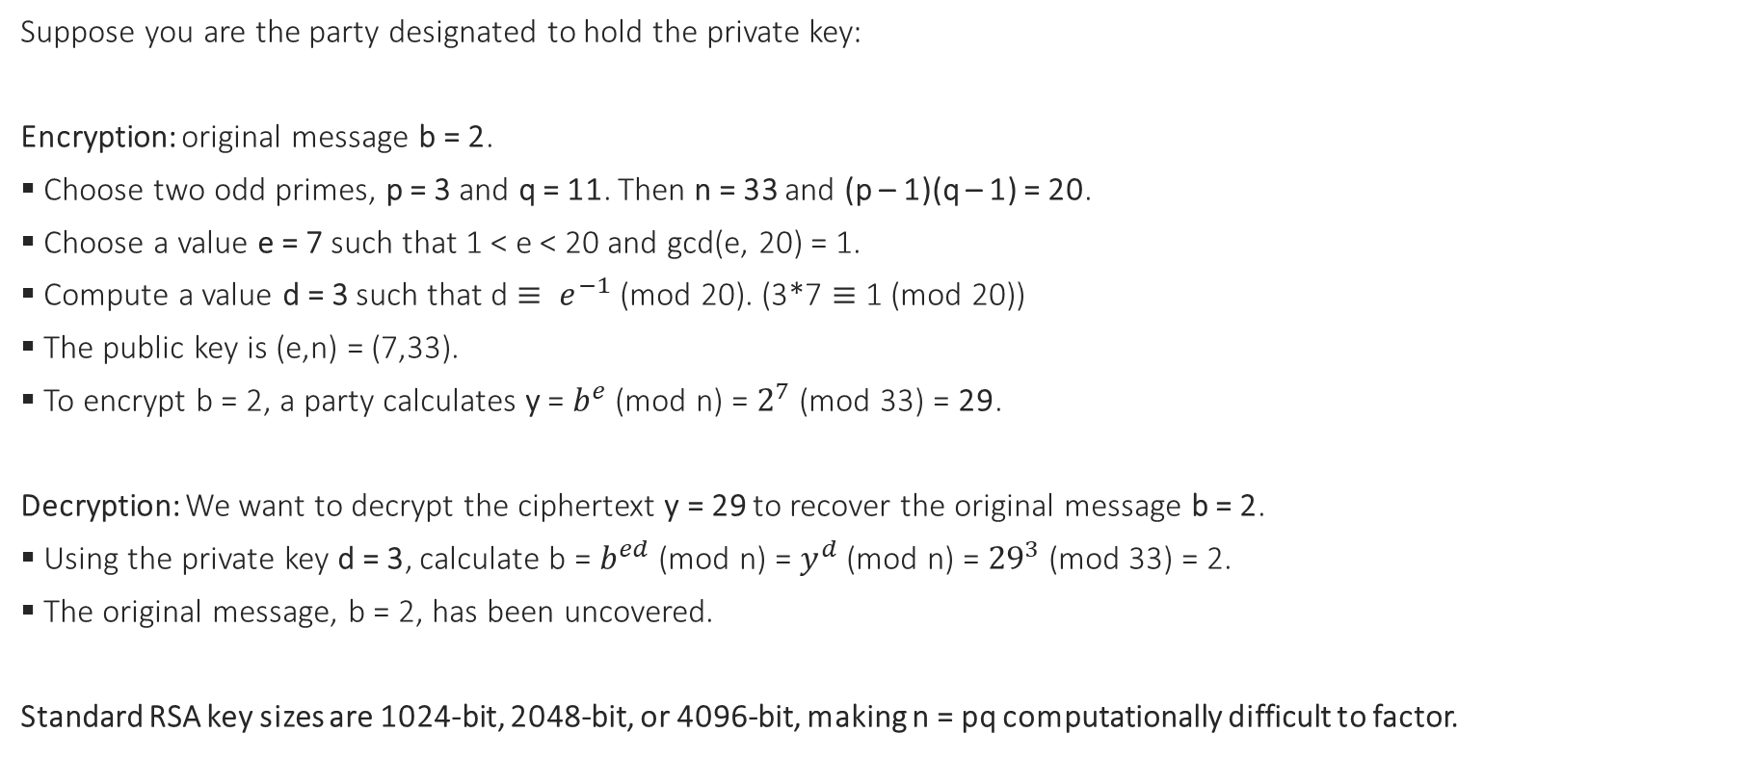
RSA Algorithm Example: n = 3*11
Suppose you are the party designated to hold the private key:
Encryption: original message b = 2.
Choose two odd primes, p = 3 and q = 11. Then n = 33 and (p – 1)(q – 1) = 20.
Choose a value e = 7 such that 1 < e < 20 and gcd(e, 20) = 1.
Compute a value d = 3 such that d $≡ e^{−1}$ (mod 20). (3*7 $≡$ 1 (mod 20))
The public key is (e,n) = (7,33).
To encrypt b = 2, a party calculates y = $b^{e}$ (mod n) = $2^{7}$ (mod 33) = 29.
Decryption: We want to decrypt the ciphertext y = 29 to recover the original message b = 2.
Using the private key d = 3, calculate b = $b^{ed}$ (mod n) = $y^{d}$ (mod n) = ${29}^{3}$ (mod 33) = 2.
The original message, b = 2, has been uncovered.
Standard RSA key sizes are 1024-bit, 2048-bit, or 4096-bit, making n = pq computationally difficult to factor.

Slide 15
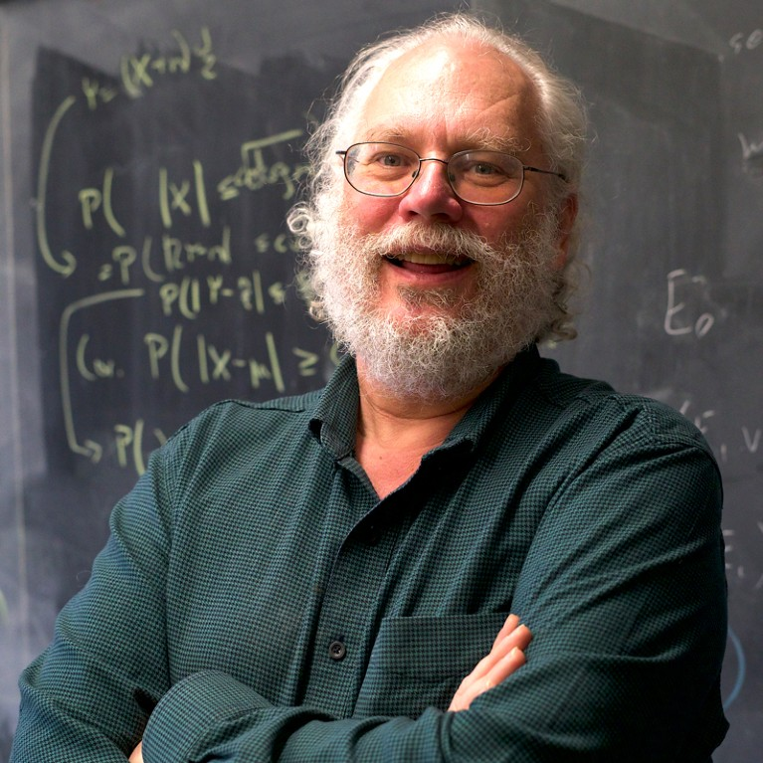
Shor’s Algorithm
A crowning achievement of the last century, developed by AT&T researcher Peter Shor in his 1994 paper “Polynomial –Time Algorithms for Prime Factorization and Discrete Logarithms on a Quantum Computer”

Slide 16
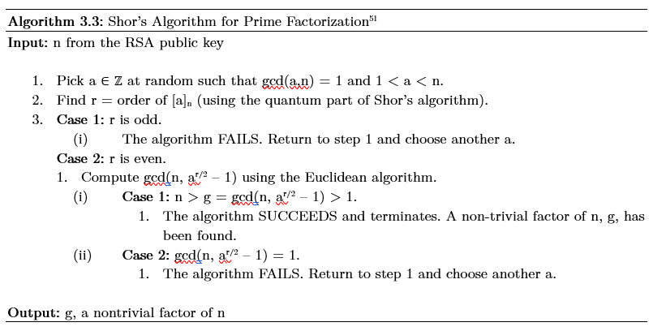
Shor’s Algorithm for Prime Factorization
A post-processing shortcut after finding the order r

Slide 17
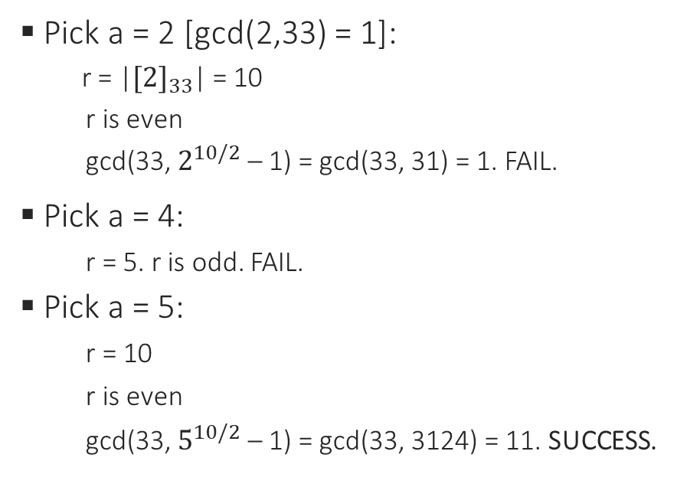
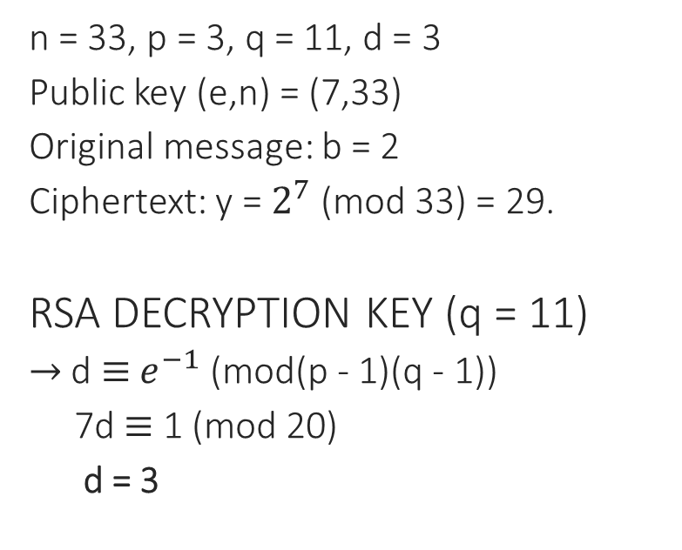
Example: RSA and Shor’s Algorithm
RSA Encryption
Shor’s Algorithm
n = 33, p = 3, q = 11, d = 3
Public key (e,n) = (7,33)
Original message: b = 2
Ciphertext: y = $2^{7}$ (mod 33) = 29.
RSA DECRYPTION KEY (q = 11)
$→$ d $≡$ $e^{−1}$ (mod(p - 1)(q - 1))
7d $≡$ 1 (mod 20)
d = 3
Pick a = 2 [gcd(2,33) = 1]:
r = |${[2]}_{33}$| = 10
r is even
gcd(33, $2^{10/2}$ – 1) = gcd(33, 31) = 1. FAIL.
Pick a = 4:
r = 5. r is odd. FAIL.
Pick a = 5:
r = 10
r is even
gcd(33, $5^{10/2}$ – 1) = gcd(33, 3124) = 11. SUCCESS.

Slide 18


The U.S. IC’s Response
The NSA officially called for a transition to quantum-resistant cryptography in 2015.
Quantum-resistant algorithm development and standardization
The National Institute of Standards and Technology (NIST)
Executing a successful transition project across national systems
NSM-10
Goal = transition national security systems and critical infrastructures by 2035

Slide 19
Quantum-Resistant Algorithm Standardization
“Solicit, evaluate, and standardize” potential replacement algorithm designs & software implementations
2015-2022: Three rounds of competition for selected algorithms
Standardization is ongoing
Algorithm evaluation criteria:
security (algorithm diversity)
cost
performance
implementation characteristics

Slide 20
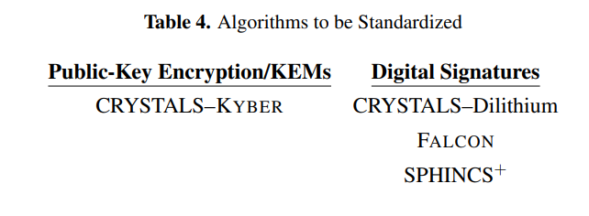
The First Set of Quantum-Resistant Algorithms Selected for Standardization (July 2022)

Slide 21
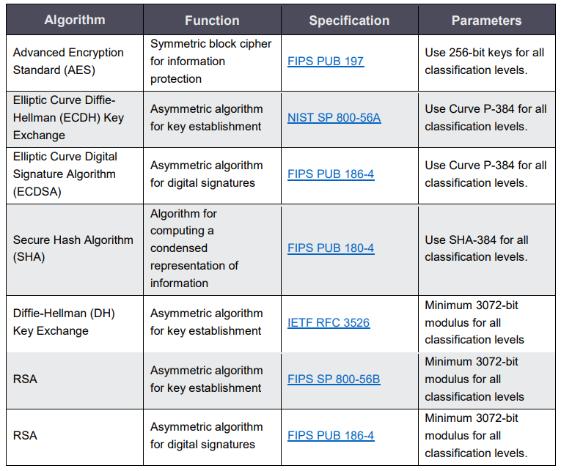
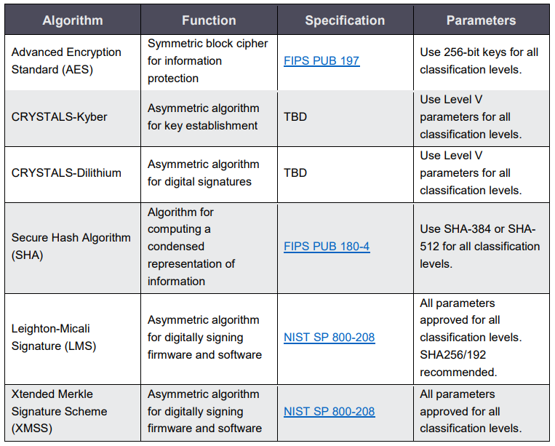
CNSA 1.0
vs
CNSA 2.0

Slide 22

National Security Memorandum 10 (NSM-10)
The Biden administration’s plans for “promoting United States leadership in quantum computing while mitigating risks to vulnerable cryptographic systems”
Published in May 2022 in anticipation of NIST’s upcoming set of standards with the goal of “mitigating as much of the quantum risk as is feasible by 2035”
Two main emphases:
Cryptographic agility (crypto-agility)
Collaboration between government, academia, industry, and foreign allies

Slide 23
SWOT Analysis of Algorithm Transition Plan
STRENGTHS | WEAKNESSES | OPPORTUNITIES | THREATS
Crypto-agility emphasis | Uncertain timing of standards and execution | Facilitate future adaptations (crypto-agility) | Adversary plans to steal vulnerable, encrypted data before re-processing
QIS R&D | Diverse infrastructures require individualized solutions | Increased QIS awareness | Large-scale disruption
Ongoing algorithm standardization | Minimal records of cryptography use/function | Organization of cryptography use/function and security standards | Negatively affecting system security or business functions
Collaboration across domains | Vulnerable to stealing encrypted data before re-processing | Stronger relationships between government, industry, standards bodies | U.S. solution export risks

Slide 24
Discussion
Research Question: How might quantum computing technology impact American cybersecurity?
Key Threats to Cybersecurity
Key Opportunities for Cybersecurity

Slide 25
Quantum Threats to Cybersecurity
DIRECT | INDIRECT | CONSEQUENCE
The destruction of RSA and public-key cryptography | Post-quantum migration entails large-scale disruption that may weaken security during the transition process (likely to continue) | Failure to transition would undermine military and civilian communications, critical control systems, online financial transactions
 | Incentivizes the stealing of U.S. solutions and vulnerable, encrypted information before re-processing | Motivates system attacks, adversary exploitation of information, decreased competition within industry
 | Losing the quantum race

Slide 26
Quantum Opportunities for Cybersecurity
DIRECT | INDIRECT | CONSEQUENCE
Extremely secure encryption and better system performance through QIS | The process of transitioning towards quantum-resistant cryptography forces the organization of cyberspace | More efficient cryptographic transitions in the future
 | Increased crypto-agility, automation, and system security going forward | Organization, documentation, and automation strengthen cybersecurity
 | NSM-10 mandates may lead to QIS advancement through government, academia, and industry partnerships | Advancement in QIS and cryptography

Slide 27
Conclusion
The impact of quantum computing depends largely on the success of the transition project but will make obsolete all forms of currently-employed public-key cryptography and introduce large-scale change and disruption across American digital systems.
Strengths and weaknesses of the case study method
Topics for further research
Research contribution

