Slide 1
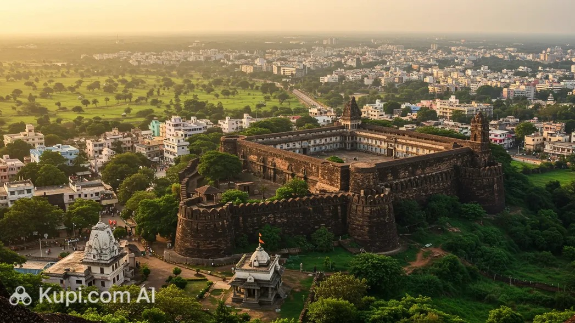
BELAGAVI
Where history meets
nature, culture & progress
A visual story of North Karnataka’s living city
12th-century fort heritage • 52 m waterfall • diverse culture
KARNATAKA • INDIA
01 / 15

Slide 2
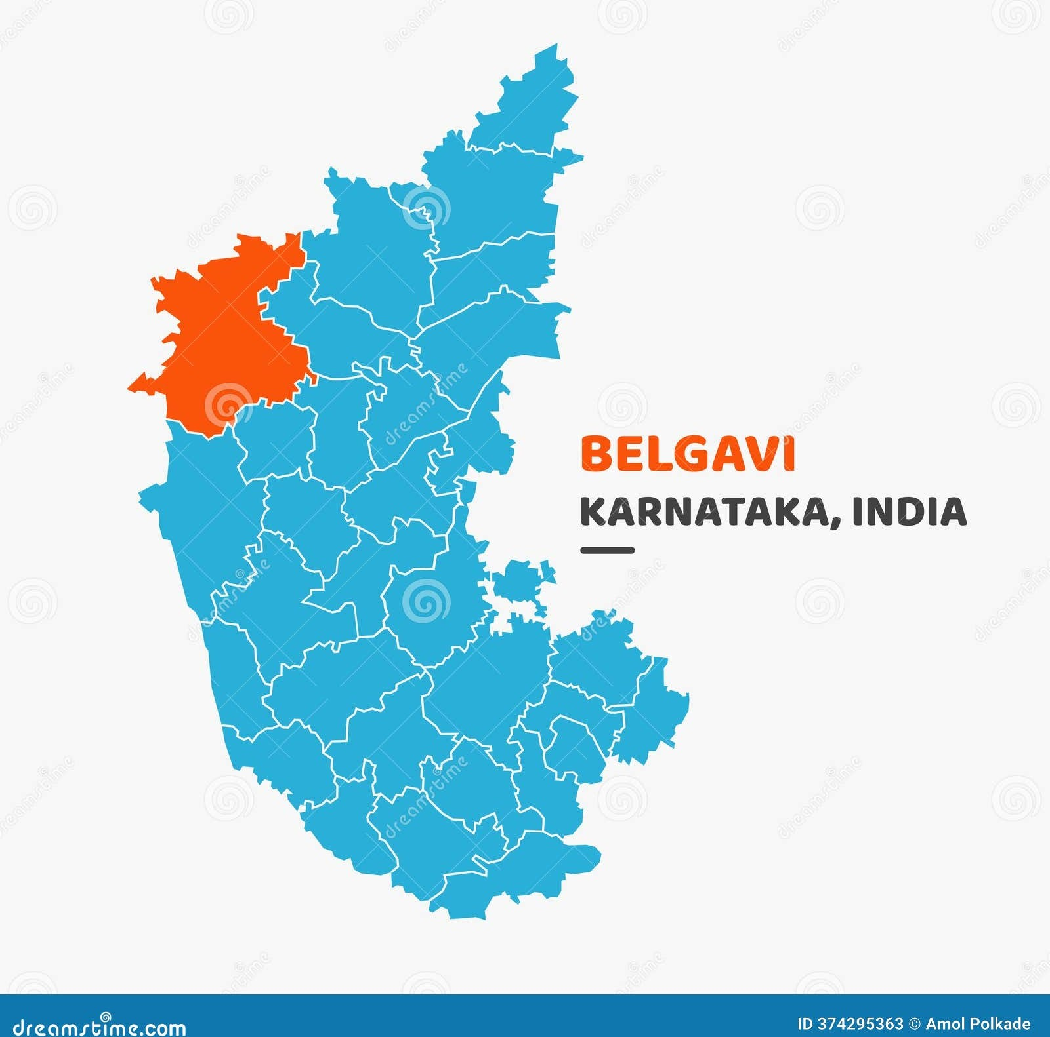
02 • LOCATION
A city at a crossroads
Its position between Karnataka, Maharashtra and Goa helps shape a layered cultural identity.
KARNATAKA
Kannada roots & North Karnataka traditions
MAHARASHTRA
Strong Marathi cultural influence
GOA
Goan influence through the wider regional corridor
A city where languages, food, trade and everyday life reflect multiple regional influences.
The result
BELAGAVI • STORY OF A LIVING CITY
02 / 15

Slide 3
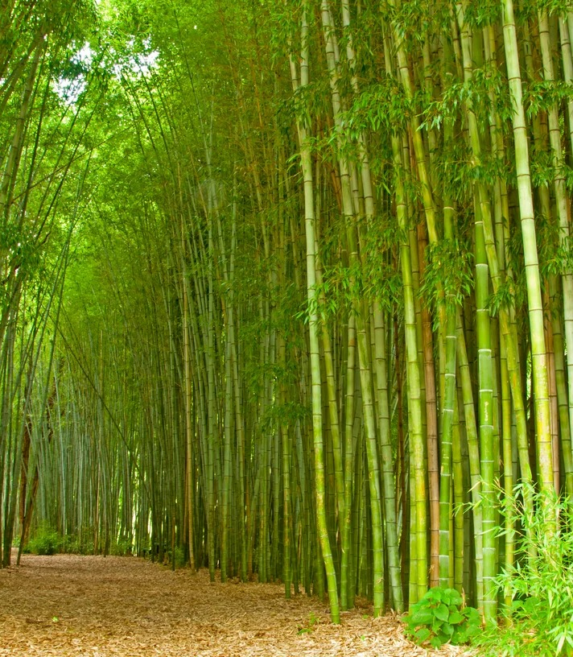
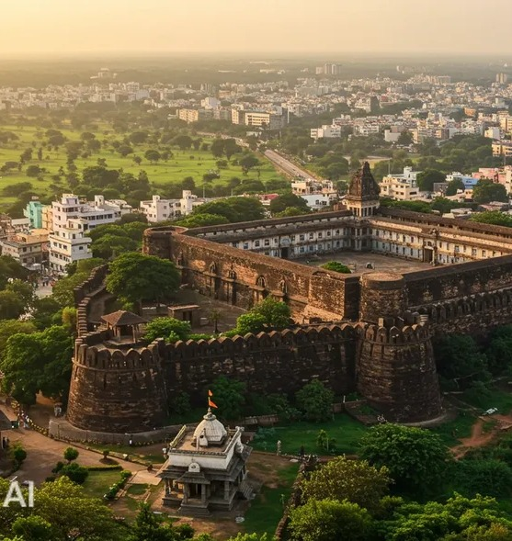
03 • ORIGINS
From Venugrama to Belagavi
The old name connects the place with bamboo and a long historical past.
VENUGRAMA
Venu = Bamboo
Grama = Village
Historical references cited in the original presentation trace the region’s antiquity to around the 2nd century AD.
A name that hints at the landscape that shaped early settlement.
VENUGRAMA
FORT CITY
“Bamboo village”
Heritage at the heart of Belagavi
BELAGAVI • STORY OF A LIVING CITY
03 / 15

Slide 4
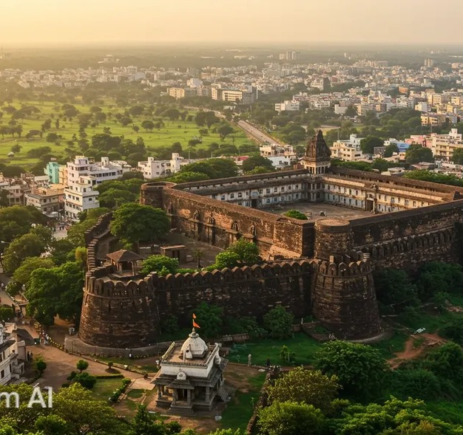
04 • HISTORY
The fort that remembers
Belagavi Fort brings together layers of Deccan history, architecture and faith.
12th century
Built by the Ratta rulers
• Later rulers added to and modified the fort over time.
• Temples and mosques within the fort reflect the region’s layered heritage.
• Safa Masjid is noted for its Deccan and Indo-Saracenic architectural features.
• Kamala Basti, built in 1204 in late Chalukyan style, adds a Jain architectural layer.
HERITAGE • ARCHITECTURE • COEXISTENCE
BELAGAVI • STORY OF A LIVING CITY
04 / 15

Slide 5
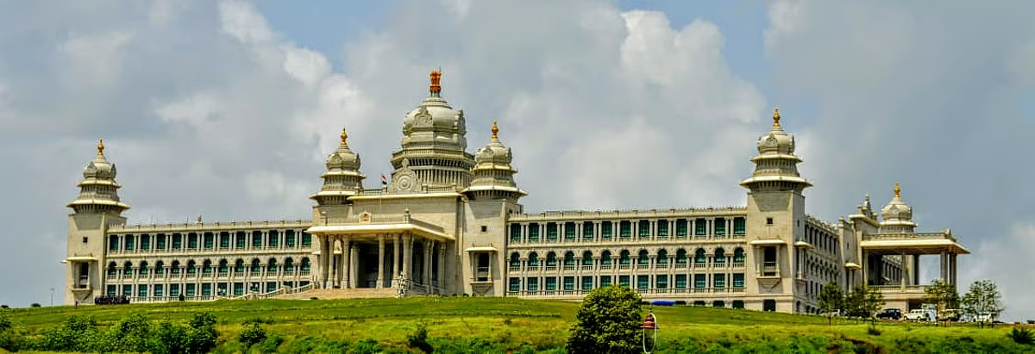
05 • LANDMARK & GOVERNANCE
Suvarna Vidhana Soudha
WHY IT MATTERS
A landmark of democracy in North Karnataka
01
A second legislative venue
.
Brings important state legislative proceedings to Belagavi. it serves as an important venue for sessions of the Karnataka Legislature, including its winter session.
02
A symbol of Karnataka
Commemorates 50 years since the formation of Karnataka in 1956.
03
A striking landmark
LOCATION
INAUGURATED
PURPOSE
Built by the Government of Karnataka to mark the golden jubilee of the state’s formation
Belagavi, Karnataka
11 October 2012
Legislative sessions & meetings
Suvarna Vidhana Soudha connects Belagavi’s identity with the democratic life of Karnataka.
BELAGAVI • STORY OF A LIVING CITY
16/16

Slide 6
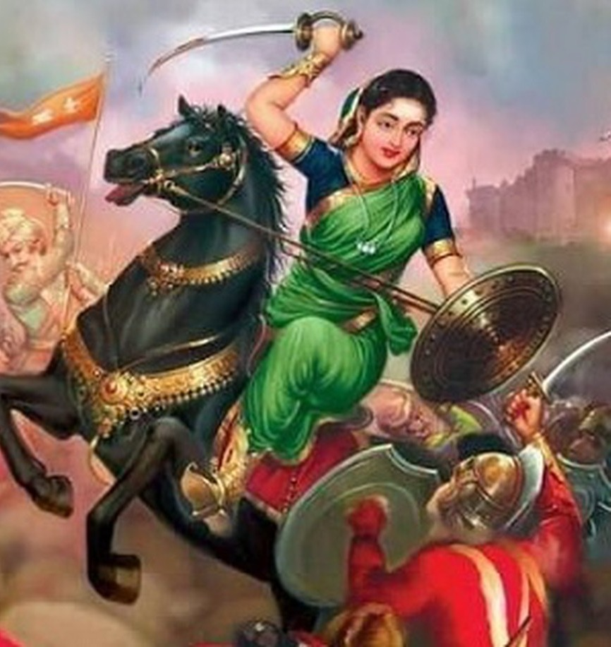
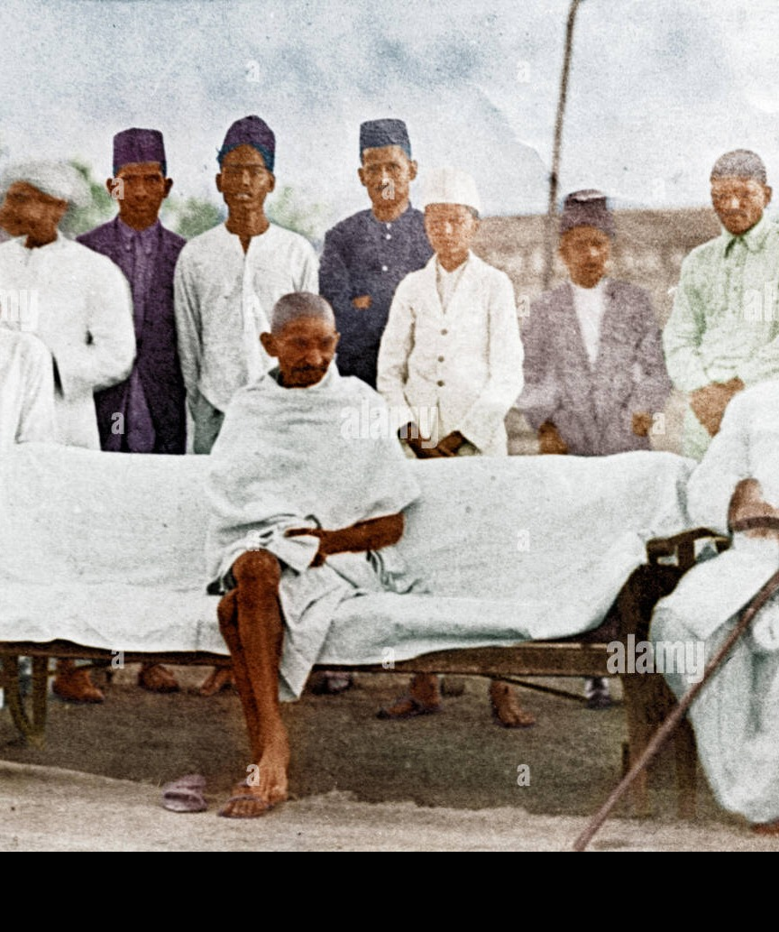
06 • FREEDOM
A city that fought for freedom
Belagavi district carries stories of resistance, leadership and India’s national movement.
39th INC SESSION
Belagavi hosted the 39th session of the Indian National Congress in 1924, presided over by Mahatma Gandhi.
COURAGE
RESISTANCE
NATIONAL MOVEMENT
KITTUR RANI CHENNAMMA
1924
A symbol of resistance
Indian National Congress session
BELAGAVI • STORY OF A LIVING CITY
05 / 15

Slide 7
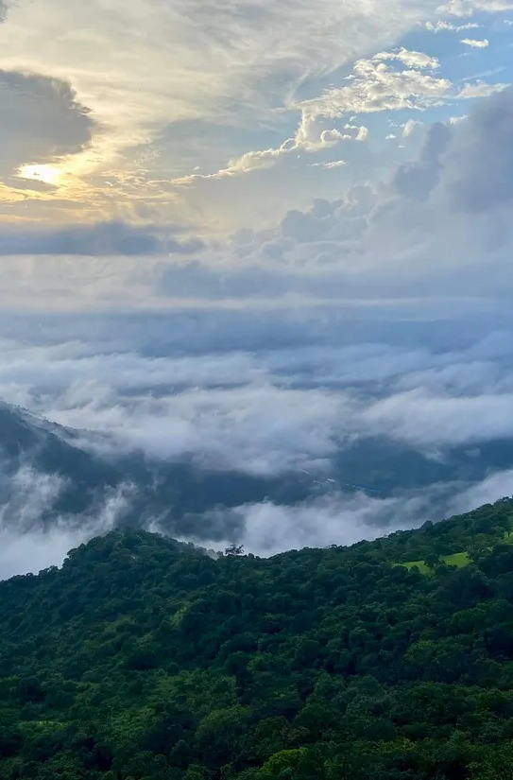
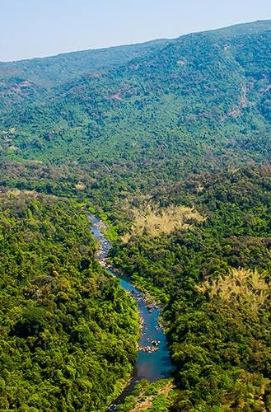
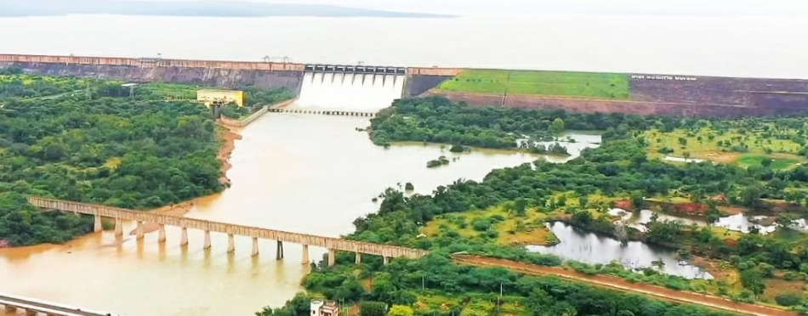
07 • GEOGRAPHY
Where nature shapes life
The district’s landscapes connect agriculture, forests, hills, rivers and monsoon scenery.
LANDSCAPE → LIVELIHOOD
Western Ghats • green hills • rivers • reservoirs • farmland
Seasonal rainfall supports a visibly green rural landscape and water-dependent livelihoods.
BELAGAVI • STORY OF A LIVING CITY
06 / 15

Slide 8
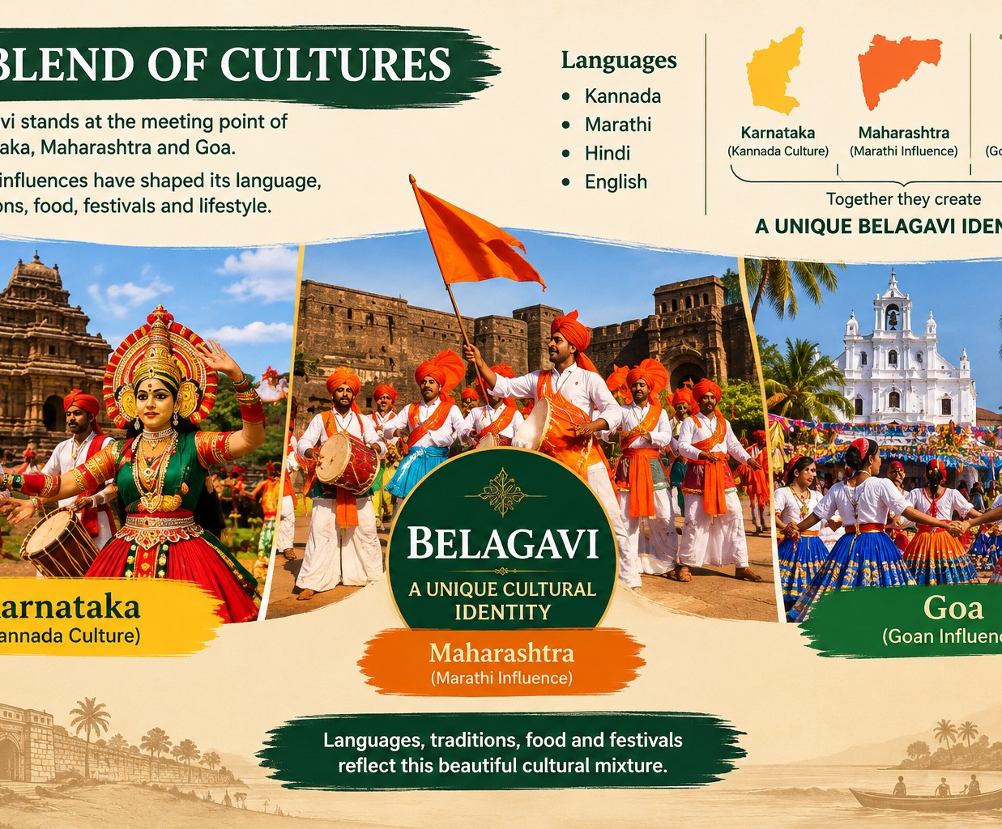
08 • PEOPLE & CULTURE
A blend of communities
Belagavi’s identity is best understood through the everyday mix of language, faith, food and celebration.
CULTURAL BLEND
• Kannada, Marathi and other regional influences meet in everyday life.
• Temple festivals, local jatras and Muslim celebrations add to the public cultural calendar.
• Food traditions show the same regional blending.
• Belagavi’s location makes it a natural meeting point between neighbouring states.
DIVERSITY • COMMUNITY • SHARED SPACE
BELAGAVI • STORY OF A LIVING CITY
07 / 15

Slide 9
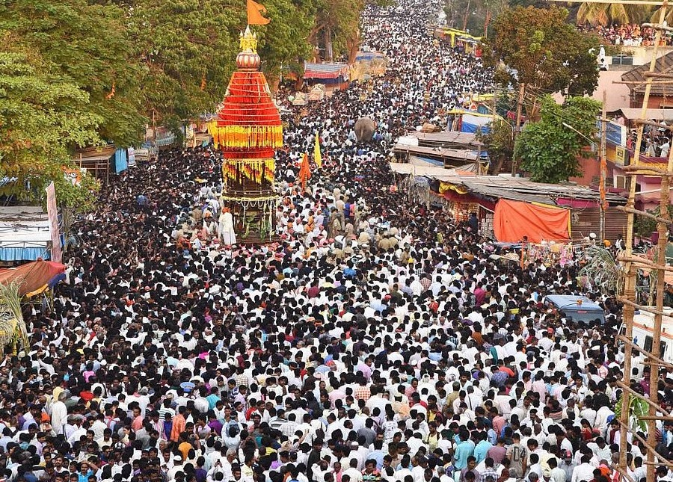
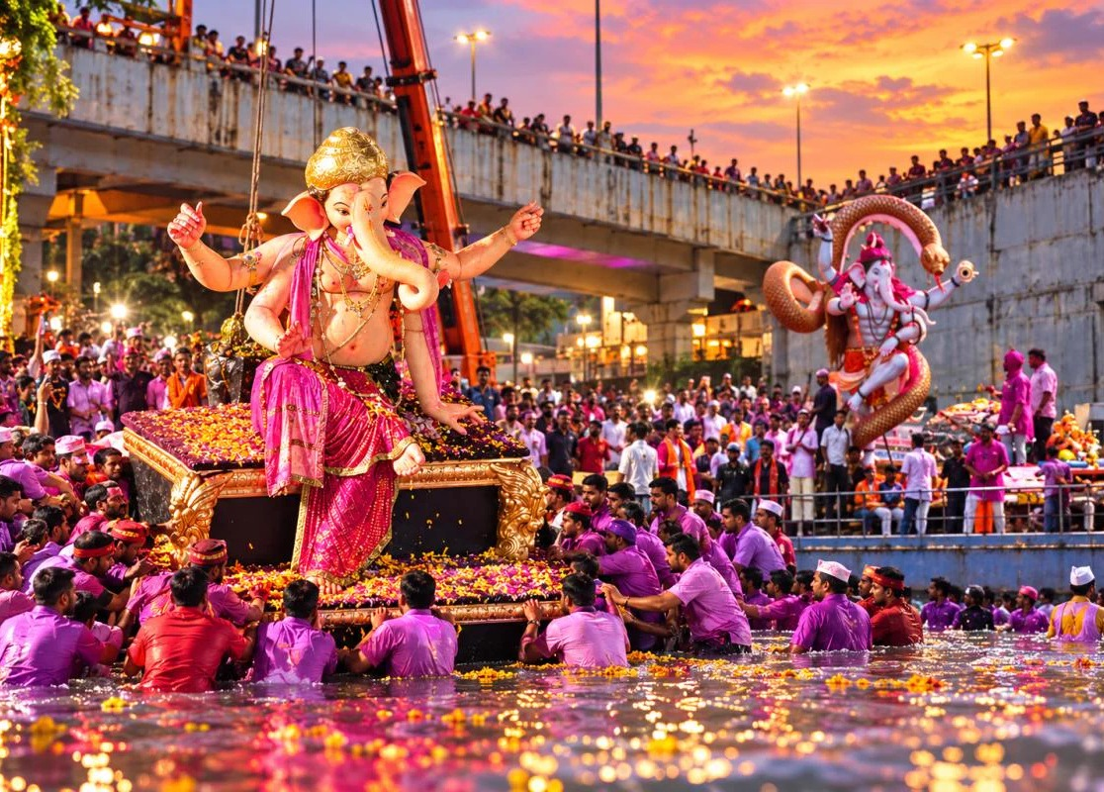
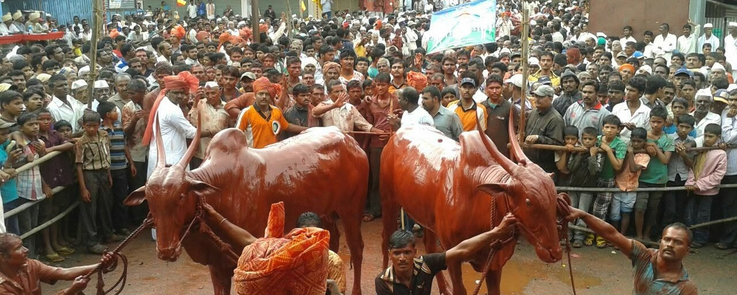
09 • TRADITIONS & FESTIVALS
Life in festivals
Celebration brings together faith, family, neighbourhoods and local traditions.
GANESH CHATURTHI
LOCAL JATRAS
KARU HUNNIME
Community celebration & public processions
Regional fairs, rituals & gathering
A traditional rural festival associated with the agricultural calendar
BELAGAVI • STORY OF A LIVING CITY
08 / 15

Slide 10
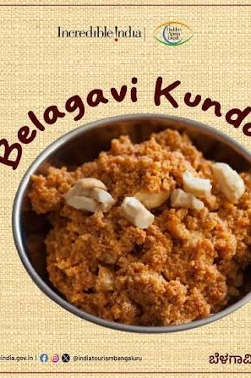
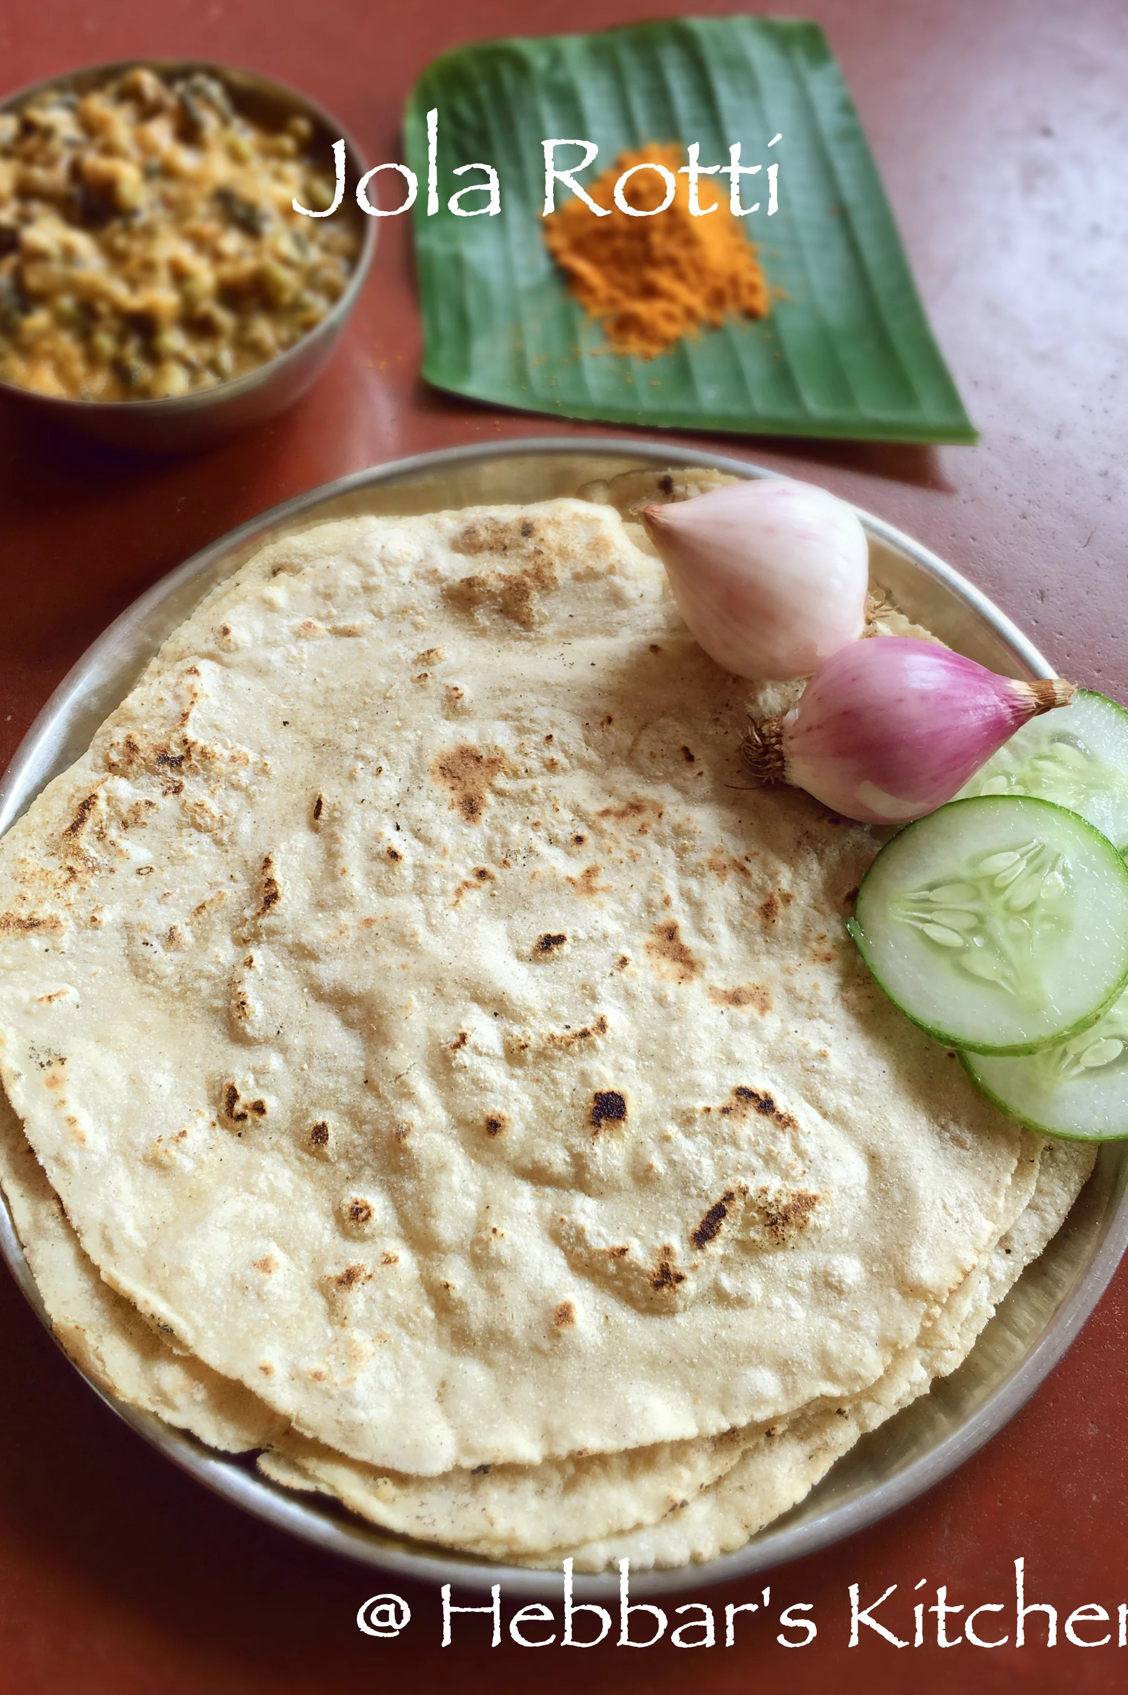
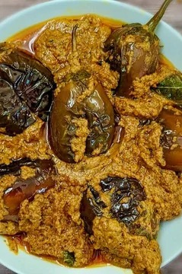
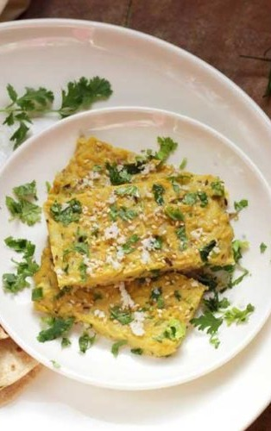
10 • FOOD
A story you can taste
North Karnataka staples meet local specialties and regional cooking traditions.
KUNDA
JOLADA ROTTI
BRINJAL CURRY
BESAN WADE / JHUNKA
Famous Belagavi sweet
Jowar flatbread
Bold local flavours
Traditional accompaniment
BELAGAVI • STORY OF A LIVING CITY
09 / 15

Slide 11
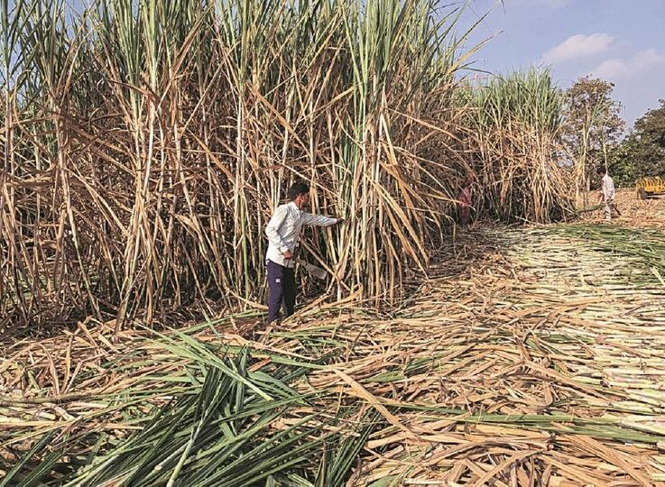
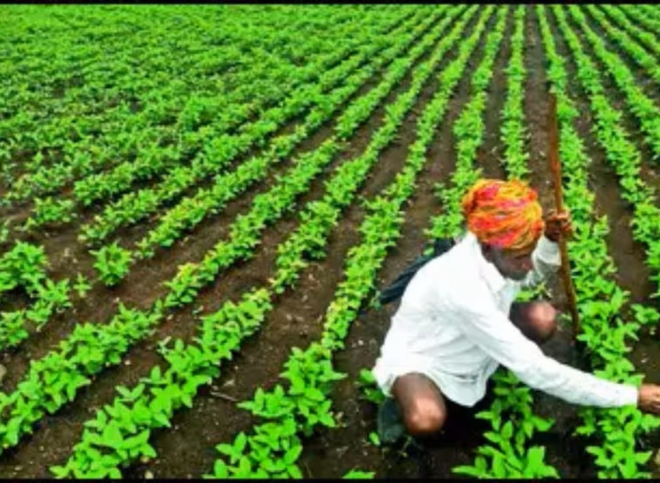
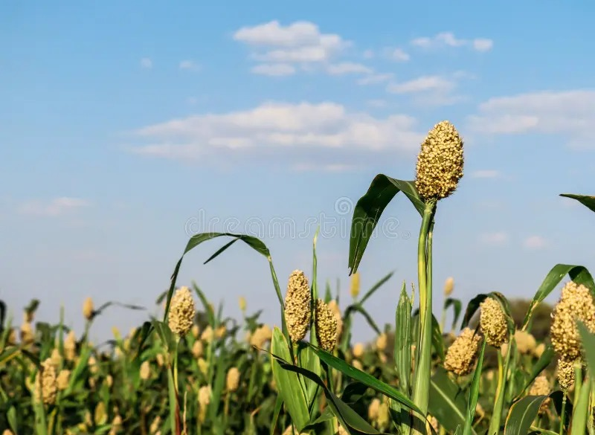
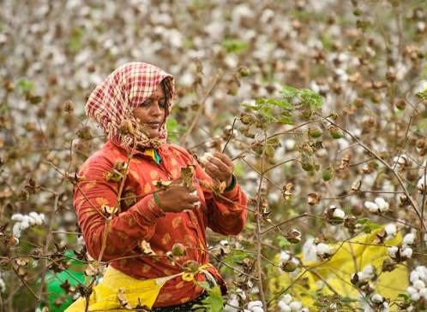
11 • AGRICULTURE
The farmer’s Belagavi
Agriculture connects farms to markets, processing and the wider district economy.
FARMER → CROP → MARKET → INDUSTRY
Important agricultural activities highlighted in the presentation include sugarcane, tobacco, cotton, jowar, oilseeds and dairy.
BELAGAVI • STORY OF A LIVING CITY
10 / 15

Slide 12
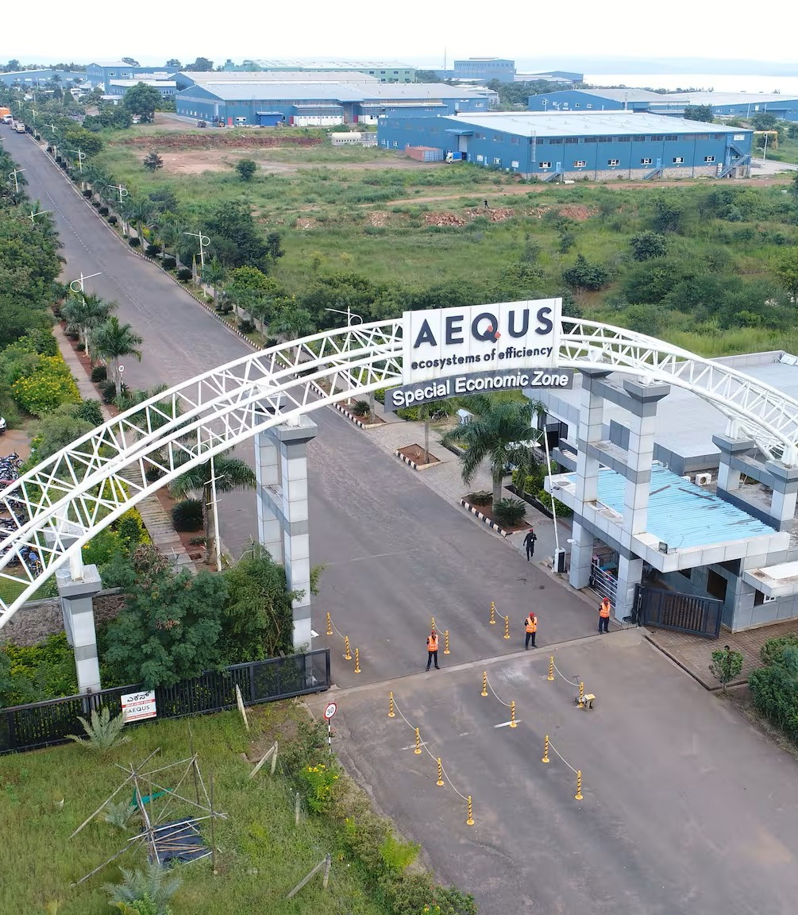
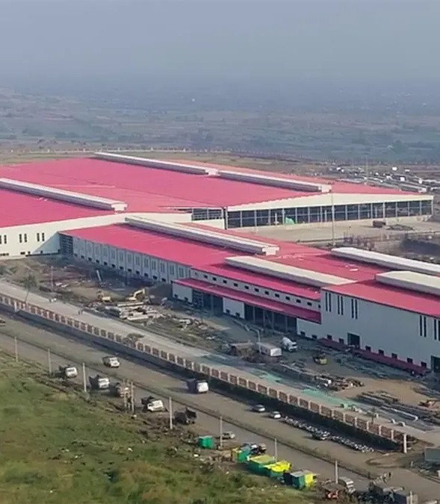
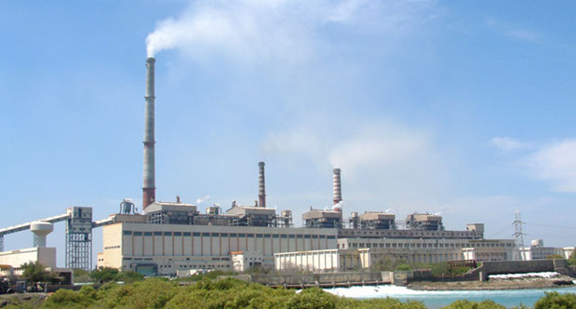
12 • ECONOMY
From farms to advanced manufacturing
Belagavi’s economy combines agriculture with engineering, aerospace, foundries, hydraulics, glass and sugar.
24 sugar factories are noted by the Belagavi district administration.
AEROSPACE
GLASS INDUSTRY
SUGAR INDUSTRY
Aerospace manufacturing ecosystem
Gold Plus glass manufacturing
Large-scale sugar processing
BELAGAVI • STORY OF A LIVING CITY
11 / 15

Slide 13
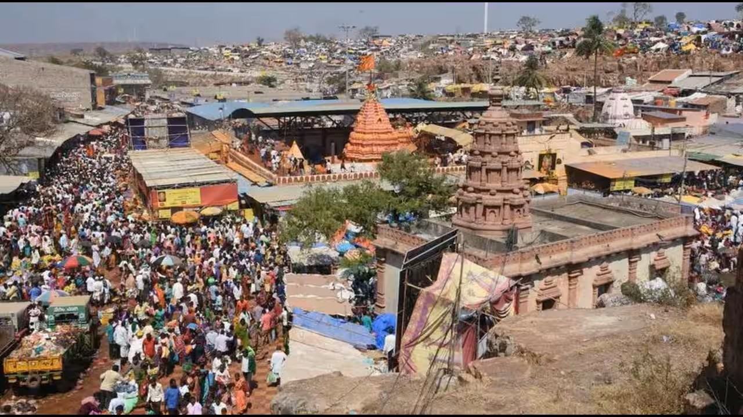
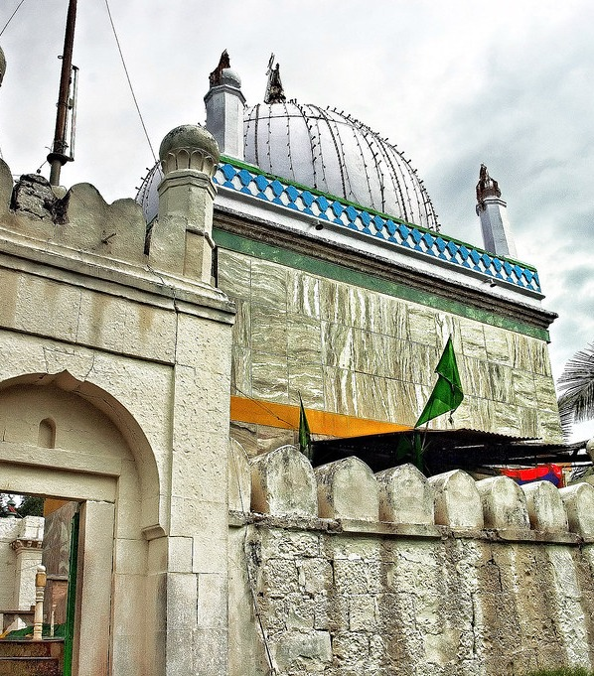
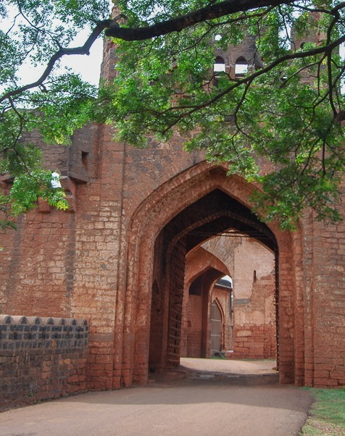
13 • FAITH & SHARED HERITAGE
Places of faith across the district
Belagavi’s heritage includes temples, Jain monuments, mosques and dargahs.
SHRI YELLAMMA DEVI TEMPLE, SAUNDATTI
KUDCHI DARGAH
BELAGAVI FORT
A famous pilgrimage site in Belagavi district, dedicated to Goddess Yellamma (Renuka Devi), attracting thousands of devotees during the annual Yellamma Jatra.
The supplied image highlights the dargah at Kudchi as part of the district’s Muslim heritage and pilgrimage landscape.
The fort is especially notable for the presence of both Hindu and Islamic architectural heritage within the historic complex.
BELAGAVI • STORY OF A LIVING CITY
12 / 15

Slide 14
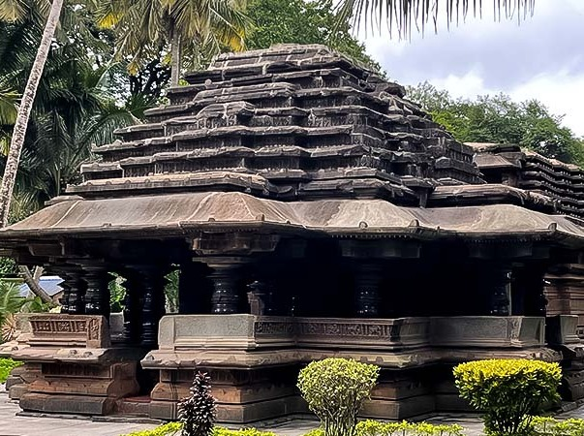
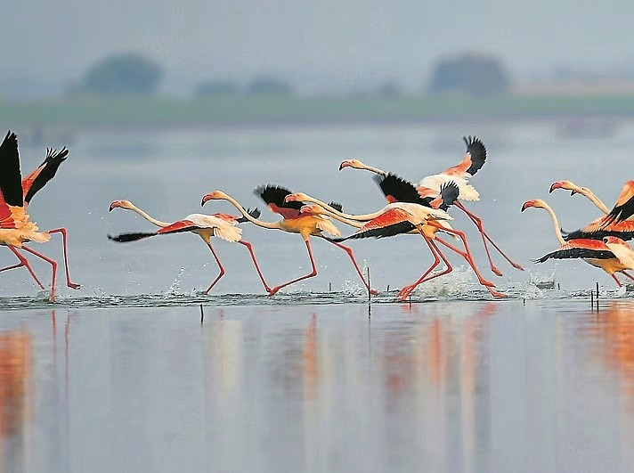
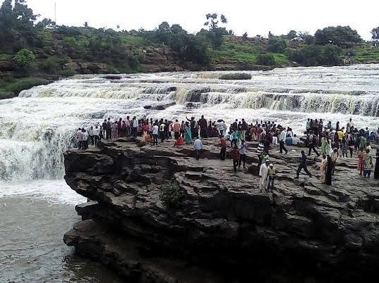
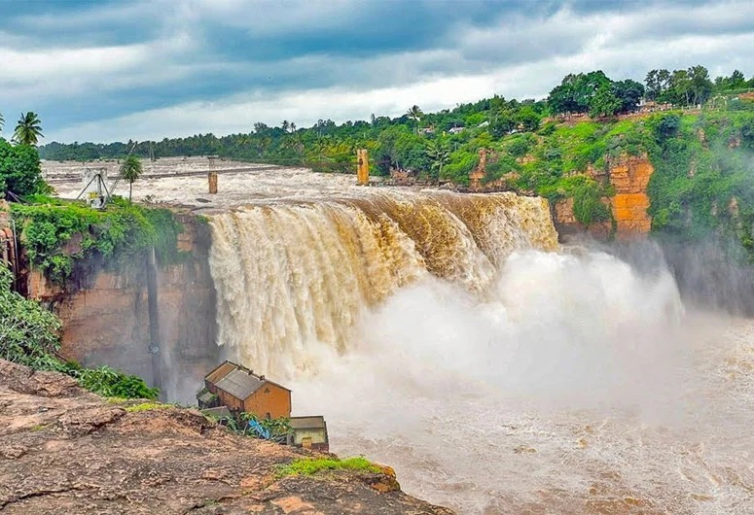
14 • TOURISM
A journey through Belagavi district
History, faith, wildlife and waterfalls create a varied tourism circuit.
KAMALA BASTI
GHATAPRABHA BIRD SANCTUARY
GODACHINMALKI FALLS
GOKAK FALLS
1204 • late Chalukyan style
Birdlife & wetland landscape
Two-stage waterfall
Major natural landmark
BELAGAVI • STORY OF A LIVING CITY
13 / 15

Slide 15
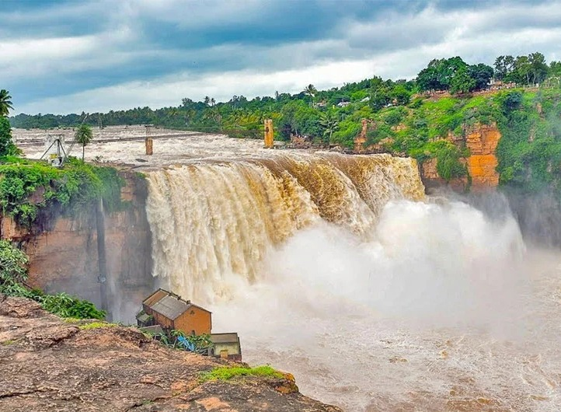
15 • GOKAK FALLS
Nature + beauty + engineering
One of Belagavi district’s signature landscapes, where the Ghataprabha River meets a dramatic rocky gorge.
52 METRES
The Ghataprabha River drops about 52 m over a rocky bed, creating a horseshoe-shaped waterfall.
1887
Early hydroelectric generation began here in 1887.
A landmark where landscape, engineering and tourism meet.
BELAGAVI • STORY OF A LIVING CITY
14 / 15

Slide 16

16 • CONCLUSION
The story continues.
Belagavi is more than a place on the map.
It is a living story of history, people, culture, nature, agriculture, industry and a changing future.
HISTORY → CULTURE → AGRICULTURE → INDUSTRY → FUTURE
Thank you
Selected factual references: District Belagavi • Karnataka Tourism
15 / 15

