Slide 1
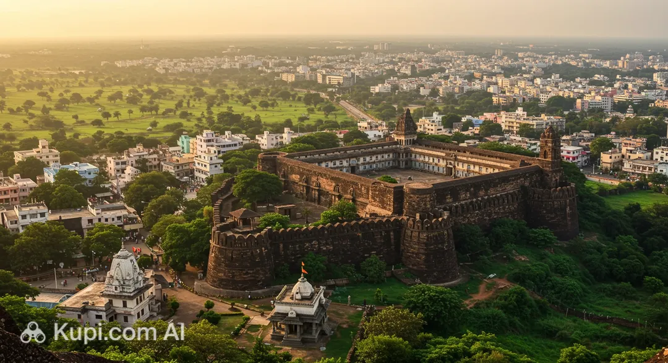
Karnataka, India
BELAGAVI
History • Nature • Industry • Culture
Presented BY: ASEEF PINJAR
Sub:cGAPP BAE QM Nalanda
A quick visual introduction

Slide 2
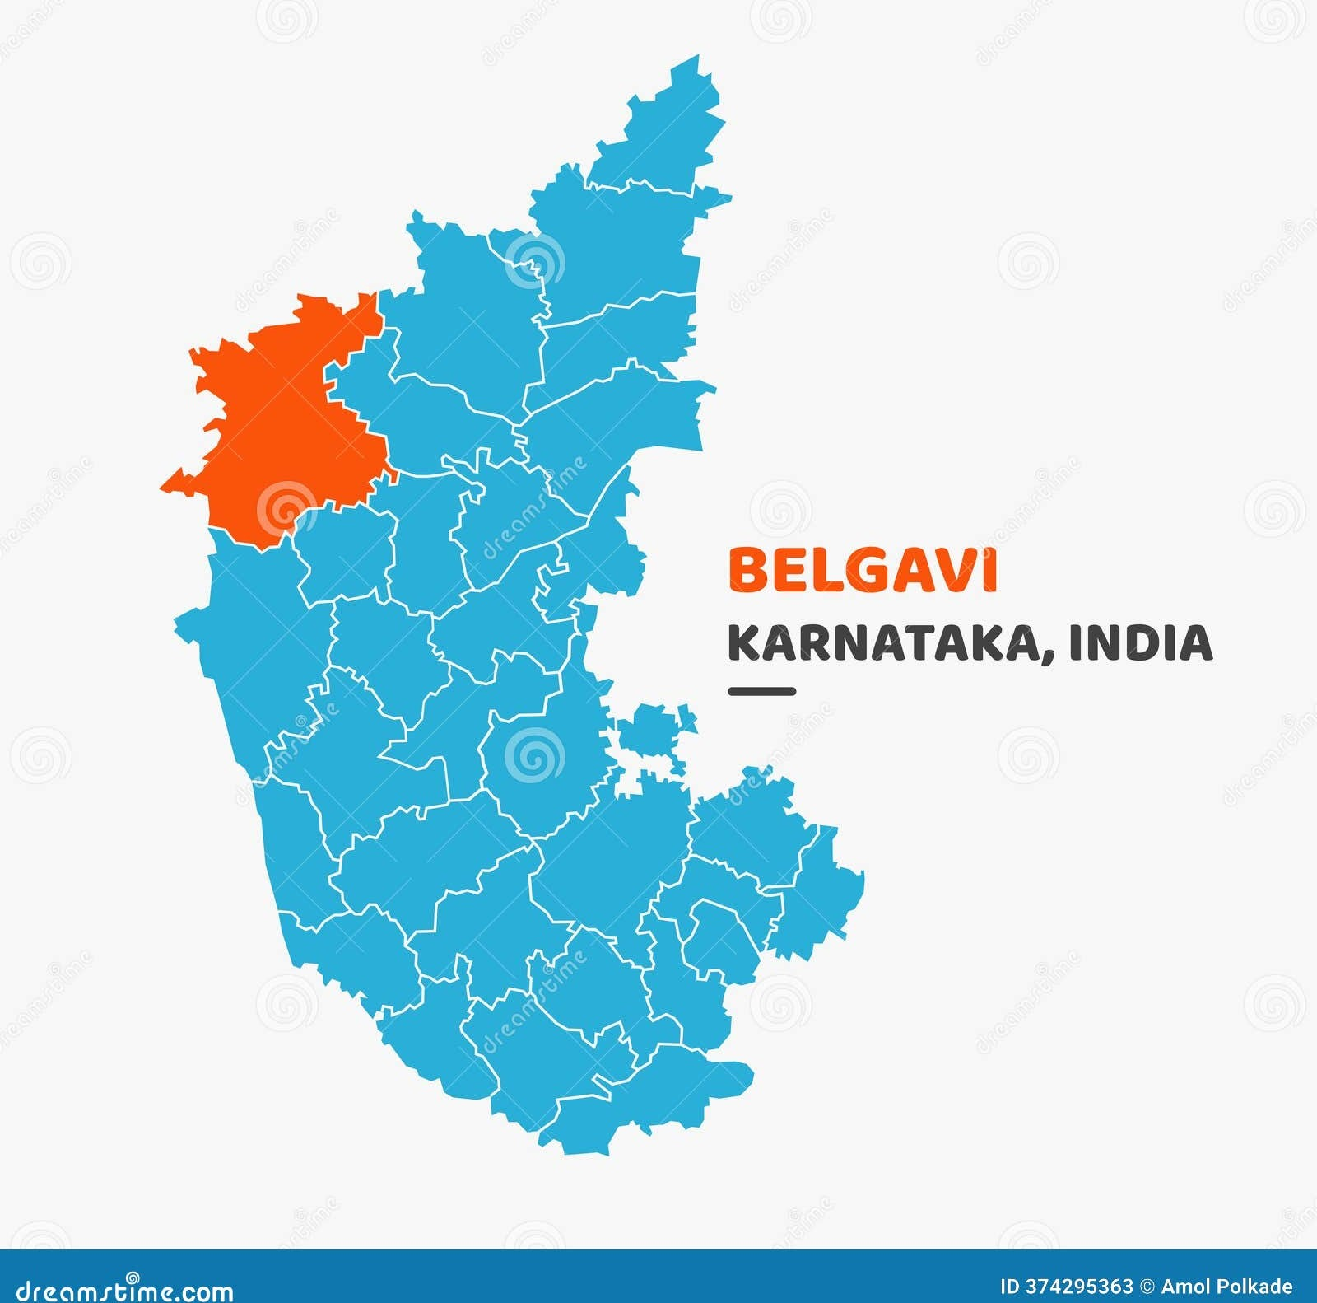
1. Introduction
Belagavi at a glance
Located in northwestern Karnataka.
Near the borders of Maharashtra and Goa.
Formerly known as Belgaum.
Historical name: Venugrama — “Bamboo Village”.
Belagavi is one of the largest districts in Karnataka by area
Area: about 13,400 km²; population: 47.8 lakh (2011 Census).
Education: Visvesvaraya Technological University (VTU), which affiliates engineering colleges across Karnataka, is headquartered in Belagavi.
MAHARASHTRA
BELAGAVI
GOA
A meeting point of landscapes and cultures
02

Slide 3
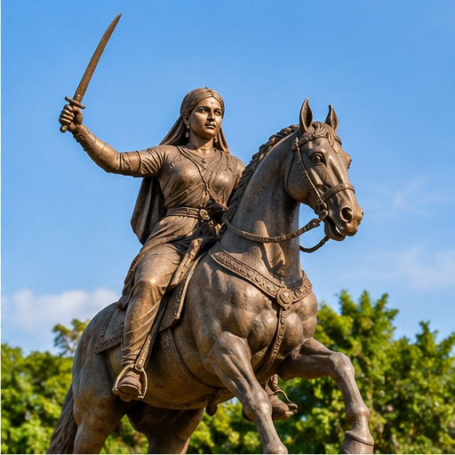
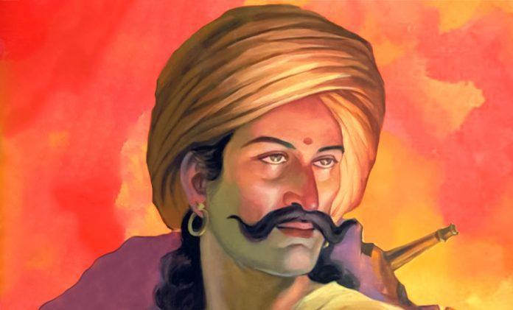
2. History & Heritage
A district with a long and layered past
Over the centuries, the Belagavi region came under the control of several dynasties
Belagavi’s history reaches back to at least the 2nd century AD.
Belagavi Fort is associated with the Ratta rulers and later Bahamani dynasties.
Kittur Rani Chennamma fought the British East India Company in 1824.
Sangolli Rayanna(15 August 1796) was a military commander and revolutionary who continued fighting British rule after Kittur Rani Chennamma's defeat. He was betrayed, captured, and publicly hanged at Nandagad on 26 January 1831.
1924: The 39th session of the Indian National Congress took place in Belgaum, presided over by Mahatma Gandhi. It was the only Congress session he chaired.
Remember: 1824 • Kittur • Freedom struggle
03

Slide 4
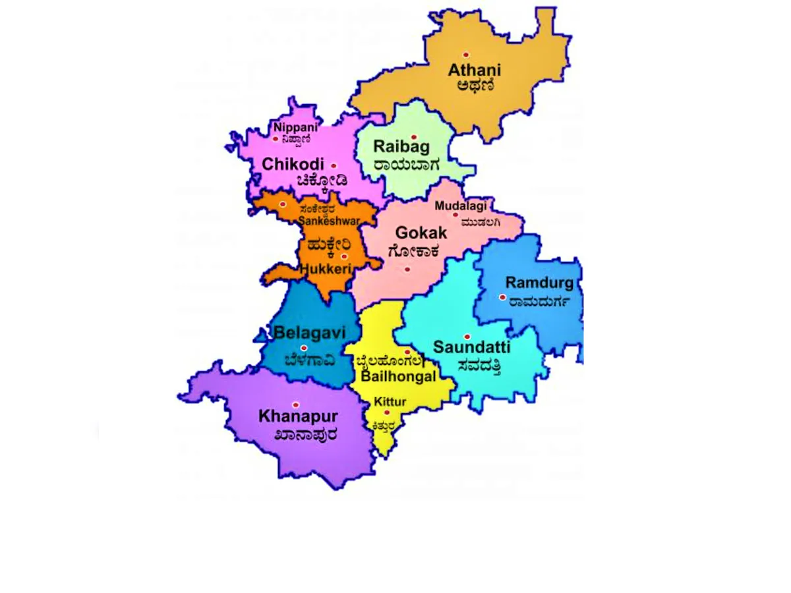
3. Geography & Nature
Rivers, waterfalls and the Western Ghats
Western areas are greener and generally receive more rainfall.
Malenadu (Hilly Region): The western part of Belagavi district, especially Khanapur, has hills, dense forests, heavy rainfall and rich biodiversity.
Gadinaadu (Transitional Region): The central belt has a mixture of rolling hills and plains, moderate rainfall and agriculture such as sugarcane and other crops.
Bayalunaadu (Plains Region): The eastern part of Belagavi district has flatter land, relatively lower rainfall and extensive cultivation of crops such as sugarcane, jowar and pulses.
Important rivers: Krishna, Ghataprabha and Malaprabha
04

Slide 5
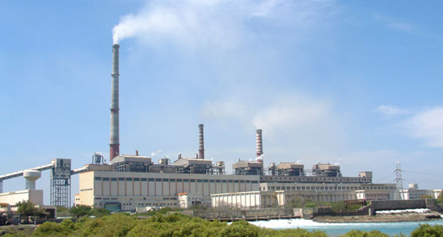
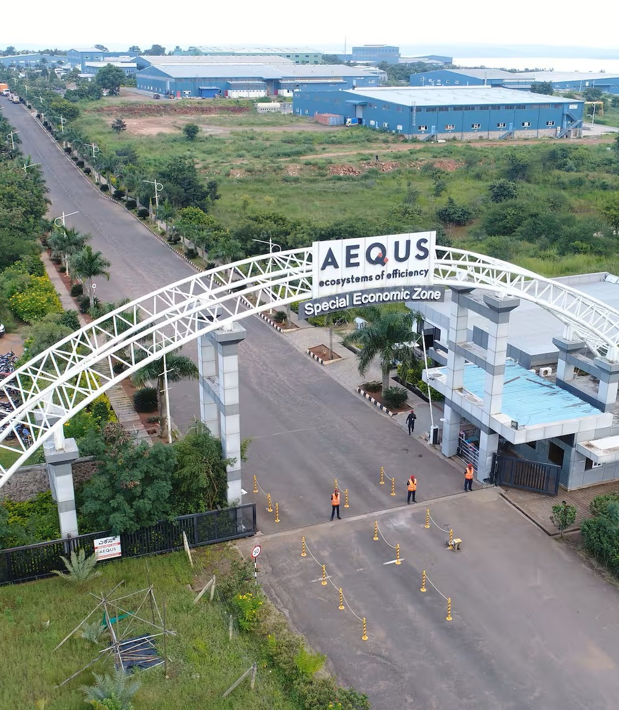
4. Economy & Work
Agriculture meets engineering
Sugar factories support farming and local employment.
24 sugar factories are noted by the Belagavi district administration.
Belagavi is known for foundries and engineering components.
Manufacturing: The district has important foundry, automotive-component, engineering, and machine-tool industrie.
Aerospace: Belagavi has an aerospace precision engineering and manufacturing special economic zone
Agriculture: Sugarcane is an important crop, supported by the region's sugar industry.
Transport: The city has its own airport and railway station, with road connections to major cities in Karnataka and neighboring states
05

Slide 6
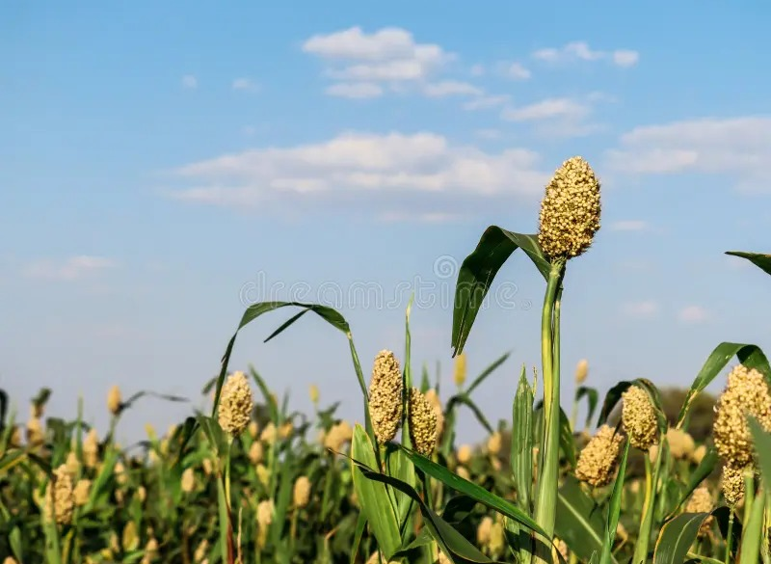
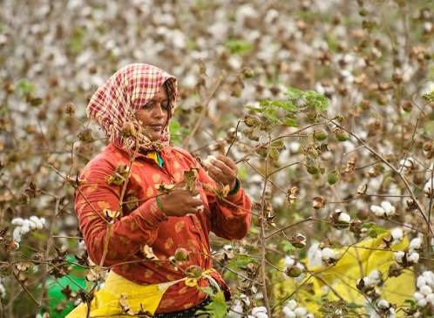
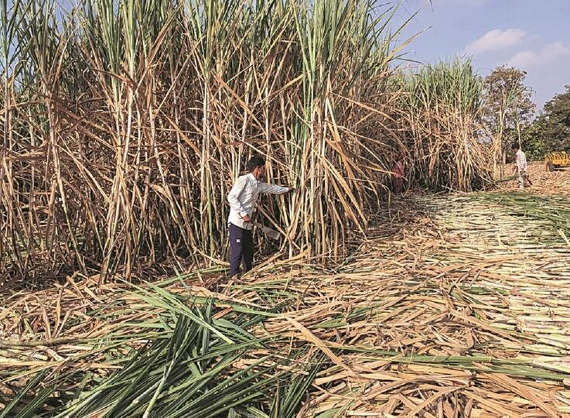
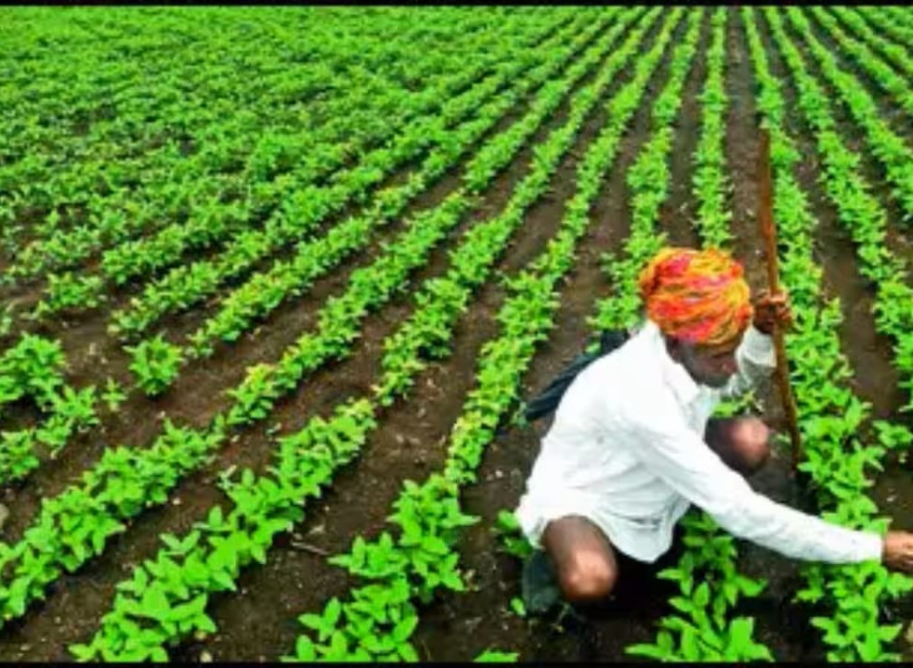
5. Agriculture
Agriculture
Major crops: Sugarcane, maize, jowar, paddy, pulses, soybean, cotton and oilseeds.
Horticulture: Mangoes, grapes, vegetables, onions, potatoes and chillies contribute to farm income.
Irrigation: The Krishna, Ghataprabha and Malaprabha, Markandeya River, Hiranyakeshi River, Doodhaganga River, Vedaganga River river systems support agriculture, along with reservoirs, canals and groundwater.
Soils: Deep and medium black soils, red loamy soils and laterite soils support different crops across the district.
Livestock: Dairy farming, sheep and goat rearing provide additional income for rural households.
Economic importance: Sugarcane supports sugar mills, while other crops supply food markets and agro-processing industries.
Raja Lakhamagouda Dam, Rakaskop Reservoir Dam, Naviluteertha Dam
05

Slide 7
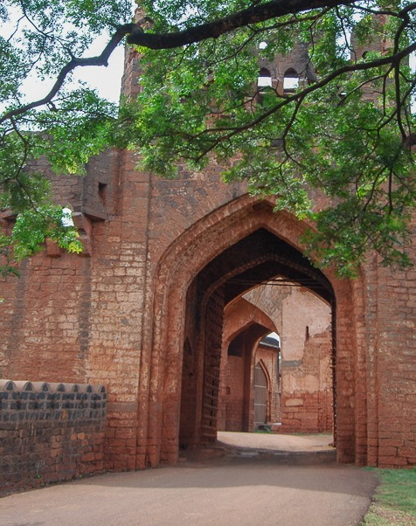
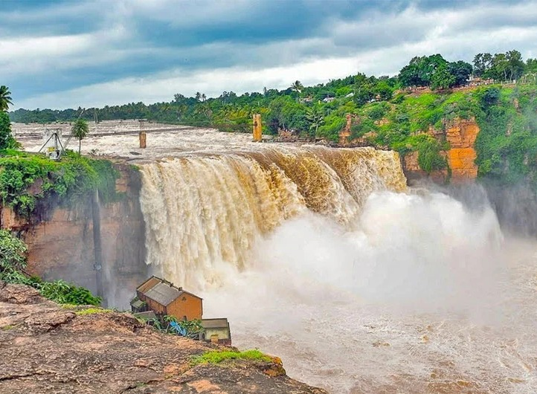
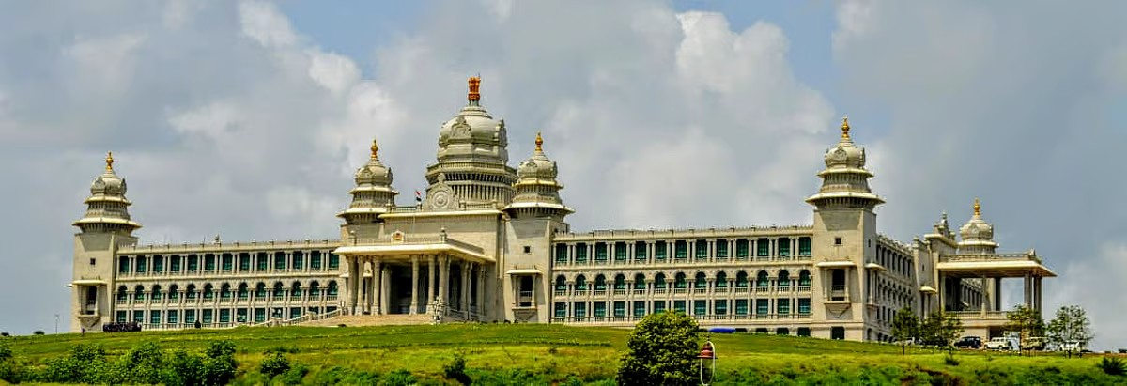
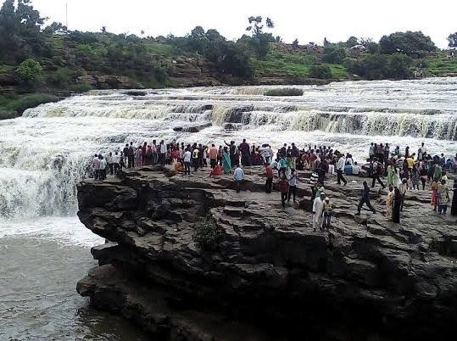
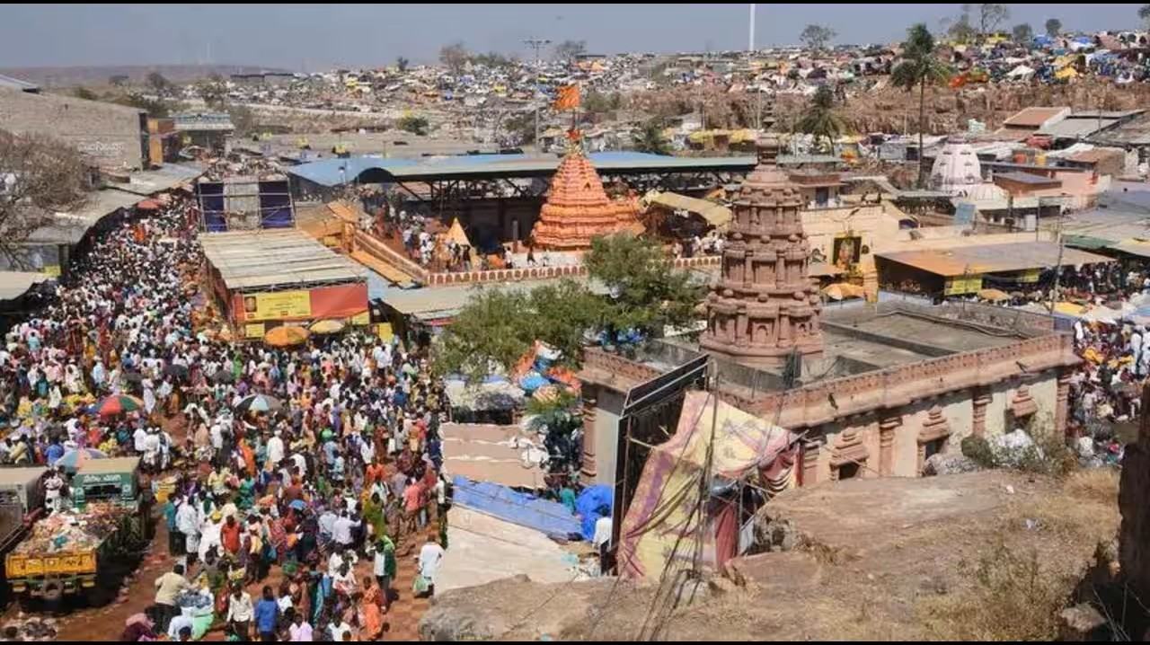
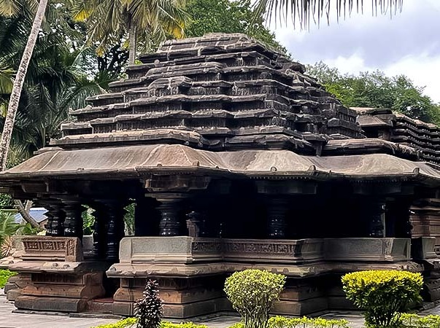
6. Places to Visit
Heritage, temples and natural beauty
Belagavi Fort
Gokak Falls
Suvarna Vidhana Soudha
Historic fort with temples and mosques.
A dramatic waterfall on the Ghataprabha River.
11 October 2012 Commemorates 50 years since the formation of Karnataka in 1956.
GODACHINMALKI FALLS
SHRI YELLAMMA DEVI TEMPLE, SAUNDATTI
KAMALA BASTI
1204 • late Chalukyan style
06

Slide 8

7. Life in festivals
Heritage, temples and natural beauty
07

Slide 9
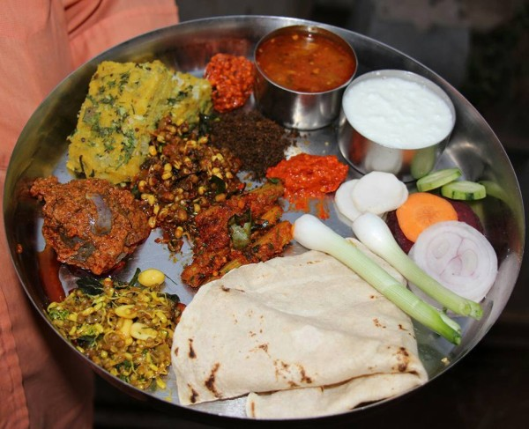
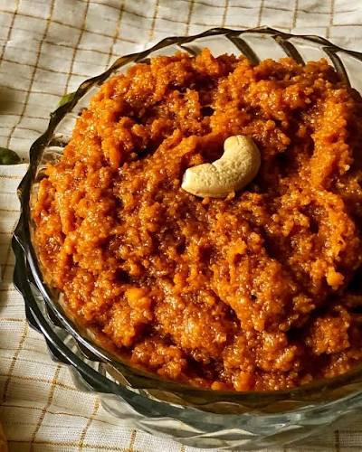
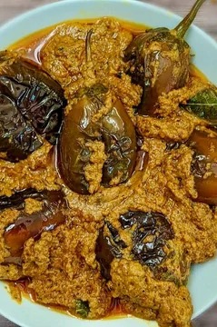
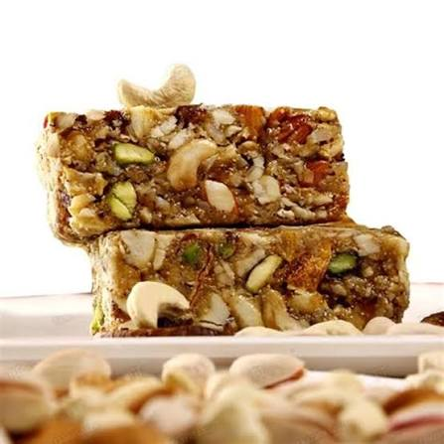
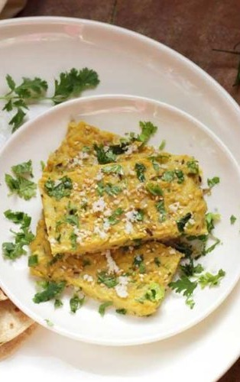
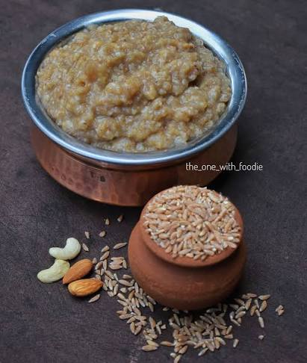
8. Food and Flavours of Belagavi
JOLADA ROTTI
KUNDA
BRINJAL CURRY
GOKAK KARADANTU
BESAN WADE / JHUNKA
WHOLE WHEAT PAYASAM
08

Slide 10
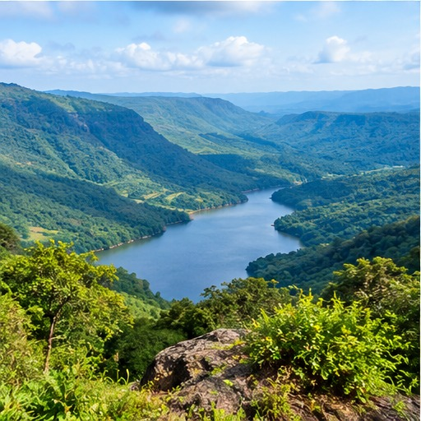
BELAGAVI
A district of many strengths
History • Natural beauty • Agriculture • Industry • Culture
Thank you!

