Slide 1
KARNATAKA, INDIA
Discover Belagavi
A showcase of historical heritage, lush sanctuaries, serene lakes, and architectural wonders.
18 Key Destinations
Comprehensive Travel Guide

Slide 2


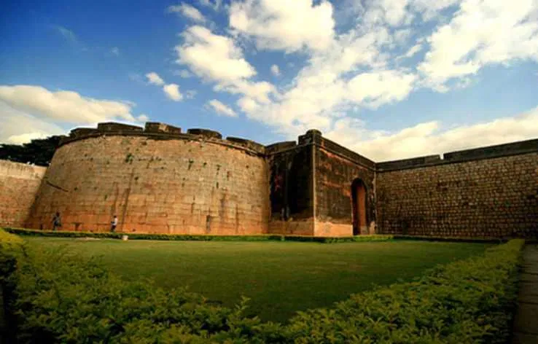
Belagavi Fort
HISTORIC CITADEL
Built in 1204 AD
Constructed by the Ratta dynasty, featuring ancient bastions and moat defenses.
CULTURAL HARMONY
Diverse Heritage
Houses ancient Jain temples, Hindu shrines, and Indo-Saracenic mosques inside its ramparts.

Slide 3

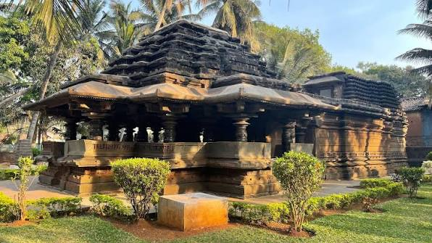
Kamal Basti
CHALUKYAN ARCHITECTURE
Lotus Ceiling Masterpiece
Renowned for its intricately carved 72-petal inverted lotus structure inside the Mukhamantapa.
SPIRITUAL SIGNIFICANCE
Jain Heritage
Houses the black stone idol of Neminatha, attracting pilgrims and heritage enthusiasts.

Slide 4
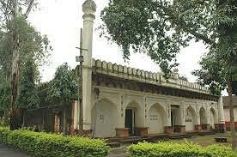
Safa Masjid
ARCHITECTURAL BLEND
Deccan & Indo-Saracenic
Features graceful minarets, elegant arches, and detailed calligraphic inscriptions.
HISTORICAL LOCATION
Inside Belagavi Fort
One of the most prominent historical mosques preserving regional architectural legacy.

Slide 5
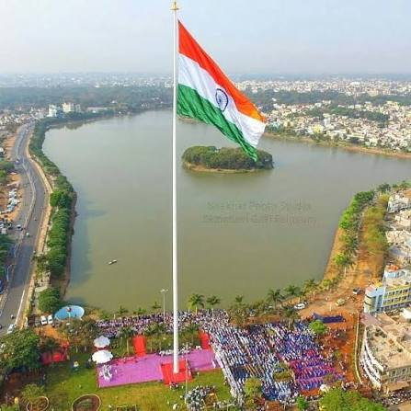
Fort Lake (Kote Kere)
NATIONAL LANDMARK
361-Ft National Flag Pole
Home to one of India's tallest national flagpoles overlooking the serene lake waters.
URBAN OASIS
Recreational Destination
Popular for evening walks, boating, and scenic views in the heart of Belagavi city.

Slide 6
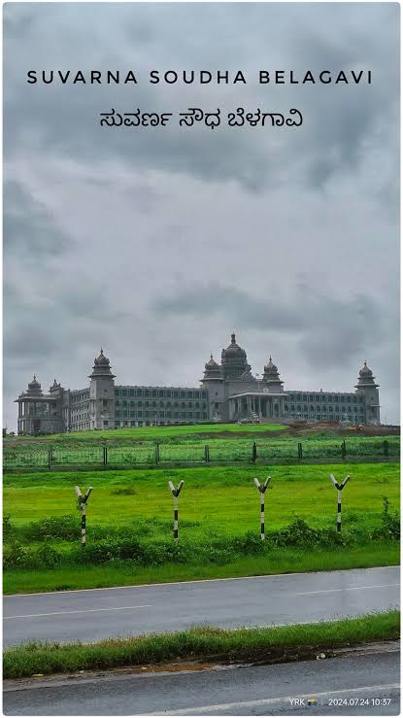
Suvarna Vidhana Soudha
ADMINISTRATIVE LANDMARK
Legislative Assembly Complex
State administrative complex hosting the annual winter session of the Karnataka Legislature.
GRAND DESIGN
Neo-Dravidian Architecture
Majestic stone structure standing amidst lush green landscapes on the city outskirts.

Slide 7
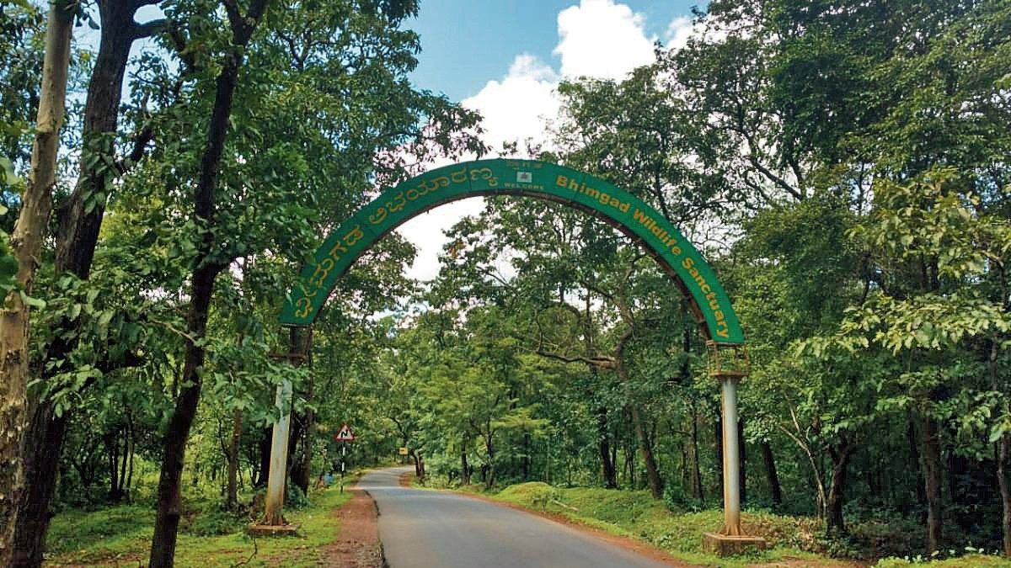
Bhimgad Wildlife Sanctuary
ECOLOGICAL HAVEN
Western Ghats Forest
Dense tropical forest biodiversity corridor connecting Karnataka and Goa.
FAUNA HABITAT
Rare Wildlife Protected
Crucial habitat for tigers, leopards, free-tailed bats, and diverse bird species.

Slide 8
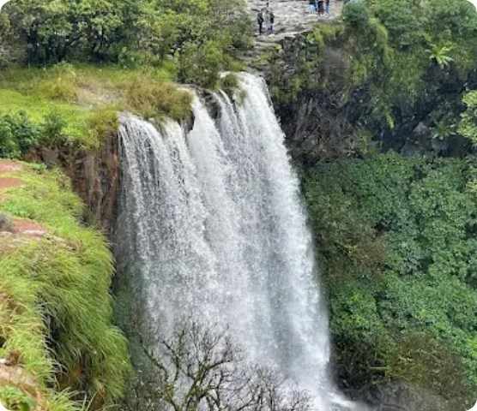
Chikale Waterfalls
MONSOON SPECTACLE
Cascading Waterfalls
Thundering natural waterfall active during monsoon months near Khanapur region.
NATURE RETREAT
Scenic Trekking Spot
Surrounded by pristine green forest hills, ideal for nature walks and photography.

Slide 9
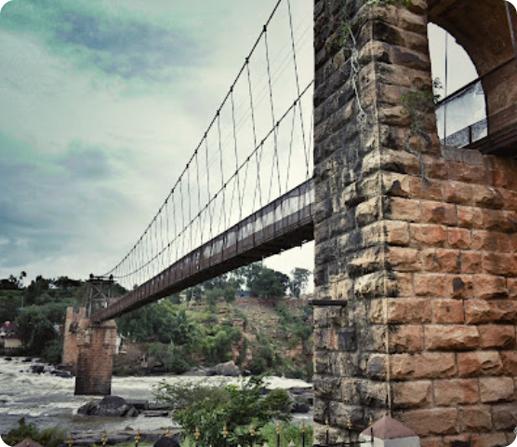
Gokak Falls & Hanging Bridge
NATURAL WONDER
Niagara of Karnataka
Ghataprabha River leaps 170 feet over a sandstone cliff into a horseshoe gorge.
HERITAGE ENGINEERING
Hanging Suspension Bridge
Features a historic colonial-era wire rope hanging bridge spanning high above the roaring river.

Slide 10
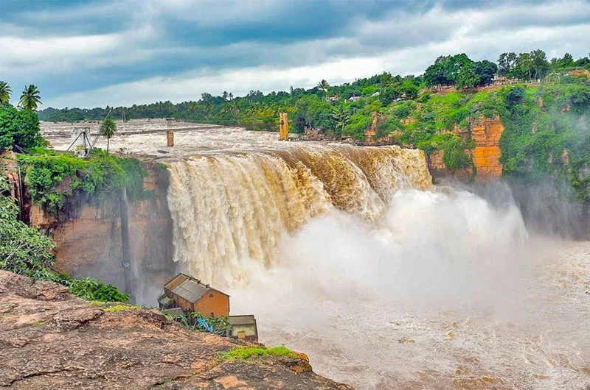
Gokak Falls
NATURAL WONDER
Niagara of Karnataka
Ghataprabha River leaps 170 feet over a sandstone cliff into a horseshoe gorge.
HERITAGE ENGINEERING
Hanging Suspension Bridge
Features a historic 200-meter colonial-era hanging bridge built high over the canyon.

Slide 11
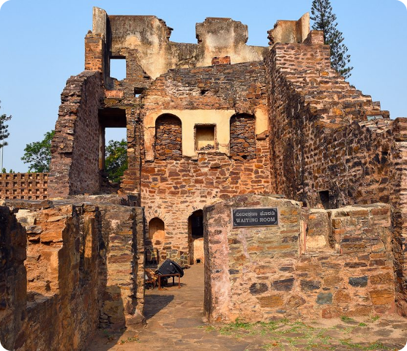
Kittur Fort & Palace
FREEDOM RESISTANCE LEGACY
Rani Chennamma Fortress
Historic seat of Rani Chennamma, who led an armed rebellion against British rule in 1824.
MUSEUM & ANTIQUITIES
Archaeological Museum
Preserves ancient weaponry, royal artifacts, stone sculptures, and historical relics.

Slide 12
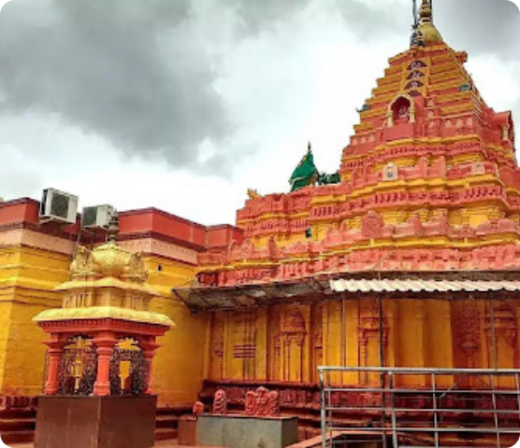
Renuka Yallamma Temple, Saundatti
PILGRIMAGE HUB
Sacred Shrine of Goddess Renuka
Revered pilgrimage destination drawing millions of devotees during Yallamma Jatre festivals.
ARCHITECTURAL SPLENDOR
Chalukyan & Rashtrakuta Influence
Features vibrant stepped gopurams and rich historical traditions atop Yellammagudda hill.

Slide 13
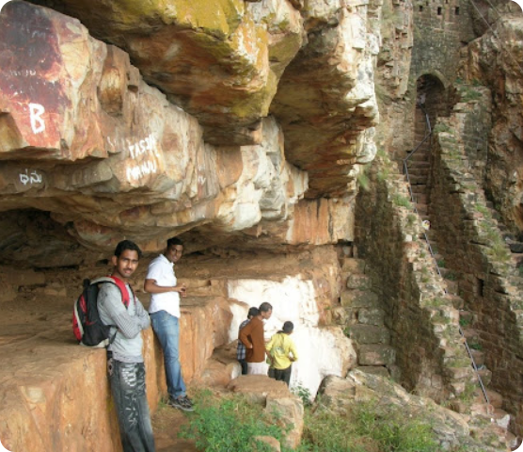
Parasgad Fort, Saundatti
HILLTOP STRONGHOLD
Ancient Ratta & Maratha Fort
Magnificent rock-hewn fort structures built by Ratta rulers and later fortified by Chhatrapati Shivaji Maharaj.
ROCK FORMATIONS & SHRINES
Maruthi & Jamadagni Caves
Features dramatic stone cliffs, ancient rock staircases, and sacred hillside monuments.

Slide 14
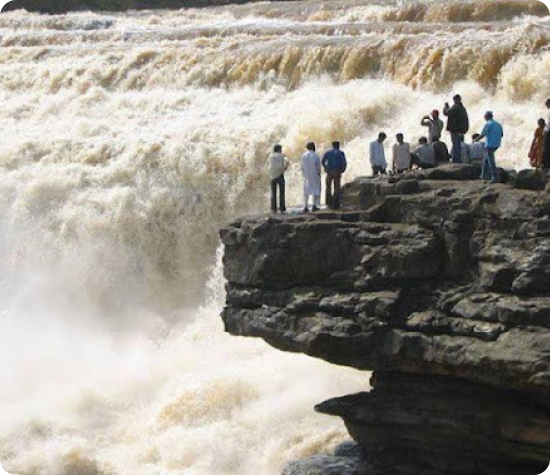
Godachimalki Waterfalls
TWO-TIER CASCADE
Markandeya River Falls
Features a dramatic two-step waterfall dropping 25 meters through a rugged green rocky gorge.
NATURAL GETAWAY
Monsoon Eco-Tourism
Located near Gokak, popular for nature trekking and scenic waterfall vistas in monsoons.

Slide 15

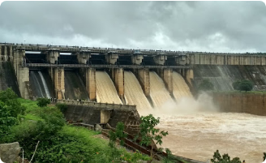
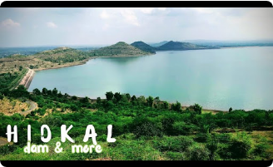
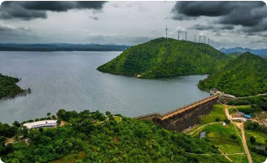
Major Reservoirs & Dams
Markandeya Dam
Hidkal Dam (Raja Lakhamagouda)
Naviluteertha Dam
Irrigation reservoir built across the Markandeya river amidst lush green hills.
Major water reservoir across Ghataprabha river with vast scenic shorelines.
Renuka Sagar dam built across Malaprabha river in a narrow valley gorge.

Slide 16
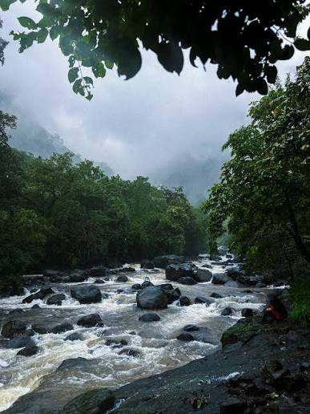

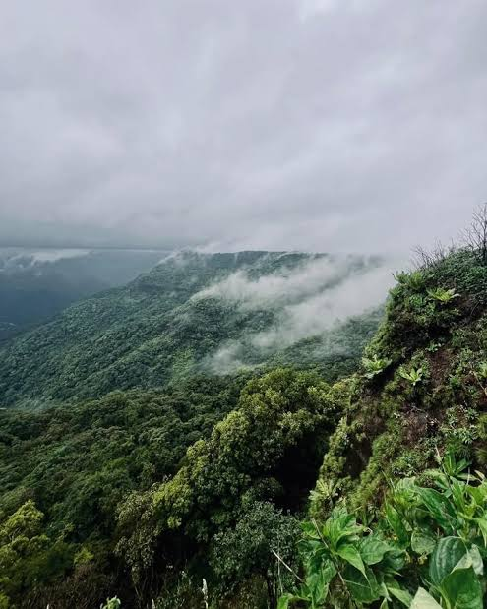
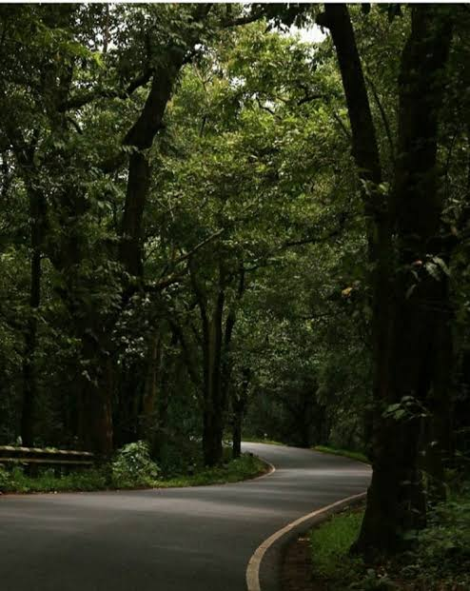
Hill Stations & Historical Monuments
Jamboti Hills
Lush hill station and source of the Mandovi River, famous for dense evergreen forests and heavy monsoon rainfall.

Slide 17
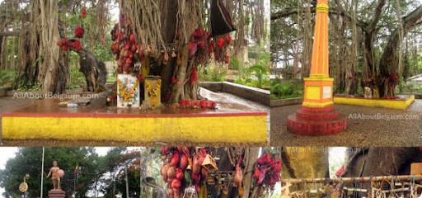
Historical Monuments
Sangolli Rayanna Monument, Nandgad
Historic memorial and banyan tree site honoring freedom fighter Krantiveera Sangolli Rayanna near Khanapur.

Slide 18
Explore Belagavi
A perfect destination blending nature, history, and culture in North Karnataka.

