Slide 1
PHYS1001B College Physics IB
Optics II Geometric Optics (Ch. 34)

Slide 2
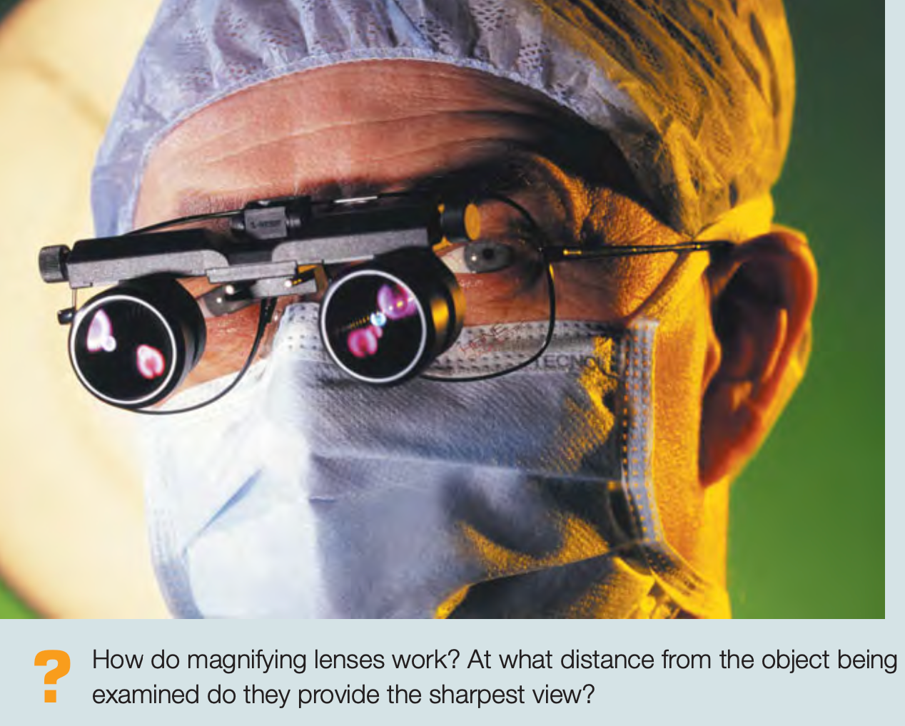
Introduction

Slide 3
Outline
34-1 Reflection and Refraction at a Plane Surface
34-2 Reflection at a Spherical Surface
34-3 Refraction at a Spherical Surface
34-4 Thin Lenses
34-5 Cameras
34-6 The Eye
34-7 The Magnifier
34-8 Microscopes and Telescopes

Slide 4
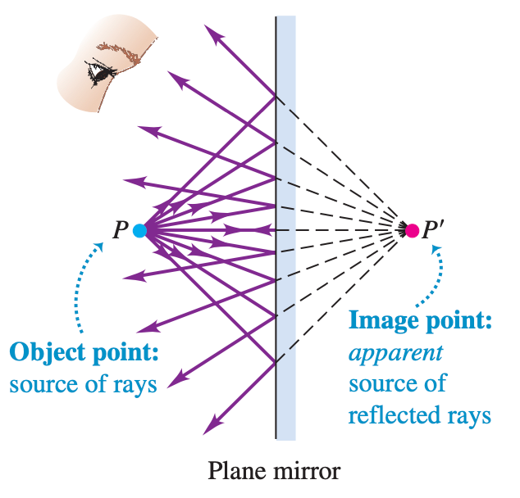
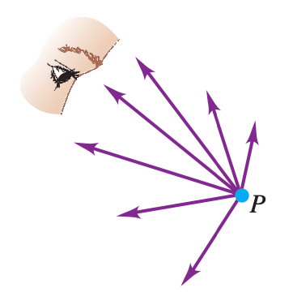
34-1 Reflection and Refraction at a Plane Surface

Slide 5
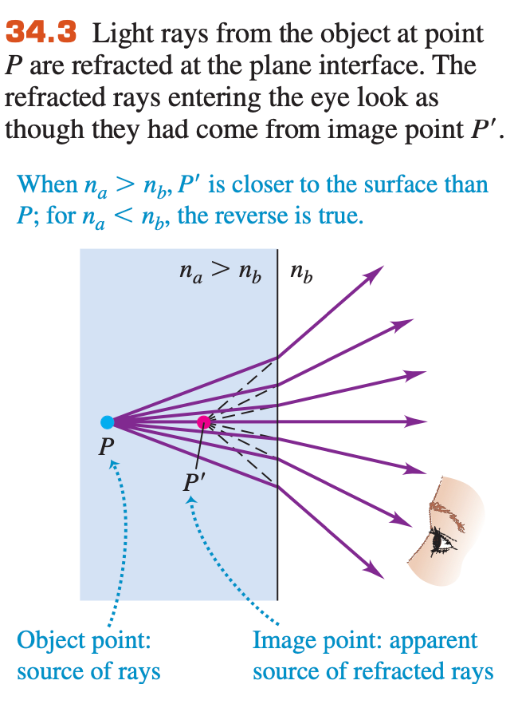
34-1 Reflection and Refraction at a Plane Surface

Slide 6
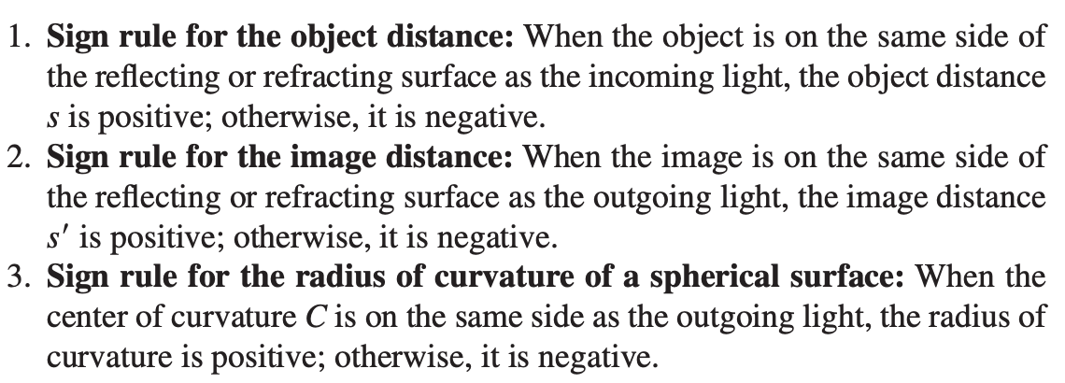
34-1 Reflection and Refraction at a Plane Surface
Sign rules

Slide 7
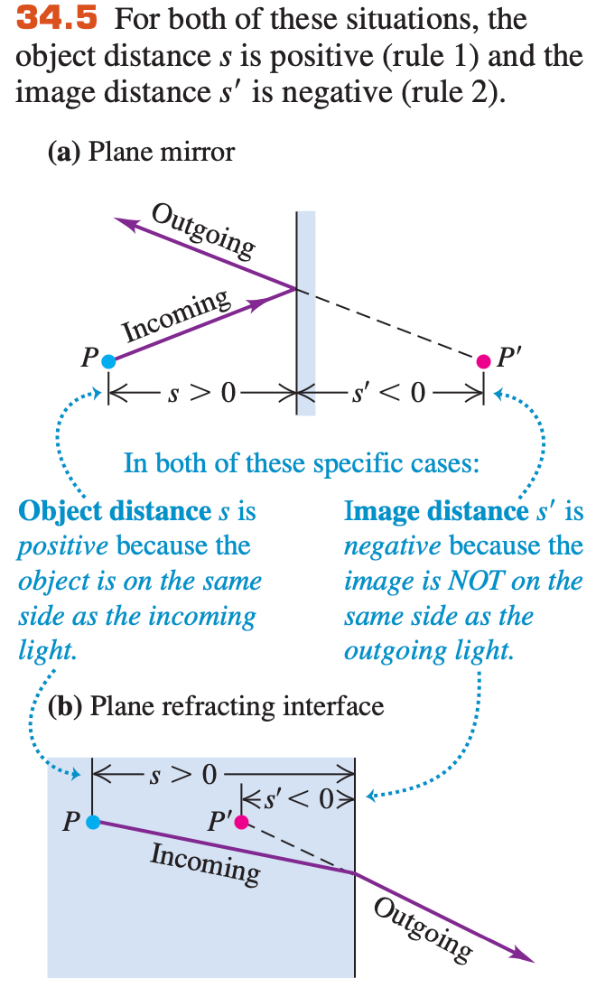
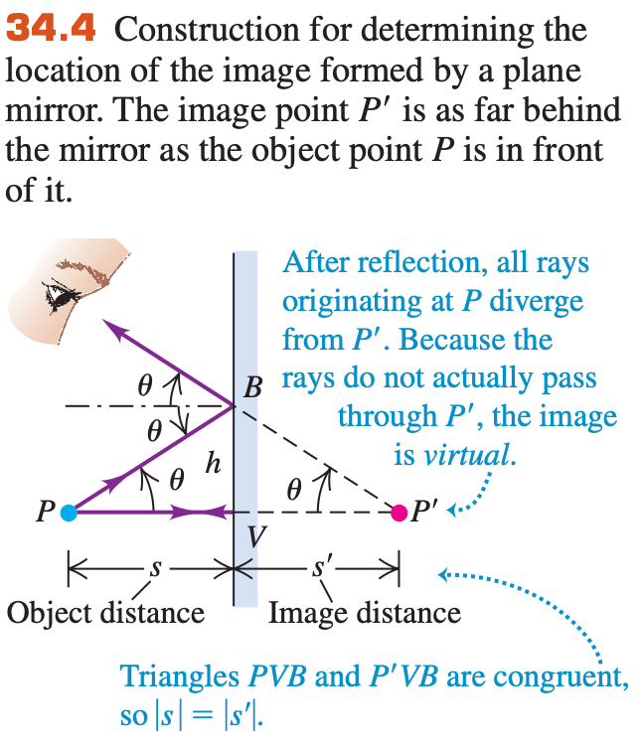
34-1 Reflection and Refraction at a Plane Surface

Slide 8
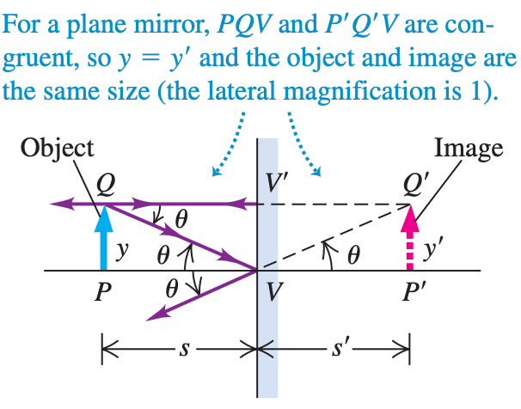
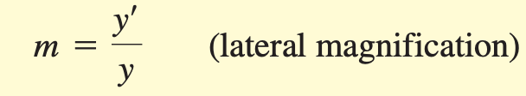
34-1 Reflection and Refraction at a Plane Surface
m>0 erect
m<0 inverted

Slide 9
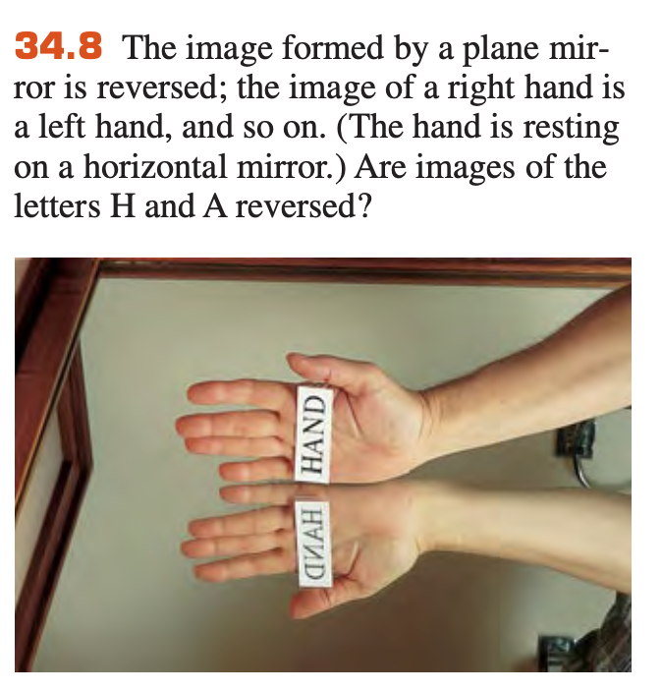
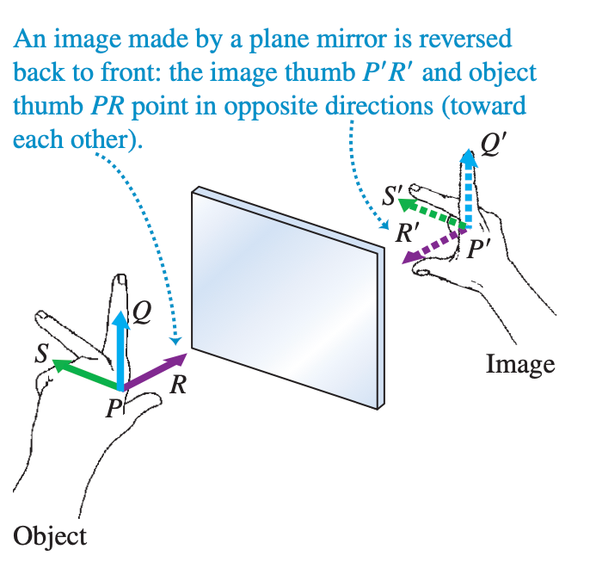
34-1 Reflection and Refraction at a Plane Surface
The image formed by a plane mirror is virtual, erect, and reversed

Slide 10
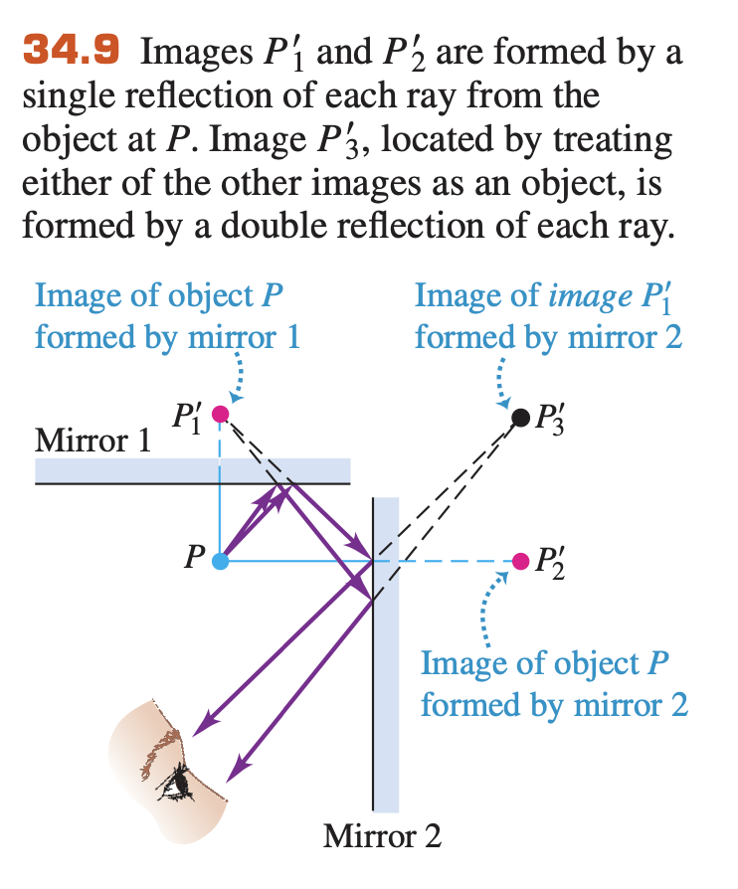
34-1 Reflection and Refraction at a Plane Surface
Image served as object for a second surface

Slide 11
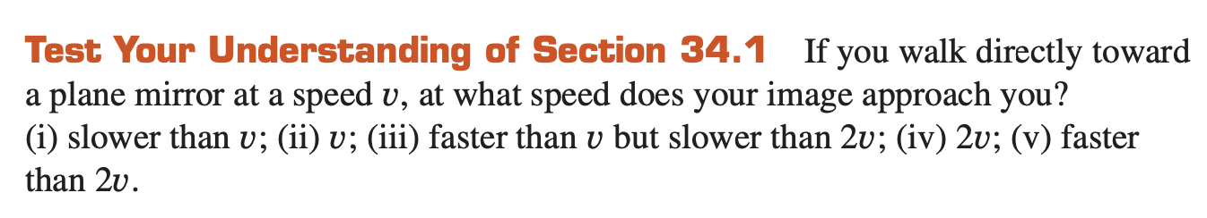
34-1 Reflection and Refraction at a Plane Surface

Slide 12
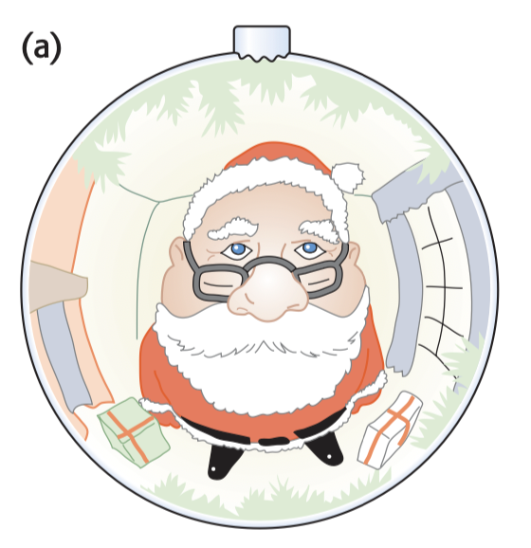
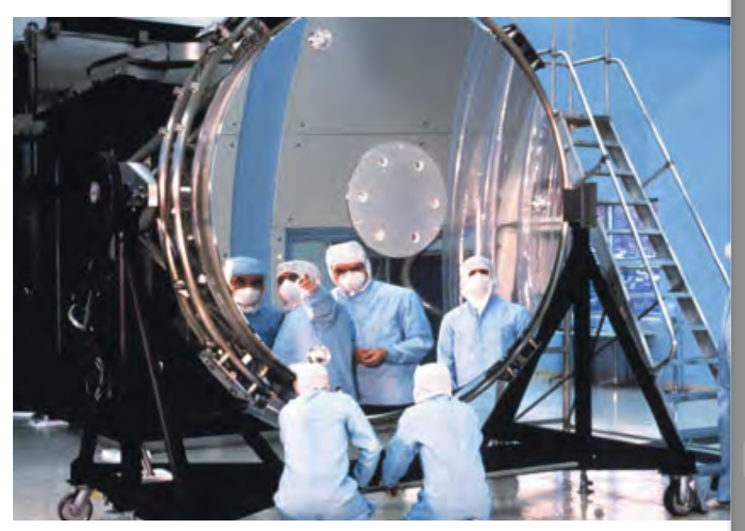
34-2 Reflection at a Spherical Surface
Magnifying mirror: Larger image
Surveillance mirrors: Smaller image

Slide 13
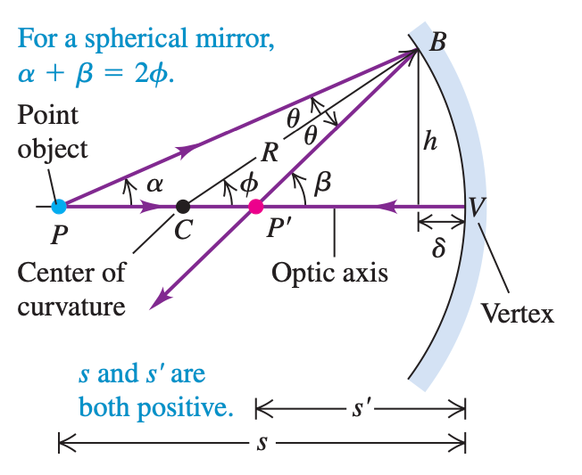


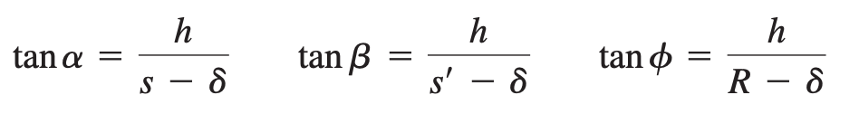
34-2 Reflection at a Spherical Surface
Concave spherical mirror: Finding position s’
s: distance to object s’: distance to image

Slide 14
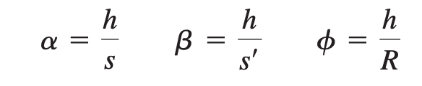
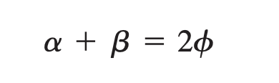
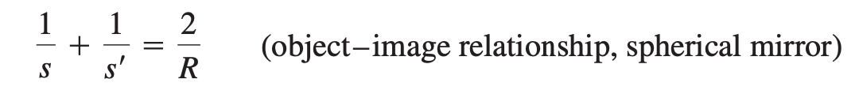
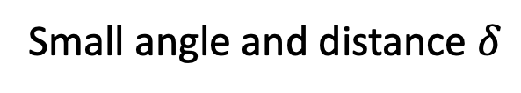
34-2 Reflection at a Spherical Surface
Concave spherical mirror: Finding position s’
Small angle and distance $δ$
Paraxial approximation
Rays nearly parallel to the axis are paraxial rays.

Slide 15
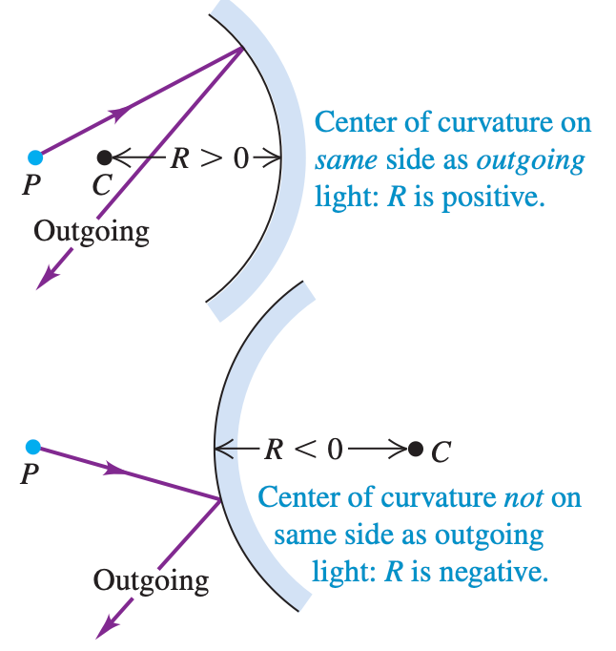
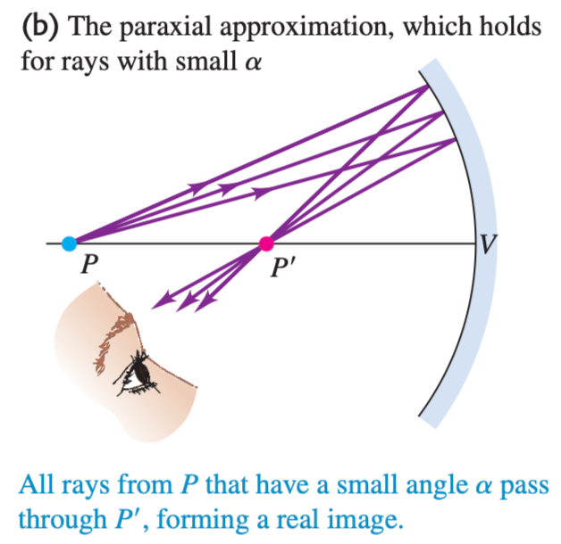
34-2 Reflection at a Spherical Surface
Positive R
Negative R

Slide 16
34-2 Reflection at a Spherical Surface
Radius of curvature becomes infinite?
What the mirror look like?

Slide 17
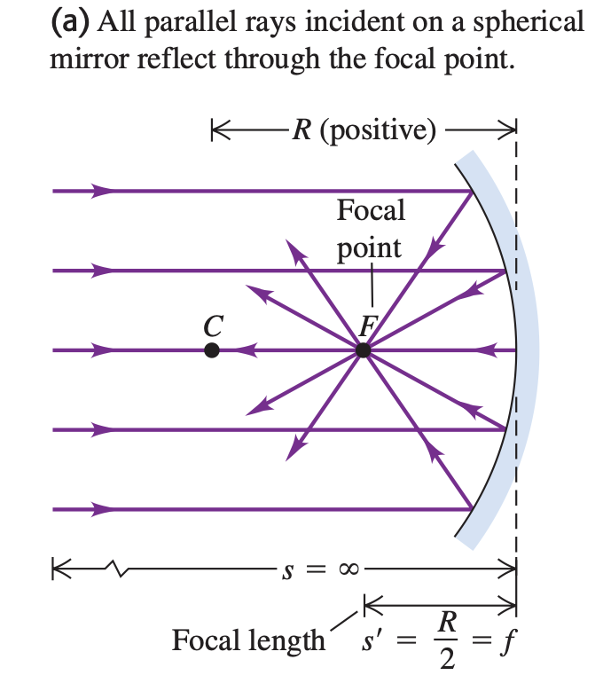
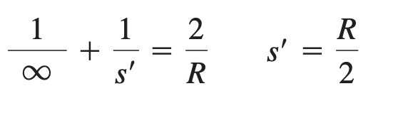
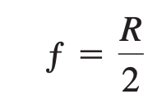
34-2 Reflection at a Spherical Surface
Focal point and Focal Length
When the object point P is very far from the spherical mirror s = ∞
Focal length

Slide 18
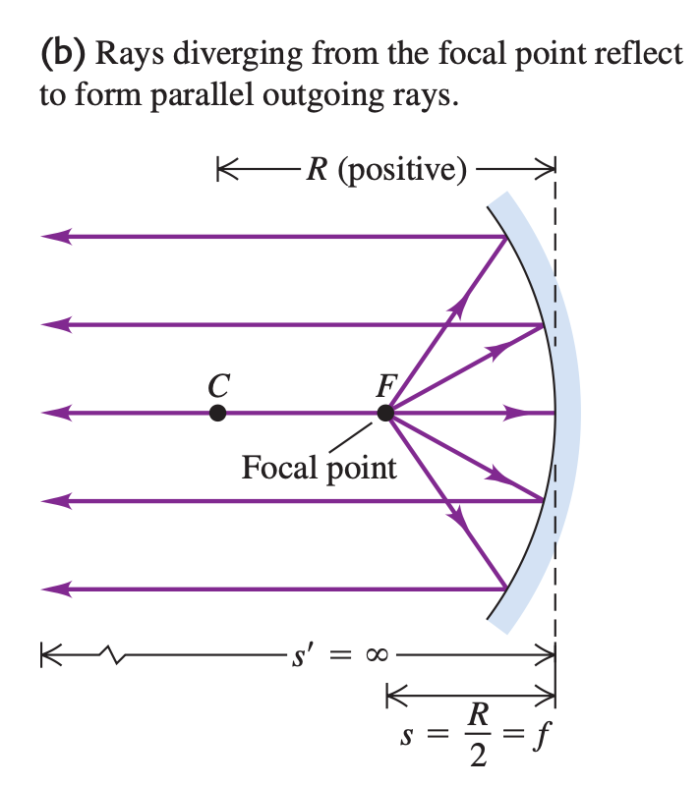
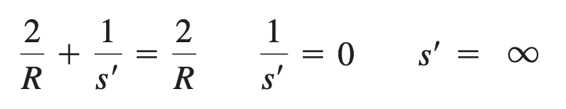
34-2 Reflection at a Spherical Surface
Focal point and Focal Length
The object is placed at the focal point F,

Slide 19
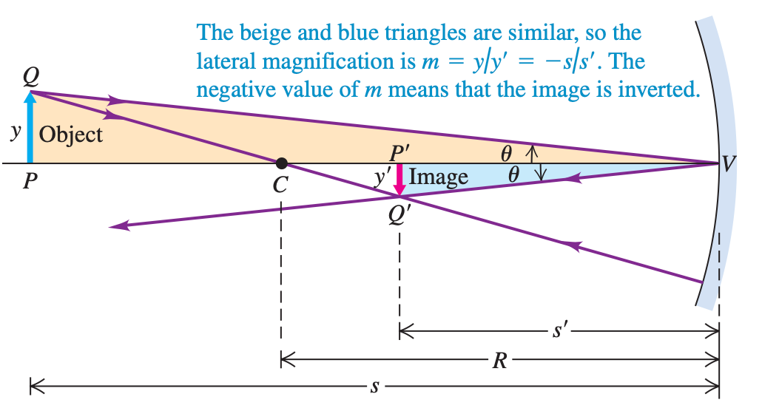
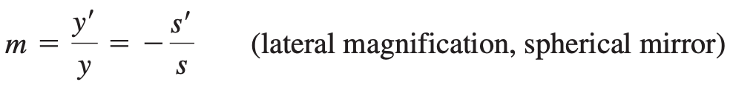
34-2 Reflection at a Spherical Surface
an object with finite size

Slide 20
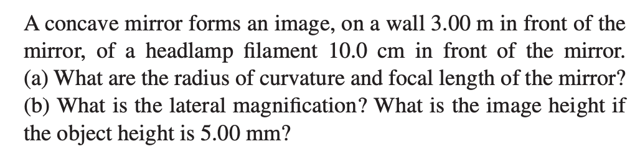
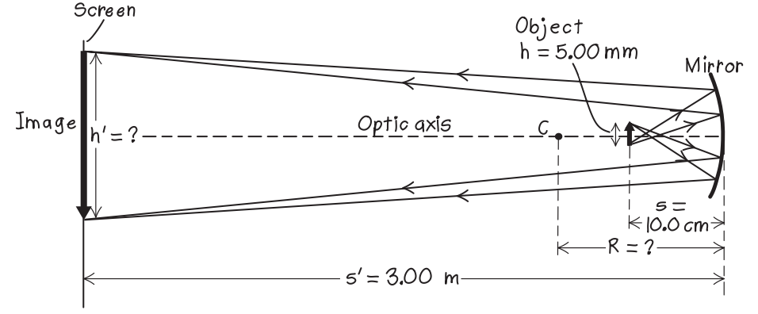
Sample Problem

Slide 21
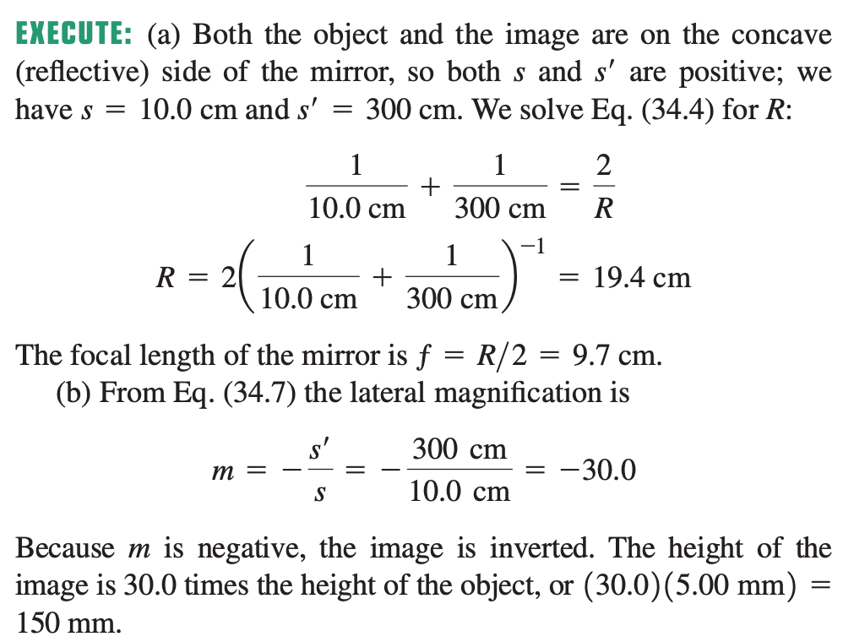
Sample Problem

Slide 22
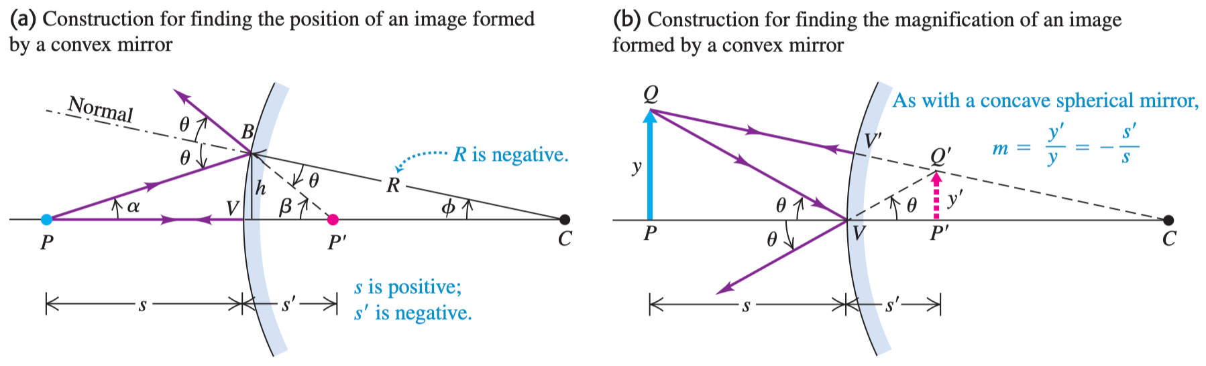
34-2 Reflection at a Spherical Surface
Image formation by a convex mirror

Slide 23
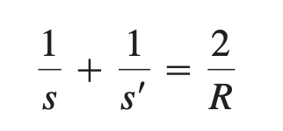
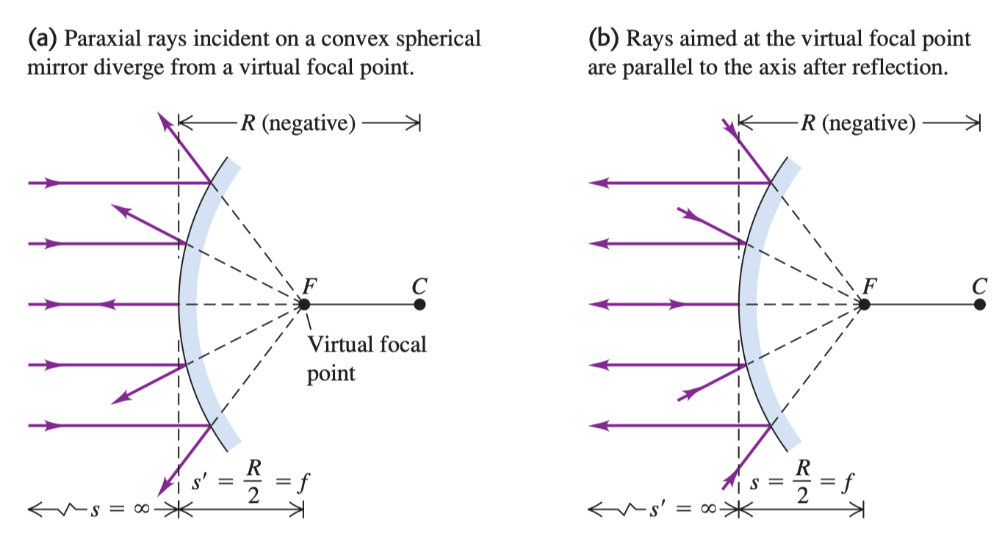
34-2 Reflection at a Spherical Surface
Focal point and focal length

Slide 24
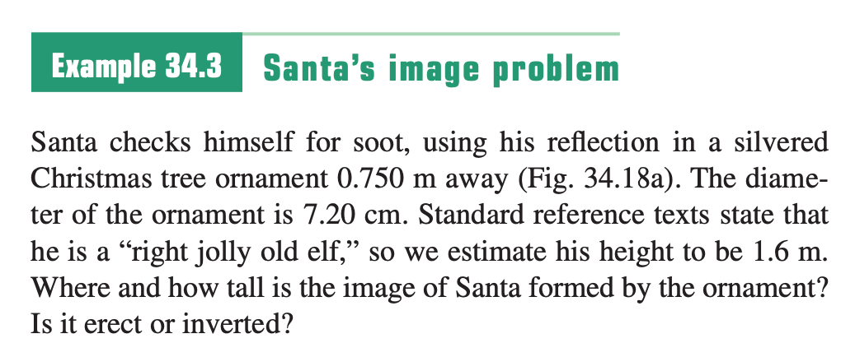
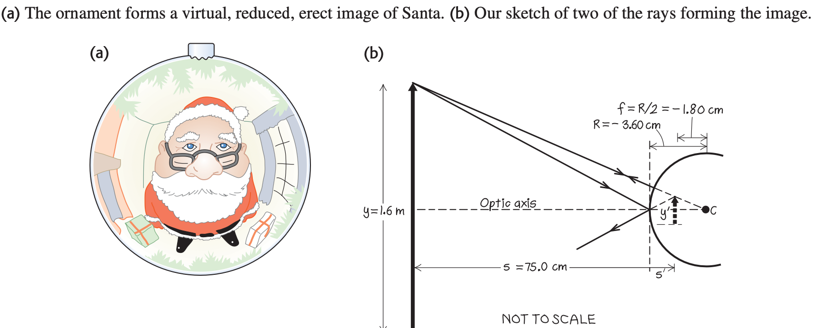
Sample Problem

Slide 25
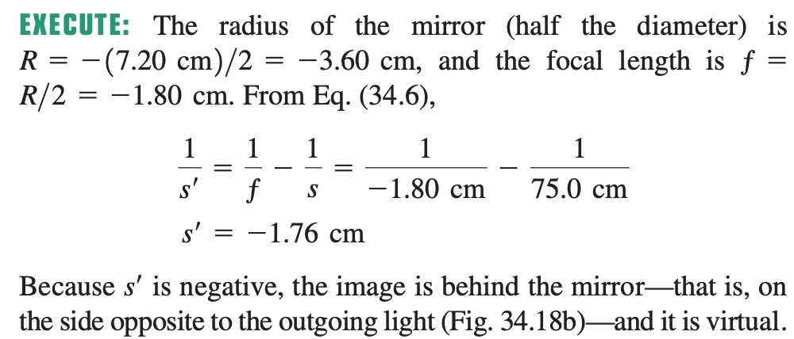
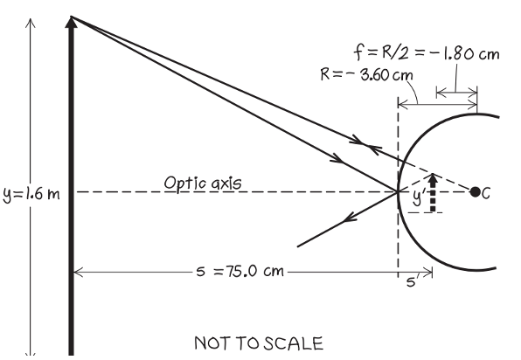
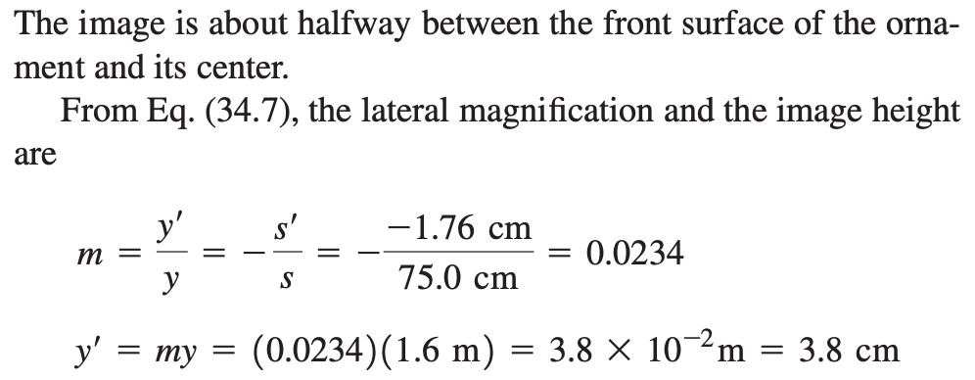
Sample Problem

Slide 26
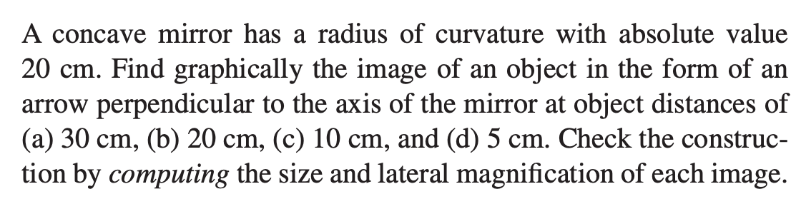
Sample Problem

Slide 27
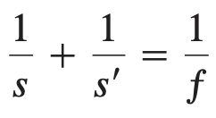
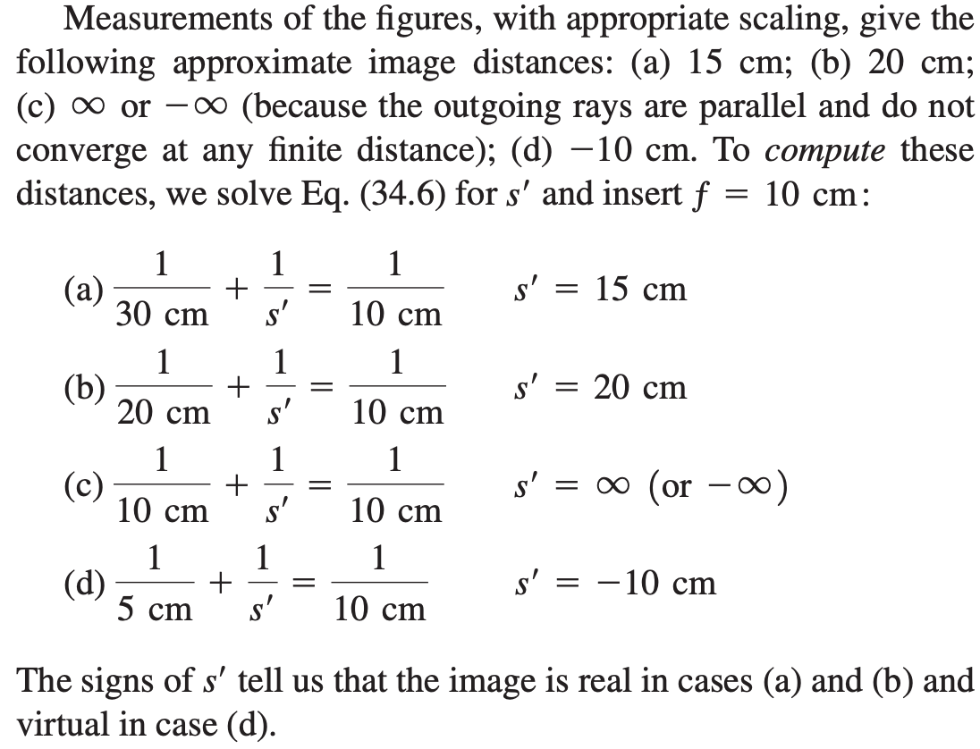
Sample Problem

Slide 28
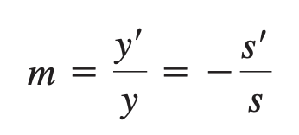
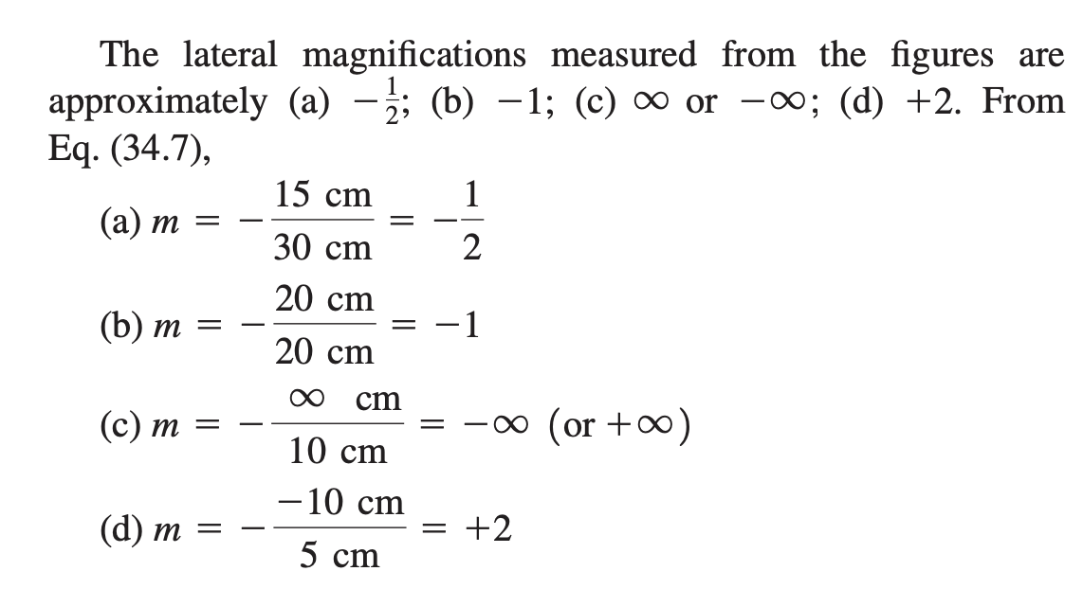
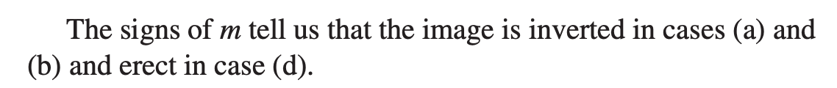
Sample Problem

Slide 29
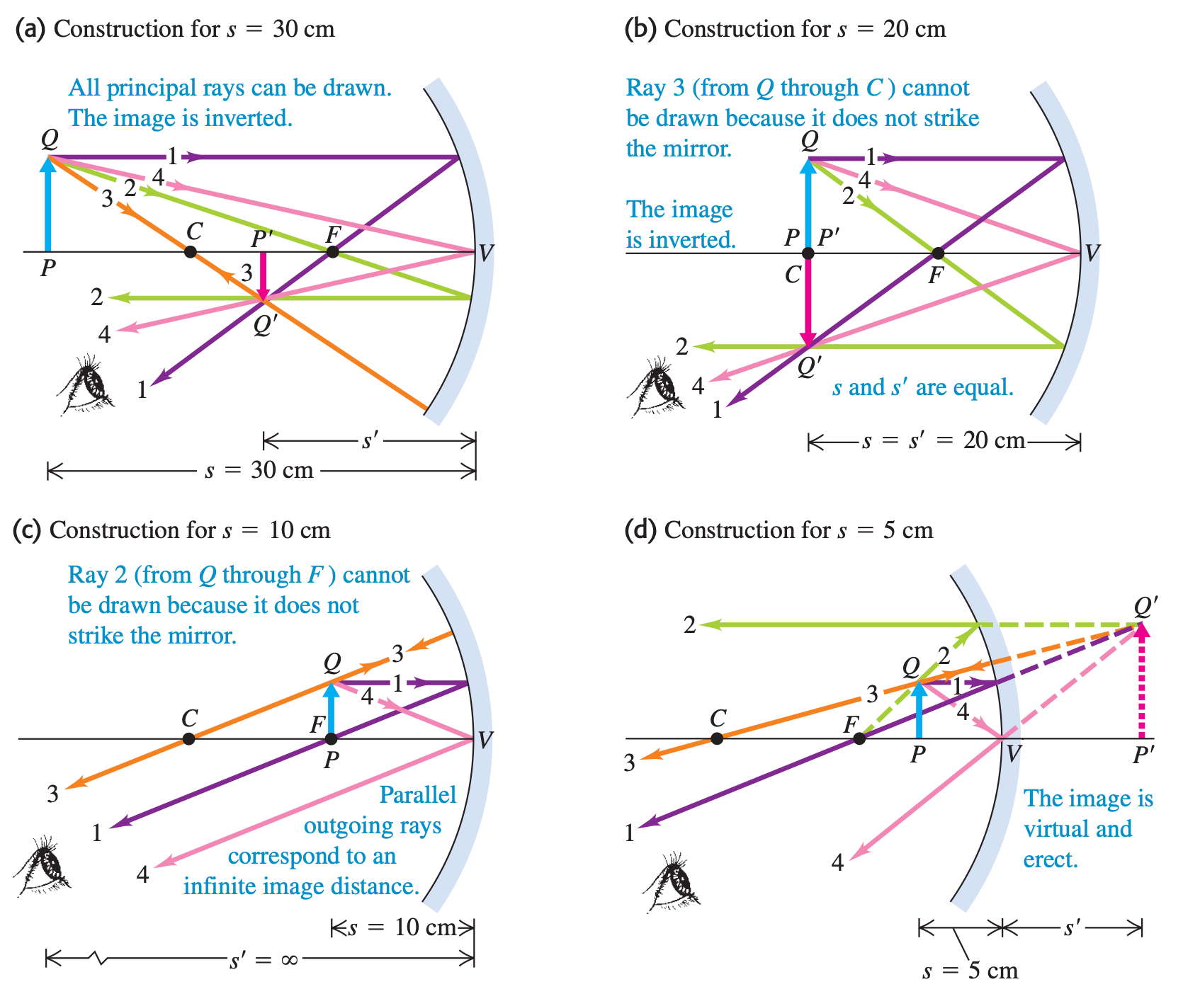
Sample Problem

Slide 30
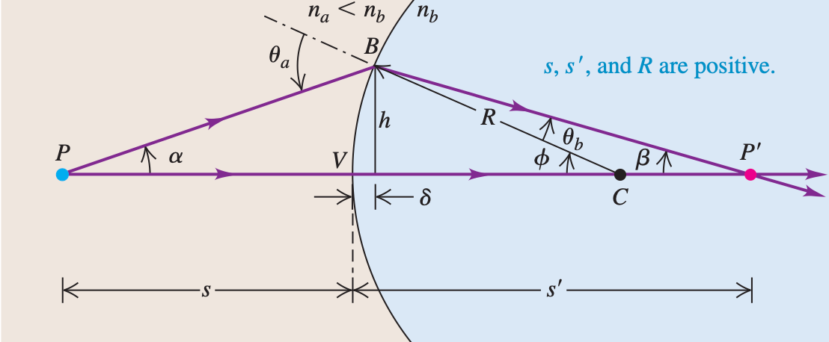


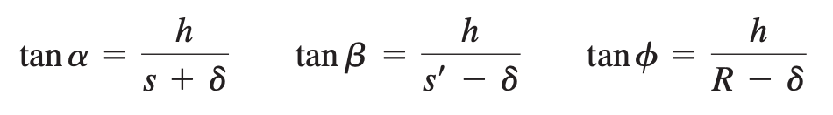

34-3 Refraction at a Spherical Surface
Point object

Slide 31



34-3 Refraction at a Spherical Surface
Object with height

Slide 32

34-3 Refraction at a Spherical Surface

Slide 33


34-3 Refraction at a Spherical Surface
Plane surface

Slide 34


34-3 Refraction at a Spherical Surface

Slide 35


Sample Problem

Slide 36

Sample Problem

Slide 37


Sample Problem

Slide 38


Sample Problem

Slide 39


Sample Problem

Slide 40

Summary

Slide 41

34-4 Thin Lenses

Slide 42



34-4 Thin Lenses
Image of an Extended Object: Converging Lens

Slide 43

34-4 Thin Lenses
Far-sighted people using
Short-sighted people using

Slide 44




34-4 Thin Lenses

Slide 45




34-4 Thin Lenses
Lensmaker’s equation for a thin lens
**Sign of R₁/R₂ is the key**

Slide 46



Sample Problem
Fig 34.35
Fig 34.31

Slide 47


Sample Problem
*Sign depends on sides of outgoing light*

Slide 48

Sample Problem

Slide 49


34-5 Cameras

Slide 50


34-5 Cameras
long focal length, called a telephoto lens, gives a small angle of view and a large image of a distant object
a lens of short focal length gives a small image and a wide angle of view and is called a wide-angle lens.

Slide 51




34-5 Cameras
For the film to record the image properly, the total light energy per unit area reaching the film (the “exposure”) must fall within certain limits.
The size of the area that the lens "sees" is proportional to the square of the angle of view of the lens, proportional to $1/f^{2}$.
Effective area is proportional to aperture diameter $D^{2}$.
Intensity of light reaching portional to $D^{2}/f^{2}$
Photographers define

Slide 52



Sample Problem

Slide 53

34-6 The Eye

Slide 54

34-6 The Eye
Hyperopic (farsighted) eye

Slide 55

34-6 The Eye
Myopic (nearsighted) eye

Slide 56

34-7 The Magnifier

Slide 57

34-7 The Magnifier

Slide 58

34-8 Microscopes and Telescopes

Slide 59


34-8 Microscopes and Telescopes

