Slide 1
PHYS1001B College Physics IB
Optics III Interference (Ch. 34)

Slide 2
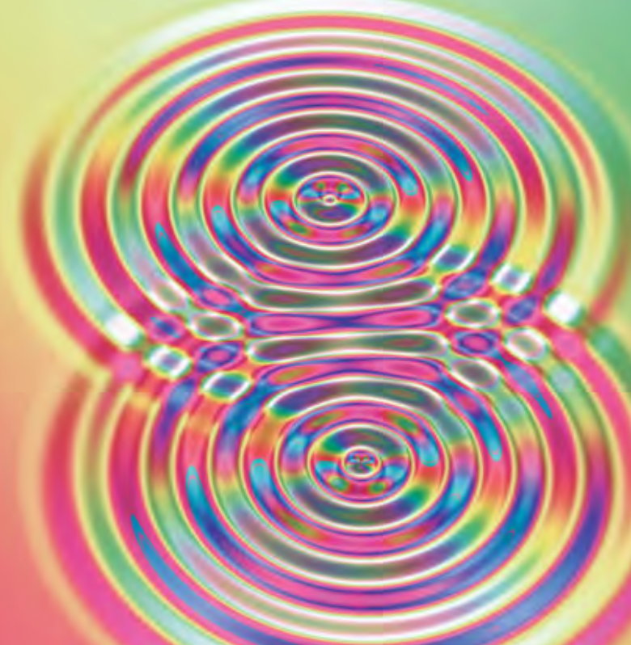
Introduction
Optical effects that depend on the wave nature of light are grouped under the heading physical optics.
Interference/ diffraction

Slide 3
Outline
35-1 Interference and Coherent Sources
35-2 Two-Source Interference of Light
35-3 Intensity in Interference Patterns
35-4 Interference in Thin Films
35-5 The Michelson Interferometer

Slide 4
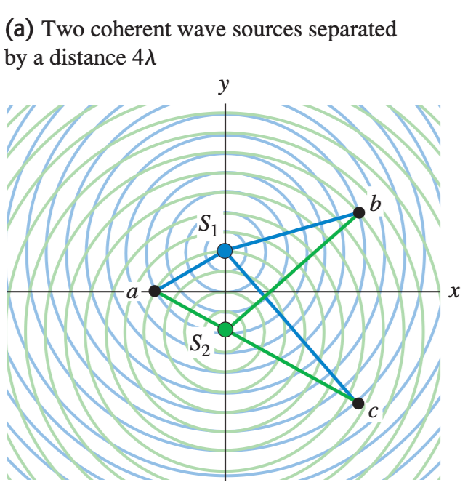
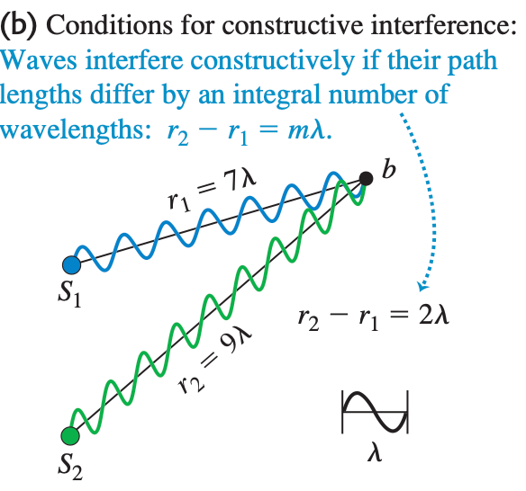
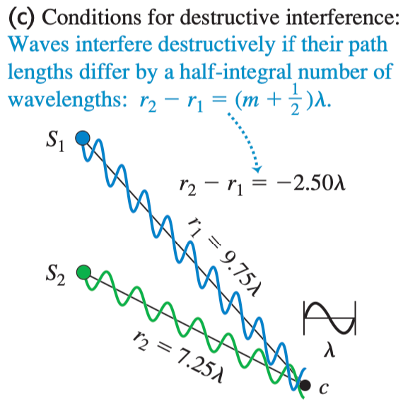
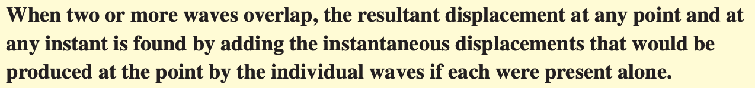
35-1 Interference and Coherent Sources
principle of superposition

Slide 5
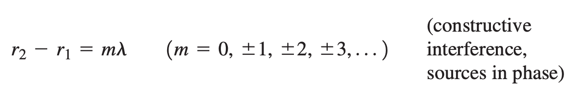
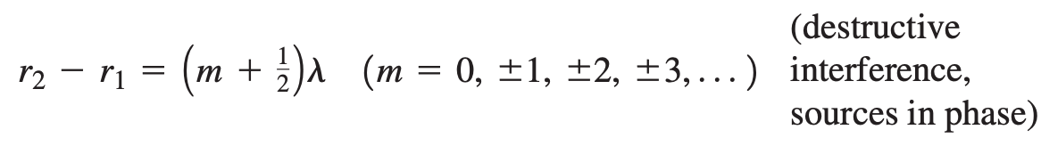
35-1 Interference and Coherent Sources

Slide 6
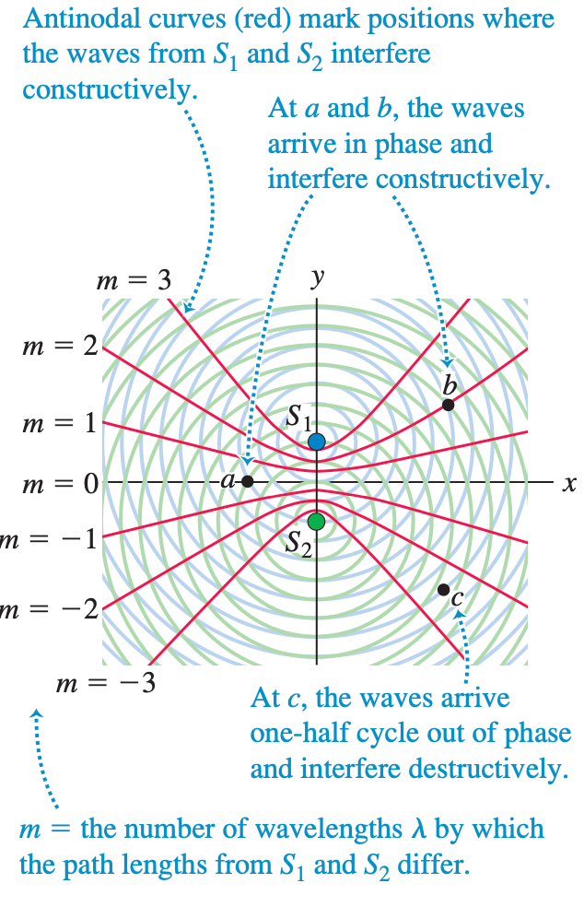
35-1 Interference and Coherent Sources

Slide 7
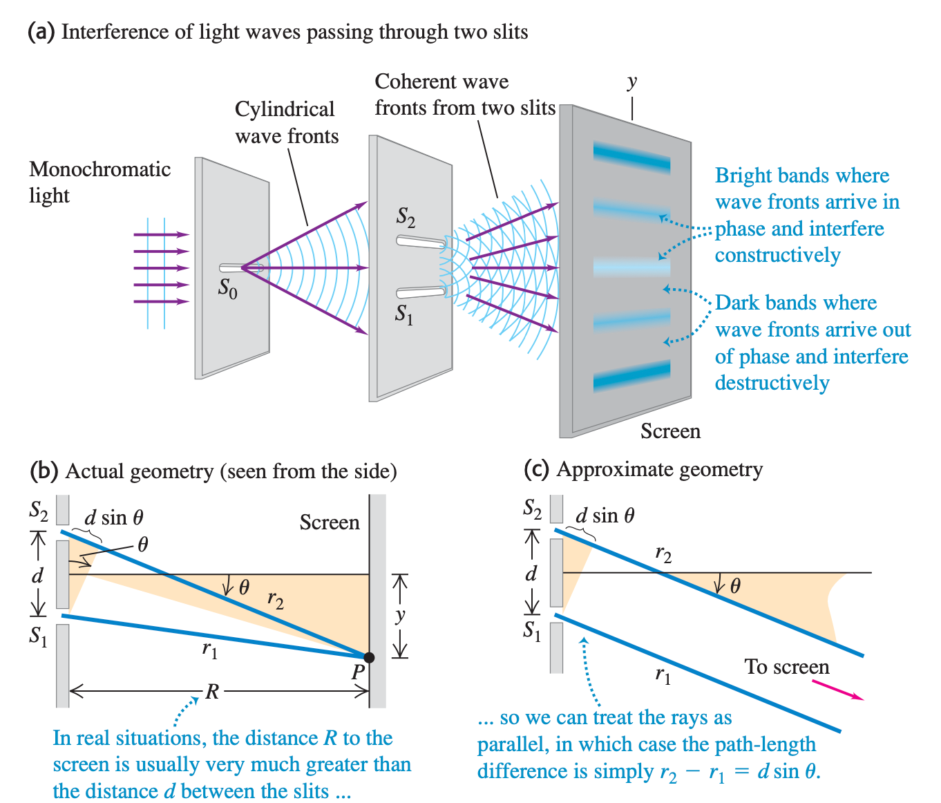
35-2 Two-Source Interference of Light

Slide 8
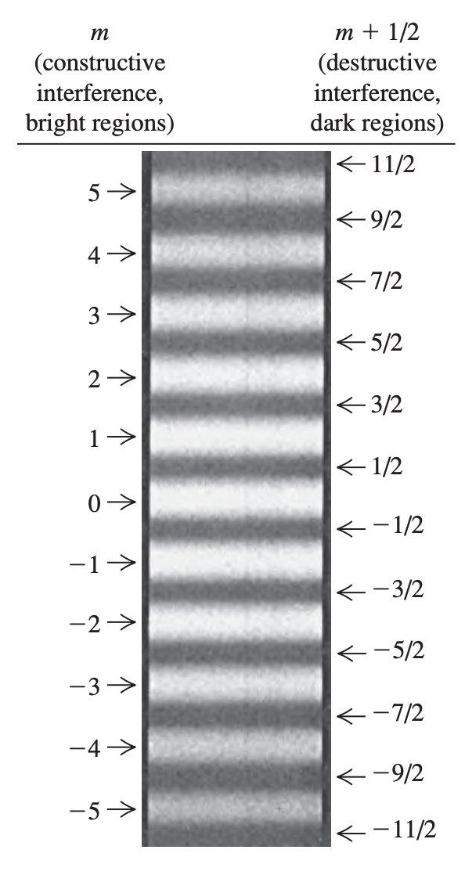


35-2 Two-Source Interference of Light
Constructive interference
Small angle
Destructive interference
Young’s double- slit

Slide 9
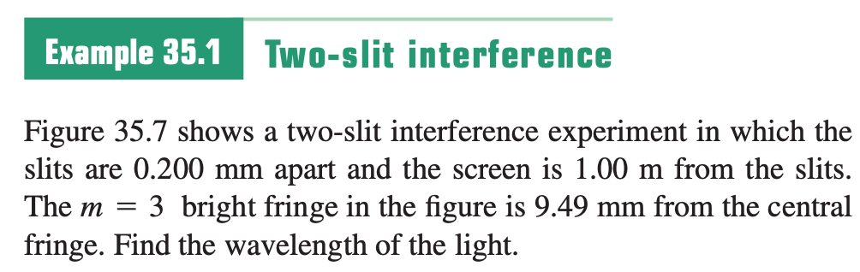
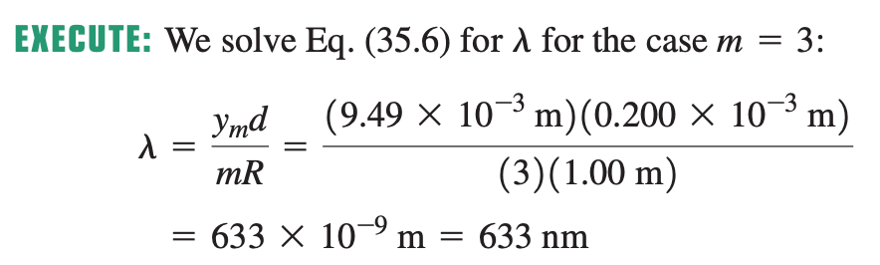
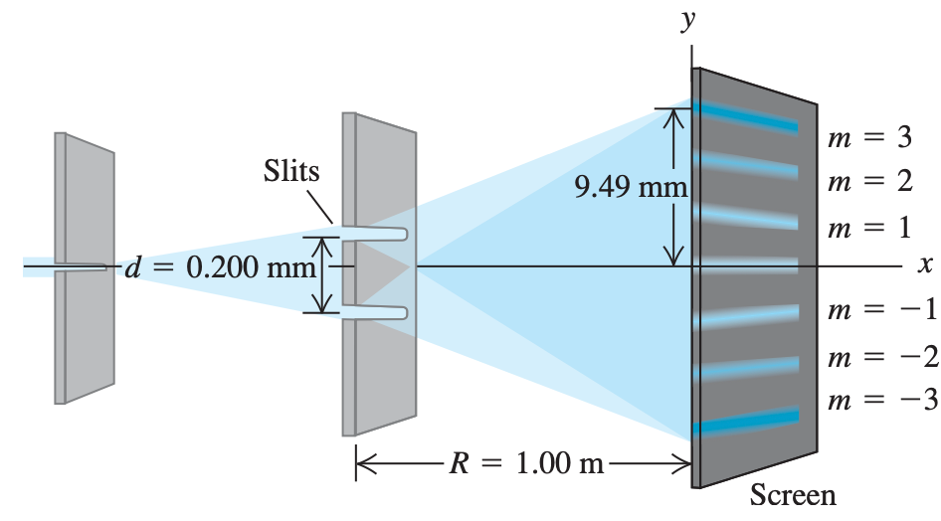
Sample Problem

Slide 10
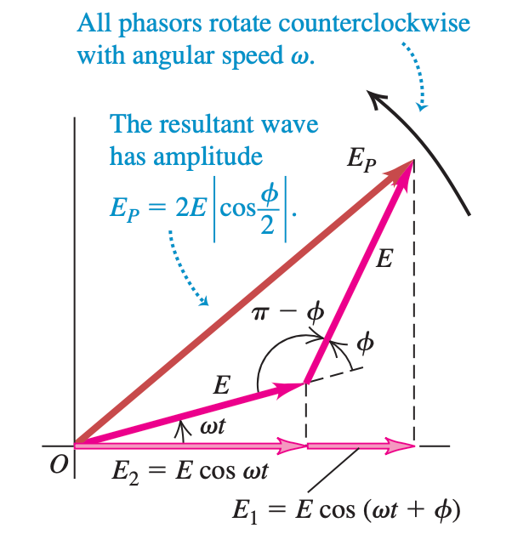
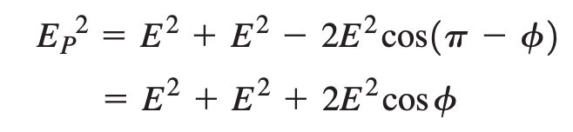
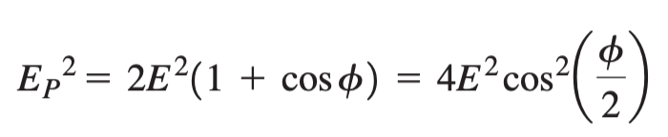
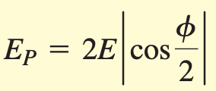
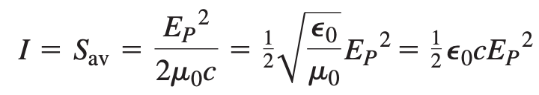
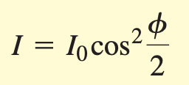
35-3 Intensity in Interference Patterns

Slide 11
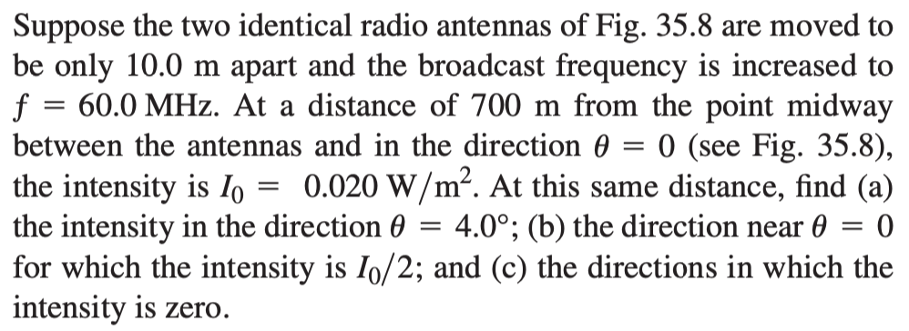
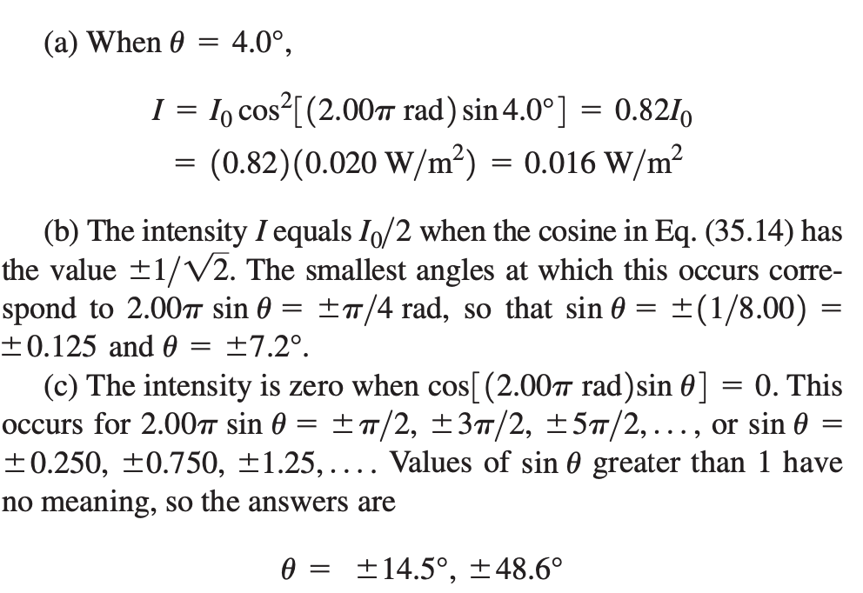
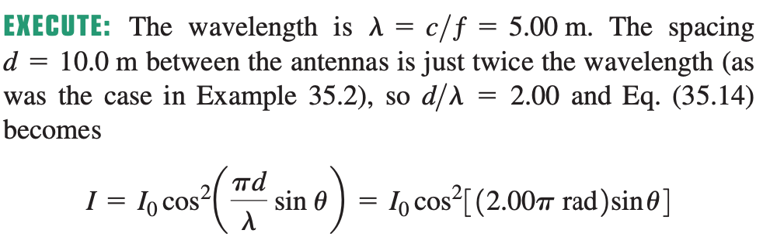
Sample Problem

Slide 12
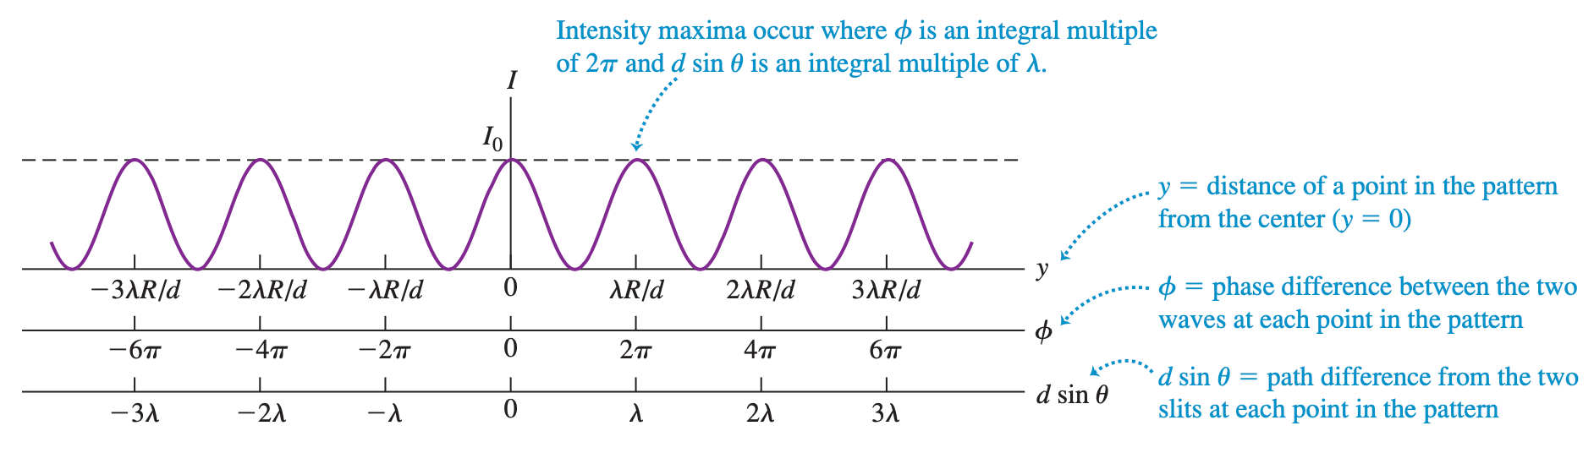
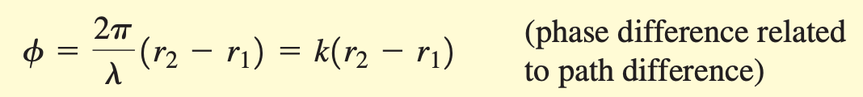
35-3 Intensity in Interference Patterns

Slide 13
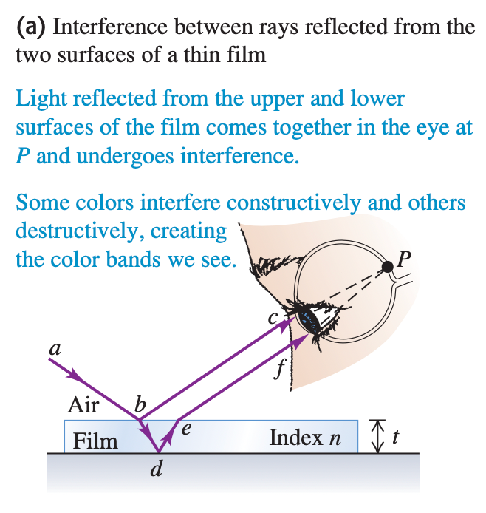
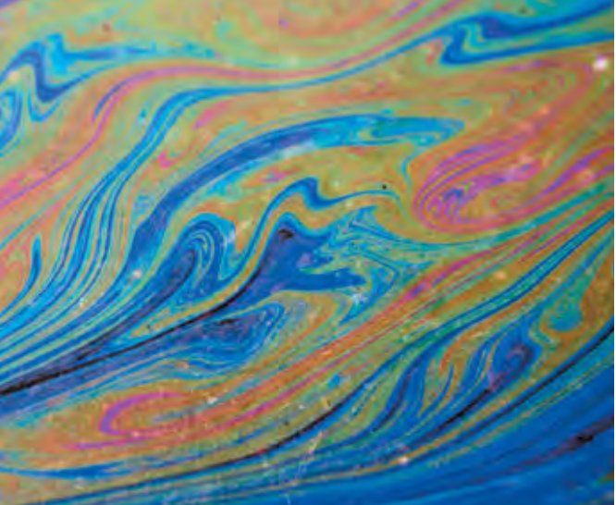
35-4 Interference in Thin Films

Slide 14
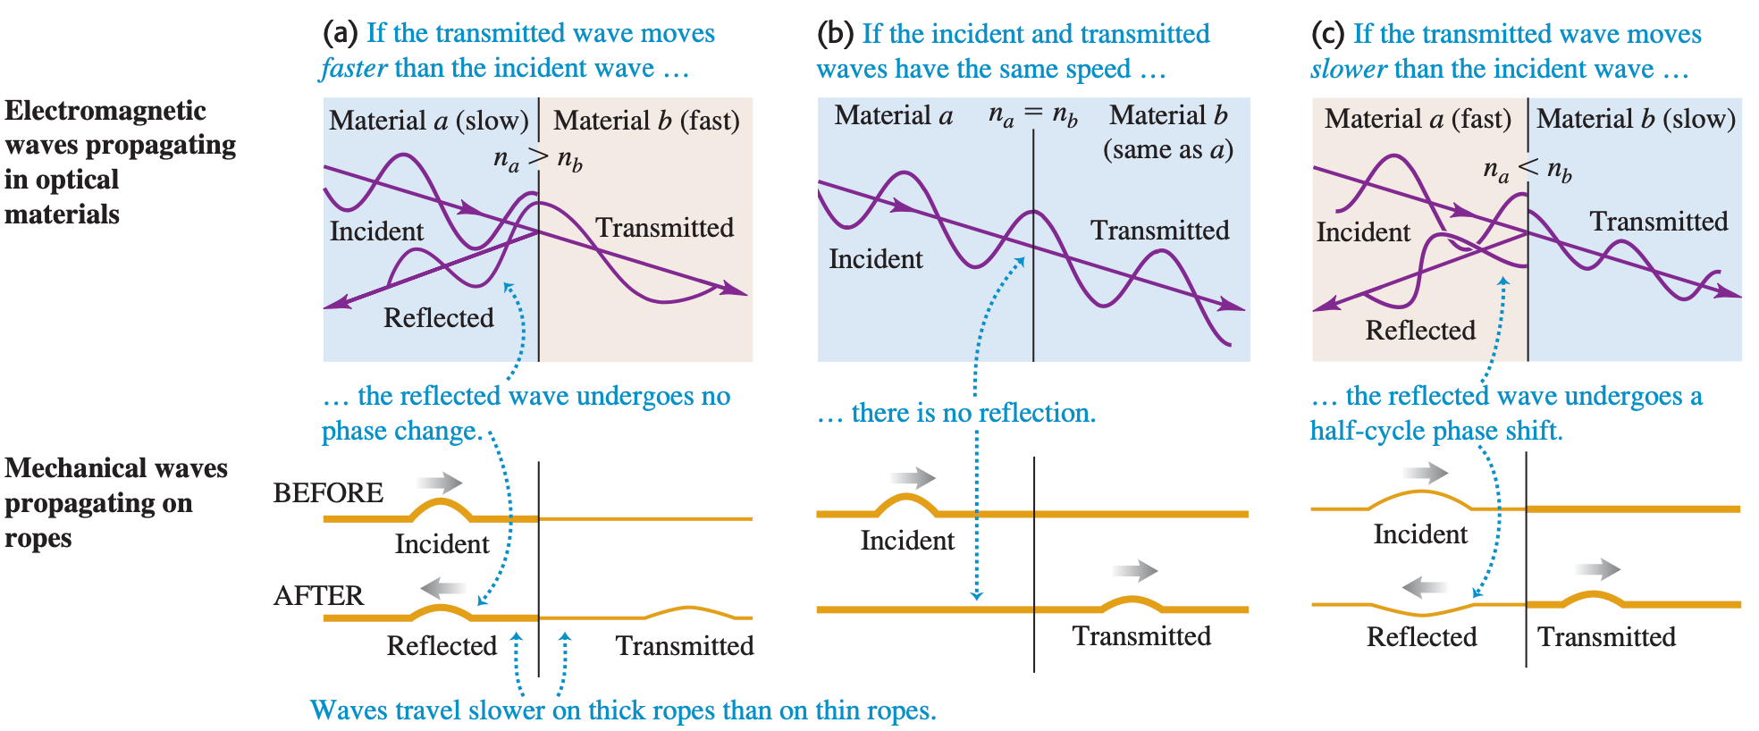
35-4 Interference in Thin Films

Slide 15
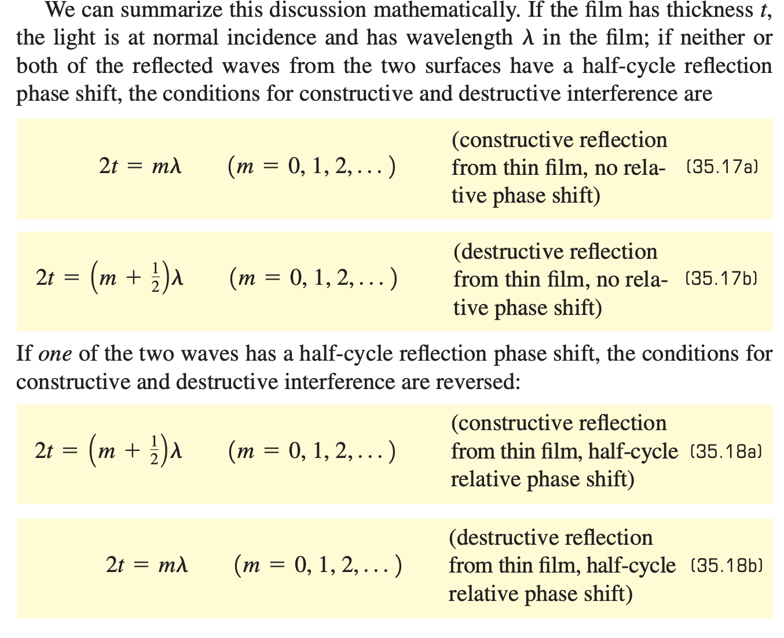
35-4 Interference in Thin Films

Slide 16
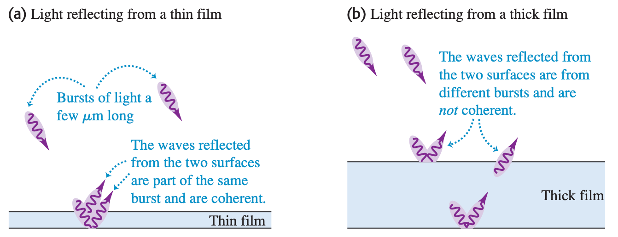
35-4 Interference in Thin Films

Slide 17
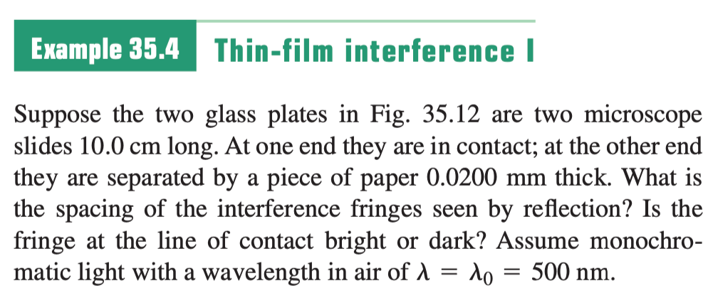
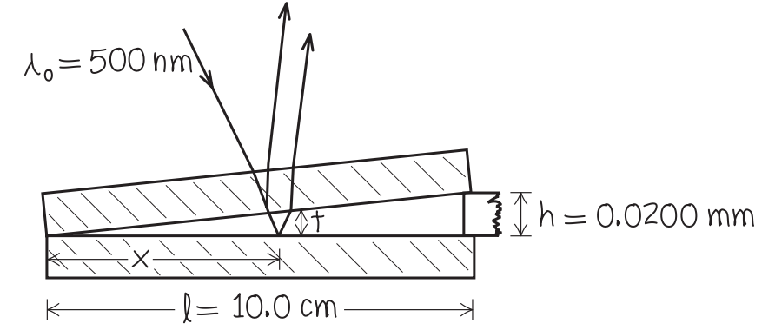
Sample Problem

Slide 18
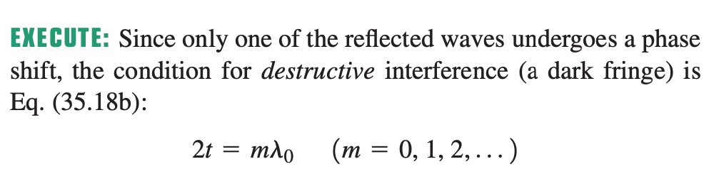
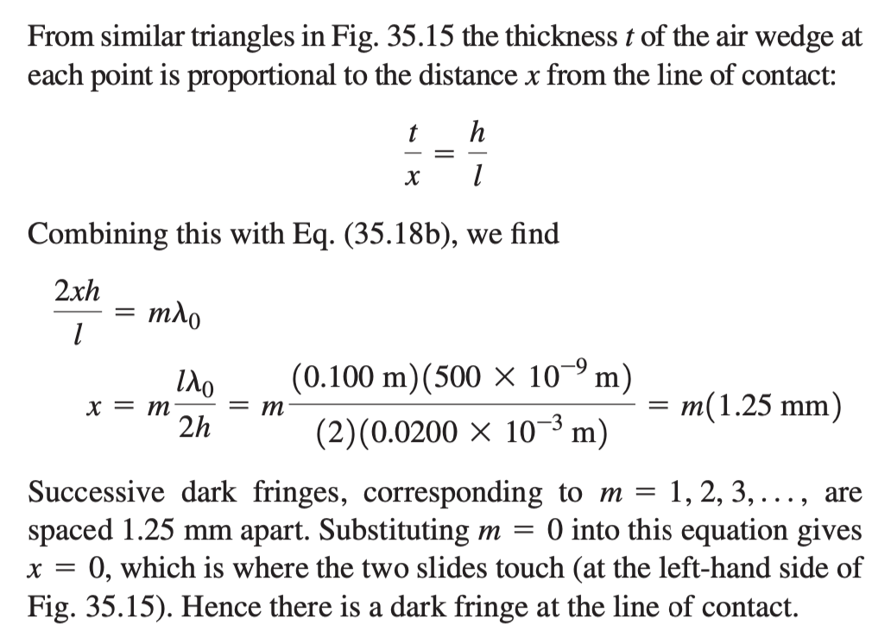
Sample Problem

Slide 19
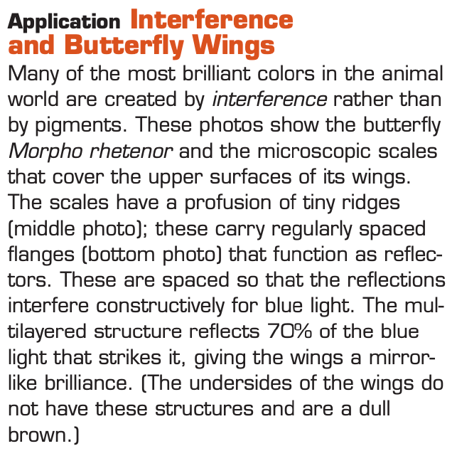
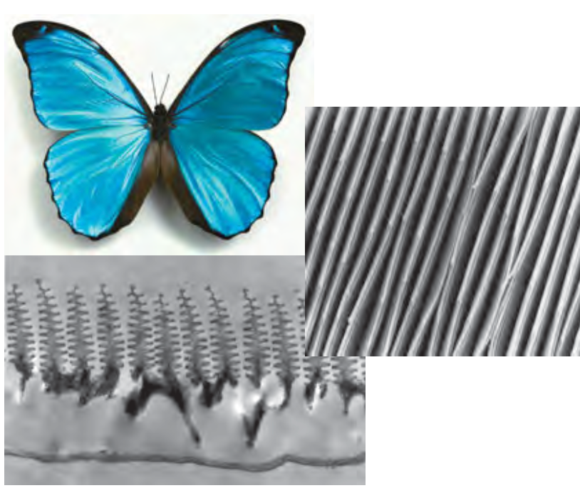
35-4 Interference in Thin Films

Slide 20
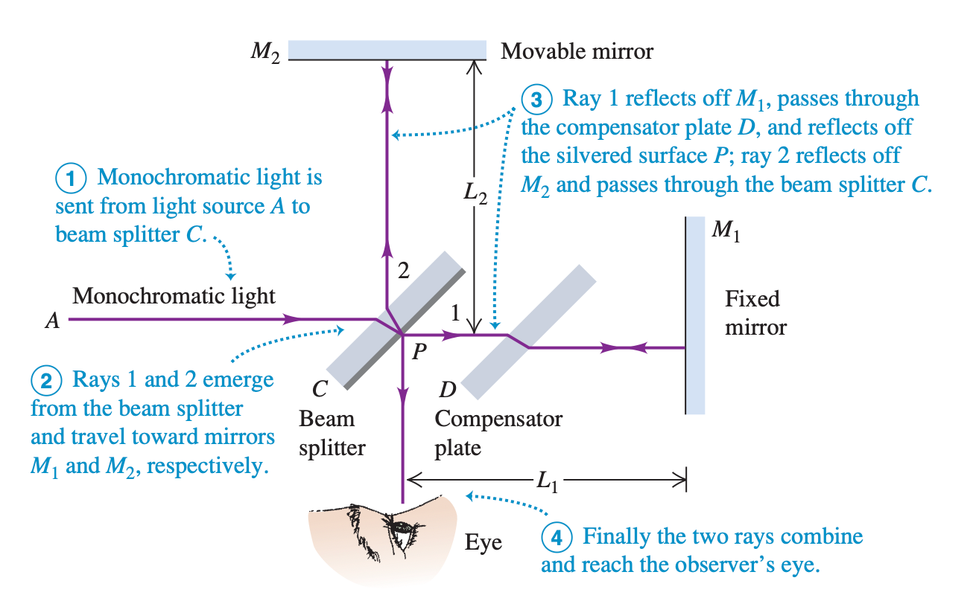

35-5 The Michelson Interferometer
Michelson interferometers are used to make precise measurements of wavelengths and of very small distances, such as the minute changes in thickness of an axon when a nerve impulse propagates along its length.

