Slide 1
PHYS1001B College Physics IB
Optics IV Diffraction (Ch. 36)

Slide 2
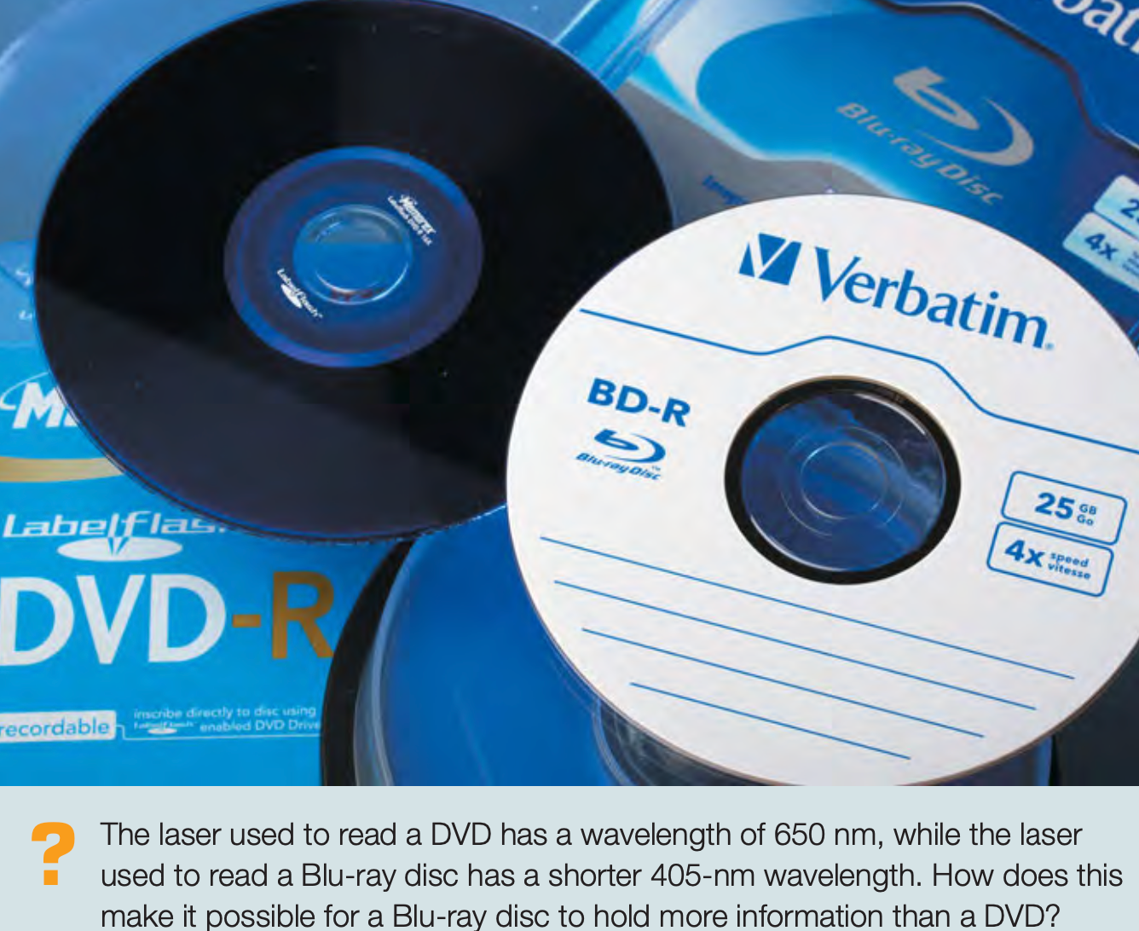
Introduction

Slide 3
Outline
36-1 Fresnel and Fraunhofer Diffraction
36-2 Diffraction from a Single Slit
36-3 Intensity in the Single-Slit Pattern
36-4 Multiple Slits
36-5 The Diffraction Grating
36-6 X-Ray Diffraction
36-7 Circular Apertures and Resolving Power
36-8 Holography

Slide 4
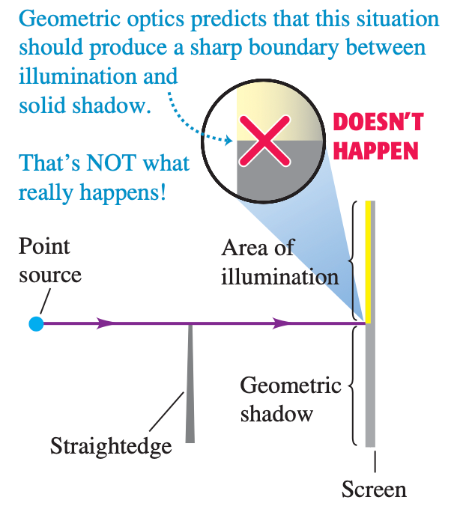
36-1 Fresnel and Fraunhofer Diffraction
no fundamental distinction between interference and diffraction
the behavior of waves after they pass through an aperture is an example of diffraction

Slide 5
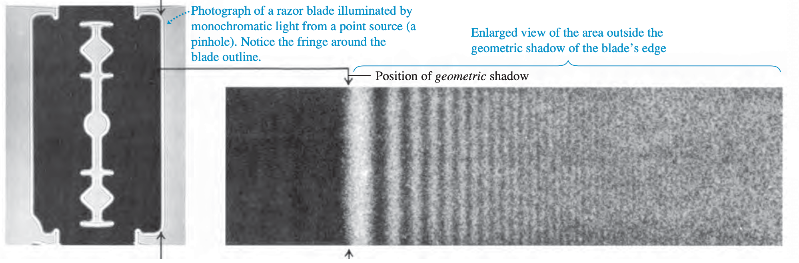
36-1 Fresnel and Fraunhofer Diffraction
Fresnel diffraction : the source, obstacle, and screen are close
Fraunhofer diffraction:the source, obstacle, and screen are far enough apart (this chapter)

Slide 6
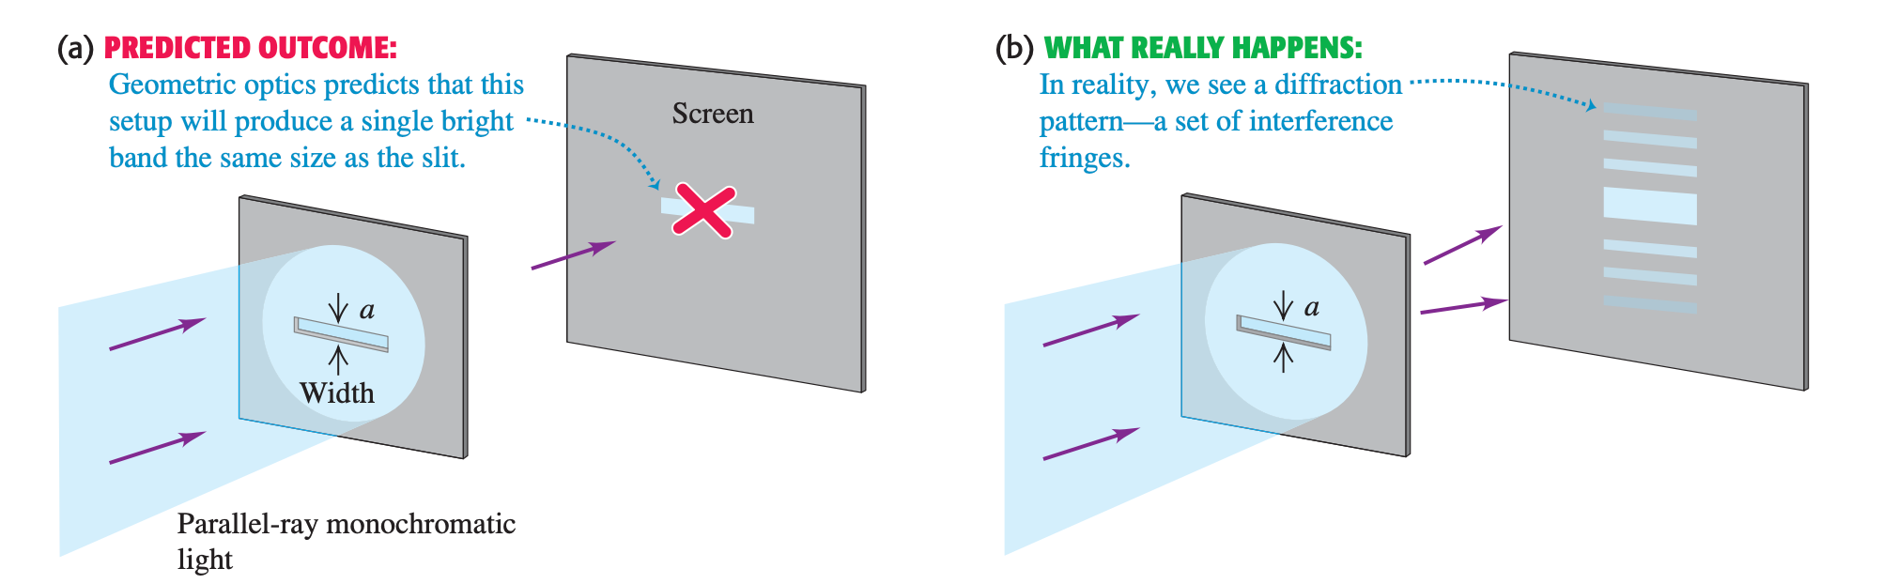
36-2 Diffraction from a Single Slit

Slide 7
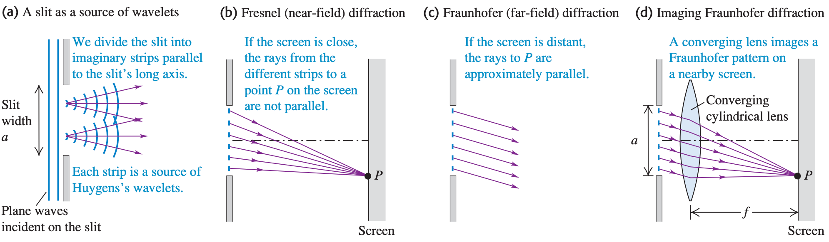
36-2 Diffraction from a Single Slit

Slide 8
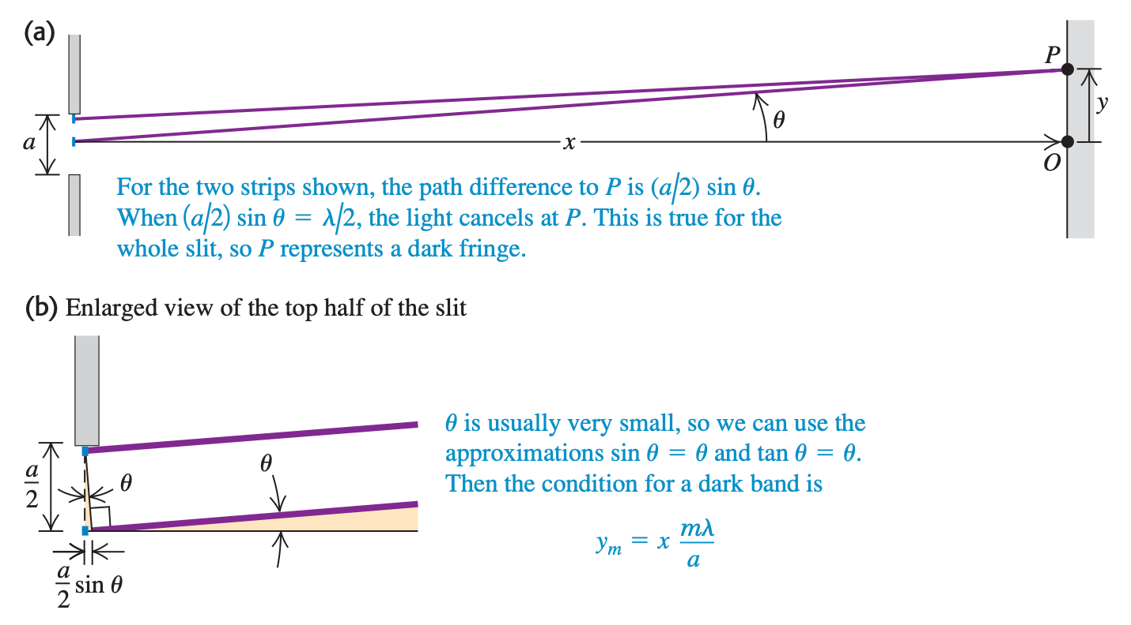
36-2 Diffraction from a Single Slit

Slide 9
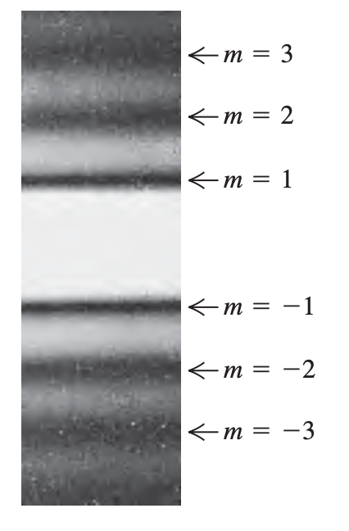
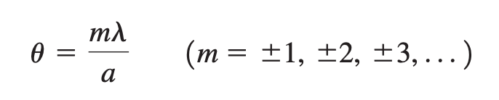
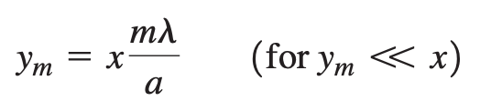
36-2 Diffraction from a Single Slit
Location of dark fringe
Small theta

Slide 10
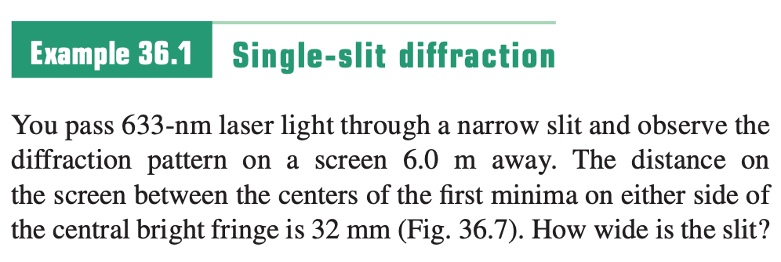
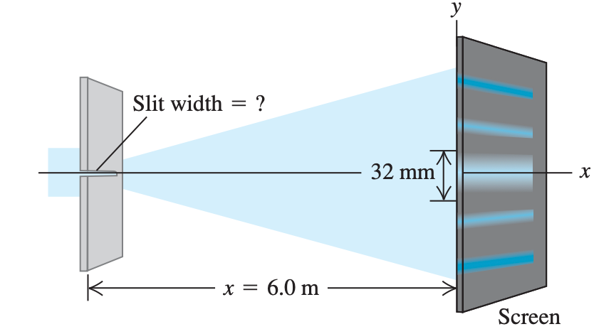
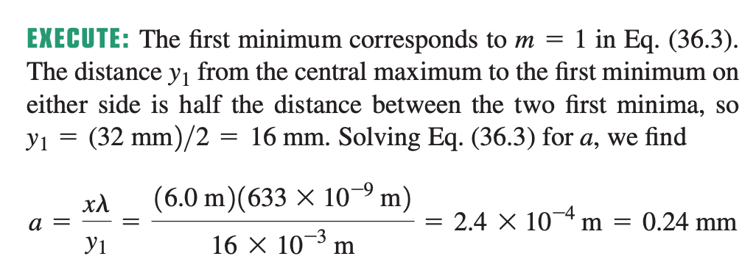
Sample Problem

Slide 11
36-3 Intensity in the Single-Slit Pattern
Location of dark fringe
Small theta

Slide 12
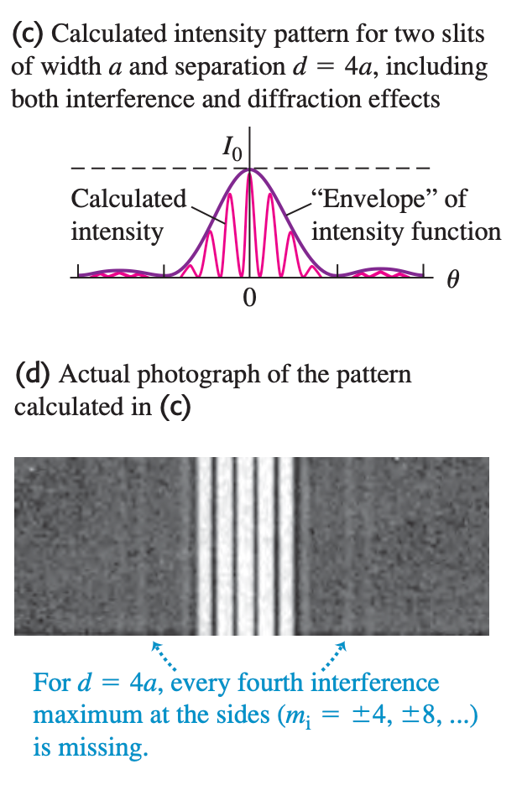
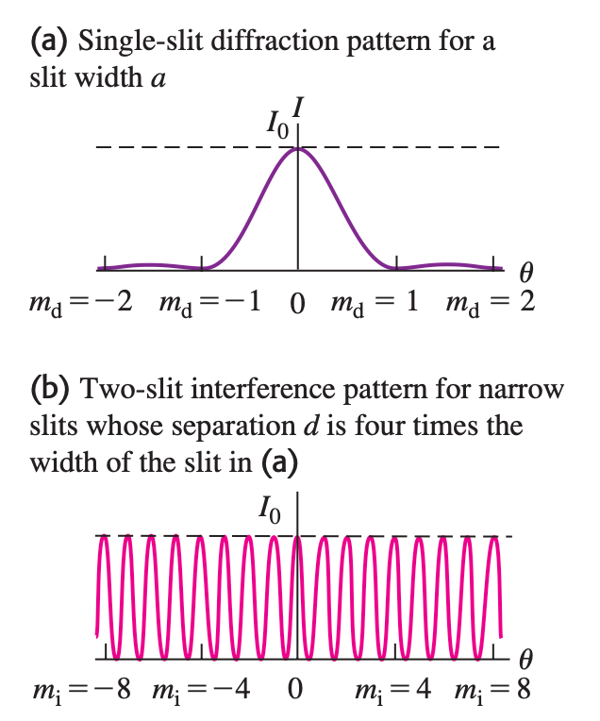
36-4 Multiple Slits
Two-slit: both interference and diffraction

Slide 13
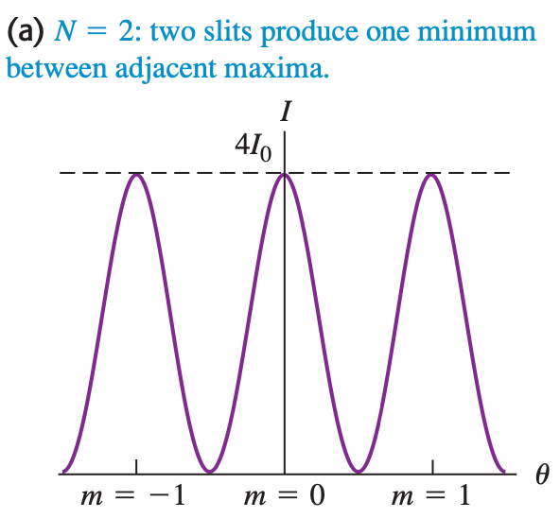
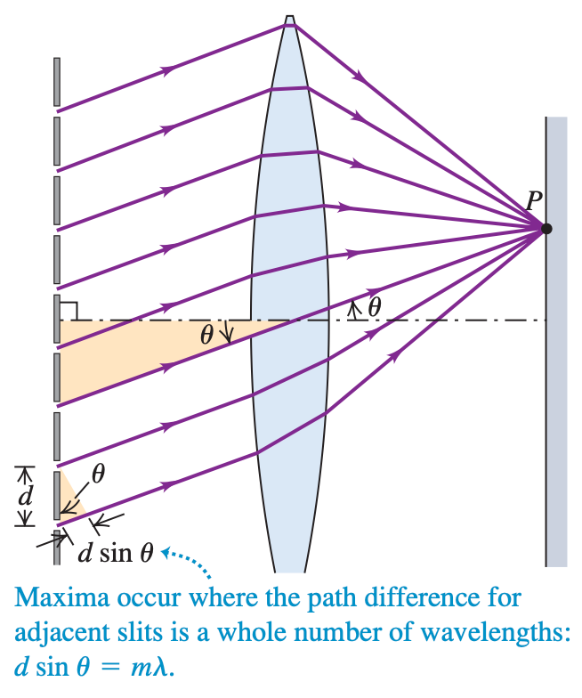
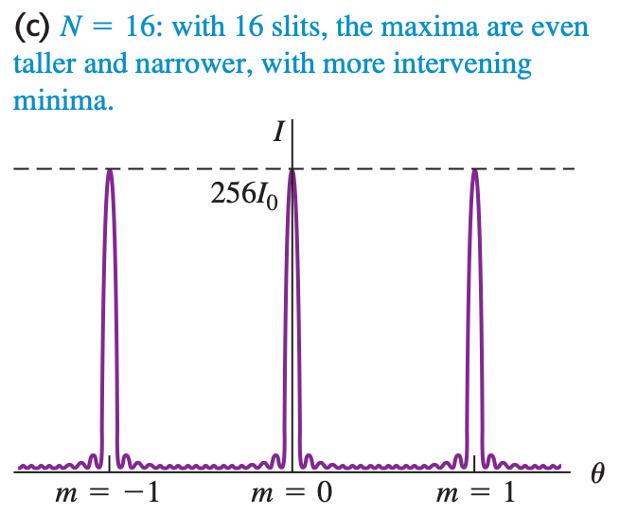
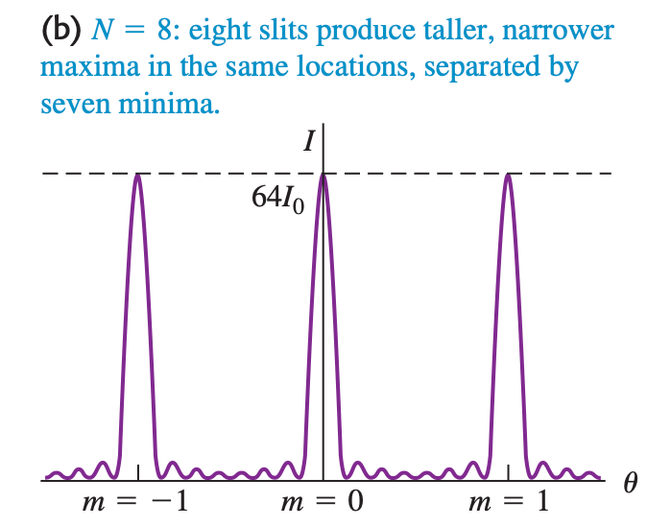
36-4 Multiple Slits

Slide 14
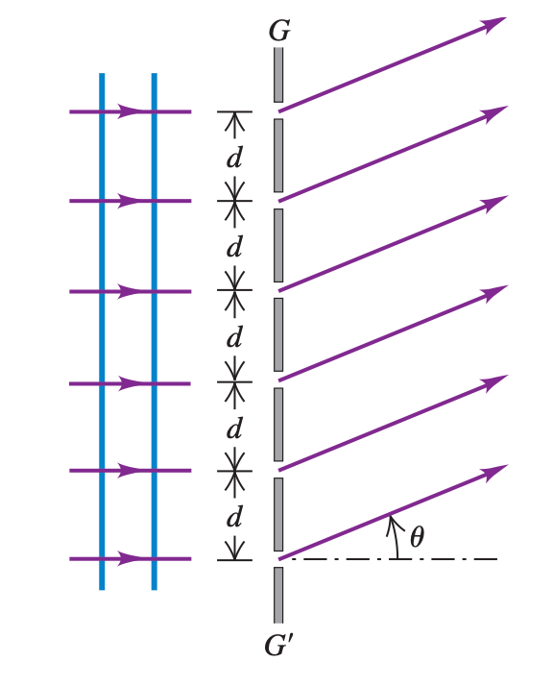
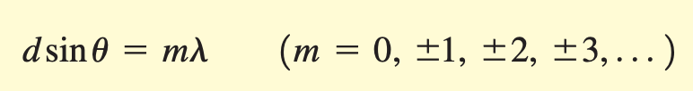
36-5 The Diffraction Grating
An array of a large number of parallel slits, all with the same width a and spaced equal distances d between centers, is called a diffraction grating.

Slide 15

36-5 The Diffraction Grating
The “grooves” are tiny pits 0.12 μm deep in the sur- face of the disc, with a uniform radial spacing of 0.74 μm = 740 nm. Information is coded on the DVD by varying the length of the pits.

Slide 16
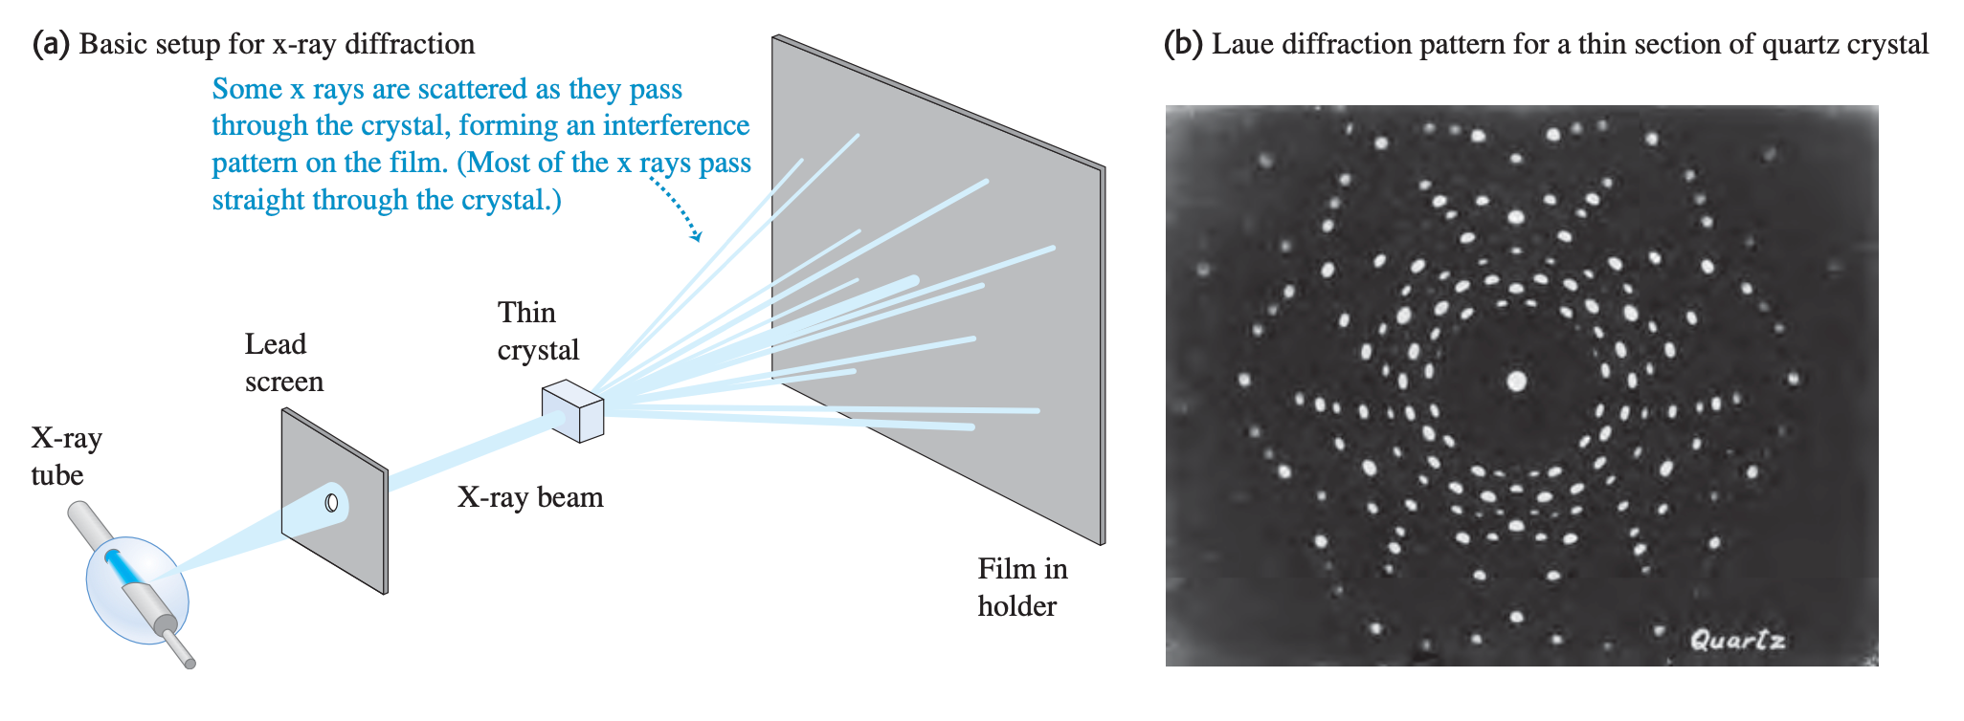
36-6 X-Ray Diffraction
Electromagnetic waves with wavelengths of the order of 10⁻¹⁰ m, similar to the scale of atomic distance

Slide 17
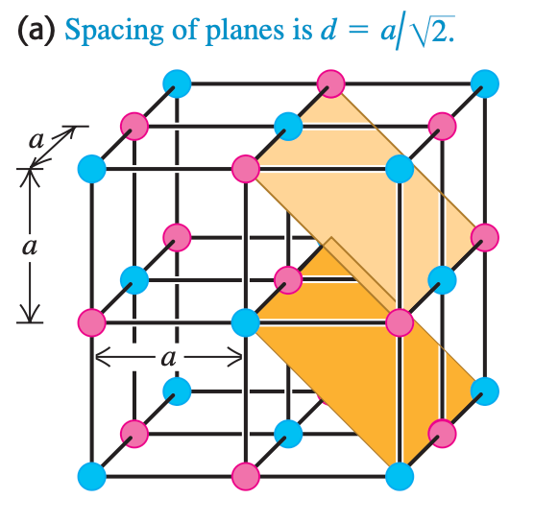
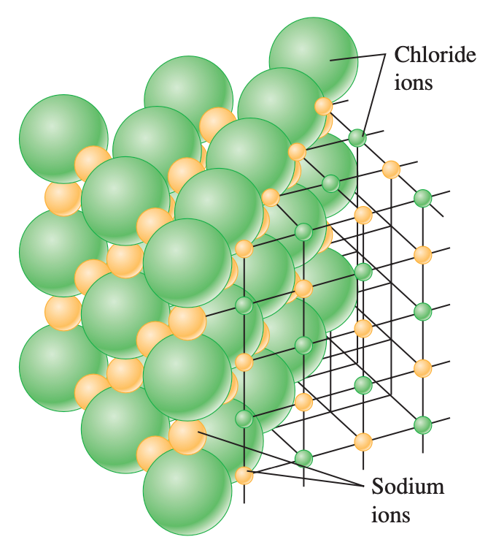
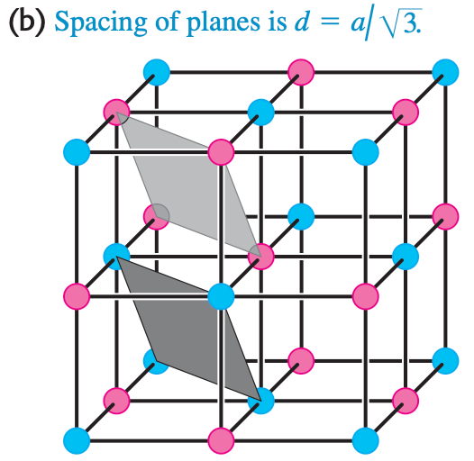
36-6 X-Ray Diffraction

Slide 18
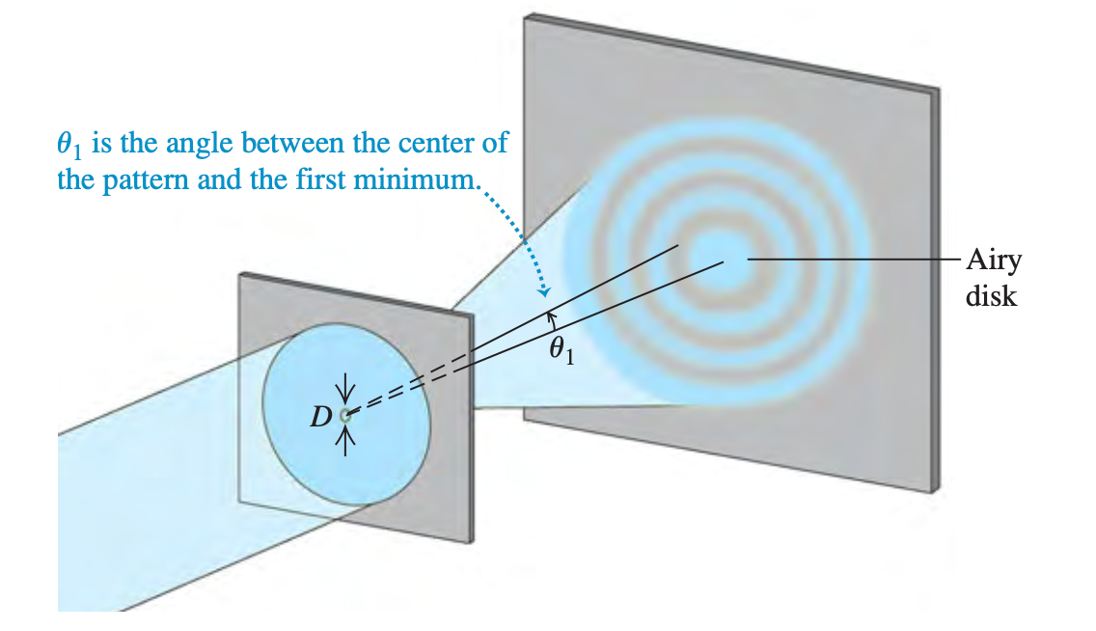
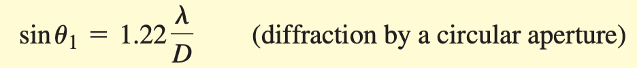
36-7 Circular Apertures and Resolving Power

Slide 19
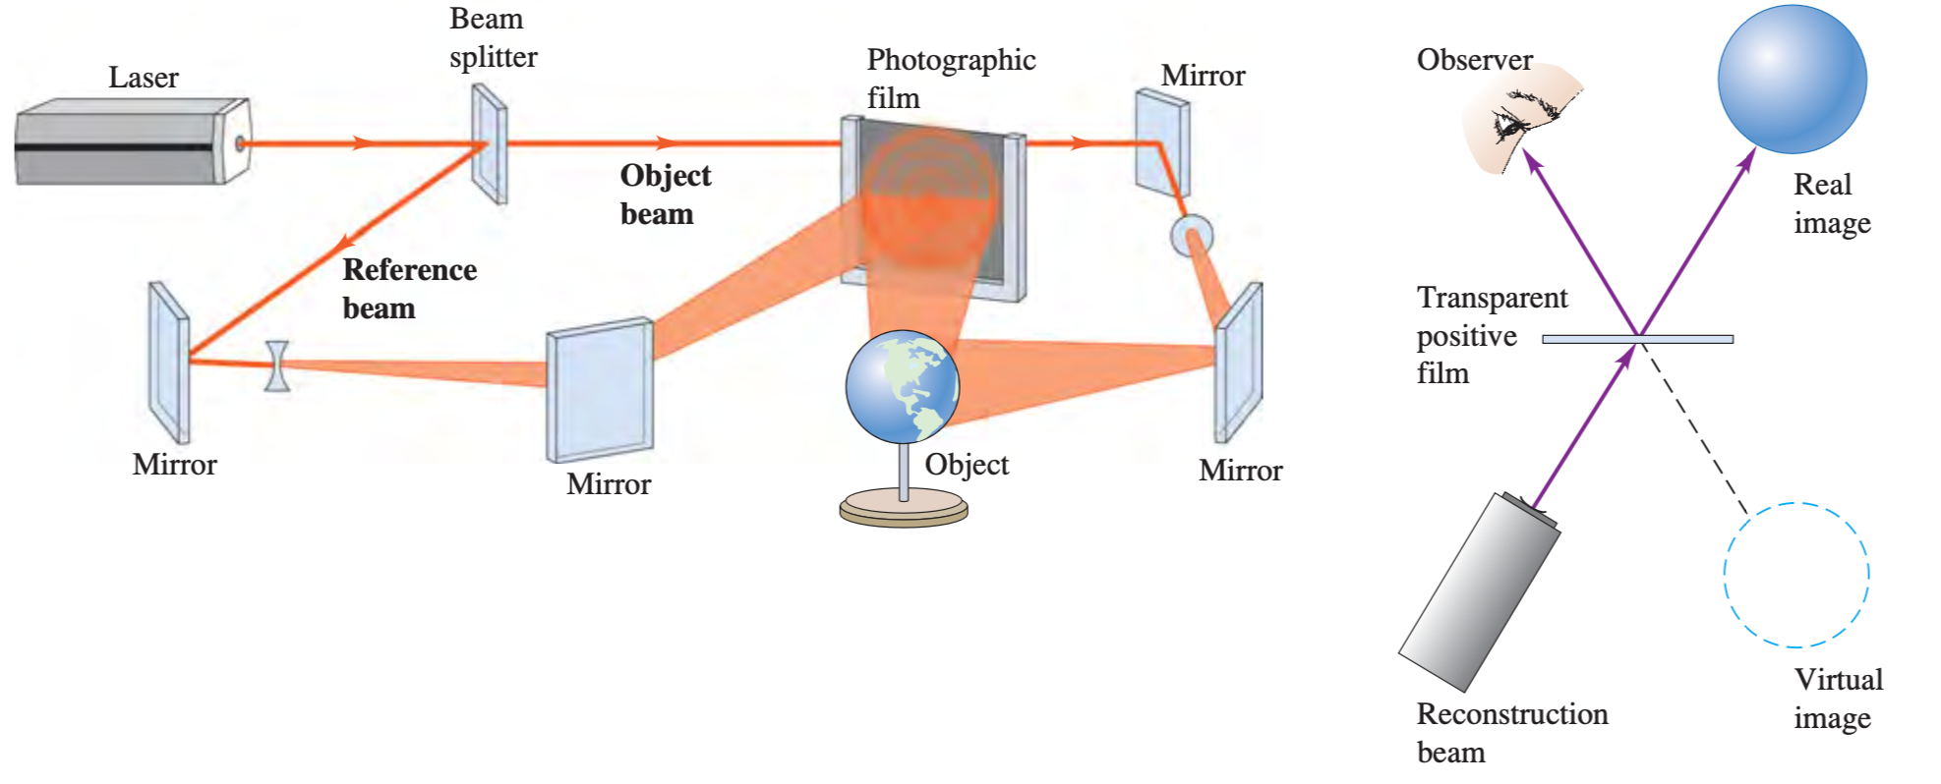
36-8 Holography
Holography is a technique for recording and reproducing an image of an object through the use of interference effects. Unlike the two-dimensional images recorded by an ordinary photograph or television system, a holographic image is truly three-dimensional.

