Slide 1
PHYS1001B College Physics IB
Modern Physics VI Relativity (Ch. 37)

Slide 2
Outline
37-1 Invariance of Physical Laws
37-2 Relativity of Simultaneity
37-3 Relativity of Time Intervals
37-4 Relativity of Length
37-5 The Lorentz Transformations
37-6 The Doppler Effect for Electromagnetic Waves
37-7 Relativistic Momentum
37-8 Relativistic Work and Energy
37-9 Newtonian Mechanics and Relativity

Slide 3
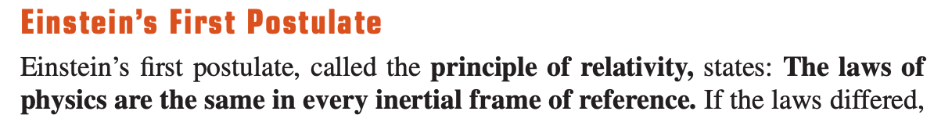
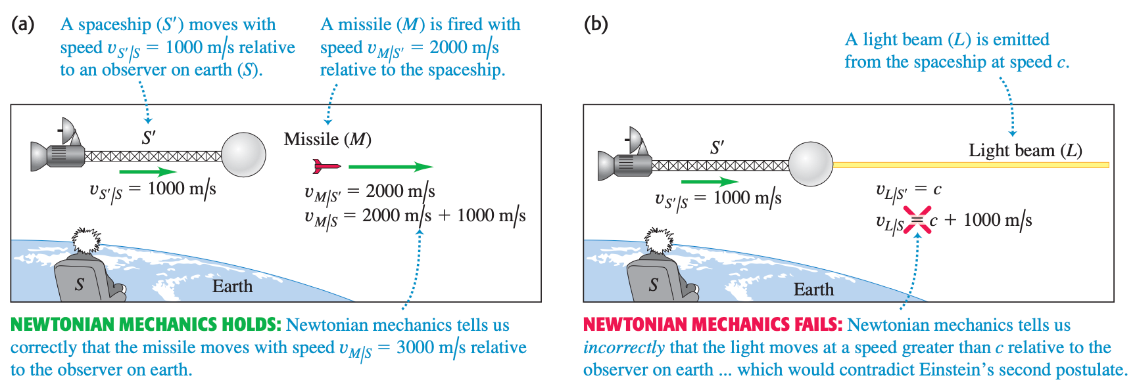
37-1 Invariance of Physical Laws

Slide 4
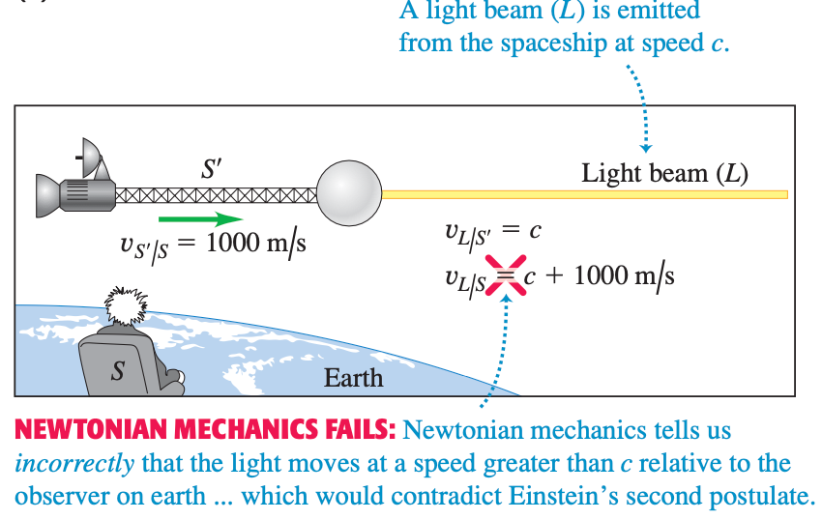
37-1 Invariance of Physical Laws

Slide 5
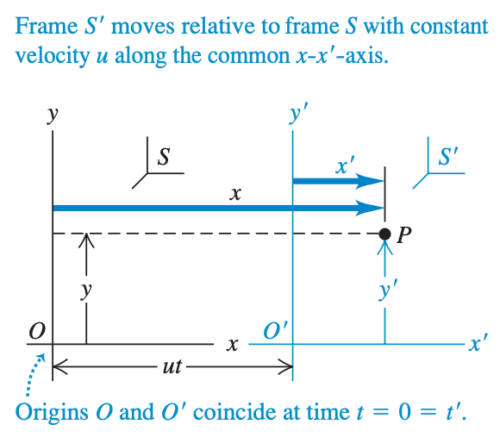

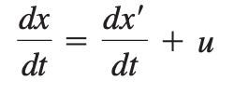

37-1 Invariance of Physical Laws
Galilean coordinate transformation

Slide 6
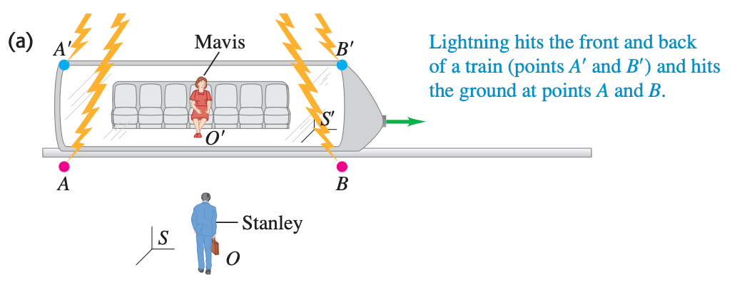
37-2 Relativity of Simultaneity

Slide 7
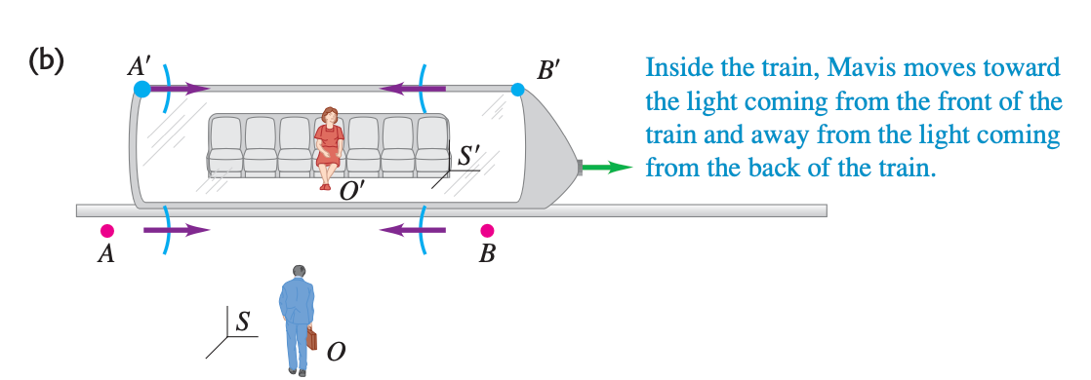
37-2 Relativity of Simultaneity

Slide 8
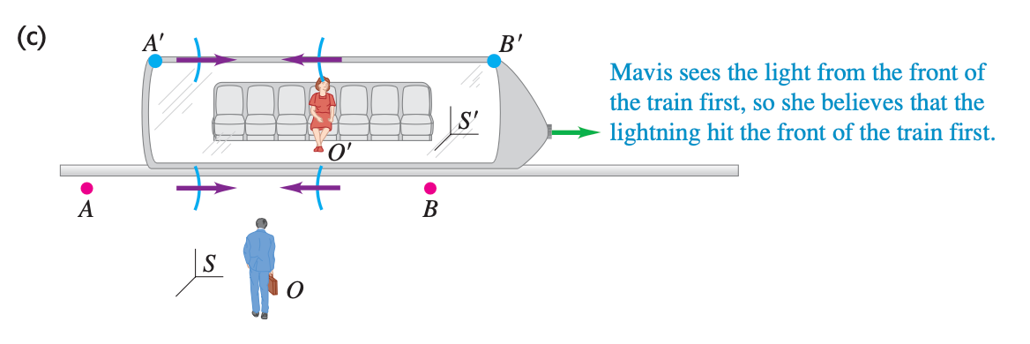
37-2 Relativity of Simultaneity

Slide 9
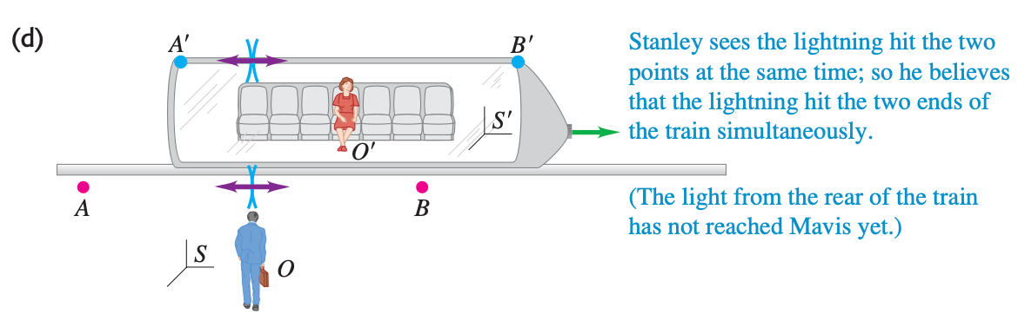
37-2 Relativity of Simultaneity

Slide 10
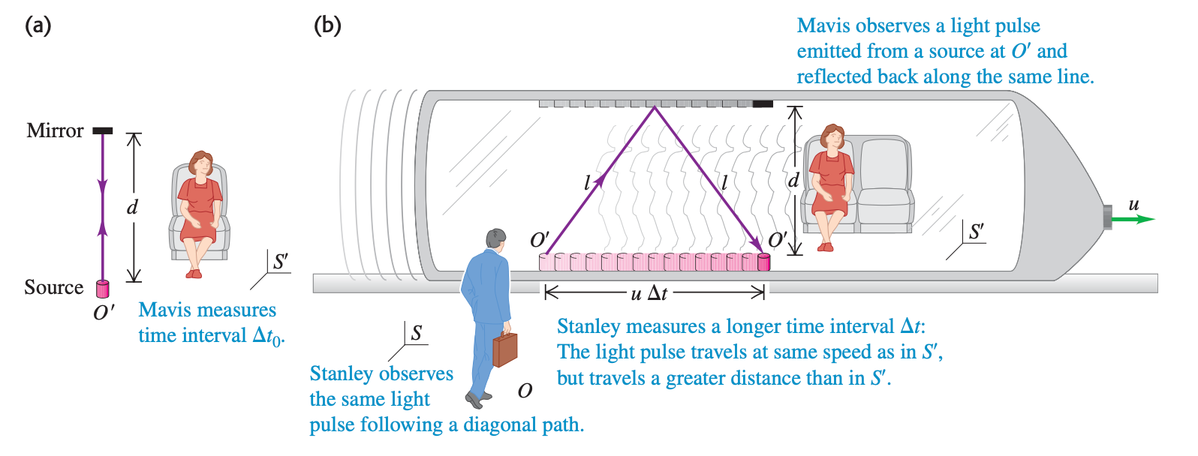
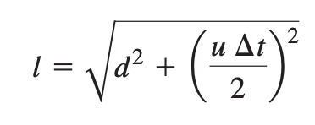
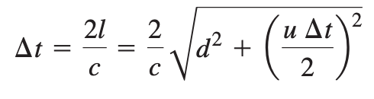

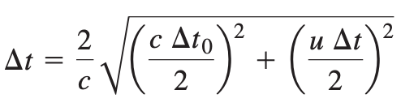
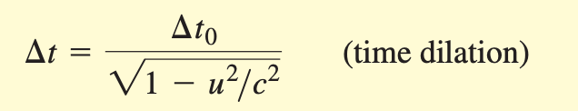
37-3 Relativity of Time Intervals

Slide 11
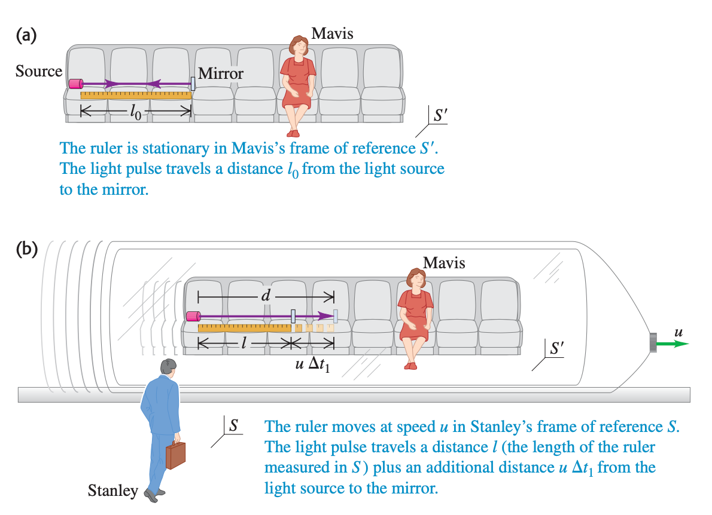
37-4 Relativity of Length

Slide 12


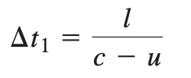
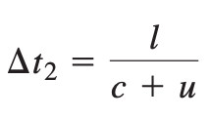
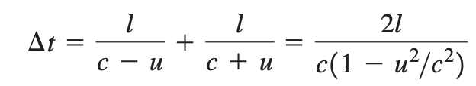
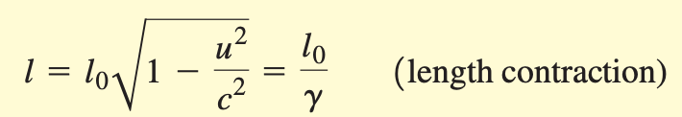
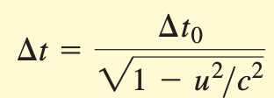
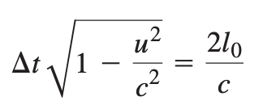
37-4 Relativity of Length

Slide 13
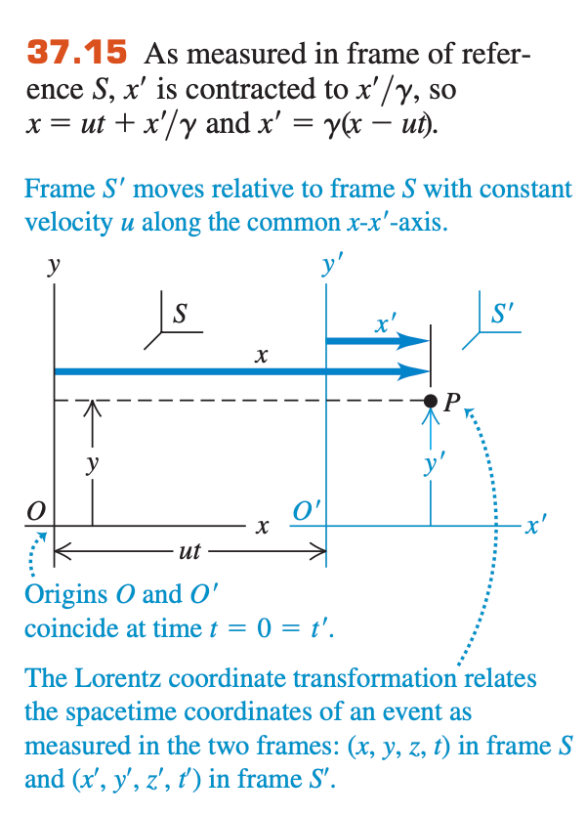
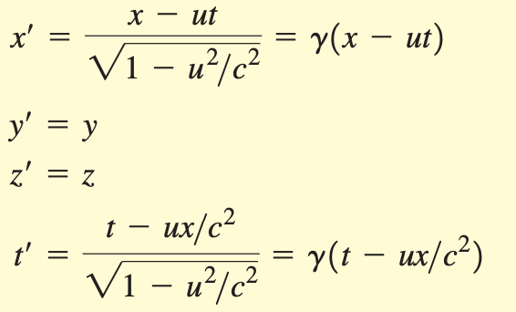
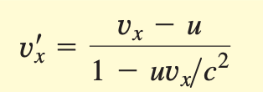
37-5 The Lorentz Transformations

Slide 14
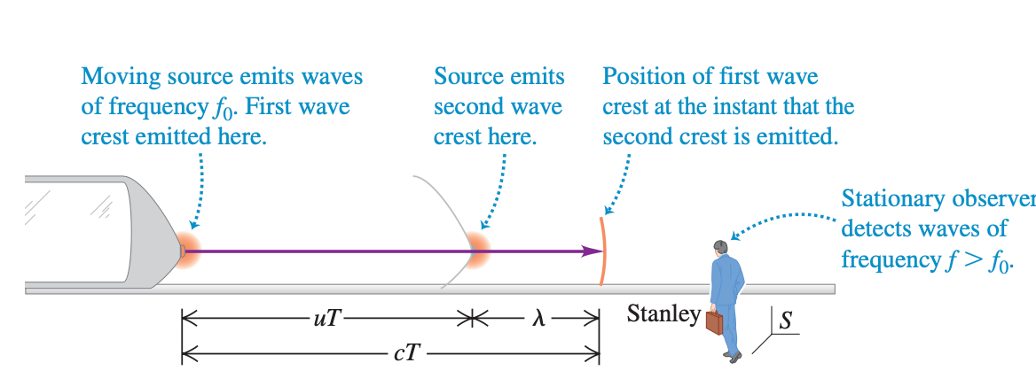
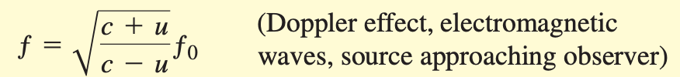
37-6 The Doppler Effect for Electromagnetic Waves

Slide 15
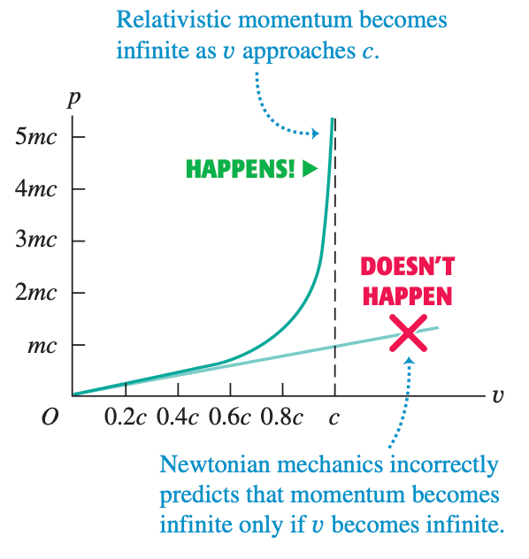
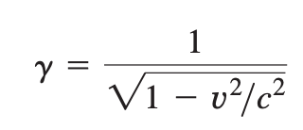

37-7 Relativistic Momentum

Slide 16
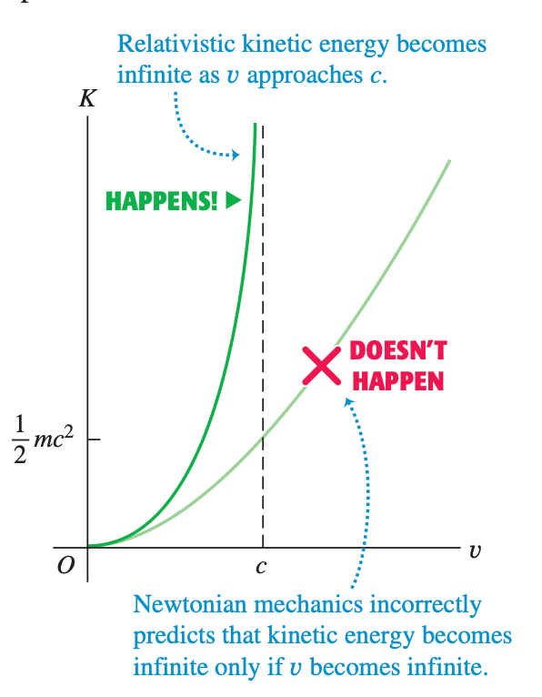
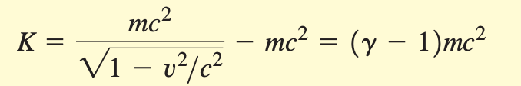

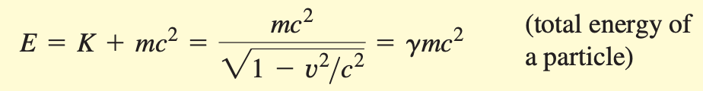

37-8 Relativistic Work and Energy

Slide 17
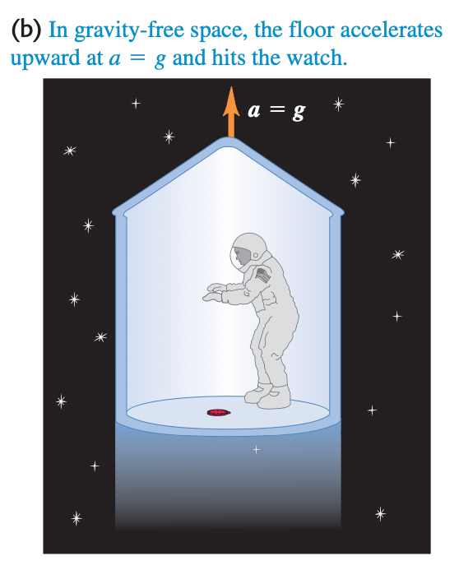
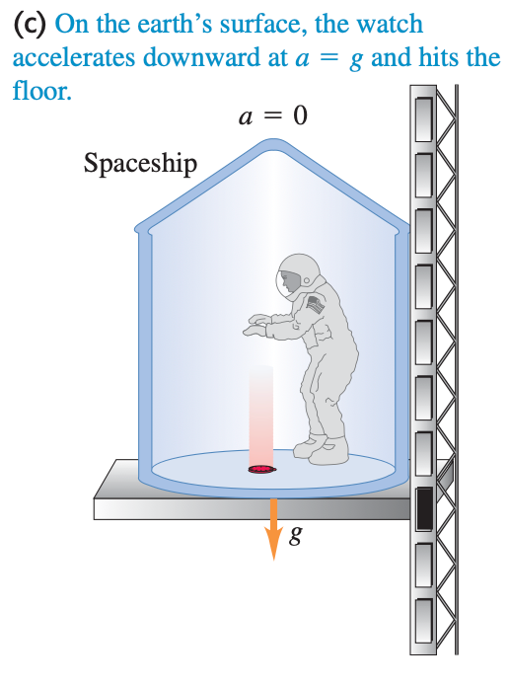
37-9 Newtonian Mechanics and Relativity
noninertial frames

Slide 18
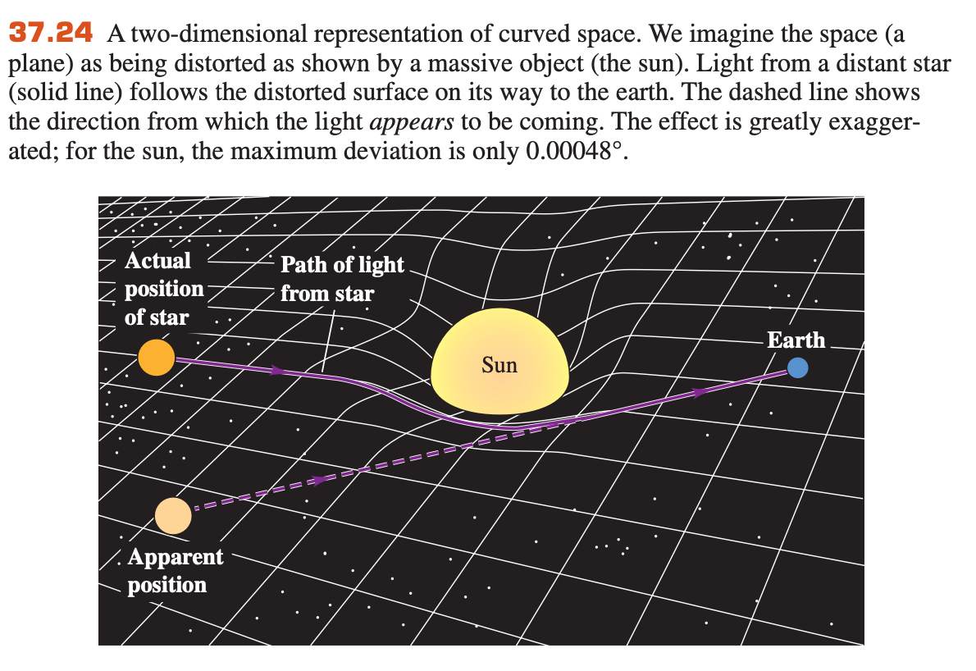
37-9 Newtonian Mechanics and Relativity

Slide 19
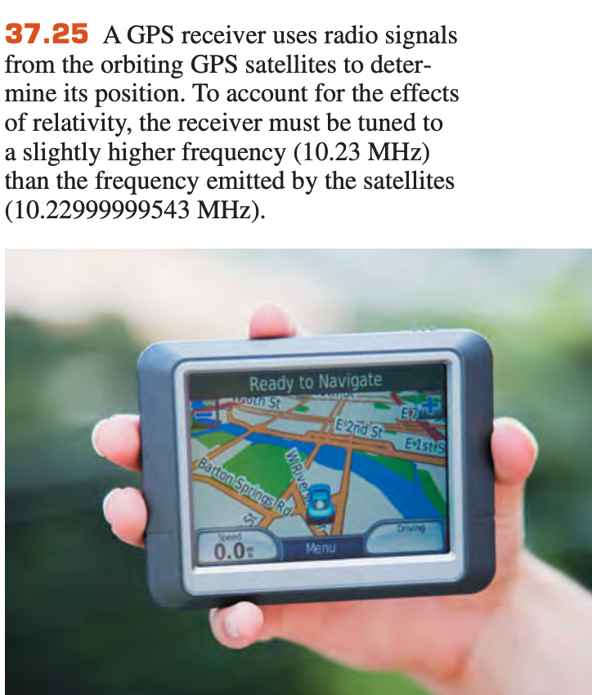
37-9 Newtonian Mechanics and Relativity
collection of more than two dozen satellites in very precise orbits.
Special theory of relativity
➔the satellites are moving relative to the receiver on earth
General theory of relativity
➔the satellites are higher in the earth’s gravitational field than the receiver

