Slide 1
PHYS1001B College Physics IB
Waves I — Mechanical Waves (Ch. 15)

Slide 2
Introduction
This chapter focuses on waves travelling along a stretched string, such as on a guitar
The next chapter focuses on sound waves, such as those produced by a guitar string being played
Before we do all this, though, our first job is to classify the countless waves of the everyday world into basic types

Slide 3
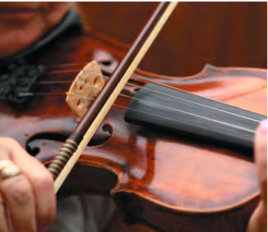

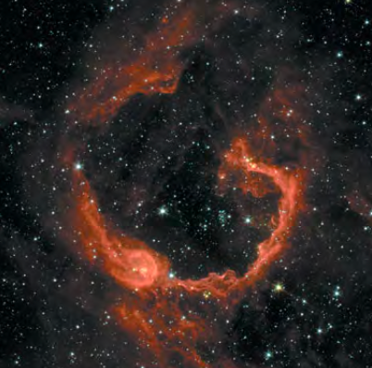
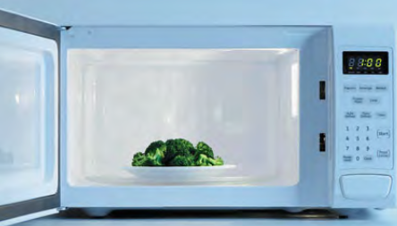

Slide 4
Outline
15-1 Types of Transverse Waves
15-2 Periodic Waves
15-3 Mathematical Description of a Wave
15-4 Speed of a Transverse Waves
15-5 Energy in Wave Motion
15-6 Wave Interference, Boundary Conditions and Superposition
15-7 Standing Waves on a String
15-8 Normal Modes of a String

Slide 5
15-1 Transverse Waves
Mechanical waves (機械波)
are governed by Newton’s laws, and exist only within a material medium
Examples include water waves, sound waves, and seismic waves
Electromagnetic waves (電磁波)
require no material medium to exist
Examples include visible and ultraviolet light, radio and television waves, microwaves, x rays, and radar waves
Matter waves (物質波)
are associated with electrons, protons, and other fundamental particles, and even atoms and molecules

Slide 6
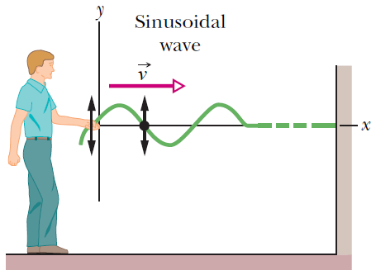
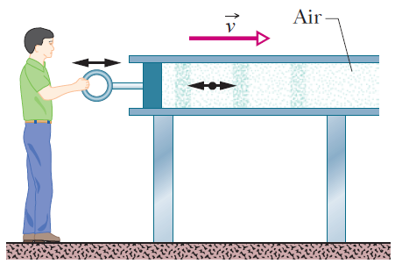
15-1 Transverse Waves
Transverse wave (橫波)
the displacement of every such oscillating element along the wave is perpendicular to the direction of travel of the wave
e.g. string waves, water waves
Longitudinal wave (縱波)
the motion of the oscillating particles is parallel to the direction of the wave’s travel
e.g. sound waves

Slide 7
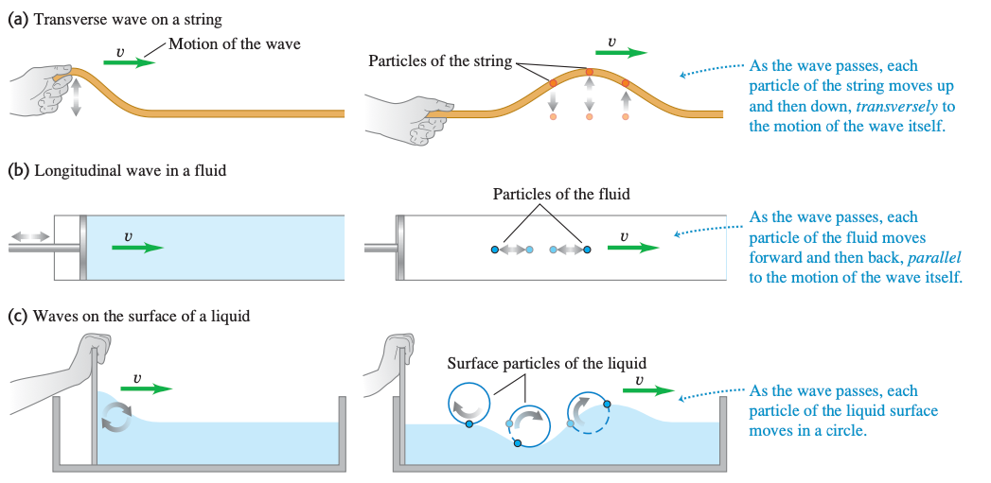
15-1 Transverse Waves

Slide 8
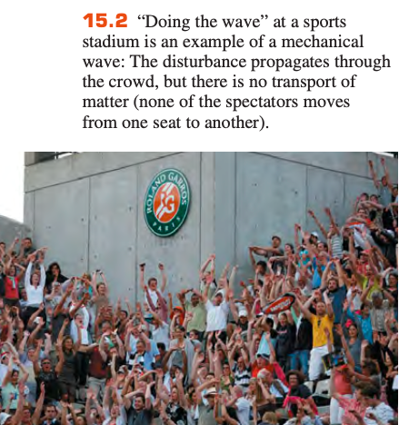
15-1 Transverse Waves
Waves transport energy, but not matter, from one region to another

Slide 9
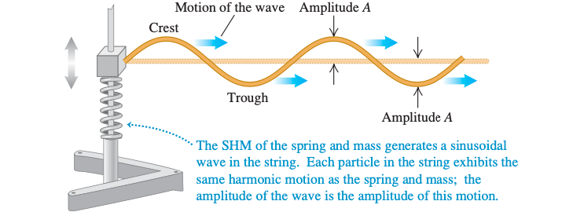
15-2 Periodic Waves
A more interesting situation develops when we give the free end of the string a repetitive, or periodic, motion. Then each particle in the string also undergoes periodic motion as the wave propagates, and we have a periodic wave.

Slide 10
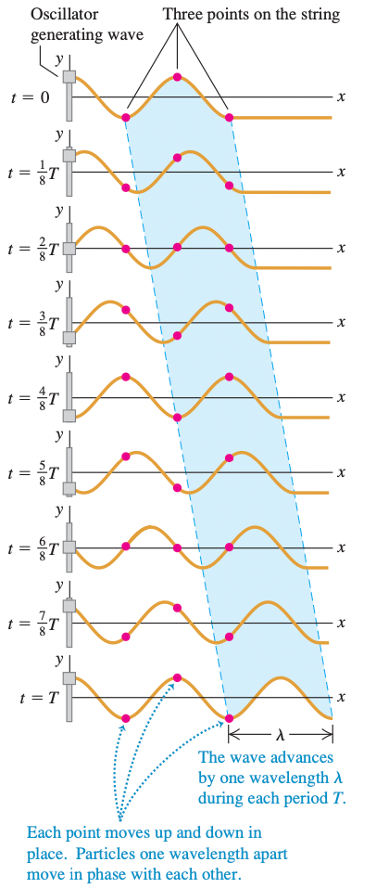
Periodic Transverse Waves

Slide 11
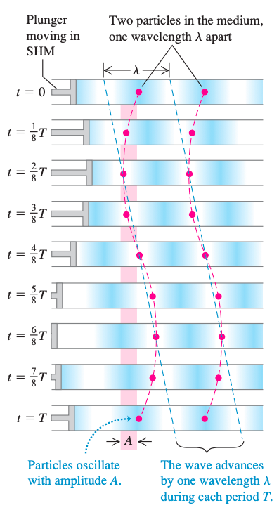
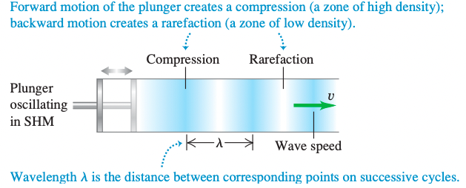
Periodic Longitudinal Waves

Slide 12

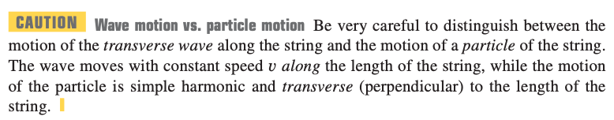

15-2 Periodic Waves
$λ$ wavelength, v wave speed, f frequency

Slide 13
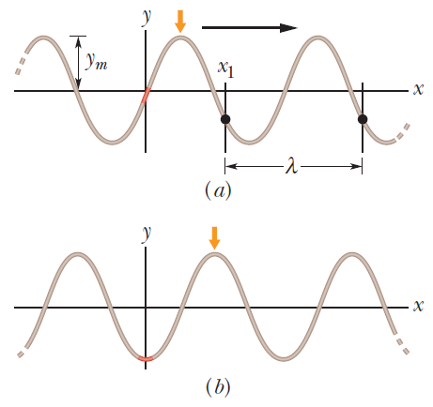
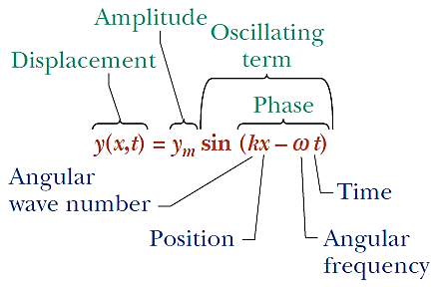

15-3 Mathematical Description of a Wave
A string wave travelling in the positive direction of an x axis is shown below
$y\left(x,t\right)=y_{m}\sin\left(kx−ωt\right)$

Slide 14
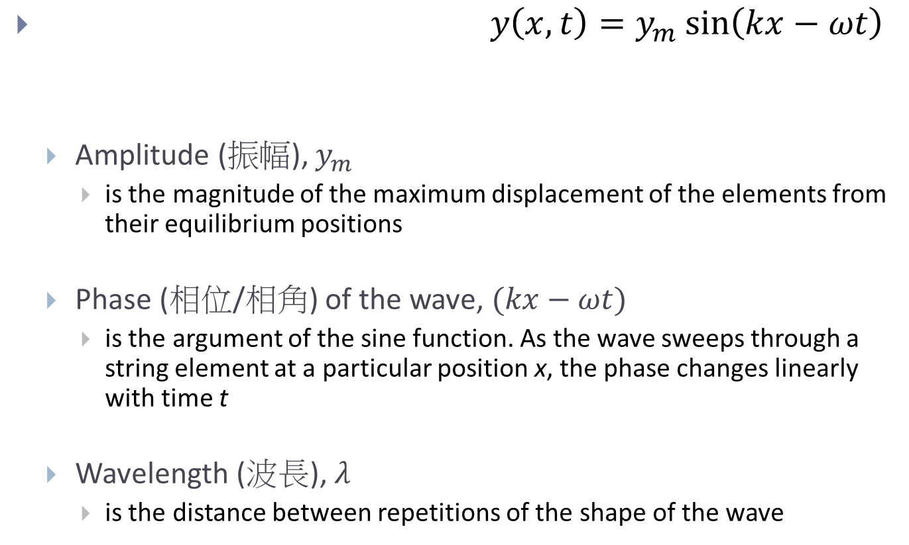
$y\left(x,t\right)=y_{m}\sin\left(kx−ωt\right)$
Amplitude (振幅), $y_{m}$
is the magnitude of the maximum displacement of the elements from their equilibrium positions
Phase (相位/相角) of the wave, $(kx−ωt)$
is the argument of the sine function. As the wave sweeps through a string element at a particular position x, the phase changes linearly with time t
Wavelength (波長), $λ$
is the distance between repetitions of the shape of the wave

Slide 15
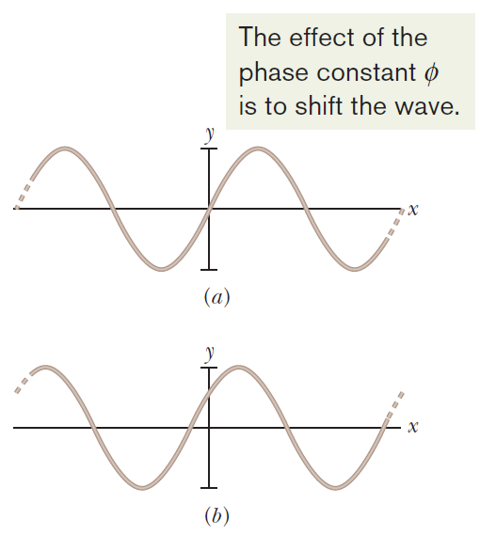
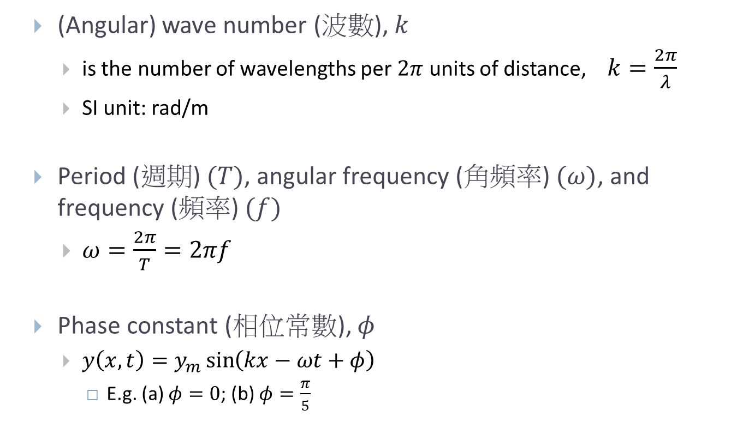
15-3 Mathematical Description of a Wave
(Angular) wave number (波數), $k$
is the number of wavelengths per $2π$ units of distance, $k=\frac{2π}{λ}$
SI unit: rad/m
Period (週期) $(T)$, angular frequency (角頻率) $(ω)$, and frequency (頻率) $(f)$
$ω=\frac{2π}{T}=2πf$
Phase constant (相位常數), $φ$
$y\left(x,t\right)=y_{m}\sin\left(kx−ωt+φ\right)$
E.g. (a) $φ=0$; (b) $φ=\frac{π}{5}$

Slide 16
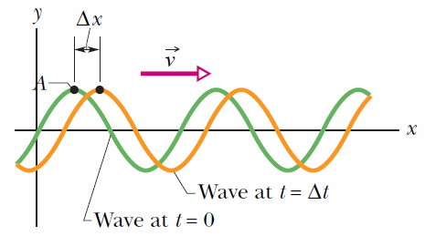
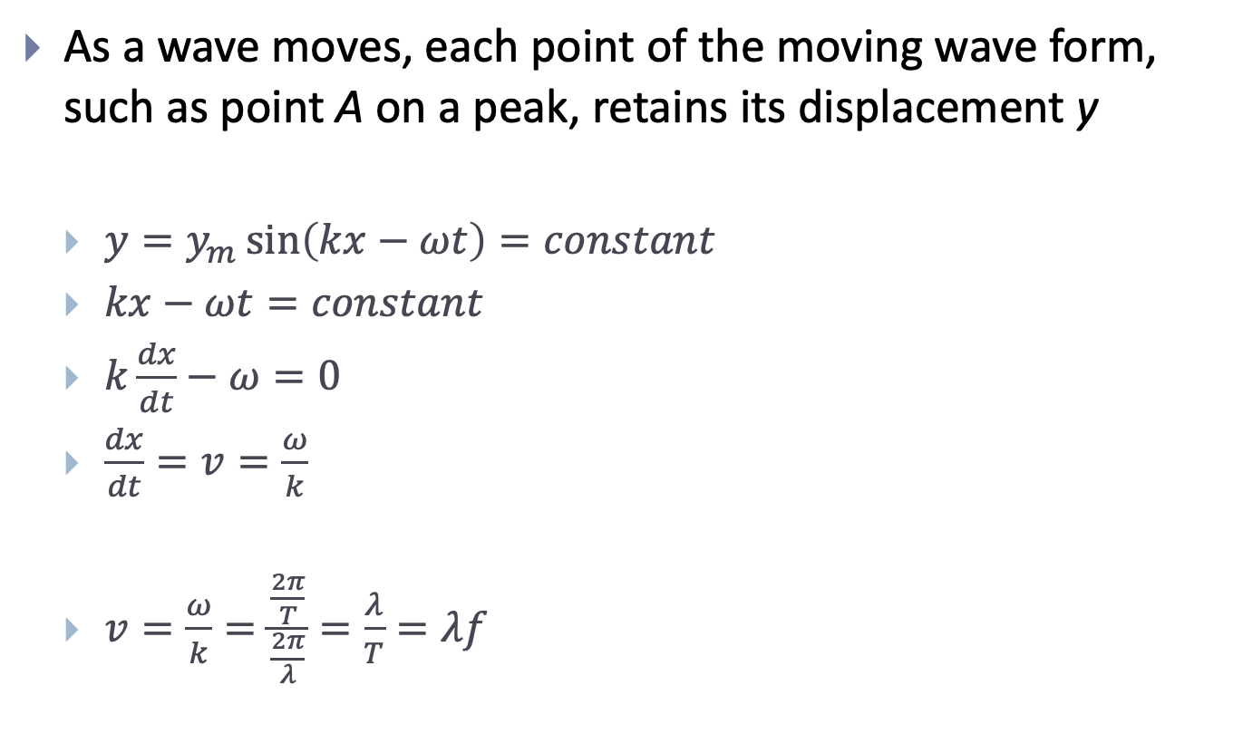
15-3 Mathematical Description of a Wave
As a wave moves, each point of the moving wave form, such as point A on a peak, retains its displacement y
$y=y_{m}\sin\left(kx−ωt\right)=constant$
$kx−ωt=constant$
$k\frac{dx}{dt}−ω=0$
$\frac{dx}{dt}=v=\frac{ω}{k}$
$v=\frac{ω}{k}=\frac{\frac{2π}{T}}{\frac{2π}{λ}}=\frac{λ}{T}=λf$

Slide 17

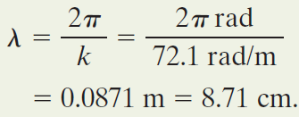


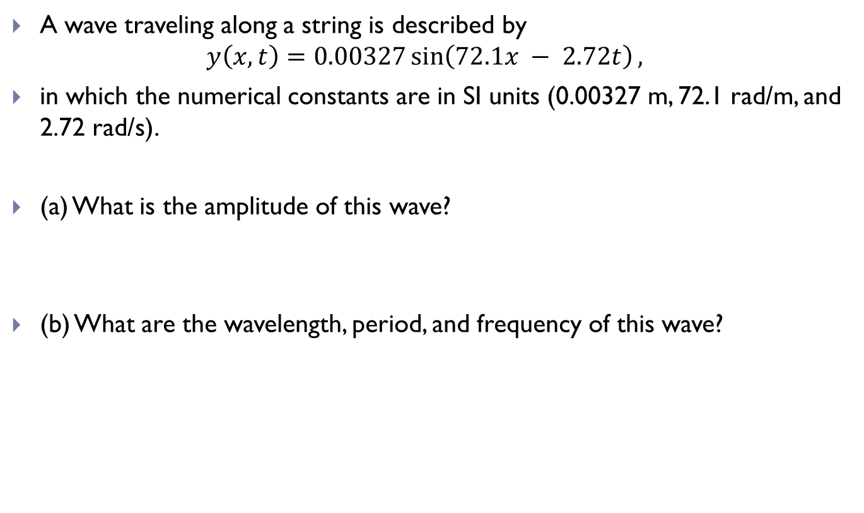
Sample Problem
A wave traveling along a string is described by
$$y\left(x, t\right)=0.00327\sin\left(72.1x − 2.72t\right),$$
in which the numerical constants are in SI units (0.00327 m, 72.1 rad/m, and 2.72 rad/s).
(a) What is the amplitude of this wave?
(b) What are the wavelength, period, and frequency of this wave?

Slide 18
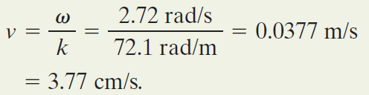
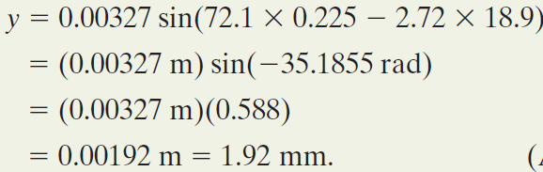
Sample Problem
(c) What is the velocity of this wave?
(d) What is the displacement y of the string at x = 22.5 cm and t = 18.9 s?

Slide 19



Sample Problem
(e) What is u, the transverse velocity of the element of the string at x = 22.5 cm and t = 18.9 s?
Remarks
For an element at a certain location x, we find the rate of change of y by taking the derivative with respect to t while treating x as a constant
A derivative taken while one (or more) of the variables is treated as a constant is called a partial derivative and is represented by the symbol $\frac{∂}{∂t}$ rather than $\frac{d}{dt}$

Slide 20
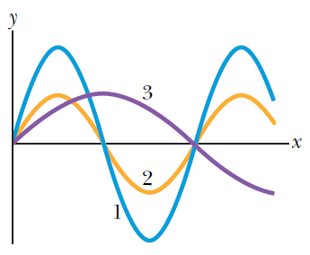
Questions
Figure shows three waves that are separately sent along a string that is stretched under a certain tension along an x axis.
Rank the waves according to their (a) wavelengths, (b) speeds, and (c) angular frequencies, greatest first.

Slide 21


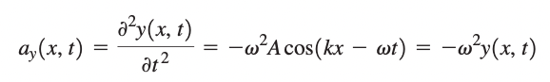
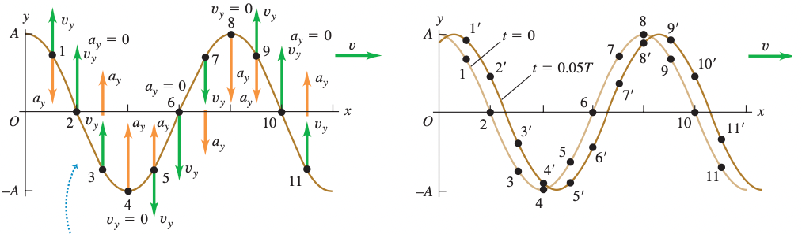
15-3 Mathematical Description of a Wave
Wave function
Velocity
Acceleration

Slide 22

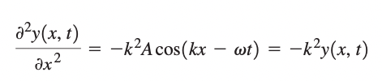


15-3 Mathematical Description of a Wave

Slide 23
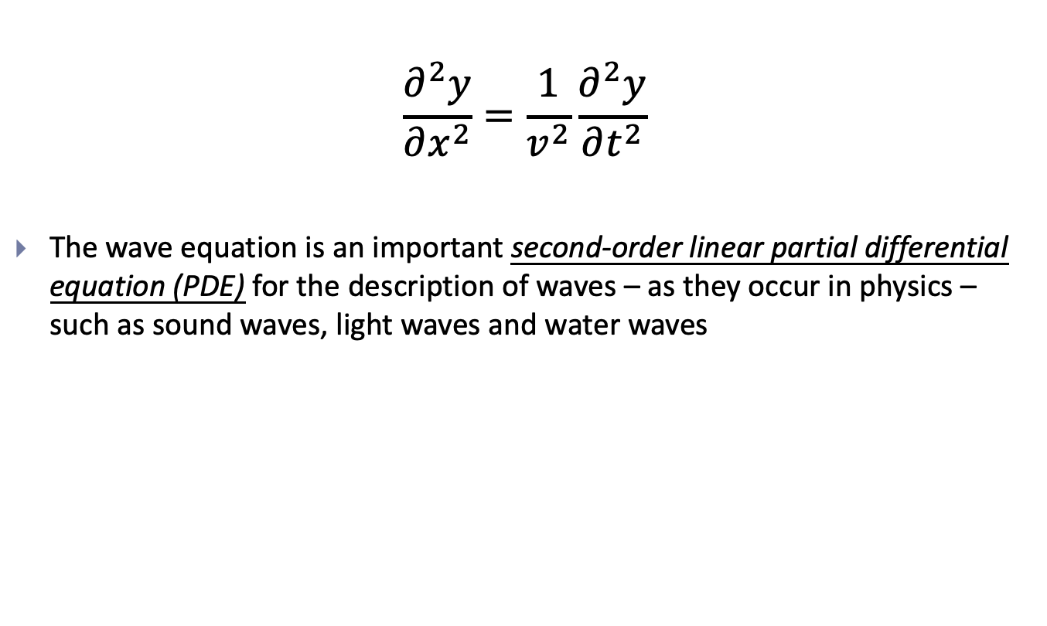
15-3 Mathematical Description of a Wave
$$\frac{∂^{2}y}{∂x^{2}}=\frac{1}{v^{2}}\frac{∂^{2}y}{∂t^{2}}$$
The wave equation is an important second-order linear partial differential equation (PDE) for the description of waves – as they occur in physics – such as sound waves, light waves and water waves

Slide 24
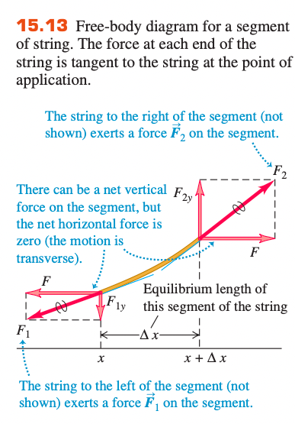



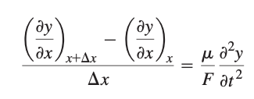
15-4 Speed of a Transverse Waves

Slide 25


15-4 Speed of a Transverse Waves

Slide 26

15-4 Speed of a Transverse Waves
General form
The tension F in the string plays the role of the restoring force; it tends to bring the string back to its undisturbed, equilibrium configuration.
The linear mass density m provides the inertia that prevents the string from returning instantaneously to equilibrium.

Slide 27
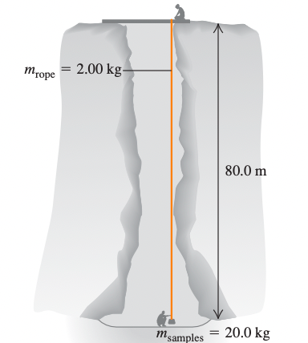
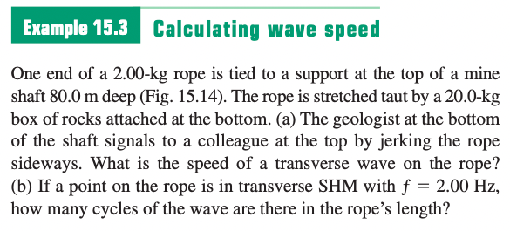
Sample Problem

Slide 28
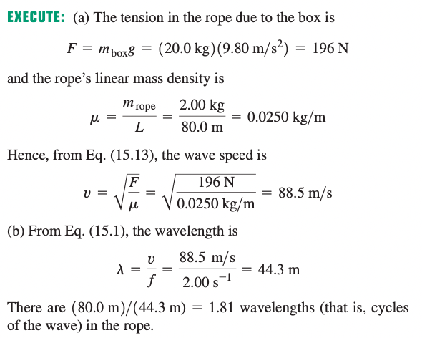
Sample Problem

Slide 29
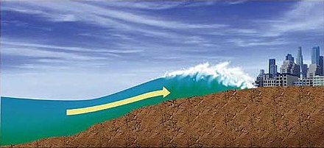
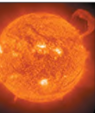

15-5 Energy in Wave Motion
Source: wikipeida, textbook

Slide 30
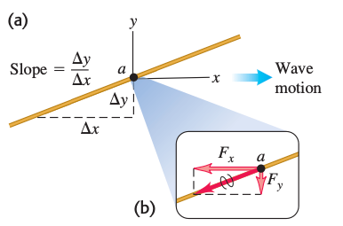
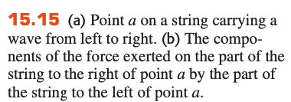


15-5 Energy in Wave Motion
This power is the instantaneous rate at which energy is transferred along the string

Slide 31
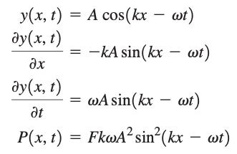



15-5 Energy in Wave Motion
Use

Slide 32
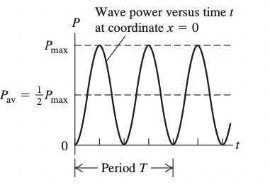


15-5 Energy in Wave Motion

Slide 33
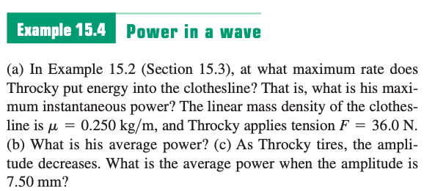

15-5 Energy in Wave Motion

Slide 34
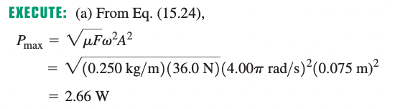
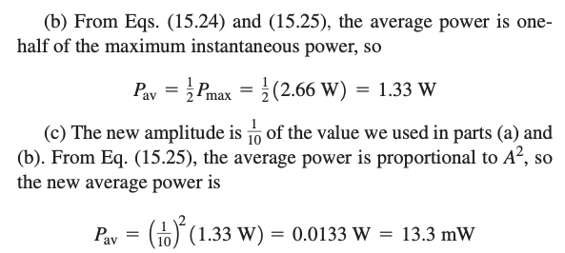
15-5 Energy in Wave Motion

Slide 35
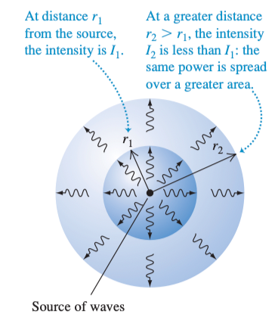



15-5 Energy in Wave Motion
intensity (denoted by I): the time average rate at which energy is transported by the wave, per unit area

Slide 36
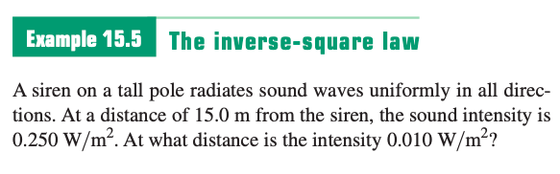
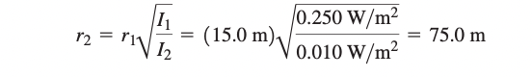
15-5 Energy in Wave Motion

Slide 37
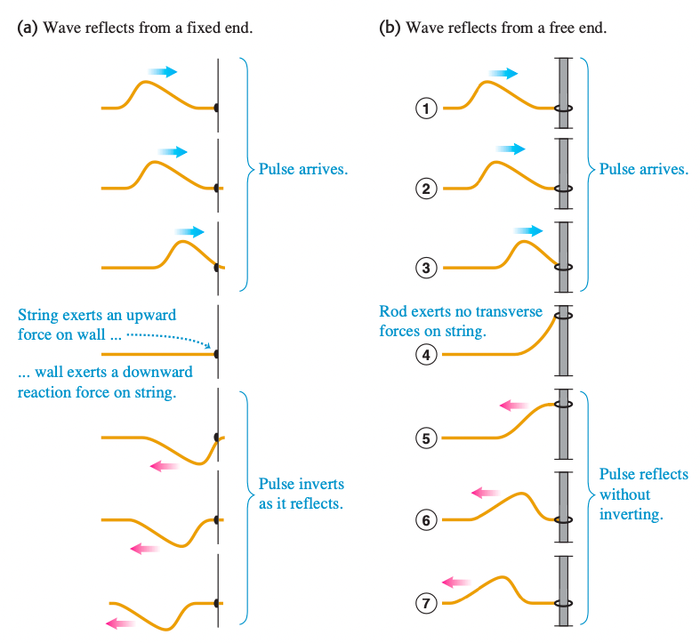
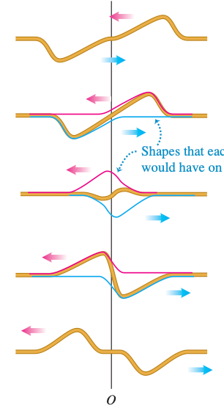
15-6 Boundary Conditions
Fixed end

Slide 38
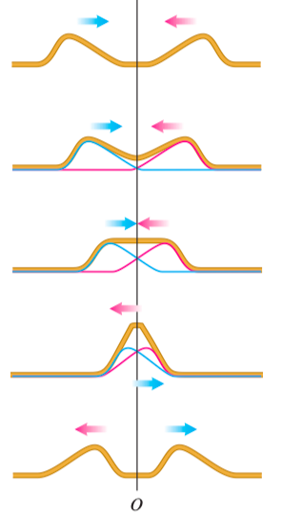
15-6 Boundary Conditions
Free end

Slide 39


15-6 Interference (干涉) of Waves
Let $y_{1}\left(x,t\right)$ and $y_{2}\left(x,t\right)$ be the displacements that the string would experience if each wave travelled alone
The Principle of Superposition
$y^{′}\left(x,t\right)=y_{1}\left(x,t\right)+y_{2}\left(x,t\right)$

Slide 40


Slide 41

15-6 Interference (干涉) of Waves
Types of interference

Slide 42

15-7 Standing Waves (駐波) on a String
If two sinusoidal waves of the same amplitude and wavelength travel in opposite directions along a stretched string, their interference with each other produces a standing wave

Slide 43


15-7 Standing Waves (駐波) on a String
To analyse a standing wave, we represent the two combining waves with the equations
$y_{1}\left(x,t\right)=y_{m}\sin\left(kx−ωt\right)$
$y_{2}\left(x,t\right)=y_{m}\sin\left(kx+ωt\right)$
The superposition principle (疊加原理) applies
$y^{′}\left(x,t\right)=y_{m}\sin\left(kx−ωt\right)+y_{m}\sin\left(kx+ωt\right)$
$\left(\begin{aligned}∵\sin{α+\sin{β}} \\ =2\sin{\frac{1}{2}\left(α+β\right)\cos{\frac{1}{2}\left(α−β\right)}}\end{aligned}\right)$

Slide 44

15-7 Standing Waves (駐波) on a String
Nodes (節點/波節)
where the string never moves (zero amplitude)
$y^{′}\left(x,t\right)=[2y_{m}\sin{kx}]\cos{ωt}$
$\sin{kx}=0$
$kx=nπ, for n=0,1,2,…$
$x=n\frac{π}{k}=n\frac{λ}{2}, for n=0,1,2,… \left(∵k=\frac{2π}{λ}\right)$

Slide 45

15-7 Standing Waves (駐波) on a String
Antinodes (腹點/波腹)
where the amplitude of the net wave is a maximum
$y^{′}\left(x,t\right)=[2y_{m}\sin{kx}]\cos{ωt}$
$\sin{kx}=1$
$kx=\left(n+\frac{1}{2}\right)π, for n=0,1,2,…$
$x=\left(n+\frac{1}{2}\right)\frac{π}{k}=\left(n+\frac{1}{2}\right)\frac{λ}{2}, for n=0,1,2,… \left(∵k=\frac{2π}{λ}\right)$

Slide 46

15-8 Normal Modes of a String
Suppose we send a continuous sinusoidal wave of a certain frequency along the string, say, toward the right. When the wave reaches the right end, it reflects and travels back to the left. The interference may produce a standing wave pattern
Such a standing wave is said to be produced at resonance, and the string is said to resonate at these certain frequencies, called resonant frequencies

Slide 47


15-8 Normal Modes of a String
Resonance can occur at wavelengths
$λ=\frac{2L}{n}, for n=1, 2, 3, …$
Resonant frequencies
$f=\frac{v}{λ}=n\frac{v}{2L}, for n=1, 2, 3, …$
n is called the harmonic number of the nth harmonic

Slide 48


15-8 Normal Modes of a String
fundamental frequency
F: tension

Slide 49


15-8 Normal Modes of a String
When a guitar string is plucked (pulled into a triangular shape) and released, a standing wave results
Source: wikipedia

Slide 50


Sample Problem

Slide 51

Sample Problem

