Slide 1
PHYS1001B College Physics IB
Thermodynamics I — Temperature and Heat (Ch. 17)

Slide 2
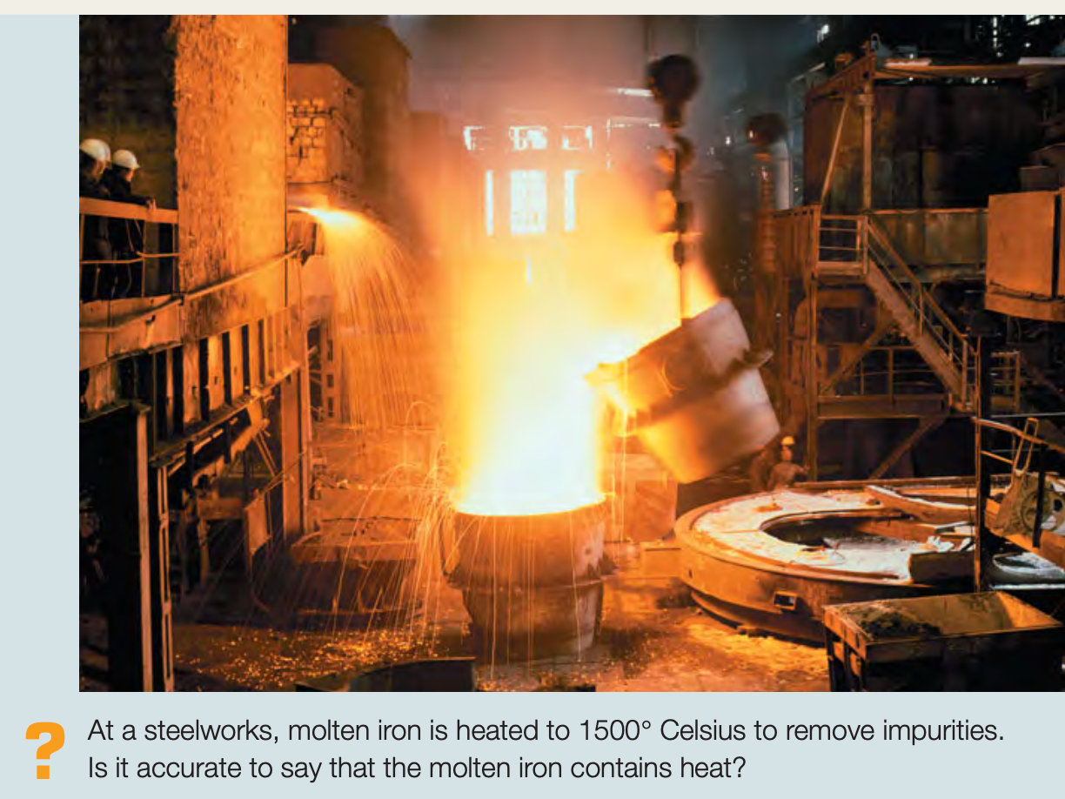
Introduction

Slide 3
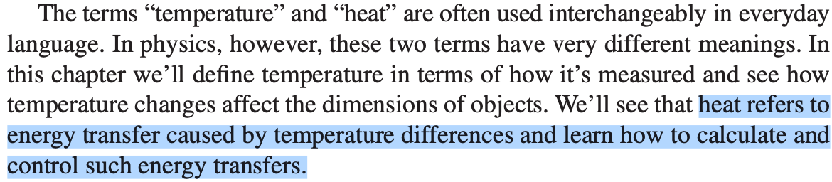
Introduction

Slide 4
Outline
17-1 Temperature and Thermal Equilibrium
17-2 Thermometers and Temperature Scales
17-3 Gas Thermometers and the Kelvin Scale
17-4 Thermal Expansion
17-5 Quantity of Heat
17-6 Calorimetry and Phase Changes
17-7 Mechanisms of Heat Transfer

Slide 5
17-1 Temperature and Thermal Equilibrium
The concept of temperature is rooted in qualitative ideas of “hot” and “cold” based on our sense of touch. A body that feels hot usually has a higher temperature than a similar body that feels cold.
To use temperature as a measure of hotness or coldness, we need to construct a temperature scale. To do this, we can use any measurable property of a system that varies with its “hotness” or “coldness.”

Slide 6
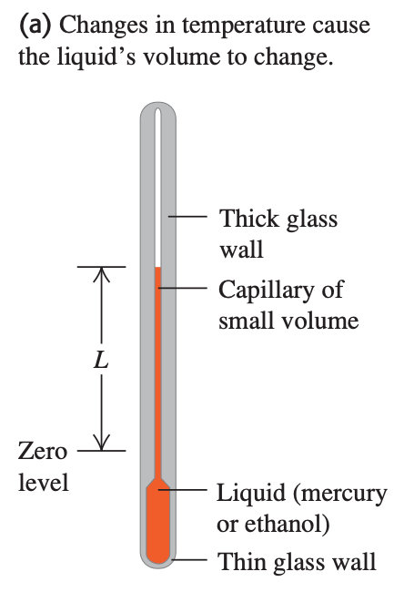
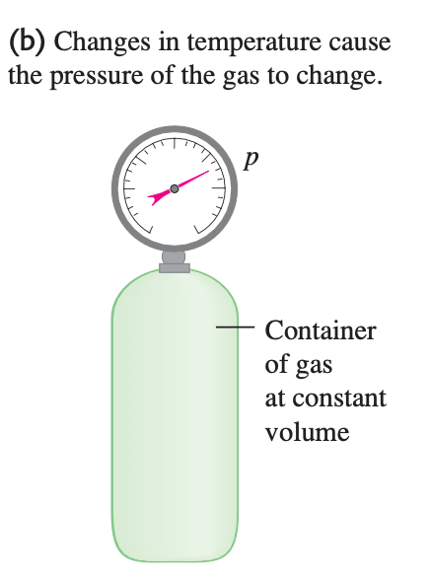
17-1 Temperature and Thermal Equilibrium

Slide 7
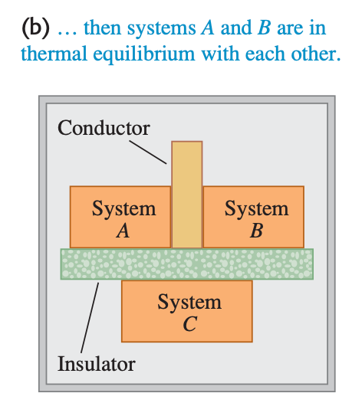
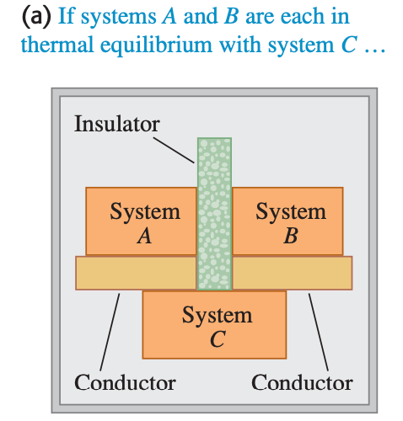
17-1 Temperature and Thermal Equilibrium
The zeroth law of thermodynamics.

Slide 8
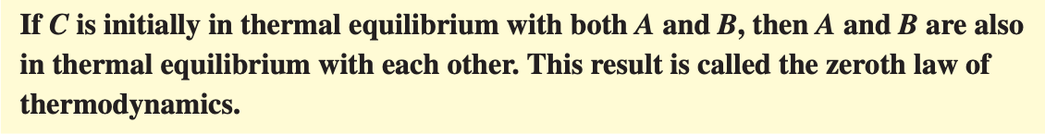
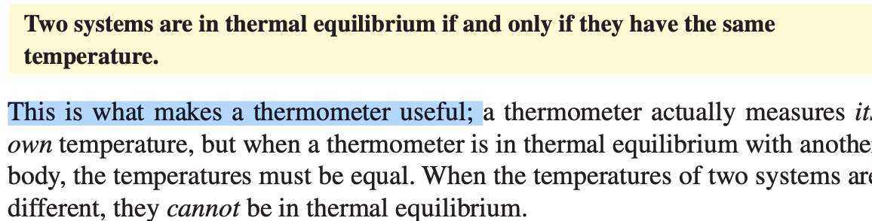
17-1 Temperature and Thermal Equilibrium
The zeroth law of thermodynamics.

Slide 9
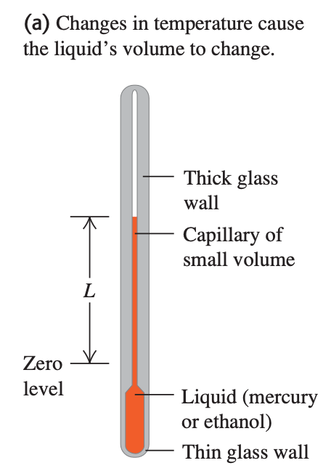
17-2 Thermometers and Temperature Scales
Suppose we label the thermometer’s liquid level at the freezing temperature of pure water “zero” and the level at the boiling temperature “100,” and divide the distance between these two points into 100 equal intervals called degrees. The result is the Celsius temperature scale (formerly called the centigrade scale in English- speaking countries). The Celsius temperature for a state colder than freezing water is a negative number.

Slide 10
17-2 Thermometers and Temperature Scales
In the Fahrenheit temperature scale, still used in everyday life in the United States, the freezing temperature of water is 32°F (thirty-two degrees Fahrenheit) and the boiling temperature is 212°F, both at standard atmospheric pressure.
There are 180 degrees between freezing and boiling, compared to 100 on the Celsius scale.

Slide 11


17-2 Thermometers and Temperature Scales
Conversion between temperature scales
Fahrenheit temperature scale
Celsius temperature scale

Slide 12
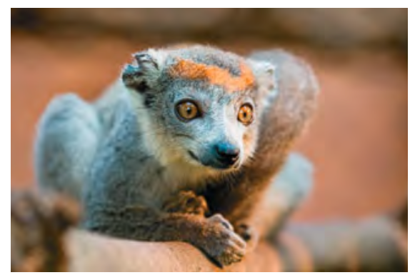
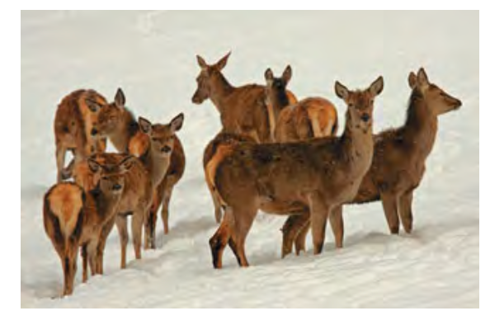
17-2 Thermometers and Temperature Scales
Most mammals maintain body temperatures in the range from 36°C to 40°C (309 K to 313 K). A high metabolic rate warms the animal from within, and insulation (such as fur, feathers, and body fat) slows heat loss.

Slide 13
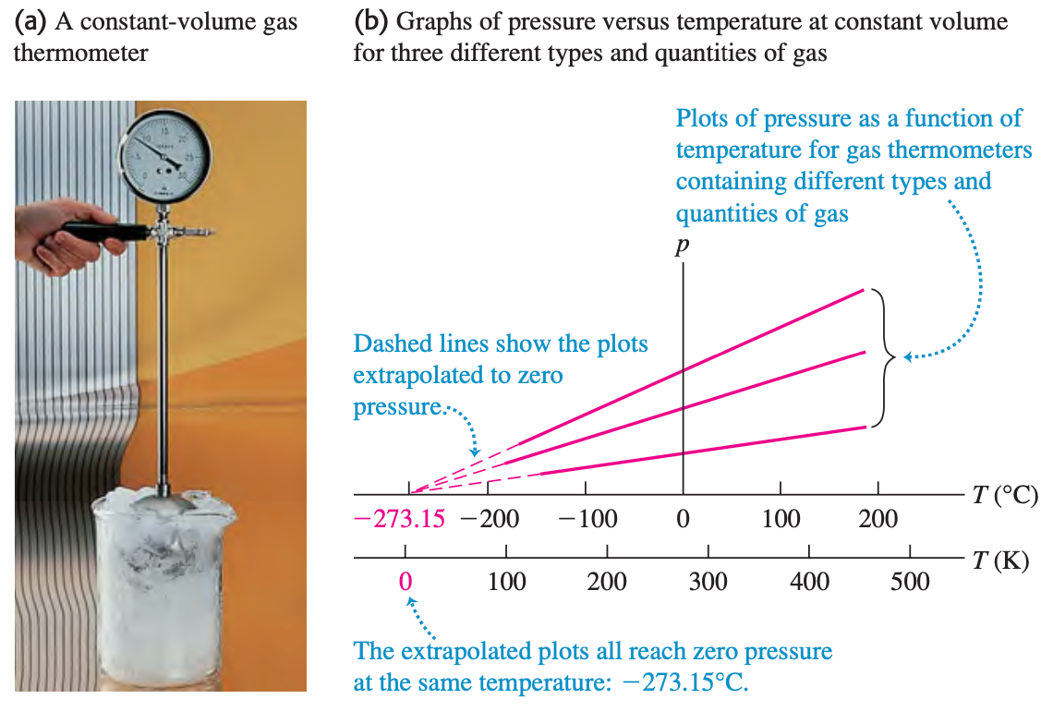
17-3 Gas Thermometers and the Kelvin Scale

Slide 14

17-3 Gas Thermometers and the Kelvin Scale
We use this extrapolated zero-pressure temperature as the basis for a temperature scale with its zero at this temperature. This is the Kelvin temperature scale, named for the British physicist Lord Kelvin (1824–1907). The units are the same size as those on the Celsius scale, but the zero is shifted so that 0 K = - 273.15°C and 273.15 K = 0°C

Slide 15
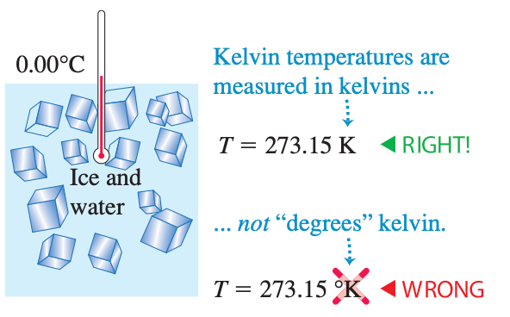
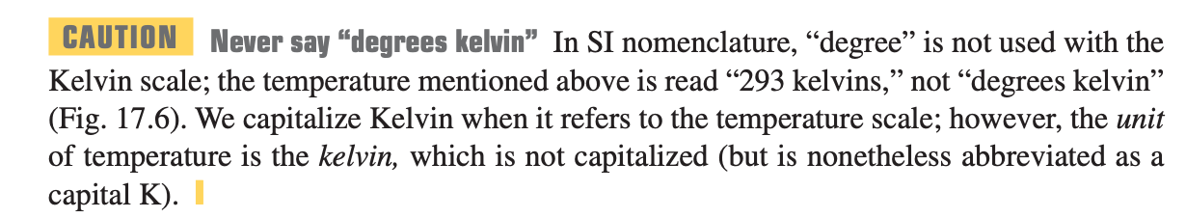
17-3 Gas Thermometers and the Kelvin Scale

Slide 16
17-3 Gas Thermometers and the Kelvin Scale
The Celsius scale has two fixed points: the normal freezing and boiling temperatures of water. But we can define the Kelvin scale using a gas thermometer with only a single reference temperature. We define the ratio of any two temperatures T₁ and T₂ on the Kelvin scale as the ratio of the corresponding gas-thermometer pressures p₁ and p₂:

Slide 17
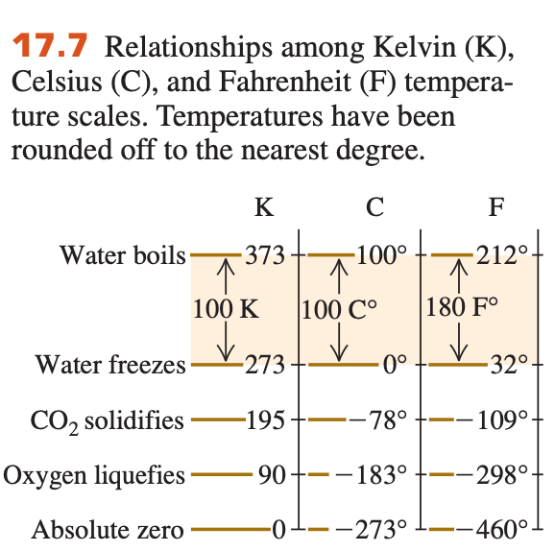
17-3 Gas Thermometers and the Kelvin Scale
The Kelvin scale is called an absolute temperature scale, and its zero point (T = 0 K = -273.15°C) is called absolute zero. At absolute zero a system of molecules (such as a quantity of a gas, a liquid, or a solid) has its minimum possible total energy (kinetic plus potential); because of quantum effects, however, it is not correct to say that all molecular motion ceases at absolute zero.

Slide 18
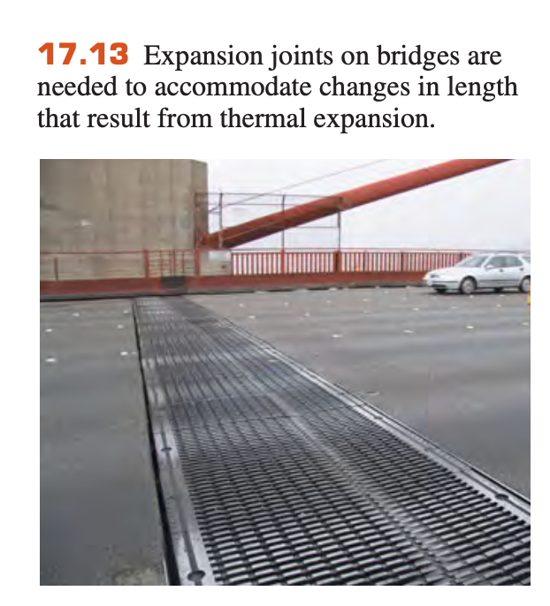
17-4 Thermal Expansion

Slide 19
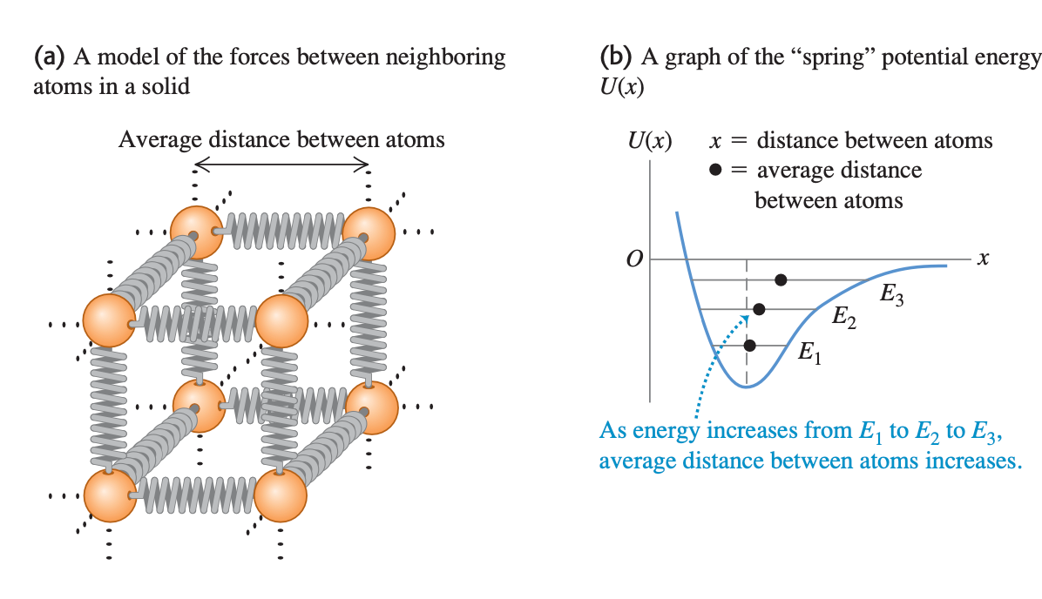
17-4 Thermal Expansion
Most materials expand when their temperatures increase

Slide 20
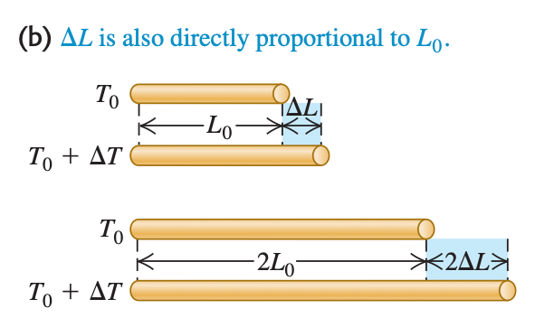
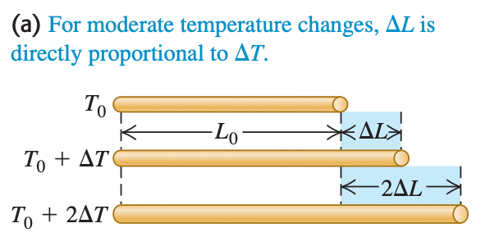
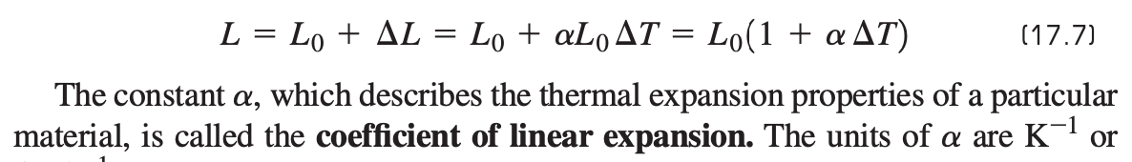
17-4 Thermal Expansion

Slide 21
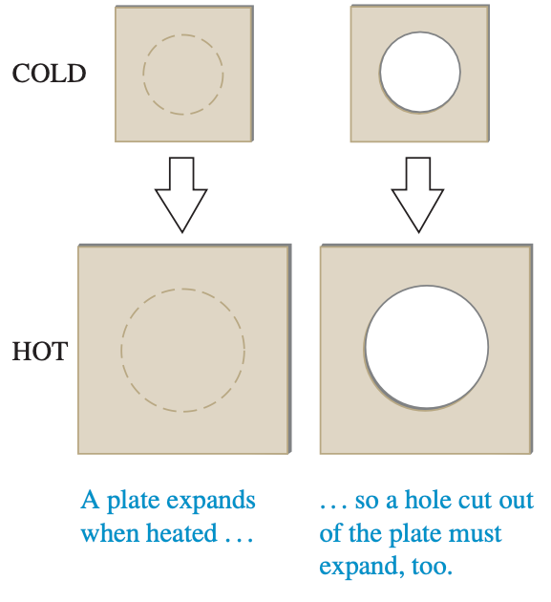
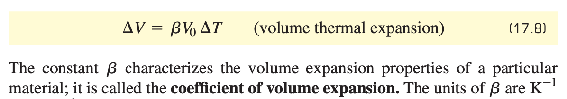
17-4 Thermal Expansion

Slide 22
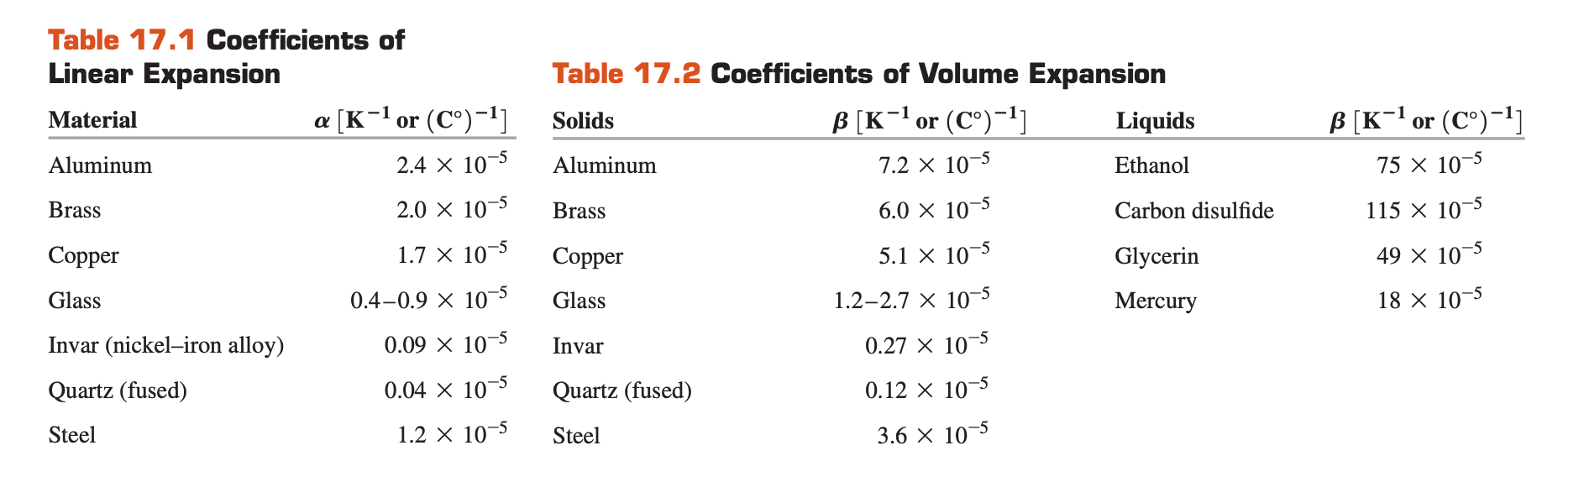
17-4 Thermal Expansion
Why beta 3 times alpha?

Slide 23
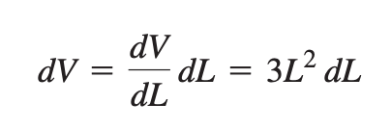
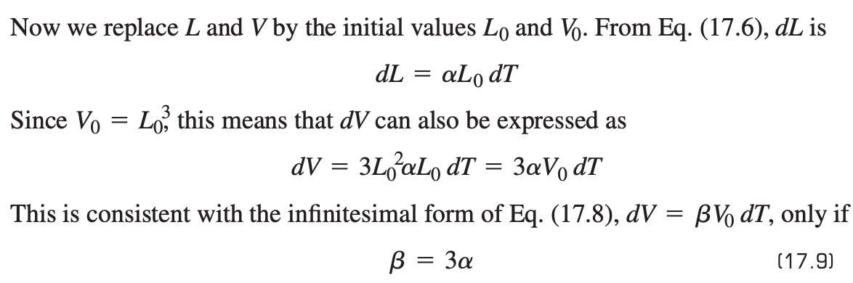
17-4 Thermal Expansion
Why beta 3 times alpha?
consider a cube of material with side length L and volume V = L³

Slide 24
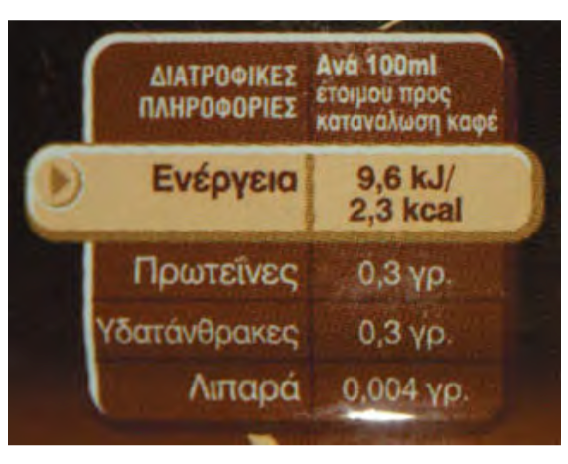
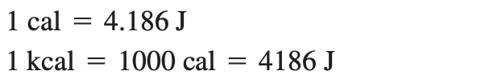
17-5 Quantity of Heat
Energy transfer that takes place solely because of a temperature difference is called heat flow or heat transfer, and energy transferred in this way is called heat.
We can define a unit of quantity of heat based on temperature changes of some specific material. The calorie (abbreviated cal) is defined as the amount of heat required to raise the temperature of 1 gram of water from 14.5°C to 15.5°C.

Slide 25
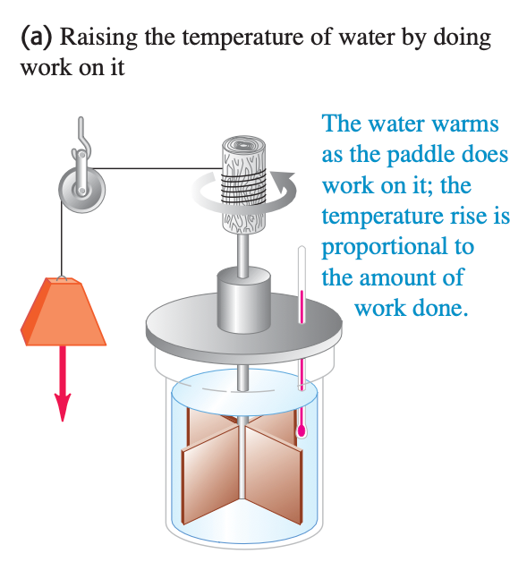
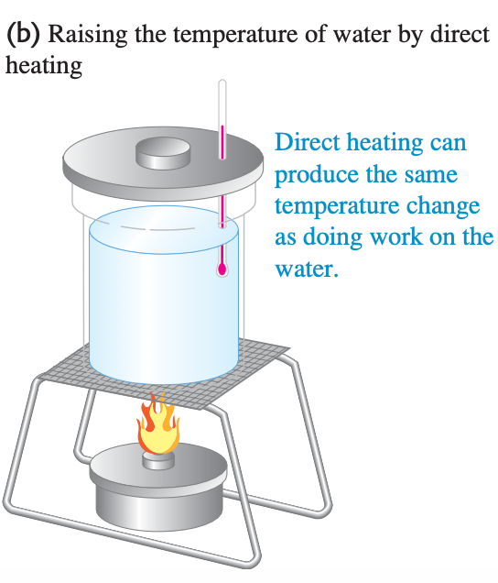
17-5 Quantity of Heat
An understanding of the relationship between heat and other forms of energy emerged during the 18th and 19th centuries. Sir James Joule (1818–1889) studied how water can be warmed by vigorous stirring with a paddle wheel
The paddle wheel adds energy to the water by doing work on it, and Joule found that the temperature rise is directly proportional to the amount of work done.

Slide 26
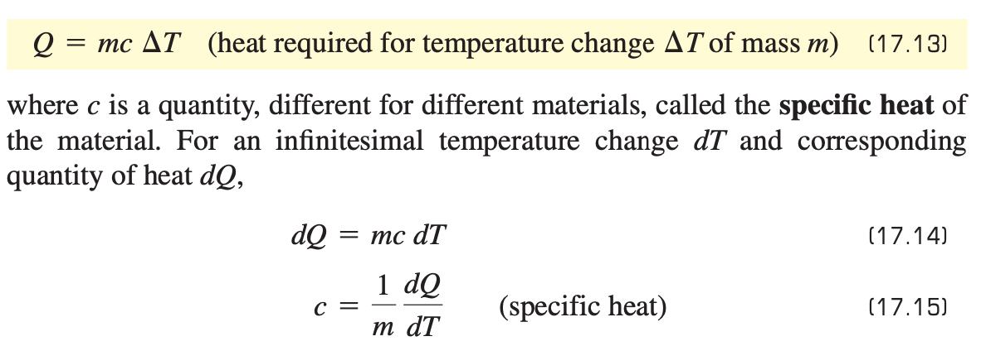
17-5 Quantity of Heat
We use the symbol Q for quantity of heat. When it is associated with an infinitesimal temperature change dT, we call it dQ.

Slide 27
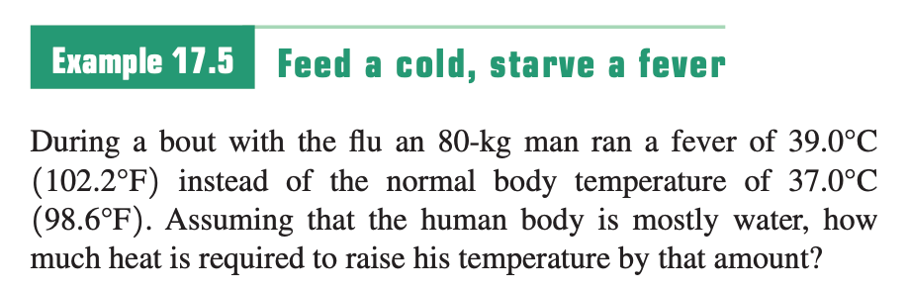
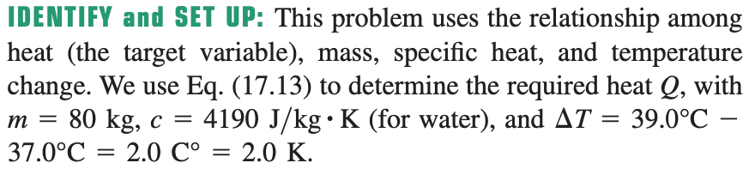
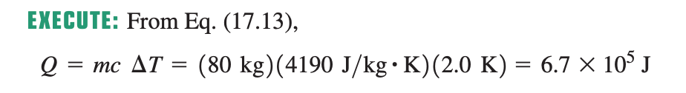
Sample Problem

Slide 28
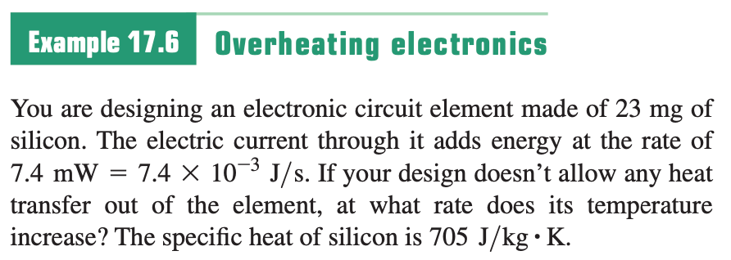

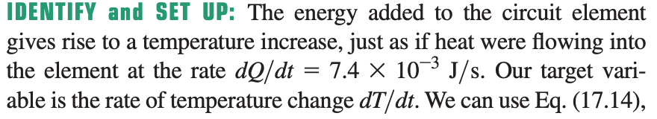

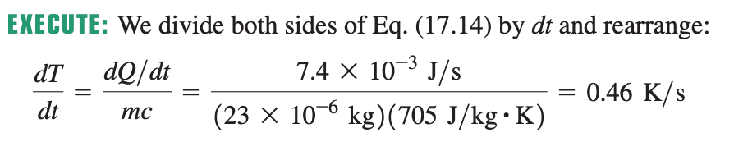
Sample Problem

Slide 29



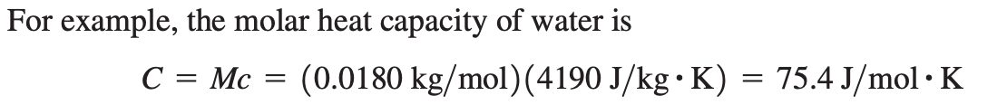
17-5 Quantity of Heat
Molar heat capacity
The molar mass of any substance, denoted by M, is the mass per mole.
In term of specific heat

Slide 30
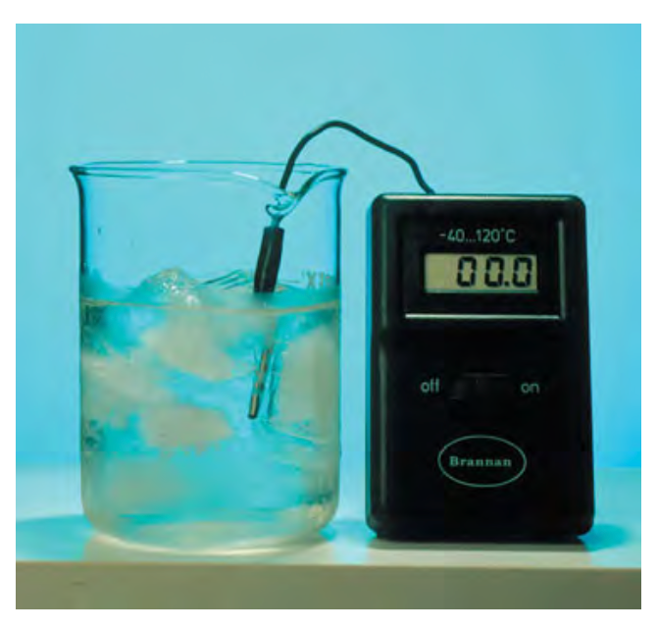
17-6 Calorimetry and Phase Changes
Calorimetry means “measuring heat.”
The surrounding air is at room temperature, but this ice–water mixture remains at 0°C until all of the ice has melted and the phase change is complete.
Heat is also involved in phase changes, such as the melting of ice or boiling of water.

Slide 31
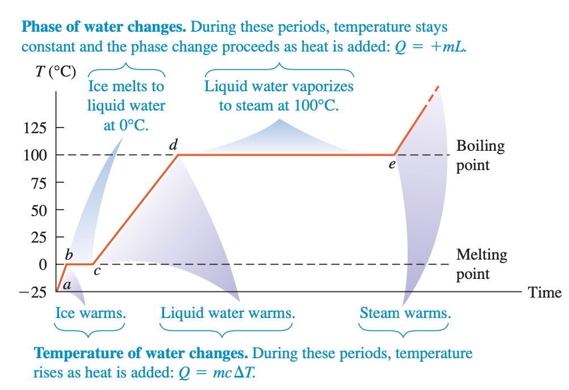
17-6 Calorimetry and Phase Changes

Slide 32
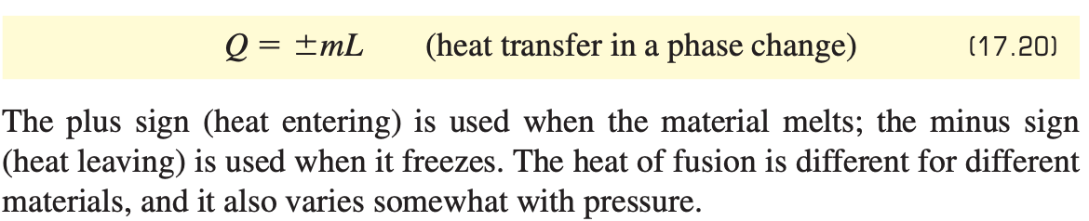
17-6 Calorimetry and Phase Changes
heat of fusion (or latent heat of fusion)
To melt a mass m of material that has a heat of fusion L requires a quantity of heat Q given by

Slide 33
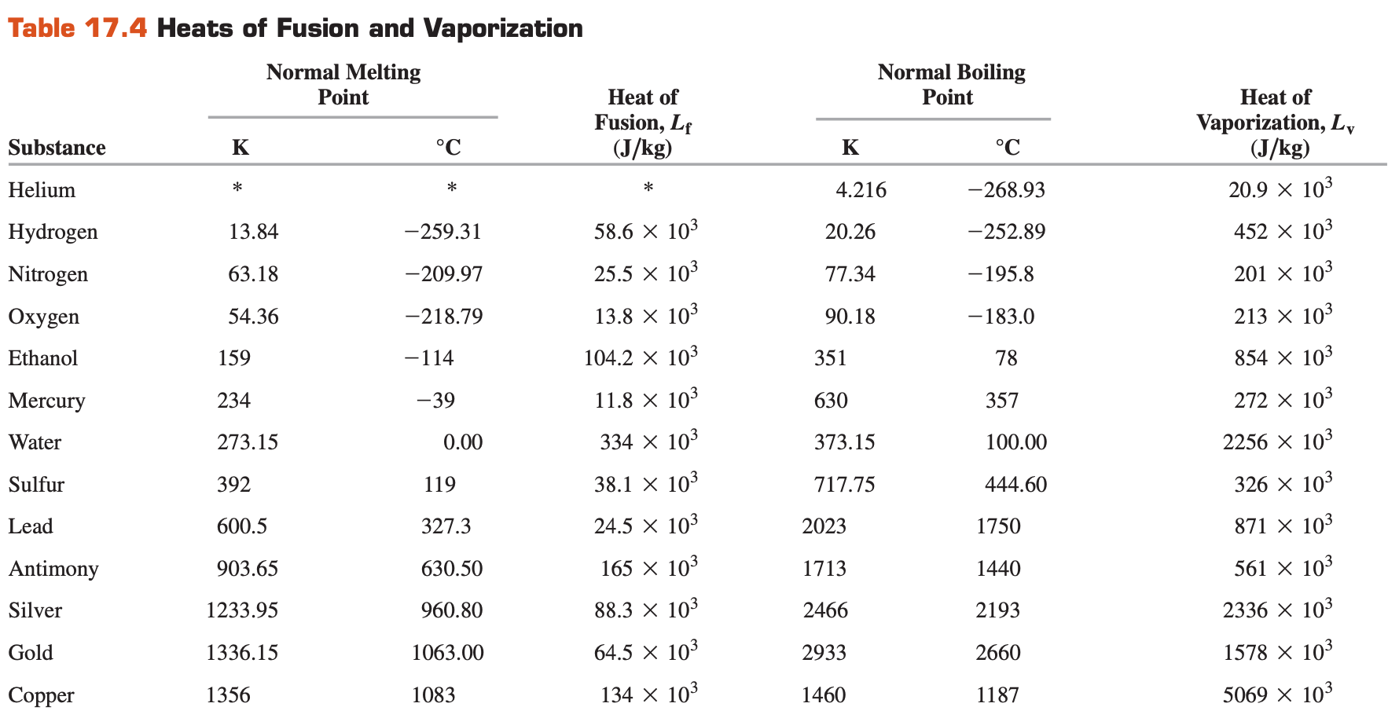
17-6 Calorimetry and Phase Changes

Slide 34
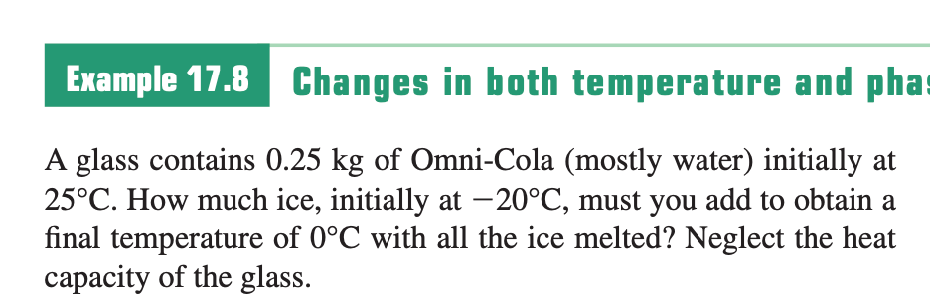
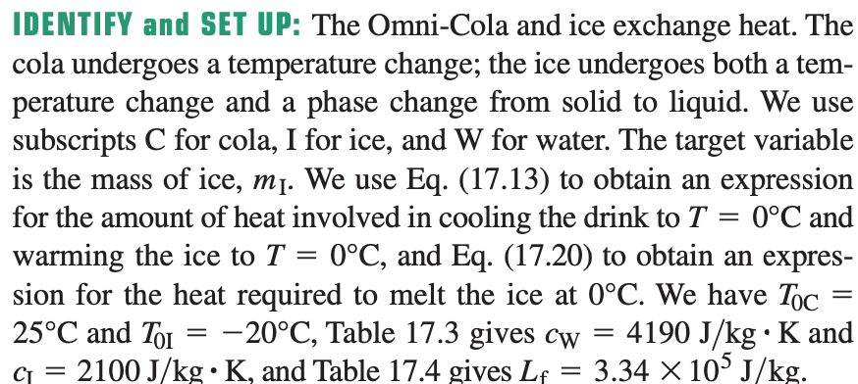
Sample Problem

Slide 35
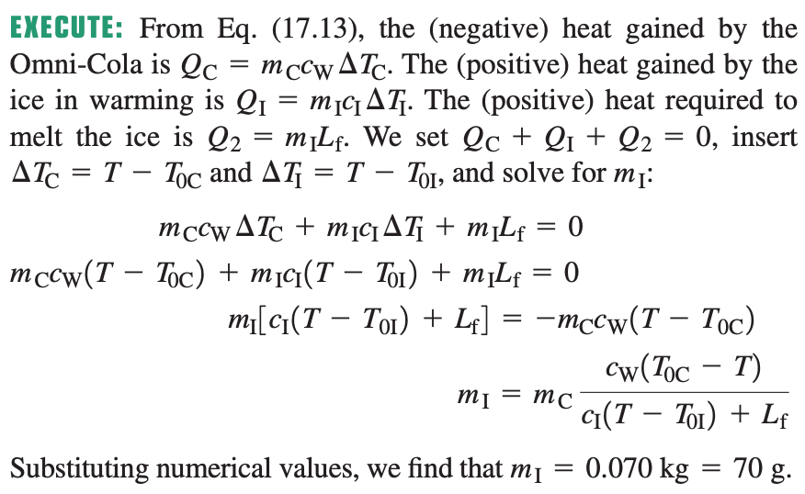
Sample Problem

Slide 36
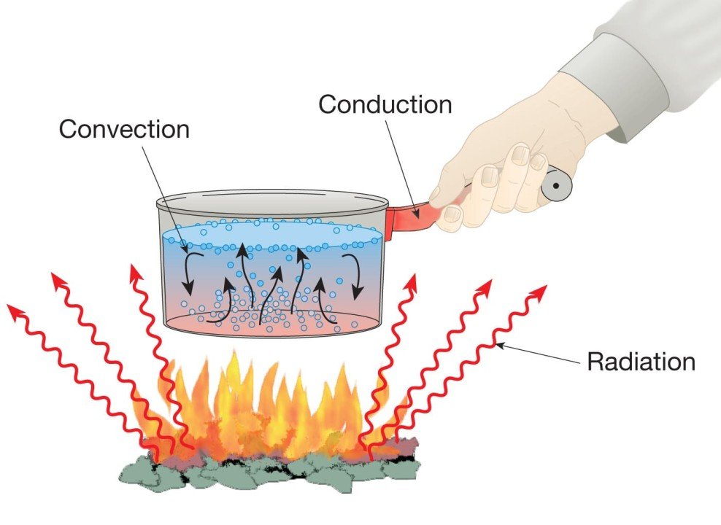
17-7 Mechanisms of Heat Transfer

Slide 37
17-7 Mechanisms of Heat Transfer
The three mechanisms of heat transfer are conduction, convection, and radiation.
Conduction occurs within a body or between two bodies in contact.
Convection depends on motion of mass from one region of space to another.
Radiation is heat transfer by electromagnetic radiation, such as sunshine, with no need for matter to be present in the space between bodies.

Slide 38
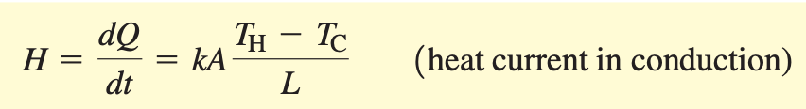
17-7 Mechanisms of Heat Transfer
When a quantity of heat dQ is transferred through the rod in a time dt, the rate of heat flow is dQ/dt. We call this rate the heat current, denoted by H
Introducing a proportionality constant k called the thermal conductivity of the material, we have
The units of heat current H are units of energy per time, or power; the SI unit of heat current is the watt (1W = 1 J/s). SI units of k are W/m K.

Slide 39
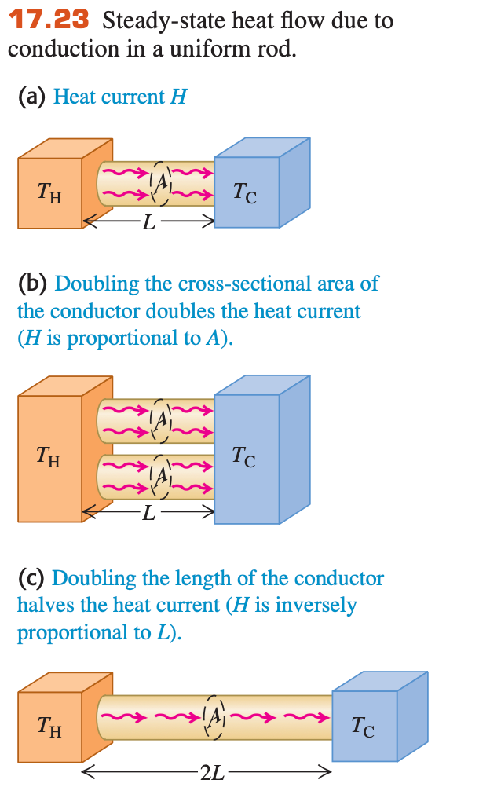
17-7 Mechanisms of Heat Transfer

Slide 40
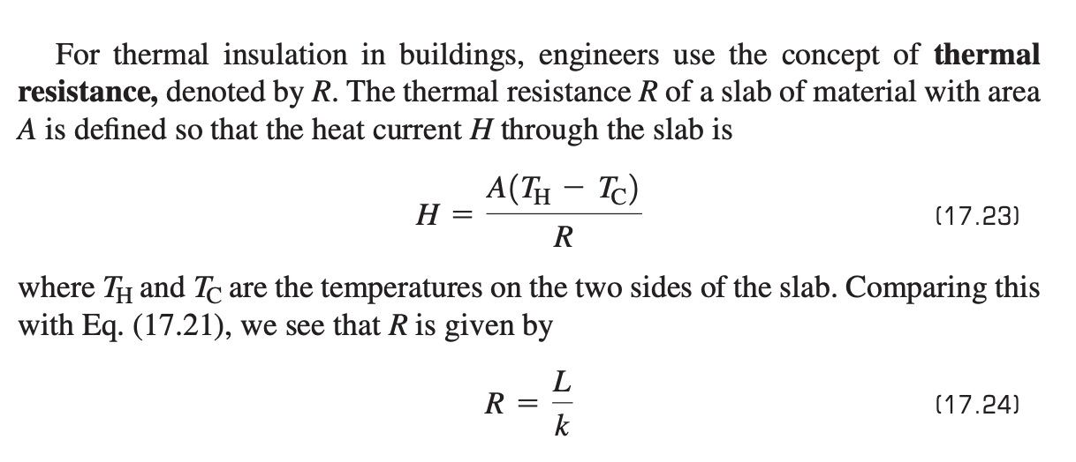
17-7 Mechanisms of Heat Transfer

Slide 41
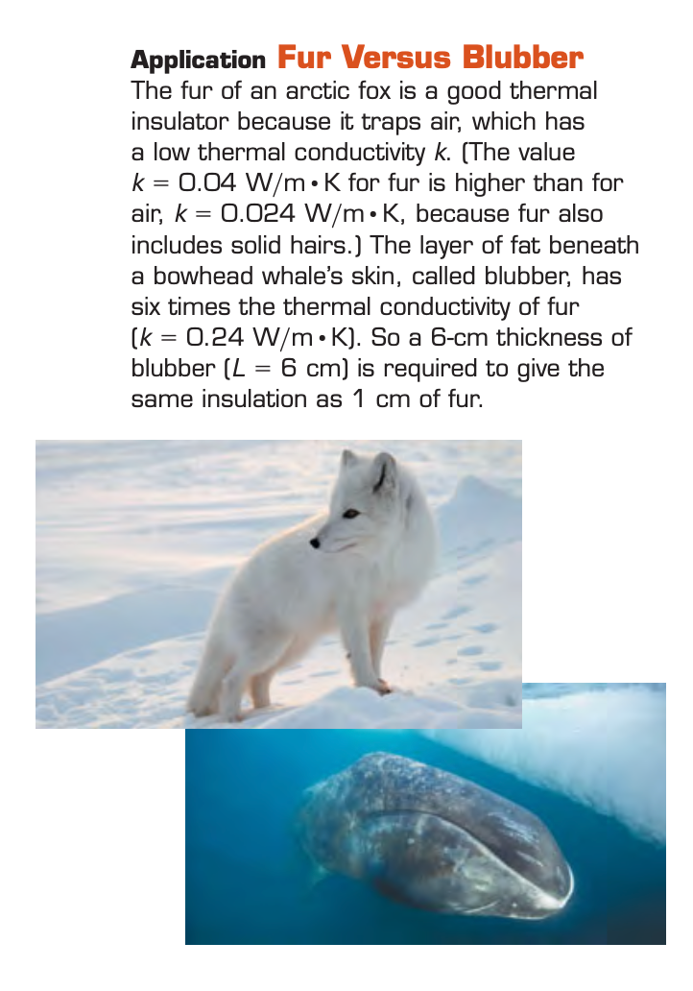
17-7 Mechanisms of Heat Transfer

Slide 42
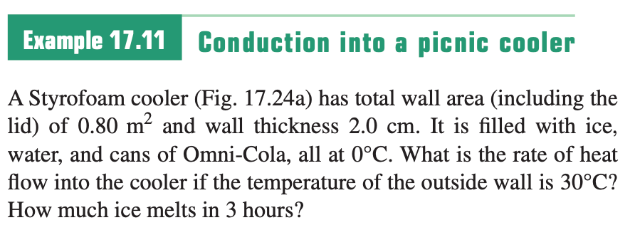


Sample Problem

Slide 43


Sample Problem

Slide 44

17-7 Mechanisms of Heat Transfer
Convection is the transfer of heat by mass motion of a fluid from one region of space to another.
If the fluid is circulated by a blower or pump, the process is called forced convection;
If the flow is caused by differences in density due to thermal expansion, such as hot air rising, the process is called natural convection or free convection

Slide 45


17-7 Mechanisms of Heat Transfer
Radiation is the transfer of heat by electromagnetic waves such as visible light, infrared, and ultraviolet radiation.
This heat transfer would occur even if there were nothing but vacuum between you and the source of heat.
Source: Wikipedia

Slide 46



17-7 Mechanisms of Heat Transfer
Stefan–Boltzmann law
where $σ$ is a fundamental physical constant called the Stefan–Boltzmann constant.

