Slide 1
PHYS1001B College Physics IB
Thermodynamics II — Thermal Properties of Matter (Ch. 18)

Slide 2
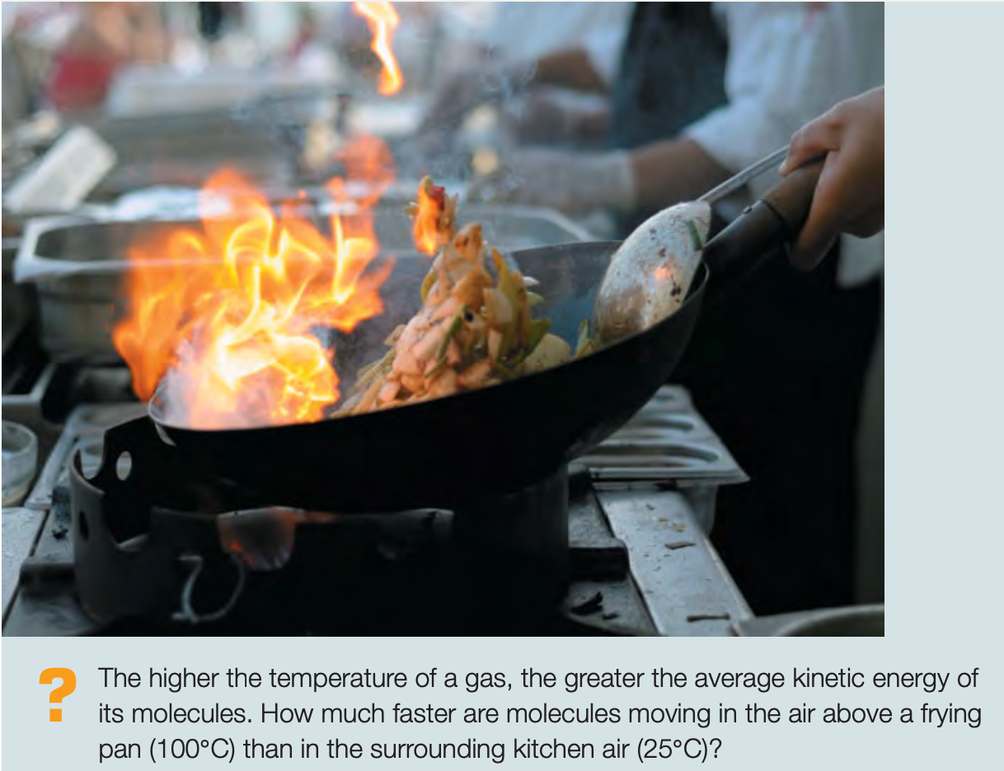
Introduction

Slide 3
Outline
18-1 Equations of State
18-2 Molecular Properties of Matter
18-3 Kinetic-Molecular Model of an Ideal Gas
18-4 Heat Capacities
18-5 Molecular Speeds
18-6 Phases of Matter

Slide 4

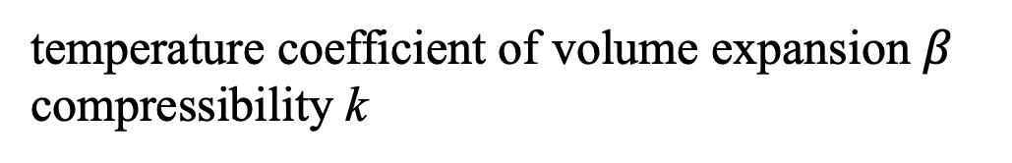
18-1 Equations of State
The conditions in which a particular material exists are described by physical quantities such as pressure, volume, temperature, and amount of substance. These variables describe the state of the material and are called state variables.
In a few cases the relationship among p, V, T, and m (or n) is simple enough that we can express it as an equation called the equation of state.
Equation of state for a solid material
temperature coefficient of volume expansion $β$ compressibility k

Slide 5
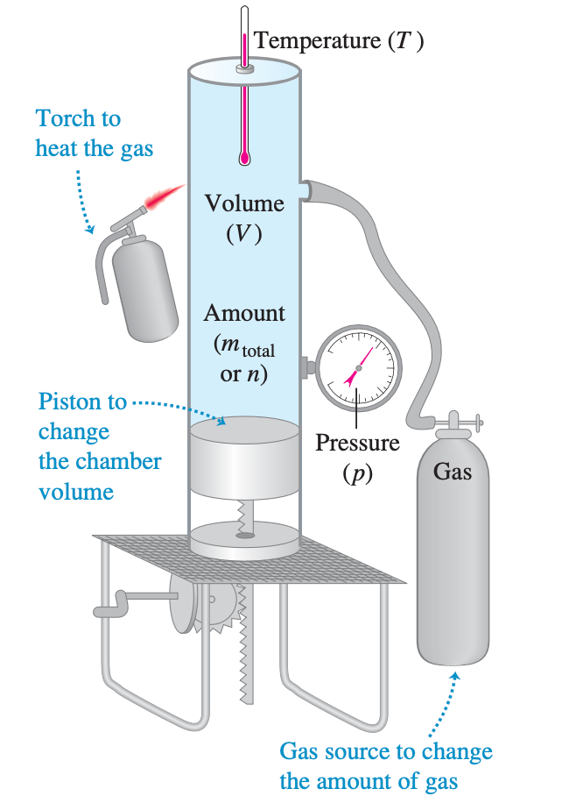
18-1 Equations of State
The volume V is proportional to the number of moles n. If we double the number of moles, keeping pressure and temperature constant, the volume doubles.
The volume varies inversely with the absolute pressure p. If we double the pressure while holding the temperature T and number of moles n constant, the gas compresses to one-half of its initial volume. In other words, pV = constant when n and T are constant.
The pressure is proportional to the absolute temperature. If we double the absolute temperature, keeping the volume and number of moles constant, the pressure doubles. In other words, p = (constant) T when n and V are constant.

Slide 6
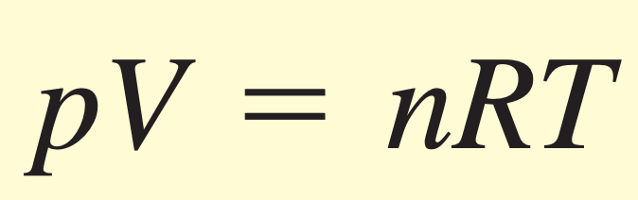

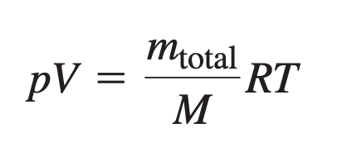
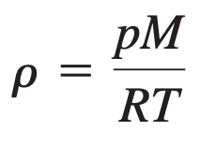
18-1 Equations of State
n: Number of moles
Ideal-gas equation
Gas constant (or ideal-gas constant)
Variation - Density expression

Slide 7
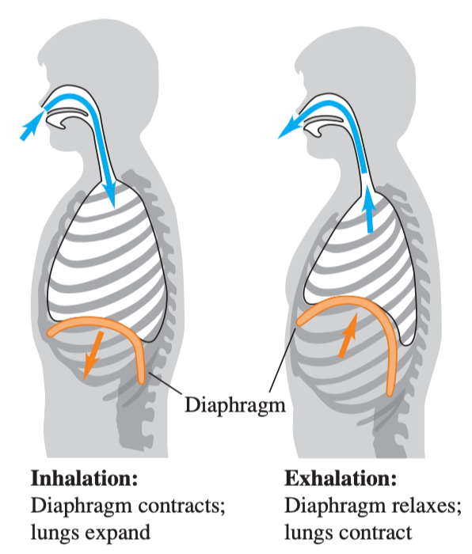

18-1 Equations of State
As the tire warms (T increases), the volume V changes only slightly but the pressure p increases.
Pressure and volume

Slide 8
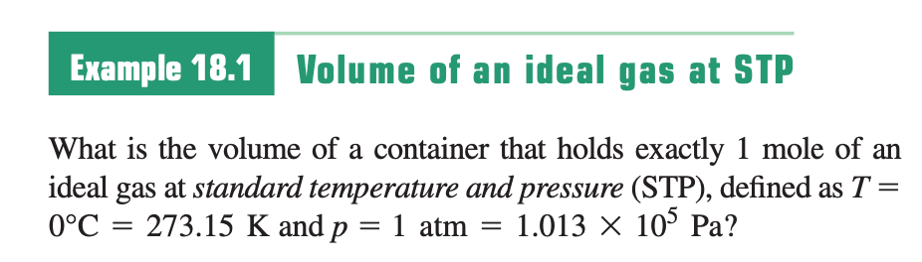
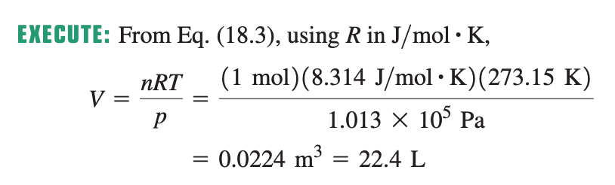
Sample Problem

Slide 9
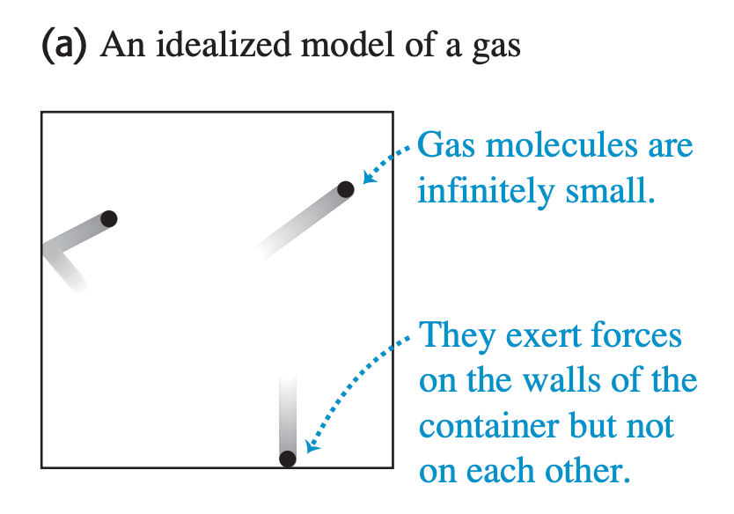
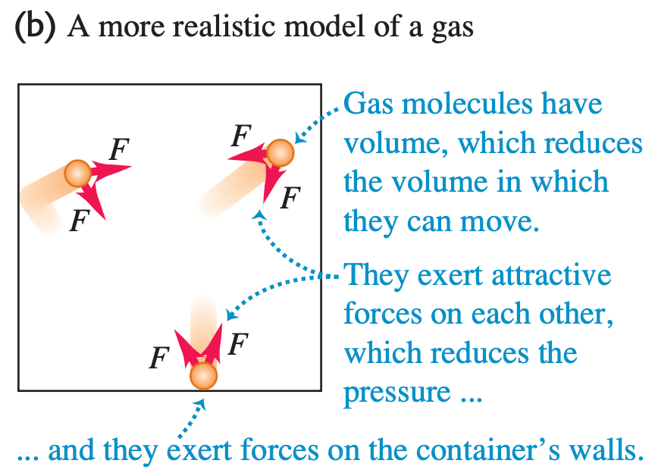
18-1 Equations of State

Slide 10
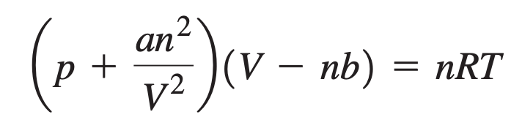
18-1 Equations of State
Ideal-gas equation
volumes of the molecules
attractive forces between molecules
Van der Waals equation
The constants a and b are empirical constants, different for different gases.

Slide 11
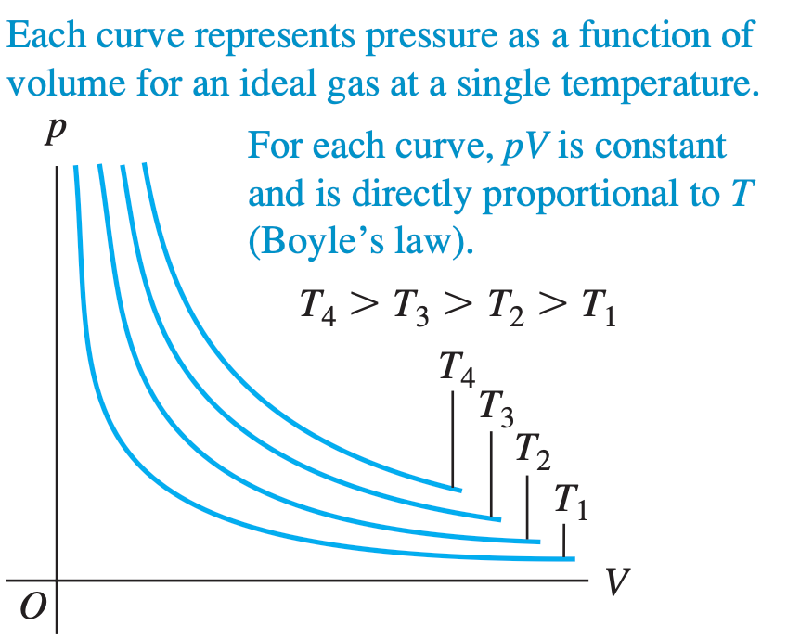
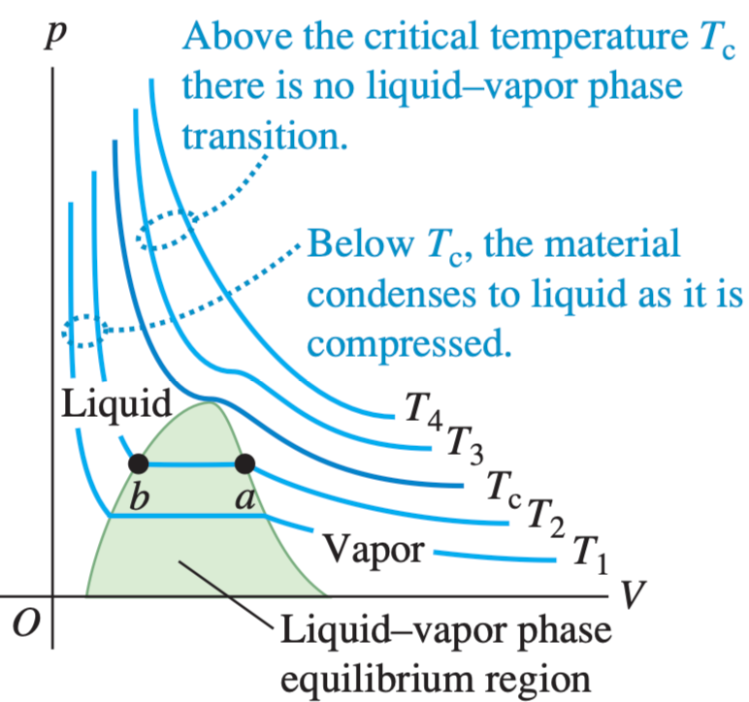
18-1 Equations of State
pV - diagram
Each curve, representing behavior at a specific temperature, is called an isotherm
Ideal gas
Nonideal gas

Slide 12
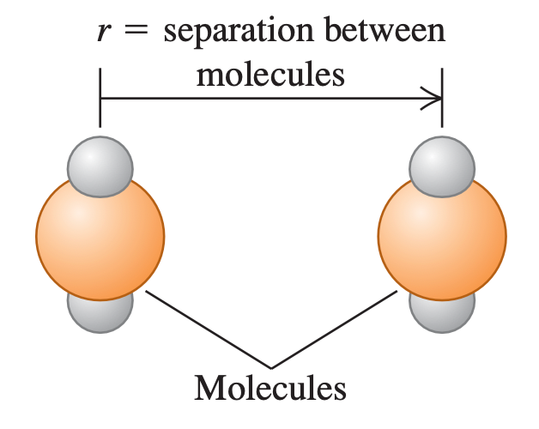
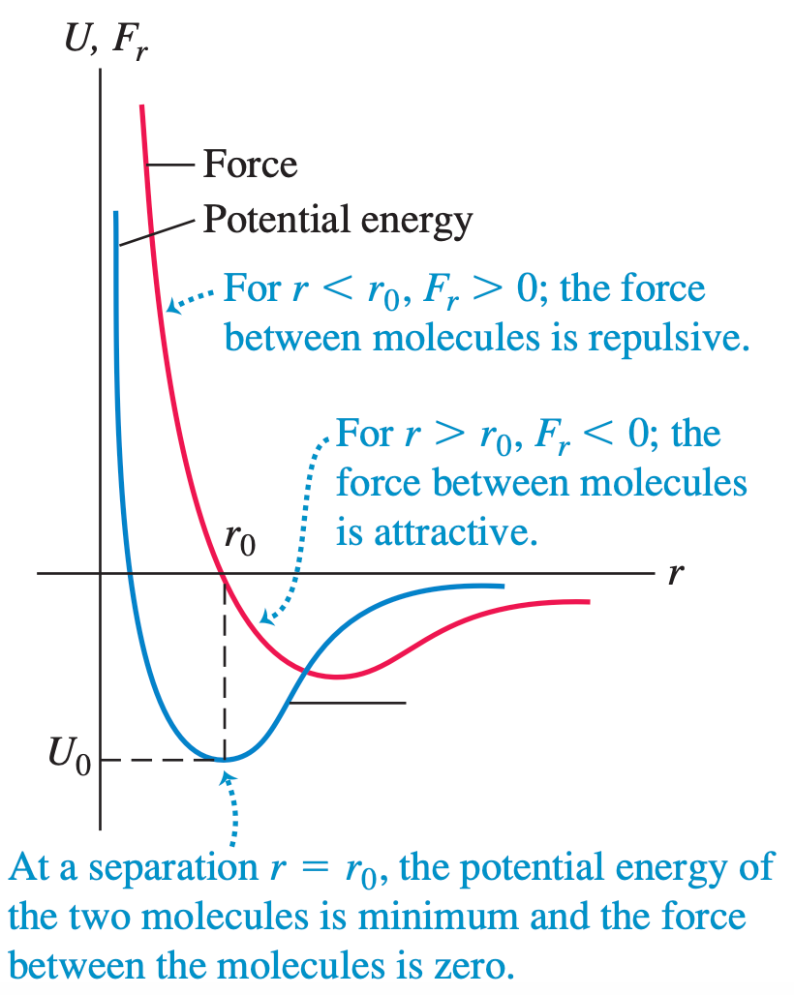
18-2 Molecular Properties of Matter
At close separations, the electrons around each atom repel each other through electrostatic repulsion.
At intermediate separations, the electrons and protons of the atoms attract each other through electrostatic (dipole) attraction.
At far separations, the binding force decreases exponentially.

Slide 13
18-2 Molecular Properties of Matter
In solids, molecules vibrate about more or less fixed points. In a crystalline solid these points are arranged in a crystal lattice. The vibration of molecules in a solid about their equilibrium positions may be nearly simple harmonic if the potential well is approximately parabolic in shape at distances close to r₀.
Notes:
https://www.chegg.com/homework-help/questions-and-answers/potential-energy-70-pm-o-ev-r-50-ev-5-pt-molecular-binding-energy-diagram-shows-potential--q53683420

Slide 14
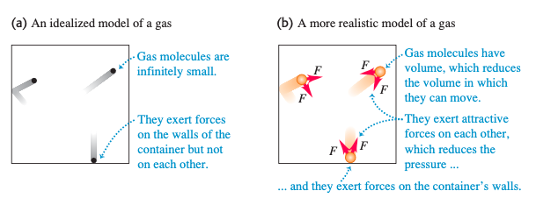
18-2 Molecular Properties of Matter
In a liquid, the intermolecular distances are usually only slightly greater than in the solid phase of the same substance, but the molecules have much greater freedom of movement.
The molecules of a gas are usually widely separated and so have only very small attractive forces. In molecular terms, an ideal gas is a gas whose molecules exert no attractive forces on each other and therefore have no potential energy.
Notes:
https://www.chegg.com/homework-help/questions-and-answers/potential-energy-70-pm-o-ev-r-50-ev-5-pt-molecular-binding-energy-diagram-shows-potential--q53683420

Slide 15
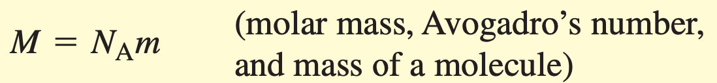
18-2 Molecular Properties of Matter
Moles and Avogadro’s Number
N_{A} = 6.022141791302 * 10²³ molecules/mol (Avogadro’s number)

Slide 16
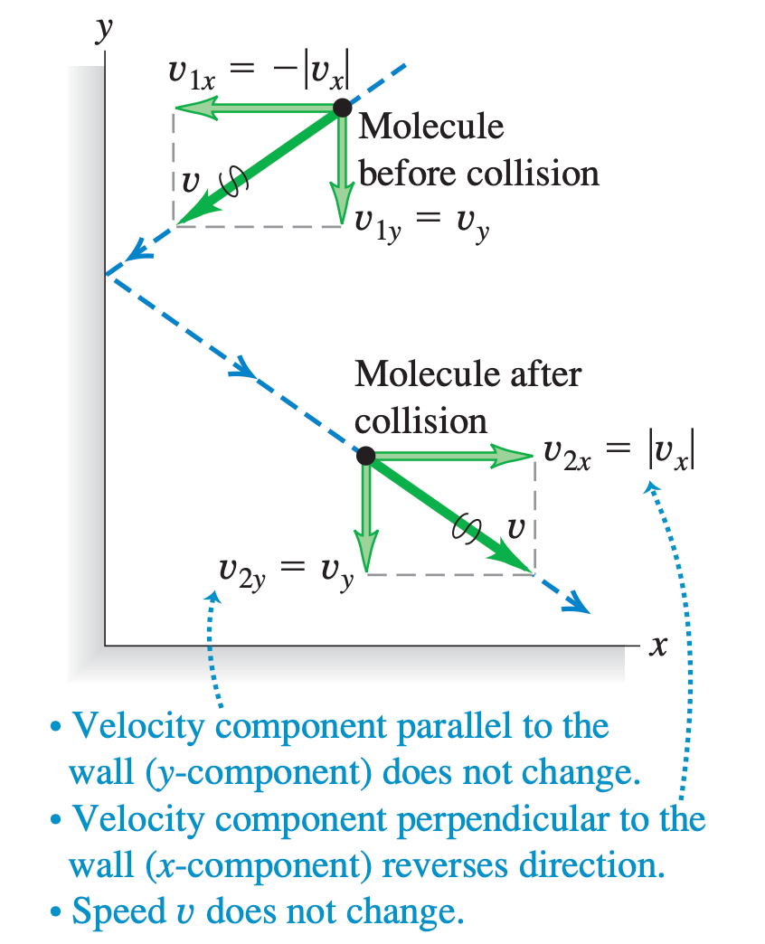
18-3 Kinetic-Molecular Model of an Ideal Gas

Slide 17
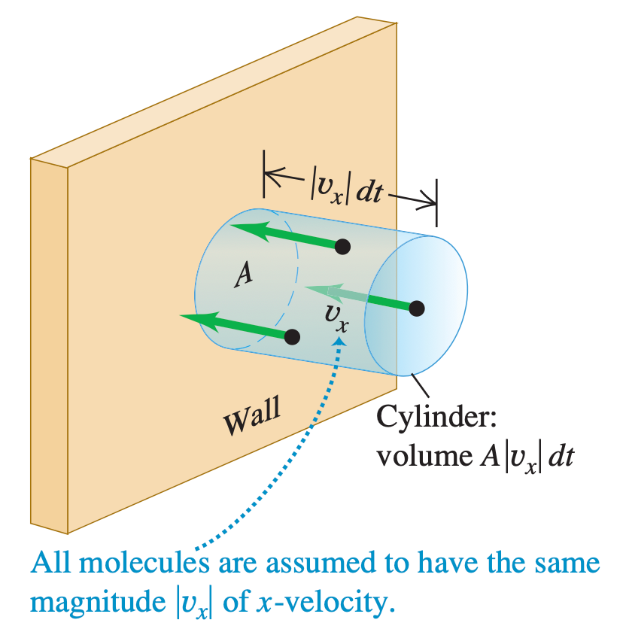
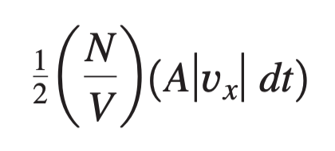
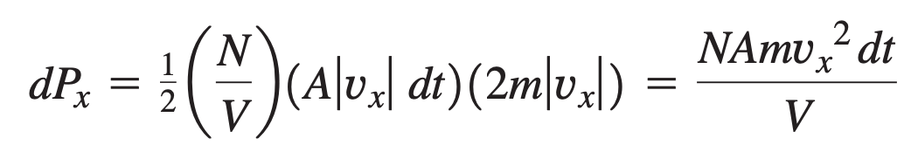
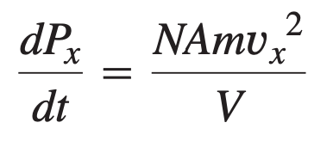
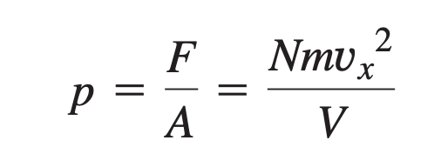
18-3 Kinetic-Molecular Model of an Ideal Gas
Number of collisions with A during dt
Change of momentum
Rate of change of momentum (Force)

Slide 18
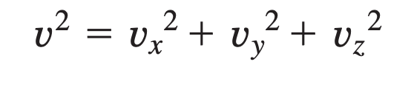
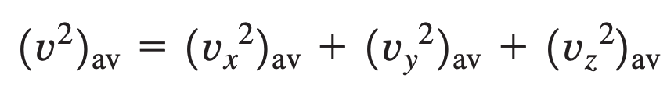
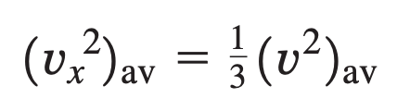
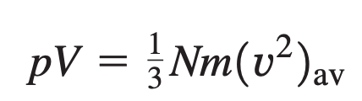
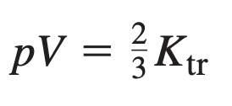

18-3 Kinetic-Molecular Model of an Ideal Gas
Pressure and Molecular Kinetic Energies
K_{tr} =

Slide 19
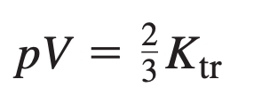
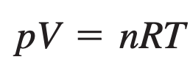
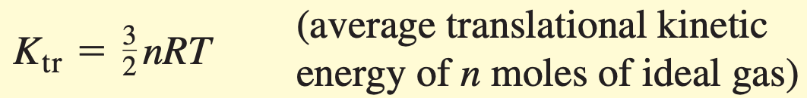
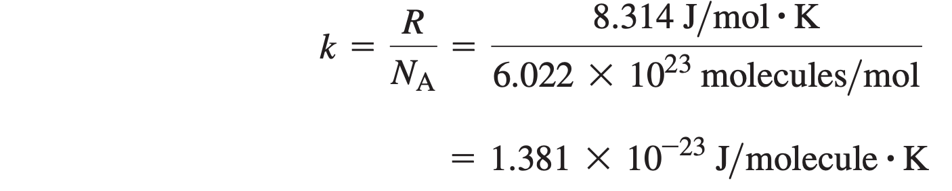
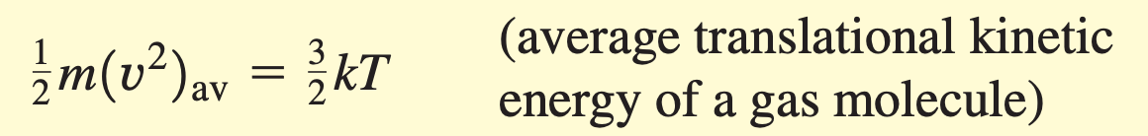
18-3 Kinetic-Molecular Model of an Ideal Gas
Boltzmann constant

Slide 20
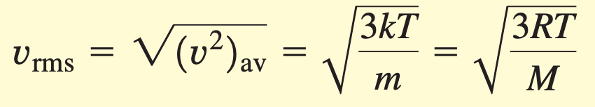
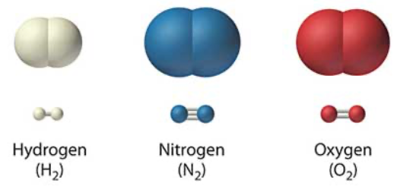
18-3 Kinetic-Molecular Model of an Ideal Gas
root-mean-square speed v_{rms}
M:
2 g mol⁻¹
28 g mol⁻¹
32 g mol⁻¹
Which one can most easy to escape from the earth?

Slide 21
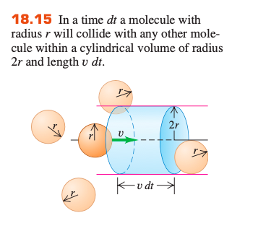

18-3 Kinetic-Molecular Model of an Ideal Gas

Slide 22
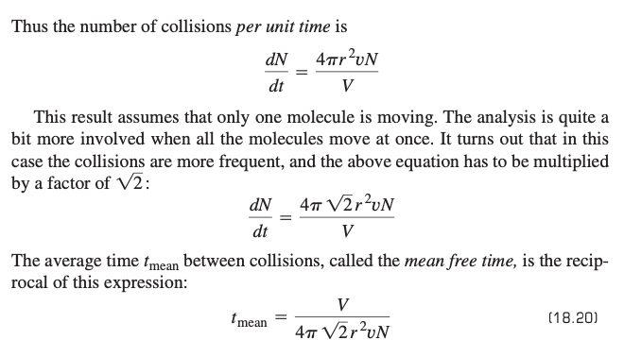
18-3 Kinetic-Molecular Model of an Ideal Gas

Slide 23
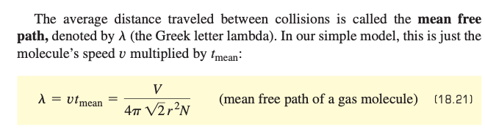
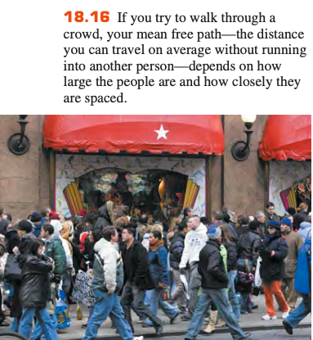

18-3 Kinetic-Molecular Model of an Ideal Gas

Slide 24
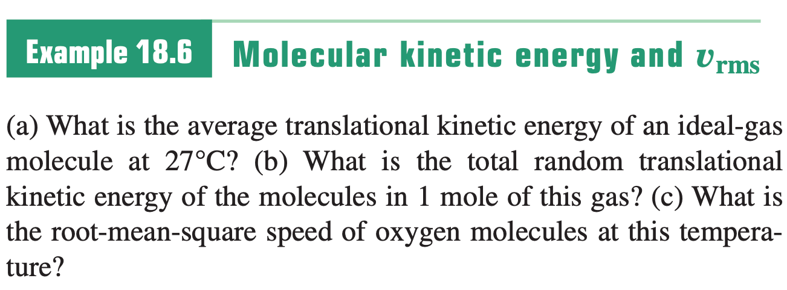
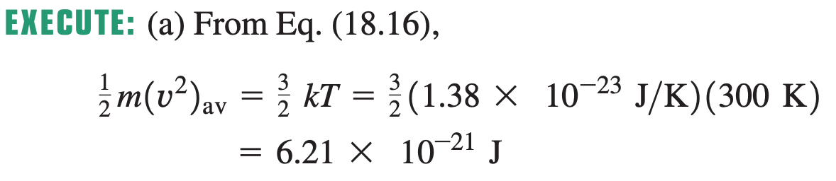
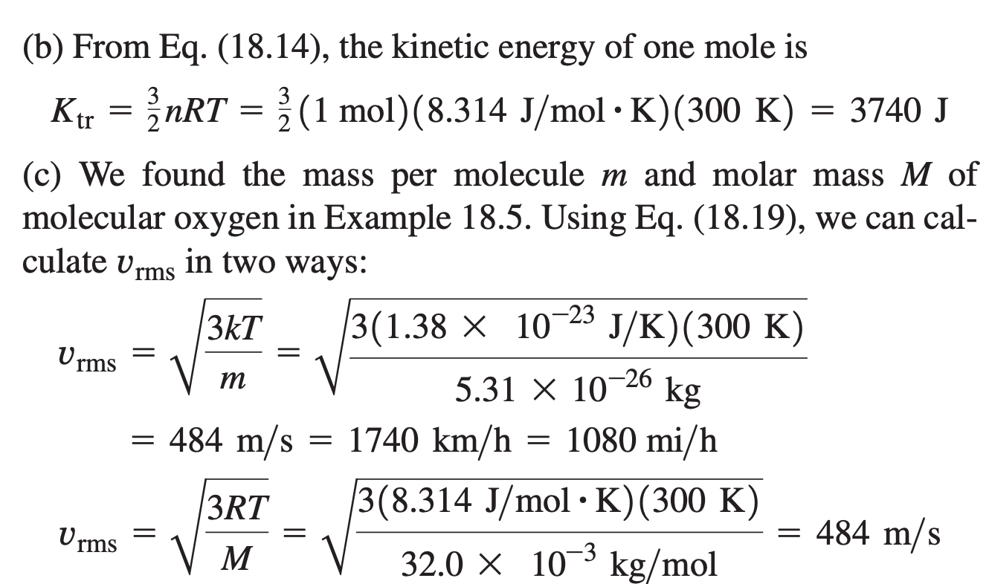
Sample Problem

Slide 25
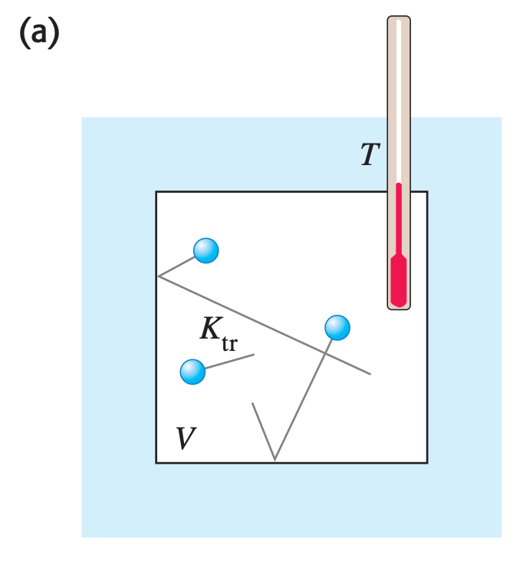
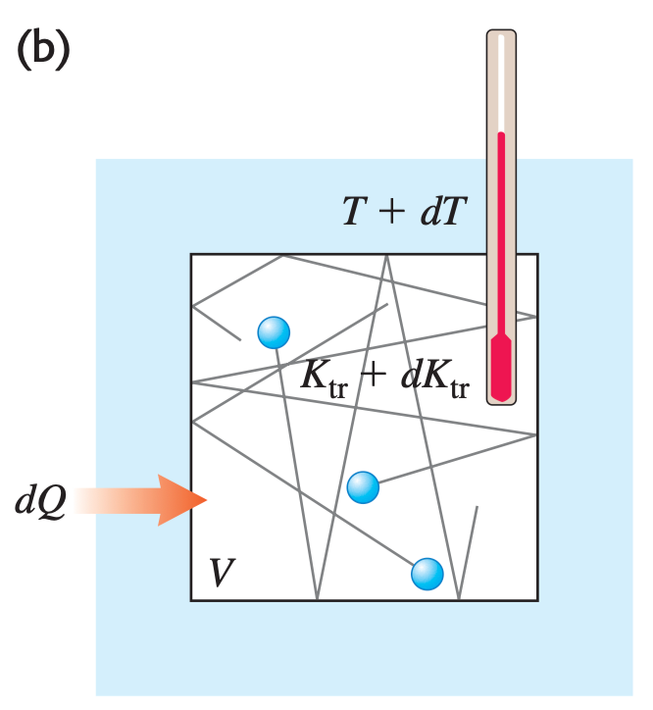
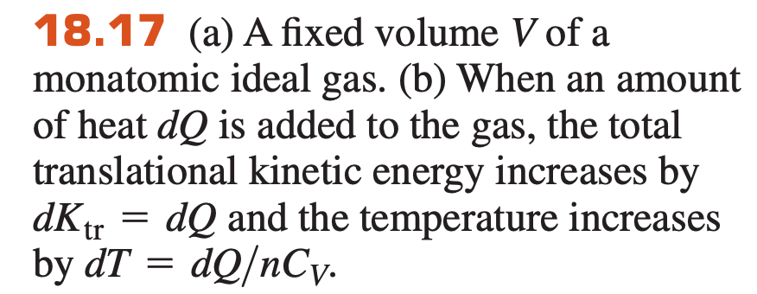
18-4 Heat Capacities

Slide 26
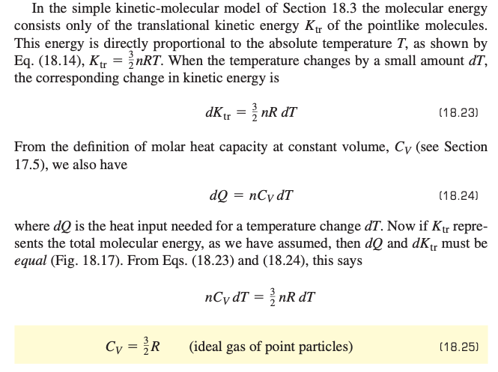
18-4 Heat Capacities

Slide 27
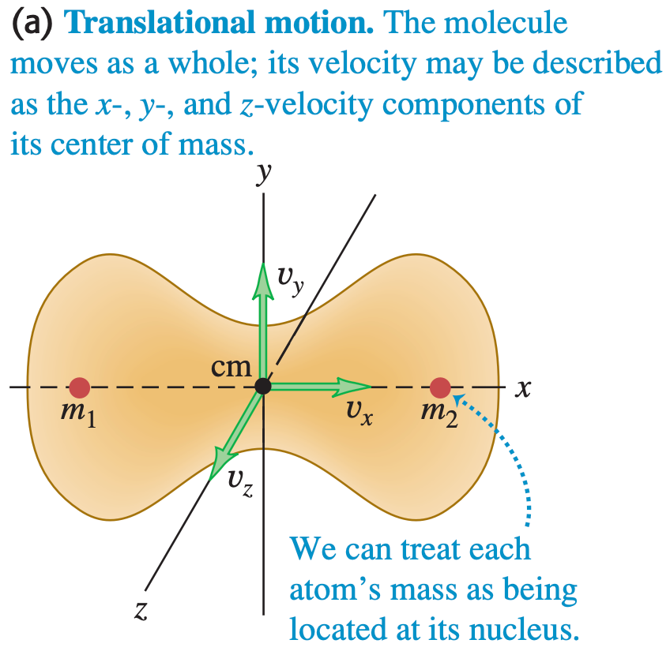
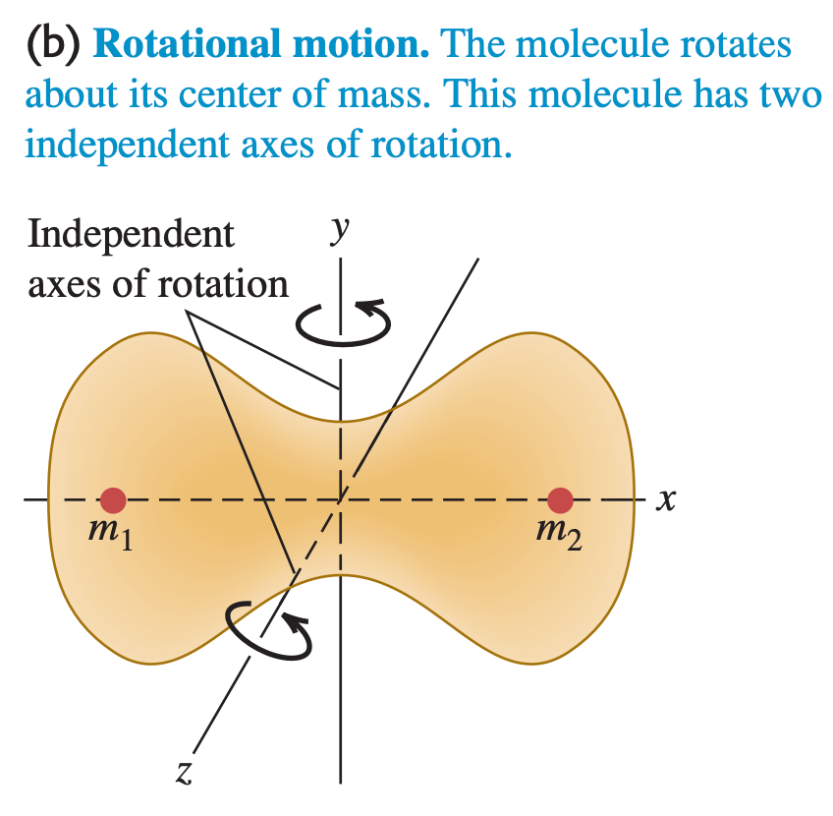
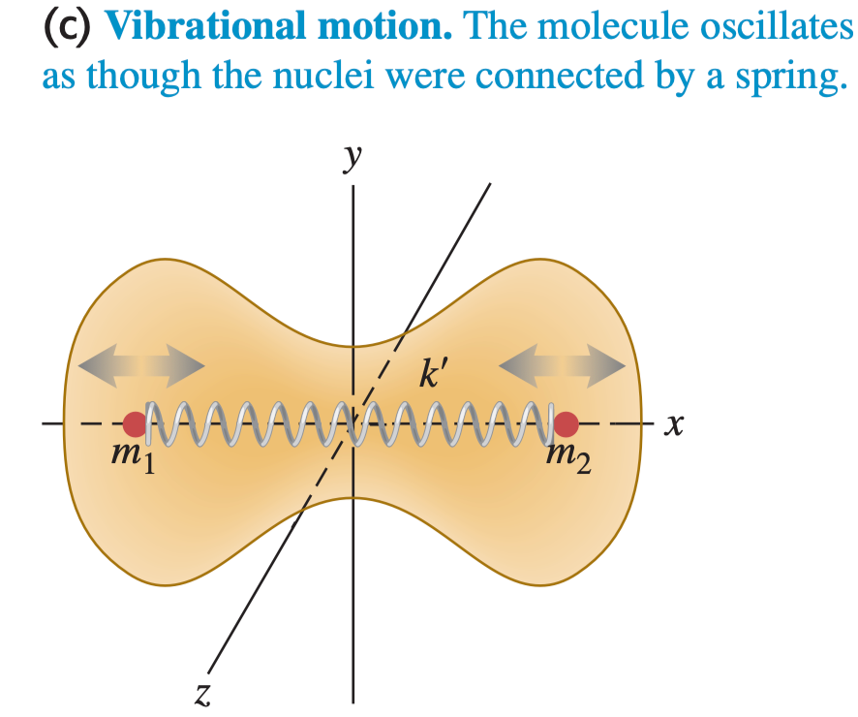
18-4 Heat Capacities
Motions of a diatomic molecule
Principle of equipartition of energy
The number of velocity components needed to describe the motion of a molecule completely is called the number of degrees of freedom

Slide 28



18-4 Heat Capacities

Slide 29

18-4 Heat Capacities

Slide 30



18-4 Heat Capacities
3D harmonic oscillator
average kinetic energy 3/2 kT
average potential energy 3/2 kT

Slide 31


18-5 Molecular Speeds

Slide 32





18-5 Molecular Speeds

Slide 33


18-5 Molecular Speeds
Maxwell–Boltzmann distribution.

Slide 34



18-5 Molecular Speeds
Most probable
Average
Root mean square

Slide 35

18-5 Molecular Speeds
related to cooling of evaporation
activation energy of chemical reaction

Slide 36

18-6 Phases of Matter
Phase diagram
A transition from one phase to another ordinarily requires phase equilibrium between the two phases

