Slide 1
PHYS1001B College Physics IB
Thermodynamics III — The First Law of Thermodynamics (Ch. 19)

Slide 2
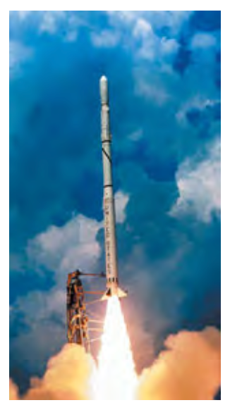
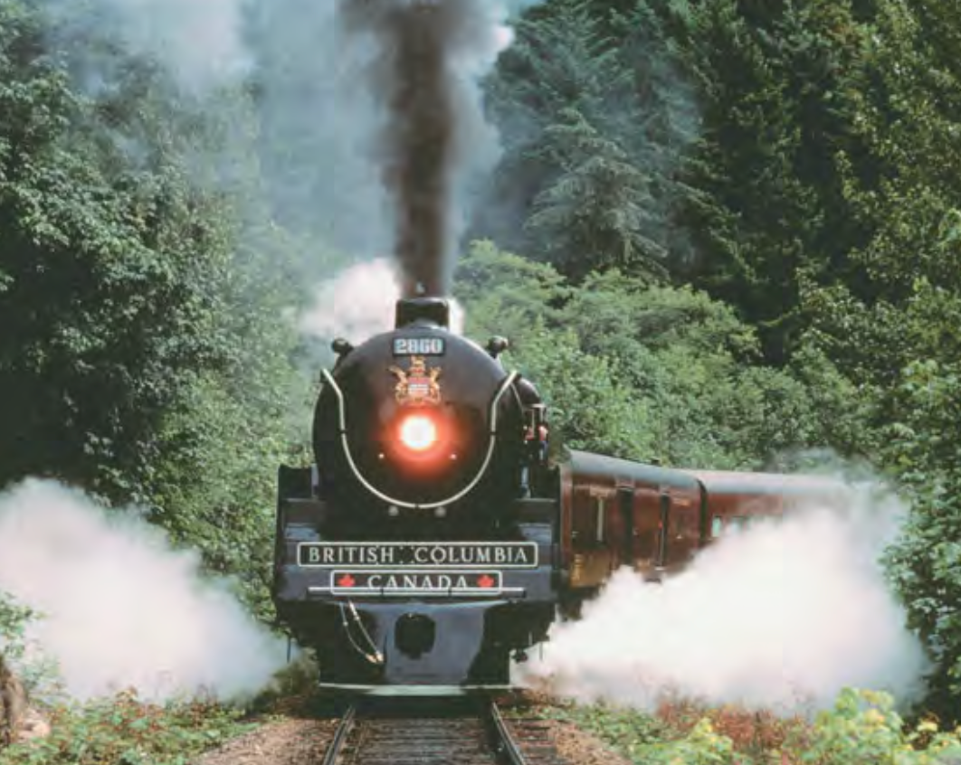
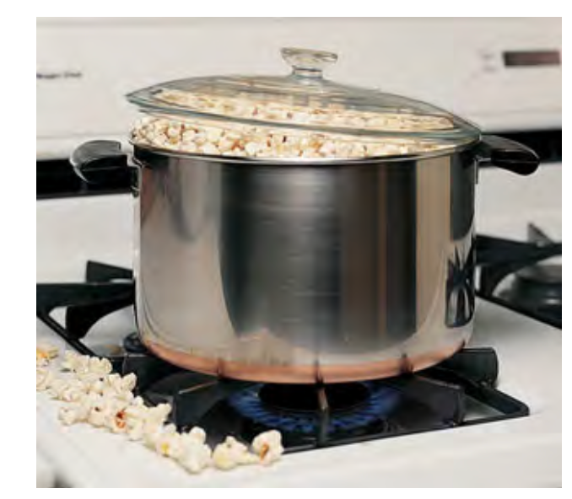
Introduction
Thermodynamics processes

Slide 3
Outline
19.1 Thermodynamic Systems
19.2 Work Done During Volume Changes
19.3 Paths Between Thermodynamic States
19.4 Internal Energy and the First Law of Thermodynamics
19.5 Kinds of Thermodynamic Processes
19.6 Internal Energy of an ldeal Gas
19.7 Heat Capacities of an Ideal Gas
19.8 Adiabatic Processes for an Ideal Gas

Slide 4
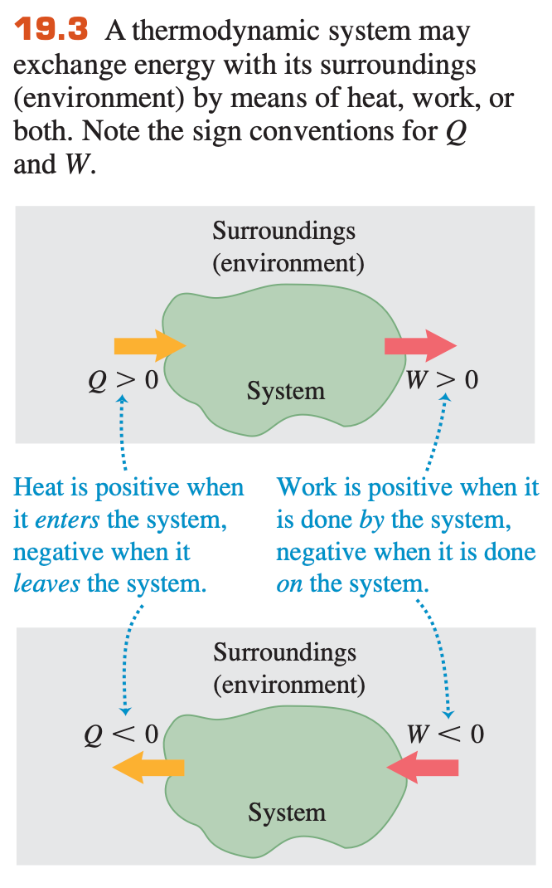

19.1 Thermodynamic Systems

Slide 5
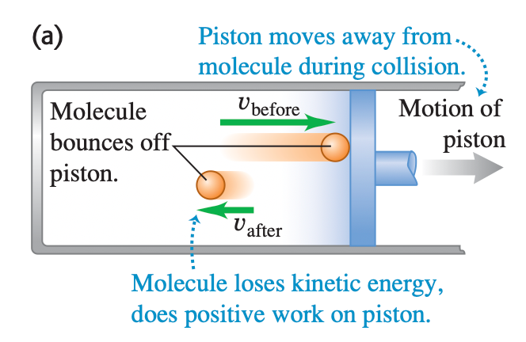
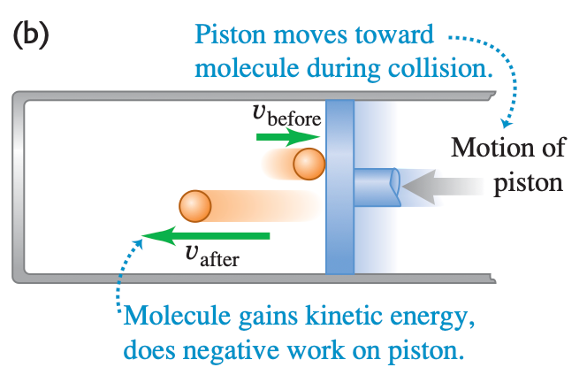
19.2 Work Done During Volume Changes

Slide 6
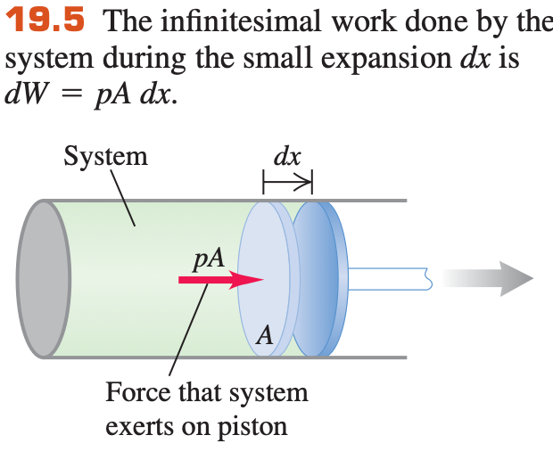



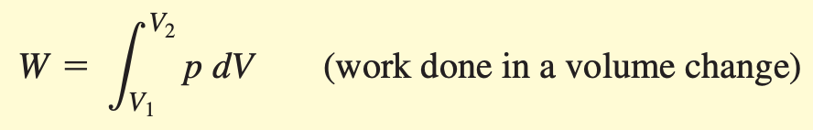
19.2 Work Done During Volume Changes

Slide 7
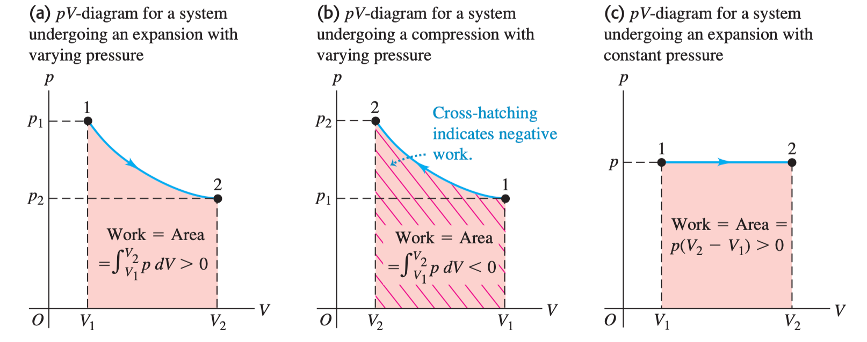
19.2 Work Done During Volume Changes

Slide 8
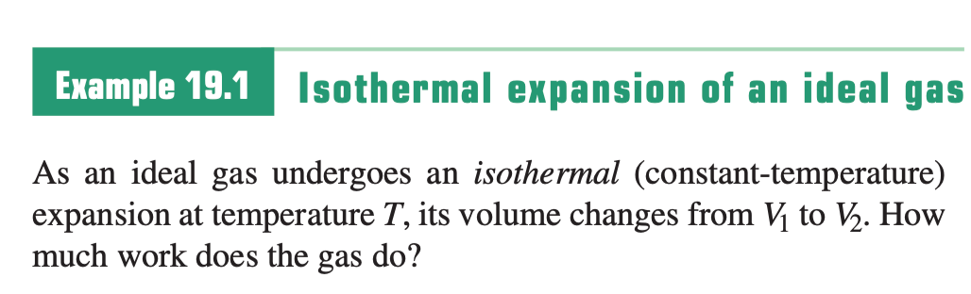
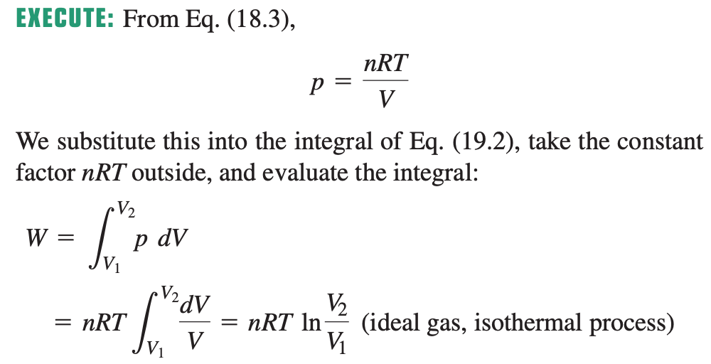
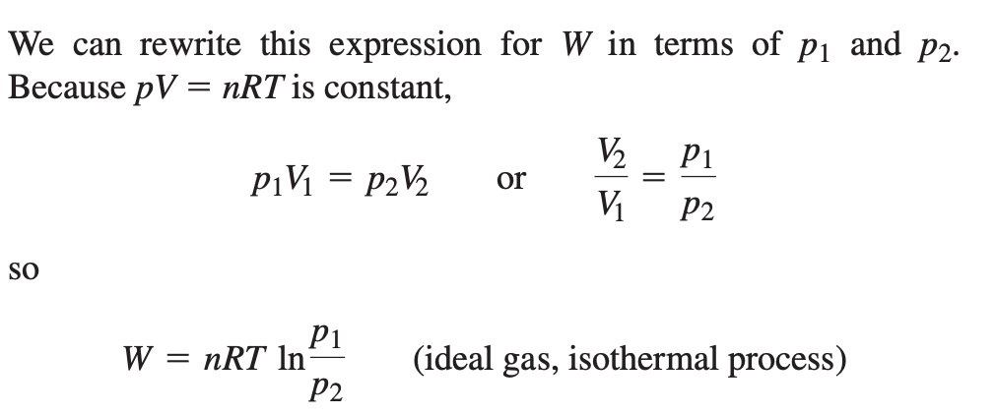
Sample Problem

Slide 9
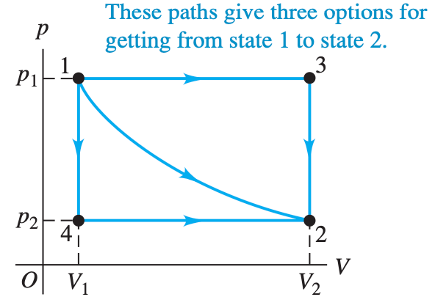
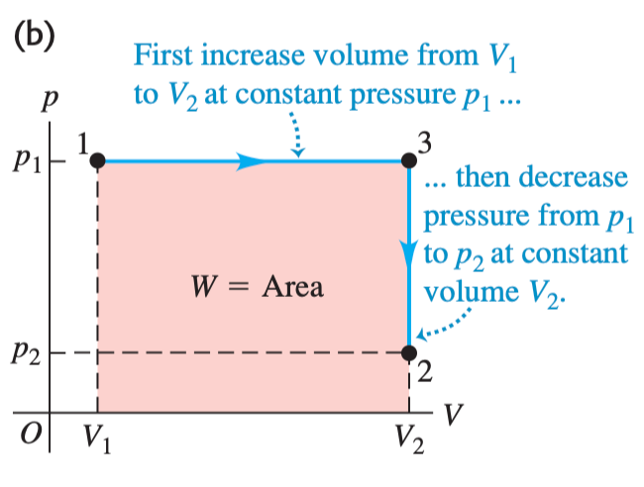
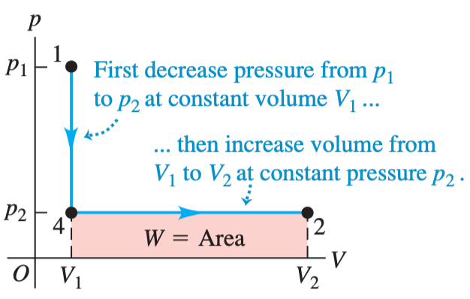
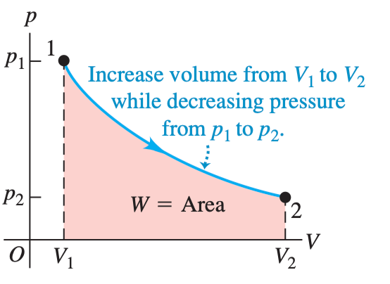
19.3 Paths Between Thermodynamic States
Work done in a thermodynamic Process

Slide 10
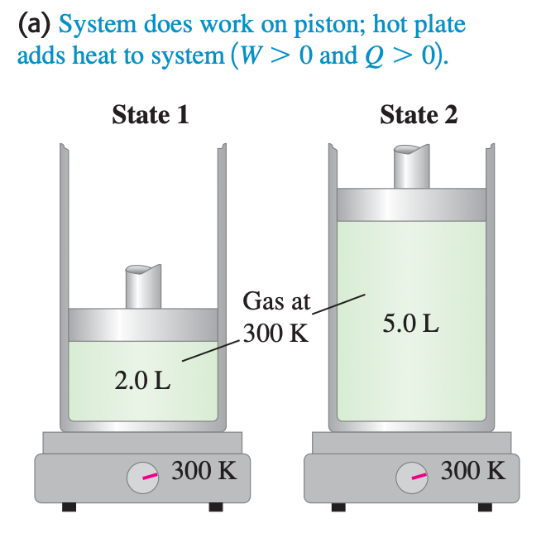
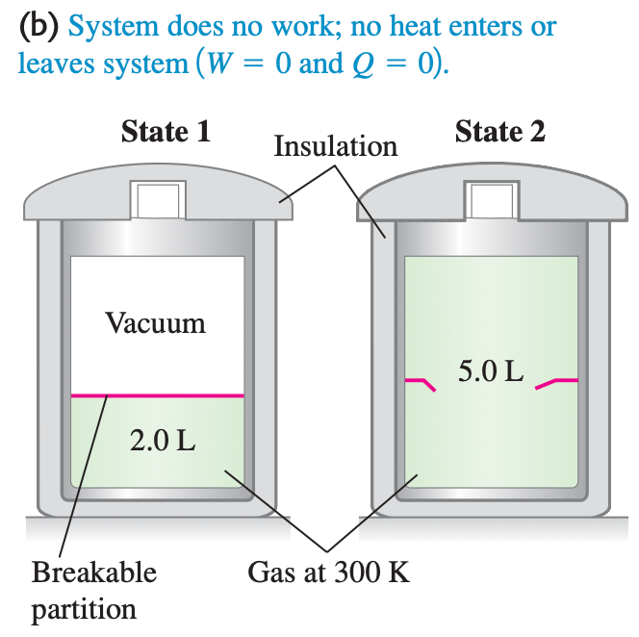
19.3 Paths Between Thermodynamic States
Heat Added in a Thermodynamic Process
heat depends not only on the initial and final states but also on the path.

Slide 11

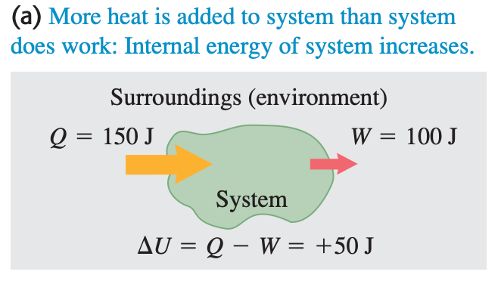
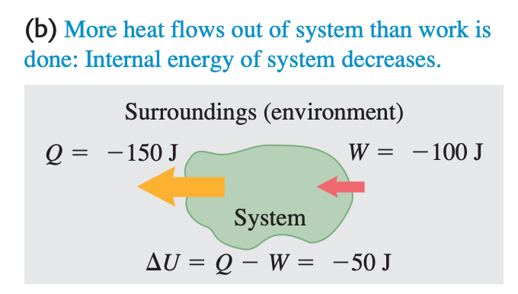
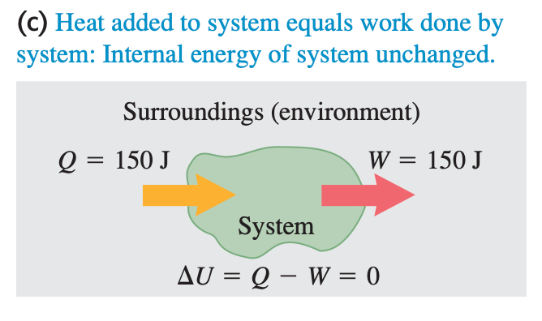
19.4 Internal Energy and the First Law of Thermodynamics
First Law of Thermodynamics
U for internal energy

Slide 12
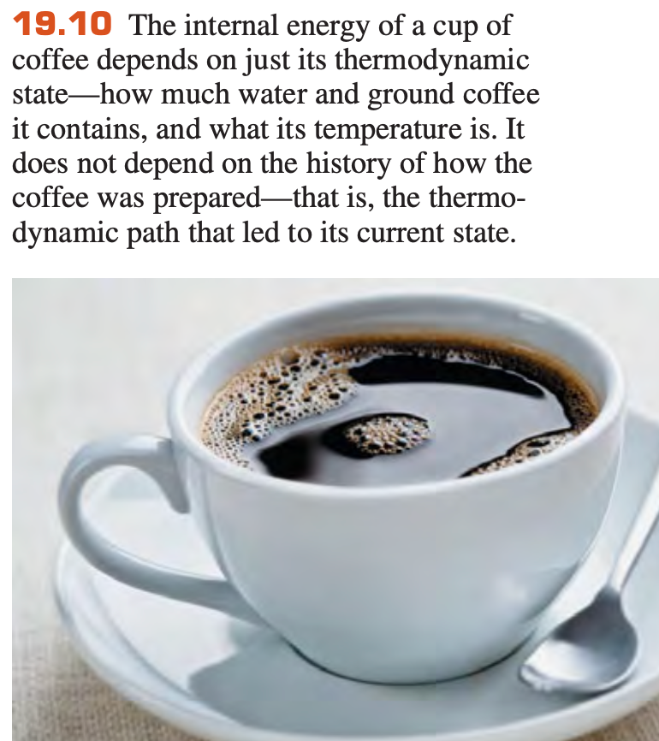
19.4 Internal Energy and the First Law of Thermodynamics

Slide 13
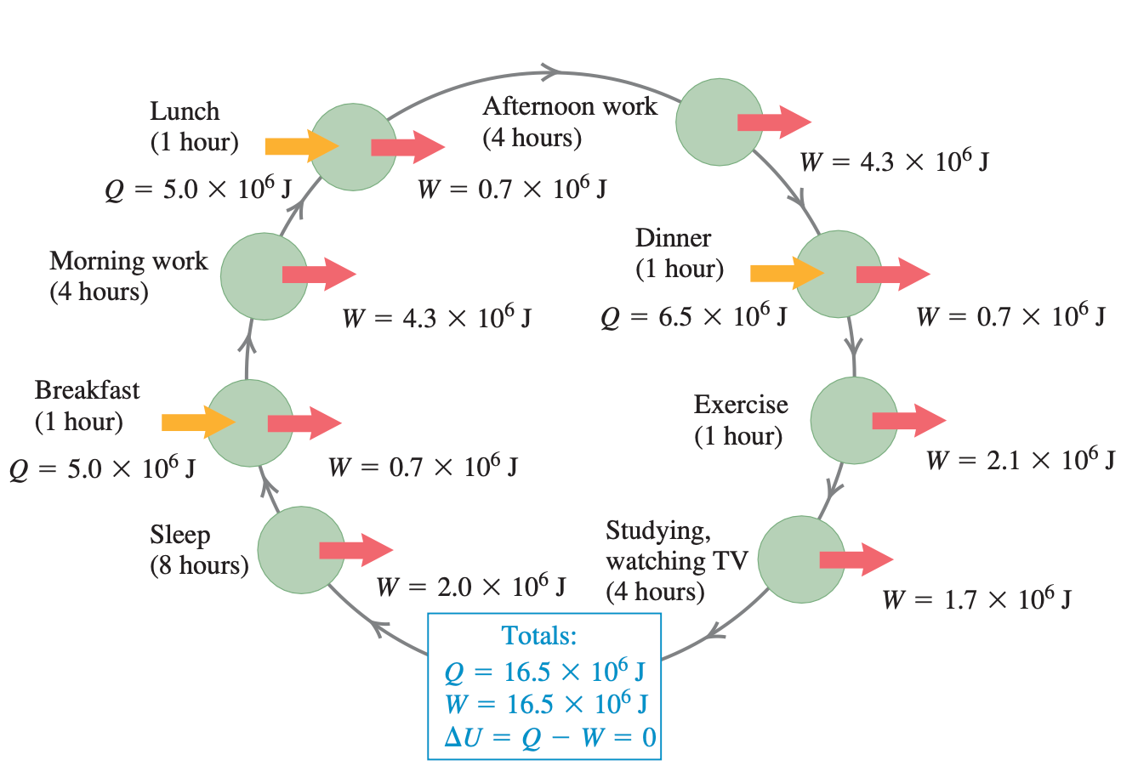
19.4 Internal Energy and the First Law of Thermodynamics
Cyclic Processes: Daily life

Slide 14
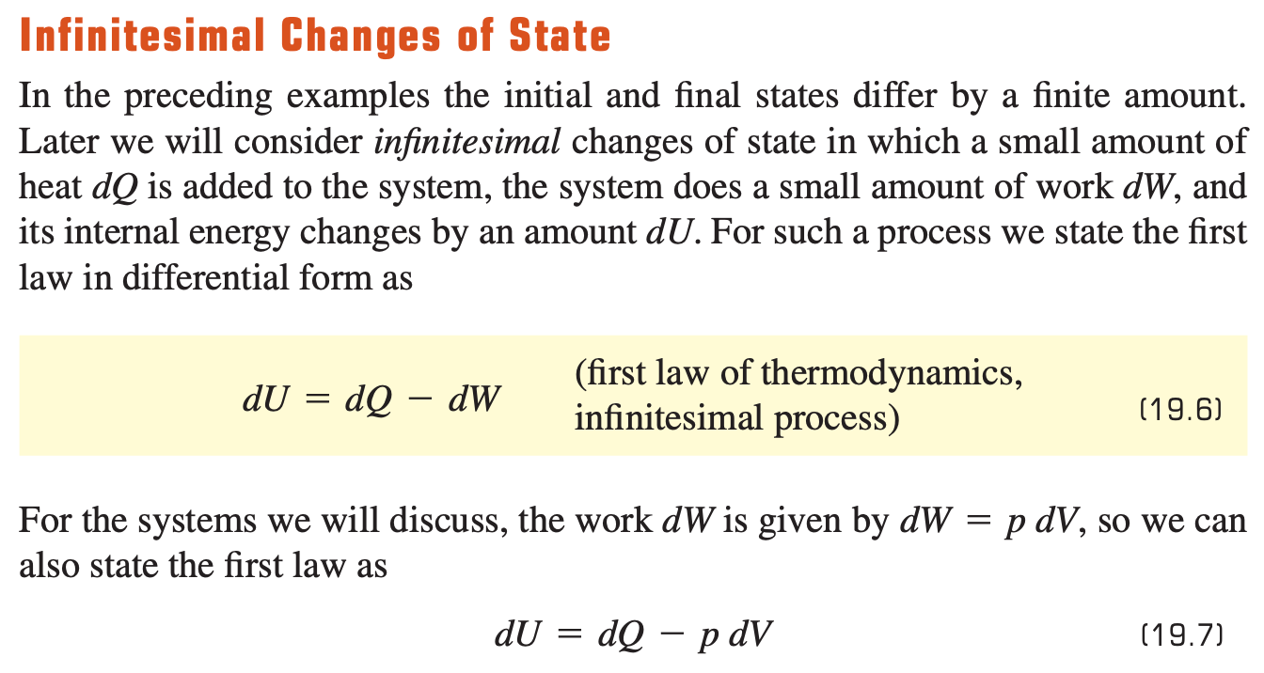
19.4 Internal Energy and the First Law of Thermodynamics

Slide 15
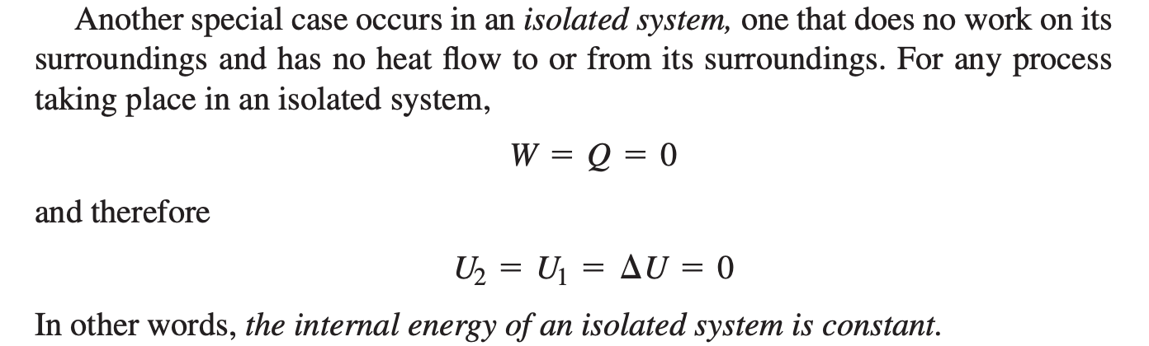
19.4 Internal Energy and the First Law of Thermodynamics
Isolated system: no work done and no heat flow to the surrounding

Slide 16
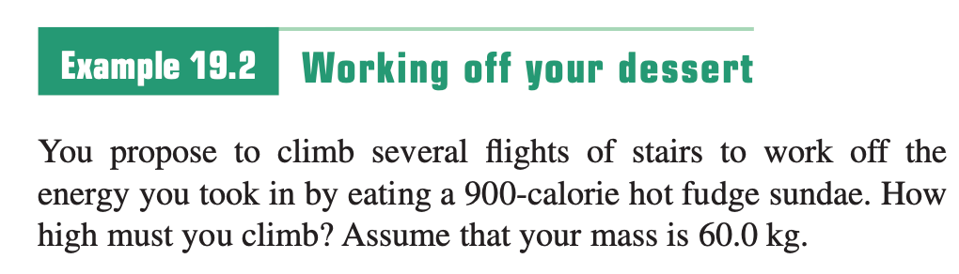
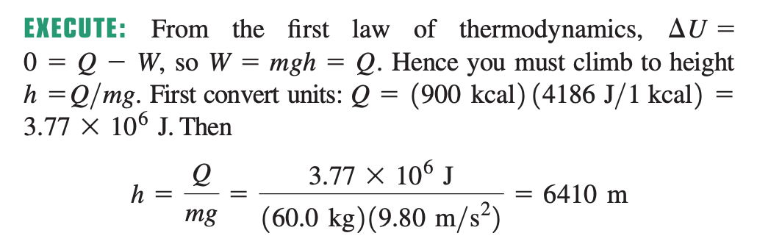
Sample Problem

Slide 17
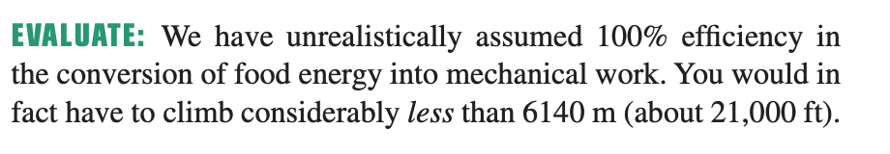
Sample Problem

Slide 18
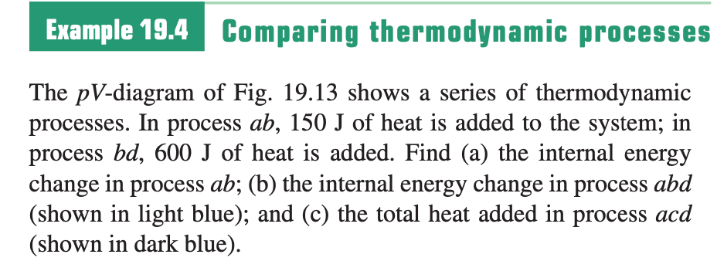
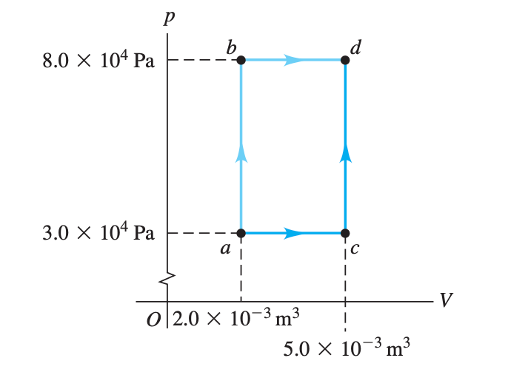
Sample Problem

Slide 19
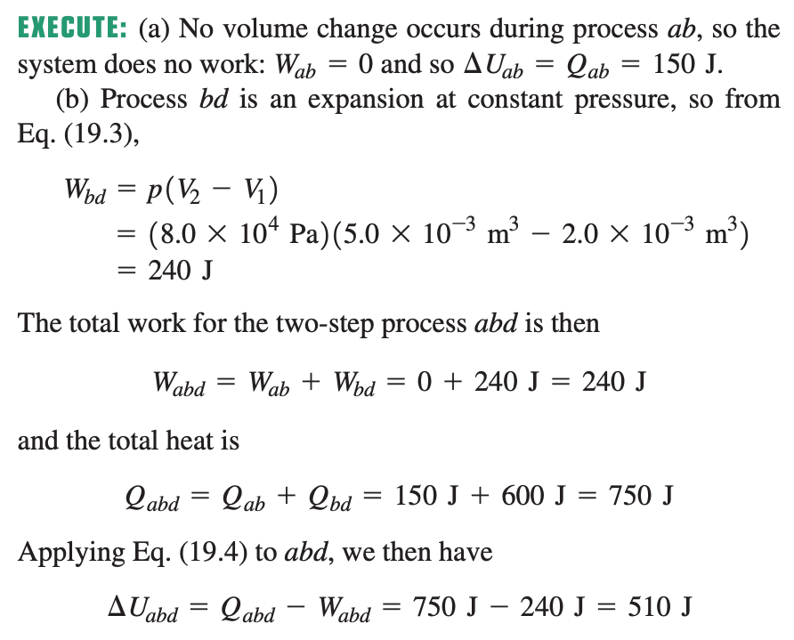
Sample Problem

Slide 20
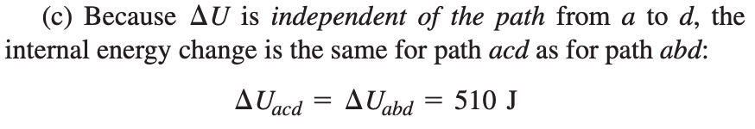
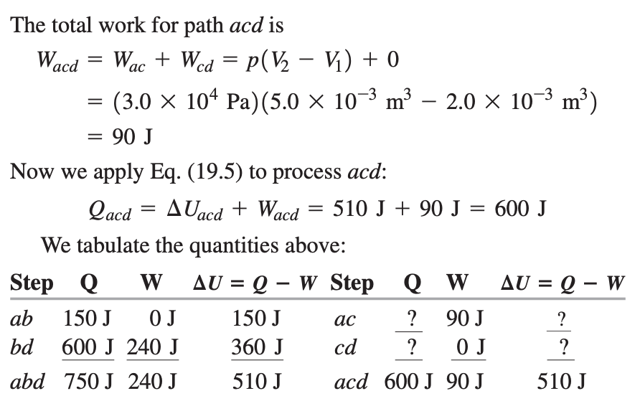
Sample Problem

Slide 21
19.5 Kinds of Thermodynamic Processes
Example of thermodynamics processes
Adiabatic process
Isochoric process
Isobaric process
Isothermal process

Slide 22
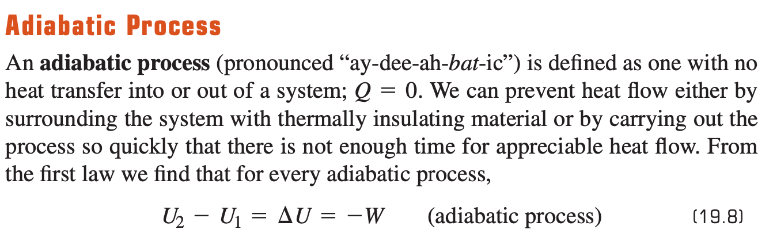
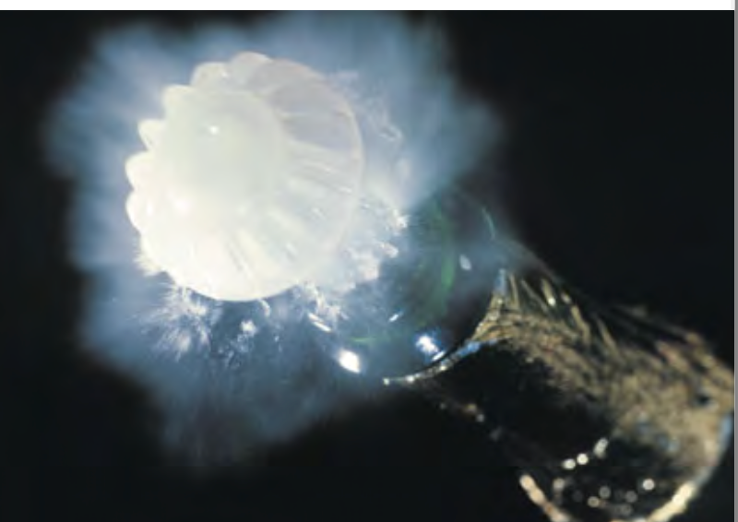
19.5 Kinds of Thermodynamic Processes
Open a champagne

Slide 23
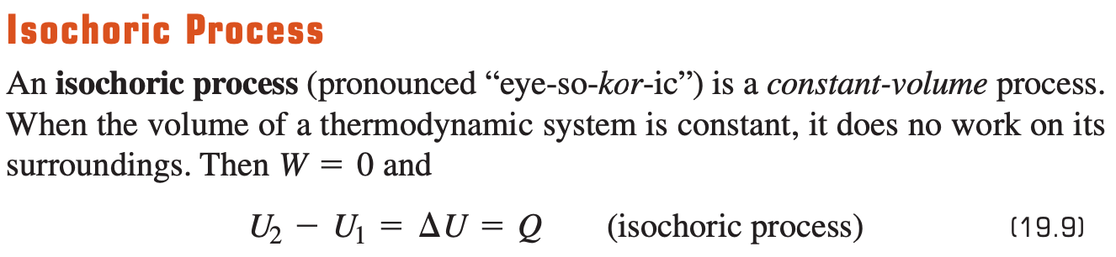
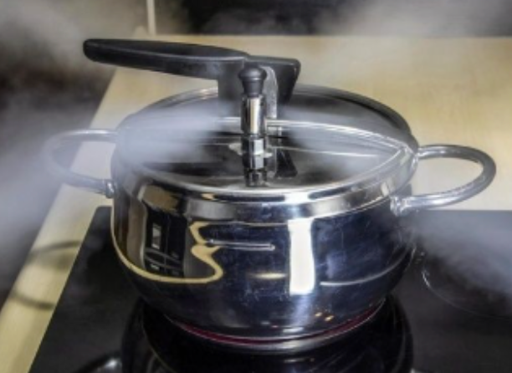
19.5 Kinds of Thermodynamic Processes
Pressure cooker

Slide 24
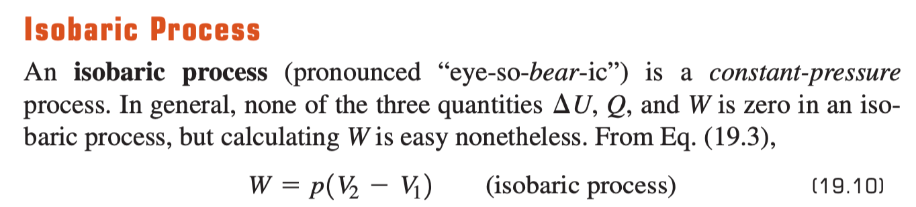
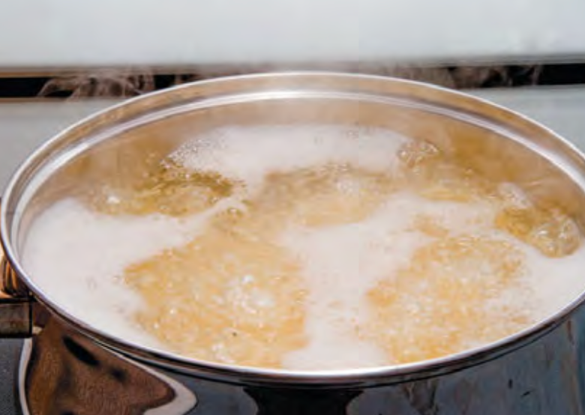
19.5 Kinds of Thermodynamic Processes
Cooking

Slide 25
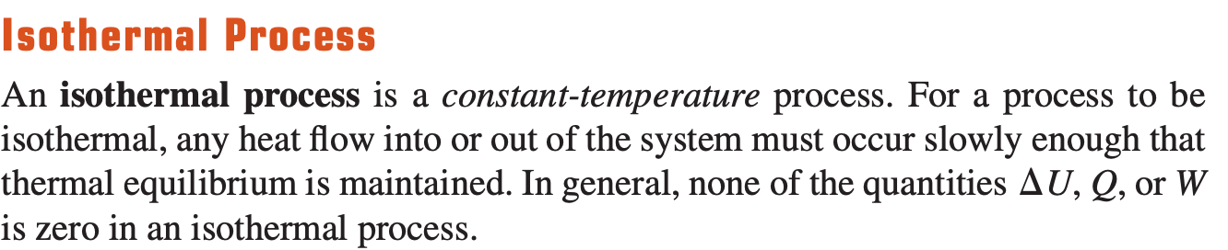
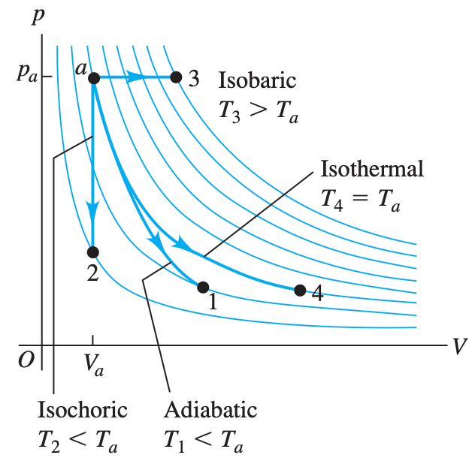
19.5 Kinds of Thermodynamic Processes

Slide 26
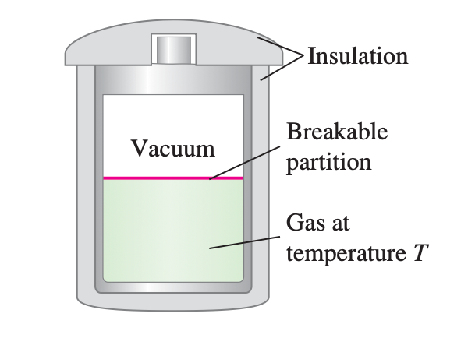
19.6 Internal Energy of an ldeal Gas
Many experiments have shown that when a low-density gas undergoes a free expansion, its temperature does not change.

Slide 27
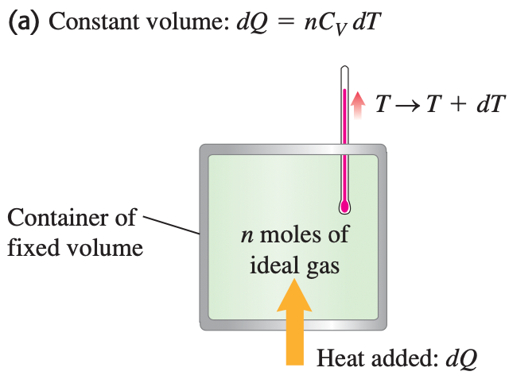
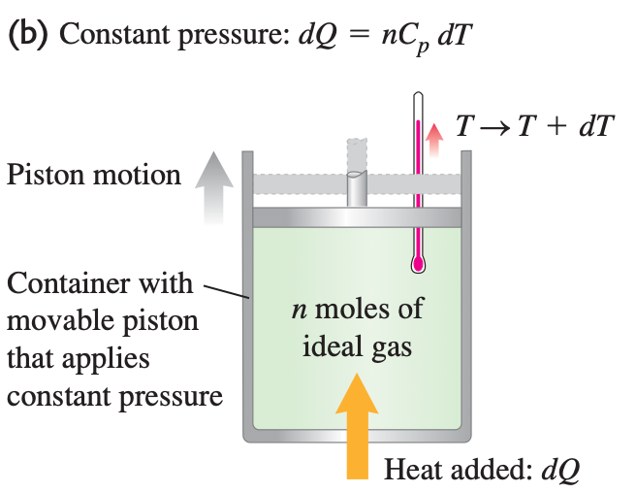
19.7 Heat Capacities of an Ideal Gas
Measuring the molar heat capacity of an ideal gas (a) at constant volume and (b) at constant pressure.

Slide 28
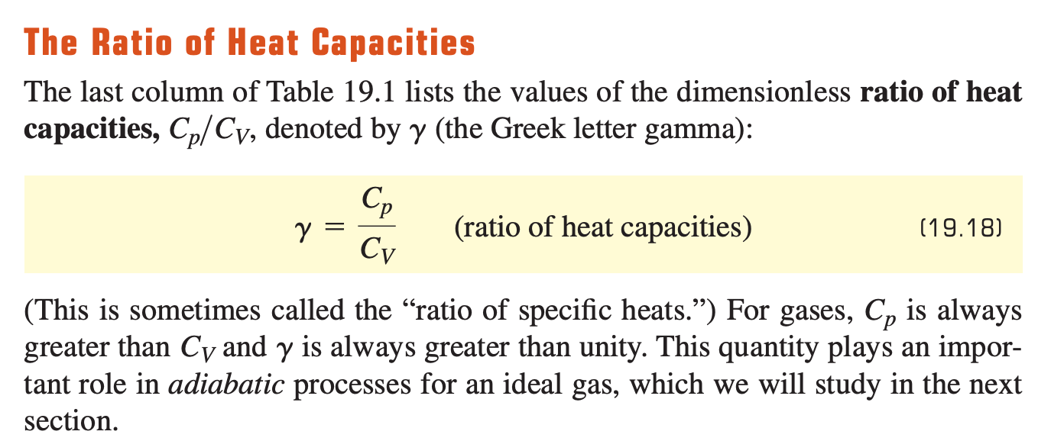
19.7 Heat Capacities of an Ideal Gas

Slide 29
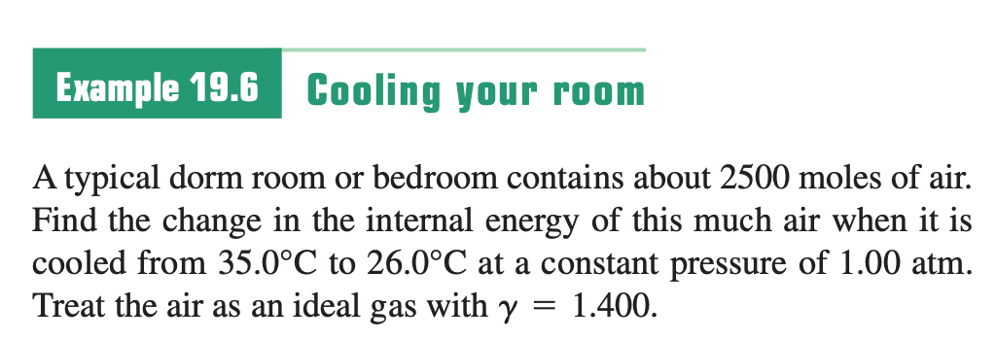
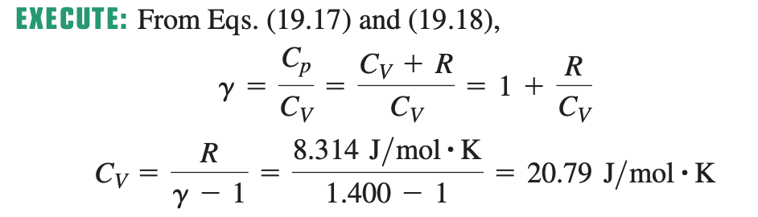
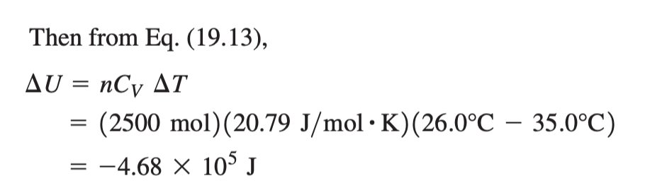
Sample Problem

Slide 30
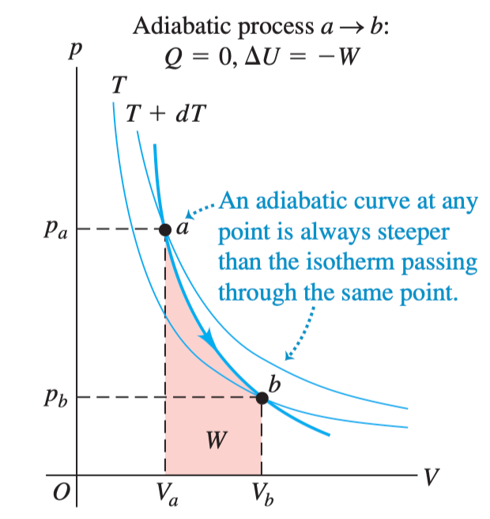

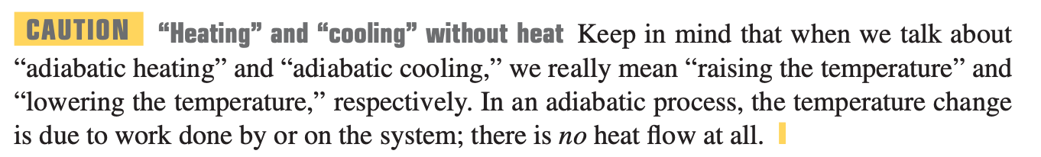
19.8 Adiabatic Processes for an Ideal Gas
Ideal gas

Slide 31







19.8 Adiabatic Processes for an Ideal Gas
Diatomic gas
Ratio of Heat Capacity

Slide 32




19.8 Adiabatic Processes for an Ideal Gas
Adiabatic Process

Slide 33

19.8 Adiabatic Processes for an Ideal Gas
Expansion: temperature drop, work is positive
Compression: temperature increases, work is negative

Slide 34


Sample Problem

Slide 35

Sample Problem

