Slide 1
PHYS1001B College Physics IB
Thermodynamics IV — The Second Law of Thermodynamics (Ch. 20)

Slide 2
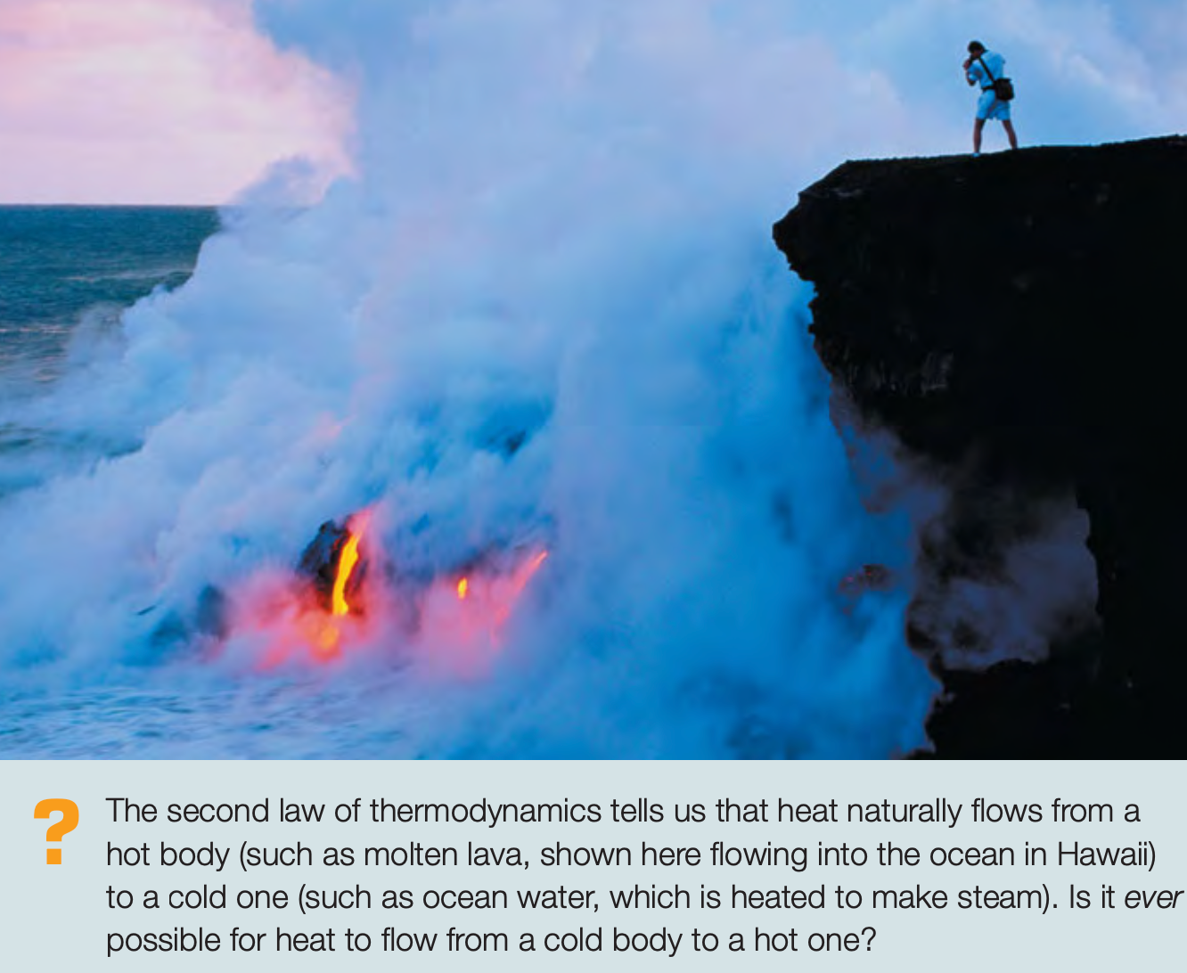
Introduction

Slide 3
Outline
20-1 Directions of Thermodynamic Processes
20-2 Heat Engines
20-3 Internal-Combustion Engines
20-4 Refrigerators
20-5 The Second Law of Thermodynamics
20-6 The Carnot Cycle
20-7 Entropy

Slide 4
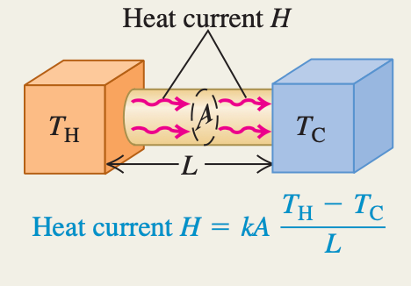
20-1 Directions of Thermodynamic Processes
Heat flow from a cool body to a hot body would not violate the first law of thermodynamics; energy would be conserved. But it doesn’t happen in nature. Why not?
directions of thermodynamic processes: second law of thermodynamics

Slide 5
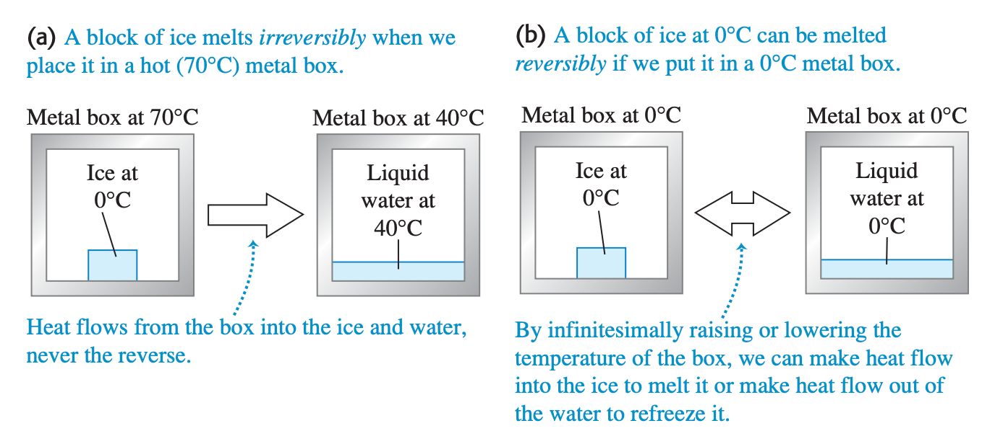
20-2 Heat Engines
Irreversible
Reversible
Thermodynamic processes that occur in nature are all irreversible processes.
Reversible processes are thus equilibrium processes, with the system always in thermodynamic equilibrium.

Slide 6
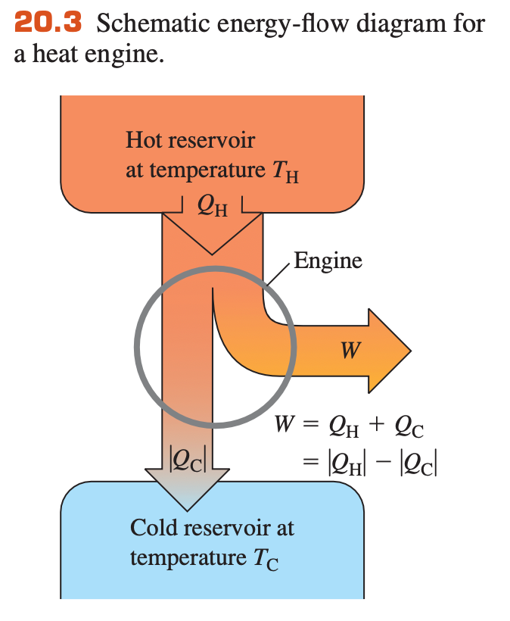

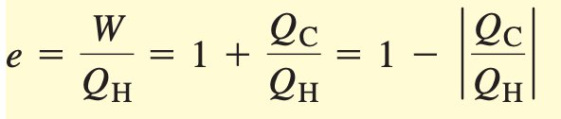
20-2 Heat Engines
thermal efficiency of an engine

Slide 7
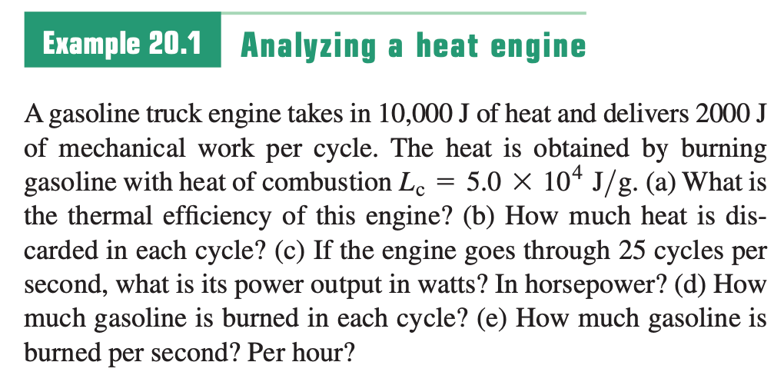
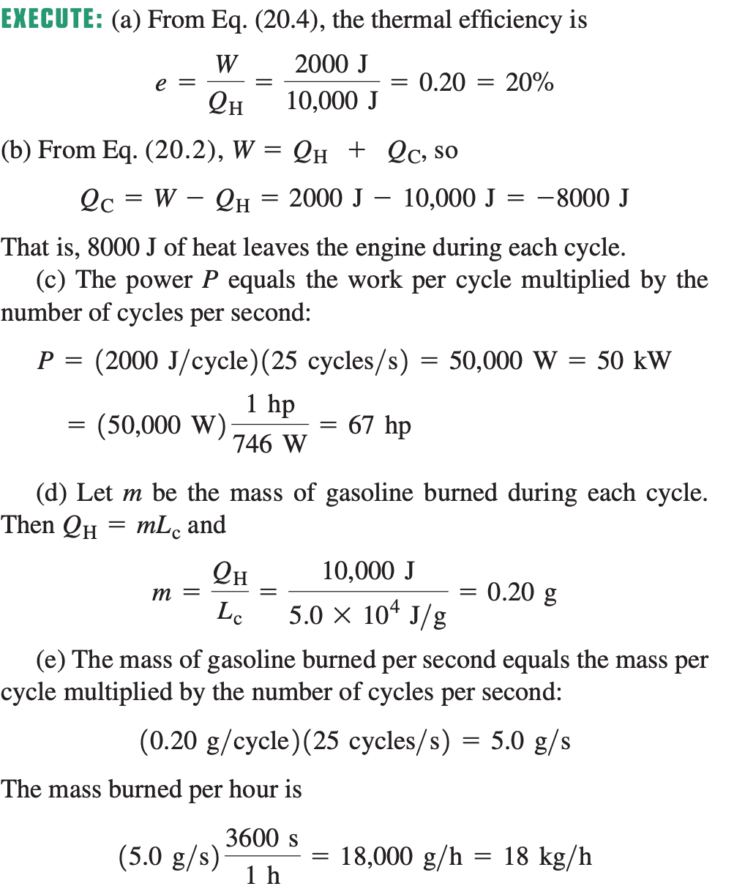
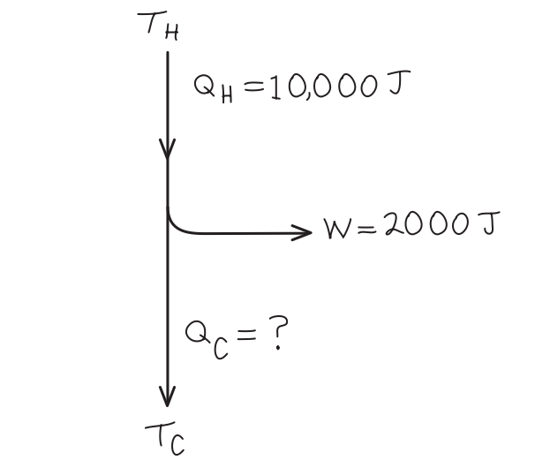
Sample Problem

Slide 8
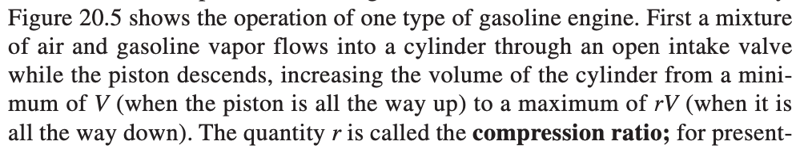
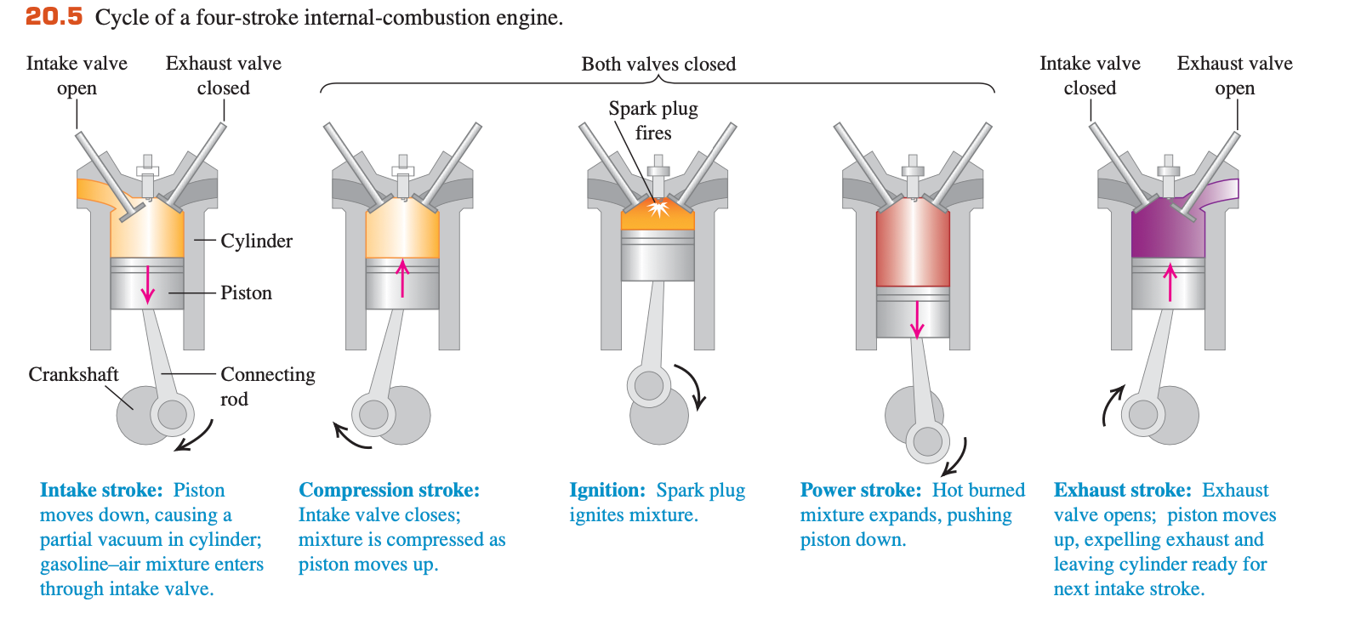
20-3 Internal-Combustion Engines

Slide 9
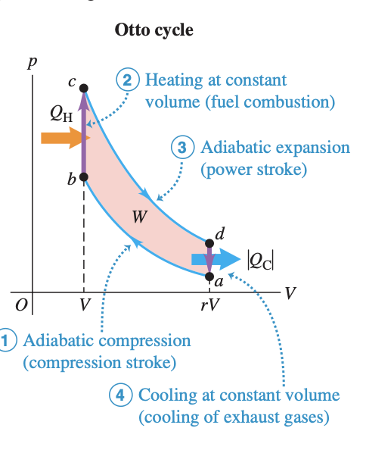
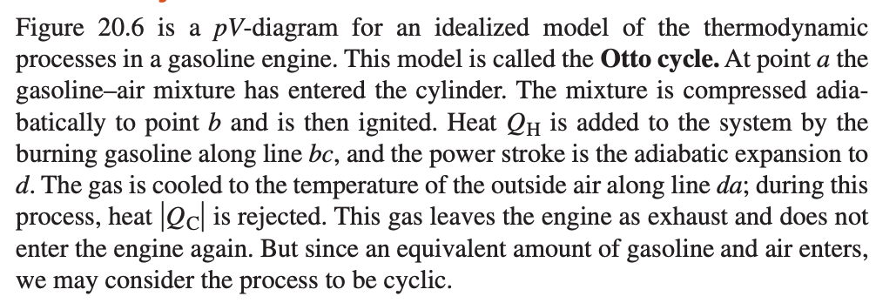
20-3 Internal-Combustion Engines

Slide 10
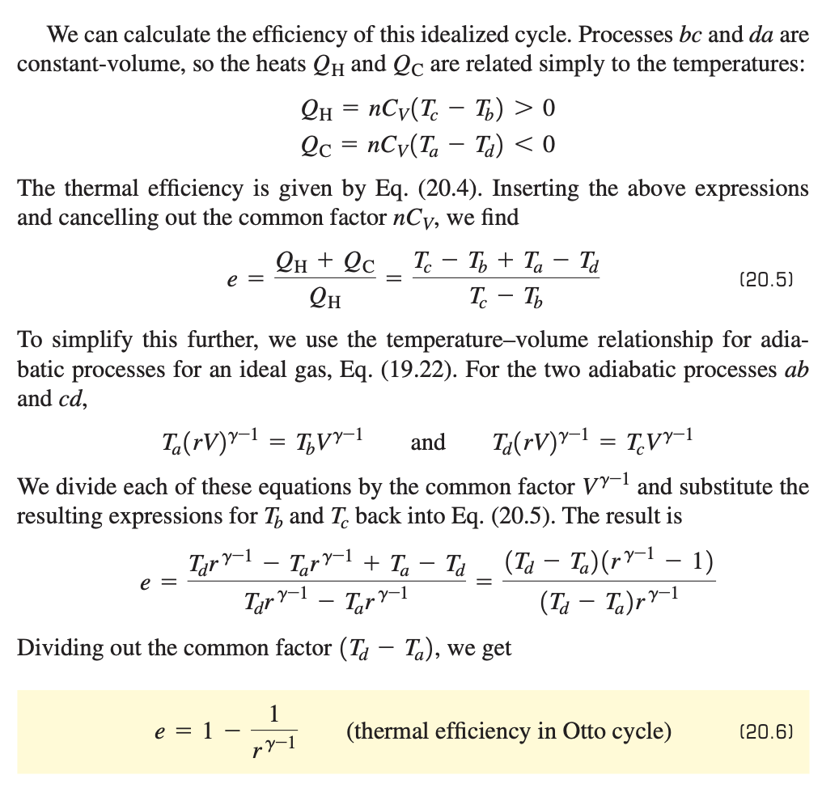
20-3 Internal-Combustion Engines

Slide 11
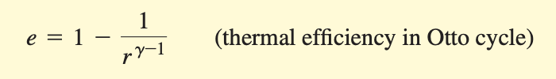
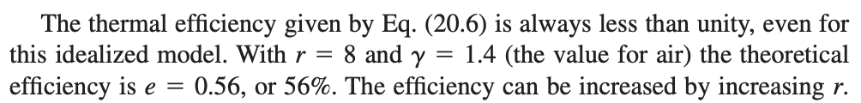
20-3 Internal-Combustion Engines

Slide 12
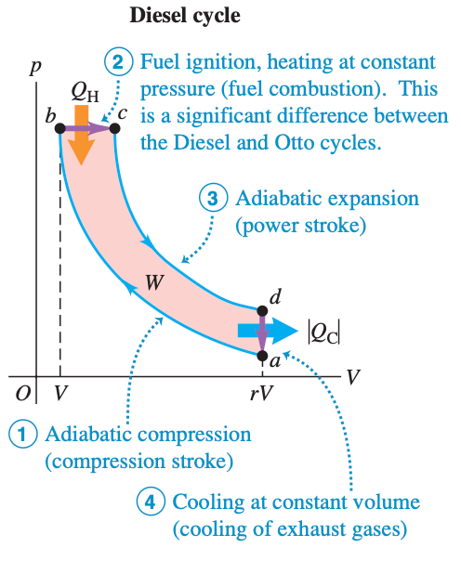
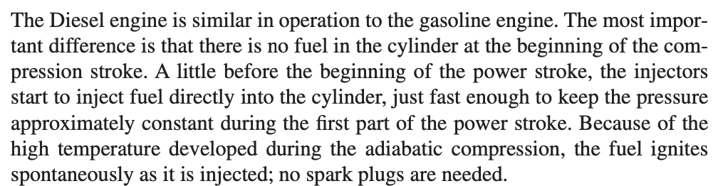
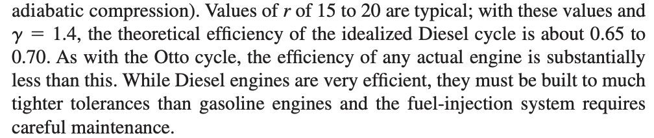
20-3 Internal-Combustion Engines

Slide 13
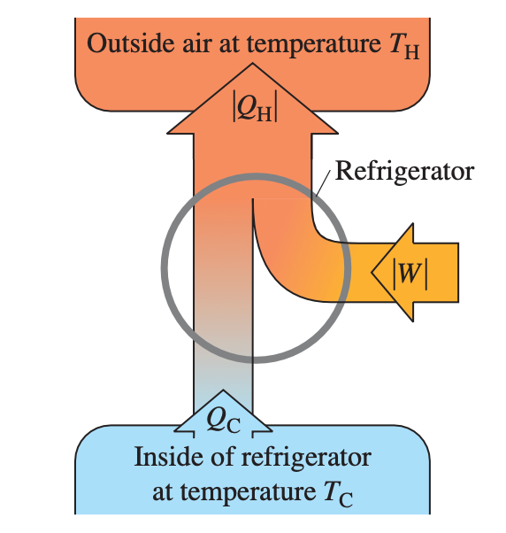
20-4 Refrigerators
Comparison
Heat engine
Refrigerator
takes heat from a hot place and gives off heat to a colder place
a net output of mechanical work
takes heat from a cold place and gives off heat to a warmer place
a net input of mechanical work

Slide 14

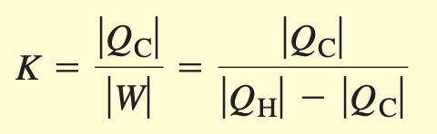
20-4 Refrigerators
Coefficient of performance
Work is always needed to transfer heat from a colder to a hotter body.
Heat flows spontaneously from hotter to colder, and to reverse this flow requires the addition of work from the outside

Slide 15
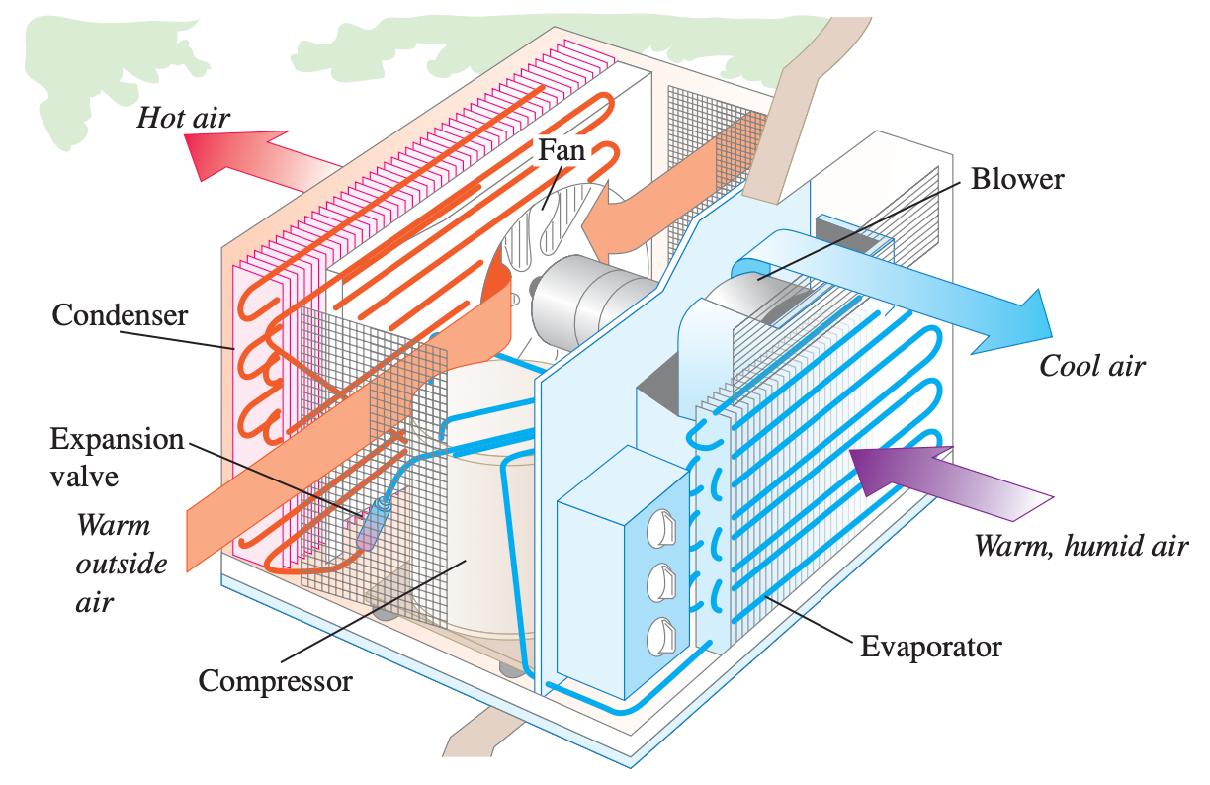
20-4 Refrigerators

Slide 16
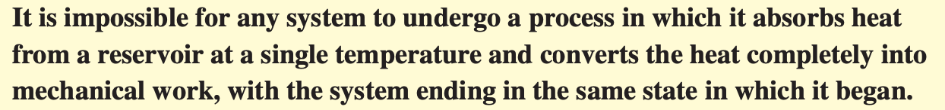
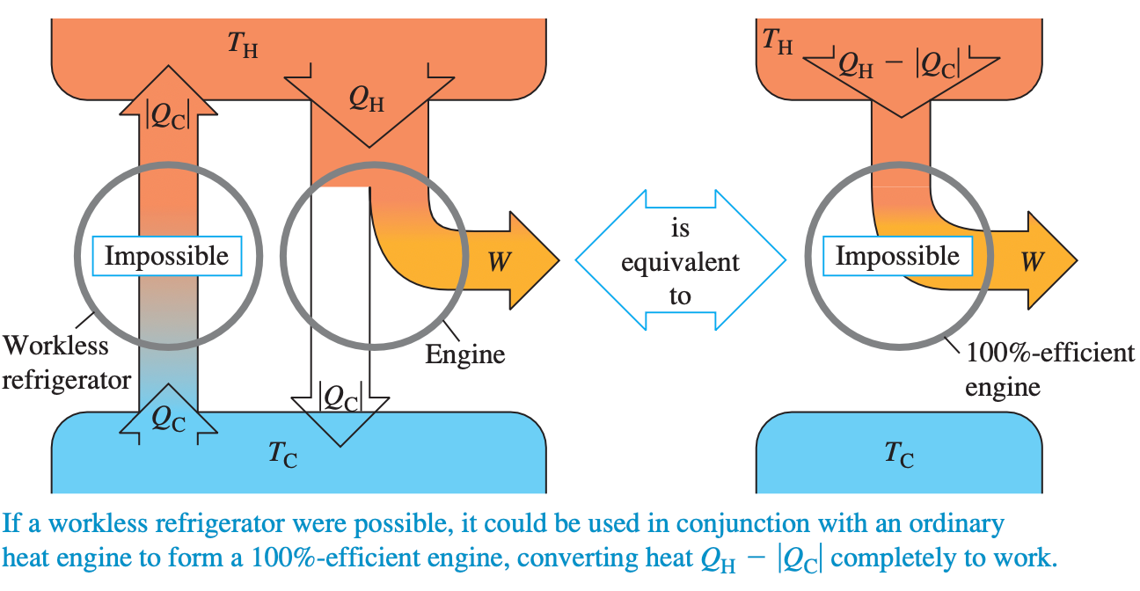
20-5 The Second Law of Thermodynamics
“Engine” statement of the second law (Kelvin–Planck statement )
impossible to build a heat engine with 100% thermal efficiency

Slide 17
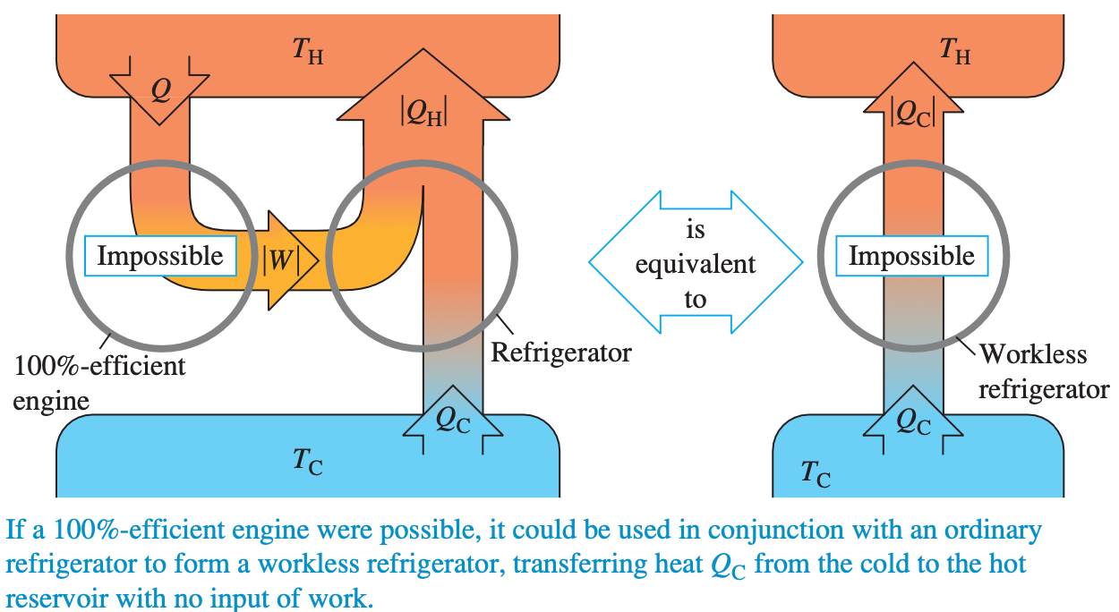
20-5 The Second Law of Thermodynamics
“Refrigerator ” statement of the second law (Clausius statement )

Slide 18
20-6 The Carnot Cycle
Carnot engine: idealized heat engine that has the maximum possible efficiency consistent with the second law
avoid all irreversible processes
Heat flow through a finite temperature drop is an irreversible process.
No heat transfer between the engine and either reservoir because such heat transfer could not be reversible.
Carnot Choice: Combination of adiabatic/ isothermal process

Slide 19
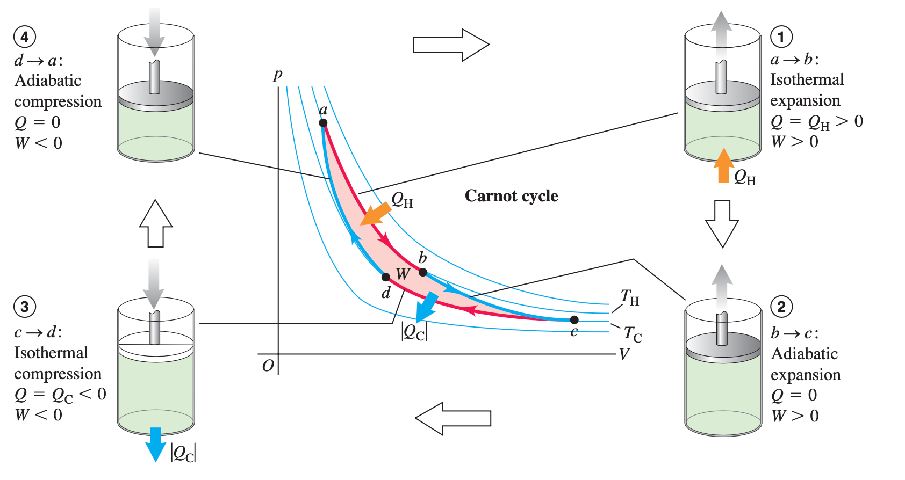
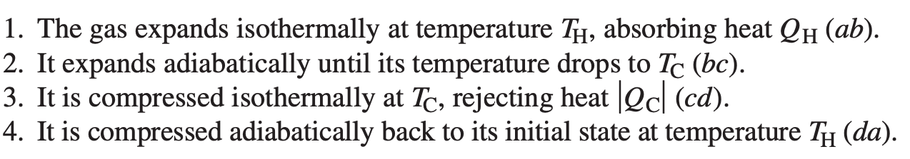
20-6 The Carnot Cycle

Slide 20
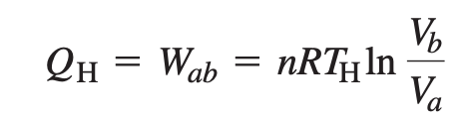
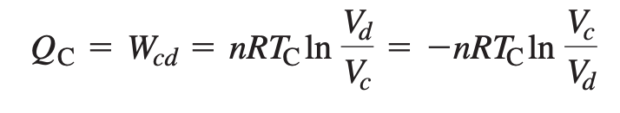
20-6 The Carnot Cycle
ab:
cd:

Slide 21
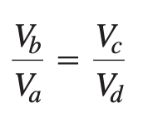

20-6 The Carnot Cycle
Adiabatic process da, bc

Slide 22
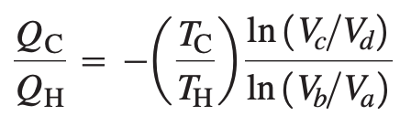
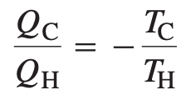
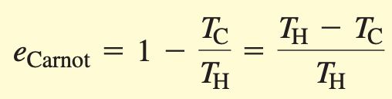
20-6 The Carnot Cycle
Thermal efficiency e of a Carnot engine
because of adiabatic process

Slide 23
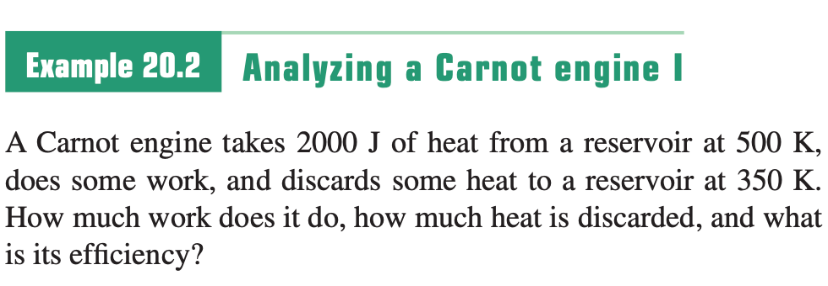
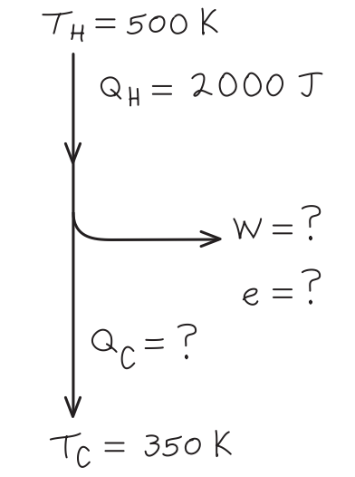
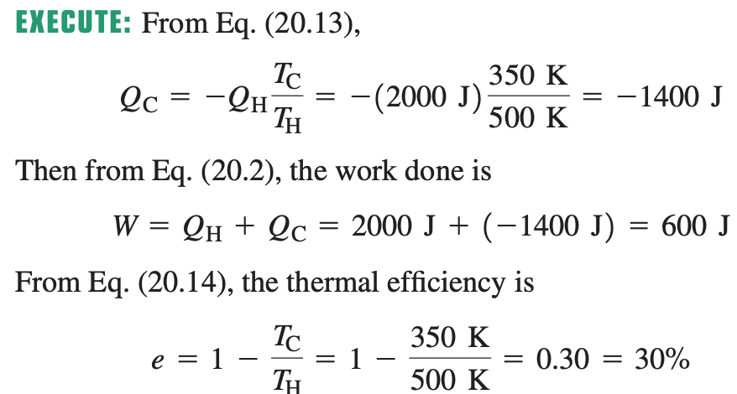
Sample Problem

Slide 24
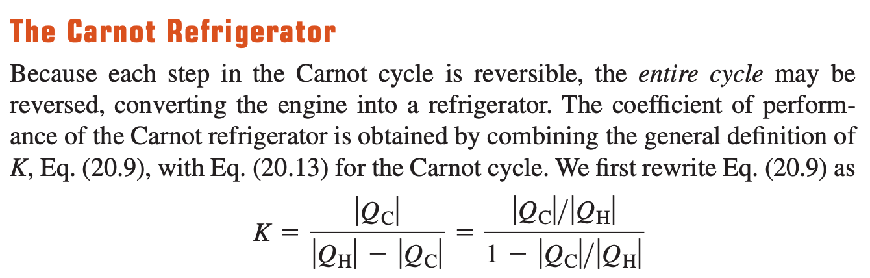
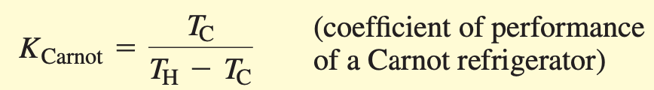
20-6 The Carnot Cycle

Slide 25
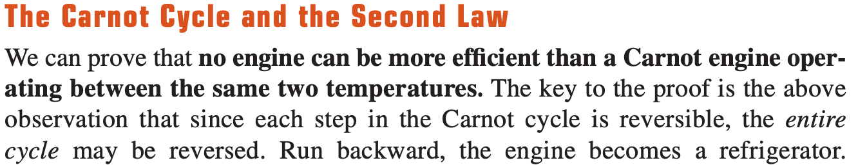
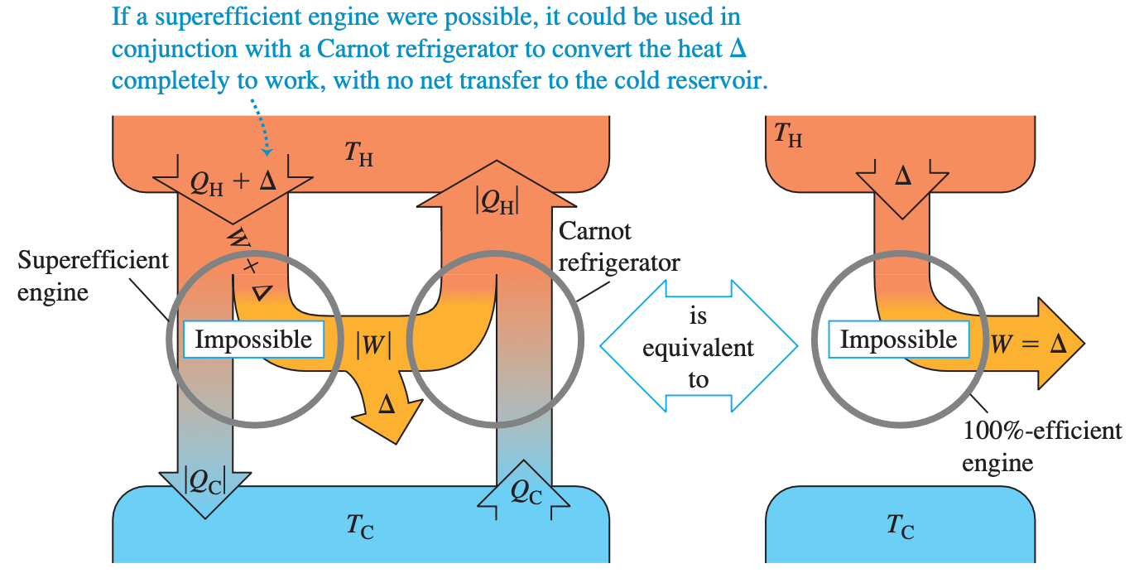
20-6 The Carnot Cycle

Slide 26

20-7 Entropy
firecrackers explode, disorder increases

Slide 27
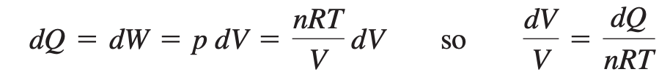
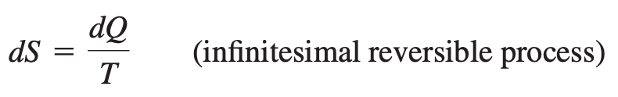
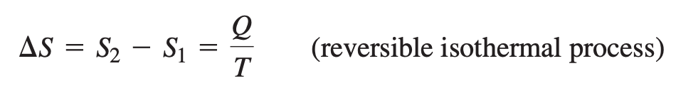
20-7 Entropy
Entropy provides a quantitative measure of disorder.
Infinitesimal entropy change

Slide 28
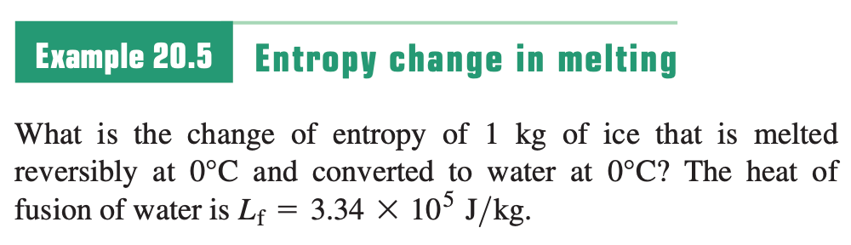
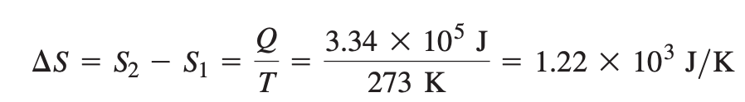
Sample Problem

Slide 29
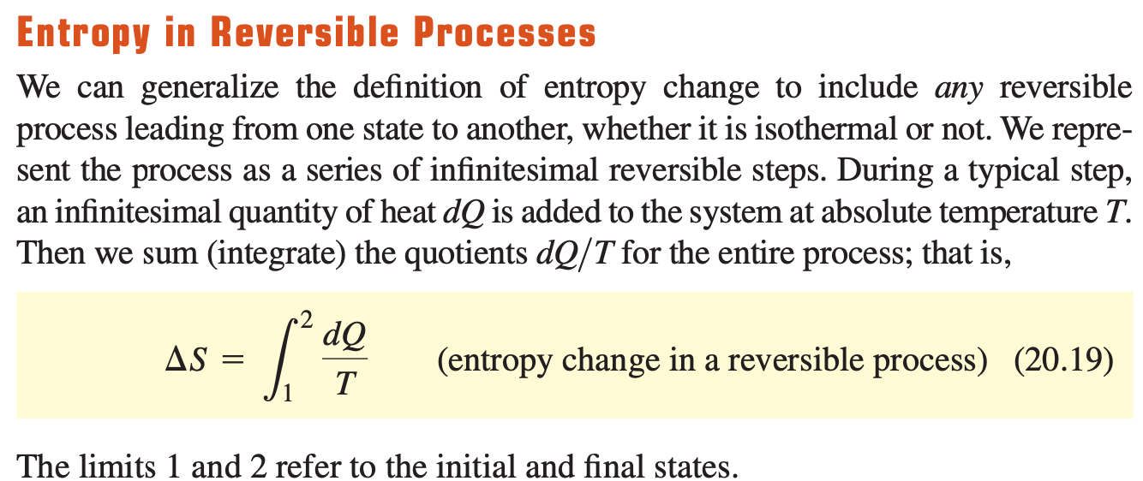
20-7 Entropy

Slide 30
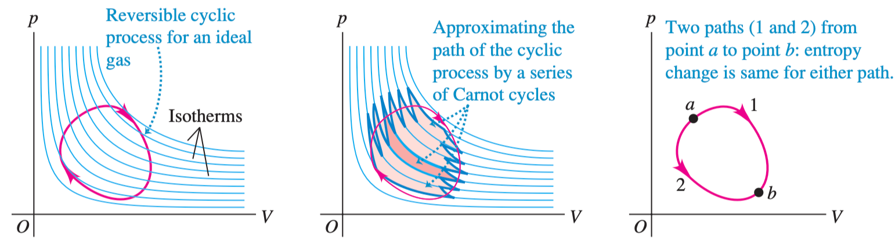
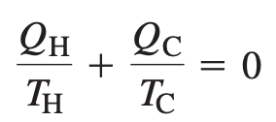
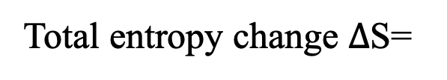
20-7 Entropy
Total entropy change $Δ$S=
Total entropy change during any reversible cycle is zero
All irreversible processes involve an increase in entropy. Unlike energy, entropy is not a conserved quantity.

Slide 31
20-7 Entropy
Entropy statement of second law:
The entropy of a closed system can never decrease. A closed system can never spontaneously undergo a process that decreases the number of possible microscopic states

Slide 32
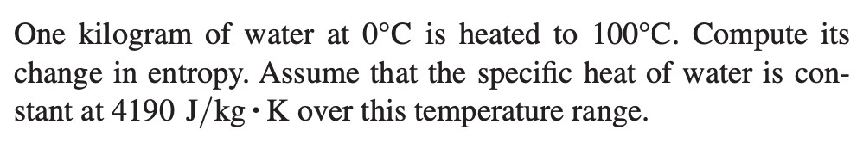
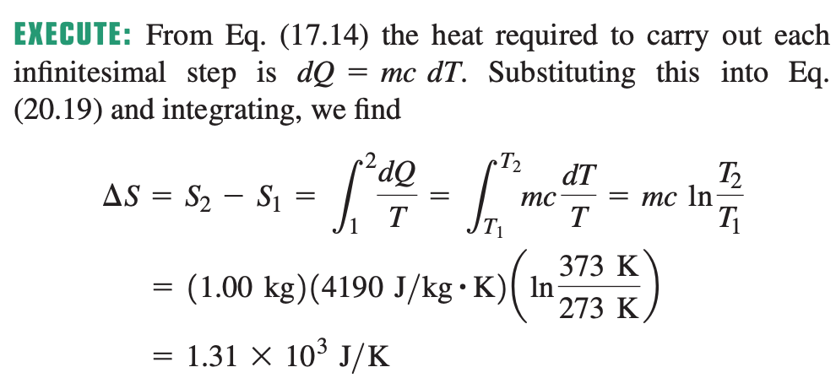
Sample Problem

