Slide 1
PHYS1001B College Physics IB
Modern Physics I Photons: Light Waves Behaving as Particles (Ch. 38)

Slide 2
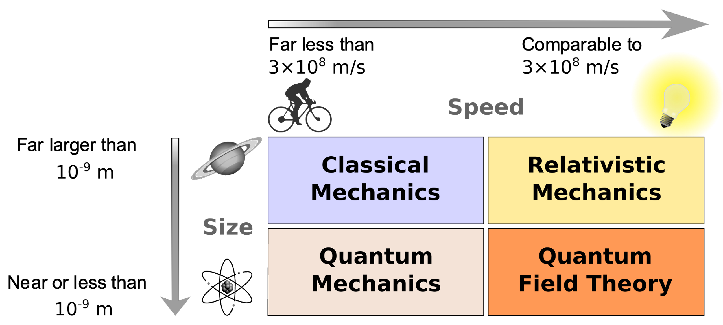
Where quantum mechanics can be applied?
Source: wikipedia

Slide 3
Outline
38.1 Light Absorbed as Photons: The Photoelectric Effect
38.2 Light Emitted as Photons: X-Ray Production
38.3 Light Scattered as Photons: Compton Scattering and Pair Production
38.4 Wave Particle Duality, Probability, and Uncertainty

Slide 4
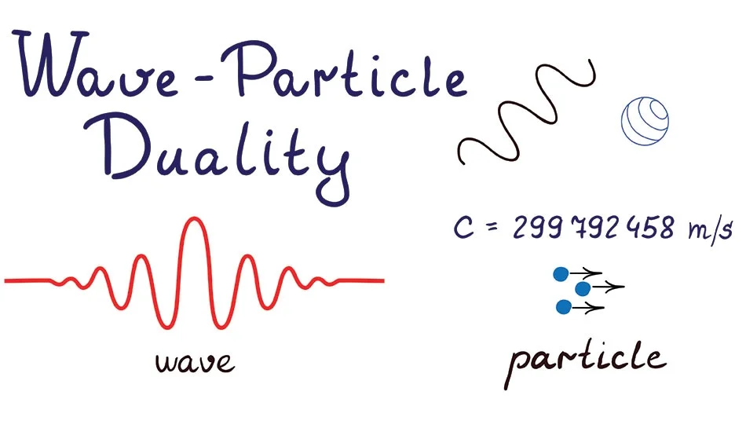

Slide 5
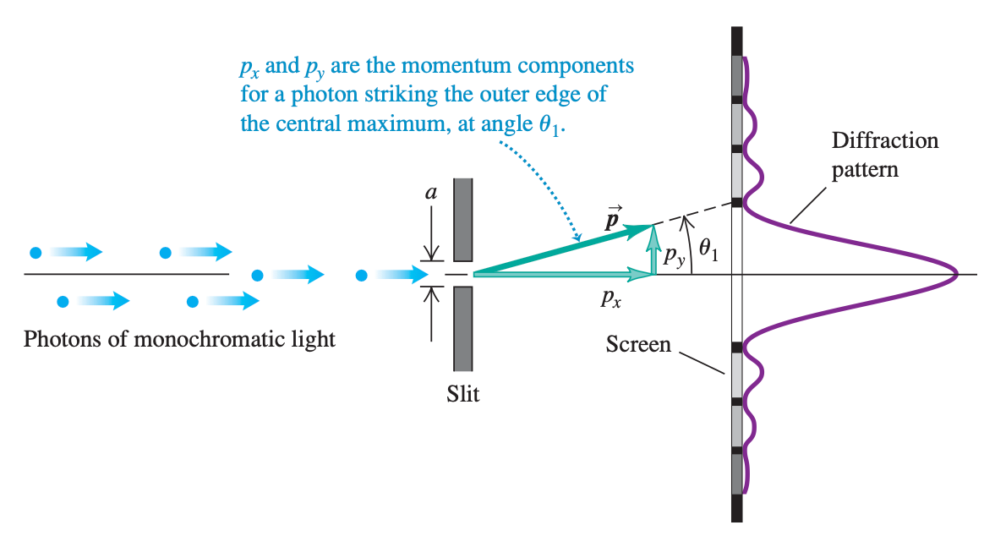
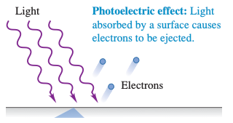
Light
Wave nature
Particle nature

Slide 6
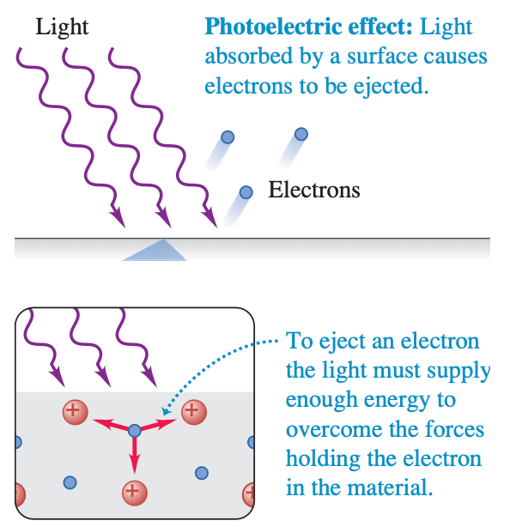
38.1 Light Absorbed as Photons: The Photoelectric Effect

Slide 7
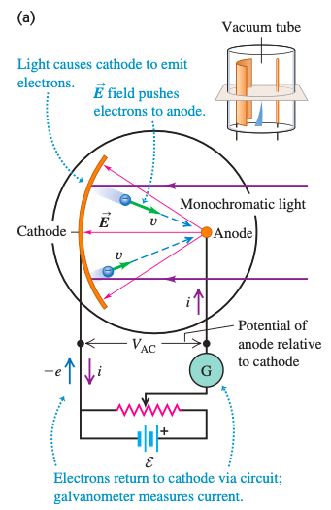
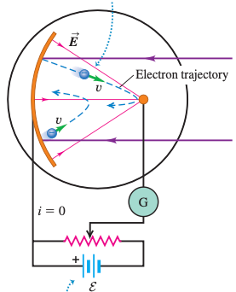
38.1 Light Absorbed as Photons: The Photoelectric Effect
Reverse electric field
V₀ is called the stopping potential

Slide 8
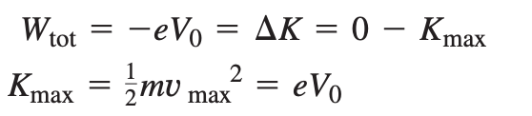
38.1 Light Absorbed as Photons: The Photoelectric Effect
Maximum kinetic energy of electron

Slide 9
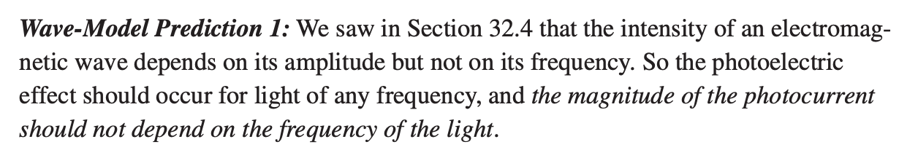
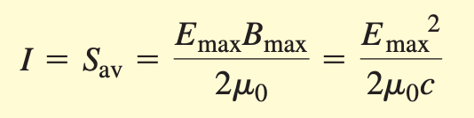
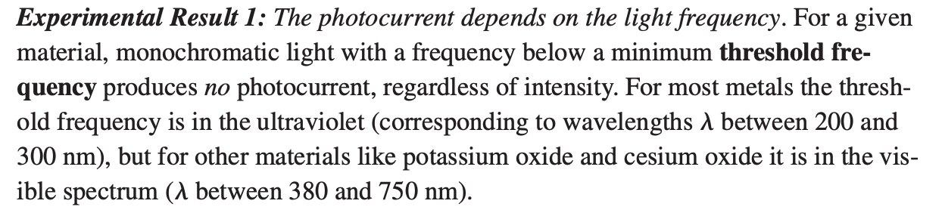
38.1 Light Absorbed as Photons: The Photoelectric Effect
vs

Slide 10
38.1 Light Absorbed as Photons: The Photoelectric Effect
Wave-Model Prediction
the magnitude of the photocurrent should not depend on the frequency of the light.
a time delay between when we switch on the light and when photo-electrons appear.
the stopping potential should not depend on the frequency of the light
Experimental results
The photocurrent depends on the light frequency.
There is no measurable time delay between when the light is turned on and when the cathode emits photoelectrons
The stopping potential does not depend on intensity, but does depend on frequency.
Contradict to Maxwell’s description of light as an electro-magnetic wave
Albert Einstein in 1905 solved the dilemma. (Phonon)

Slide 11
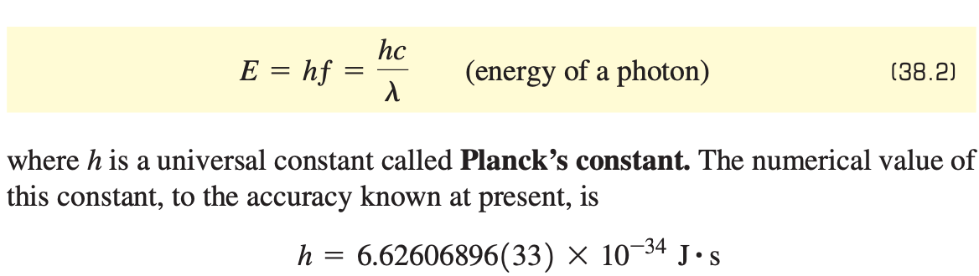
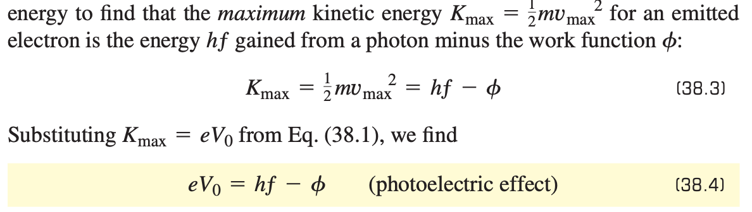
38.1 Light Absorbed as Photons: The Photoelectric Effect

Slide 12
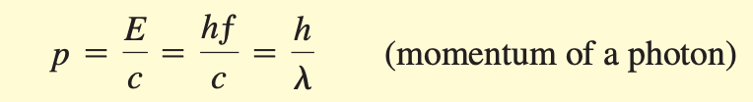
38.1 Light Absorbed as Photons: The Photoelectric Effect
Furthermore, according to the special theory of relativity, every particle that has energy must also have momentum, even if it has no rest mass.

Slide 13
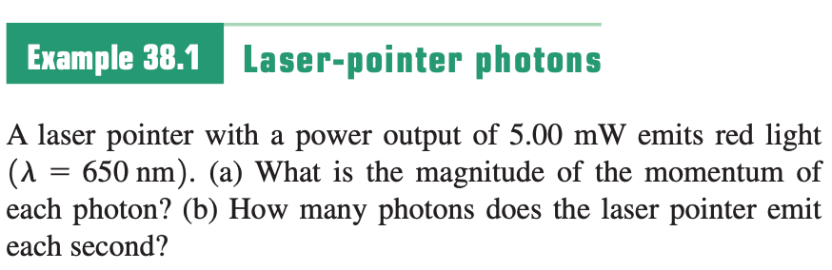
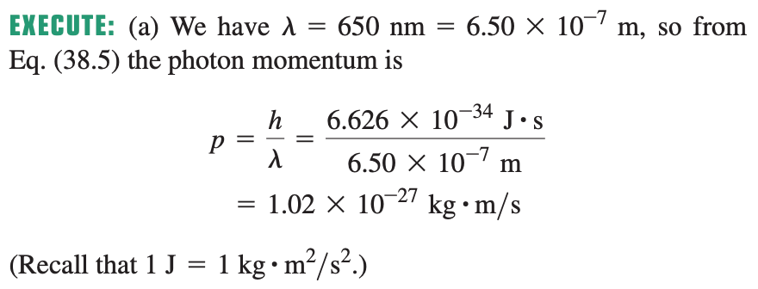
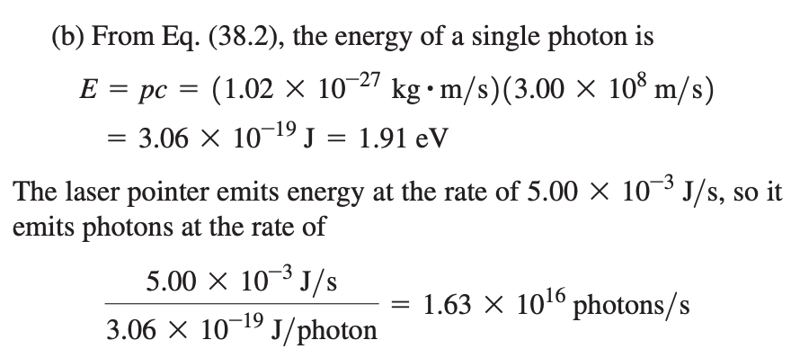
Sample Problem

Slide 14
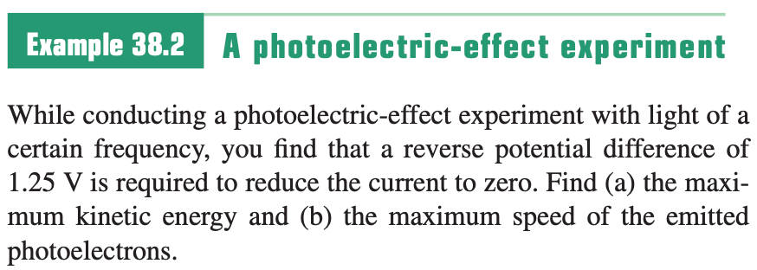
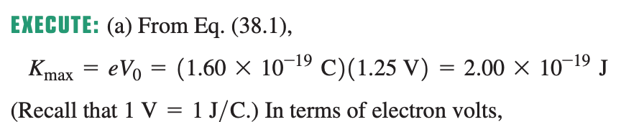
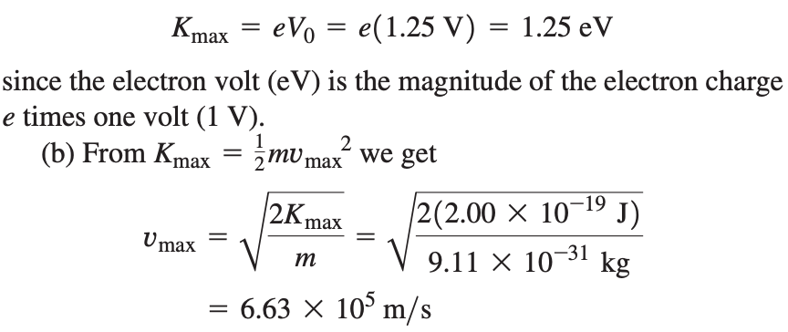
Sample Problem

Slide 15
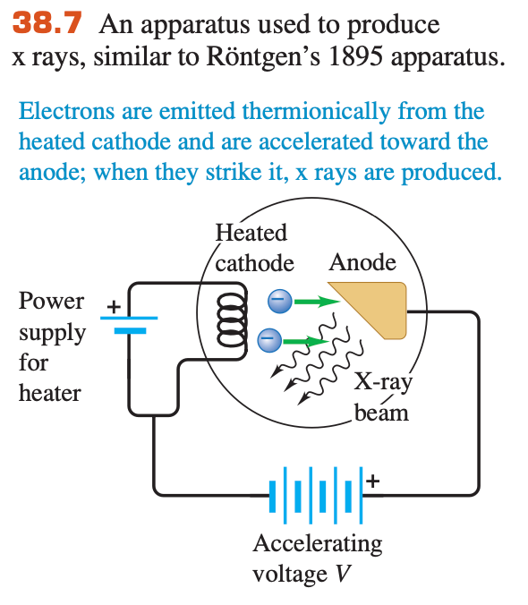
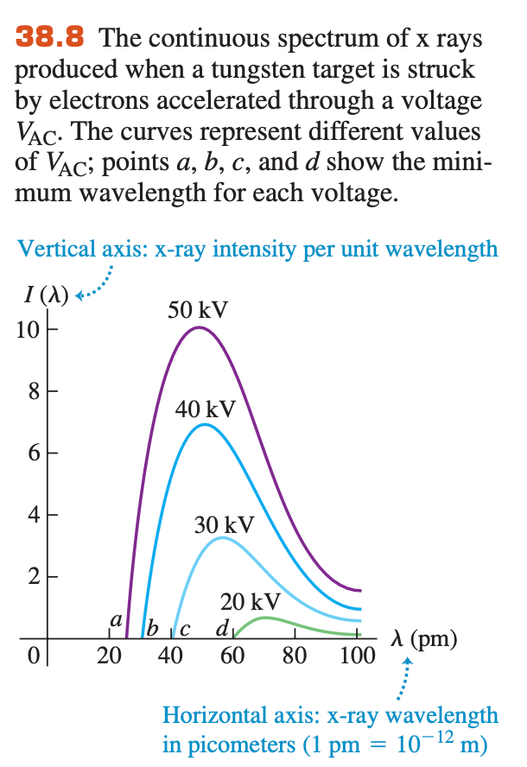
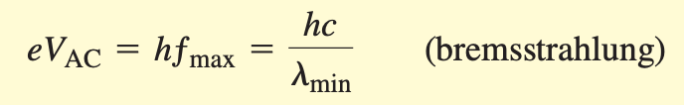
38.2 Light Emitted as Photons: X-Ray Production

Slide 16

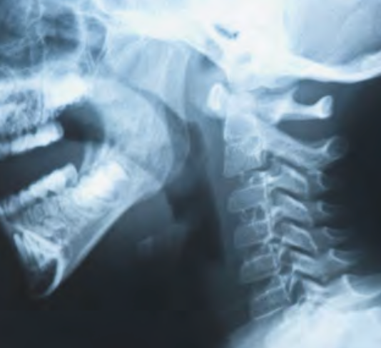
38.2 Light Emitted as Photons: X-Ray Production

Slide 17
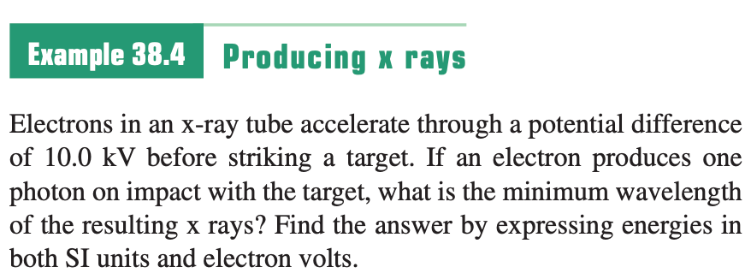
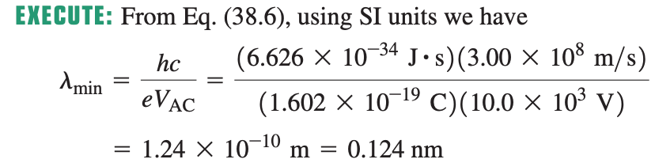
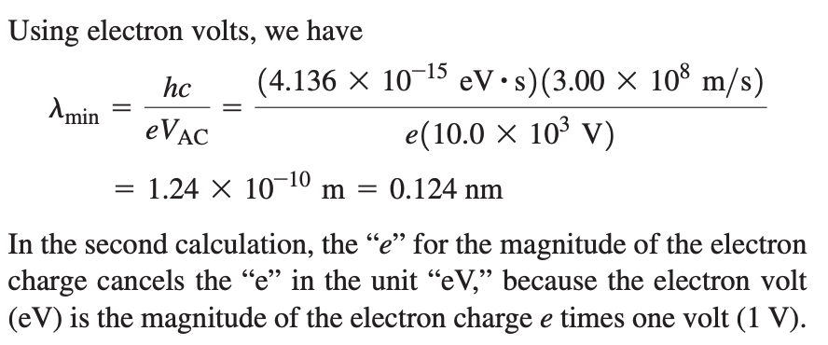
Sample Problem

Slide 18
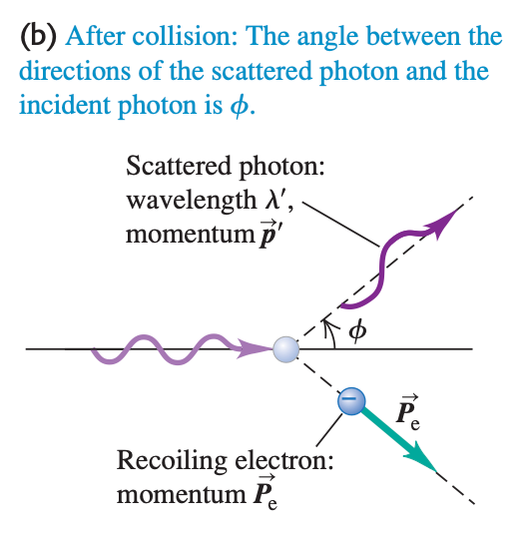
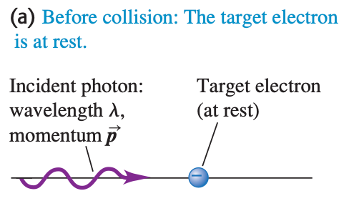
38.3 Light Scattered as Photons: Compton Scattering and Pair Production
Compton-effect experiment

Slide 19
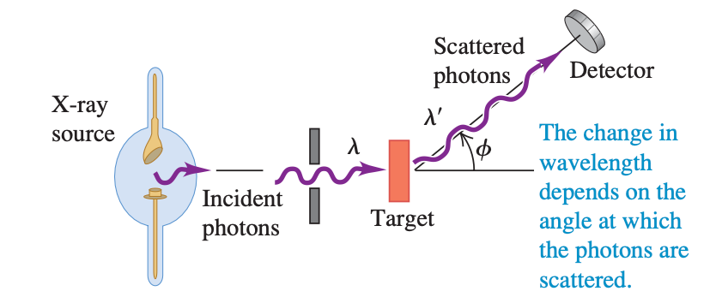
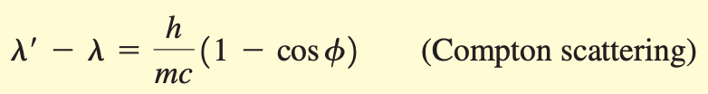
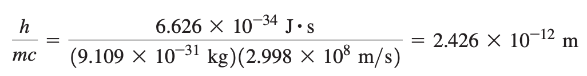
38.3 Light Scattered as Photons: Compton Scattering and Pair Production

Slide 20
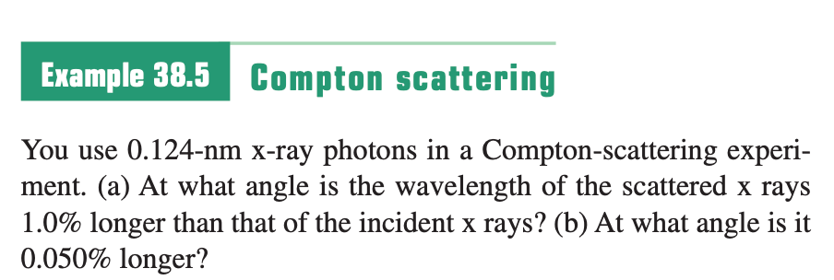
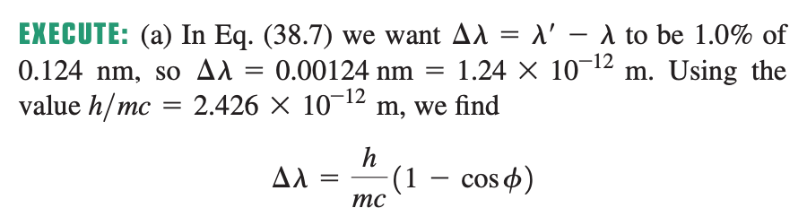
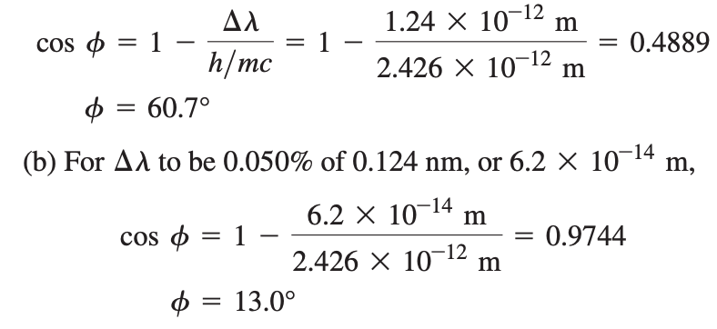
Sample Problem

Slide 21
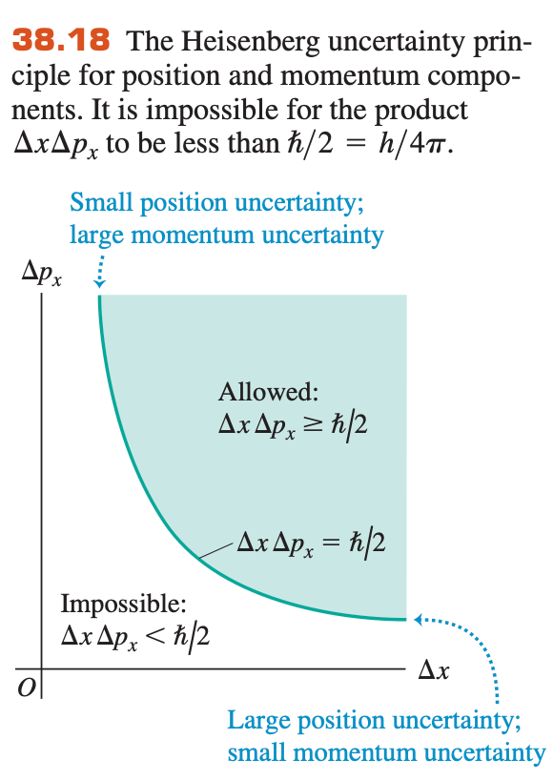

38.4 Wave Particle Duality, Probability, and Uncertainty
Uncertainty principle:
Impossible to measure the position and momentum simultaneously
Heisenberg uncertainty principle

Slide 22
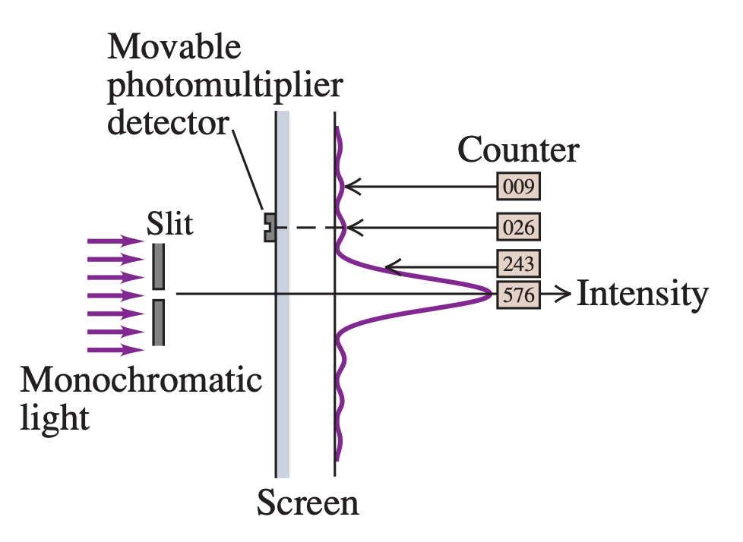
38.4 Wave Particle Duality, Probability, and Uncertainty
Counting number of photons
Uncertainty example

Slide 23
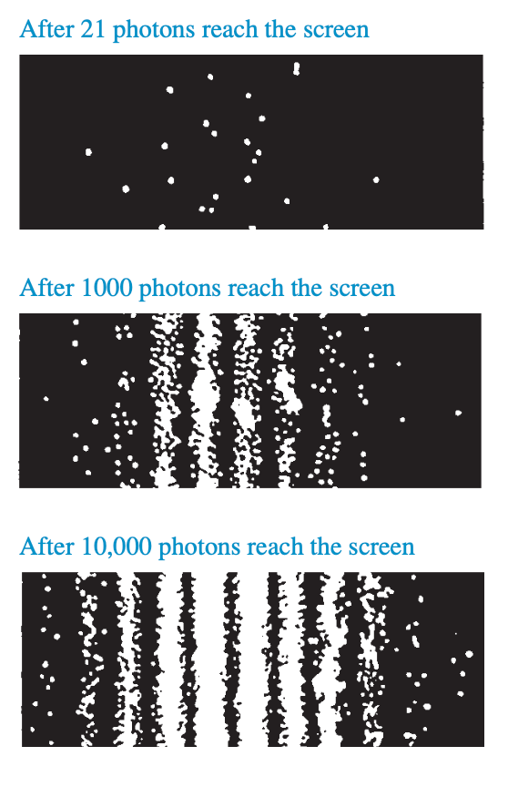
38.4 Wave Particle Duality, Probability, and Uncertainty
The uncertainty of position $∆x:$ the slit width, not sure the exact position of the incoming photons
The uncertainty of momentum $∆p:$ contribute to the angular direction of the photon motion,
Affect the position of photon appearing on screen

Slide 24



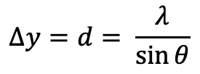

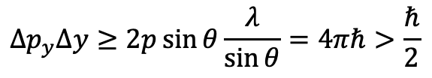

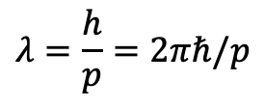
38.4 Wave Particle Duality, Probability, and Uncertainty
Path difference of ray from single slit
$$=d\sin{θ}$$
Path difference for destructive interference$=nλ$
First order p.d. $=λ$
$$∆y=d= \frac{λ}{\sin{θ}}$$
For the first minimum
$$p_{y}=p\sin{θ}$$
Uncertainty for the momentum of photon at least got (+/- direction)
$$∆p_{y}≥2p\sin{θ}$$
Wavelength relation with momentum
$$λ=\frac{h}{p}=2πℏ/p$$
$$∆p_{y}∆y≥2p\sin{θ\frac{λ}{\sin{θ}}}=4πℏ>\frac{ℏ}{2}$$

Slide 25
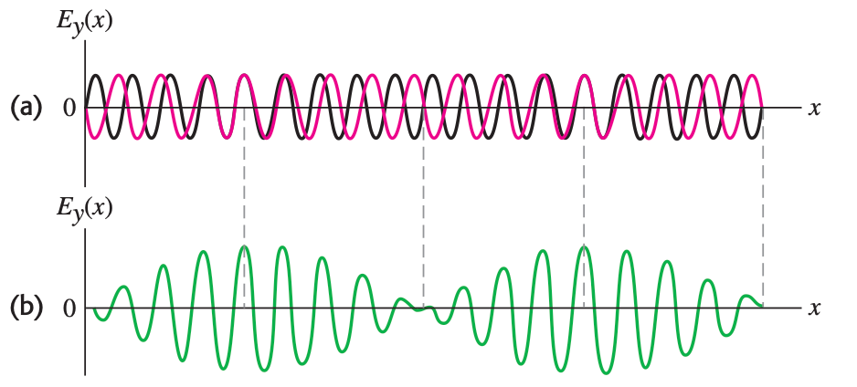

38.4 Wave Particle Duality, Probability, and Uncertainty
The photon is most likely to be found at the times when the amplitude is large. The price we pay for localizing the photon in time is that the wave does not have a definite energy.

Slide 26
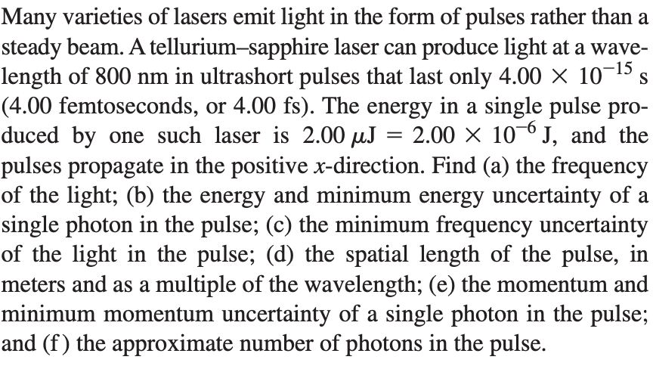
Sample Problem

Slide 27
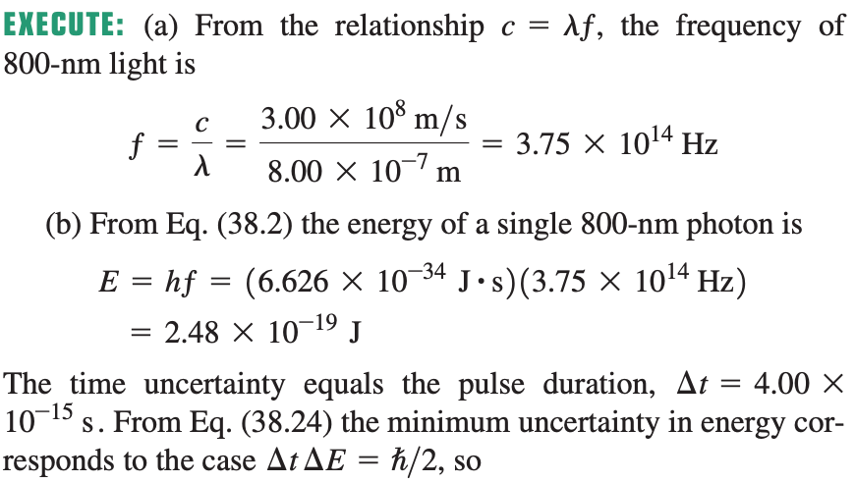
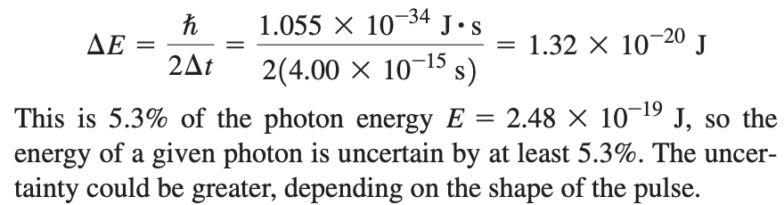
Sample Problem

Slide 28
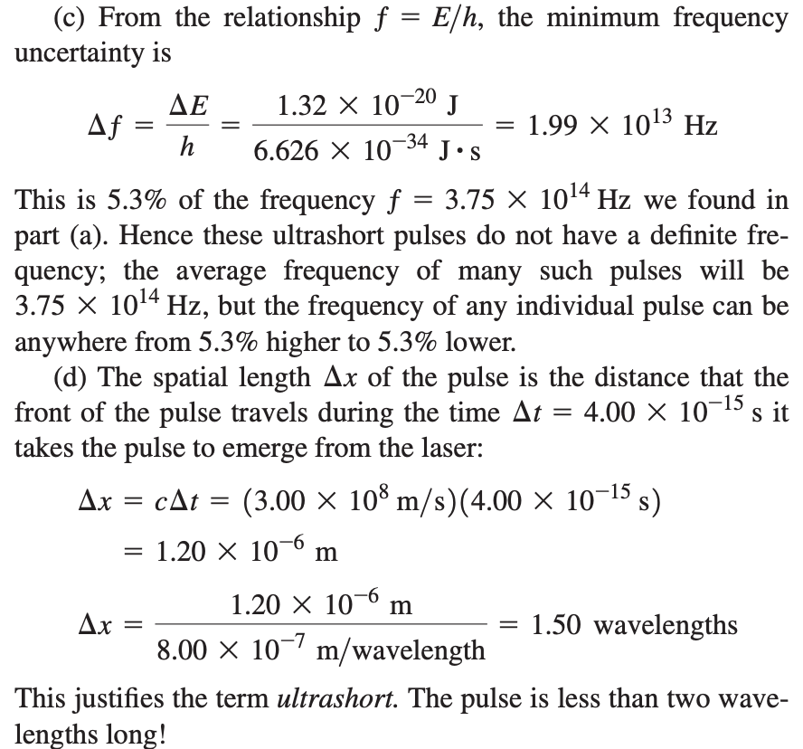
Sample Problem

Slide 29
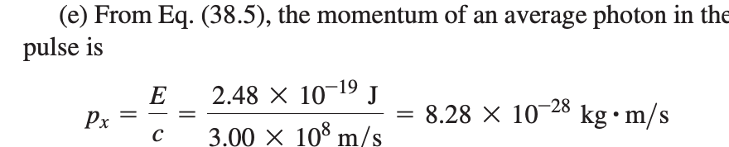
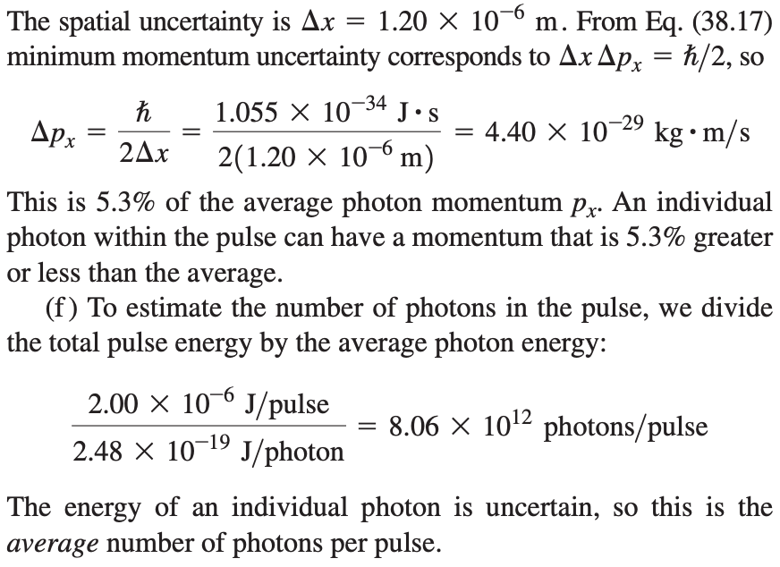
Sample Problem

