Slide 1
PHYS1001B College Physics IB
Modern Physics II Particles Behaving as Waves (Ch. 39)

Slide 2
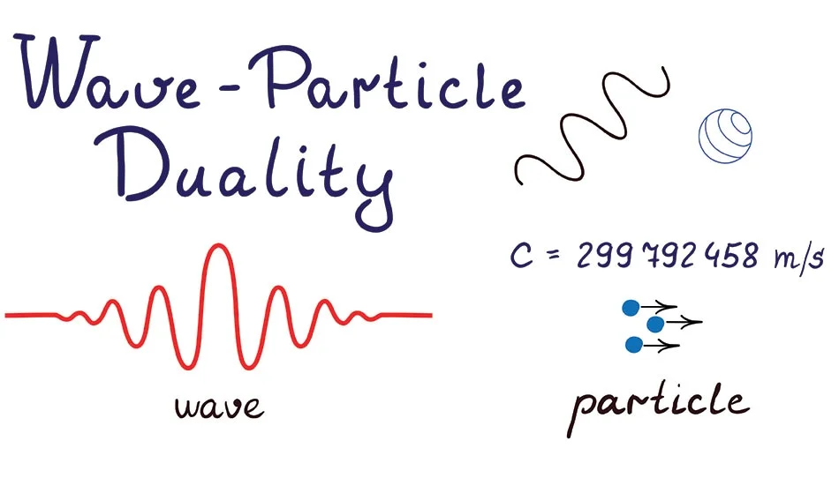
Introduction

Slide 3
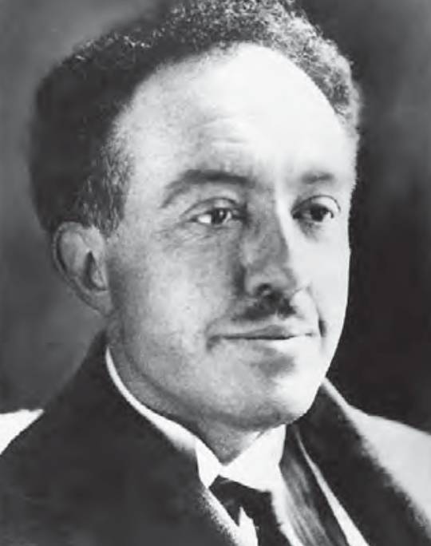
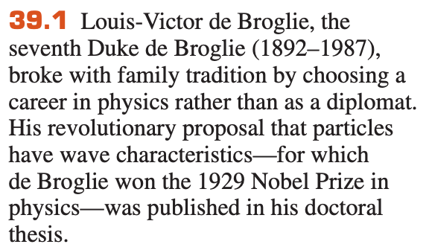
Nature loves symmetry
Light have duality, how about particles?

Slide 4
Outline
39-1 Electron Waves
39-2 The Nuclear Atom and Atomic Spectra
39-3 Energy Levels and the Bohr Model of the Atom
39-4 The Laser
39-5 Continuous Spectra
39-6 The Uncertainty Principle Revisited

Slide 5


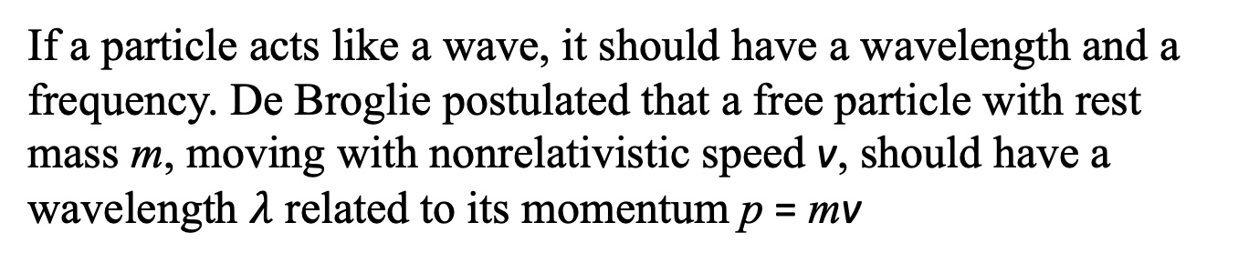
39-1 Electron Waves
If a particle acts like a wave, it should have a wavelength and a frequency. De Broglie postulated that a free particle with rest mass m, moving with nonrelativistic speed v, should have a wavelength $λ$ related to its momentum p = mv
where h is Planck’s constant.
Energy of the particle

Slide 6
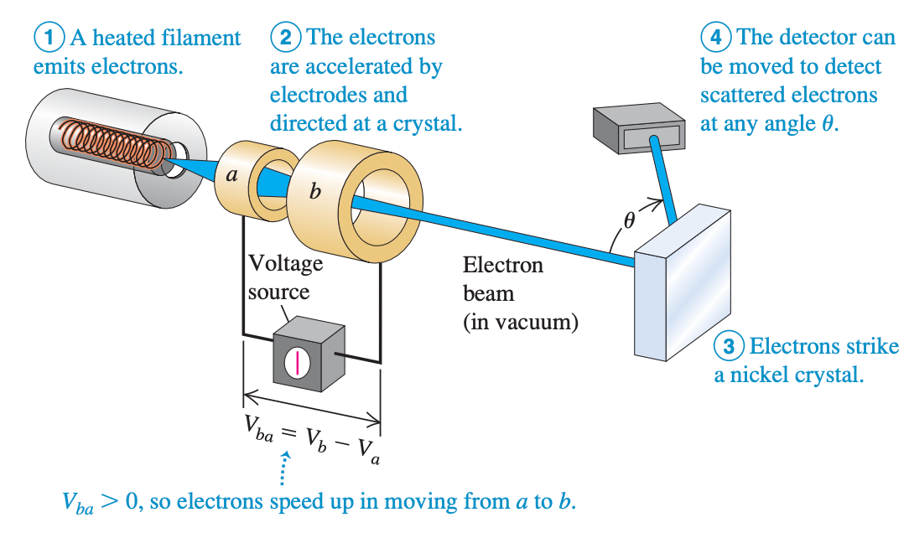
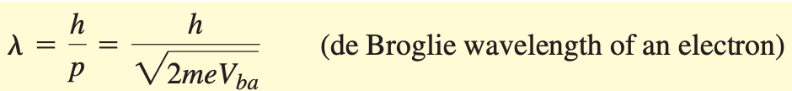

39-1 Electron Waves
Observing the Wave Nature of Electrons

Slide 7
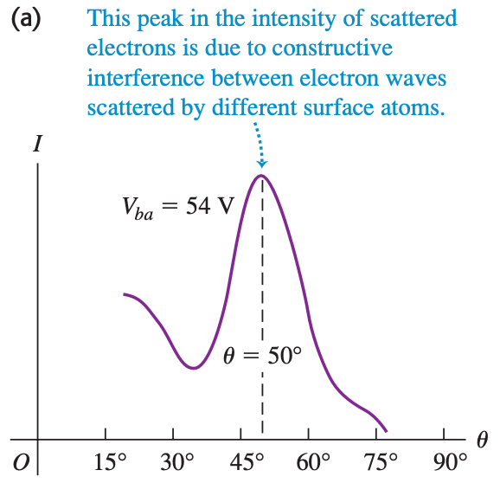
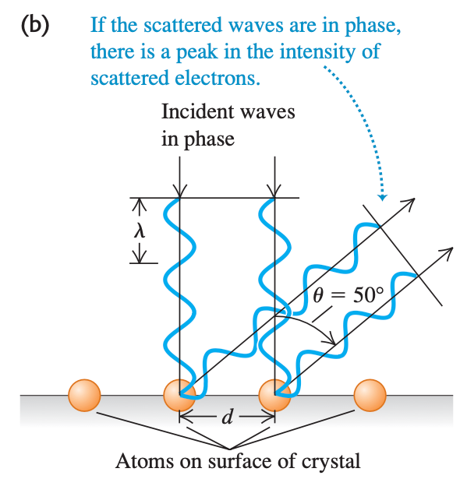

39-1 Electron Waves

Slide 8
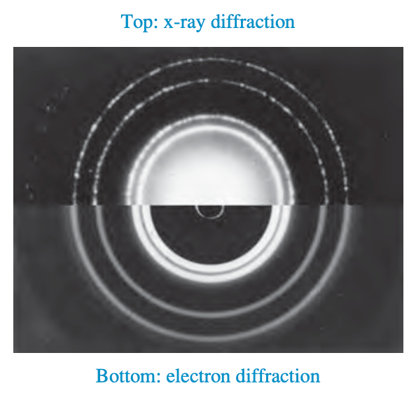
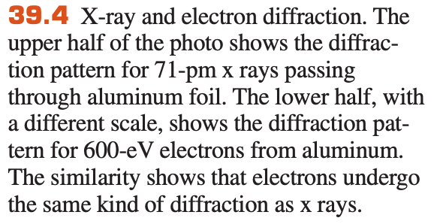


39-1 Electron Waves

Slide 9
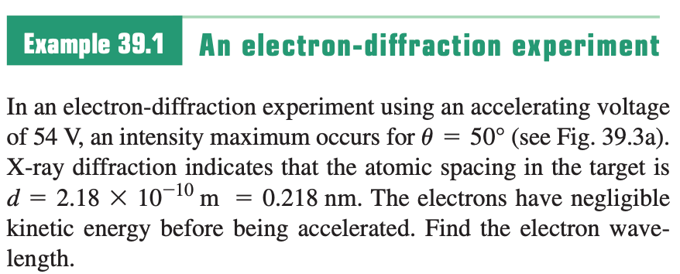
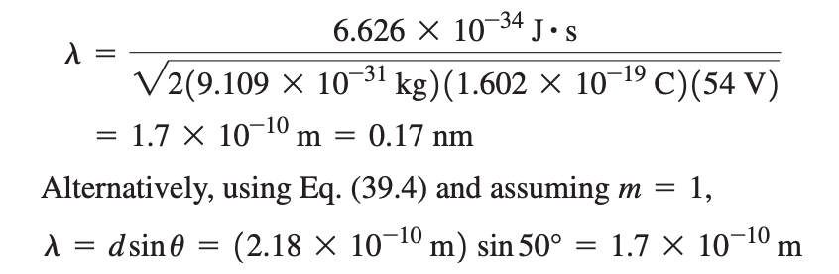
Sample Problem

Slide 10

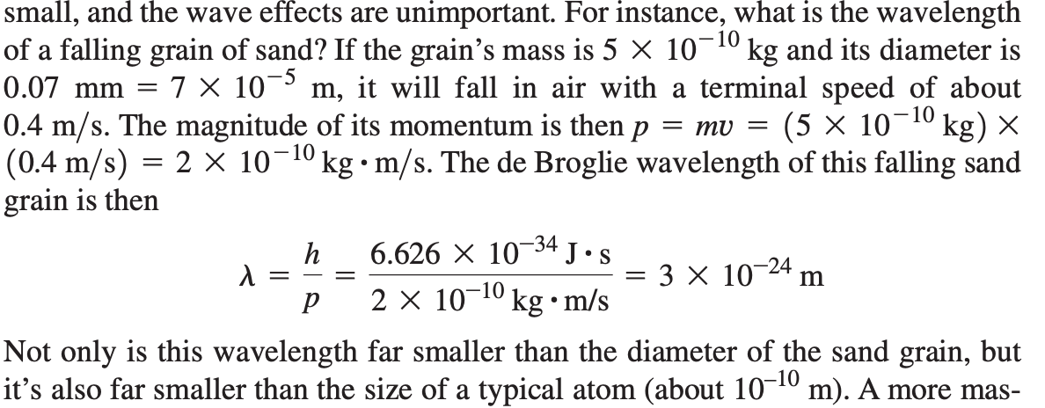
39-1 Electron Waves
De Broglie Waves and the Macroscopic World

Slide 11
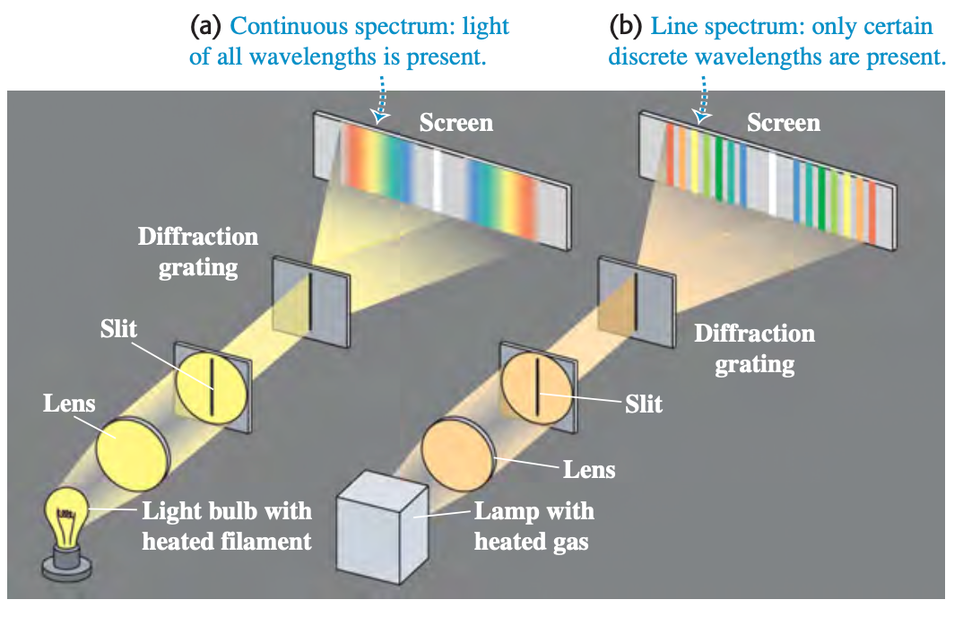
39-2 The Nuclear Atom and Atomic Spectra

Slide 12
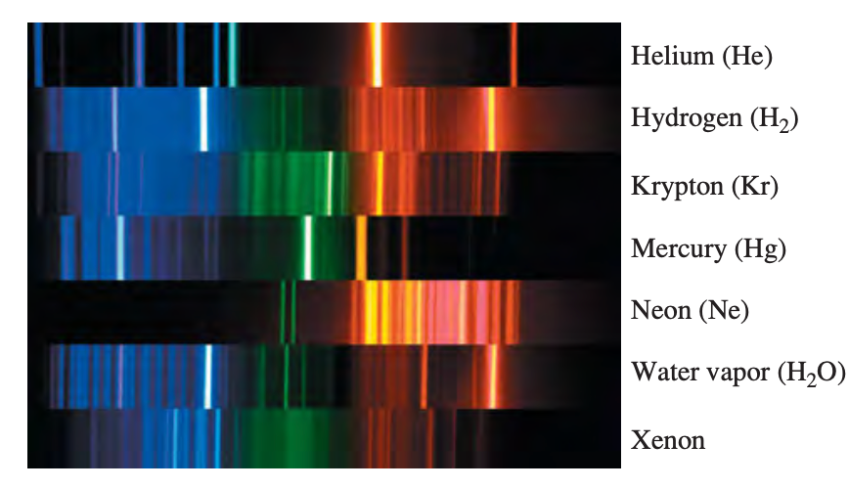
39-2 The Nuclear Atom and Atomic Spectra
Heated gas emits only certain wavelengths
Cool gas absorbs certain wavelengths

Slide 13
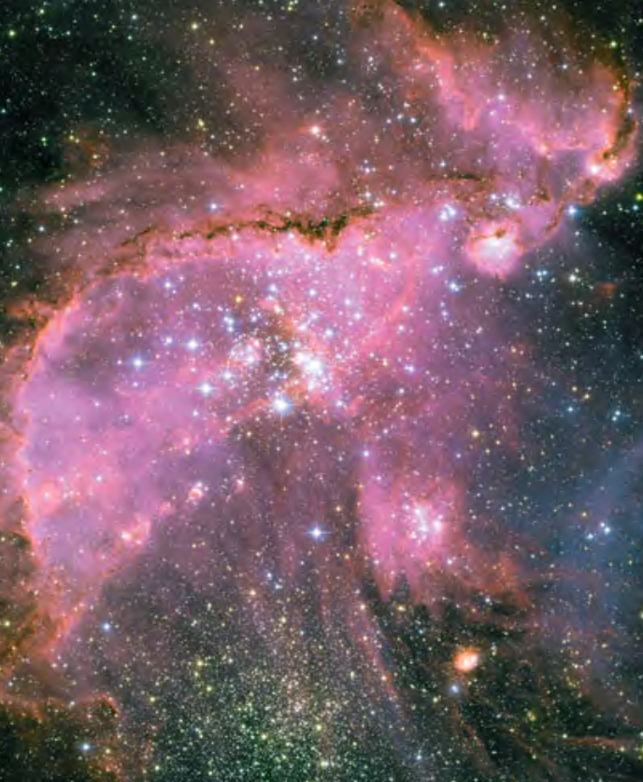
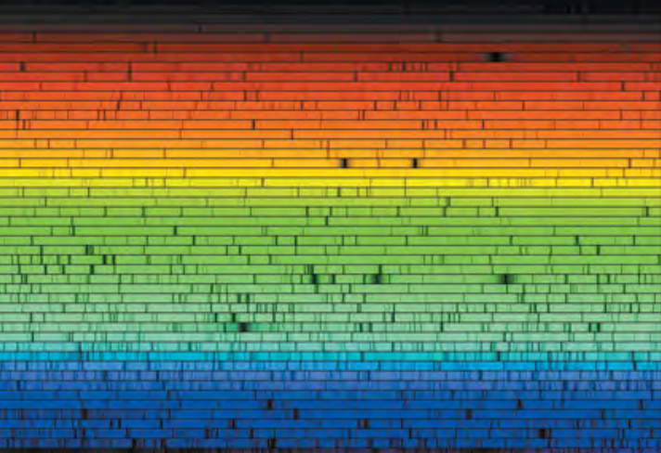
39-2 The Nuclear Atom and Atomic Spectra

Slide 14
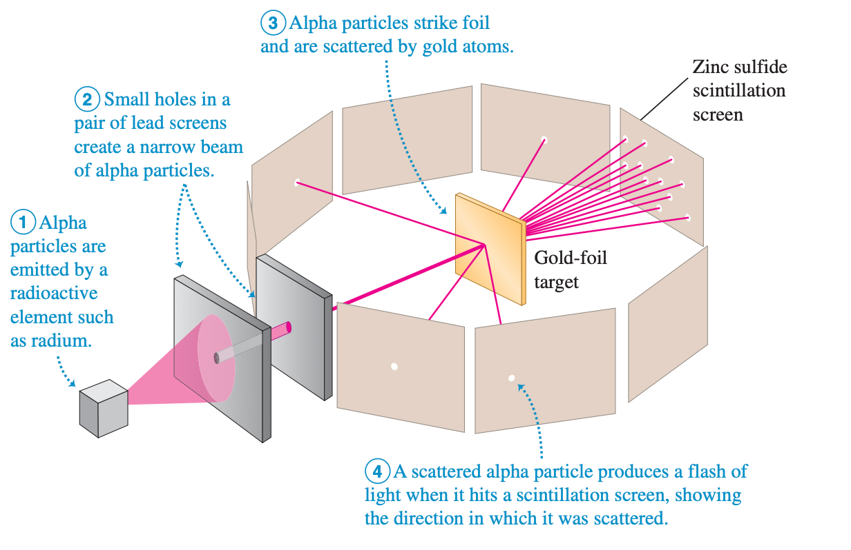
39-2 The Nuclear Atom and Atomic Spectra
Exploration of the atom: Rutherford scattering experiments

Slide 15
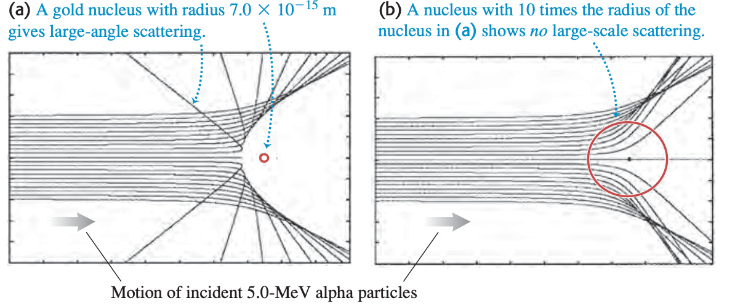
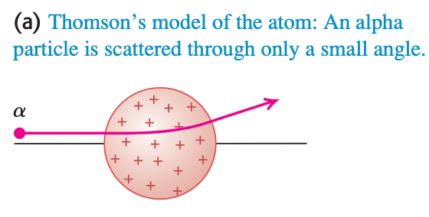
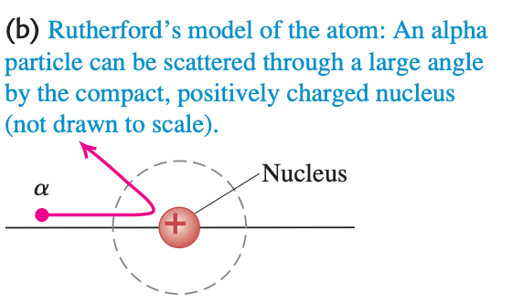
39-2 The Nuclear Atom and Atomic Spectra

Slide 16
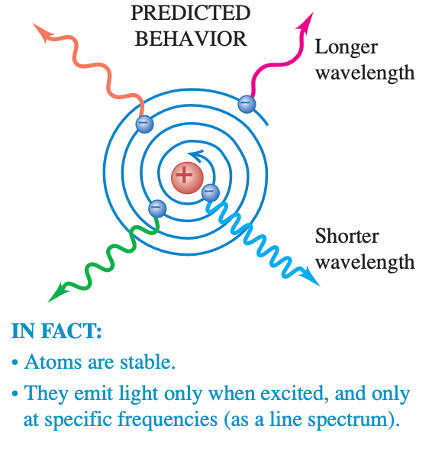
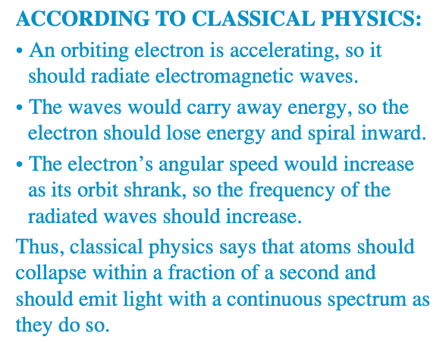
39-2 The Nuclear Atom and Atomic Spectra
Failure of classical physics

Slide 17
39-2 The Nuclear Atom and Atomic Spectra
Failure of classical physics
Need improvement of the model
From Rutherford to Bohr

Slide 18
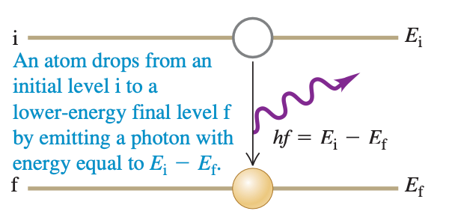
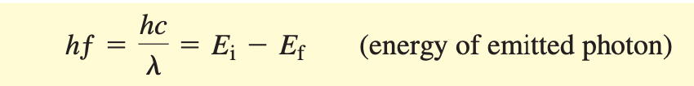
39-3 Energy Levels and the Bohr Model of the Atom

Slide 19
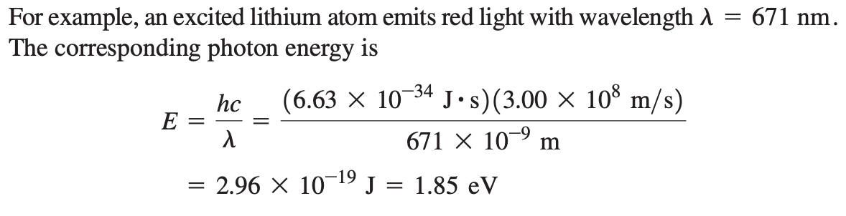
39-3 Energy Levels and the Bohr Model of the Atom

Slide 20
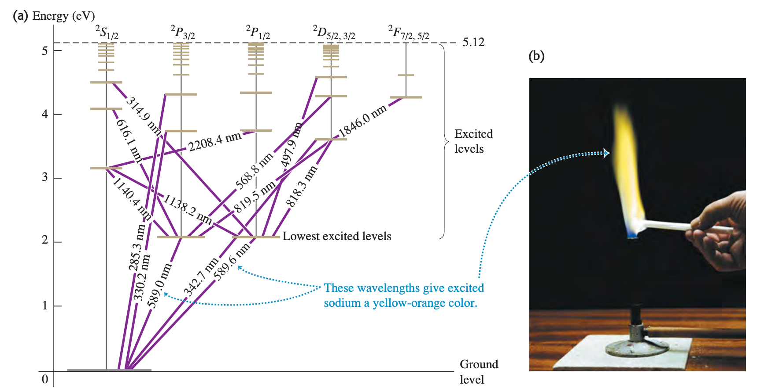
39-3 Energy Levels and the Bohr Model of the Atom

Slide 21
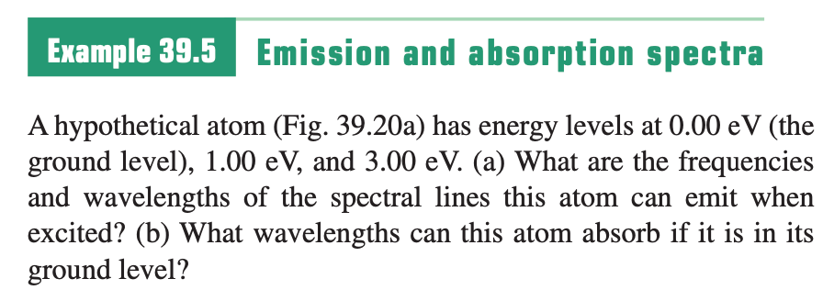
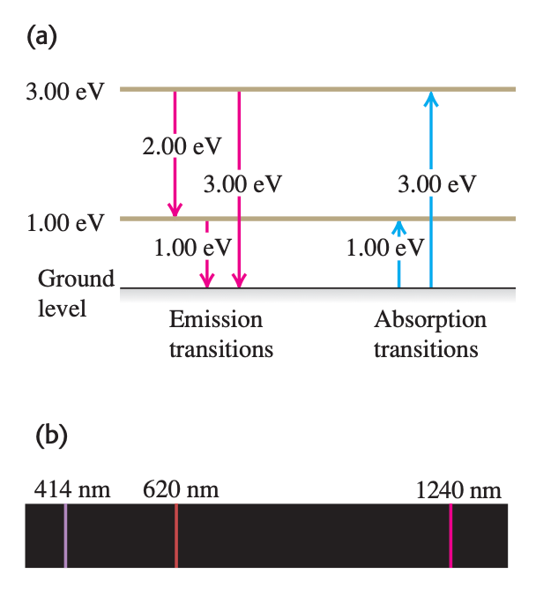
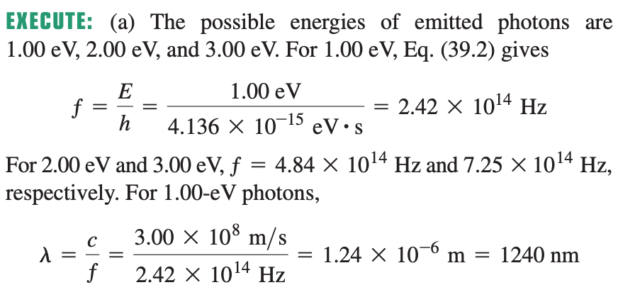
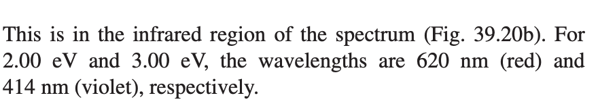
Sample Problem

Slide 22
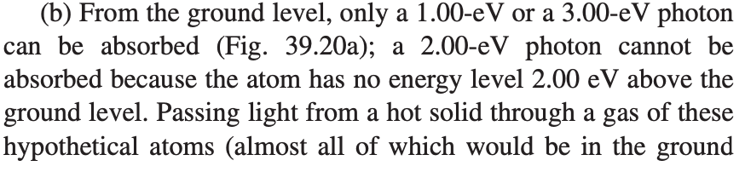
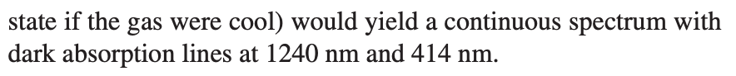
Sample Problem

Slide 23
39-3 Energy Levels and the Bohr Model of the Atom
Bohr model: Concept of quantization
Quantized angular momentum
Quantized orbital radius
Quantized energy
Quantum!

Slide 24
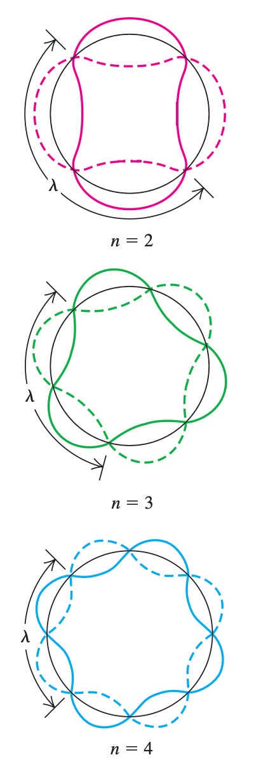
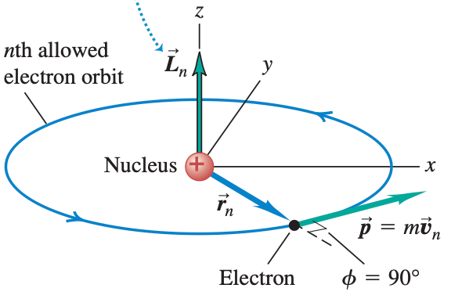
39-3 Energy Levels and the Bohr Model of the Atom
Bohr proposal of quantized angular momentum

Slide 25



39-3 Energy Levels and the Bohr Model of the Atom
Simpler proof of Bohr proposal: standing wave of wave

Slide 26
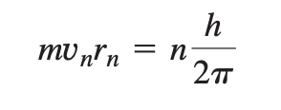
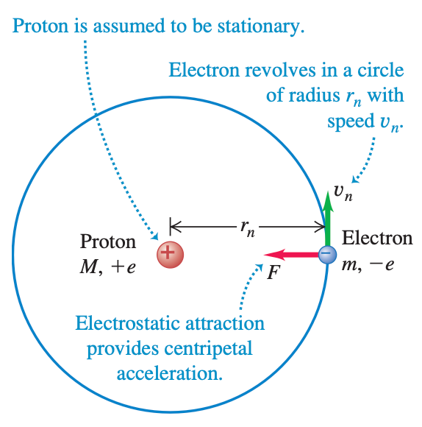
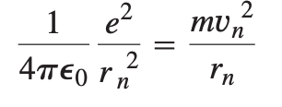

39-3 Energy Levels and the Bohr Model of the Atom
Bohr model of the hydrogen atom
Quantized orbital radii

Slide 27
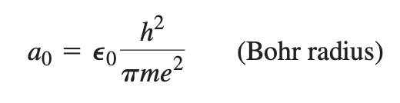

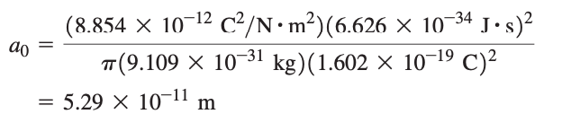
39-3 Energy Levels and the Bohr Model of the Atom
Define

Slide 28
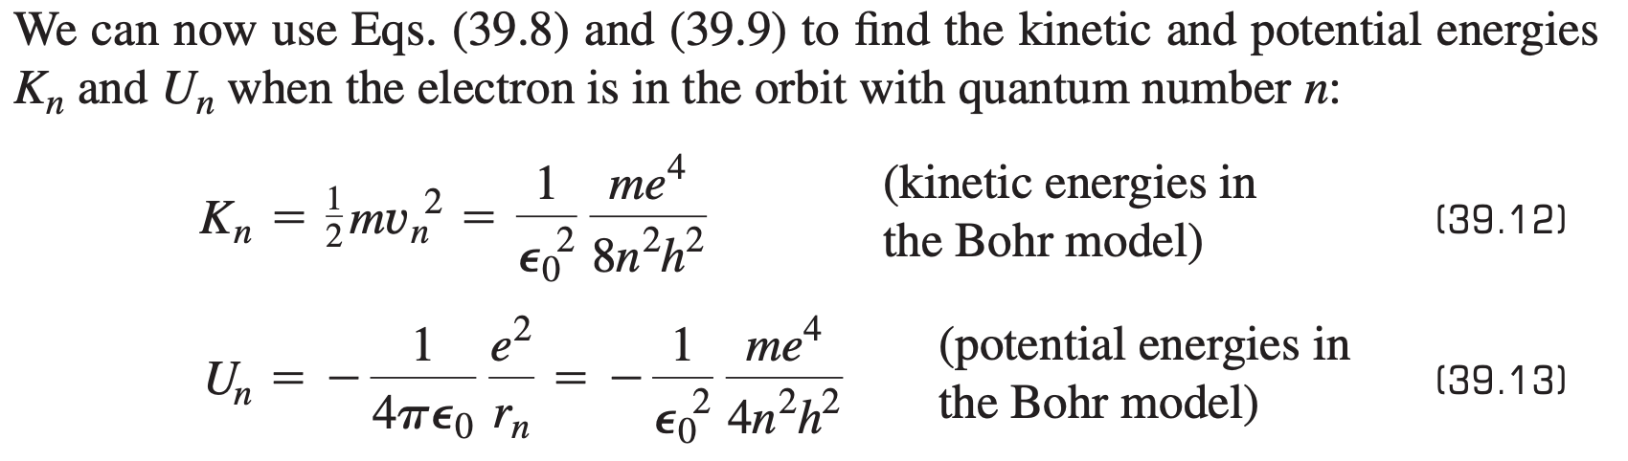
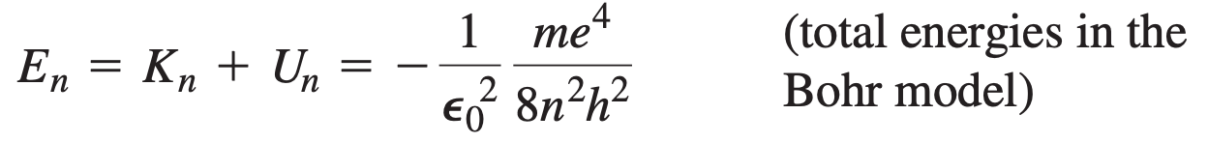
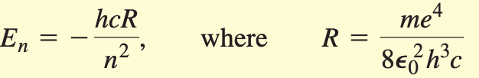
39-3 Energy Levels and the Bohr Model of the Atom

Slide 29
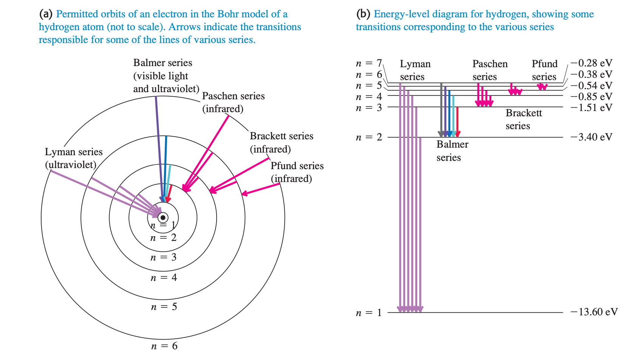
39-3 Energy Levels and the Bohr Model of the Atom

Slide 30
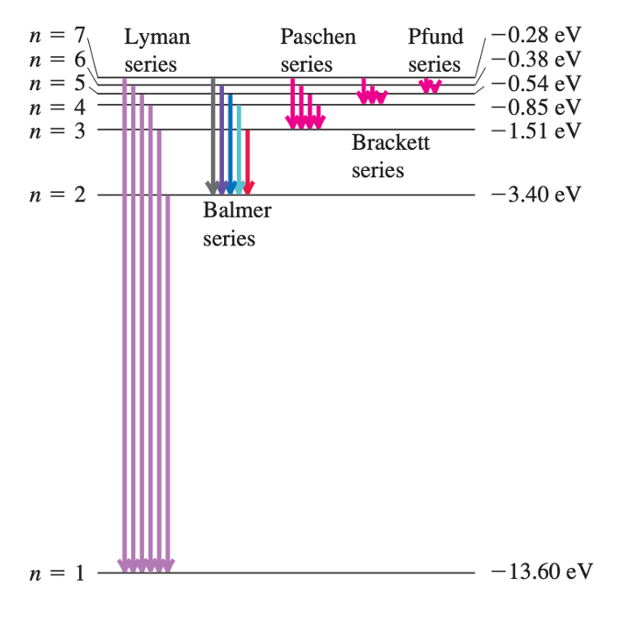
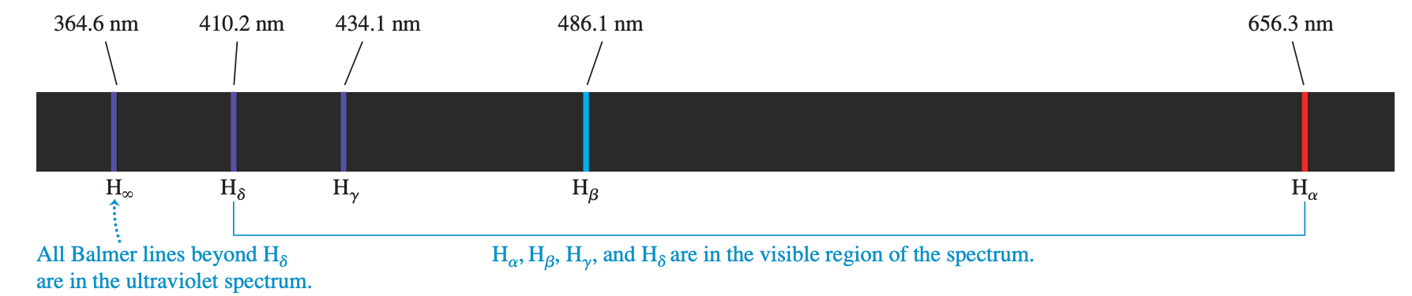
39-3 Energy Levels and the Bohr Model of the Atom

Slide 31
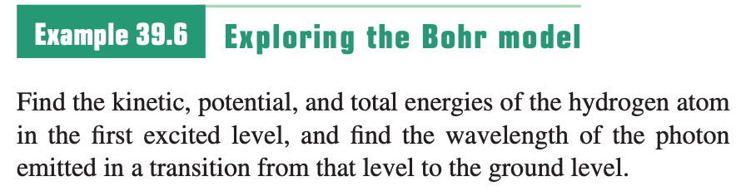
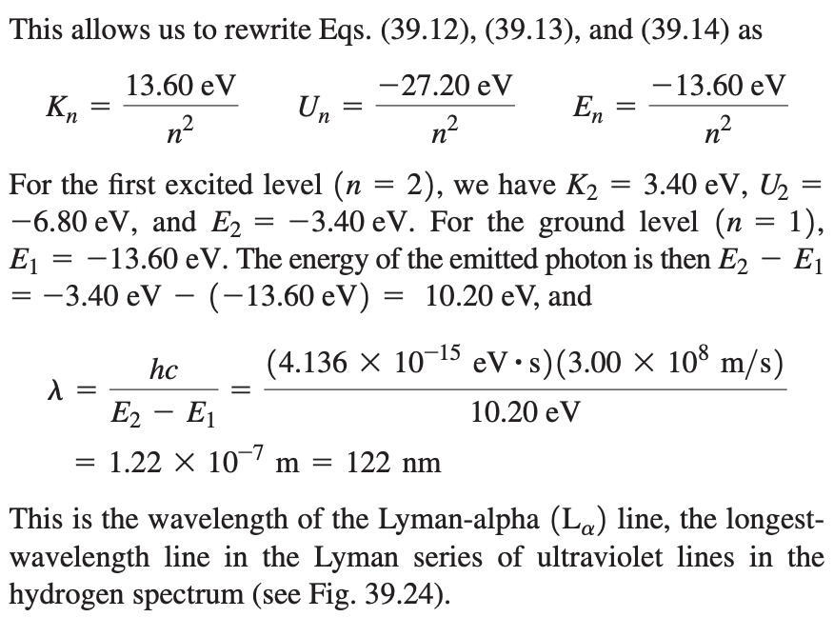
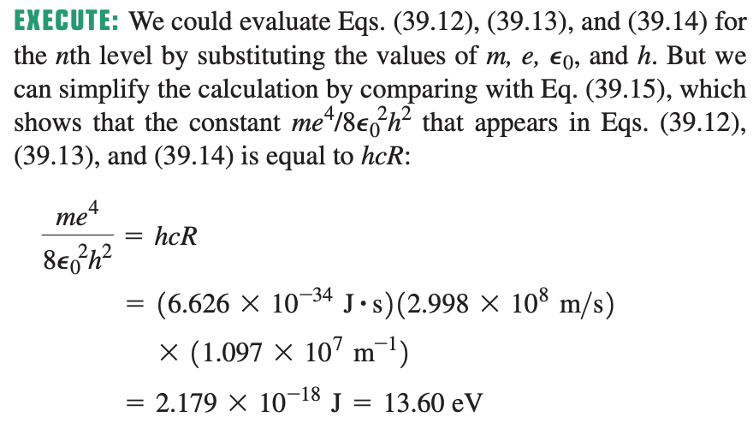
Sample Problem

Slide 32
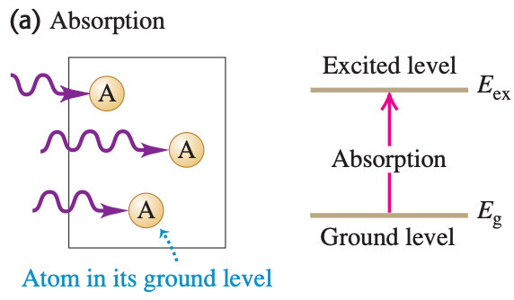
39-4 The Laser

Slide 33

39-4 The Laser
Random phase and direction

Slide 34

39-4 The Laser
Resonance effect
Phonons with same phase and direction

Slide 35


39-4 The Laser

Slide 36

39-4 The Laser
Laser: a nonequilibrium situation in which the number of atoms in a higher-energy state is greater than the number in a lower-energy state, population inversion

Slide 37

39-4 The Laser
Laser: a nonequilibrium situation in which the number of atoms in a higher-energy state is greater than the number in a lower-energy state, population inversion

Slide 38



39-5 Continuous Spectra
Stefan–Boltzmann law for a blackbody

Slide 39


39-5 Continuous Spectra
Dark sunspots

Slide 40



39-5 Continuous Spectra
Wien displacement law
Peak wavelength
Total intensity

Slide 41





39-5 Continuous Spectra
Quantum hypothesis
Planck radiation law
Resulting in Wien law
Resulting in Stefan–Boltzmann law
Solve

Slide 42



Sample Problem

Slide 43



39-6 The Uncertainty Principle Revisited

Slide 44




Sample Problem

