Slide 1
PHYS1001B College Physics IB
Modern Physics III QUANTUM MECHANICS (Ch. 40)

Slide 2
Introduction
Quantum mechanics?
Microscopic level
Particle-wave duality
Uncertainty principle with Planck constant
Quantized energy with Planck constant

Slide 3

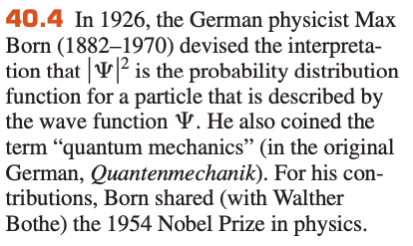
Introduction

Slide 4
Outline
40-1 Wave Functions and the One-Dimensional Schrodinger Equation

Slide 5
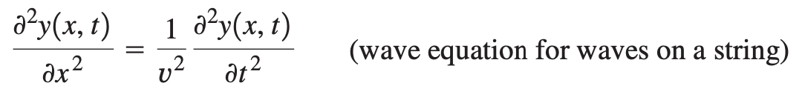
40-1 Wave Functions and the One-Dimensional Schrodinger Equation
Wave equation

Slide 6
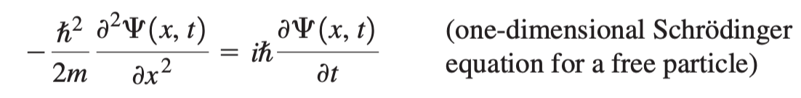
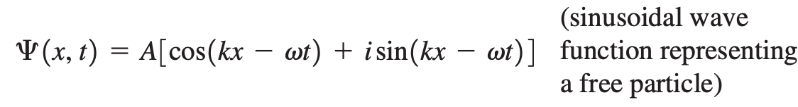

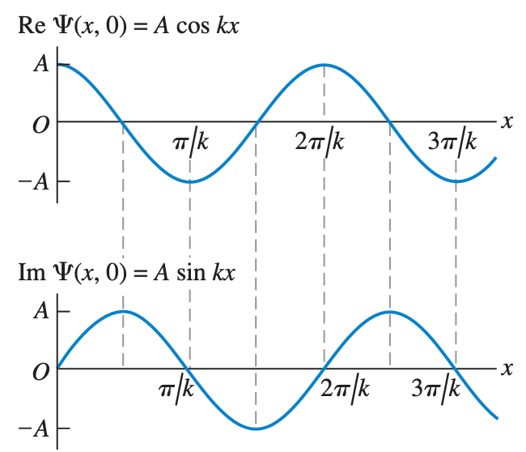
40-1 Wave Functions and the One-Dimensional Schrodinger Equation

Slide 7

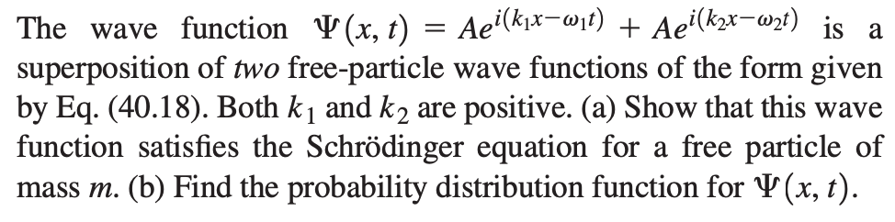
Sample Problem

Slide 8
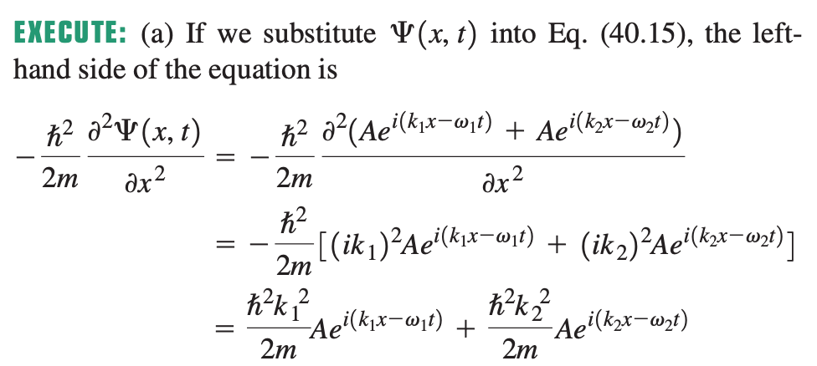
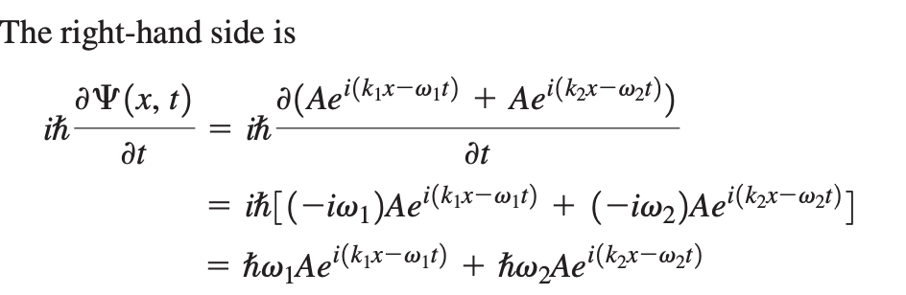
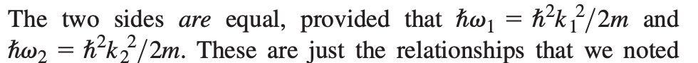
Sample Problem

Slide 9
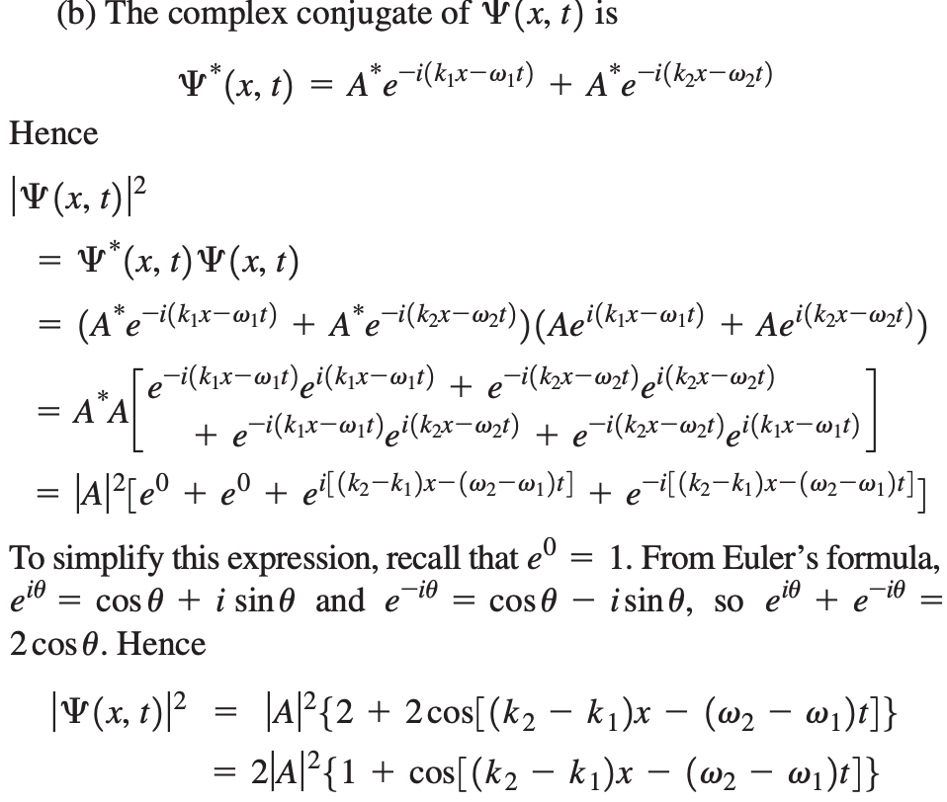
Sample Problem

Slide 10
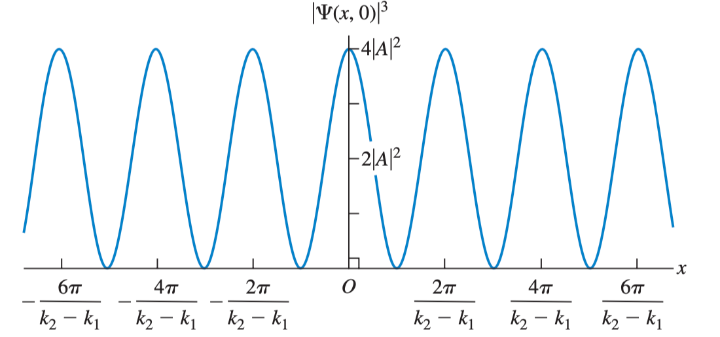
Sample Problem
2

Slide 11

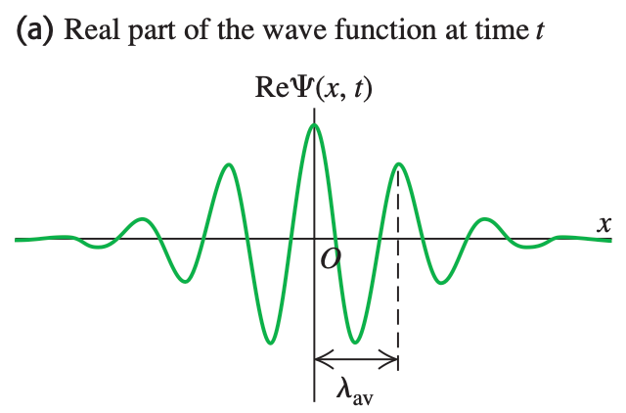
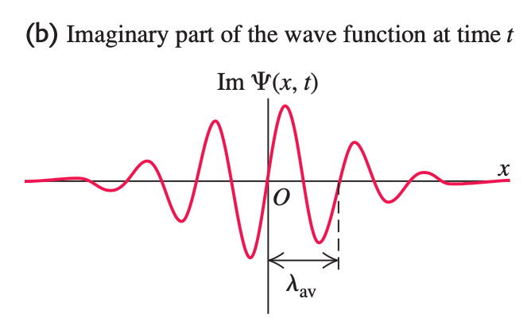
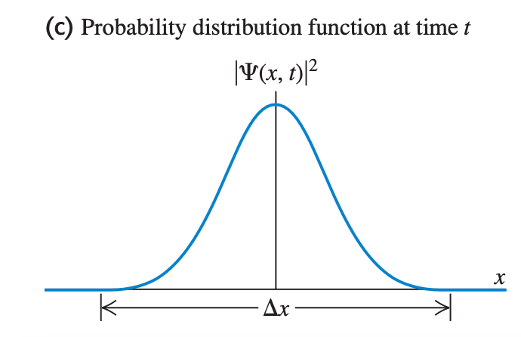
40-1 Wave Functions and the One-Dimensional Schrodinger Equation
Wave packet / wave pulse with wavelength

Slide 12
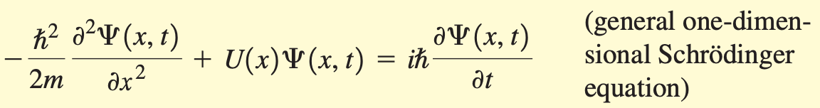

40-1 Wave Functions and the One-Dimensional Schrodinger Equation

Slide 13
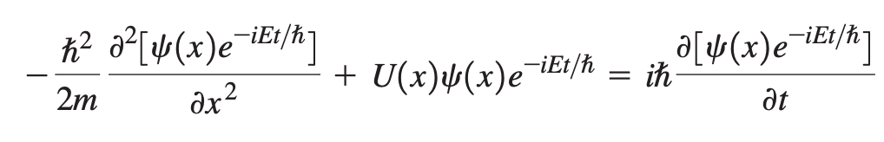
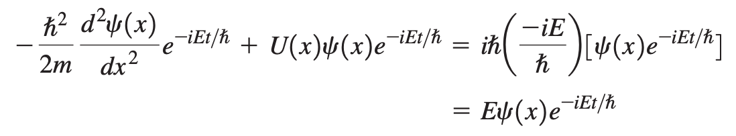
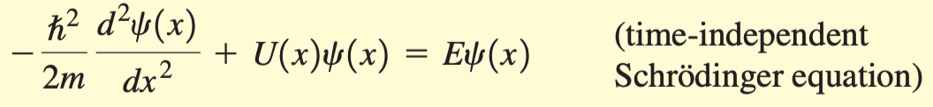
40-1 Wave Functions and the One-Dimensional Schrodinger Equation

Slide 14
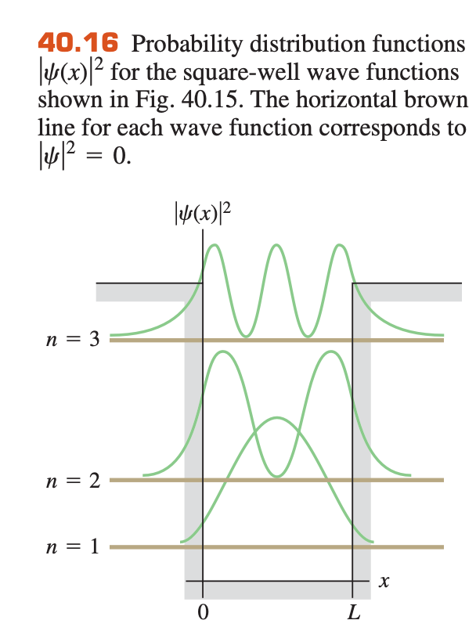
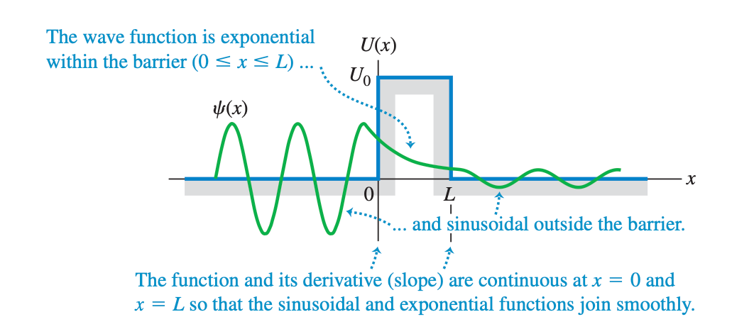
Interesting phenomena resulted
Barrier and tunneling (unlike classical mechanics)

