Slide 1

Digital Design
With an Introduction to the Verilog HDL, VHDL, and SystemVerilog
6th Edition
Chapter 04
Combinational Logic

Slide 2
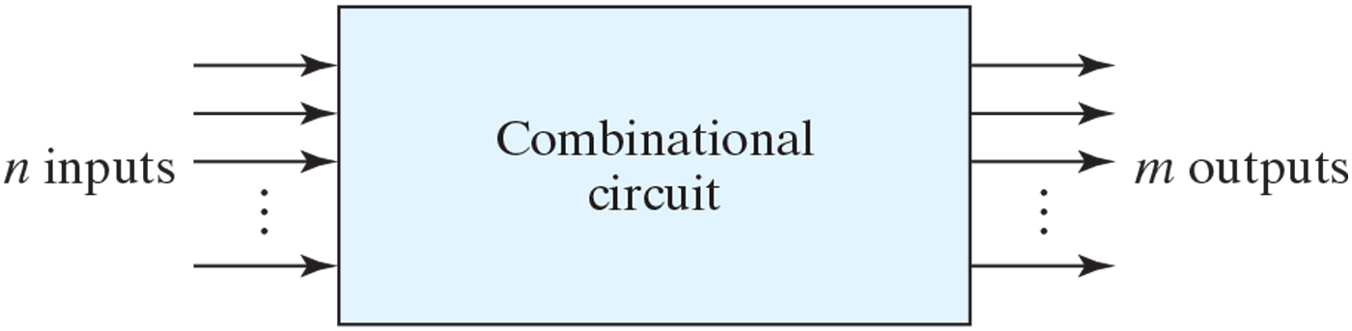
Figure 4.1 Block diagram of combinational circuit.

Slide 3
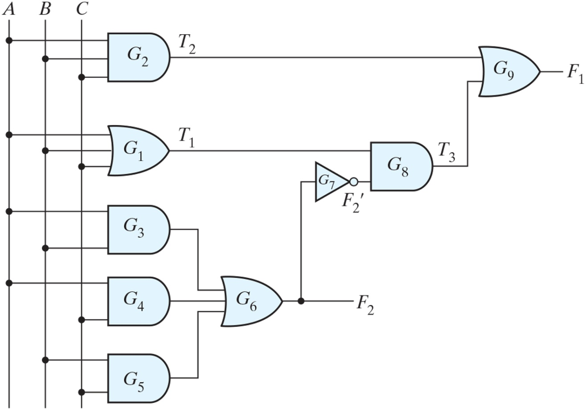
Figure 4.2 Logic diagram for analysis example.

Slide 4
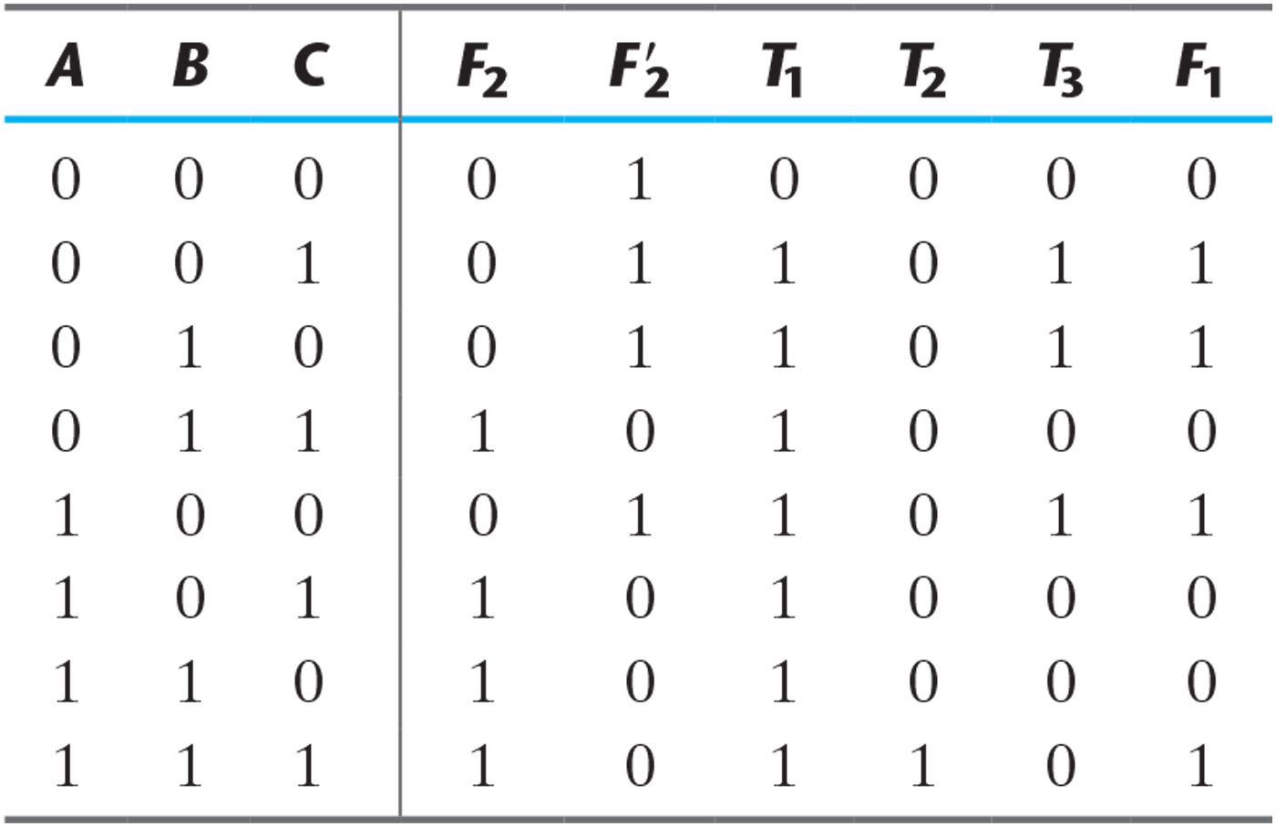
Table 4.1 Truth Table for the Logic Diagram of Fig. 4.2.

Slide 5
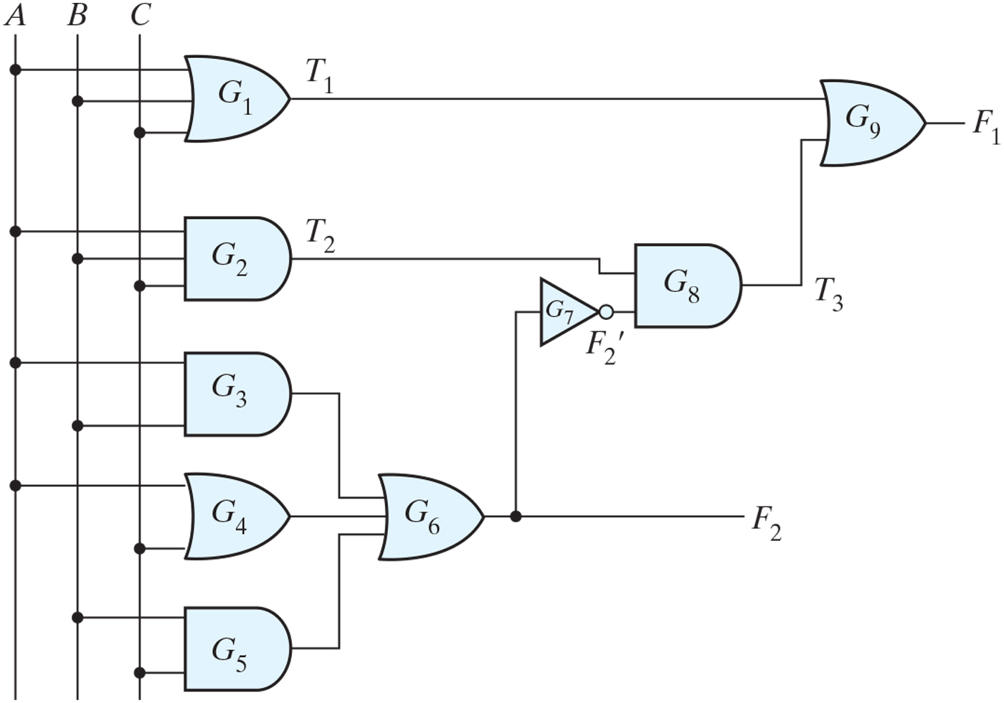
Figure PE4.1

Slide 6
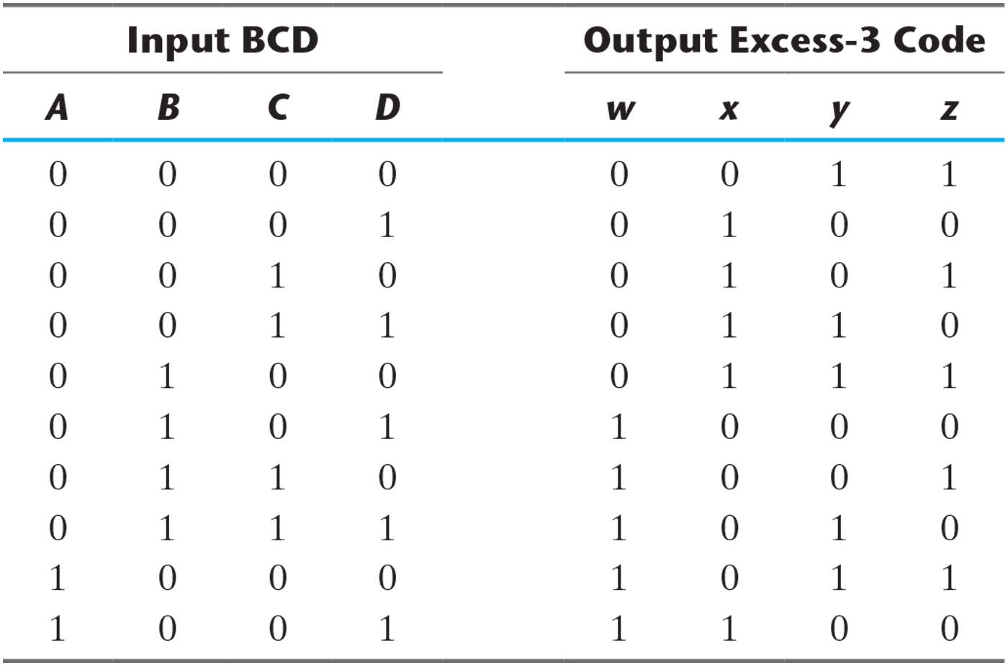
Table 4.2 Truth Table for Code Conversion Example.

Slide 7
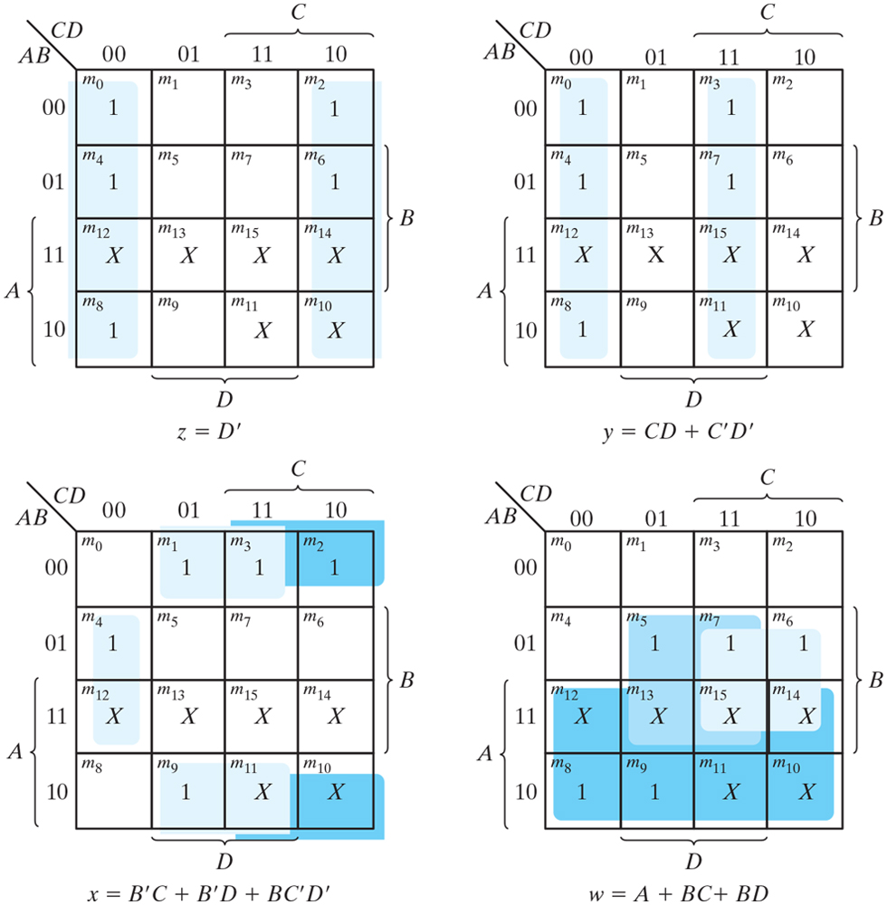
Figure 4.3 Maps for BCD-to-excess-3 code converter.

Slide 8
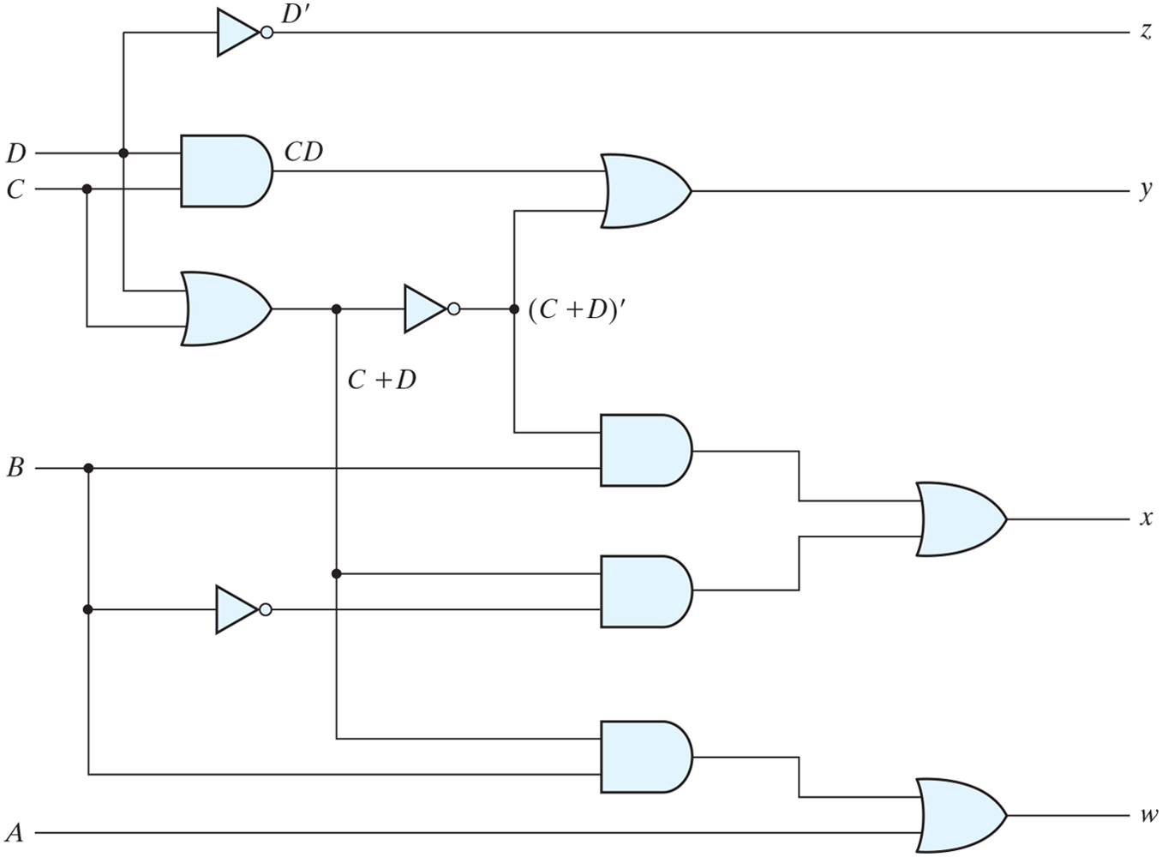
Figure 4.4 Logic diagram for BCD-to-excess-3 code converter.

Slide 9
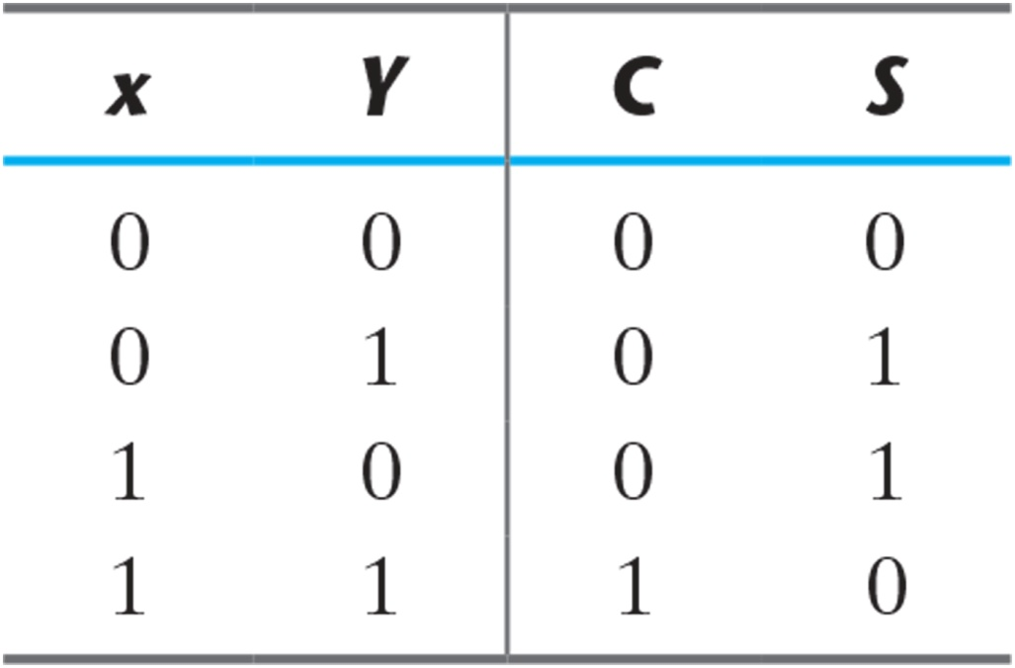
Table 4.3 Half Adder.

Slide 10
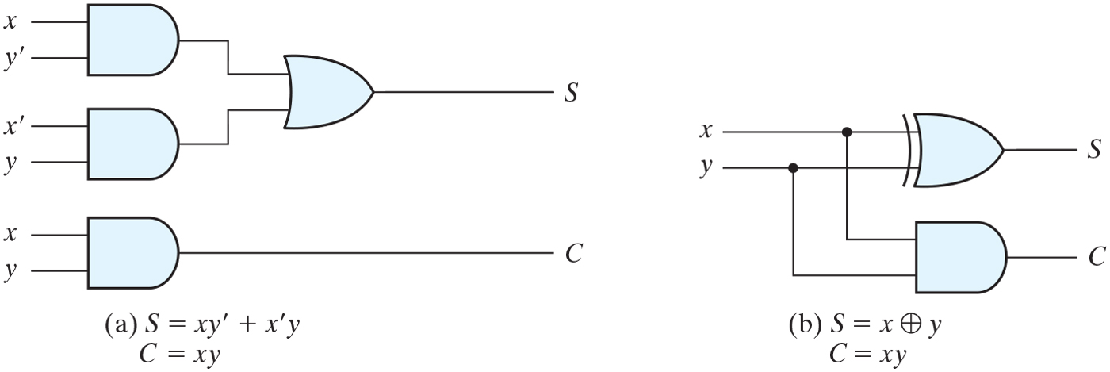
Figure 4.5 Implementation of half adder.

Slide 11
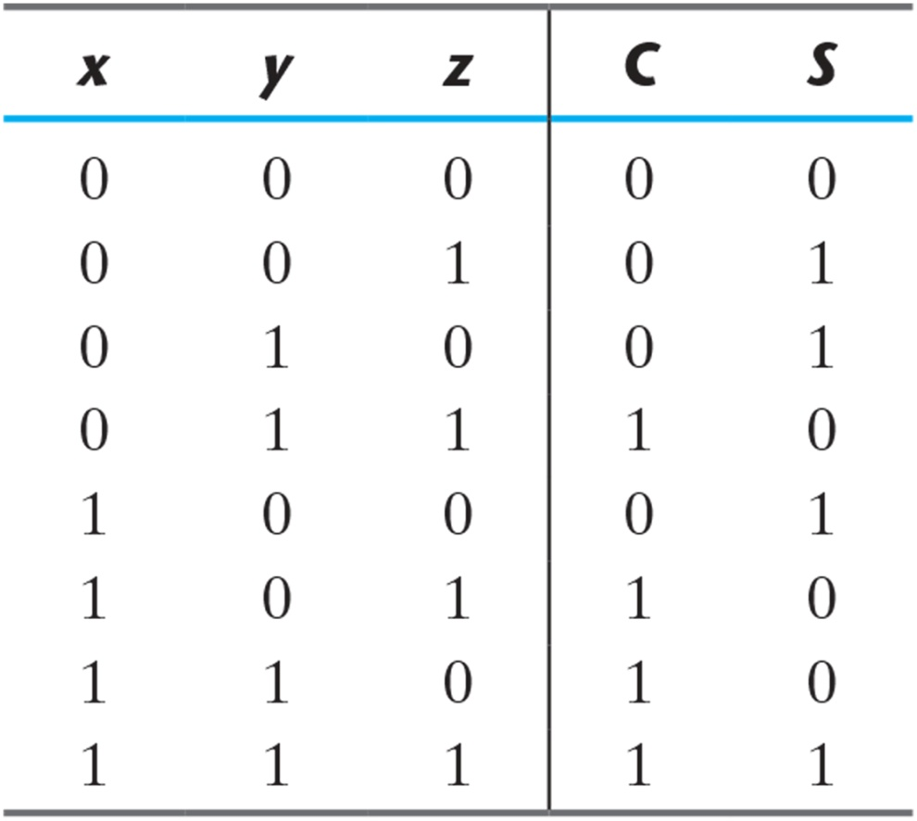
Table 4.4 Full Adder.

Slide 12
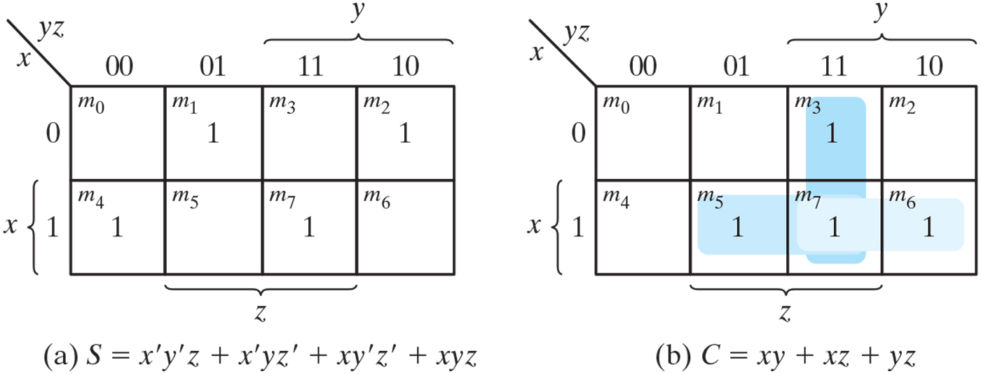
Figure 4.6 K-Maps for full adder.

Slide 13
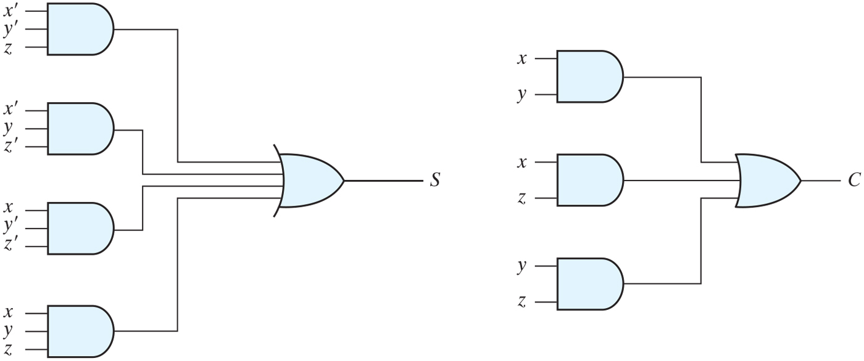
Figure 4.7 Implementation of full adder in sum-of-products form.
S=x’y’z+x’yz’+xy’z’+xyz
=(x’y’z+xyz)+x’yz’+xy’z’
=(x’y’+xy)z+(x’y+xy’)z
=(x xor y)’z + (x xor y)z
=x xor y xor z
C=xy+yz+xz=xy+xyz+x’yz+xz
= xy+xyz+x’yz+xy’z
= xy+xyz+(x XOR y)z
= xy + (x XOR y)z

Slide 14
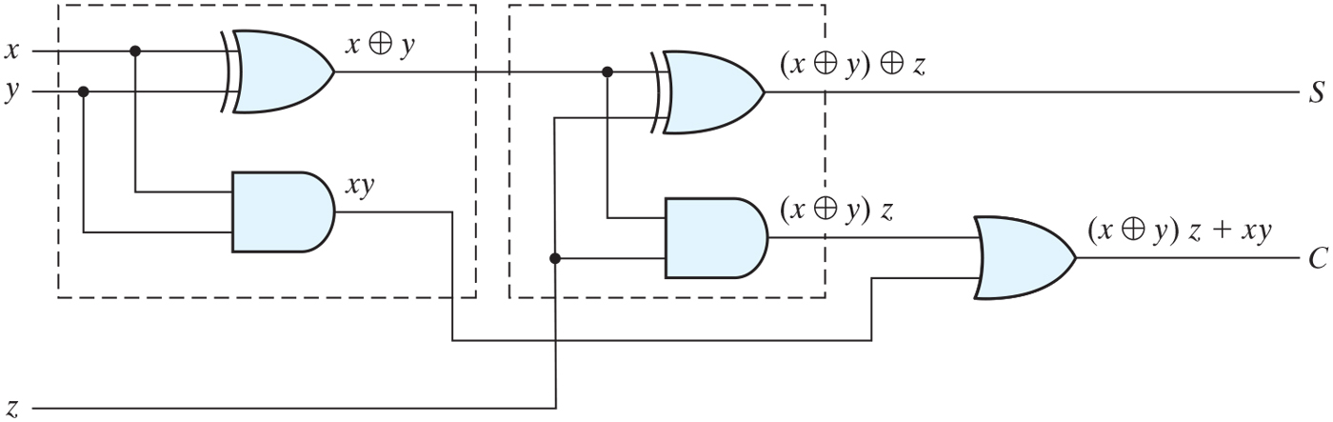
Figure 4.8 Implementation of full adder with two half adders and an OR gate.
C=xy+yz+xz=xy+xyz+x’yz+xz
= xy+x’yz+xyz+xy’z
= xy+xyz+(x XOR y)z
= xy + (x XOR y)z
S=x’y’z+x’yz’+xy’z’+xyz
=(x’y’z+xyz)+x’yz’+xy’z’
=(x’y’+xy)z+(x’y+xy’)z
=(x xor y)’z + (x xor y)z
=x xor y xor z

Slide 15
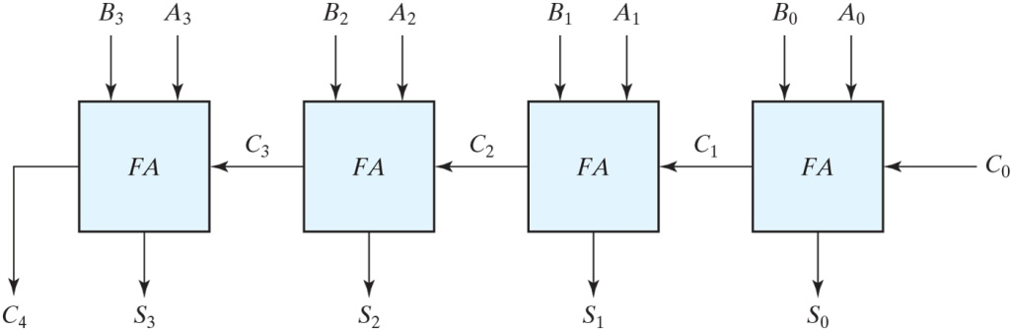
Figure 4.9 Four-bit adder.

Slide 16
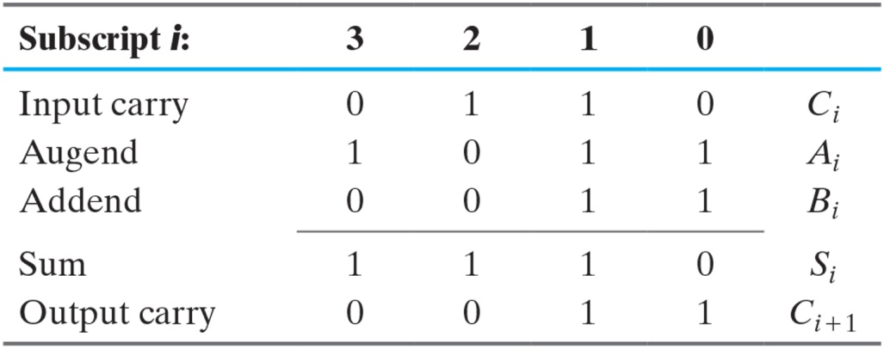
Binary Adder

Slide 17
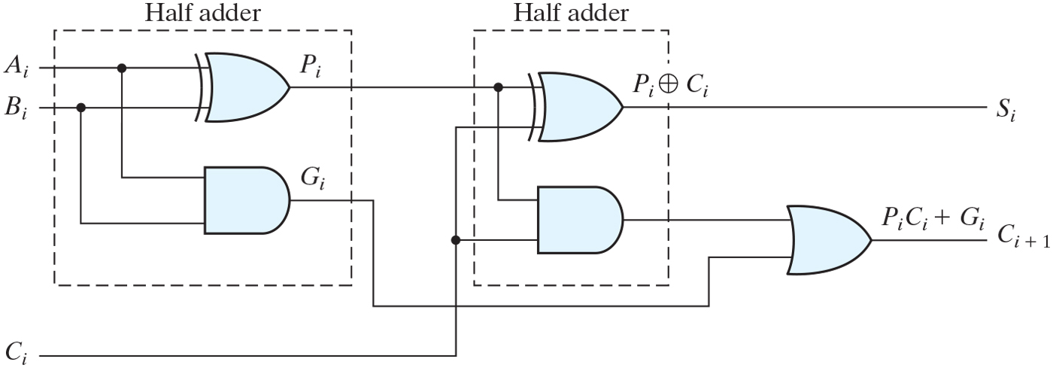
Figure 4.10 Full adder with P and G shown.
C=xy+yz+xz=xy+xyz+x’yz+xz
= xy+x’yz+xyz+xy’z
= xy+xyz+(x XOR y)z
= xy + (x XOR y)z

Slide 18
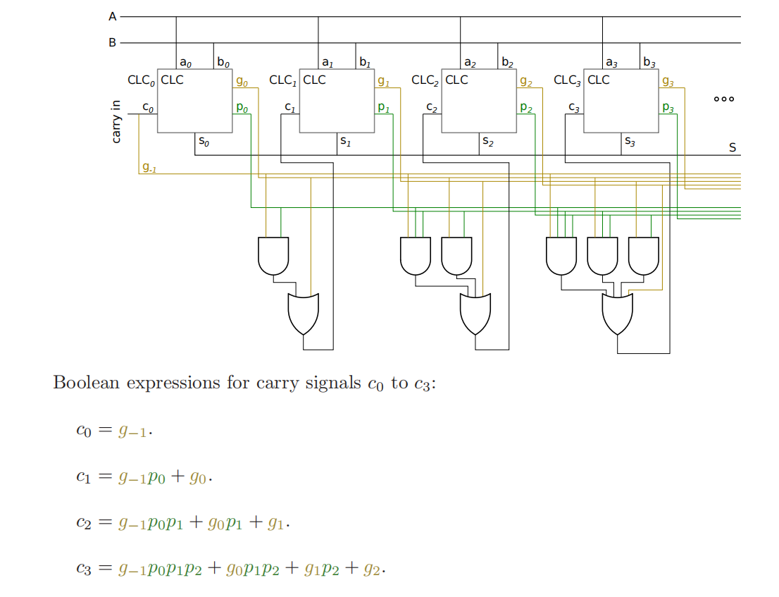
Figure 4.12 Four-bit adder with carry lookahead.

Slide 19
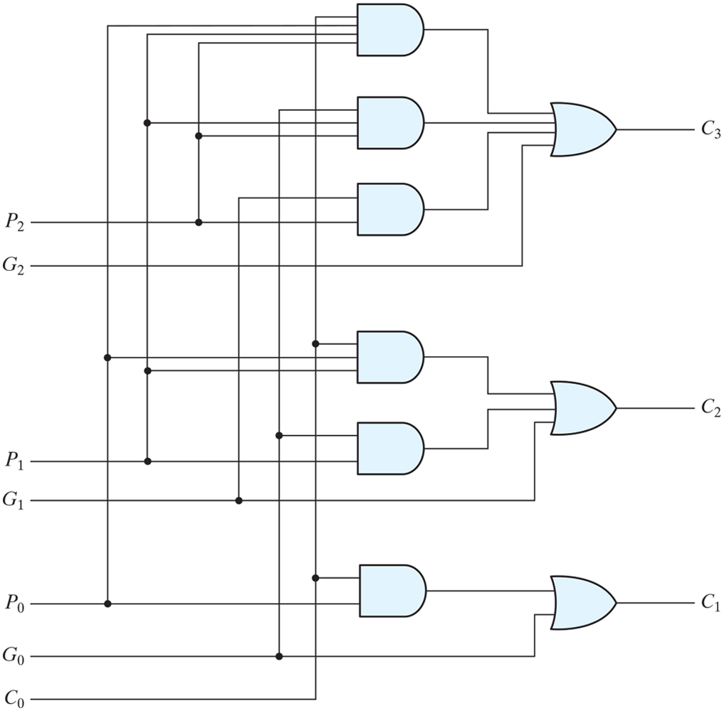
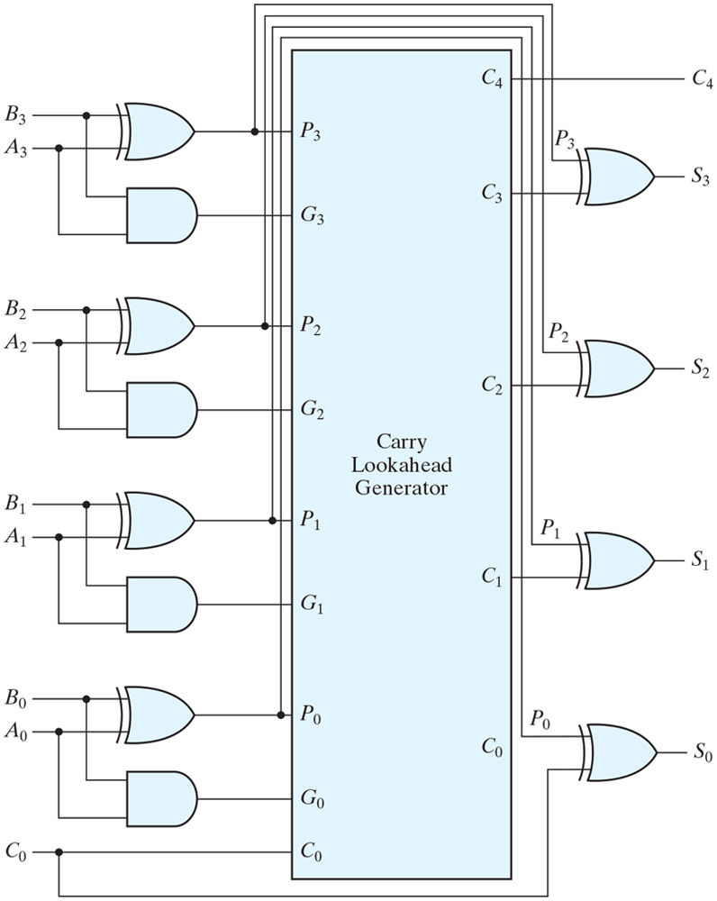
Figure 4.11 Logic diagram of carry lookahead generator.

Slide 20
Figure 4.12 Four-bit adder with carry lookahead.

Slide 21
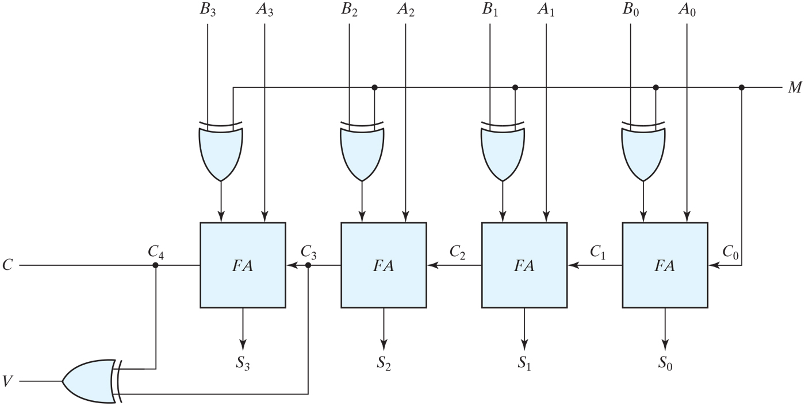
Figure 4.13 Four-bit adder–subtractor (with overflow detection).

Slide 22
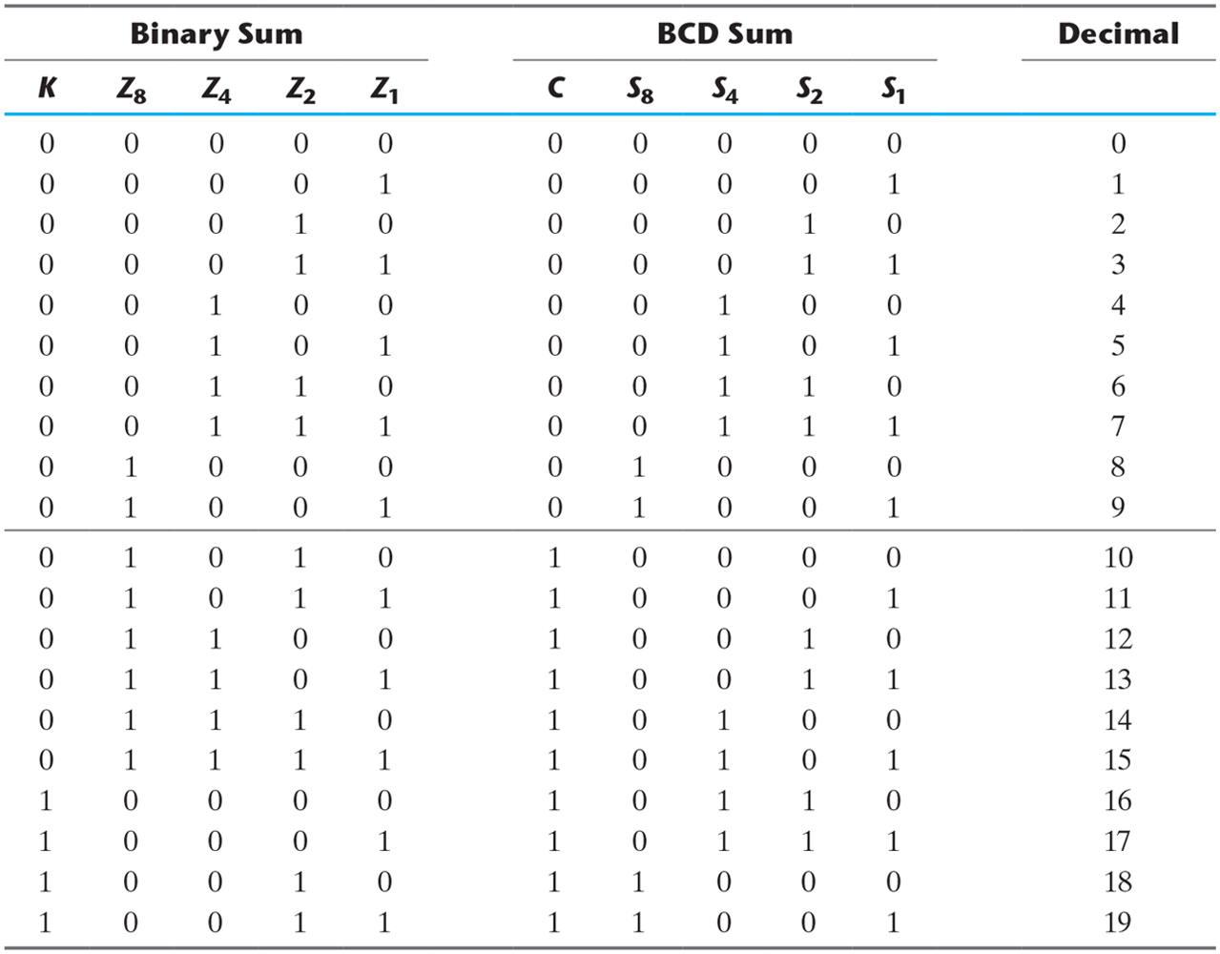
Table 4.5 Derivation of BCD Adder.
+6
+6
……
+6

Slide 23
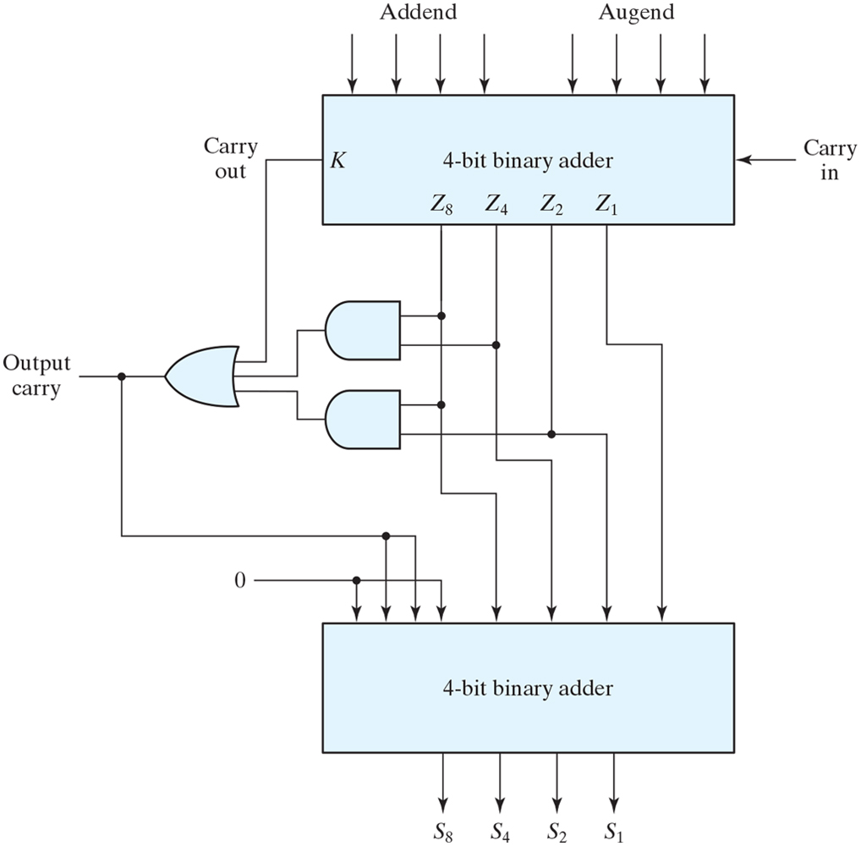
Figure 4.14 Block diagram of a BCD adder.

Slide 24
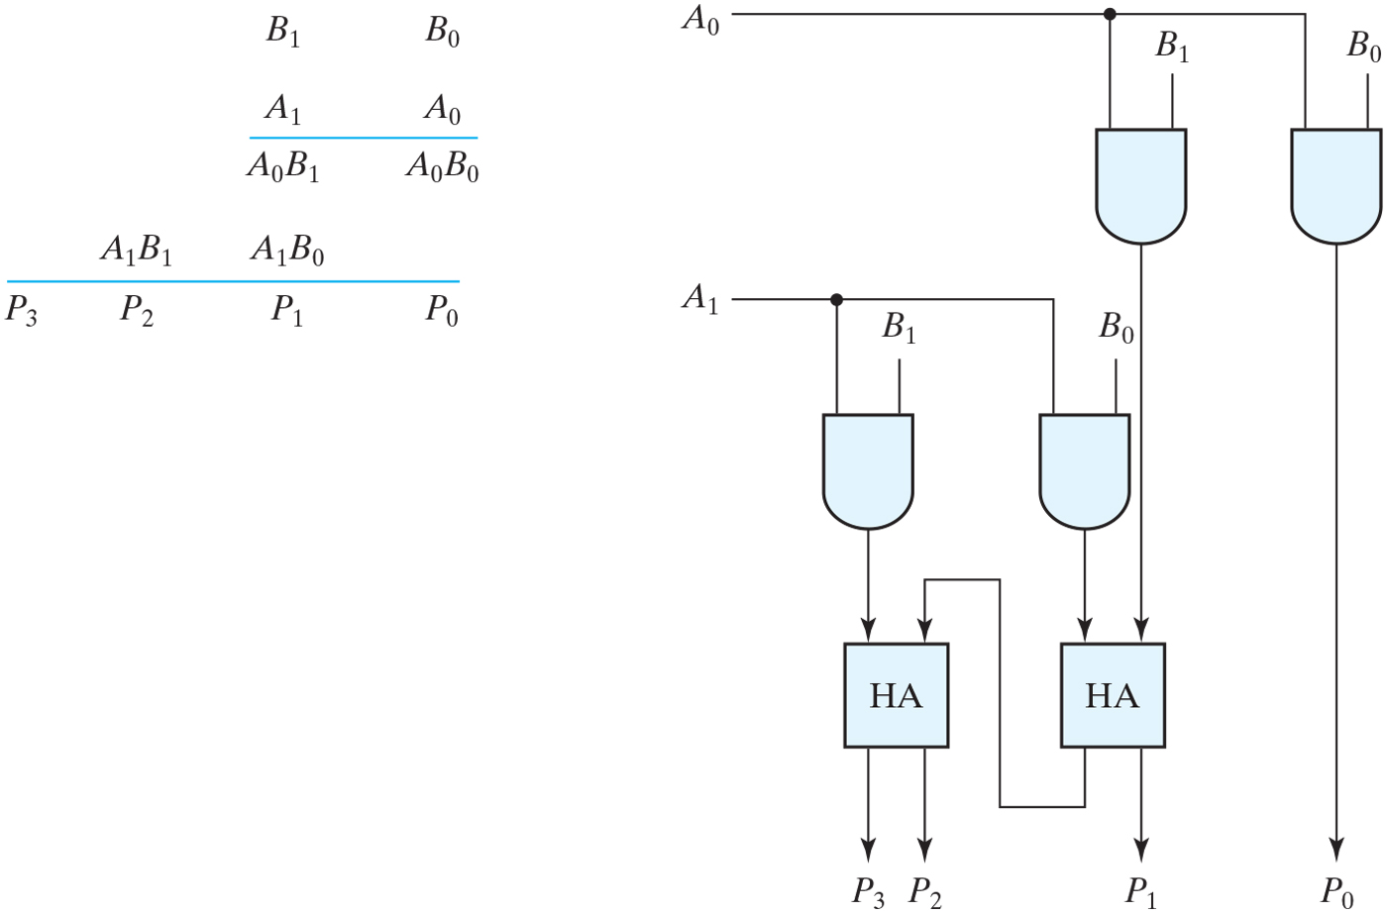
Figure 4.15 Two-bit by two-bit binary multiplier.

Slide 25
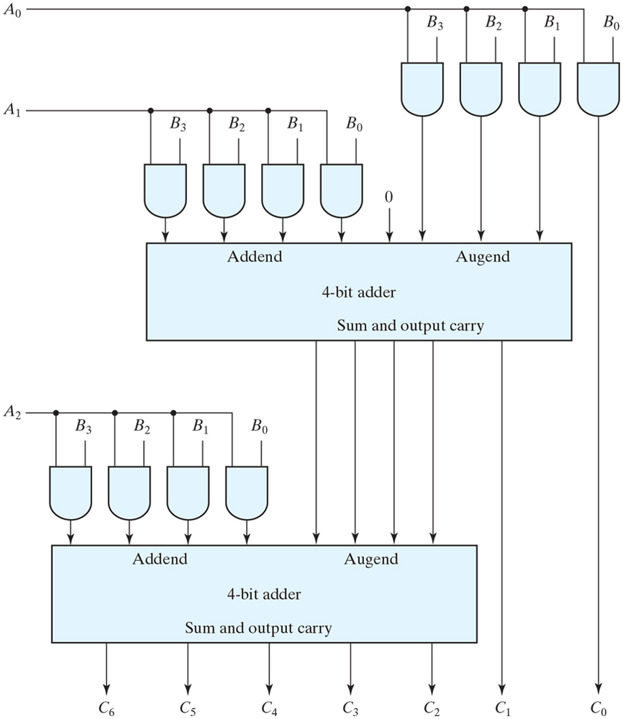
Figure 4.16 Four-bit by three-bit binary multiplier.

Slide 26
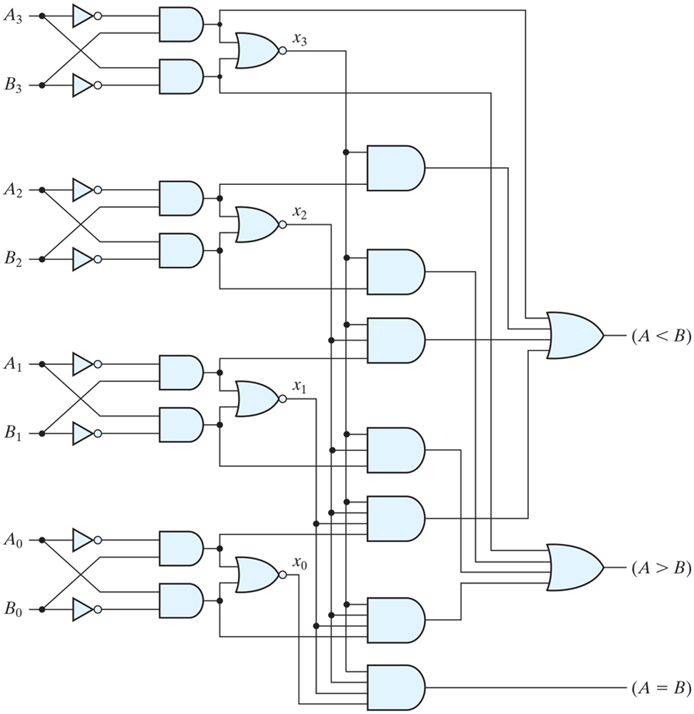
Figure 4.17 Four-bit magnitude comparator.
If the first n bits are equal, then compare the n-1 bit …
幅值比较
A=B
A=0, B=1: A<B
A=1, B=0: A>B
A=0, B=1: A<B
A=1, B=0: A>B
A=0, B=1: A<B
A=1, B=0: A>B

Slide 27
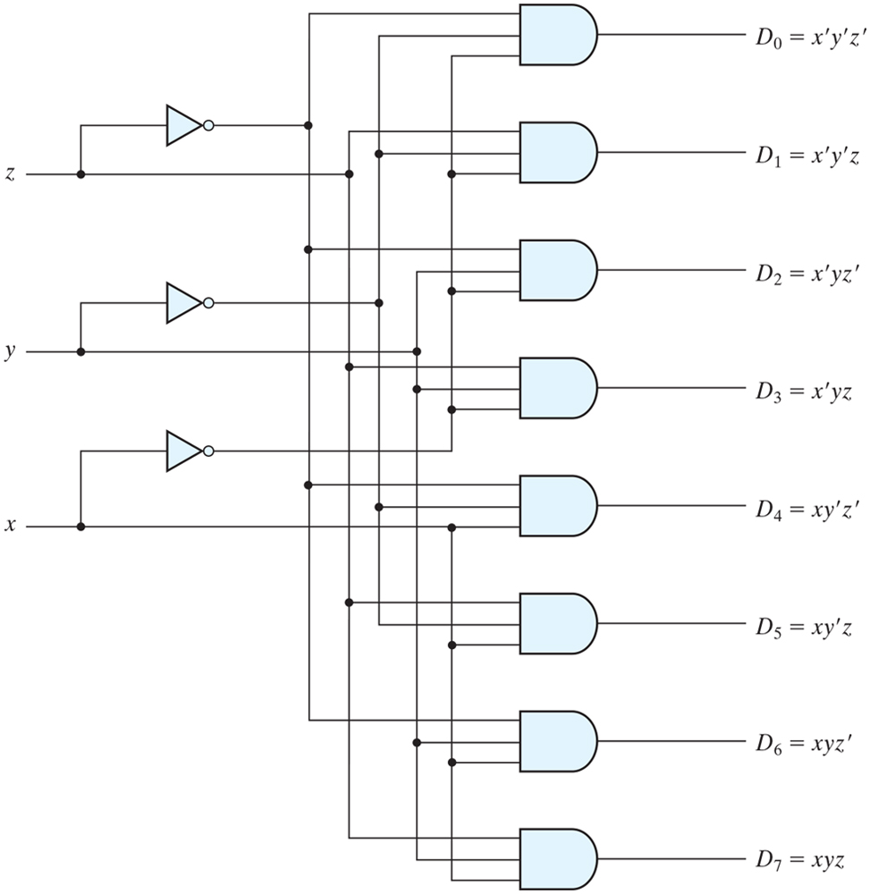
Figure 4.18 Three-to-eight-line decoder.

Slide 28
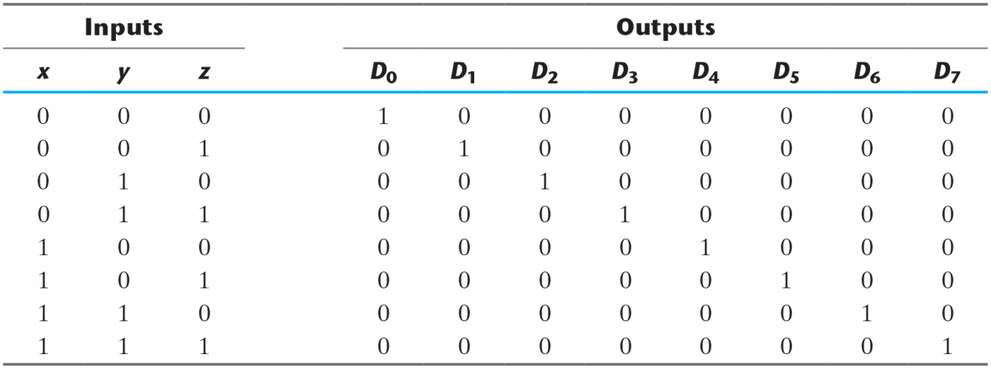
Table 4.6 Truth Table of a Three-to-Eight-Line Decoder.
A full adder can be built with 3-8 decoder

Slide 29
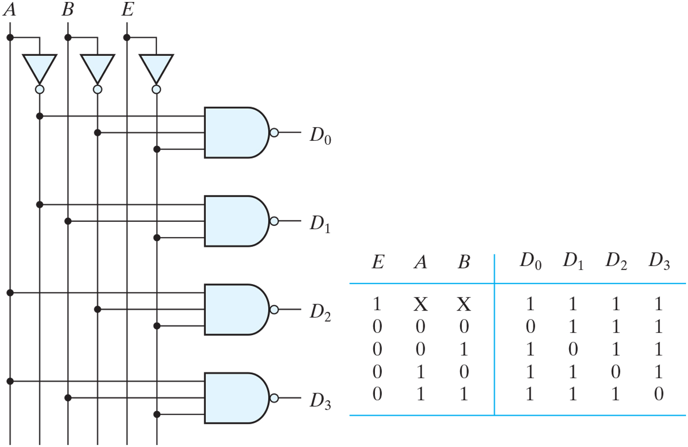
Figure 4.19 Two-to-four-line decoder with enable input.

Slide 30
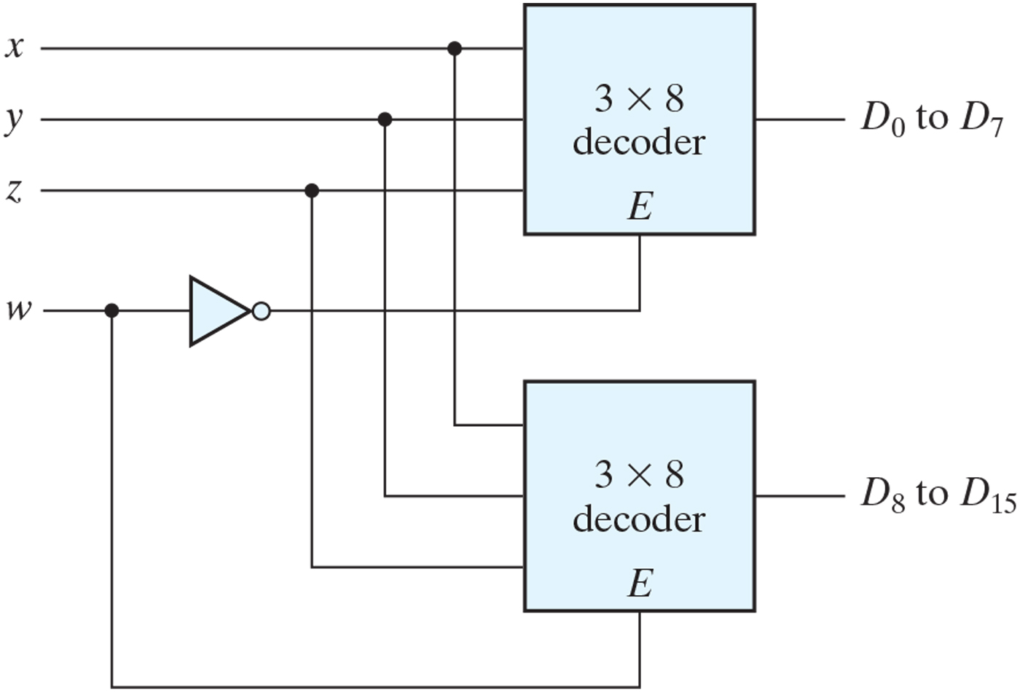
Figure 4.20 4 x 16 decoder constructed with two 3 x 8 decoders.

Slide 31
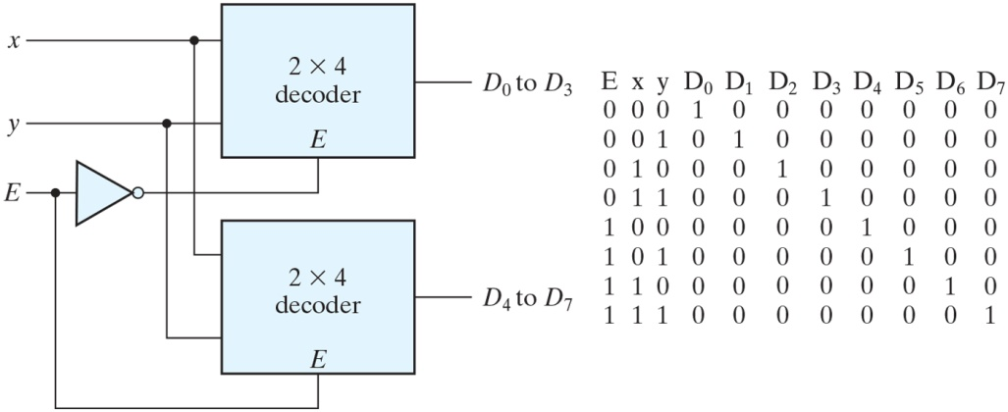
Figure PE4.8

Slide 32
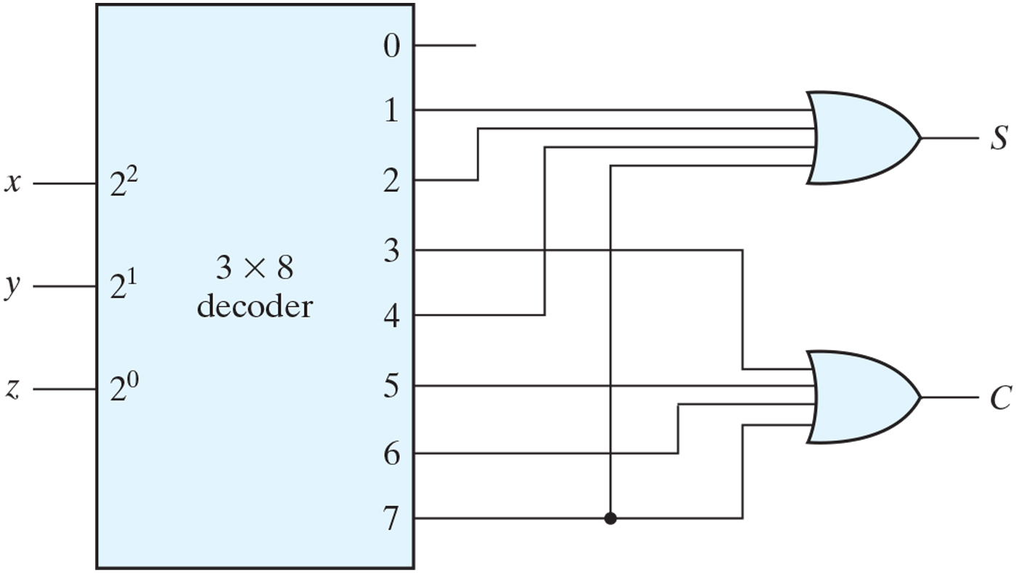
Figure 4.21 Implementation of a full adder with a decoder.

Slide 33
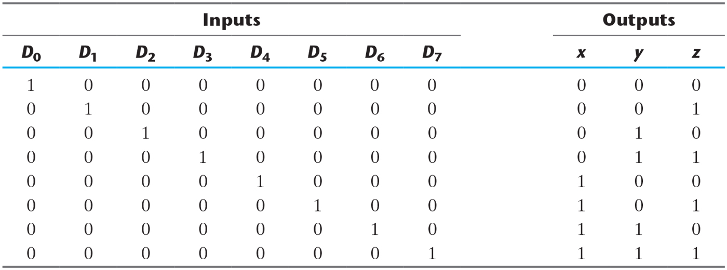
Table 4.7 Truth Table of an Octal-to-Binary Encoder.
Encoder :Inverse of 3-8 decoder
编码器

Slide 34
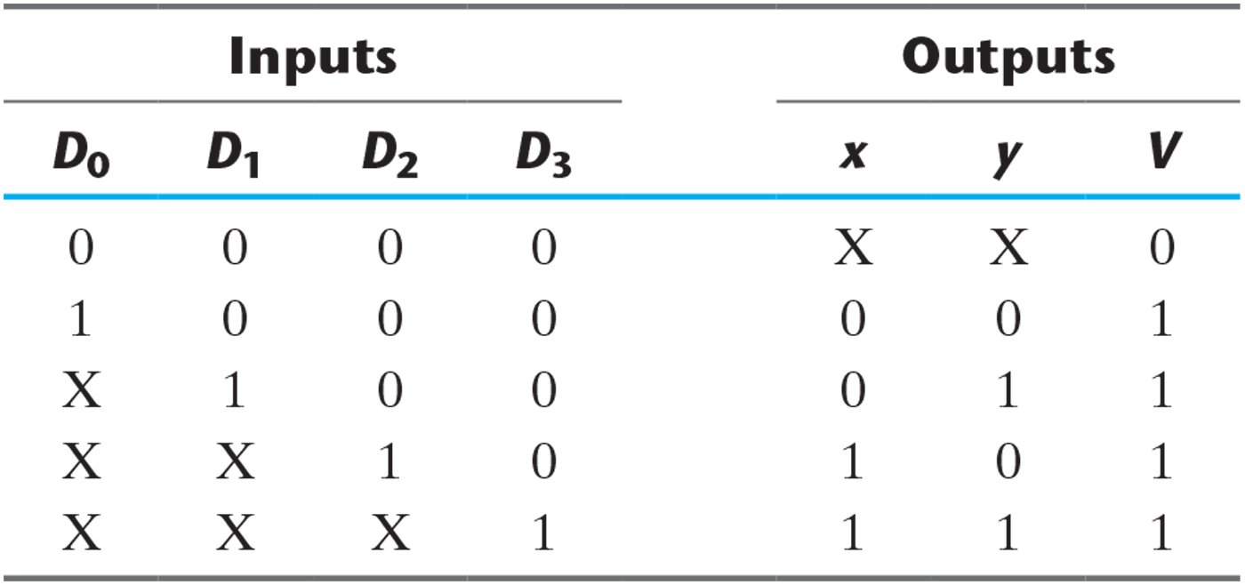
Table 4.8 Truth Table of a Priority Encoder.

Slide 35
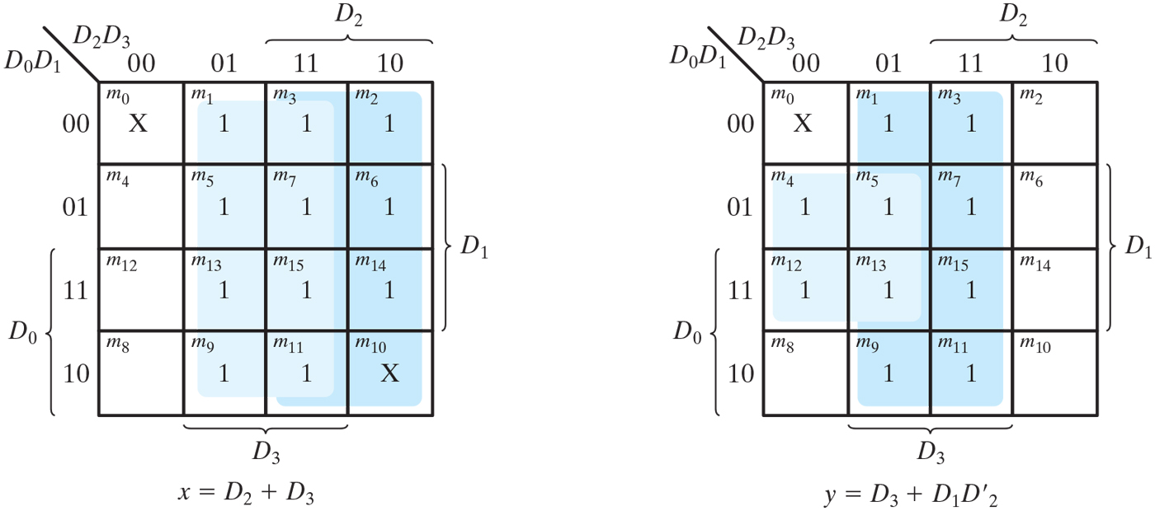
Figure 4.22 Maps for a priority encoder.

Slide 36
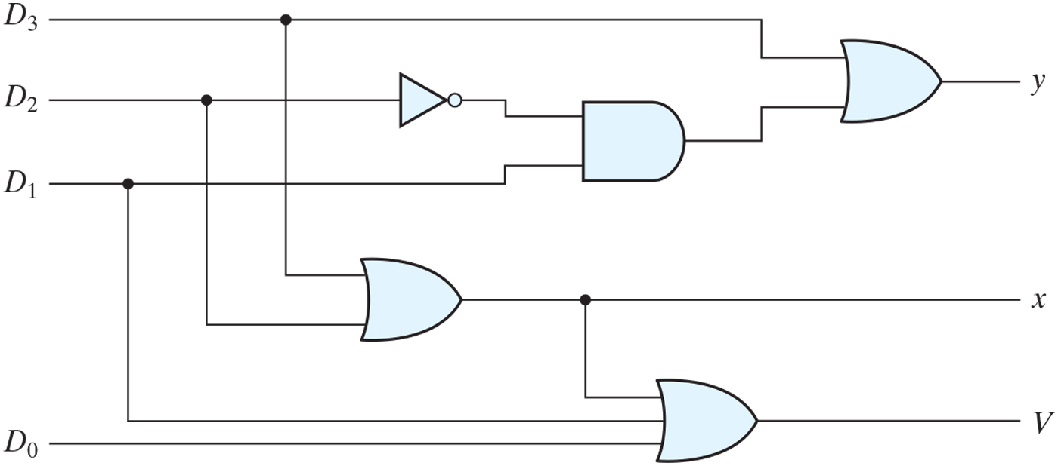
Figure 4.23 Four-input priority encoder.

Slide 37
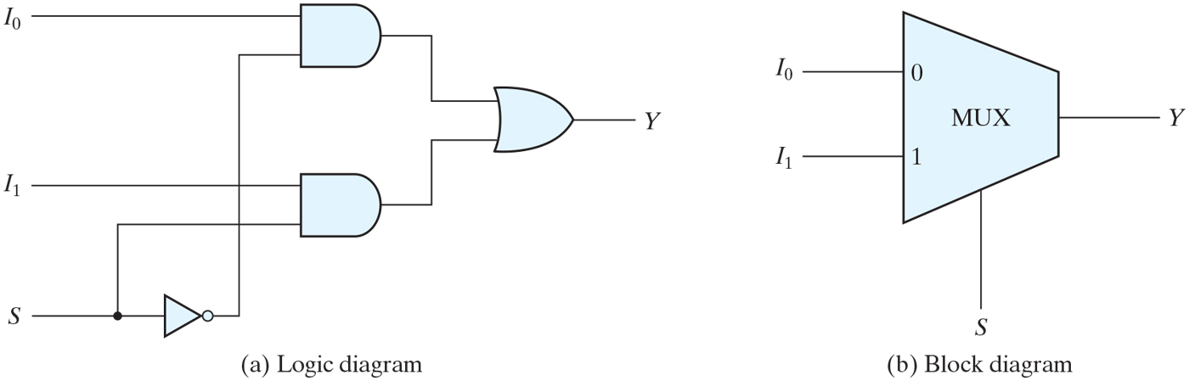
Figure 4.24 Two-to-one-line multiplexer.

Slide 38
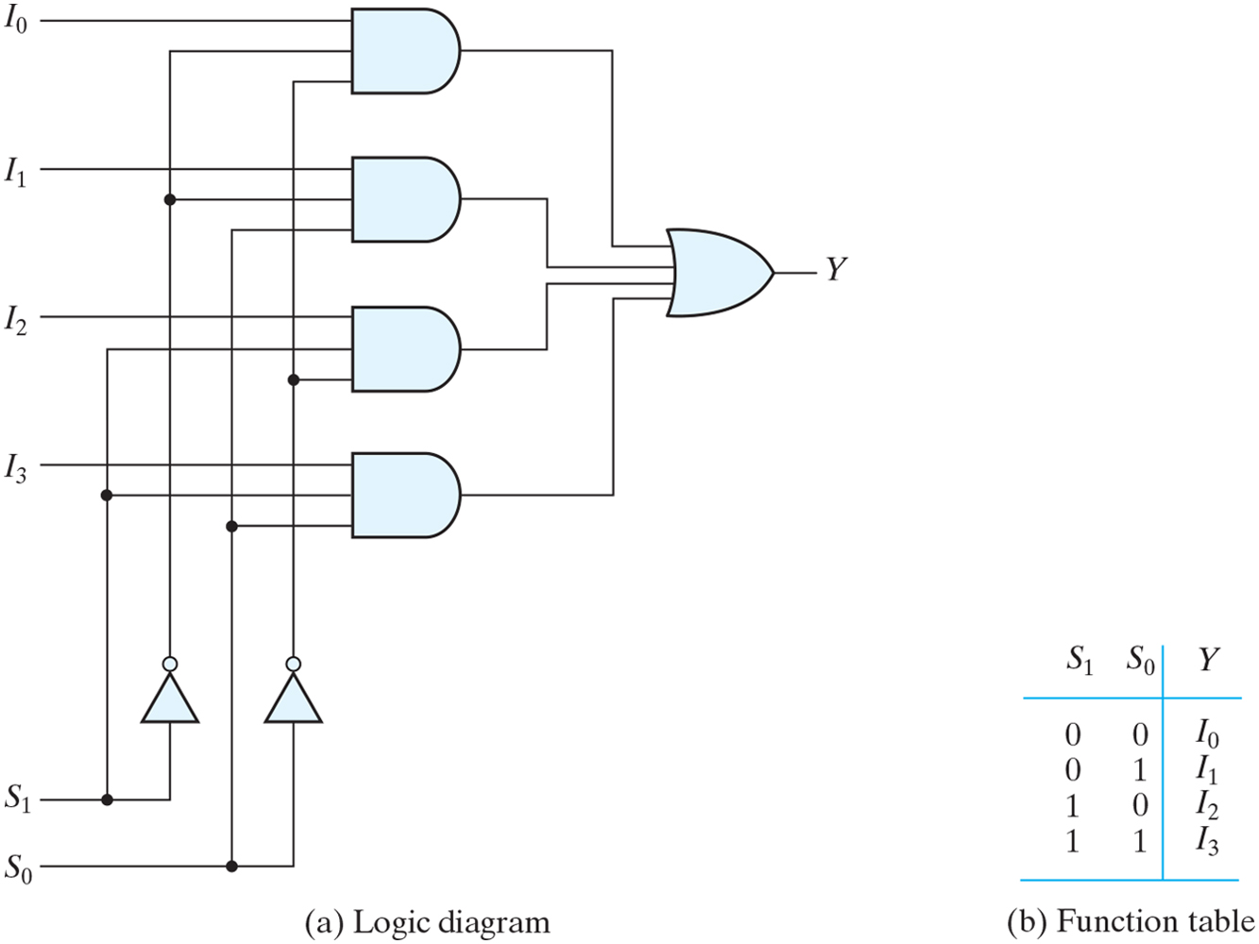
Figure 4.25 Four-to-one-line multiplexer.

Slide 39
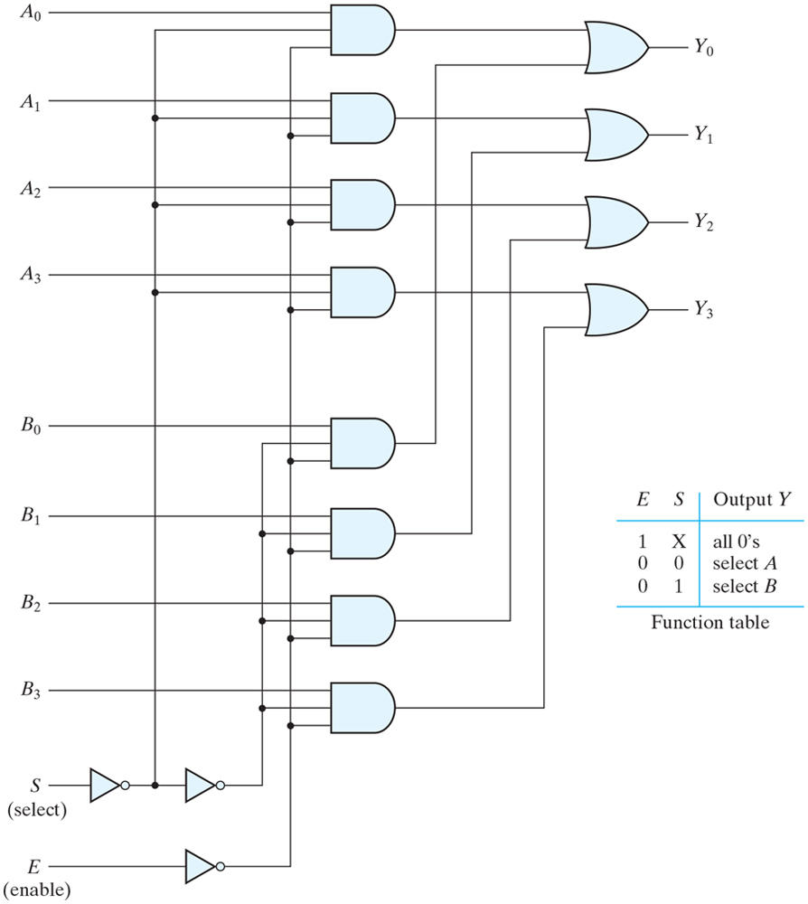
Figure 4.26 Quadruple two-to-one-line multiplexer.
4X 2-input multiplexer

Slide 40
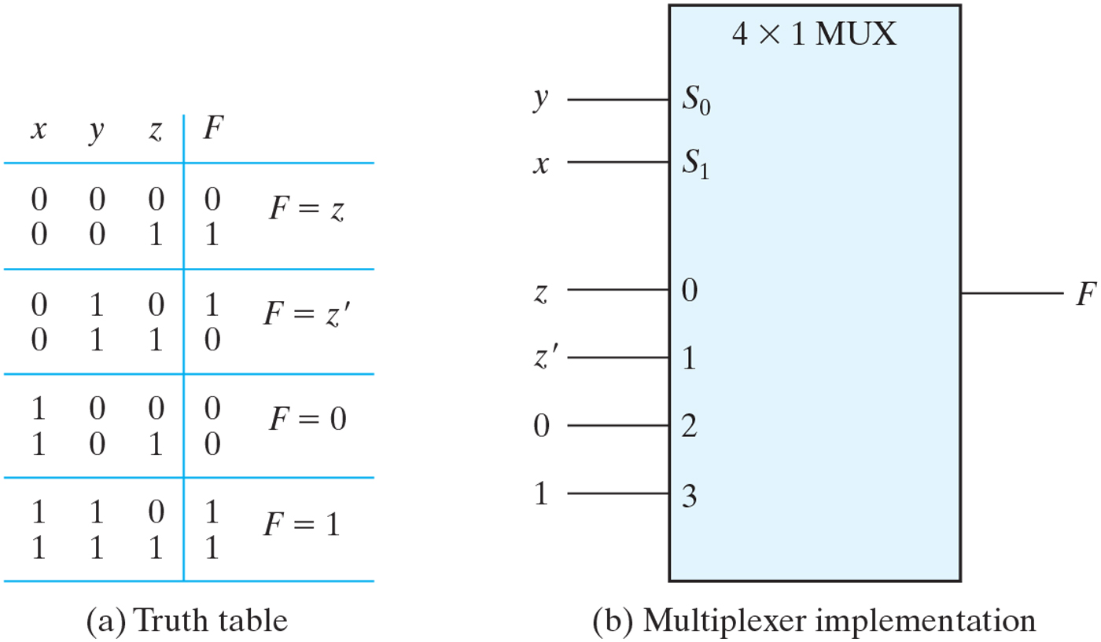
Figure 4.27 Implementing a Boolean function with a multiplexer.

Slide 41
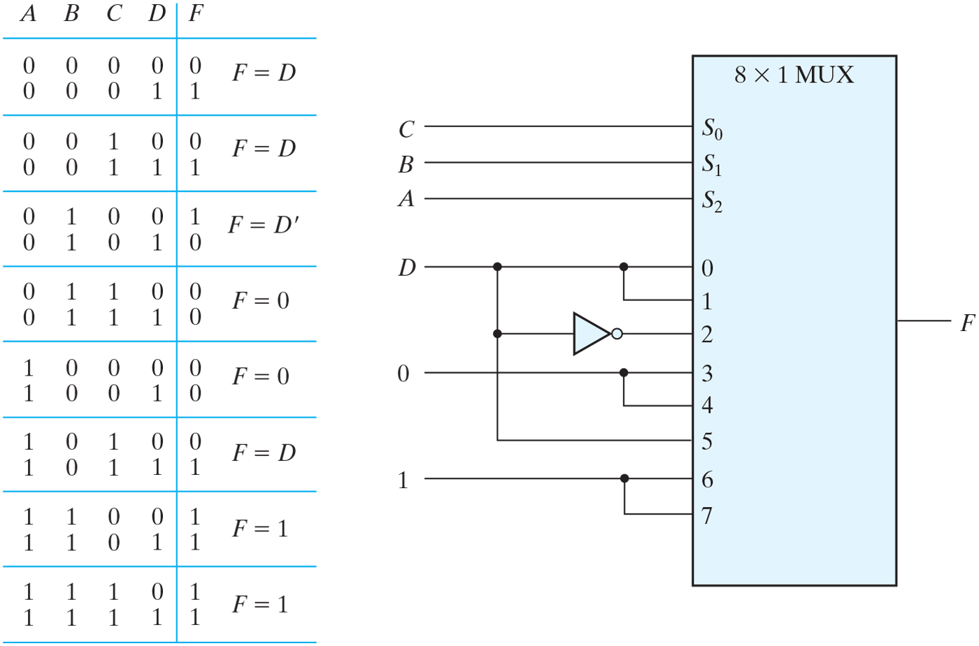
Figure 4.28 Implementing a four-input function with a multiplexer.

Slide 42
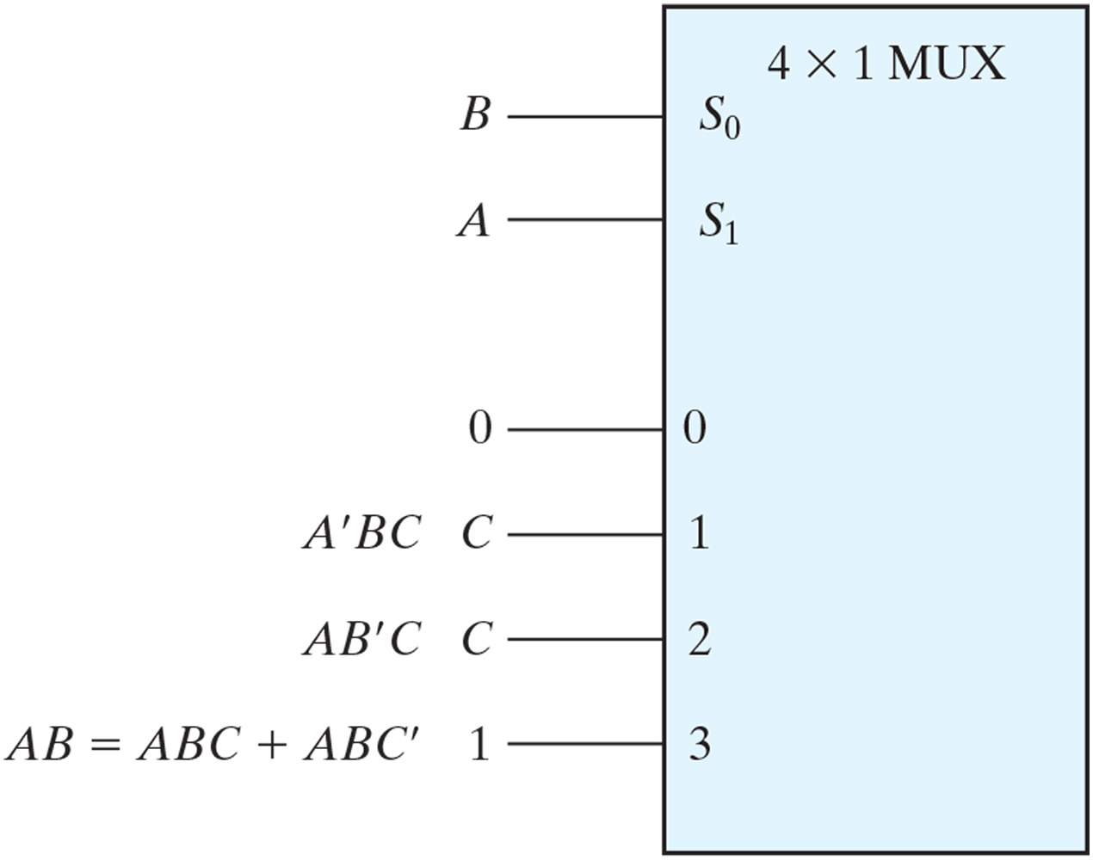
Figure PE4.9

Slide 43
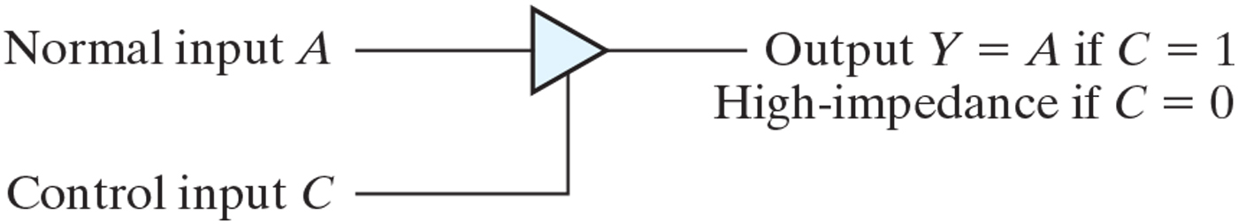
Figure 4.29 Graphic symbol for a three-state buffer.

Slide 44
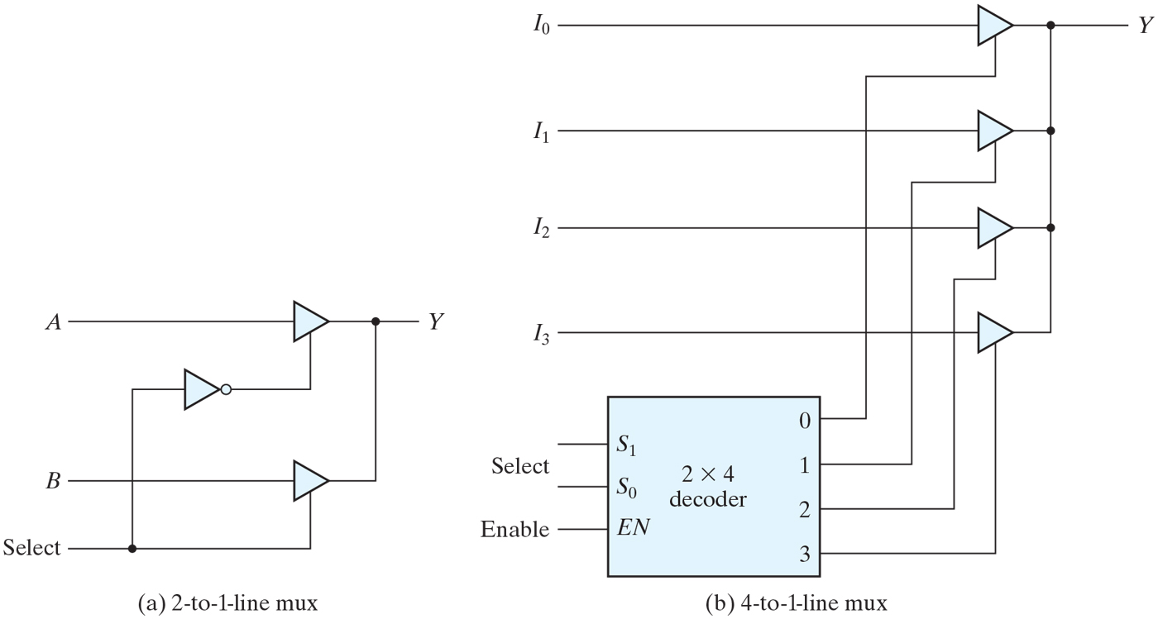
Figure 4.30 Multiplexers with three-state gates.

Slide 45
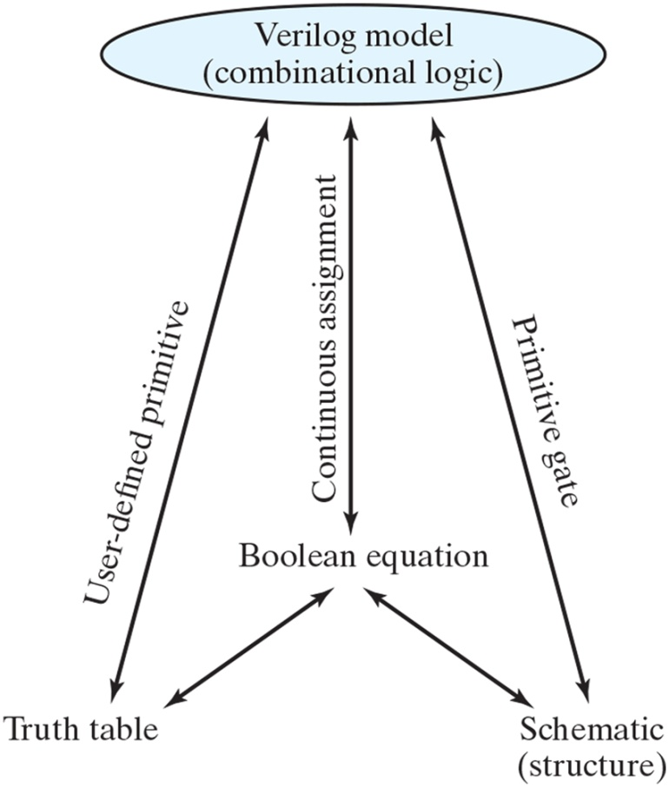
Figure 4.31 Relationship of Verilog constructs to truth tables, Boolean equations, and schematics.

Slide 46
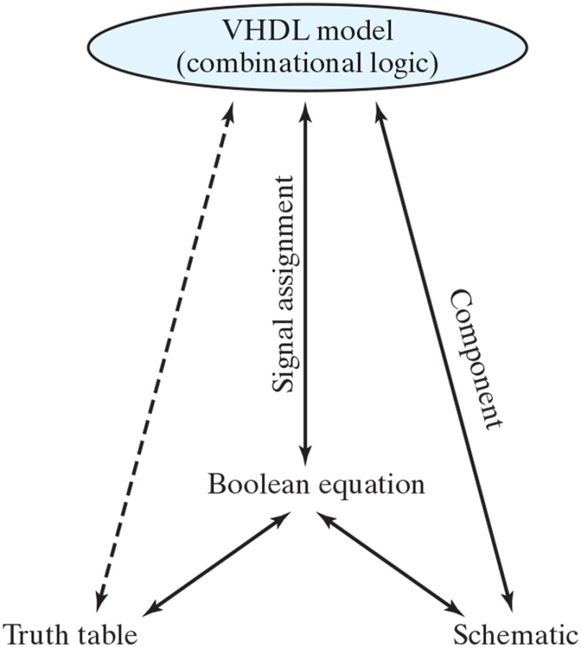
Figure 4.32 Relationship of VHDL constructs to truth tables, Boolean equations, and schematics three-state gates.

Slide 47
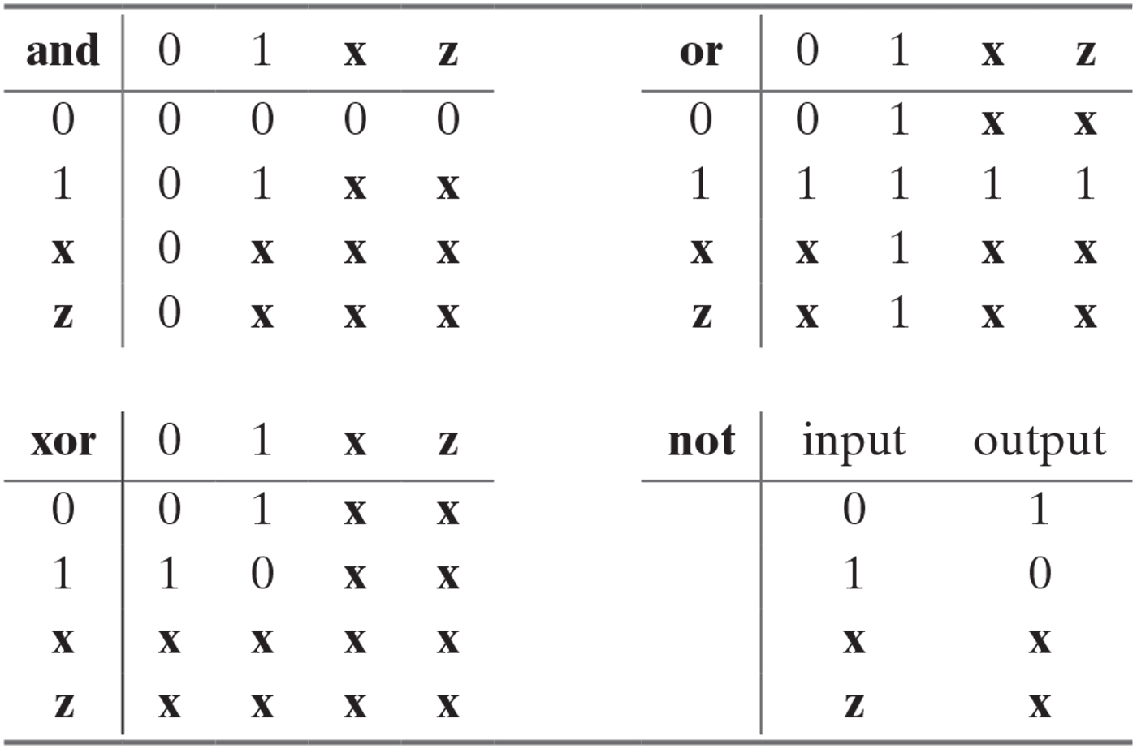
Table 4.9 Truth Table for Predefined Primitive Gates.

Slide 48
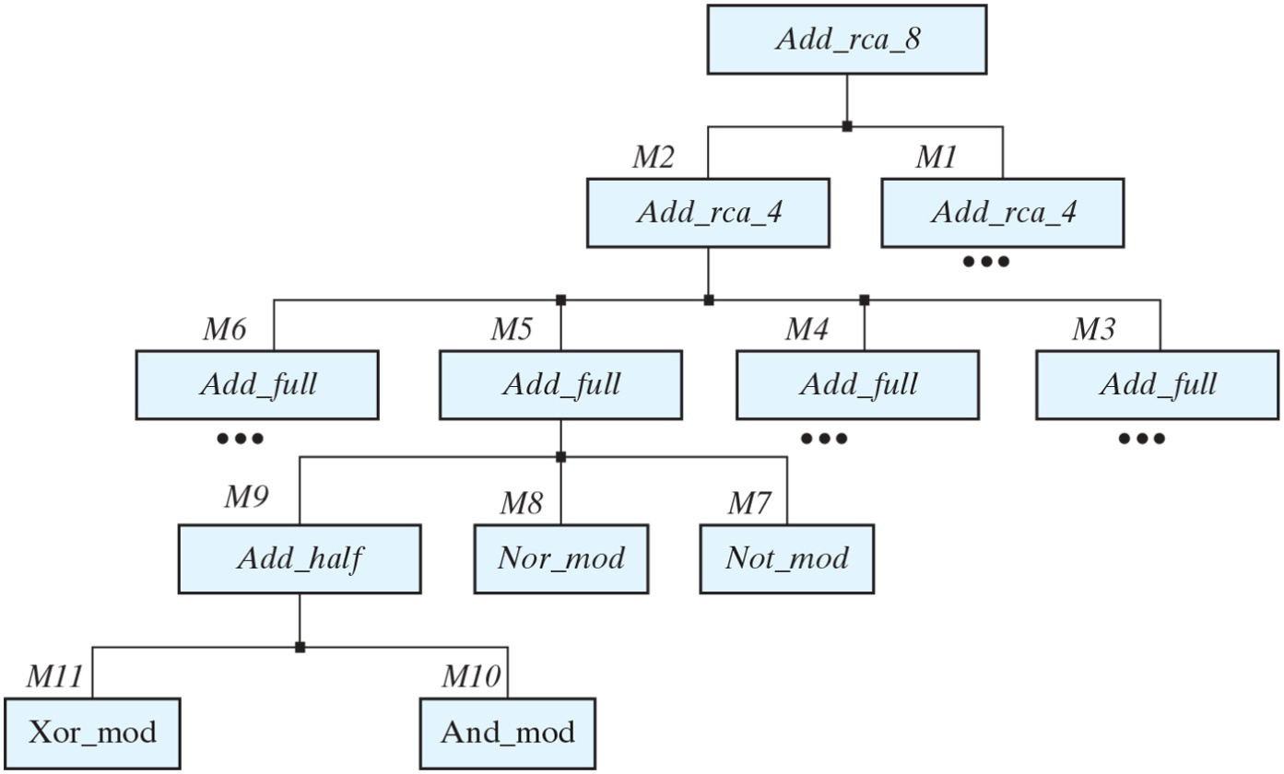
Figure 4.33 Design hierarchy of an 8-bit ripple-carry adder. For simplicity, some blocks are omitted where they replicate what is already shown.

Slide 49
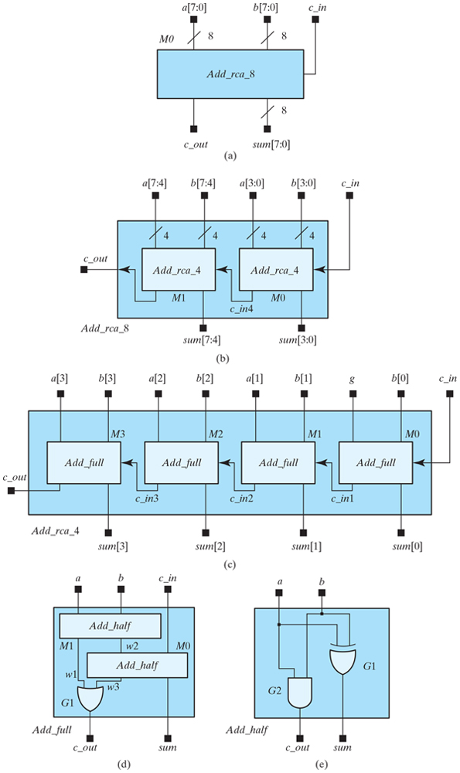
Figure 4.34 Decomposition of an 8-bit ripple carry adder into a chain of two 4-bit adders;⁹ each 4-bit adder consists of a chain of four full adders. The full adders are composed of half adders and one OR gate; the half adders are composed of logic gates.

Slide 50
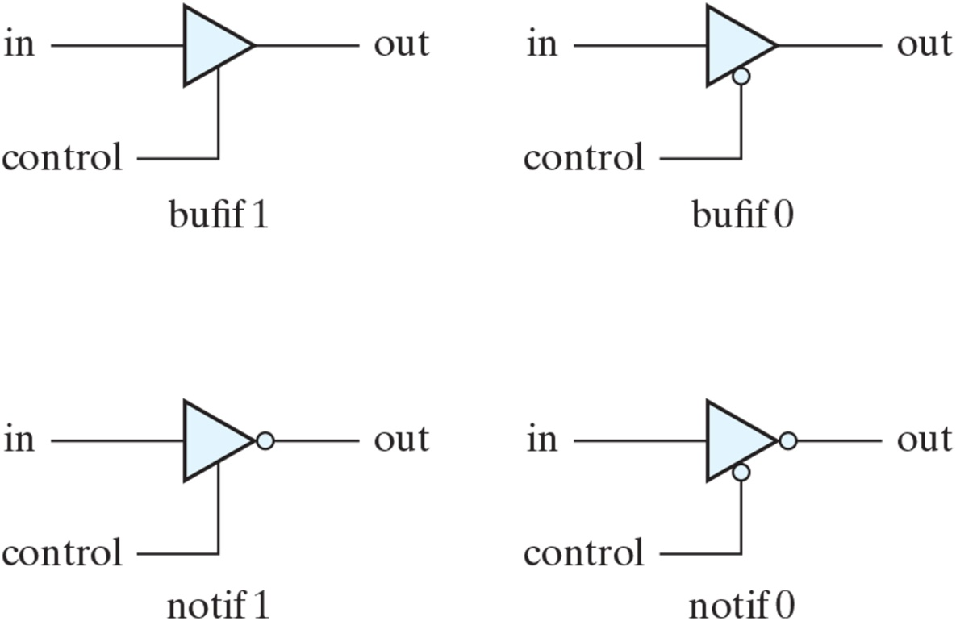
Figure 4.35 Three-state gates.

Slide 51
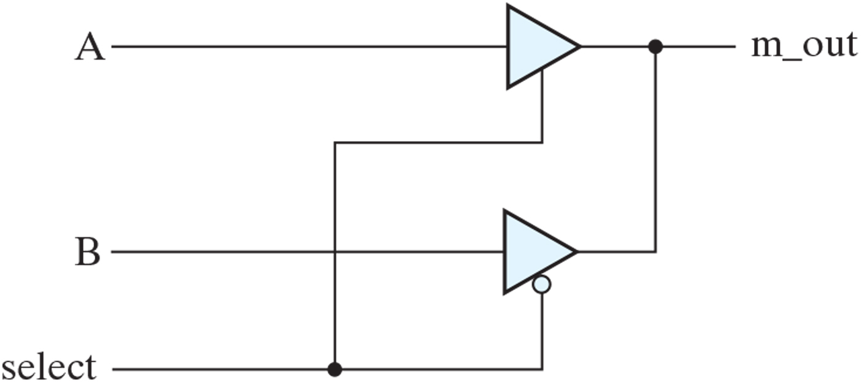
Figure 4.36 Two-to-one-line multiplexer with three-state buffers.

Slide 52

Table 4.10 Some Verilog Operators.

Slide 53

Table 4.11a SystemVerilog Assignment Operators¹⁵.
ignore

Slide 54

Table 4.11b SystemVerilog Increment/Decrement Operators.

Slide 55

Table 4.12 Predefined VHDL Data Types.

Slide 56

Table 4.13 VHDL Operators.

Slide 57

Figure 4.37 Interaction between testbench and Verilog design unit.

Slide 58

Figure 4.38 Interaction between testbench and VHDL design unit.

Slide 59

Figure 4.39 Circuit for event-driven simulation.

Slide 60

Figure 4.40 Representation of event-driven simulation (with zero delay).

Slide 61

Figure 4.41 Representation of event-driven simulation (with propagation delay).

Slide 62

FIGURE P4.1

Slide 63

FIGURE P4.2

Slide 64

FIGURE P4.9

Slide 65

FIGURE P4.16

