Slide 1

Predicting heart disease
using
machine learning

Slide 2


ABOUT Predicting heart disease
PRESENTATION
Dataset Description
Loading Dataset
Algorithem
Conclusion

Slide 3

Dataset Description
(1190, 12)

Slide 4
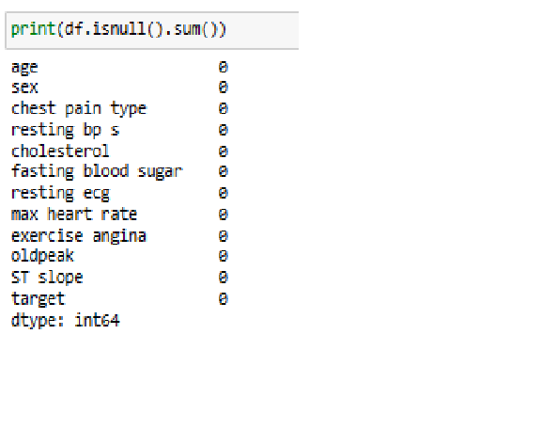
Dataset Description

Slide 5
Dataset Description
This dataset consists of 11 features and a target variable. It has 6 nominal variables and 5 numeric variables. The detailed description of all the features are as follows:

Slide 6
Features
resting ecg: Result of electrocardiogram while at rest
Age: Patients Age in years .
max heart rate: Maximum heart rate achieved
Sex: Gender of patient
(Male - 1, Female - 0) (Nominal)
exercise angina: Angina induced by exercise 0 depicting NO 1 depicting Yes
Chest Pain Type: Type of chest pain experienced by patient categorized into 1 typical, 2 typical angina, 3 non- anginal pain, 4 asymptomatic
oldpeak: Exercise induced ST-depression in comparison with the state of rest
resting bp s: Level of blood pressure at resting mode
ST slope: ST segment measured in terms of slope during peak exercise 0: Normal 1: Upsloping 2: Flat 3: Downsloping
cholestrol: Serum cholestrol
fasting blood sugar: Blood sugar levels on fasting > 120 mg/dl represents as 1 in case of true and 0 as false
target: It is the target variable which we have to predict 1 means patient is suffering from heart risk and 0 means patient is normal

Slide 7
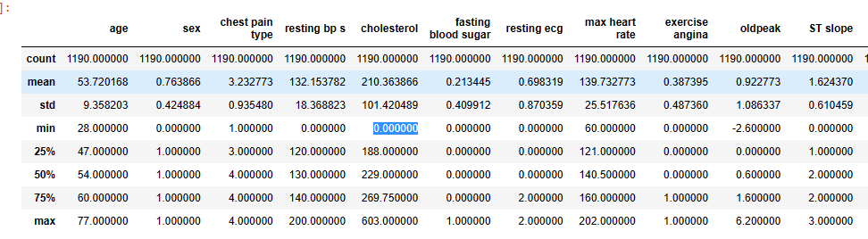
Describe The Data

Slide 8
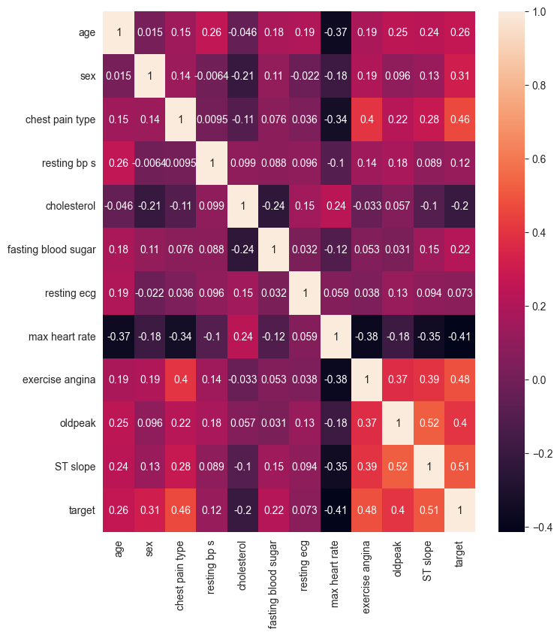

Slide 9
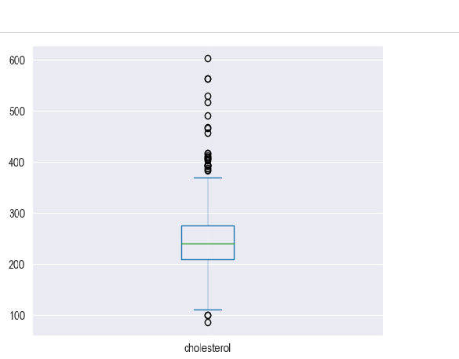
Outliers Analysis using BoxBlot

Slide 10

XGB Classifier
Logaistic regreision
Decision Tree
SUPPORT
VECTOR
MACHINE (SVM)
Naïve bays
Random Forest

Slide 11
Evaluate the model
Gradient decent foe svc
RandomizedSearchCV, GridSearchCV

Slide 12
Support Vector Algoriyhem :​
Accuracy score of the training data : 0.9977272727272727​
​
​
Accuracy score of the test data : 0.9090909090909091

Slide 13
Logistic Regression:​​
Accuracy score of the traning data :0.616161
​Accuracy score of the test data :0.595959

Slide 14
XGB Classiffier :
Accuracy score of the training data : 1.0 ​
​
​
​
Accuracy score of the test data : 0.9090909090909091

Slide 15
Decision Tree Classifier :​
Accuracy score of the training data : 1.0
​ ​
the accuracy = 0.9141414141414141

Slide 16
Random Forest Classifier :​
Accuracy score of the training data : 1.0 ​
​
​
Accuracy score of the test data : 0.919191919

Slide 17
Naive Bayes Algorithm :​
Accuracy score of the training data : 0.827020202020202
Accuracy score of the test data : 0.8484848484848485

Slide 18
Conclusion ​
As we have seen, stacked XGB and SVM of power machine learning algorithms resulted in
higher performance than any individual machine learning model.

Slide 19

TEAM Project
Aseel Iyad
Alaa zaid
Ikhlas adely

