Slide 1
ENCS4320 · APPLIED CRYPTOGRAPHY
SecureVault
A multi-user encrypted document exchange system built on an untrusted server
PART 1
PART 2
PART 3
Accounts, key hierarchy, RSA-PSS, HMAC and HKDF
Formats, ChaCha20-Poly1305, transport, client and server
P-256 and ECDH, sharing, TOFU, freshness
Birzeit University · Faculty of Engineering and Technology
Aseel Hamed 1231891
Ru’a Othman 1230014
Yaqeen Salameh 1230011
Notes:
One line on the goal: people keep documents on a server they do not trust and can still share them. Name the three parts in the order they will be presented.

Slide 2
OVERVIEW
02
The problem, in one story
Everything in the design exists to make this story safe
01
02
03
04
Layla signs up
She uploads a file
She shares it with Omar
Omar opens it
A password she chooses, on her own machine
The server stores encrypted contents and can see required metadata
She names him; the system wraps a key for him
Omar verifies Layla's share, then decrypts the document
The threat story
What we built
The server stores every byte and must not read document contents
A network attacker can modify or replay any message
The server database may be stolen in full
A command-line client and a server process
A shared_network directory standing in for the network
Every message is a file you can open during the demo
The boundary, stated once
The specification allows a simulated network. We use a shared directory so the message flow is visible during the demo. Security does not depend on trusting the transport; the protected objects carry their own authentication.
Notes:
Four steps, then the two blocks. Present the simulated network as a choice with a reason, not as something missing.

Slide 3
OVERVIEW
03
Threat model
Who we defend against, and what we deliberately do not
PARTY | WHAT WE ASSUME THEY CAN DO
Users | Run our client on a trustworthy machine. An attacker cannot read an honest user's memory or disk.
The server | Honest-but-curious: follows the protocol, never fabricates or deletes, reads everything it is given, and its whole database may be stolen.
The attacker | Observes and modifies all traffic, replays old messages, registers their own accounts, and may hold a full copy of server storage.
Out of scope, deliberately
Why we can say that
Malware on a user's own machine, and coercion of a user
Traffic analysis of message sizes and timing
Denial of service
These are the four the specification places out of scope. Naming them keeps every later claim precise: when we say something is protected, we mean against the attacker in the table above.
The sentence that settled every later decision
The server is not a party we protect from outsiders it is one of the parties we protect the user from. Whenever we had to decide where a value may live, that sentence decided it: if the server does not strictly need it, the server does not get it.
Notes:
Stress the last row of the table: a full copy of server storage is in scope, and that drives Decision 7.1 and one of our stated limits.

Slide 4
OVERVIEW
04
Required property → mechanism
The seven guarantees named in the specification, and where we provide each
PROPERTY | MECHANISM | PART
Confidentiality | ChaCha20-Poly1305, fresh 32-byte key per document; the server never receives a key | 2
Integrity | The Poly1305 tag is checked before any plaintext is produced | 2
Origin authentication | RSA-PSS signature by the sender over the share object | 3
Non-repudiation | The same signature , it covers the key grant, not yet the document bytes | 3
Credential protection | Argon2id at a measured work factor, fresh 16-byte salt per account | 1
Freshness | One-time challenges and request IDs; sequence numbers and timestamps on shares | 1, 3
Metadata binding | Every cleartext field sits in the AEAD associated data or the signed bytes | 2, 3
How they fit together
The row we will not gloss over
Confidentiality and integrity come from one operation, so the order-of-operations mistake the specification warns about cannot occur
Metadata binding is not a separate mechanism — it is what the associated data is for
Freshness appears twice because replay looks different at each layer
Non-repudiation is the one property we do not fully deliver. Our signature proves who authorised a key for a document; it does not commit the sender to that document's bytes. We found this ourselves, we can demonstrate it, and Decision 7.5 explains why a MAC could never have given it either.
Notes:
This is the map for the whole talk. Point at the Part column so the audience knows who answers what, and raise the non-repudiation row yourselves.

Slide 5
OVERVIEW
05
How the work splits, and what holds it together
Three connected parts, one shared contract
PART 1
PART 2
PART 3
Accounts
Application and AEAD
Sharing
RSA-3072 and RSA-PSS
HMAC-SHA-256 and HKDF
Argon2id account values
Registration, login, sessions
Private-key wrapping and recovery
SHA-256
ChaCha20, Poly1305, AEAD
Byte-level object formats
Shared-directory transport
Client and server dispatch
P-256 arithmetic and ECDH
Trust-on-first-use fingerprints
Share creation and recovery
Freshness and replay checks
Persisted trust and freshness state
The contract all three parts share
The byte-level object formats, one definition of a public-key fingerprint, and the exact bytes every AEAD tag and every signature covers. If any of the three drifts, verification fails silently which is why the interfaces are documented in docs/account_interfaces.md and tested across module boundaries, not only inside each module.
And it did drift once
We had an integration bug where two parts hashed different byte layouts for the public-key fingerprint. We fixed it by making both sides hash the same canonical PublicKey encoding, and we kept a cross-boundary test to prevent the definitions from drifting again.
Notes:
The shared-contract block shows the team worked as one system rather than three folders. The drift line sets up slide 17.

Slide 6
PART ONE
Accounts and key hierarchy
From one password to account records, sessions and key recovery
01
02
03
Password derivation and Decision 7.1
Registration and login
Sessions, password change, evidence
06

Slide 7
PART 1 · ACCOUNTS
07
Part 1 — password derivation
One password becomes two separated secrets
01
02
03
04
Password
Argon2id
Two HKDF labels
Two 32-byte outputs
UTF-8 string; never leaves the client
16-byte salt · 128 MiB · t=3 · p=1
securevault:v1:auth and securevault:v1:wrap
auth value and wrap key
Decision 7.1 — what we rejected
Why split with two labels
What a change breaks
PBKDF2 and bcrypt: not memory-hard enough for our threat model
scrypt: considered; Argon2id is the current recommendation
Parameters chosen by measuring eight candidates; median closest to 0.25 s was 0.2301 s
The auth side may be stored on the server
The wrap side must never reach it
Distinct HKDF labels mean knowing the stored value tells you nothing about the wrapping key
The wrap key changes, so the bundle is re-wrapped
The verifier changes, so every live session key dies
Both happen in one transaction; the identity keys are never regenerated
What a stolen credential store is worth — 8-character alphanumeric, 62⁸ ≈ 2.18 × 10¹⁴ candidates, half that on average
3 hours
≈4,100 years
800,000 years
Still weak
with a bare SHA-256, on one high-end GPU the design we rejected
illustrative 24 GB GPU estimate: 128 MiB allows about 190 parallel guesses
on a single CPU core at our measured 0.2301 s
a password from a common word list falls in days the space collapses, not the hash
Notes:
If asked how we arrived at the numbers: half of 62^8, divided by guesses per second, where a GPU's guesses per second is bounded by memory — 24 GB over 128 MiB, each taking 0.2301 s. Order of magnitude for one plausible attacker, not a guarantee.

Slide 8
PART 1 · ACCOUNTS
08
Part 1 — registration and login
The server can verify access without ever receiving private material
Registration
What never crosses the boundary
Client derives auth and wrap values with a fresh salt
Client generates the RSA-3072 and P-256 identity keys
Server stores Credential, PublicKey and WrappedPrivateKey in one transaction
The password, and the Argon2id output
The wrap key
The auth value itself — only its SHA-256 is stored
Any private key in the clear
Login
The account that does not exist
begin_login returns a one-time challenge, the salt and the parameters
The client derives the login key and answers with an HMAC over the whole transcript
The transcript binds the challenge, the salt and the Argon2 parameters, so they cannot be downgraded in transit
The wrapped private key is released only after the response is accepted
A stable dummy salt from HMAC(server secret, user ID), so repeated probes see the same salt
A dummy key, so the server does the same work either way
One external message for every failure: Authentication failed
The challenge is consumed on the first finish attempt, pass or fail
Evidence for both halves
Atomicity: interruption tests kill a child process at each write boundary; after restart, the database contains either no account or a complete one. Timing: wrong-password and unknown-user attempts are compared under the same conditions — evidence, not proof of no leakage.
Notes:
If asked why the dummy salt must be deterministic: if it changed on every attempt an attacker could tell a real account from a fake one just by asking twice.

Slide 9
PART 1 · ACCOUNTS
09
Part 1 — sessions, password change and evidence
Every sensitive request is authenticated on its own
Sessions
Password change
Tests
Session key = HKDF(login key, session ID), derived on both sides and never sent
Each request carries a fresh request ID and an HMAC over operation, payload and identity
The server takes the identity from its own session record, not from the request field
Accepted request IDs are stored, so a captured request cannot be replayed
The old password must unwrap the current bundle — a stolen session is not enough
Fresh salt and new wrap key; the same identity keys re-wrapped
Compare-and-swap, so a stale concurrent change is refused
Every session for that user is invalidated in the same transaction
237 tests passed in the complete pytest suite
RFC 4231 and RFC 5869 vectors, plus reference-library cross-checks
Interruption at every write boundary
Verified directly, not assumed
The limit we accept: a stolen credential store
After a password change the recovered bundle is byte-identical to the original and the public fingerprint is unchanged. That is what lets a trust relationship established before the change keep working afterwards — and it is why Part 3 can pin a key at all.
Our login is an HMAC challenge-response keyed by the stored verifier. An attacker holding a copy of the store can answer any challenge and sign in as any user without recovering a password — a stolen store is sufficient for impersonation, not merely helpful.
Why we did not simply fix it
Because login is a symmetric HMAC proof, the server must store a verifier it can use to check responses. That protects the password and wrap key, but a stolen verifier can still impersonate. A stronger version would sign the login transcript with the user's RSA key; we identified it but did not finish it.
Notes:
Do not soften the stolen-store limit. State it, then give the structural reason. An acknowledged limit with a diagnosis scores; a vague one invites the question you cannot answer.

Slide 10
PART TWO
Formats, AEAD and transport
The byte contract every other part depends on, and the path a document actually travels
01
02
03
Shared object formats
Decision 7.2 and the AEAD
Decision 7.6, transport and evidence
10

Slide 11
PART 2 · FORMATS
11
Part 2 — shared object formats
Five records, one parsing discipline
OBJECT | TYPE | FIELDS, IN ORDER
Credential | 1 | user ID, salt (16), Argon2 parameters (20), stored verifier (32)
PublicKey | 2 | user ID, P-256 point (65), RSA modulus (384), exponent (3)
WrappedPrivateKey | 3 | user ID, nonce (12), ciphertext, tag (16)
Document | 4 | document ID (16), owner, filename, MIME type, size, timestamp, nonce, ciphertext, tag
Share | 5 | document ID, sender, recipient, both fingerprints, sequence, timestamp, ephemeral point, wrapped key, signature (384)
Parsing rules
Canonical encoding
Why this matters
A version byte and a type byte open every object
Variable fields carry a 4-byte length prefix
Crypto fields are fixed width, with a ceiling checked before anything is decrypted
Truncated input, trailing bytes and a wrong type are refused
RSA integers inside the wrapped bundle are stored in minimal form
The parser rejects a leading zero byte
Otherwise one key would have several valid encodings — and anything that hashes or signs an encoding would give two answers for one key
If field order, sizes, signed bytes or AAD bytes differ between modules, verification fails silently
A wrong constant fails on the first vector; a wrong field order only fails when two people who tested separately try to talk
One number worth quoting
A wrapped private-key bundle is at most 1282 bytes, and that ceiling is enforced before decryption — a malformed length prefix cannot become a large allocation.
Notes:
If asked why the version and type bytes sit inside the authenticated data: so an attacker cannot re-label one object as another.

Slide 12
PART 2 · AEAD
12
Part 2 — document encryption
Decision 7.2 : protect the contents and bind the metadata
01
02
03
04
Read the file
Fresh key and nonce
AEAD encrypt
Store the object
Plaintext stays on the client machine
32-byte key and 12-byte nonce from the OS
Metadata goes into the associated data
The server holds ciphertext and tag, and no key
Why ChaCha20-Poly1305
How nonce reuse is prevented
Metadata binding
Rejected AES-GCM: repeated nonces are dangerous, and from-scratch GF(2¹²⁸) multiplication is easy to get subtly wrong
A dedicated AEAD mode, so encryption and authentication are never composed by hand in the wrong order
Counter 0 gives the Poly1305 key; encryption starts at counter 1
Every document gets a freshly generated key, so each key encrypts exactly once and the question does not arise
For the wrapped private key, where one key may be used again, the nonce comes fresh from the OS
wrap_private_keys takes no nonce argument at all
Filename, MIME type, size, timestamp and owner stay readable by the server
All of them sit in the associated data
Change any one and the tag check fails, so the download is refused
Being straight about the current client
Document keys are saved locally wrapped under the user's wrap key. The command-line client still keeps active session material, the wrap key and recovered identity keys in a plain JSON file under client_local. This fits the trusted-client threat model for the demo; a production client should keep them in memory or protected OS storage.
Notes:
Name the plaintext local state yourselves. Doing so turns a finding into a limitation you already knew about.

Slide 13
PART 2 · TRANSPORT
13
Part 2 — transport, dispatch and storage
Decision 7.6 : a shared directory standing in for the network
01
02
03
04
client.py
transport.py
server.py
storage
commands and local state
shared_network inboxes
type byte → handler
SQLite for accounts; file storage for encrypted documents and shares
What the server cannot do
What it can still do
Delivery detail
Read a document — it has no key to try
Forge a share — it has no user's signing key
Recover a private key — the bundle is wrapped under the password
Refuse service, delete or reorder objects — out of scope by our threat model
See owner, filename, size and time, which is why those fields are authenticated rather than hidden
A message is written to a temporary file, then renamed
Readers never see partial messages
A deployed system would use a real authenticated channel
A weakness in the envelope, stated plainly
The reply address in a message envelope is not authenticated, so a network attacker can redirect a response to an inbox of their choosing. The one-time request identifier still blocks replay, and nothing in a redirected reply is usable without the password , the private-key bundle is still wrapped and the session key is derived on both sides rather than transmitted. Authenticating the envelope, not only the body, would close it. This is the one place the simulated transport shows through into the security argument, and we would rather name it than have it found.
Notes:
If asked whether the simulated network weakens the result: no mechanism above it depends on the transport being trusted. Then point straight at the envelope limitation as the exception.

Slide 14
PART 2 · EVIDENCE
14
Part 2 — evidence
Primitives against published vectors; plumbing tested end to end
Primitives, against published vectors
The application path
ChaCha20 block function — RFC 8439 §2.3.2 matches
ChaCha20 encryption — RFC 8439 §2.4.2 matches
Poly1305 — RFC 8439 §2.5.2 matches, including the empty-message case
Full ChaCha20-Poly1305 — RFC 8439 §2.8.2 ciphertext and tag both match
SHA-256 — agrees with a reference implementation
Parsers reject wrong headers, truncated fields and trailing bytes
A tampered tag or altered metadata fails before any plaintext is returned
A full-system runner executes the real Layla → Omar flow and tests replay, tampering and TOFU substitution
Two client directories keep separate identities through a server restart
What this proves, and what it does not
Library declaration for this part
It proves the primitives match known correct outputs rather than merely being self-consistent, and that the parts work together over the real path. It does not prove the absence of side channels, which we have not measured beyond the login timing check.
None. SHA-256, ChaCha20, Poly1305 and the AEAD construction are all written by the team. A reference library appears only inside test files, to compare our output against — never as the implementation.
The test that mattered most during integration
This caught a seam bug: changing the AEAD function signature could swap AAD and plaintext without a type error. The integration test caught the wrong result instead of letting a silent mismatch pass.
Notes:
The argument-order story shows judgement about what tests are for. Use it if asked how you know the implementation is correct rather than just consistent with itself.

Slide 15
PART THREE
Sharing, trust and freshness
Getting one document key from Layla to Omar over an untrusted server
01
02
03
Decision 7.3 and Decision 7.4
The share object
Freshness, replay and evidence
15

Slide 16
PART 3 · ECC
16
Part 3 — P-256 and ECDH
Decision 7.3 — public-key roles and matching security levels
WHERE | PARAMETER | LEVEL
Document and key wrapping | ChaCha20-Poly1305 | 256-bit key, 128-bit tag
Key agreement | P-256 (secp256r1) | ≈ 128-bit
Signatures | RSA-3072 with PSS | ≈ 128-bit
Hashing throughout | SHA-256 | 128-bit collisions
Why P-256, and why hybrid
A clearly published parameter set we could implement and check against known points
Cofactor 1, so an on-curve check is sufficient — no small-subgroup check needed
The document is encrypted once under a symmetric key; ECDH only wraps those 32 bytes
Sharing with a second person costs one more small wrap, not a second copy of the file
01
02
03
04
Ephemeral key
ECDH
HKDF
Wrap
Layla generates a one-time P-256 pair
Her ephemeral private key with Omar's public key
Derive the share-wrapping key
AEAD encrypts the 32-byte document key
Quantifying the ECC choice — size advantage, security match
Public key size is the clear advantage: a P-256 point is 65 bytes, while a 3072-bit finite-field value is 384 bytes (about 5.9× larger). We do not claim a speed win: our measured 52 ms for a P-256 scalar multiplication against 6 ms for a 3072-bit modular exponentiation is implementation-dependent, not an ECC result. The important point is that P-256, RSA-3072 and SHA-256 all target about 128-bit security, so no component is weaker than the rest.
Notes:
The speed result is a strength: the specification asked for a measurement rather than a claim, and we report what we measured including the part that does not flatter us.

Slide 17
PART 3 · TRUST
17
Part 3 — trusting a public key
Decision 7.4 — the server gives us keys, and the server is not trusted
What we chose
What the fingerprint covers
Why not a certificate authority
Trust on first use, with change detection
The first public key seen is pinned
Any later change is refused, not silently accepted
SHA-256 over the canonical PublicKey record — exactly the bytes the server stores
The user ID as well as both public keys, so a key cannot be moved to another identity
Changing either key, or the identity, changes the fingerprint
It moves the trust to the CA key
More code and more operational trust to defend
Trust on first use is simpler and testable inside this scope
The assumption, stated plainly
A real bug this slide exists because of
Trust on first use is exactly as strong as the first contact. If the server substitutes a key before Layla and Omar ever interact, nothing detects it we only guarantee that the key never changes afterwards without a refusal. Closing that needs the users to compare fingerprints once, out of band; our client prints the fingerprint at login for exactly that.
Two parts of the project computed the fingerprint from different byte layouts. Each side agreed with itself, so all their tests passed but the value a user would compare out of band was not the value bound into a share. We found it only when we wrote a test that compared the two definitions directly.
What we did about it
One definition now: both paths hash the canonical PublicKey record. The cross-boundary test that exposed the split is kept in the suite it failed on the old build and passes on the fixed one, so the two definitions cannot drift apart again without something going red. The wider lesson is the one on slide 05: each part was well tested on its own, and the defect lived in the seam between them.
Notes:
This is the strongest evidence that the team tested across boundaries rather than only inside each module. Expect a question about how you kept three people's interfaces consistent — this is the answer.

Slide 18
PART 3 · SHARING
18
Part 3 — sharing a document key
Encryption and signing do two different jobs
01
02
03
04
Ephemeral key
ECDH and HKDF
Wrap
Sign
A one-time P-256 pair, so the sender's long-term key never touches the agreement
Derive a wrapping key only Omar can reproduce
AEAD over the document key, all share metadata in the associated data
RSA-PSS over the share's signed bytes
Omar's side, in order, each check stops before the next
Sender pinned?
Fingerprint matches?
Signature verifies?
Is it fresh?
Unwrap the key
Key mismatch
Key mismatch
Verification failed
Stale object
Then decrypt the document
Only three visible failures
Why the metadata is in the associated data
Key mismatch, Verification failed, Stale object. The recipient learns that something failed, not which field the attacker got wrong. A detailed error message is free information for whoever is probing.
Every field the share carries in the clear — both identities, both fingerprints, the sequence number, the timestamp and the ephemeral point — is inside the AEAD associated data and inside the signed bytes. Editing any of them breaks both checks.
Where Part 1 hands over
The sender's RSA signing key and the recipient's P-256 public key both come out of the identity bundle that login recovers — which is why a password change must not rotate those keys.
Notes:
Walk the five checks in order and say what each one stops. This slide answers 'alter one field of the metadata now and show us what happens'.

Slide 19
PART 3 · FRESHNESS
19
Part 3 — freshness, replay and evidence
An attacker who cannot forge can still re-send an old object
The freshness rule
What it stops
Evidence
State is kept per sender and per document
The sequence number must strictly increase
The timestamp may not move backwards
State is written to disk and survives a client restart
The same share delivered twice
An older share resurrected after a newer one
A captured share replayed after the client restarts
Both fields are inside the signed bytes, so neither can be edited in transit
237 tests passed in the complete pytest suite
P-256 known-point and ECDH agreement tests
Full-system replay, tampering and TOFU substitution tests
Attack cases covered by the tests
The honest edge of the rule
A wrong recipient cannot unwrap the key
Tampered metadata, sequence, signature, tag or wrapped key are all rejected
An untrusted sender and a changed fingerprint are rejected
A replay is rejected after the state has been saved and reloaded
The first share for a sender and document pair is always accepted, because there is nothing yet to compare it against. Replay protection begins at the second message; the first one is protected by the signature, not by freshness.
The gap we found in our own share object
We wrote an attack against ourselves: take a document received from Layla, keep the document key, and re-encrypt different contents under the same document identifier. Layla's original signature still verifies, because the signed bytes cover the identifier and the wrapped key but not the document bytes. So the share authenticates the key grant, not the content. Closing it is one 32-byte field, a SHA-256 of the Document object inside the signed bytes — and the next slide explains why that matters for a named requirement.
Notes:
If the document hash has landed before the presentation, change this block to say it is closed and show the test that fails on the old build and passes on the new one.

Slide 20
CLOSING
20
Decision 7.5 — MAC or signature
Where each tool belongs, and what each one can prove
PLACE | MECHANISM | WHY THAT ONE
Document and key encryption | Poly1305 tag inside the AEAD | Both sides hold the same key; nothing needs proving to a third party
Login response | HMAC-SHA-256 over the transcript | The server holds the verifier and only has to satisfy itself
Session requests | HMAC with a per-session key | Same reason, and a signature per request would be far more expensive
Sharing a document | RSA-PSS signature | Omar may have to convince someone who was not there — only a signature can do that
Why a MAC can never give non-repudiation
Where our signature stops short
Verifying a MAC requires the same key that produced it
So the verifier could have produced the tag themselves
A third party cannot tell the two apart, and no tag length changes that
This is why sharing is the one place we pay for a signature
It proves Layla authorised a key for a document identifier. It does not commit her to that document's bytes, so a recipient who already holds the key can substitute different contents and the signature still verifies. We provide data-origin authentication of the key grant; full content non-repudiation needs the document hash inside the signed bytes.
The answer we would give to the direct question
Ours proves the key grant; full content proof needs a document hash in the signed bytes.
Notes:
The specification's own list of likely questions points straight at this slide. Rehearse it, and be ready to be asked to demonstrate the substitution.

Slide 21
CLOSING
21
The complete flow, end to end
From starting the server to a verified document in Omar's hands
01
02
03
04
Start the server
Register
Log in
Open a session
It watches shared_network/server
Keys on the client; three records in one transaction
Challenge, Argon2id, HMAC, then key recovery
Request HMAC and replay protection
05
06
07
08
Upload
Share
Receive
Download
AEAD encrypt; the server stores ciphertext
Ephemeral ECDH wrap, then RSA-PSS signature
Pin, fingerprint, signature, freshness
Tag checked, then decrypt
Then we break it, on purpose
The boundary check
Flip one ciphertext byte → refused
Edit one metadata field → refused
Replay an old share → rejected as stale
Change the password → old sessions die, the same identity keys still work
Open the stored credential row and stored document → no password or plaintext
Crossing it: the three account records, encrypted documents, share objects, and one-time challenges and responses. Never crossing it: the password, the Argon2id output, the wrap key, the session key, any private key in the clear, and any document key. Two terminals, two client directories, one server process and every message on the wire is a file you can open mid-demo.
Notes:
Rehearse with the real commands. The four failure cases are demonstration items 6, 7 and 8, and they are the ones that go wrong live.

Slide 22
CLOSING
22
What we can show on screen
# | DEMONSTRATION ITEM | HOW WE SHOW IT
1 | Two users register and log in separately | Two client directories against one real server process
2 | The stored credential reveals no password or wrap key | Open the SQLite row: salt, parameters and stored verifier hash
3 | The server's stored document is unreadable | Open stored object: ciphertext + tag
4 | The second user downloads and opens it | The full share, receive and download path
5 | The recipient learns who produced it | RSA-PSS verification, with the caveat on slide 20
6 | One ciphertext byte altered → rejected | AEAD tag check, before any plaintext
7 | One metadata field altered → rejected | The metadata is inside the associated data
8 | An old object replayed → rejected as stale | Sequence number and persisted freshness state
9 | Every primitive verified live | RFC vectors for SHA-256, ChaCha20, Poly1305 and the AEAD, RFC 4231 and 5869 for HMAC and HKDF, known points for P-256, reference cross-checks for RSA-PSS
Item 9 deserves its own minute
Published vectors and reference checks show our primitives match known outputs, not only our own expectations.
Notes:
Keep this slide open during the demo if it helps; it maps one to one onto the specification's own table.

Slide 23
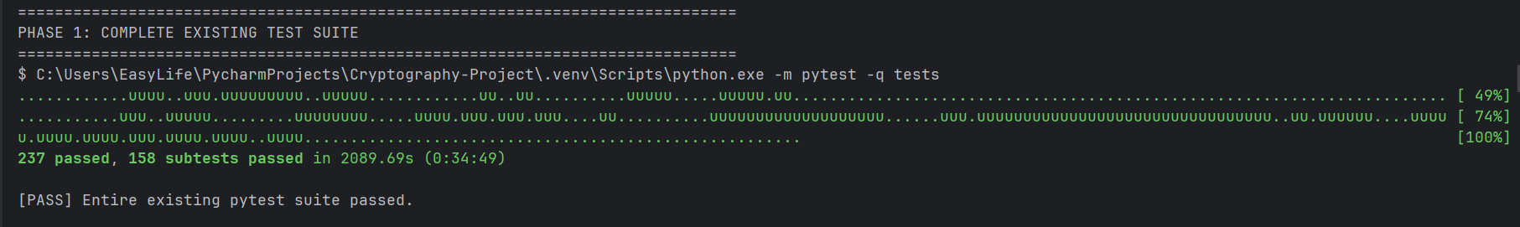
CLOSING · DEMO EVIDENCE
23
Demo evidence — full test suite
The complete pytest suite passed before the real application flow was executed.

Slide 24
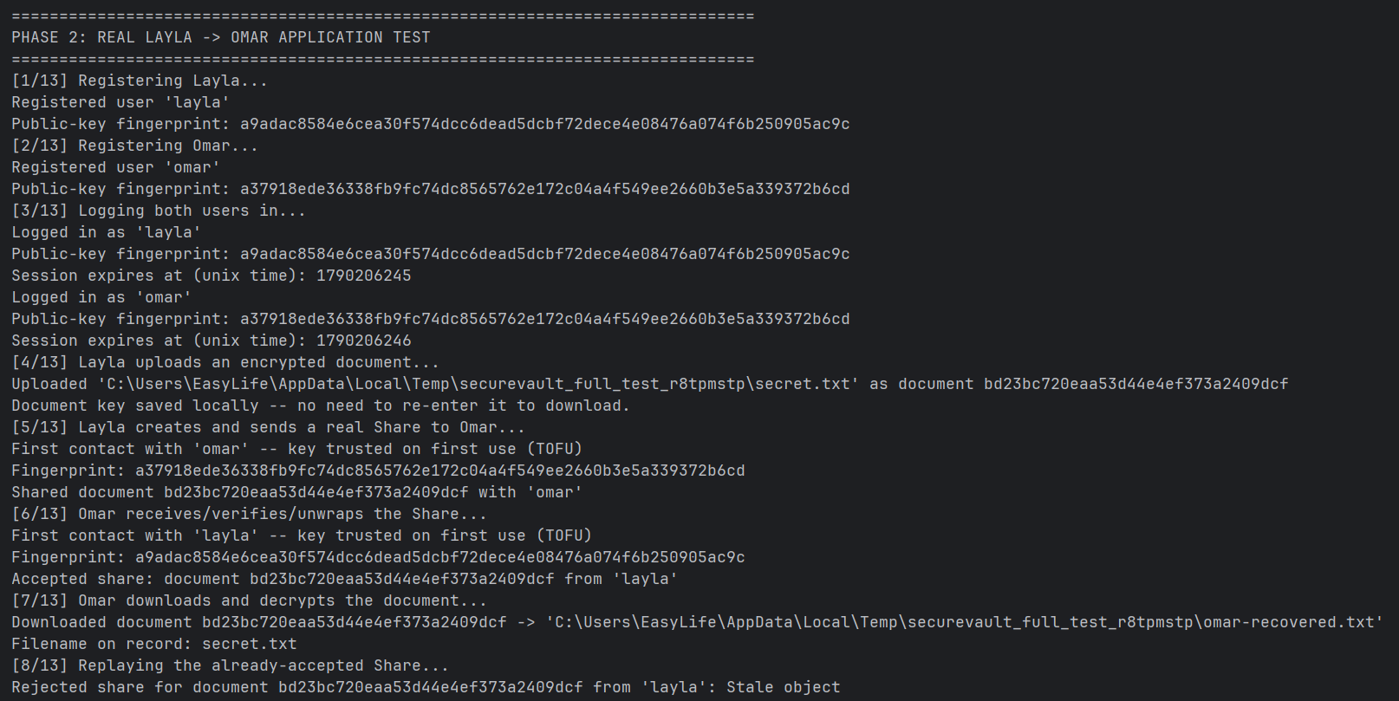
CLOSING · DEMO EVIDENCE
24
Demo evidence — real Layla → Omar flow
The real client and server complete registration, login, upload, share, receive and download.
This is the same flow as the live demo: two users, two client directories and one real server process.

Slide 25
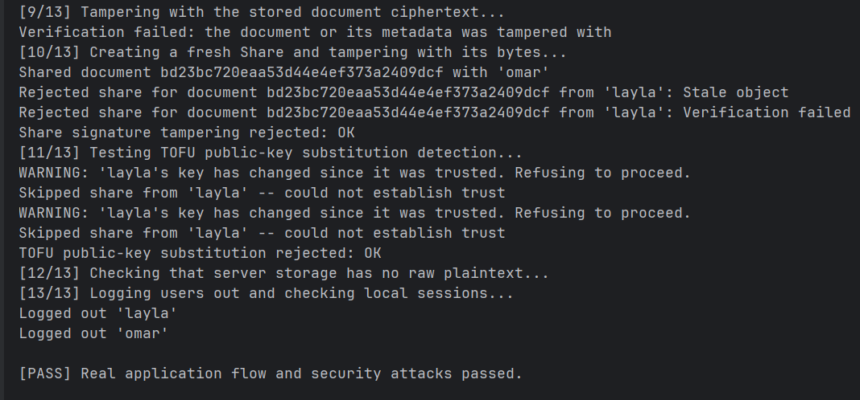
CLOSING · DEMO EVIDENCE
25
Demo evidence — attack cases rejected
Replay, document tampering, share tampering and TOFU key substitution are refused.
These outputs map directly to the required failure cases: tampering, replay, and public-key substitution.

Slide 26
CLOSING
26
Limitations and from-scratch declaration
What we implemented, what we used, and what stays outside this version
LIMITATION | WHAT IT WOULD TAKE TO CLOSE IT
A stolen credential store allows impersonation without recovering a password | An asymmetric login proof: sign the transcript, verify against the stored public key
The share signature does not commit the sender to the document contents | A 32-byte SHA-256 of the Document object inside the signed bytes
Trust on first use protects only after the first contact | Users compare fingerprints out of band once; the client already prints them
The reply address in a message envelope is not authenticated | Authenticate the envelope, not only the body
No rate limiting on login; challenges, sessions and request IDs are never pruned | A per-account attempt counter and a periodic cleanup
The client keeps the wrap key and recovered identity keys in a plain local file | Keep session values in memory or protected OS storage
Timing checked on one machine with a fixed tolerance; no wider side-channel analysis | Evidence, not proof — a larger sample on varied hardware
Written by the team, from scratch
Declared library use, and the closing line
SHA-256; HMAC-SHA-256; HKDF
ChaCha20; Poly1305; the ChaCha20-Poly1305 AEAD
RSA-3072 keygen, Miller-Rabin, MGF1, PSS signing and verification
P-256 arithmetic, keygen, point validation, ECDH
All object formats, the trust store, the share construction, the freshness rule
Argon2id through argon2-cffi, justified on slide 07: a memory-hard function that is slow or subtly wrong would weaken the exact property we chose it for. Big integers, OS randomness, SQLite, JSON, file handling and pytest are not cryptographic components. We implemented and tested the security path we designed, and we are naming its boundary rather than claiming there is not one two of the rows above are single-field fixes we identified ourselves.
Notes:
An honest limitations section earns marks and a claim of unconditional security loses them. Do not let anyone talk you out of a row.

Slide 27
SecureVault
Questions
ACCOUNTS
DOCUMENTS
SHARING
A password becomes two separated secrets, and the server holds only one of them
Encrypted under a key the server never receives, with the metadata bound to the ciphertext
A key agreement the server cannot join, and a signature it cannot forge
Thank you
Notes:
Close on the three themes, then invite questions on the two open gaps yourselves if nobody raises them.

