Slide 1

MoodCloset:
A Multi-Stage AI System for Personalized Outfit Generation
CLOTHING CLASSIFICATION, SKIN UNDERTONE DETECTION, AND MOOD-BASED RECOMMENDATIONS.
Presented By: Jumanah Al-Nahdi-Aseel Bajaber- Jwdee Alamam

Slide 2

Table of Content
01
05
Introduction & Problem Definition
Discussion, Limitations & Future Work
02
06
Methodology & Architecture
Live Demo & Q&A
03
Implementation Details
04
Results & Evaluation

Slide 3

Introduction and Problem Definition
The Gap in Fashion AI
• Existing fashion recommendation systems often rely solely on text-based preferences or purchase history.
• They fail to integrate crucial physical (Skin Undertone) and emotional (Mood) user variables.
• MoodCloset is a Hybrid AI System designed to fill this gap.

Slide 4
Introduction and Problem Definition
MoodCloset Solution: The Project Objectives
The system integrates Visual Classification, Color Science, and Psychological Mood Mapping to provide personalized recommendations. Our objectives are to:
1. Accurately Classify uploaded clothing items using deep learning.
2. Detect the user's skin undertone (Warm, Cool, Neutral).
3. Extract dominant colors from the item image.
4. Map user-selected mood to a suitable color palette.
5. Generate a complete, tailored outfit recommendation.

Slide 5
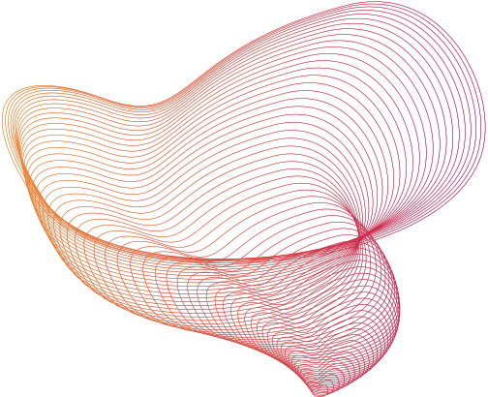
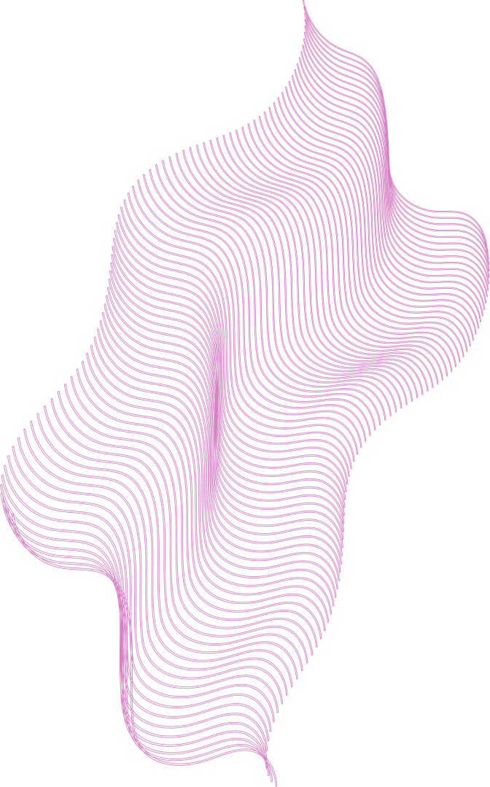
System Architecture (The 3-Stage AI Pipeline)
MoodCloset operates through a clear three-stage pipeline:
Stage:
Process:
Technolog:
The model identifies the type of clothing item uploaded (e.g., Dress, Shirt, Jeans).
MobileNetV2 (Transfer Learning) →
Clothing Category
  Clothing Classification
a. Extracts dominant colors from the item.
b. Detects skin undertone from a user's selfie.
K-Means Clustering Dominant
Colors (Hex Codes) → Skin
Undertone (Warm/Cool/Neutral)
2. Color Processing & User Input
Combines the outputs of Stage 1& 2 with the user's mood choice.
Rule-Based Logic → Recommended
Outfit & Colors
3. Recommendation Engine

Slide 6
Dataset Description
The project uses the Small Clothing Dataset, a folder-organized collection of real clothing images across 9 categories (dress, top, jeans, skirt, pants, shirt, sweater, jacket, shorts).
Images vary in lighting, angle, and background, making the model more realistic.
Processing Steps:
  Resize to 224×224
  Normalize pixel values
  Generate batches with flow_from_directory
Augmentation:
Rotation, zoom, flips, and shifts to increase model robustness.

Slide 7
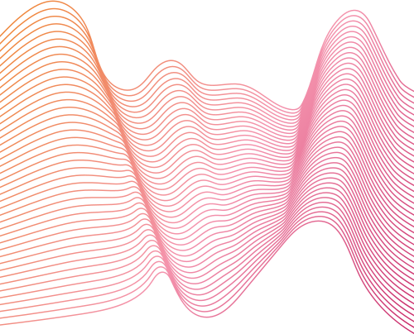
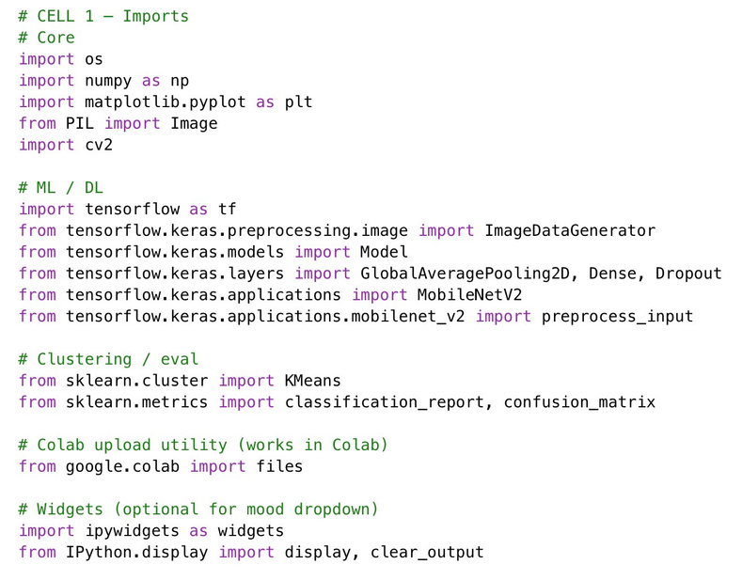
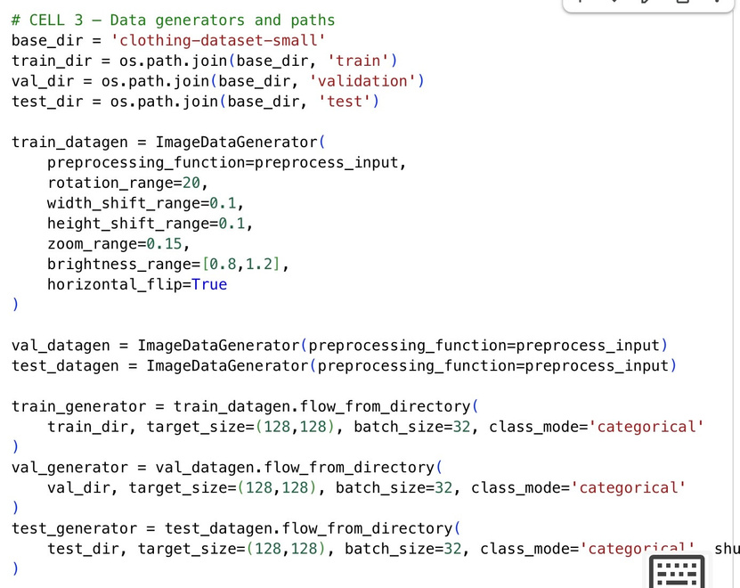
Stage 1 — Data Preparation
This stage prepares all clothing images for training.
The dataset is loaded using flow_from_directory, which automatically assigns labels from folder names.
Images are resized to 224×224, normalized, and split into training/validation sets.
Data augmentation (rotation, zoom, and flipping) increases model generalization.

Slide 8
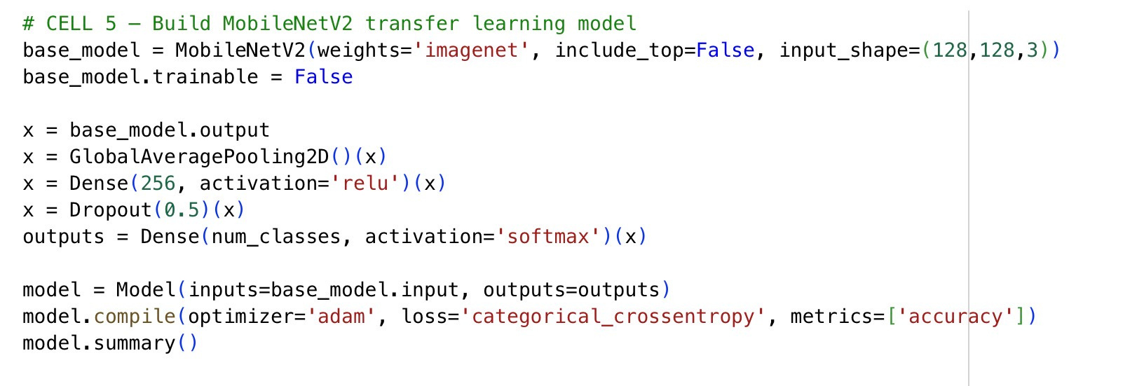
STAGE 2 — CLOTHING CLASSIFICATION MODEL Model Architecture
MobileNetV2 is used for clothing classification through transfer learning.
The pretrained base is frozen, and custom dense layers are added for 9 clothing categories.
This creates a lightweight, efficient model suitable for small datasets.

Slide 9
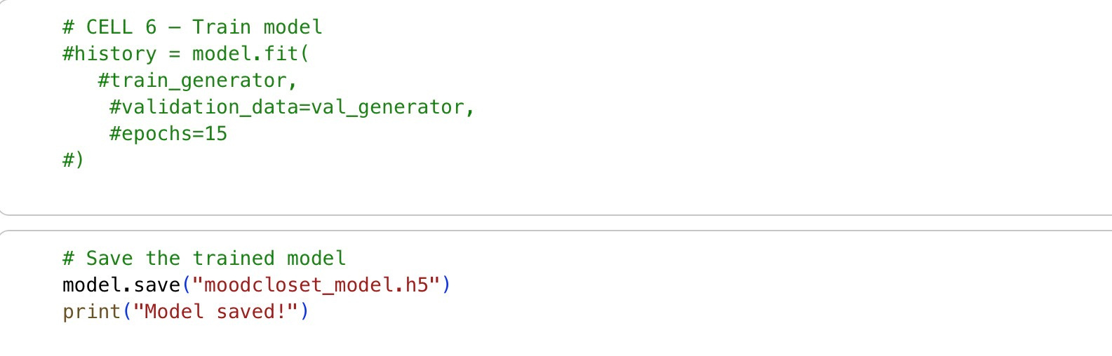
Stage 2
Model Training
Training is performed with model.fit() for multiple epochs.
The model learns to classify clothing types by adjusting weights using the Adam optimizer (LR = 1e-4).
Training and validation accuracy/loss curves help evaluate performance.

Slide 10
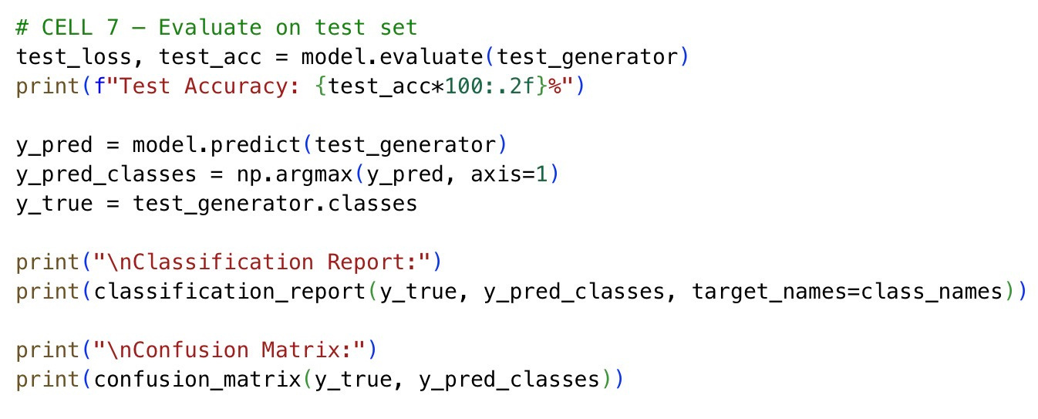
Stage 2 Evaluation & Results
The model is evaluated using predictions and a confusion matrix.
Metrics include:
Accuracy
Precision
Recall
F1-score
These metrics confirm that the classifier achieves strong performance on most categories.

Slide 11
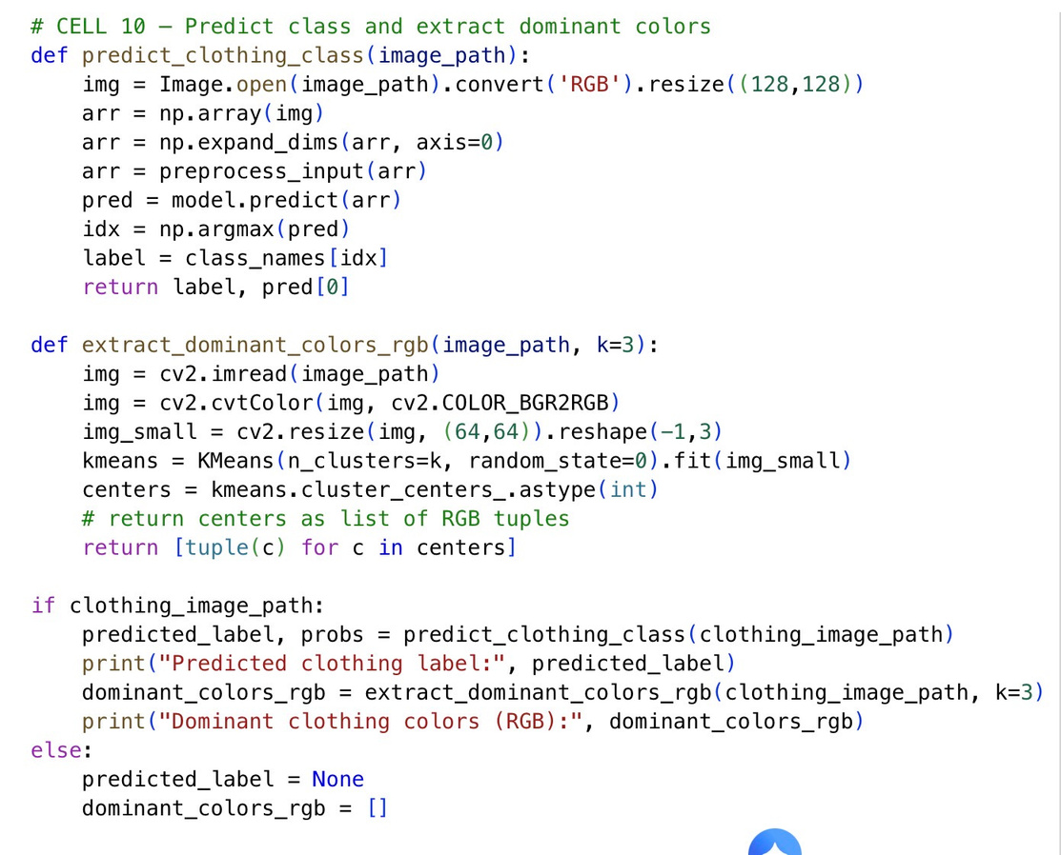
STAGE 3 — DOMINANT COLOR EXTRACTION
Color Extraction (K-Means)
K-Means clustering is applied to extract the three dominant colors from the uploaded clothing image.
The image is converted to a NumPy array, flattened, and clustered into 3 color groups.
Each cluster center is converted to RGB and HEX format.

Slide 12
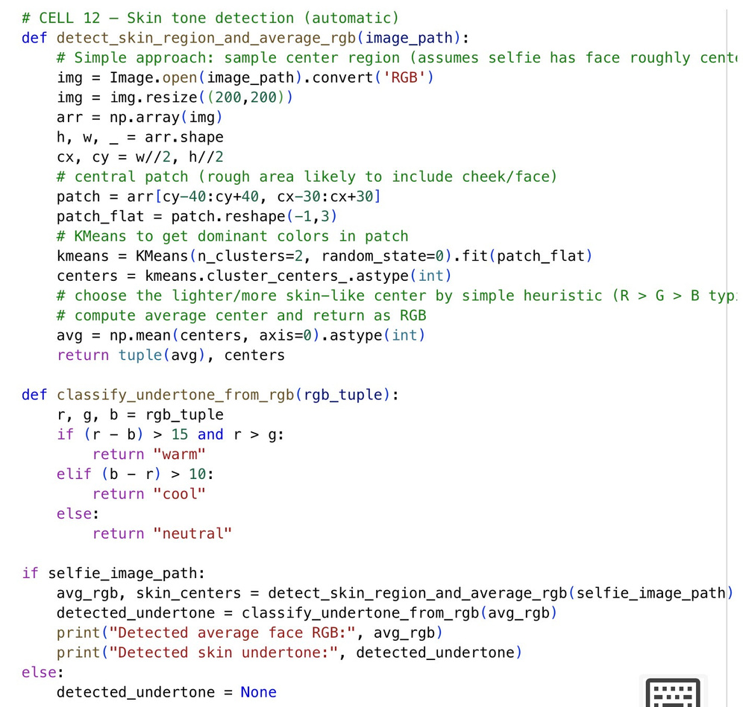
STAGE 4 SKIN UNDERTONE DETECTION
Undertone Detection Logic
• K-Means is also applied to the face image to detect the user's undertone.
The algorithm checks which color groups dominate:
Warm: yellow, gold, olive
Cool: pink, red, blue
Neutral: balanced mix
The undertone is determined by comparing cluster colors to these groups.

Slide 13
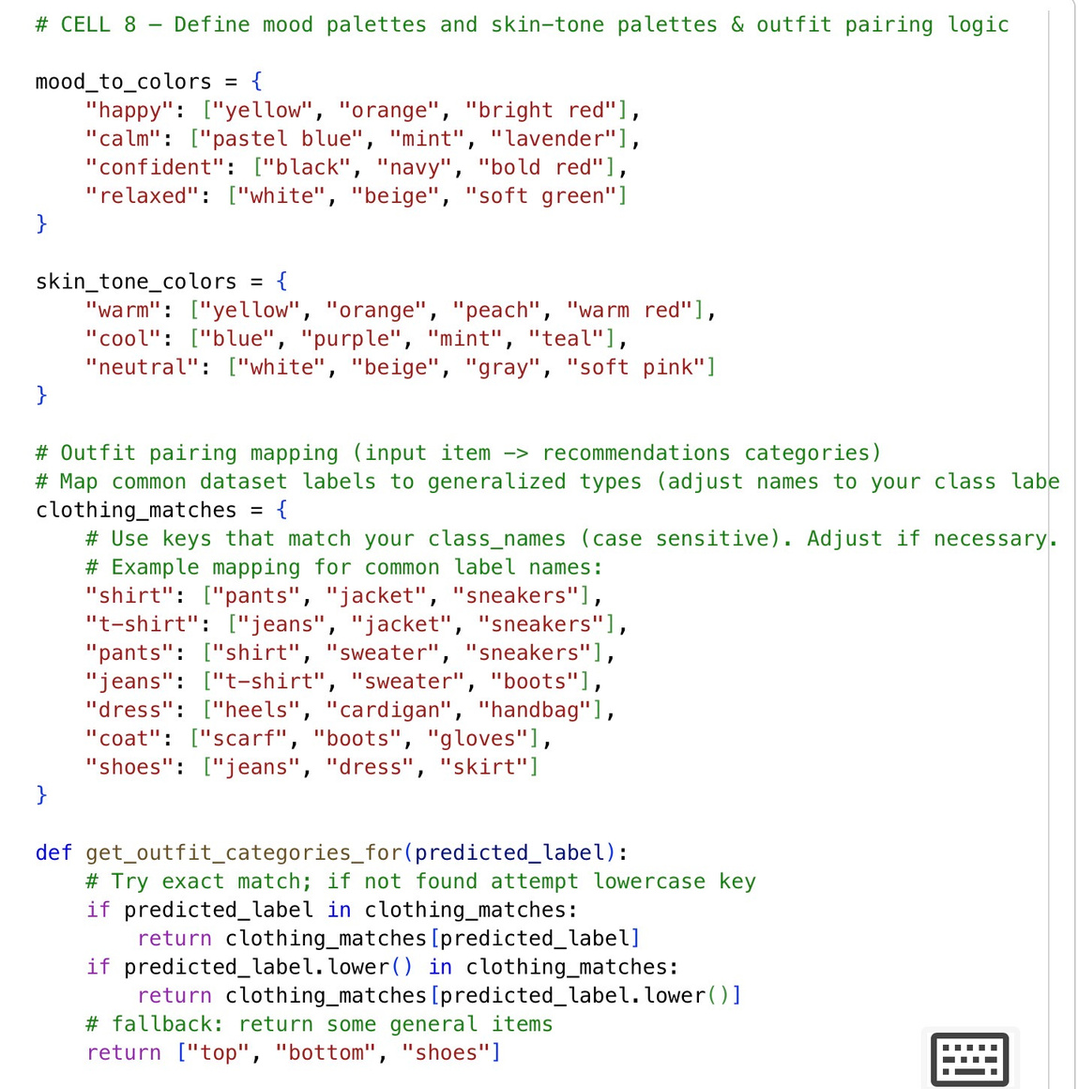
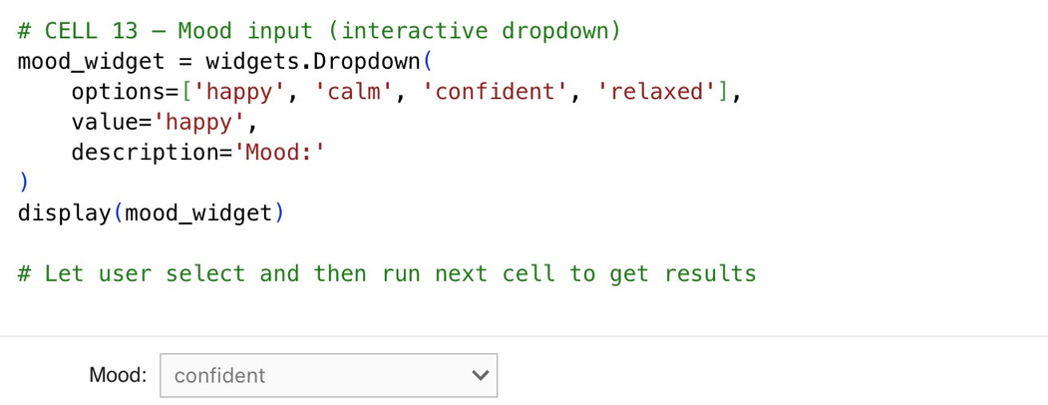
STAGE 5 — MOOD-BASED COLOR MAPPING Mood Color Mapping
Each user-selected mood is mapped to a predefined set of colors.
The system supports four moods:
Happy → warm/bright colors
Calm → pastel colors
Confident → dark bold colors
Relaxed → neutral soft colors
These palettes guide the final outfit design.

Slide 14
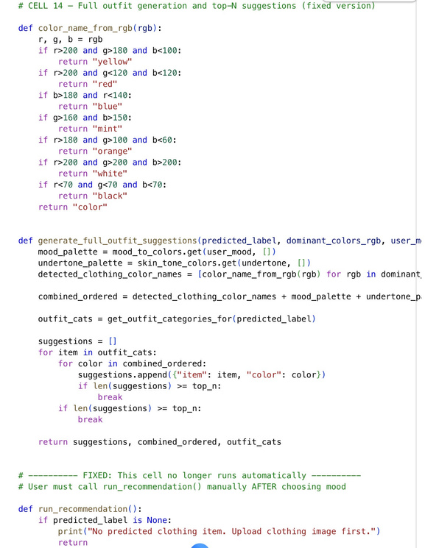
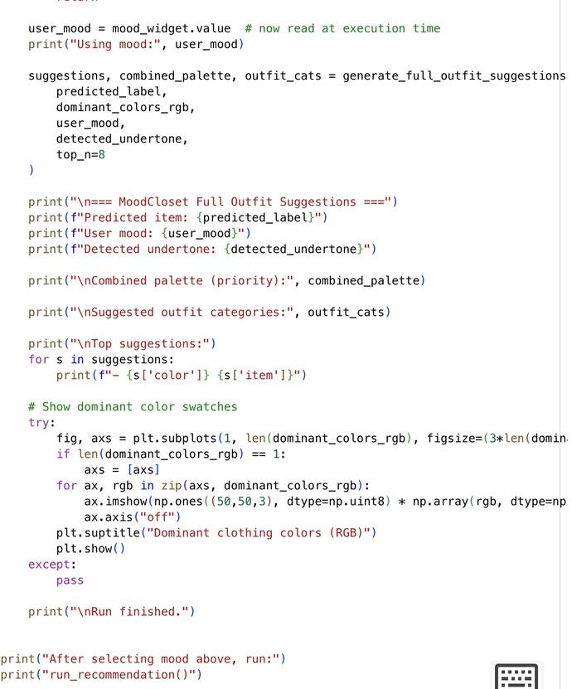
STAGE 6 FINAL OUTFIT RECOMMENDATION ENGINE
Recommendation Logic
This stage combines all model outputs to create the final outfit recommendation.
Inputs used:
Clothing type prediction
Dominant clothing colors
Detected skin undertone
Mood-based color palette
The system selects colors and styles that match the user's mood and undertone.

Slide 15
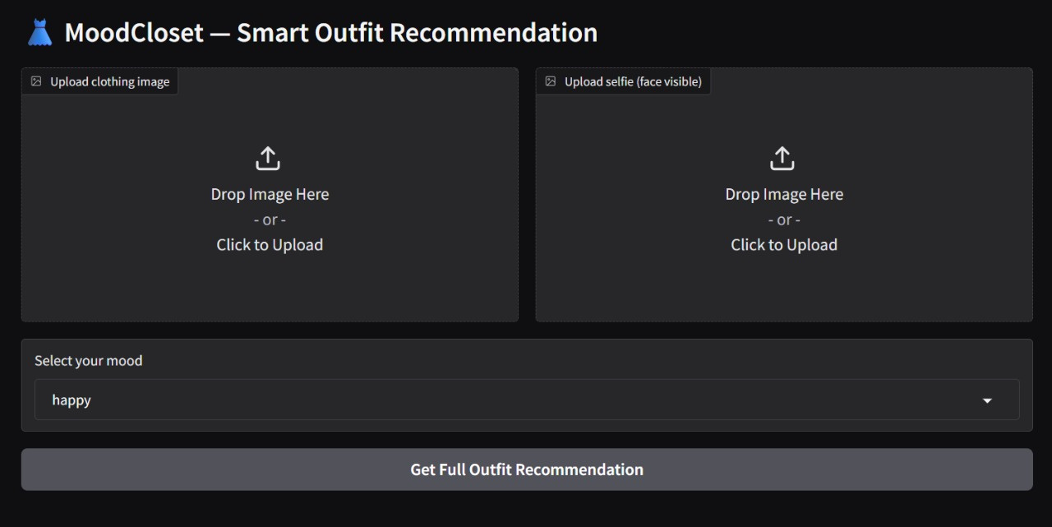
The interface

Slide 16
Discussion, Limitations, and Future Work
System Strengths
• Uniqueness: Personalized integration of emotion (Mood) and physical features (Undertone).
• Efficiency: Uses a lightweight MobileNetV2 model suitable for rapid inference.
• Interpretability: Recommendations are easily traceable back to the user's mood and undertone rules.
Current Limitations
• Dataset Size: Still a constraint, which impacts the model's ability to generalize to rare clothing types.
• Mood Input: Currently requires manual selection (not automatic).
• Undertone Detection: The current image processing logic is sensitive to varying lighting conditions.
Future Work
• Integrate Automatic Mood Detection using Facial Expression Recognition from the user's selfie.
• Train a dedicated CNN model for robust skin tone classification.
• Expand the dataset and potentially move from a rule-based system to a Learned Recommendation System that adapts to individual user style.

Slide 17

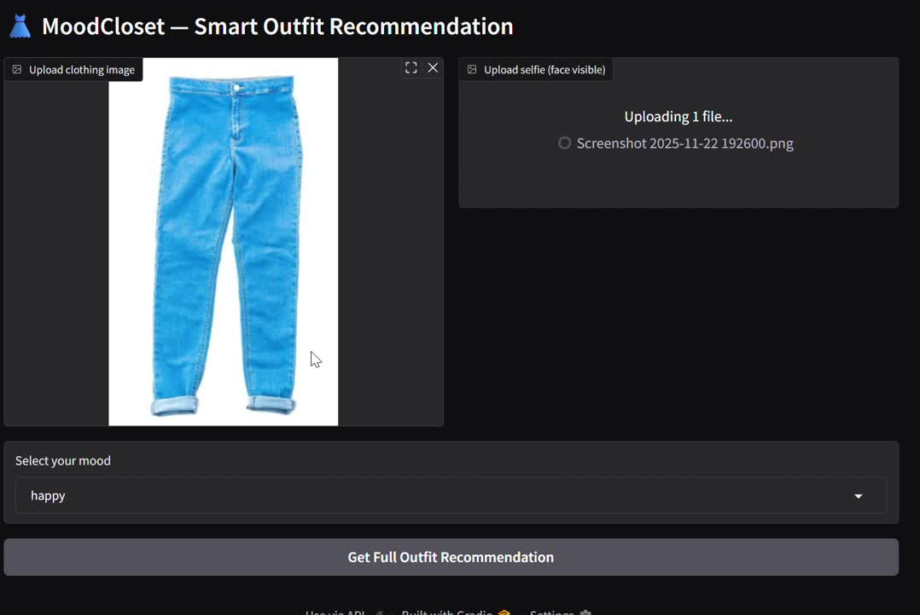
Live Demonstration and Q&A

Slide 18

Thank you

