Slide 1
How do State regulations affect alcohol consumption?
Authors:
Aseem Mangaokar
Jonathan Barajas
Amila Mevic
Taulant Krasniqi
Menes Muhammad

Slide 2
Hypothesis
Initially:
Higher taxes and fees should correlate with lower alcohol consumption
Conclusively
Taxes and fees do not affect alcohol consumption in a significant way
Required modification of the scope of the exercise, using more economic indicators
Personal Income per Capita
National Unemployment Rate

Slide 3
How do we measure the effects of state policy on alcohol consumption?
Taxes
Liquor License Fees
Alcohol Consumption Over Time
National Unemployment Rate
Gross Personal Income

Slide 4
Data SOURCES
Alcohol Policy Information System - https://alcoholpolicy.niaaa.nih.gov/
Ballotpedia - https://ballotpedia.org/
openICPSR - https://www.openicpsr.org/openicpsr/
LatLong - https://www.latlong.net/
Kaggle - https://www.kaggle.com/

Slide 5
Key Findings
The data shows that while alcohol consumption varies slightly by state, it does so to a lesser degree than do taxes and fees on alcohol products, and does not bear a strong correlation to either fees or taxes on the same
Methods of data analysis and visualization:
Hvplots
Scatter
Line
Stacked Bar
Mapbox plot
Summary statistics
Seaborn (lmplot)
Correlation

Slide 6
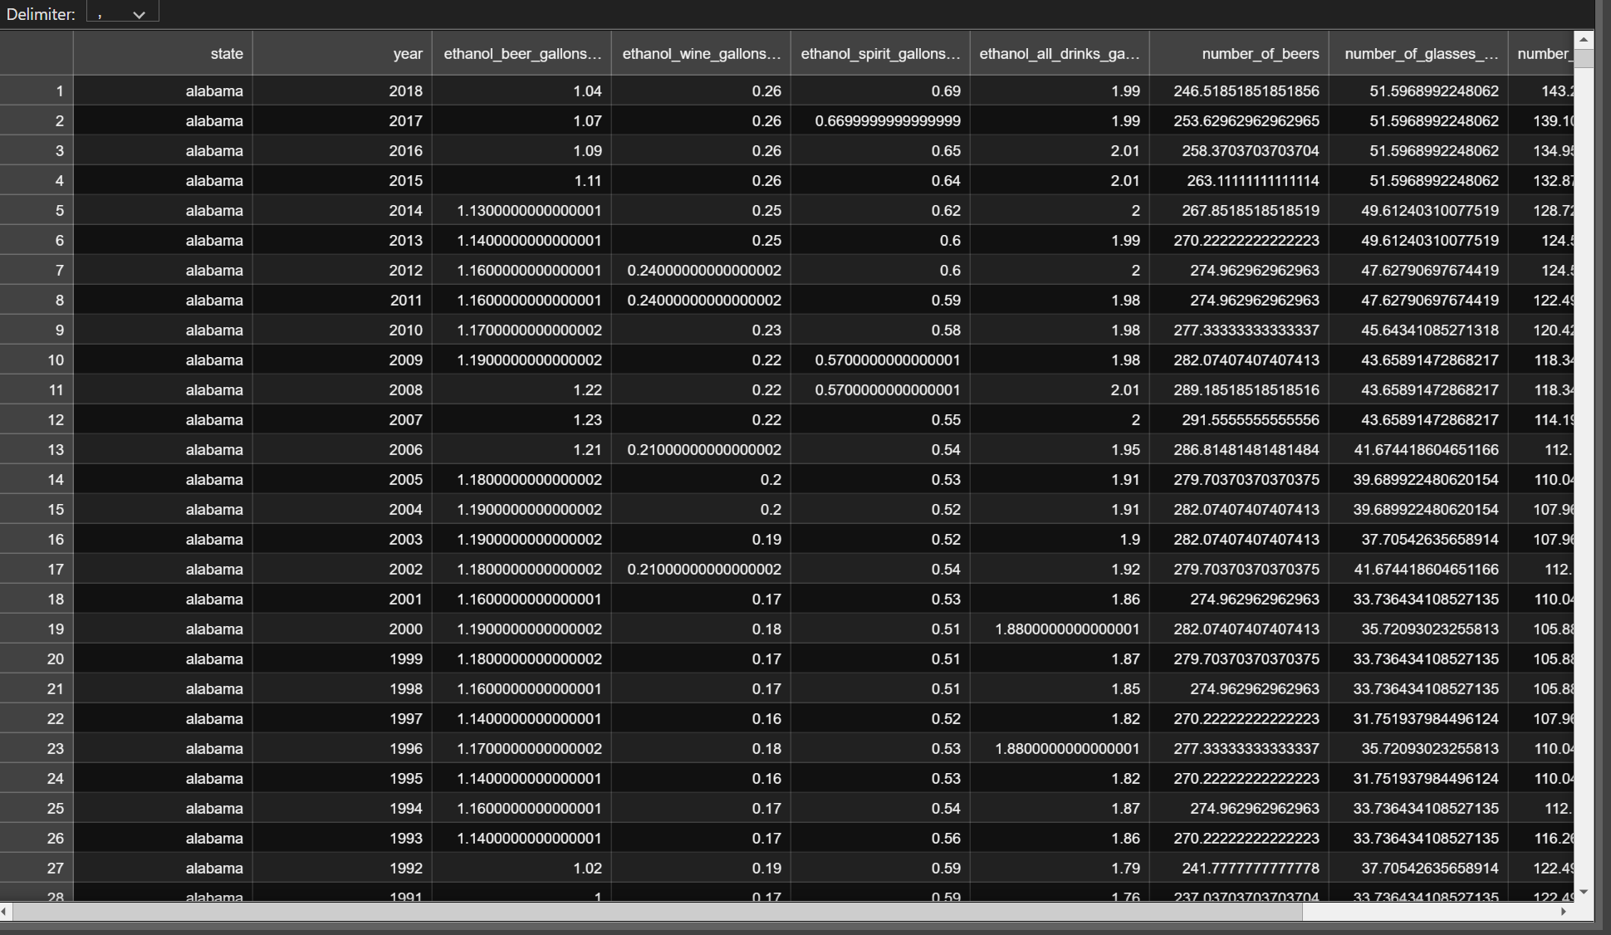
Data cleansing

Slide 7
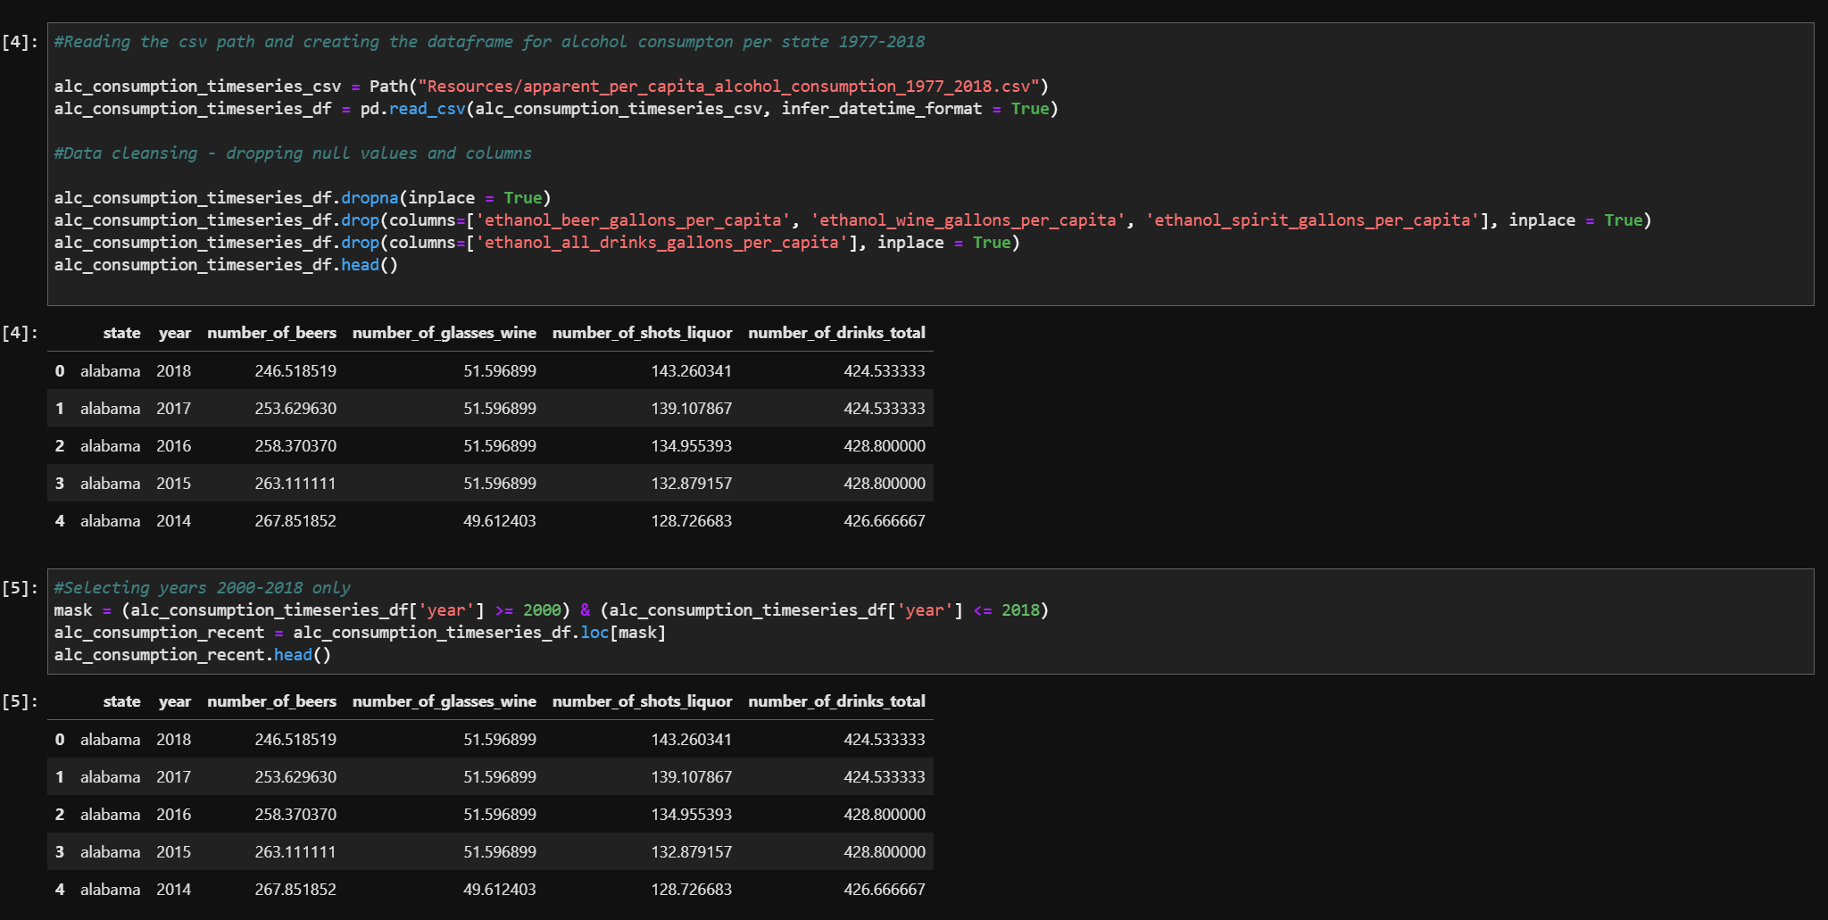
Data Cleansing I

Slide 8
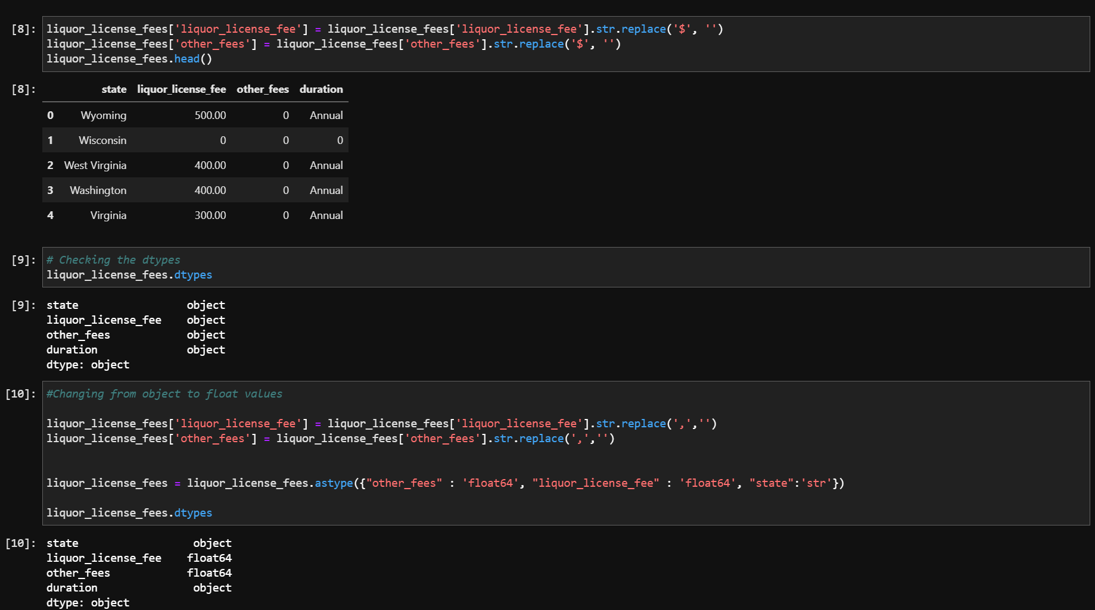
Data Cleansing II

Slide 9
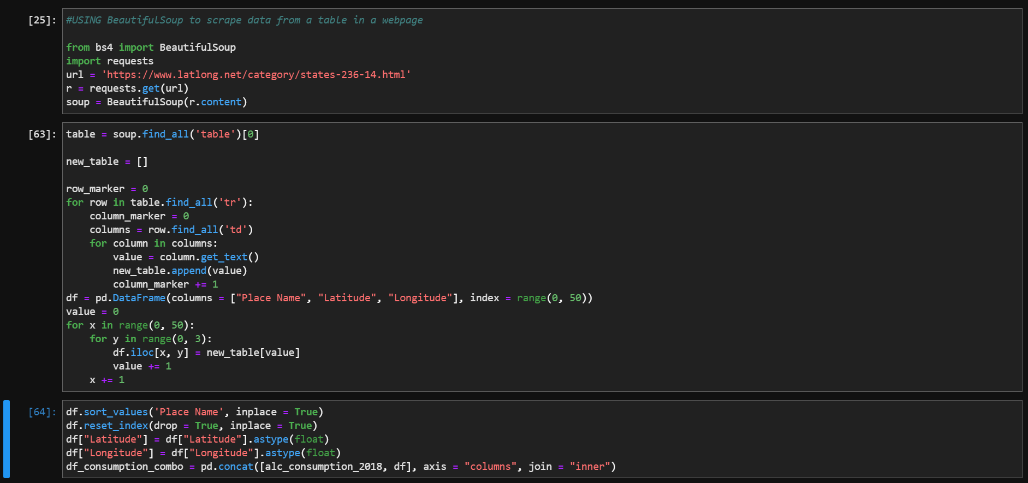
BeautifulSoup Library

Slide 10
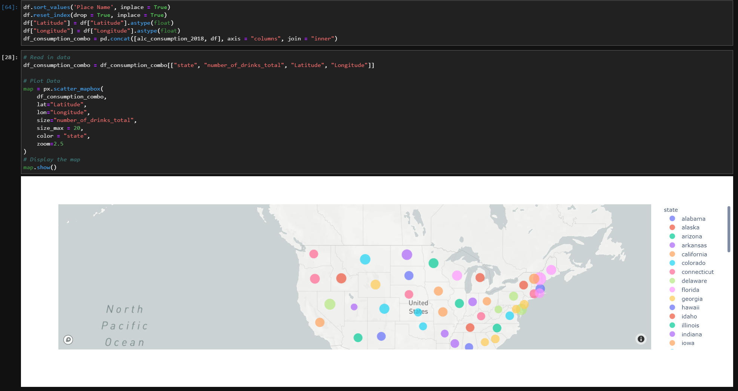
Mapbox api

Slide 11
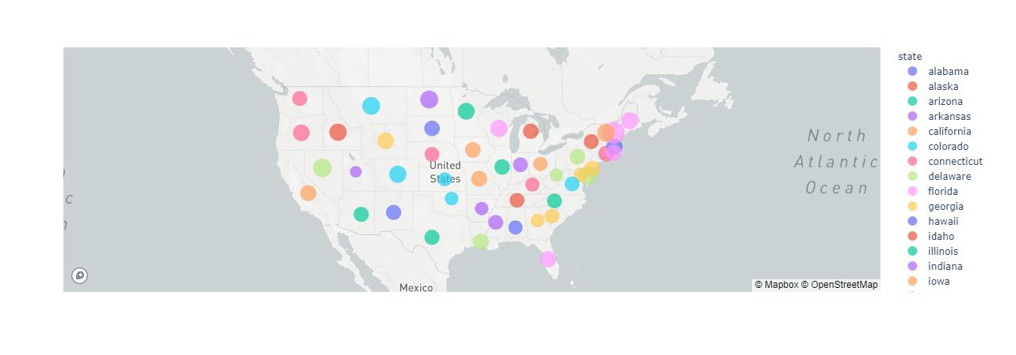
Consumption map
Notes:
Geographical data obtained using BeautifulSoup library
Mapped using Mapbox API
Point out – New Hampshire
Point out – Utah
Point out – California

Slide 12
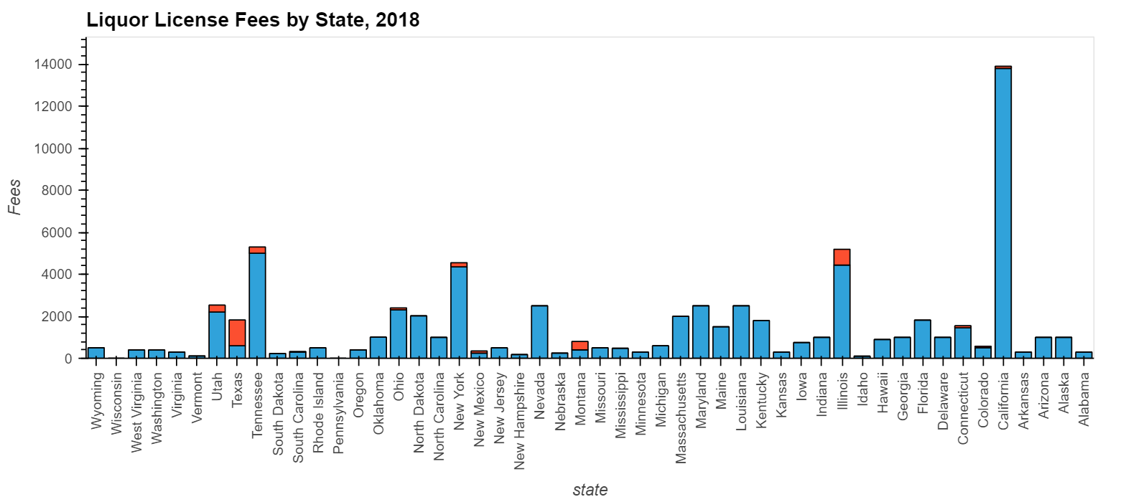
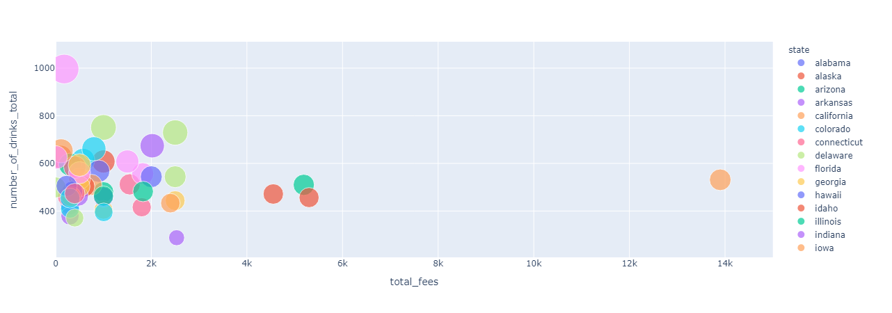
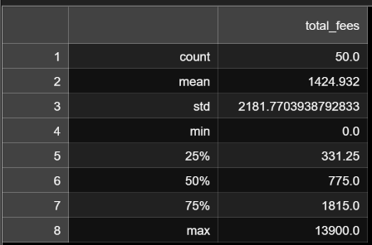
Liquor license fees by state
CORRELATION BETWEEN FEES AND CONSUMPTION

Slide 13
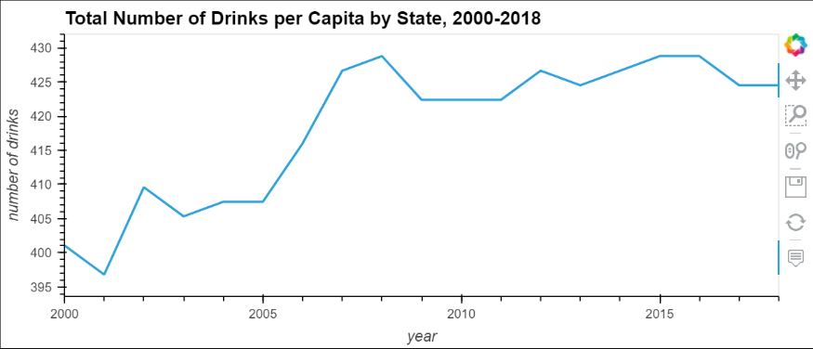
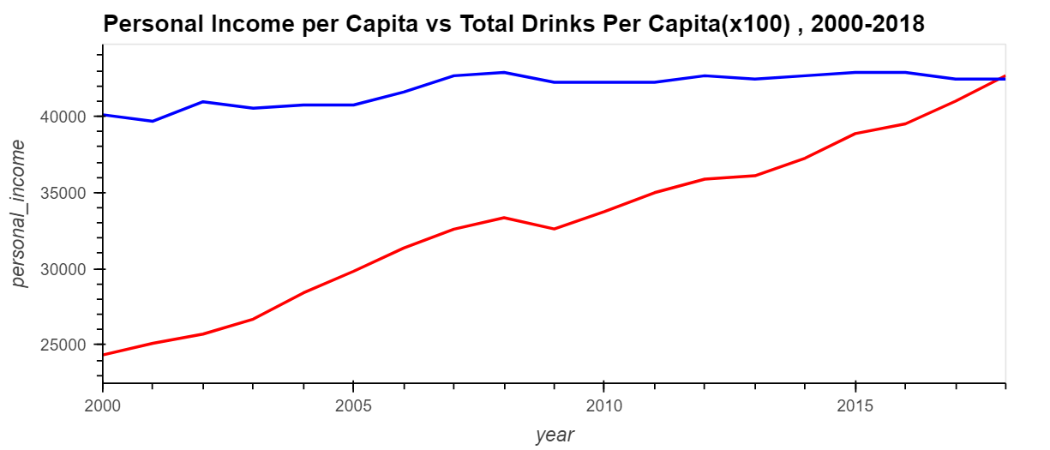
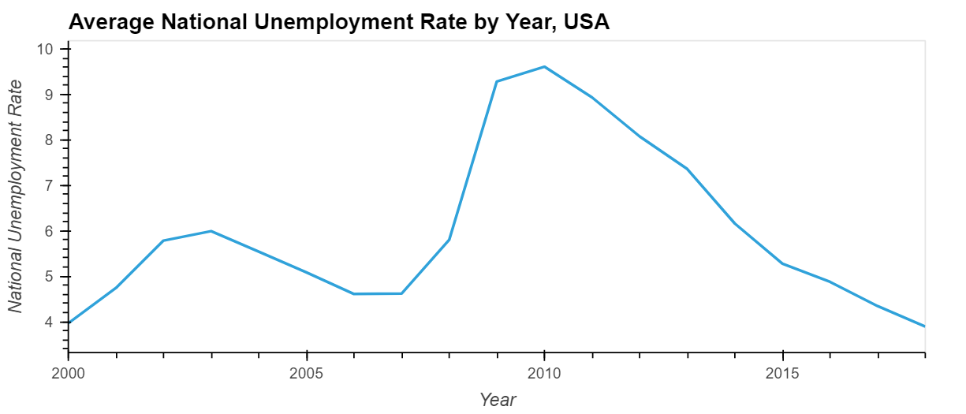
Unemployment
Yearly Drinks per Capita
Personal Income vs. Consumption
Alabama
Alabama
Notes:
Increase in Unemployment -> decrease in personal income -> decrease in yearly drinks

Slide 14
Conclusions I

Slide 15
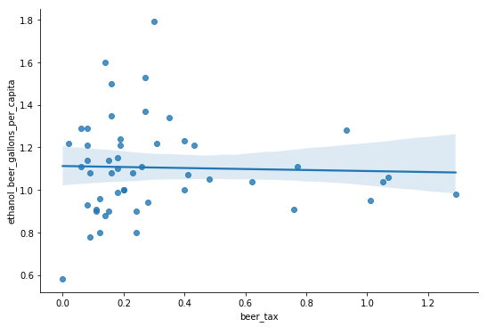
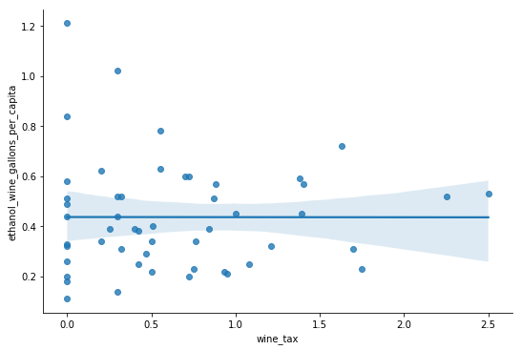
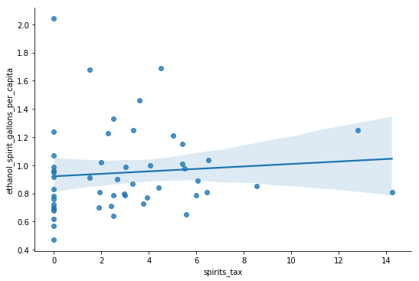
CONCLUSIONS - II
Notes:
Low correlation if any

Slide 16
CONCLUSIONS - III
Alabama
Notes:
Drinks per capita move inline with income per capita

Slide 17
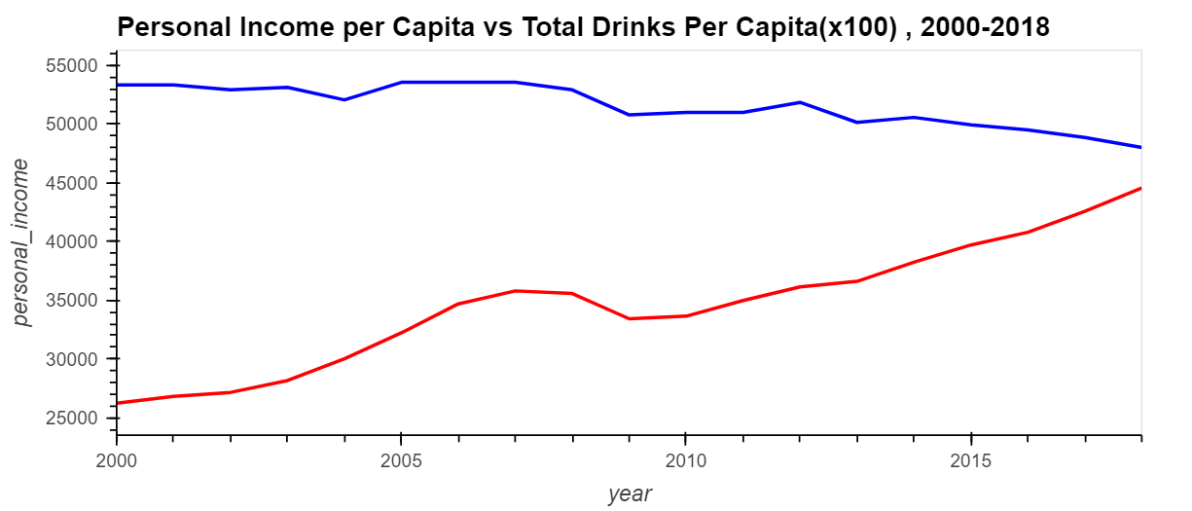
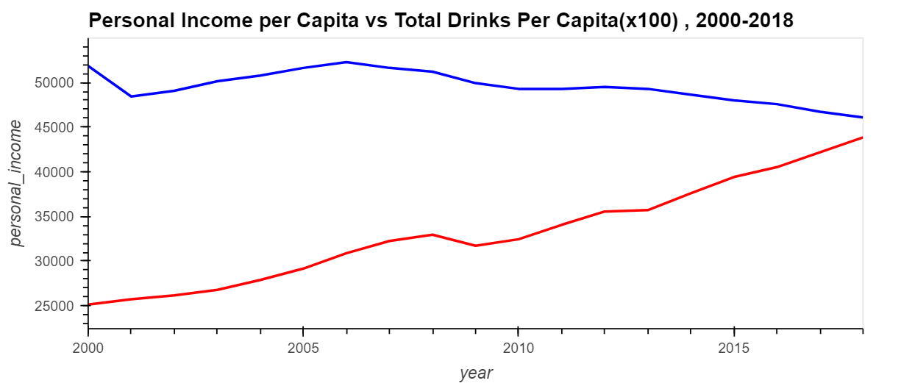
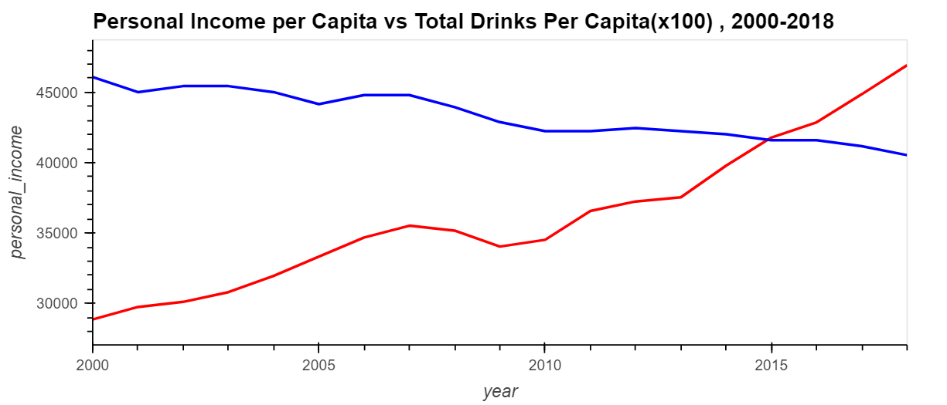
Outliers
Arizona
South Carolina
Georgia
Notes:
Outliers in trend

Slide 18
Implications of Our Findings
Why do some states drink less than others?
What non-economic factors affect drinking habits from state to state?
Economics of alcohol products

