Slide 1
Movie recommendation system
Machine Learning Project
Aseem Patni - 12CS10008 Nishkarsh Shastri - 12CS10034 Ashutosh Baheti-12CS10012 Pramesh Gupta - 12CS10036
Eashaan Baberwal- 12EC30010

Slide 2
Base Strategy
A movie recommendation works on the following concept:
A set of users initially rated some subset of movies (e.g., on the scale of 1 to 5) that they have already seen.
These ratings serve as the input. The recommendation system uses these known ratings to predict the ratings that each user would give to those not rated movies by him.
Recommendations of movies given to each user based on the predicted ratings.

Slide 3
Dataset Used
The MovieLens data of 1 million ratings from 6000 users and 4000 movies.
The dataset contains ratings of movies on the scale of 1-5. Along with them, the genres associated with movies are also present.

Slide 4
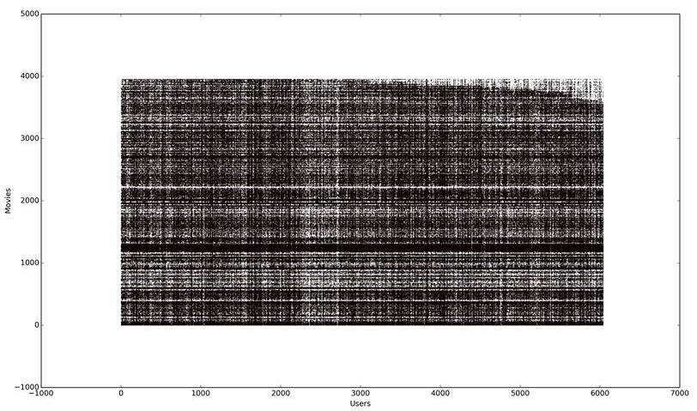
Graphical representation

Slide 5
Prediction strategy
Approach Used : Item Prediction, Predict a ranked list of movies that a user is likely to see.
Alternative approach: Rating prediction, i.e., predict the rating score that a user is likely to give to a movie that he has not seen or used before.

Slide 6
Basic approach
Collaborative filtering (or collaborative recommendations):
The user will be recommended movies that people with similar tastes and preferences liked in the past.

Slide 7
A naive CF approach
Implemented collaborative filtering which calculates similarity between users by their movies watched.
The ratings are given to the movies with similarity as weight.
Recommend top rated movies.

Slide 8
SVD- Singular Value Decompositiion
Incremental SVD approach was used.
Motivation for application
Simon Funk at his blog site for netflix prize competition.
The mathematics of SVD is explained in the next slide.

Slide 9
SVD - From Wiki
Suppose M is an m × n matrix whose entries come from the field K, which is either the field of real numbers or the field of complex numbers. Then there exists a factorization of the form
where U is an m × m unitary matrix over K (orthogonal matrix if K = R), Σ is an m × n diagonal matrix with non-negative real numbers on the diagonal, and the n × n unitary matrix V∗ denotes the conjugate transpose of the n × n unitary matrix V. Such a factorization is called a singular value decomposition of M.
The diagonal entries σ_{i} of Σ are known as the singular values of M. A common convention is to list the singular values in descending order. In this case, the diagonal matrix Σ is uniquely determined by M (though the matrices U and V are not).

Slide 10
Why SVD?
Challenges faced with Collaborative Filtering:
Sparsity - No relation between users can be found.
Scalability- Nearest neighbour computing algorithm’s running time increases with number of users and ratings.

Slide 11
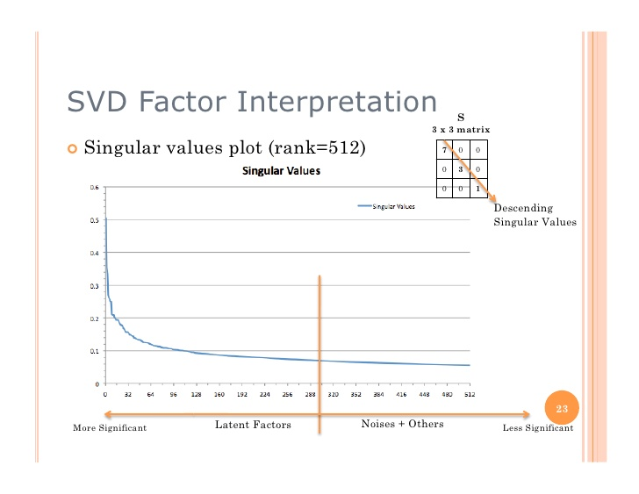
How SVD helped ?

Slide 12
Benefits of SVD
SVD is used to reduce dimensionality, so neighbourhood formation happens in reduced user space.
It helps models to find the low rank approx dataset matrix while retaining the critical latent factors and ignoring noise.

Slide 13

Implementation
Implemented using python- Ocelma-python recsys.
To compute the prediction, it uses this equation (u=USERID, i=ITEMID): denotes the set of k items rated by u, which are most similar to i.

Slide 14
SVD Recommendation for a User- Testing
Removed 10 top rated entries for the user.
When we ran SVD, we obtained 4 of those in recommended list based on other movies watched.
The recommendations were found to be quite accurate based on personal choice.
When an alternate method of accurate rating was implemented the subsequent result obtained was:
Movielens 1M dataset (number of ratings in the Test dataset: 209,908):
 | SVD | SVD Neigh.
RMSE | 0.91811 | 0.875496
MAE | 0.71703 | 0.684173

Slide 15
Using the recommendation system widely used.
GraphLabs was used for checking the standard of the recommendations. The initial testing was done by testing the output of self built system with that of the GraphLabs one. The SVD was more accurate than naive CF approach.

Slide 16
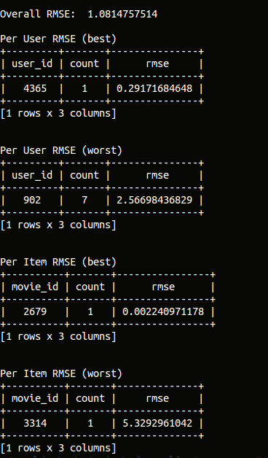
GraphLabs Result
On random split between training and test case

Slide 17
Running
Movies watched by user no 8
['608', 'Fargo (1996)', 'Crime|Drama|Thriller'] (608, 5.4379336606517334)
['2571', 'Matrix', ' The (1999)', 'Action|Sci-Fi|Thriller'] (2571, 5.3864636642597699)
['2858', 'American Beauty (1999)', 'Comedy|Drama'] (2858, 5.3047273466526796)
['296', 'Pulp Fiction (1994)', 'Crime|Drama'] (296, 5.2707903742082411)
['589', 'Terminator 2: Judgment Day (1991)', 'Action|Sci-Fi|Thriller'] (589, 5.139567599364347)
['110', 'Braveheart (1995)', 'Action|Drama|War'] (110, 5.1320697329809599)
['1265', 'Groundhog Day (1993)', 'Comedy|Romance'] (1265, 5.0816431984831372)
['2762', 'Sixth Sense', ' The (1999)', 'Thriller'] (2762, 4.9716432379545061)
['2019', 'Seven Samurai (The Magnificent Seven) (Shichinin no samurai) (1954)', 'Action|Drama'] (2019, 4.9547897752324532)
['527', "Schindler's List (1993)", 'Drama|War'] (527, 4.9540942298500497)

Slide 18
Recommendation by CF
getRecommendations(‘8’, 10):
Ulysses (Ulisse) (1954) 5.0
Schlafes Bruder (Brother of Sleep) (1995) 5.0
One Little Indian (1973) 5.0
Mamma Roma (1962) 5.0
Inheritors, The (Die Siebtelbauern) (1998) 5.0
Gate of Heavenly Peace, The (1995) 5.0
Dingo (1992) 5.0
Callejn de los milagros, El (1995) 5.0
Bittersweet Motel (2000) 5.0
Angela (1995) 5.0

Slide 19
Recommendation by SVD
Seven Samurai (The Magnificent Seven) (Shichinin no samurai) (1954) (923, 4.9287137958077594)
Citizen Kane (1941) (50, 4.9242963920621534)
Usual Suspects (2905, 4.9238567835180778)
Sanjuro (1962) (745, 4.8954304543938703)
Close Shave (1240, 4.8886972268093798)
Terminator (318, 4.8879722434534596)
Shawshank Redemption (904, 4.8840041756003512)
Rear Window (1954) (1148, 4.8634391226529923)
Wrong Trousers

Slide 20
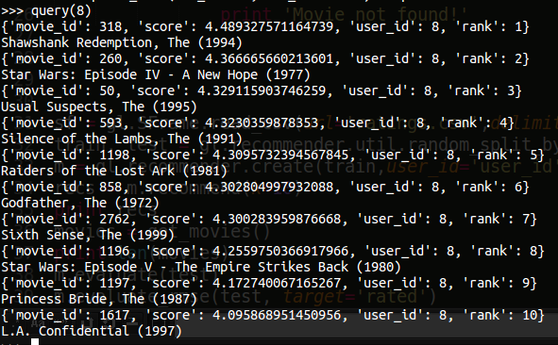
Recommendation by GraphLabs

