Slide 1

Digit Recognition Using Normalized Cross Correlation
Prepared By: Aseer Ishraqul Hoque
ID: 1603110201206
Section: A

Slide 2
Goal
Recognizing number from given input number
30px
6
Input
0
0
5
1
2
3
4
300px
0 1 2 3 4 5 6 7 8 9
30px
30px
6
7
8
9
0 1 2 3 4 5 6 7 8 9

Slide 3
Motivation
Work with new research branch.
Overcoming number identification problem of different rotation angle.
Overcoming the problem of identifying 6 & 9 or 5 & 6 with special pattern recognition techniques.
Exploring image processing techniques and algorithms.

Slide 4
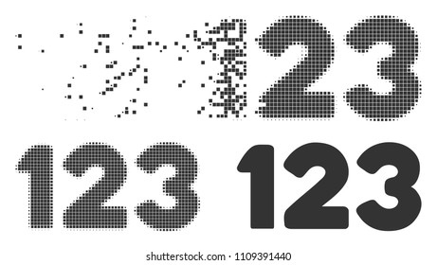
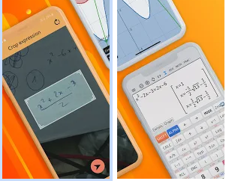
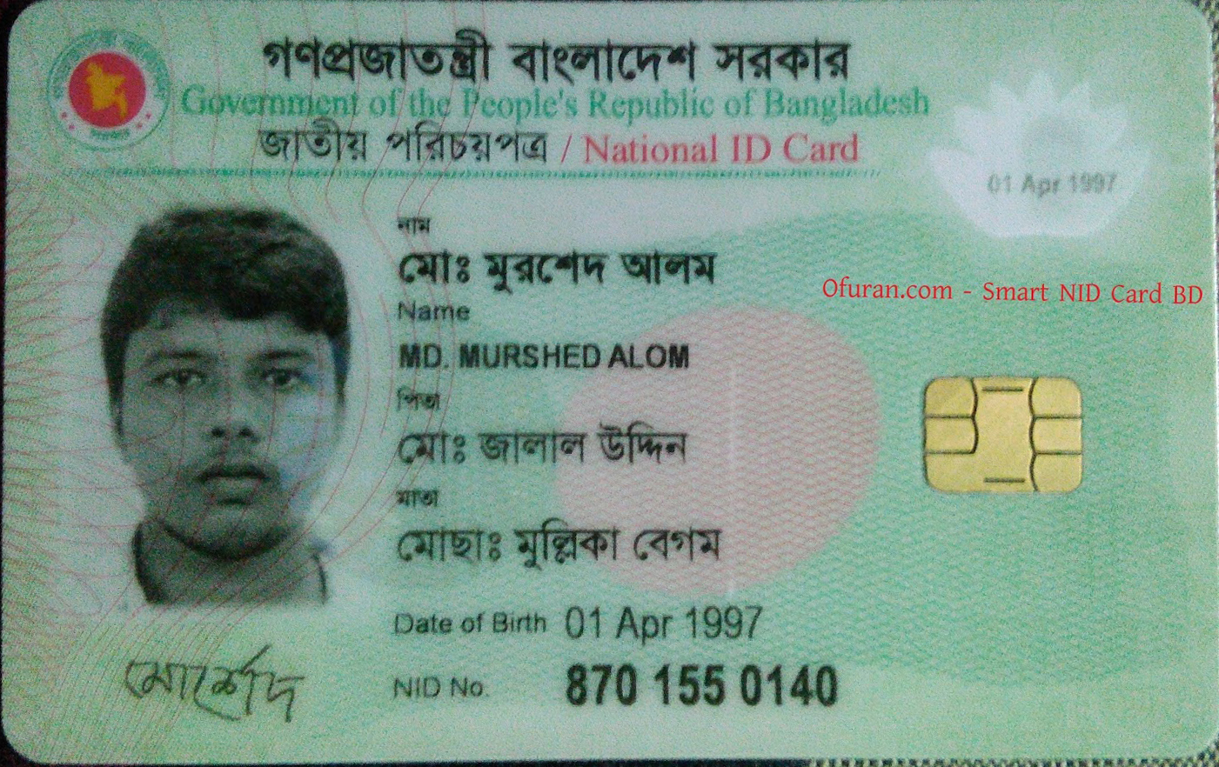
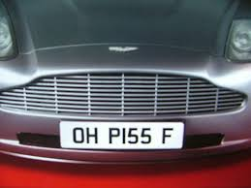
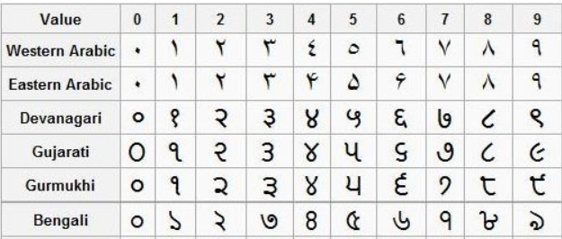
Application
Number plate recognition
Driving license or voter id card number recognition
Automatic Equation solver
Number reconstruction from dissolved or old documents
Digit Recognition in more than one languages

Slide 5
Proposed Framework
User Input Image
30px
Input Image
0 | 0 | 0 | 0 | 0 | 0 | 0 | 0
0 | 0 | 0 | 0 | 1 | 1 | 0 | 0
0 | 0 | 0 | 1 | 0 | 0 | 0 | 0
0 | 0 | 1 | 1 | 1 | 0 | 0 | 0
0 | 0 | 1 | 0 | 0 | 1 | 0 | 0
0 | 0 | 1 | 0 | 0 | 1 | 0 | 0
0 | 0 | 0 | 1 | 1 | 1 | 0 | 0
0 | 0 | 0 | 0 | 0 | 0 | 0 | 0
6
6
RGB to Gray
Convert RGB image to
Gray scale image
30px
Binarize image by thresholding
Compute Threshold
Binarize 2D gray scale image
Normalized Cross Correlation
Recognition Results
Figure : Block diagram of proposed framework

Slide 6


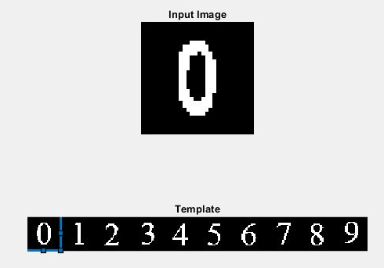
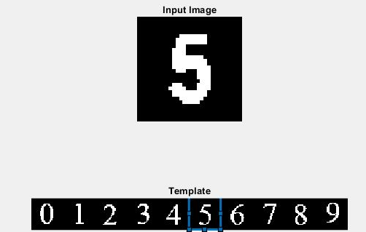
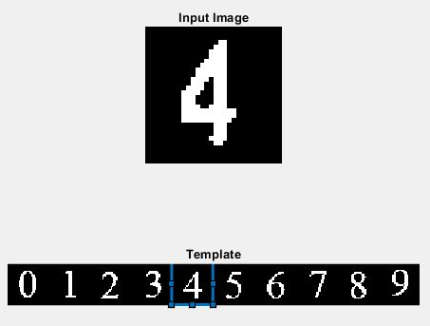
Processing Example
(a)
(b)
(c)
(d)

Slide 7
Conclusion
In this project we have recognized digits by implementing normalized cross correlation. Here, if we summarize the procedure an input image is converted into a 30x30 2D array. The array is cross checked with the template/database which is also converted into a 2D array of size 300x30. Finally, we received results by implementing normalized cross correlation.
Merits:
Easy to implement
Easy to calculate as NCC is confined between -1 and 1
Demerits:
Computation time increases dramatically as the window size of the template gets larger
Not efficient for handwritten digits.
Does not work on low quality images.

Slide 8
References
Weisstein, Eric W. "Cross-Correlation." From MathWorld--A Wolfram Web Resource. http://mathworld.wolfram.com/Cross-Correlation.html
Rabiner, Lawrence R.; Gold, Bernard (1975). Theory and Application of Digital Signal Processing. Englewood Cliffs, NJ: Prentice-Hall. pp. 401. ISBN 0139141014.

Slide 9




Thank You

