Slide 1
Checker User Manual
Verify that every pre-plan meeting happened and that the photos are genuine
For the check-back team · desktop · meetingchecker.com
Notes:
Welcome. This session is for the check-back team, the ten checkers at head office. By the end, every checker should be able to open a submitted territory, judge each AMO meeting, check every SR photo, mark SRs as checked, read the dashboard and download the two Excel reports. Plan about 40 minutes including a live demo on a desktop browser.

Slide 2





How the daily process works
AMO
TSO
Check-back team (you)
Runs a zone
Owns the territory
Head-office checkers
Holds the pre-plan meeting, uploads the meeting photo and an outlet plan photo for each SR, then submits the zone.
Reviews every zone, approves each SR, adds a TSO photo and makes the final submission of the territory.
Checks the meetings and photos, marks each SR as checked and reports SRs with images not uploaded.
Only after the TSO submits: until then a territory shows “Not submitted by TSO”.
Last 3 days only: older data is deleted
Notes:
Walk the chain left to right. The AMO runs the meeting and uploads the photos, the TSO approves and makes the final submission, and only then does the territory reach the check-back team. Stress the two rules at the bottom: a territory is invisible to checkers until the TSO submits it, and the portal only keeps the last three days, so checking cannot be left for later.

Slide 3




Your job: three check points
Purpose: confirm that every pre-plan meeting really happened and that the photos uploaded for it are genuine, today’s and correct.
1
2
3
Meeting held with a valid photo
A photo for every SR
Correct photos
For each AMO zone: was the meeting held, and does the meeting photo prove it?
Every SR needs an outlet plan photo. SRs without one show “No photo” and go into the missing-images Excel.
Is it a real, current outlet plan for this SR? Watch for REUSED and OLD flags. Record your verdict and sign off.
In the portal: Meeting held with valid photo? Yes / No
In the portal: Photos · # Photos · No photo
In the portal: Correct photos? · Checked
Notes:
These three check points are the whole job. One: for each AMO zone, decide whether the meeting was held with a valid photo. Two: make sure every SR has a photo; missing ones are reported through the missing-images Excel. Three: for SRs with photos, decide whether the photos are correct, add a remark if needed and press Checked. The rest of the manual shows where each of these lives in the portal.

Slide 4




What this manual covers
01
02
Getting started
Territory details (Tab 1)
Sign in, the two tabs and the 3-day window
Filters, summary, meeting check, SR table, photo viewer, flags, Correct photos, Checked, bulk tools
03
04
Dashboard & reports (Tab 2)
Quick reference
KPI tiles, pie and bar charts, drill-down, missing-images and full status Excel
Daily routine checklist, FAQ and troubleshooting, where to get help
Notes:
Four parts. Part 1 is short. Part 2 is the core of the daily work in the Territory details tab. Part 3 covers the Dashboard tab and the two Excel downloads. Part 4 is reference material to keep at hand.

Slide 5
Getting started
01
Sign in and find your way around the check-back portal

Slide 6
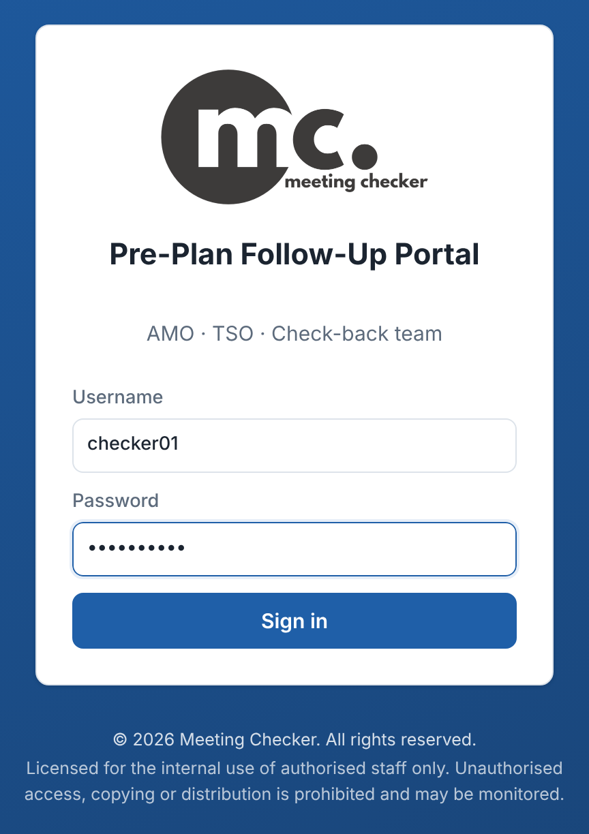
Sign in to the portal
1
Open meetingchecker.com
Use Chrome or Edge on your desktop. Bookmark the page.
2
Enter your Username
Your checker username from the admin, e.g. checker01.
3
Enter your Password and click Sign in
You land on the Check-back portal.
4
Change your password
Password button, top right. New password: 8+ characters.
Keep your account to yourself
Every check is saved under your name. Forgot your password? Ask your admin to reset it. Click Log out on shared PCs.
Sign-in page at meetingchecker.com
Notes:
Demonstrate sign-in live. Each checker has a personal username (checker01 to checker10). Every Checked click is stored with that username and shown in the table and the Excel, so accounts must never be shared. There is no self-service reset: the admin resets a forgotten password. A sign-in lasts about 24 hours; after that the portal asks you to sign in again.

Slide 7
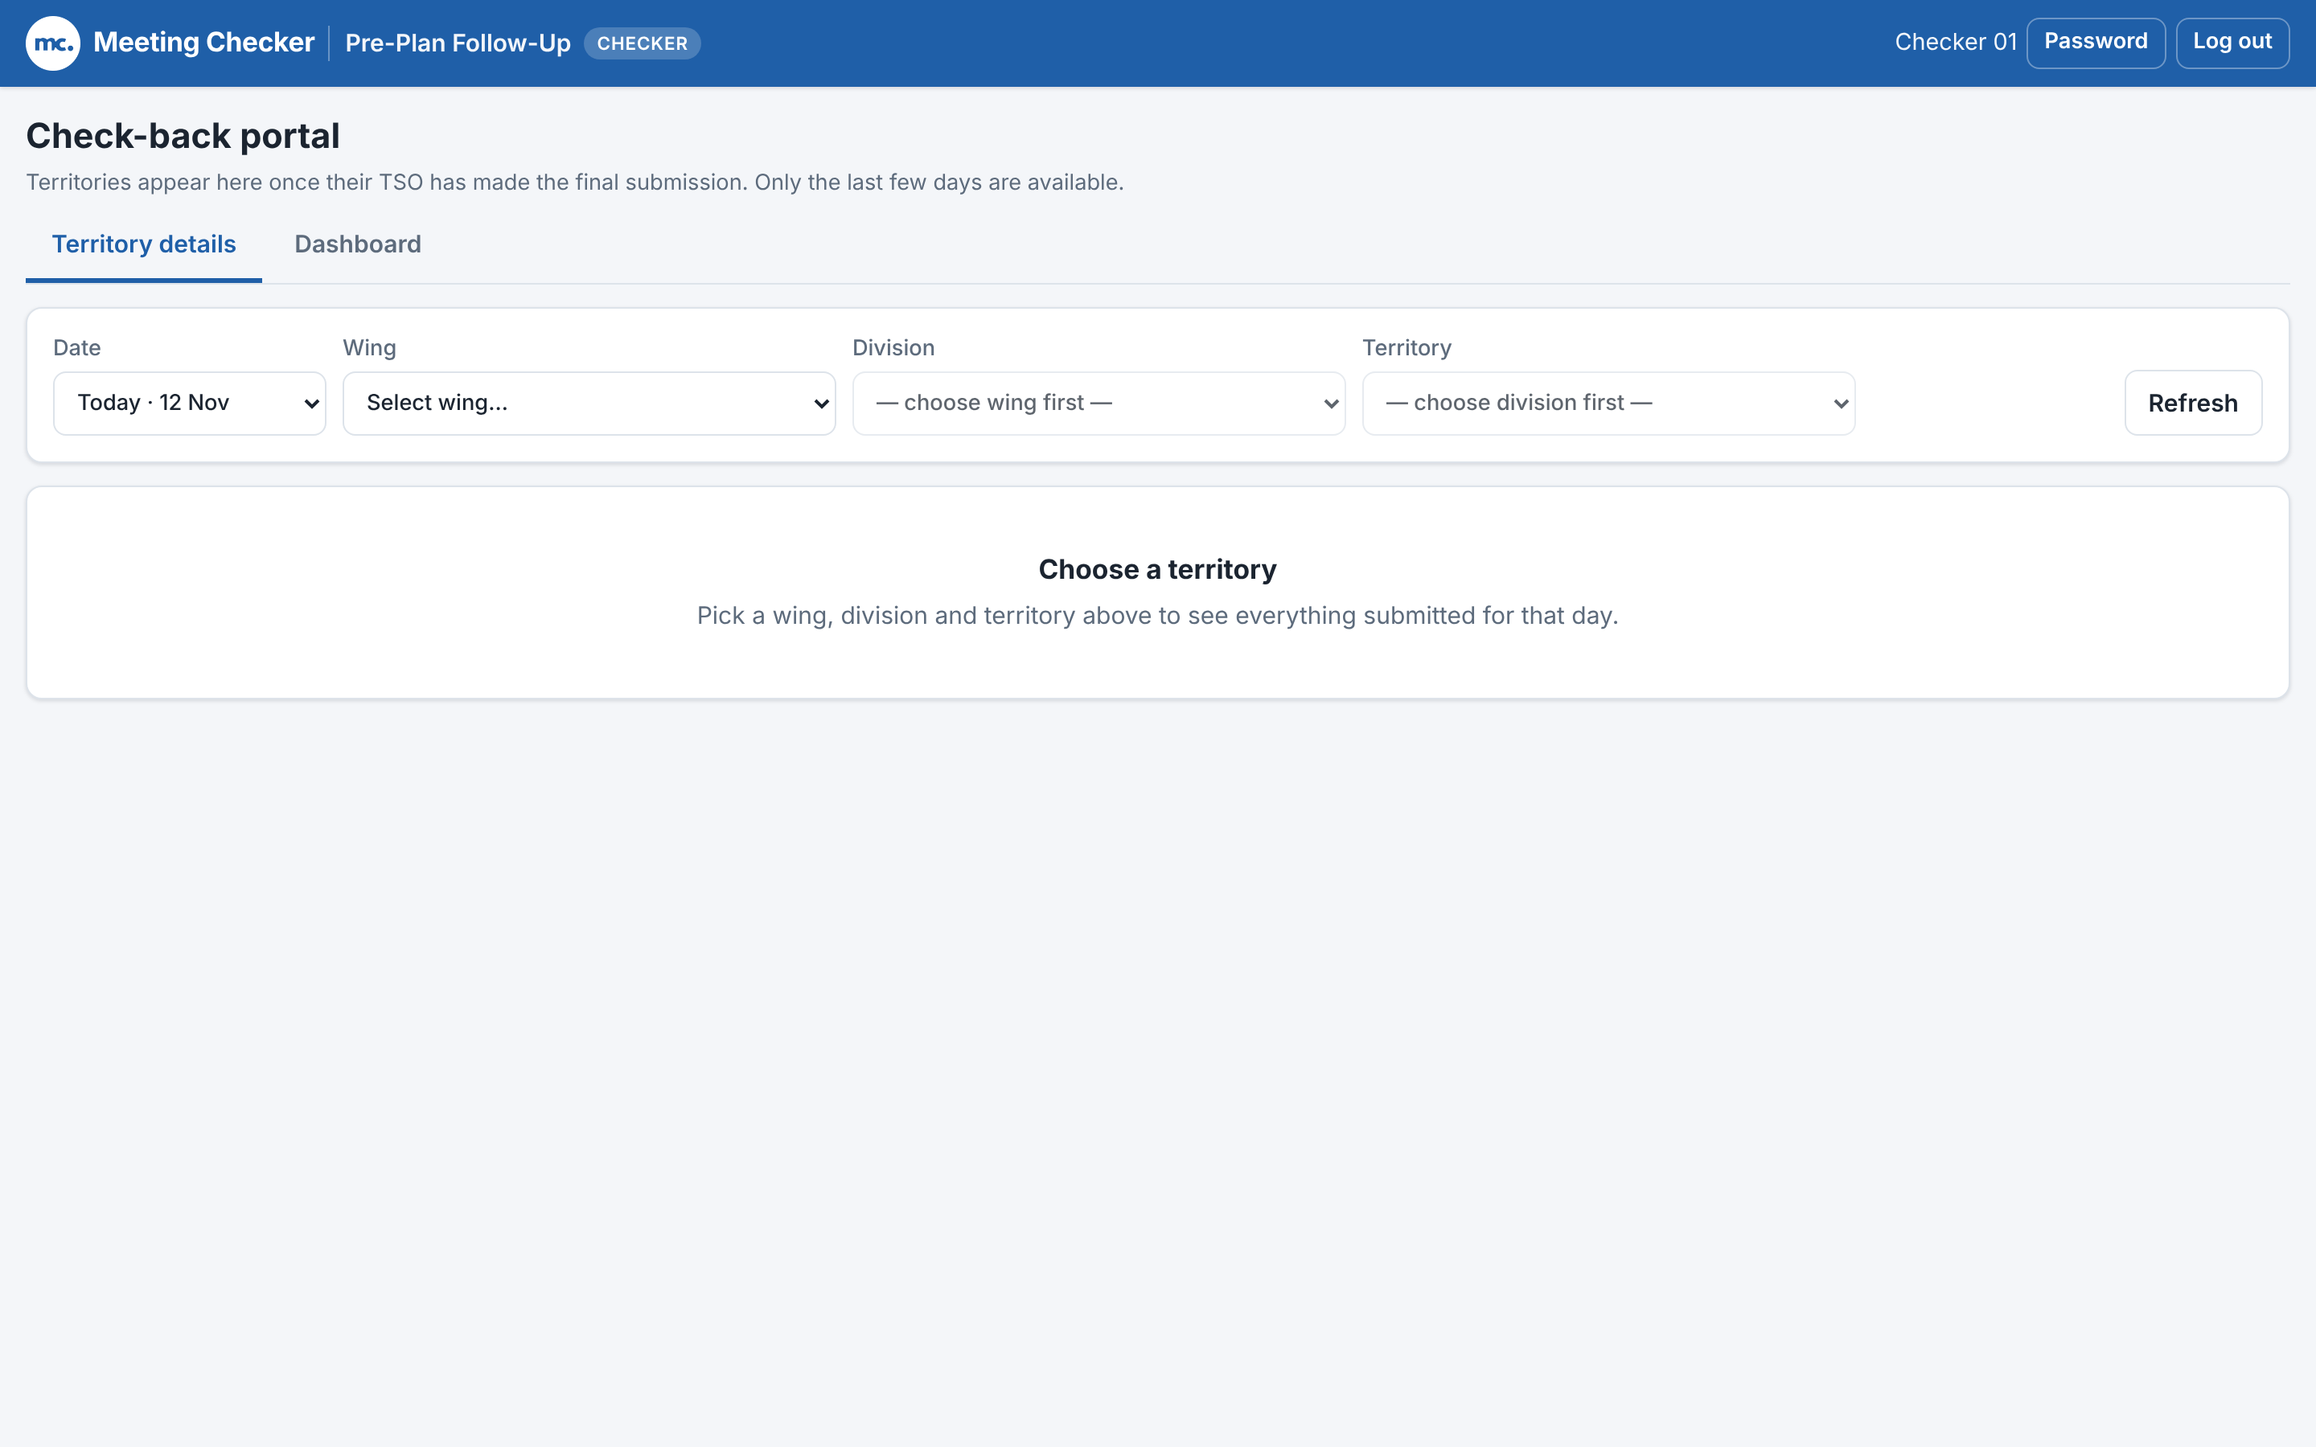

Two tabs, the last three days
Territory details
Pick one territory and check it: meetings, SR photos, Correct photos and Checked.
Dashboard
Progress across all wings: KPI tiles, charts, drill-down and the two Excel downloads.
Date list = 3 days
Today
Yesterday
Day before
Older days are deleted
Photos and data older than 3 days are removed automatically. Finish checking in time.
Check-back portal right after sign-in
Notes:
The portal has two tabs. Territory details is where checking happens, one territory at a time. Dashboard shows progress and holds the Excel downloads. The Date list in both tabs only offers three days: today, yesterday and the day before. Anything older is deleted automatically, photos included, so a day must be fully checked and exported before it drops off the list.

Slide 8
Territory details
02
Tab 1: open a submitted territory and check it SR by SR

Slide 9
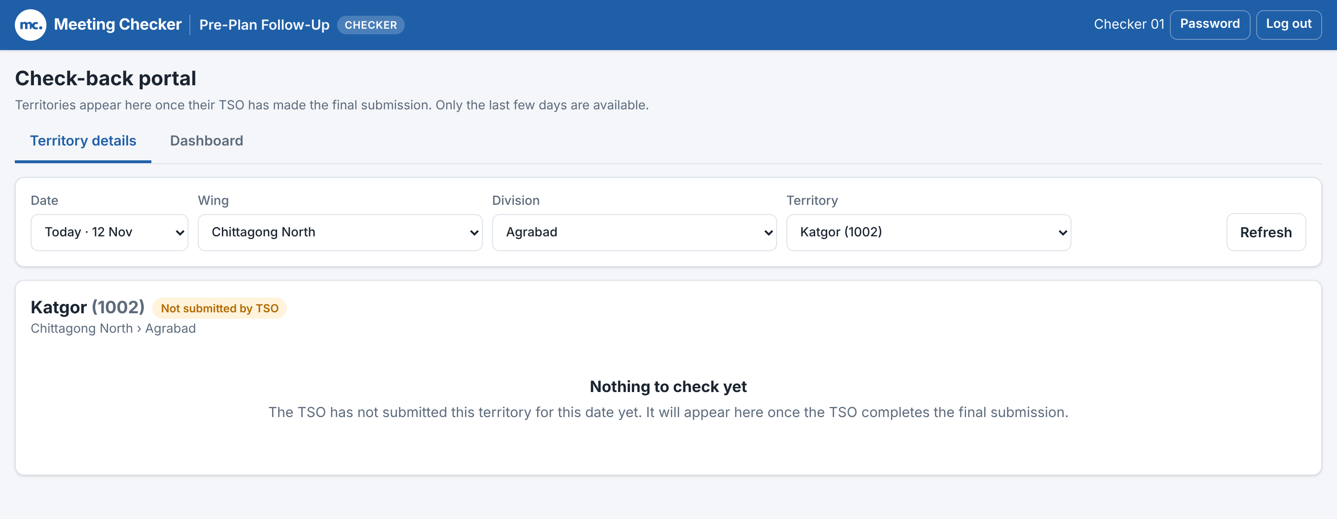
Choose a date and territory
Filters at the top of Territory details
1
Date
Today, Yesterday or the day before.
2
Wing
Unlocks the Division list.
3
Division
Unlocks the Territory list.
4
Territory
Name and code, e.g. Agrabad (1001). Loads at once.
A territory the TSO has not submitted yet
Not submitted by TSO
Nothing to check yet. It appears after the TSO’s final submission: use Refresh later.
5
Refresh
Reloads the territory to see the latest changes.
Notes:
The four lists cascade: choose the wing first, then the division, then the territory. The page remembers the last selection, so next time you return straight to it. A territory only shows data once its TSO has made the final submission. Until then you see the amber badge Not submitted by TSO and the message Nothing to check yet. Check back later and press Refresh.

Slide 10
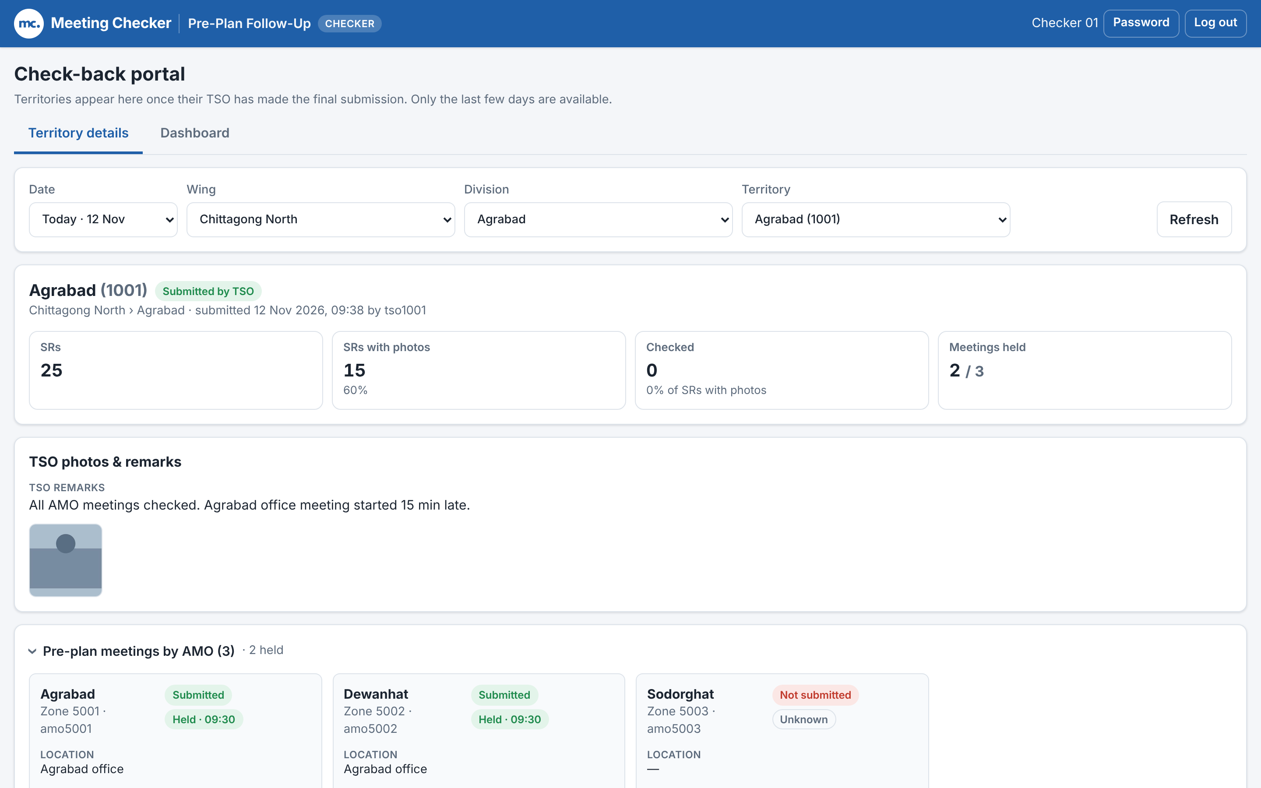
Read the territory summary
Submitted by TSO
Green badge, with time and TSO username.
SRs · SRs with photos
All SRs in the territory and how many have at least one photo.
Checked
SRs checked so far, as % of SRs with photos.
Meetings held
AMO zones that held the meeting, e.g. 2 / 3.
TSO photos & remarks
The TSO’s own photo and note. Click to enlarge.
A submitted territory: header, totals, TSO photos and AMO meetings
Notes:
Once the territory is submitted, the top card shows the name and code, the green Submitted by TSO badge and when and by whom it was submitted. The four tiles give the totals: SRs, SRs with photos, Checked (which updates live as you work) and Meetings held. Below is the TSO card with the TSO remarks and photo, then the collapsible list of AMO pre-plan meetings, then the SR table.

Slide 11
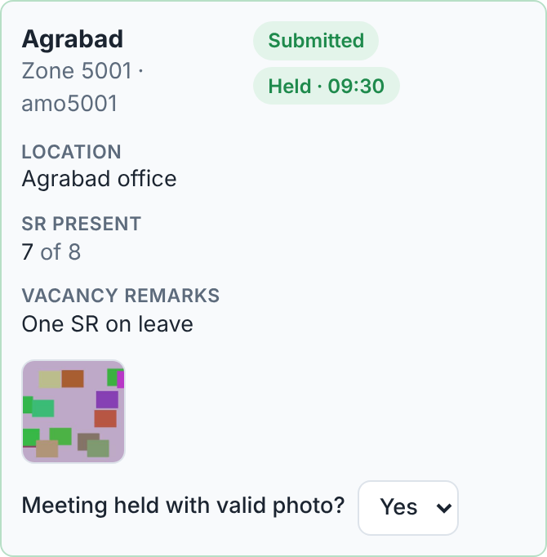
Check point 1: was the meeting held?
1
Open “Pre-plan meetings by AMO”
One card per AMO zone. Click the heading to open or close it.
2
Read the badges
Submitted / Not submitted, and Held · time or Not held.
3
Click the meeting photo
Location, SR present and remarks help you judge it.
4
Choose Yes or No
In Meeting held with valid photo? It saves at once (Saved).
Choose No when…
There is no meeting photo, it does not show a meeting, or it is not today’s. Not submitted zones are locked.
One AMO card in Pre-plan meetings by AMO
Notes:
Each AMO zone has a card. The badges show whether the AMO submitted the zone and whether the meeting was held and at what time. Check the location and the number of SRs present, open the photo and decide. Choose Yes or No in Meeting held with valid photo; it saves immediately, a green Saved message appears, and the card border turns green for Yes or red for No. For a zone the AMO never submitted, the list is greyed out because there is nothing to judge. Leave it on the dash if you have not decided yet.

Slide 12
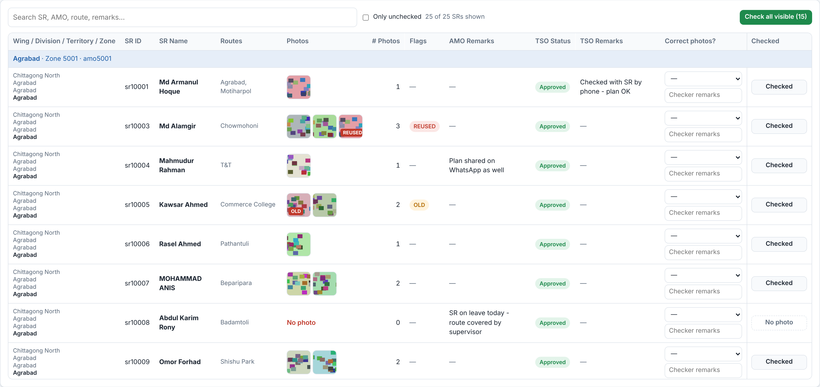
The SR table: one row per SR
Wing / Division / Territory / Zone
where the SR sits
SR ID · SR Name · Routes
who and which routes
Photos · # Photos
click a thumbnail to enlarge
Flags
REUSED or OLD warnings
AMO Remarks · TSO Status · TSO Remarks
what the AMO and TSO said
SR table, grouped by zone
Correct photos?
your verdict and Checker remarks
Find an SR fast
Type in the search box: SR, AMO, route or remarks. The blue band above each group shows the zone and AMO.
Checked
your sign-off button
Notes:
Every SR in the territory has a row, grouped by AMO zone with a blue band showing the zone name, zone code and AMO username. Go through the columns left to right: location, SR identity and routes, the photos and their count, the flags, then the AMO and TSO comments. The last two columns are yours: Correct photos with a remarks box, and the Checked button. The search box filters the rows as you type. On a narrow screen the table scrolls sideways; the Checked column always stays visible on the right.

Slide 13
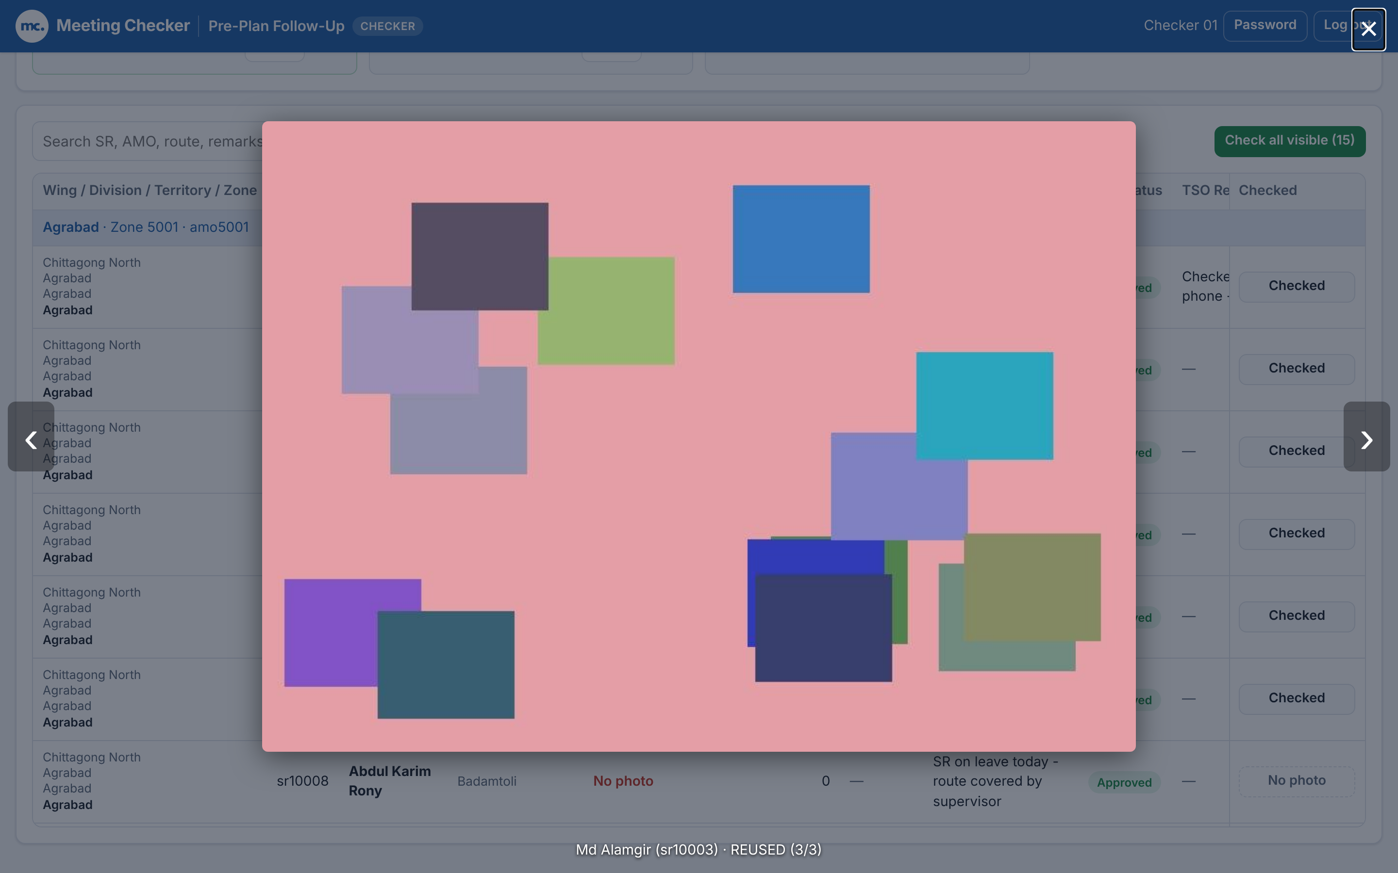
Open the photos and read the flags
1
Click a thumbnail
The photo opens full size.
2
Use ‹ and › to move
Caption: SR name (ID), flag, e.g. (3/3).
3
Close with × or Esc
You return to the same row.
REUSED
Same photo was uploaded before. Usually Correct photos = No.
OLD
Taken more than 2 days before the report date.
Photo viewer: caption shows SR, flag and photo count
No photo
Nothing uploaded. Read the AMO Remarks for why.
Flags also show as small labels on the thumbnails themselves.
Notes:
Click any thumbnail to open the photo viewer. Use the arrows to move between the photos of the same SR; the caption shows the SR name and ID, any flag and the position, for example 3 of 3. Close with the cross or Escape. Flags: REUSED means the exact same photo file was uploaded before, which usually means it is not today’s plan. OLD means the photo’s own capture date is more than two days before the report date. No photo means nothing was uploaded; the AMO remarks often explain why, for example SR on leave.

Slide 14
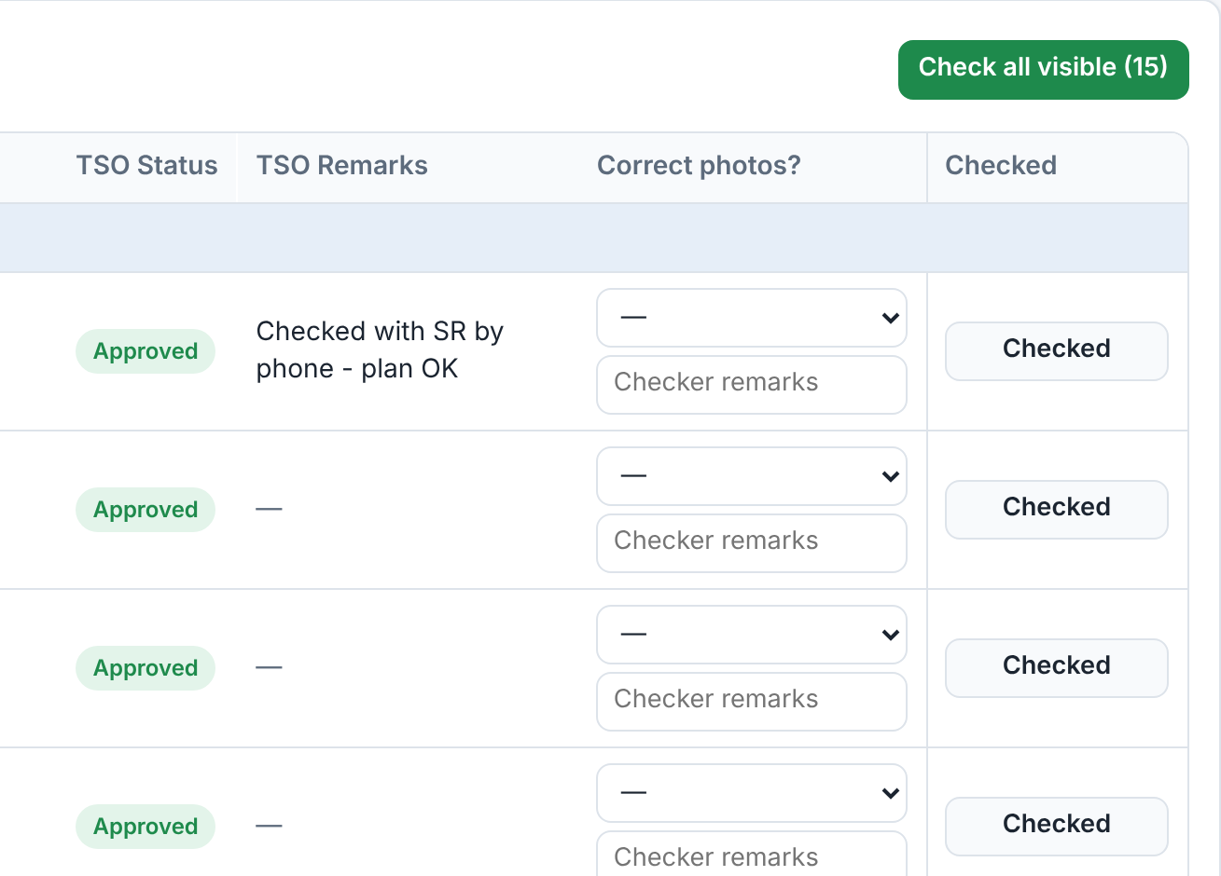
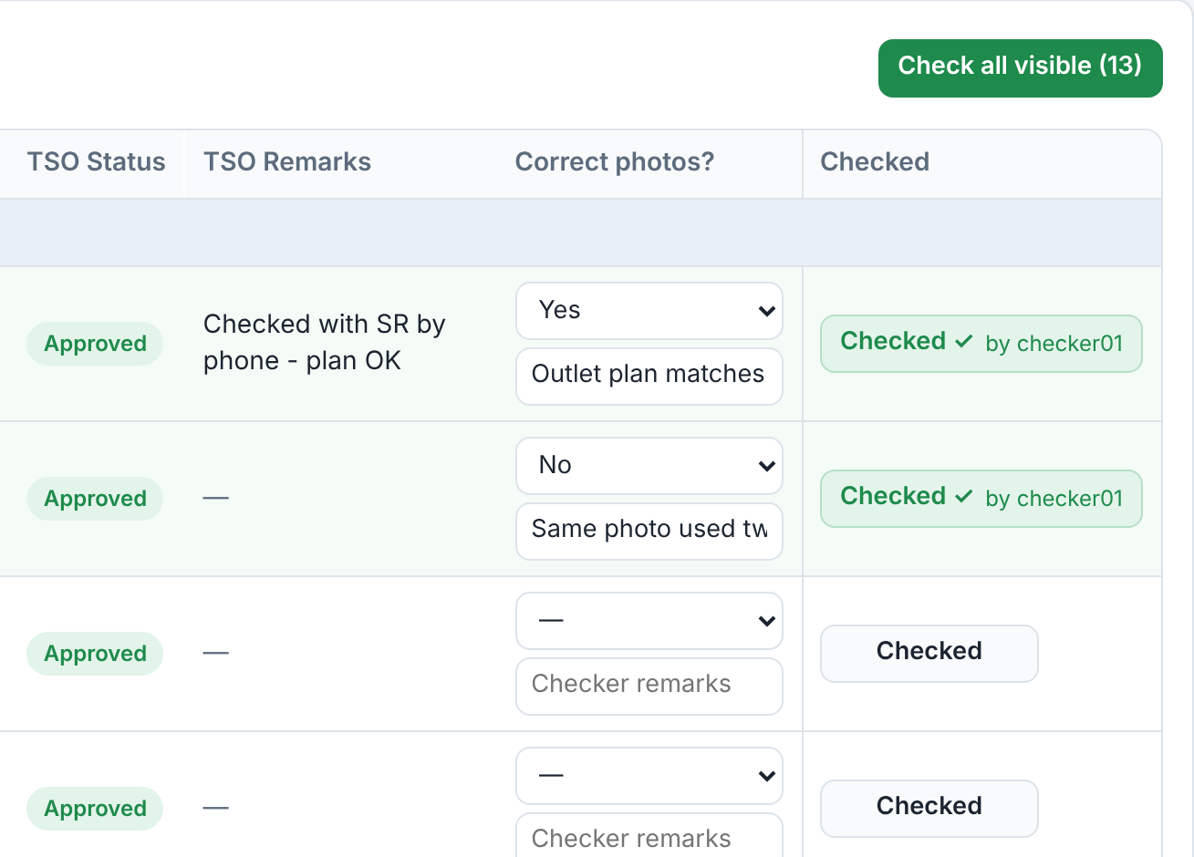
Check point 3: record your verdict and click Checked
Before
After
Not yet checked
Row 1: Yes, row 2 (REUSED): No, both checked
1
Correct photos?
Choose Yes or No. Saves at once.
2
Checker remarks
Type why, especially for No.
3
Click Checked
Turns green: Checked ✓ by you. Click again to undo.
Notes:
This is check point three. For each SR with photos, look at the photos and choose Yes or No under Correct photos. Add a short checker remark, especially when you choose No, so the reason appears in the Excel. Then click Checked: the row turns green and the button shows Checked with your username. Clicking it again undoes the check. Every SR with photos should end the day checked. SRs without a photo show a dashed No photo button that cannot be clicked: there is nothing to check, and they are reported through the missing-images Excel, which covers check point two.

Slide 15
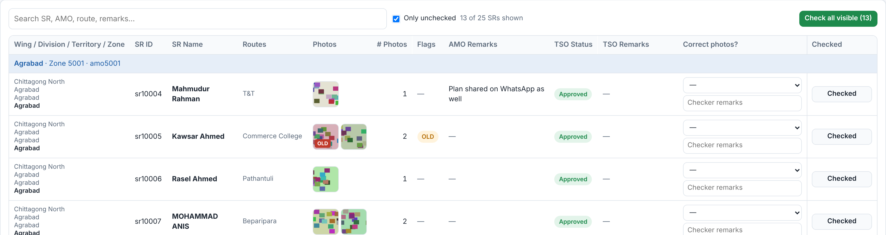


Work faster: Only unchecked and Check all visible
Only unchecked ticked: 13 of 25 SRs shown
Only unchecked
Hides SRs already checked and SRs with no photo. Your to-do list.
Check all visible (n)
Marks every visible unchecked SR as checked after you confirm.
Undo a check
Click a green Checked ✓ button again. It goes back to unchecked.
Notes:
Tick Only unchecked to hide everything already checked, plus SRs with no photo; what remains is your to-do list, and the counter shows how many rows are visible. Check all visible marks every visible, unchecked SR with photos as checked; the button shows how many, and the browser asks you to confirm. Only use it after you have actually looked at those photos, and combine it with the search box to limit it to one zone. To undo any check, click the green Checked button again.

Slide 16
Dashboard & reports
03
Tab 2: see progress everywhere and download the Excel reports

Slide 17



Dashboard: the five KPI tiles
KPI tiles for Today, all wings
Pre-plan meetings held
AMO zones that held the meeting, of all zones.
SRs with outlet-wise pre-plan
SRs with photos, of all SRs, and how many are missing.
Checked by checkers
Checked SRs of uploaded SRs, and how many to go.
Check pass rate
Share of checked SRs marked Correct photos = Yes.
Territories submitted
Territories whose TSO made the final submission.
Filters drive everything
Date, Wing, Division and Territory change the tiles, charts, table and both Excel downloads.
Notes:
Open the Dashboard tab. The five tiles summarise the selected date and scope. Pre-plan meetings held counts AMO zones; SRs with outlet-wise pre-plan shows photo coverage and the number missing; Checked by checkers is our own progress with the number still to go; Check pass rate is the share of checked SRs marked correct; Territories submitted shows how many TSOs have finished. Each tile with a bar shows the percentage visually. All of it follows the four filters at the top.

Slide 18
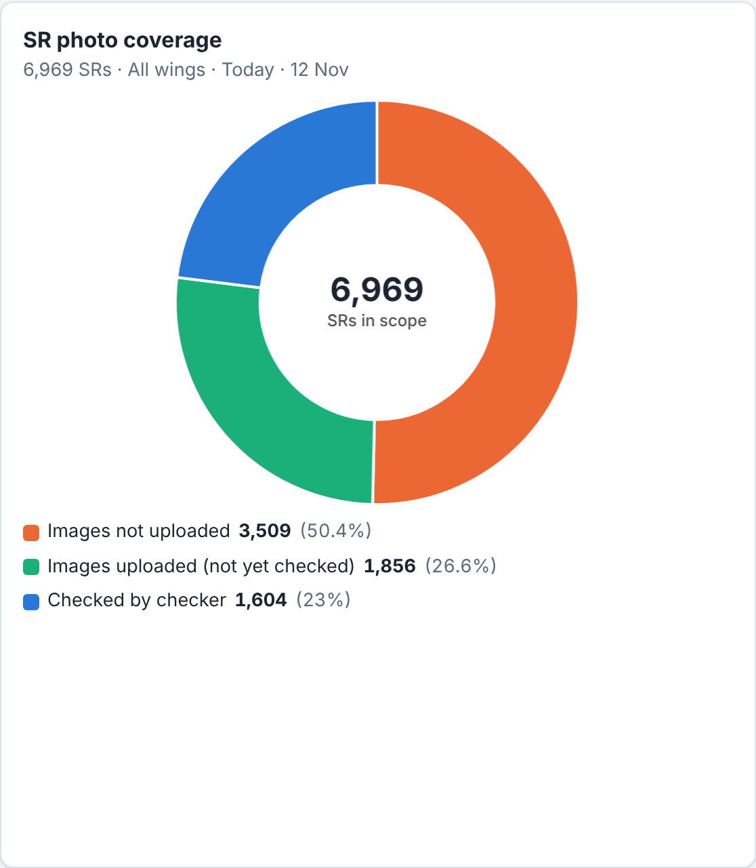
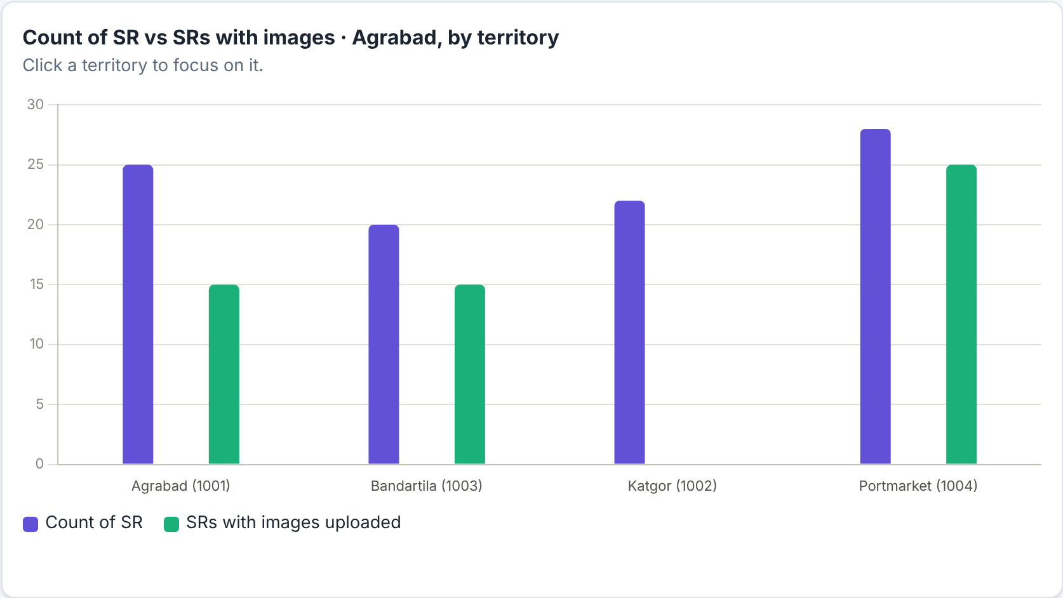
Charts: photo coverage and drill-down
Images not uploaded
No photo, or the TSO has not submitted yet.
Uploaded, not yet checked
Your remaining work.
Checked by checker
Done.
After clicking Agrabad: bars per territory
1
Click a division bar
Bars now show its territories.
SR photo coverage
2
Click a territory bar
Focus on that territory.
Or click a row in the Division numbers table. Go back with All divisions.
Notes:
The doughnut splits all SRs in scope into three groups: orange, images not uploaded; green, uploaded but not yet checked, which is the work left for the team; blue, checked. The centre shows the number of SRs in scope. The bar chart compares Count of SR (purple) with SRs with images uploaded (green) for each division. Click a division bar, or a row in the Division numbers table below, to drill into that division; the bars then show its territories, and clicking a territory focuses on it. To go back, set Division to All divisions. Note that SRs in a territory the TSO has not submitted count as not uploaded.

Slide 19

Download the Excel reports
Set the filters first, then click a download button
Both files start with: Date, Wing, Division, Territory Code, Territory, Zone Code, AMO (Zone), AMO Username, Route Codes, Routes, SR ID, SR Name
Download missing-images Excel
Full status Excel
missing_images_<date>.xlsx
sr_status_<date>.xlsx
Only SRs with no photo. Share it with the field team.
Adds: AMO Report Status (Not started, Draft (not sent), Submitted to TSO, Returned to AMO), TSO Submission Status, AMO Remarks, TSO Remarks.
Every SR in scope: the day’s record.
Also adds: # Photos, Images Uploaded (Yes/No), TSO Status, Checked (Yes/No), Correct Photos?, Checker Remarks, Checked By.
Notes:
Both downloads use the current Date, Wing, Division and Territory filters, so set the scope first. The button shows Preparing while the file is built. Both files share the twelve location and SR columns. The missing-images file lists only SRs without a photo, with the AMO report status (Not started, Draft, Submitted to TSO, Returned to AMO), whether the TSO submitted, and the remarks that usually explain why. The full status file lists every SR with photo count, Images Uploaded yes or no, TSO status, Checked yes or no, our Correct Photos verdict, checker remarks and who checked it. Each column has a filter in Excel.

Slide 20


Daily routine checklist
Start
Each territory
End of day
Sign in at meetingchecker.com
Territory details: pick the territory
Only unchecked: list should be empty
Dashboard: Territories submitted and “to go”
Meeting held with valid photo? for each AMO
Download missing-images Excel and share it
Finish yesterday first if anything is left
Open photos, watch REUSED / OLD
Keep the Full status Excel as a record
Correct photos? + remarks, then Checked
Notes:
Hand this slide out as the one-page routine. Start of day: sign in, look at the dashboard and finish any territory left over from yesterday, because the window is only three days. For every submitted territory: judge each AMO meeting, open the photos, record Correct photos with a remark, then click Checked. End of day: tick Only unchecked in each territory to confirm nothing is left, download the missing-images Excel and send it to the field team, and keep the full status Excel.

Slide 21




FAQ and troubleshooting
It says “Not submitted by TSO”
The button says “No photo”
I clicked Checked by mistake
The TSO has not made the final submission. Check again later and click Refresh.
No photo was uploaded, so nothing to check. The SR is in the missing-images Excel.
Click the green Checked ✓ button again to undo it.
I can’t find an older date
The meeting list is greyed out
An error or the login page appears
Only the last 3 days are kept. Older data and photos are deleted.
The AMO did not submit that zone, so there is no meeting to judge.
Your sign-in expired (24 h) or the network dropped. Sign in again and repeat.
Notes:
Common questions. Not submitted by TSO: the territory is not ready; nothing can be checked until the TSO submits. No photo: the SR has no image, so it cannot be checked and is reported in the missing-images Excel. Wrong click: click Checked again. Older dates: the portal only keeps three days. Greyed-out meeting list: the AMO never submitted that zone. Errors or a sudden sign-in page: the 24-hour session ran out or the connection dropped; sign in again. If a territory looks wrong, for example many SRs counted as not uploaded, remember that SRs only count as uploaded once the TSO has submitted.

Slide 22
Need help?
Access, new accounts and password resets: contact your admin
Site: meetingchecker.com · Sign in with your own checker username
Notes:
Close by repeating where to get help. The admin creates accounts and resets passwords; there is no self-service reset. The site is meetingchecker.com. Invite questions and, if time allows, let each checker sign in and check one SR live.

