Slide 1
TSO User Manual
Review your AMOs’ reports, approve SRs and submit your territory every day
For Territory Sales Officers · desktop or phone · meetingchecker.com
Notes:
Welcome. This session is for Territory Sales Officers (TSOs). By the end, every TSO should be able to review the AMO reports of their territory, approve SRs, return a zone when something is wrong, upload their own photo and submit the territory on time.

Slide 2





How the daily process works
AMO
TSO (you)
Check-back team
Each AMO runs a zone
You own the territory
Head-office checkers
Records the meeting, uploads the outlet plan photo for each SR, adds remarks and submits the zone report.
Reviews every zone, approves each SR, returns a zone if needed, adds a TSO photo and submits the territory.
Sees the territory only after you submit. Checks photos and reports SRs with images not uploaded.
Not right? Return to AMO sends the zone back with your reason. The AMO fixes it and submits again.
Same day: today or yesterday only
Notes:
Walk through the chain left to right. AMOs submit zone reports; the TSO is the quality gate for the whole territory; nothing reaches the check-back team until the TSO presses Submit. Point out the red loop: the TSO can send a zone back to its AMO with a reason. Mention the time limit, which is covered in detail later: work can only be done for today or yesterday.

Slide 3




What this manual covers
01
02
Getting started
Review & approve
Sign in, the territory overview and the totals at the top
Meeting info, photos and flags, approve SRs, undo, approve all, return a zone, zones not started
03
04
Submit your territory
Quick reference
TSO photo, overall remarks, when Submit appears, final submission and deadlines
Using a phone, daily checklist, FAQ and troubleshooting, where to get help
Notes:
Four parts. Parts 1 to 3 follow the order of a normal working day; part 4 is reference material to keep at hand. Allow roughly 30 to 40 minutes including a live demo.

Slide 4
Getting started
01
Sign in and read your territory at a glance

Slide 5
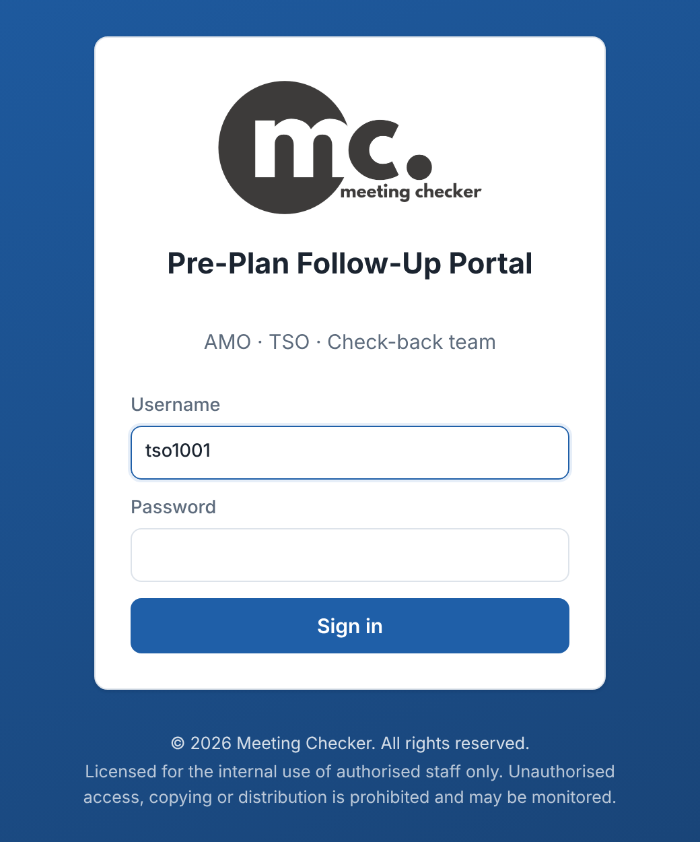
Sign in to the portal
1
Open meetingchecker.com
Any browser on a computer or phone. Bookmark it.
2
Enter your Username
Your TSO username from the admin, e.g. tso1001.
3
Enter your Password and tap Sign in
You land straight on your territory review page.
4
Change your password
Password button, top right. 8+ characters. Signs you out on other devices.
Keep your account to yourself
Never share your password. 8 wrong passwords lock sign-in for 15 minutes. Forgot it? Ask your admin to reset it. Log out on shared devices.
Sign-in page at meetingchecker.com
Notes:
Demonstrate sign-in live. Usernames come from the admin and follow the pattern tso plus territory code. Show the Password button in the top bar and the Log out button next to it. There is no self-service reset: a forgotten password is reset by the admin, who gives the TSO a new one. A sign-in lasts 24 hours. Changing the password signs the user out on every other device. After 8 wrong passwords in 15 minutes the portal shows Too many failed attempts. Please wait 15 minutes and try again.

Slide 6
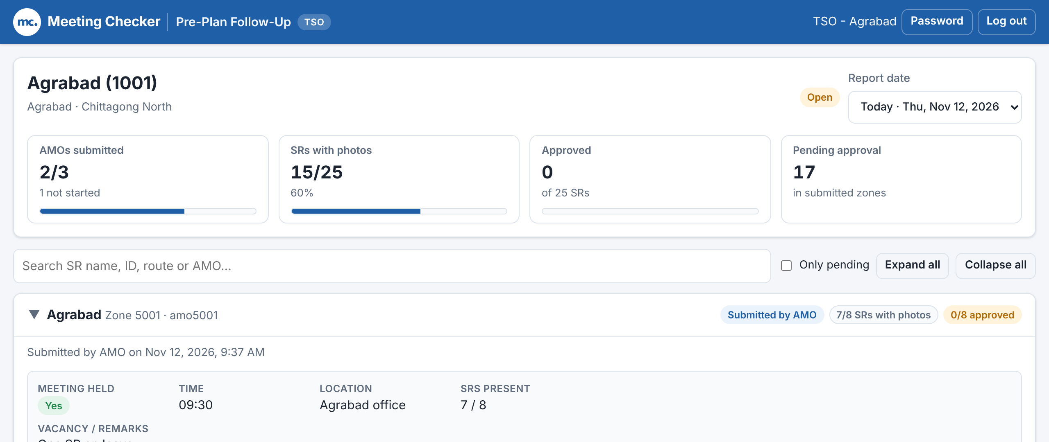
Your territory at a glance
AMOs submitted
Zones whose AMO has submitted, e.g. 2/3. Shows how many have not started.
SRs with photos
SRs that have at least one outlet plan photo.
Approved
SRs you have approved, out of all SRs.
Pending approval
SRs in submitted zones still waiting for you.
Top of the TSO page: territory, status, report date and totals
Status & Report date
Open = still editable. Submitted ✓ = locked. Report date lists Today and yesterday.
Find things fast
Search SR name, ID, route or AMO. Tick Only pending to hide approved SRs. Use Expand all / Collapse all.
Notes:
Explain each of the four tiles. Pending approval is the number that must reach zero before you can submit. Show the Report date list: it offers Today and the previous day. Then show the toolbar: the search box filters SRs and zones, Only pending hides everything already approved, and Expand all / Collapse all open or close every zone card. Zones that need attention open automatically.

Slide 7
Review & approve
02
Check each AMO zone, approve SRs or send the zone back

Slide 8
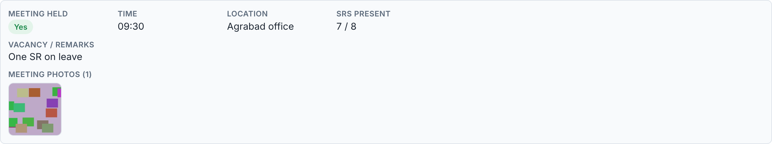



Open a zone and check the meeting
Zone header (top) and the meeting block of a submitted zone
Meeting held
Yes / No. If No, the AMO’s reason is shown instead of the time.
Time, Location, SRs present
Does it match what you know about today’s meeting?
Meeting photos
Tap a photo to enlarge it. “No meeting photo” in red needs attention.
Notes:
Click a zone header to open or close it. The header shows the zone name, zone code, AMO username and badges: the status (Submitted by AMO, AMO drafting, Returned to AMO or Not started), how many SRs have photos, and for submitted zones how many are approved. Inside, the grey meeting block shows what the AMO entered. Check it against what you know. Photos open full size when tapped; use the arrows to move between them.

Slide 9
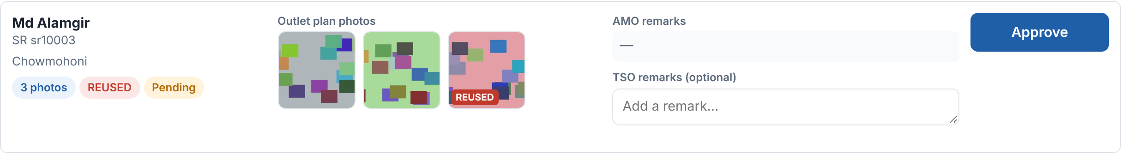
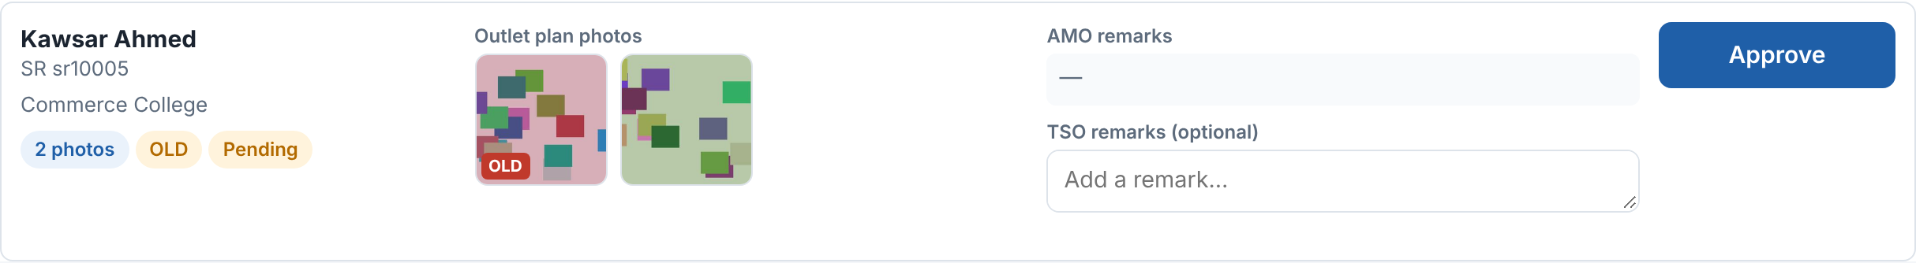
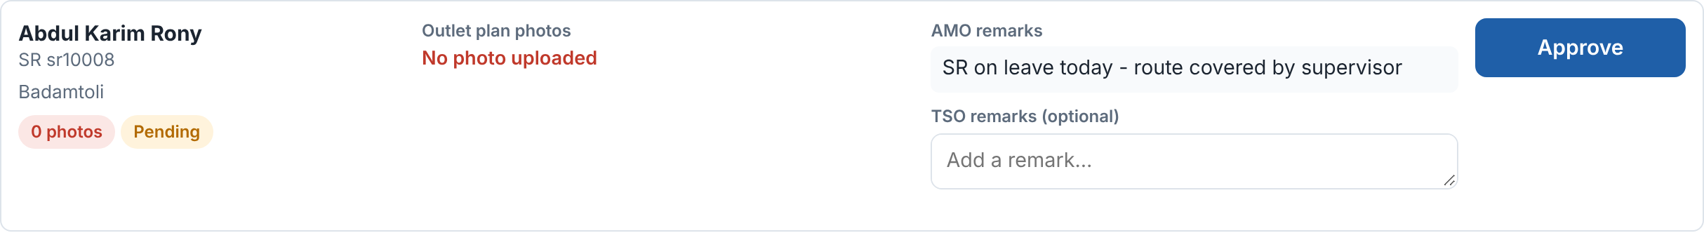
Review each SR: photos, flags and AMO remarks
REUSED
This exact photo was uploaded before. Ask the AMO why; return the zone if it is not today’s plan.
OLD
The photo was taken well before the report date (from the photo’s own data). Check it.
0 photos
No photo uploaded. Read the AMO remarks for the reason (e.g. SR on leave).
Notes:
Each SR row has four parts: SR name, ID and routes with badges; Outlet plan photos; AMO remarks plus your optional TSO remarks; and the Approve button. The badges are your red flags. REUSED means the same image file was uploaded before. OLD means the photo’s capture date is days before the report date. 0 photos with "No photo uploaded" means the AMO only left a remark. Flags are information, not automatic rejections: use judgement, and return the zone if the AMO must fix something.

Slide 10
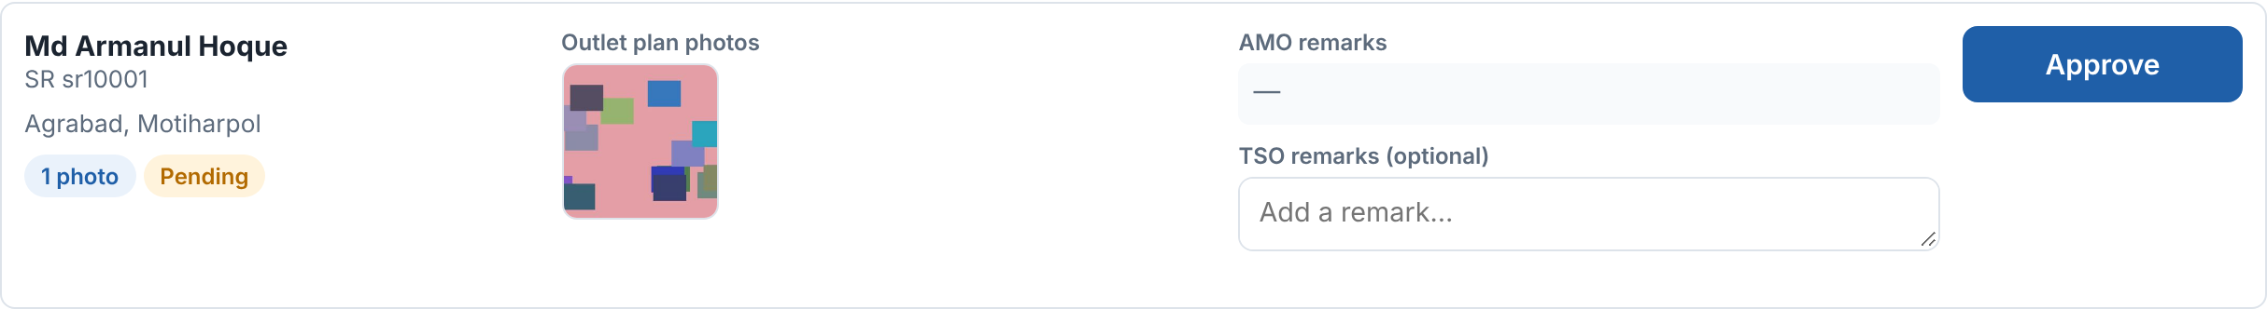
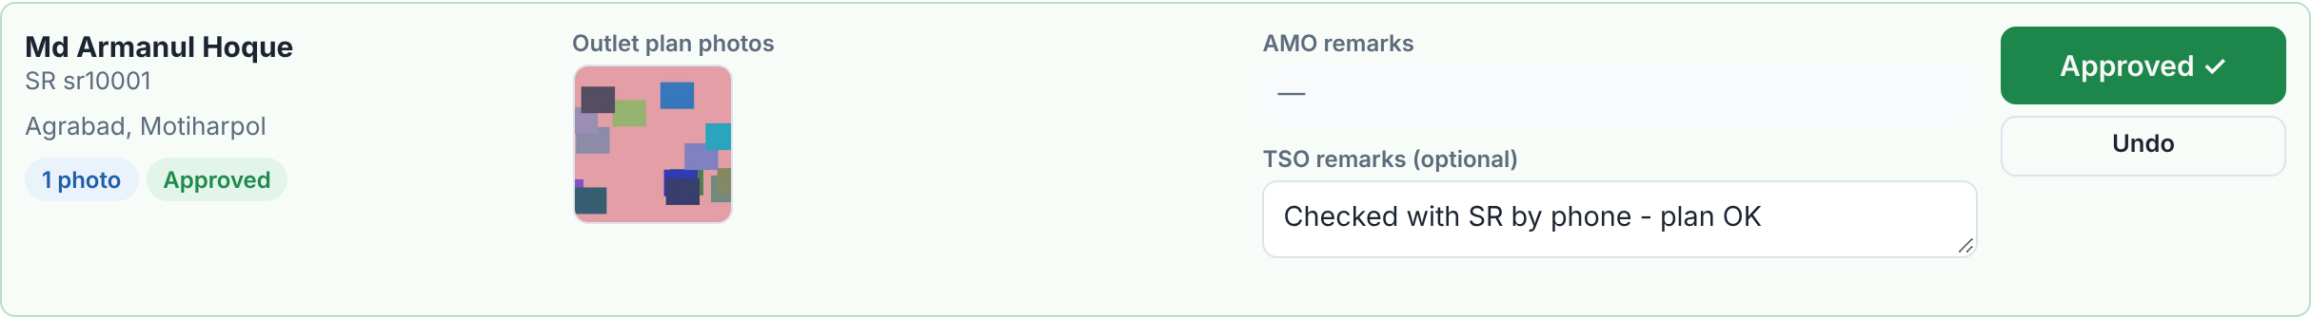
Approve an SR, with an optional remark
BEFORE
1
Check photos and remarks
Tap thumbnails to enlarge.
2
Add a TSO remark (optional)
Type in TSO remarks; it saves by itself (Saved ✓).
AFTER
3
Click Approve
Turns into a green Approved ✓ and the row turns green.
4
Changed your mind? Click Undo
The SR goes back to Pending.
Remarks are optional
You can approve without writing anything. Use TSO remarks when the check-back team should know something about this SR. Undo works until you submit the territory.
Notes:
Show one SR being approved live. The TSO remark box auto-saves about a second after you stop typing and shows Saved. Approve and Undo take effect immediately; the totals at the top update at once. Undo is available on every approved SR until the territory is submitted, after which everything is locked.

Slide 11
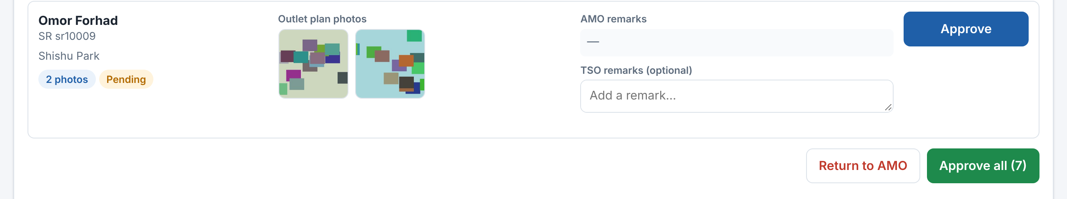
Approve a whole zone at once
Zone actions at the bottom of every submitted zone
1
Review the zone first
Look at every SR, especially REUSED, OLD and 0 photos.
Approve all is not a shortcut for checking
You are confirming every SR in the zone. Any TSO remarks you typed are kept. Once all SRs are approved the button shows Approve all (0) and is greyed out.
2
Click Approve all (n)
n = SRs still pending in this zone.
3
Confirm the pop-up
It says how many will be approved and how many have no photo.
Notes:
Approve all is at the bottom of each submitted zone next to Return to AMO. The browser shows a confirmation such as: Approve all 7 pending SR(s) of Agrabad? 1 of them have no photo (AMO remark only). Click OK to approve. Remind TSOs that approving means they vouch for the zone; the check-back team will see who approved.

Slide 12
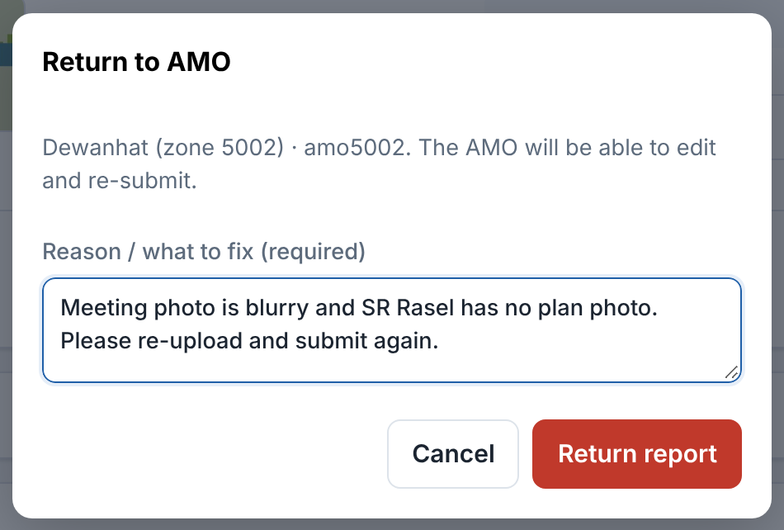
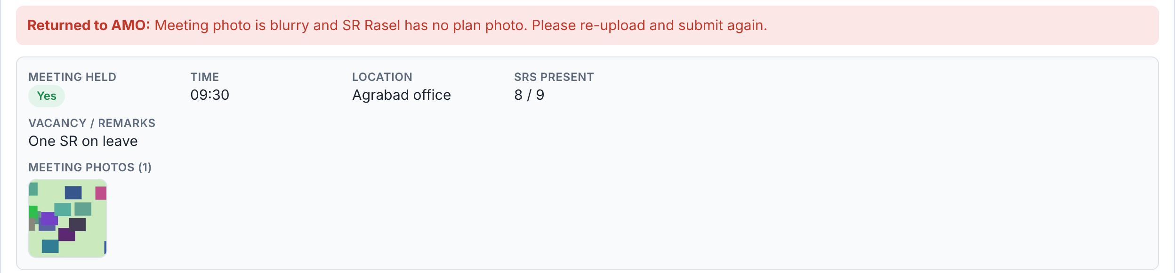
Return a zone to the AMO
1
Click Return to AMO
At the bottom of the submitted zone.
2
Write the reason (required)
Say exactly what to fix, e.g. which SR and which photo.
3
Click Return report
Status becomes Returned to AMO with your reason in red.
4
Wait for the AMO
The AMO edits and submits again; then review and approve.
Return to AMO dialog
A returned zone blocks your submission
You cannot submit the territory until the AMO submits the zone again.
Notes:
Use Return to AMO when something must be fixed by the AMO: missing or wrong photos, reused photos, wrong meeting info. The reason is mandatory and is shown to the AMO. While returned (or while the AMO is still drafting) the zone blocks your final submission, so return early in the day and follow up with the AMO by phone. When the AMO re-submits, the zone shows Submitted by AMO again and you approve as usual.

Slide 13
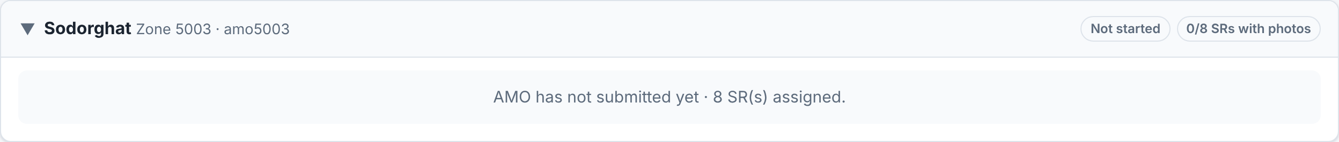
Zones not started and other zone statuses
A zone whose AMO has not started today
Not started
AMO drafting
Submitted by AMO
Returned to AMO
AMO has not saved anything.
Does not block. Its SRs are reported as not uploaded.
AMO is still preparing.
Blocks Submit until the AMO submits.
Ready for your review.
Approve every SR or return it.
You sent it back.
Blocks Submit until re-submitted.
Call AMOs who have not started before you submit: once you submit, their SRs count as images not uploaded.
Notes:
Explain the four zone statuses. Only drafting and returned zones block the Submit button. A zone that was never started does not block, but the TSO gets a warning and has to tick a confirmation box, and every SR in that zone is reported to the check-back team as images not uploaded. So the TSO should chase those AMOs first.

Slide 14
Submit your territory
03
Your photo, overall remarks and the final hand-over

Slide 15
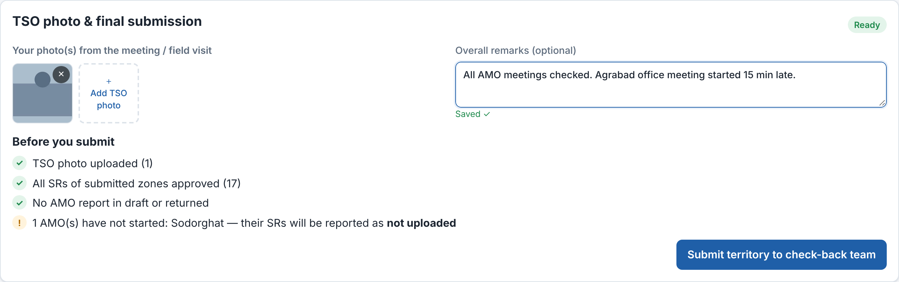
Add your TSO photo and overall remarks
1
Scroll to the bottom card
TSO photo & final submission.
2
Tap + Add TSO photo
Camera or gallery. Up to 10 photos from the meeting or field visit.
3
Wrong photo? Tap ×
Removes it while the territory is open.
TSO photo & final submission card (bottom of the page)
At least one TSO photo is required
Without it the Submit button never appears. Wait until the upload finishes before leaving the page; the portal warns you if an upload is still running.
Overall remarks (optional)
Anything the check-back team should know. Saves by itself.
4
Notes:
The TSO photo is proof that the TSO attended or visited. It is mandatory: at least one, at most ten. Photos can be taken directly with the phone camera. The overall remarks box auto-saves and shows Saved. Both can be changed until the territory is submitted.

Slide 16
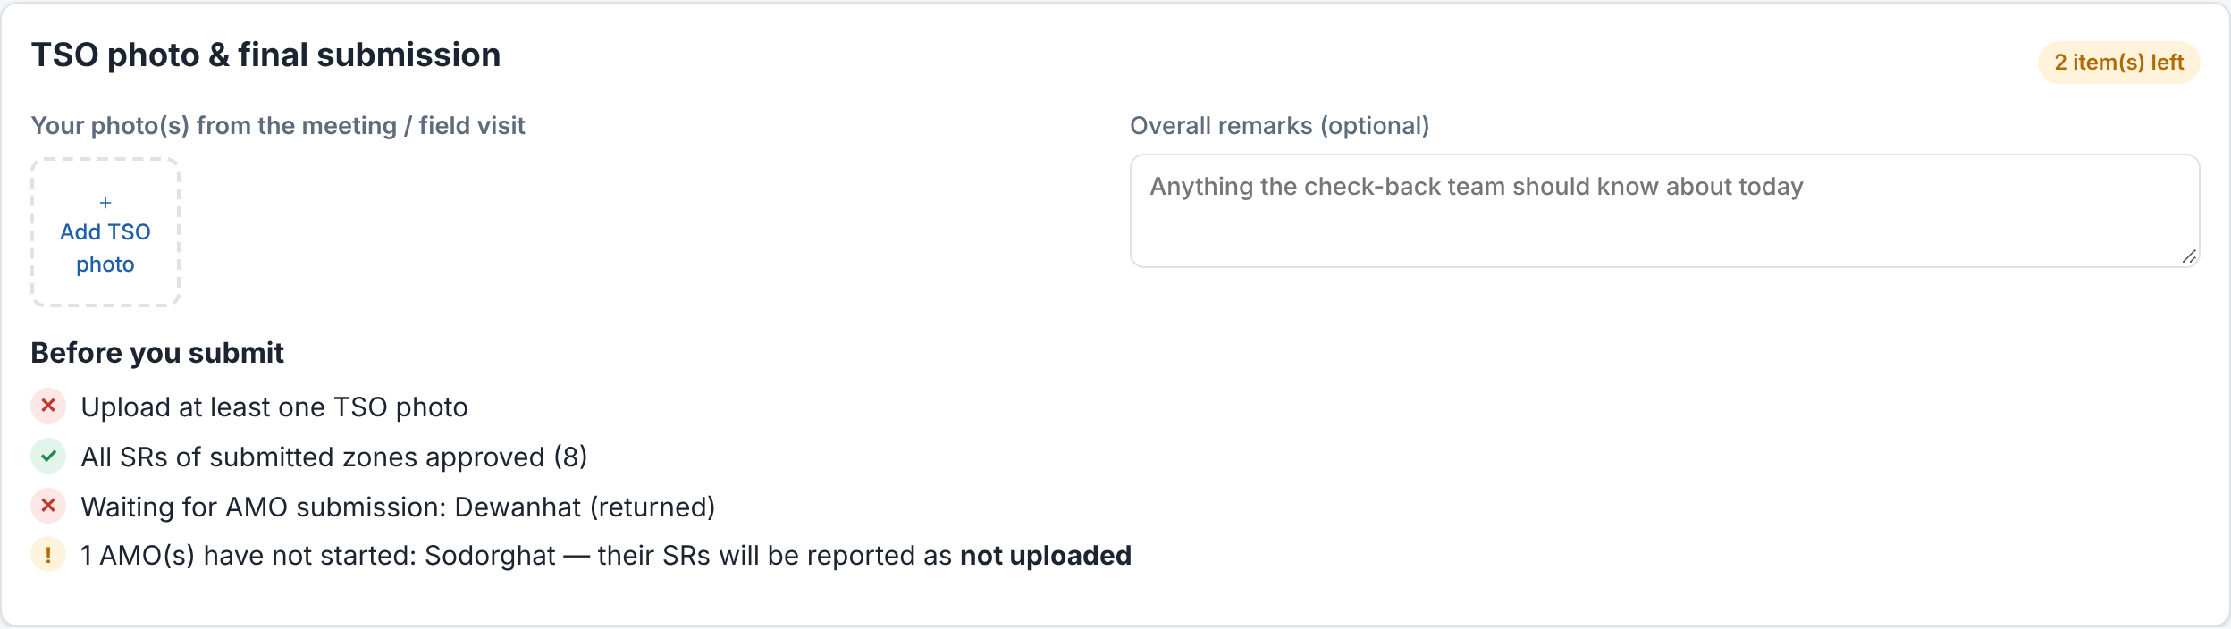




When does the Submit button appear?
NOT READY: 2 ITEM(S) LEFT
TSO photo uploaded
At least one.
All SRs approved
Every SR of every submitted zone.
No zone in draft or returned
Those AMOs must submit first.
READY
Not started (! warning)
Does not block, but you confirm it.
All clear: Submit territory to check-back team appears.
Notes:
The Before you submit checklist is the TSO’s to-do list. A red cross is a blocker; a green tick is done; an amber exclamation mark is a warning only. The badge at the top right of the card says how many items are left, or Ready. The Submit button is hidden until every blocker is cleared. Note that the date must also still be open (today or yesterday).

Slide 17
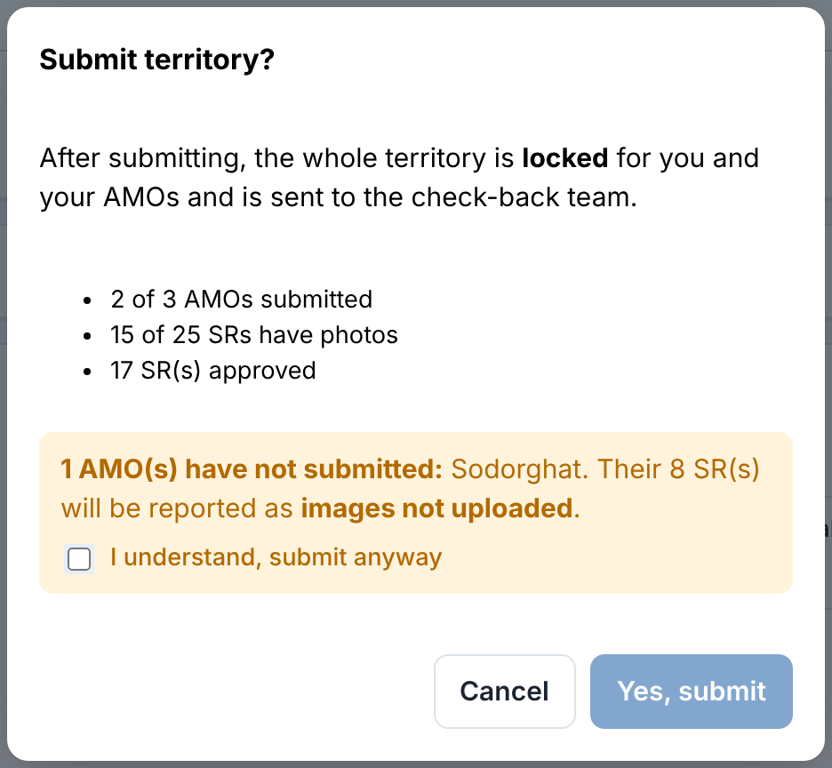
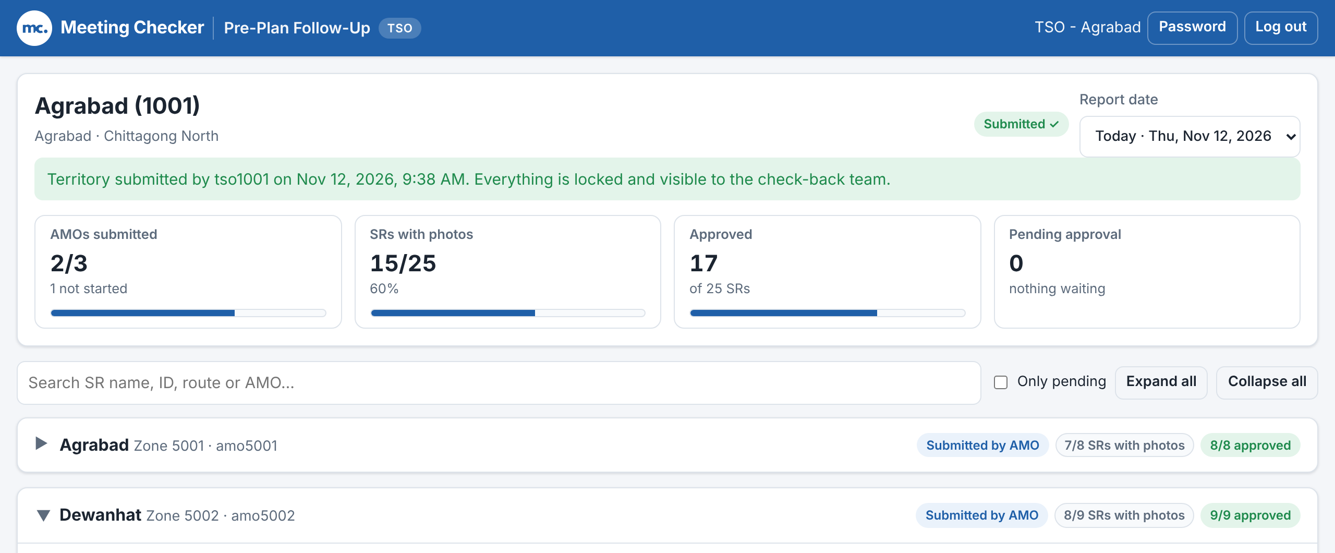

Final submission: what happens and what locks
After submitting: green banner and Submitted ✓
Confirmation dialog
Submission is final: there is no undo
You can no longer approve, undo, return or change photos and remarks. Your AMOs cannot edit their zones. The territory goes to the check-back team.
1
Click Submit territory to check-back team
2
Tick “I understand, submit anyway” (only if shown), then Yes, submit
Notes:
The dialog summarises the day: AMOs submitted, SRs with photos and SRs approved. If any AMO has not started, an amber warning lists those zones and how many SRs will be reported as images not uploaded; Yes, submit stays disabled until the TSO ticks I understand, submit anyway. After submitting, a green banner shows who submitted and when, and the status changes to Submitted. Stress that the portal has no re-open: check everything first.

Slide 18


Deadlines and the 3-day window
Today
Yesterday
Day before
Older
Open for work
Last chance
Closed
Photos deleted
Review, approve, return and submit.
Still editable. Pick it in Report date.
No more changes. Not in the Report date list.
Only the last 3 days of photos are kept.
Submit every day, ideally the same day
“Today” follows Bangladesh time. If yesterday was not submitted, choose it in Report date and finish it first.
Locked banner
“This date is closed for editing. View only.” means the window has passed.
Notes:
Editing is possible for today and yesterday only. The Report date list shows exactly those two days, with today labelled Today. After that the date is closed and the page shows a yellow banner: This date is closed for editing. View only. Photos are deleted automatically after three days, so problems must be raised quickly. The day changes at midnight Bangladesh time (Asia/Dhaka).

Slide 19
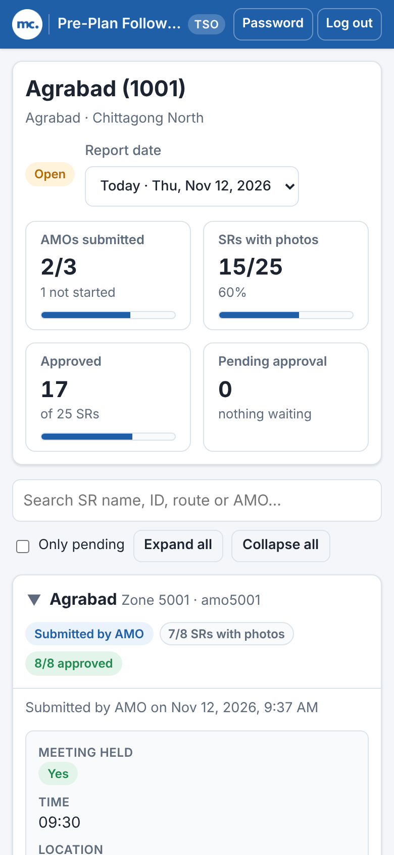
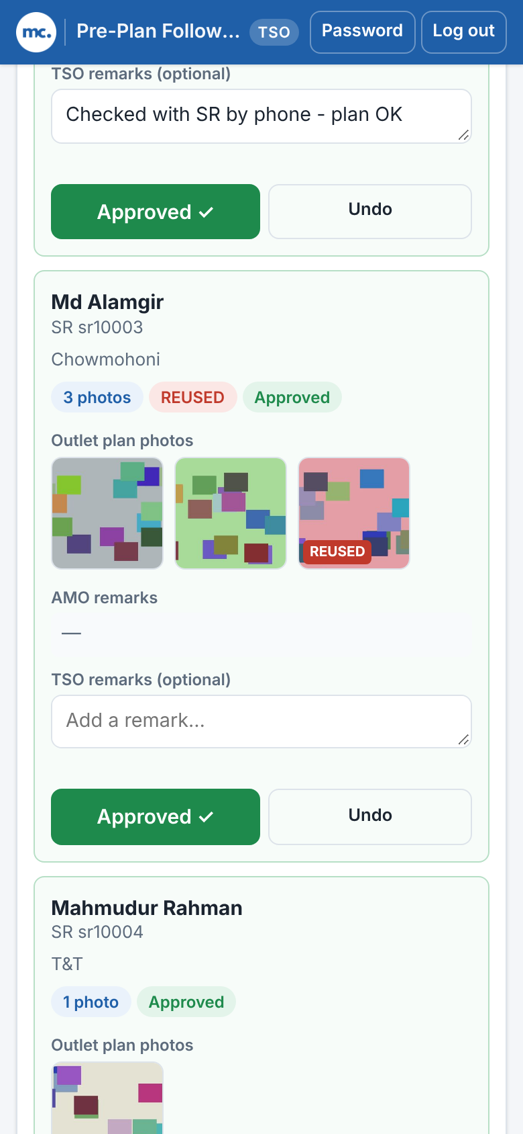
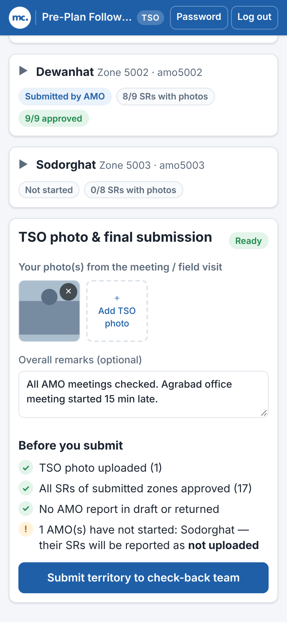


Working from your phone
Add TSO photo opens the camera
Take the photo at the meeting or visit.
Weak signal?
Wait for each upload to finish before leaving the page.
Use search and Only pending
Less scrolling on a small screen.
Log out on shared phones
Top right of every page.
Totals stack in two columns
SR cards: tap photos, Approve / Undo
Photo, remarks and Submit
Notes:
The page is identical on a phone; it simply stacks. Zone badges wrap under the zone name, each SR becomes a card with Approve and Undo side by side, and the submission card ends with a full-width Submit button. Encourage TSOs to take the TSO photo directly with the phone camera via Add TSO photo.

Slide 20
Your daily checklist
Sign in at meetingchecker.com and check Report date shows Today
Approve SRs (or Approve all); add TSO remarks where useful
1
5
Check AMOs submitted; call AMOs who are drafting or not started
Return a zone to the AMO with a clear reason if something is wrong
2
6
Open each submitted zone: meeting info and meeting photos
Upload at least one TSO photo; add overall remarks if needed
3
7
Check each SR: photos, REUSED / OLD flags, AMO remarks
Clear every red item in Before you submit, then submit the territory
4
8
Notes:
This is the routine to follow every day, in order. Suggest printing this slide. The key habits: chase AMOs early, look at the flags, never leave the day without submitting, and if yesterday is still open, finish it first.

Slide 21

FAQ and troubleshooting
I can’t see the Submit button
Approve is missing on a zone
I approved the wrong SR
Look at Before you submit: every red ✕ must be cleared (TSO photo, pending SRs, draft or returned zones).
You can only approve zones with Submitted by AMO. Drafting, returned and not-started zones have no buttons.
Click Undo on that SR. This works until the territory is submitted.
I submitted by mistake
“This date is closed for editing”
Locked out or forgot password
Submission is final in the portal. Tell the check-back team so they know.
The date is outside today / yesterday. It is view only now.
“Too many failed attempts”: wait 15 minutes, then try again. Forgot it? Ask your admin to reset it.
Notes:
Go through the most common questions. Other points if asked: if a photo upload fails, check the connection and try again; if the page shows an error after a long time, sign in again (sign-in lasts about 24 hours); if an AMO is mapped to the wrong zone or a TSO sees the wrong territory, the admin must fix the account.

Slide 22
Need help?
Contact your admin for account and password problems
Portal: meetingchecker.com
Notes:
Close by reminding TSOs where to go: the admin resets passwords and fixes accounts; the portal address is meetingchecker.com. Invite questions.

