Slide 1
AMO User Manual
How to send your daily pre-plan meeting report and SR plan photos, step by step
Notes:
Welcome. This training is for Area Marketing Officers (AMOs). It shows, step by step, how to send the daily report in the Meeting Checker portal from a mobile phone. Ask everyone to have their phone and their username ready.

Slide 2




How the process works
You (AMO)
TSO
Checker
Every day: fill in the pre-plan meeting and take live plan photos for each SR. Then tap Submit to TSO.
Checks your report. Approves it, or returns it to you to fix.
The check-back team verifies the photos after the TSO submits the territory.
If the TSO returns your report, it opens again for you. Fix it and tap Re-submit to TSO.
Your job each day
One report per day, for your own zone.
Notes:
Explain the chain: the AMO fills in the report, the TSO reviews it, and the check-back team (Checker) verifies it at the end. If the TSO is not happy, the report comes back to the AMO with a note. Stress that nothing reaches the TSO until the AMO taps Submit to TSO.

Slide 3





What you will learn
1. Sign in
Username, password, keep it safe
2. Pick the date
Today or yesterday
3. Pre-plan meeting
Held or not held
4. SR plan photos
Live camera, instant upload, photo rules
5. Submit to TSO
Fix errors, locked report, returns
6. Checklist and help
Daily checklist, problems, support
Notes:
Agenda. Six short parts. Parts 3 to 5 are the daily work. Keep the pace slow and let people follow on their own phones.

Slide 4
Getting started
01
Sign in, keep your password safe, and choose the right date

Slide 5
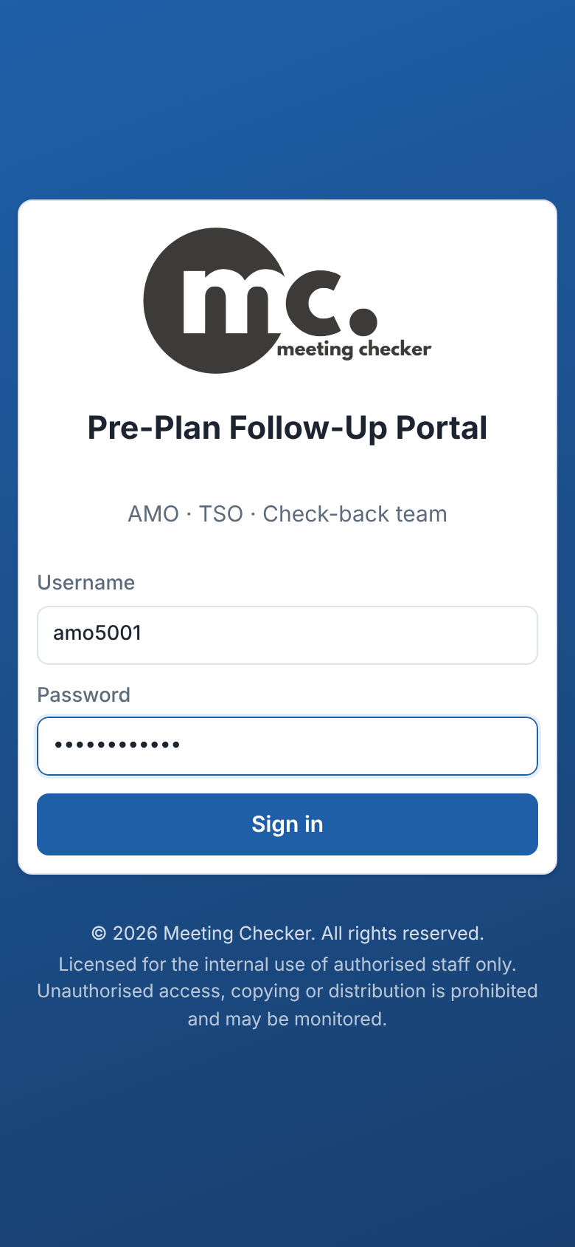
Sign in
1
Open the website
Type meetingchecker.com in your phone browser (Chrome).
Tip
Add the site to your home screen so you can open it in one tap.
2
Type your Username
Example: amo5001. Your admin gives it to you.
Too many wrong tries?
After 8 wrong passwords the account is locked for 15 minutes. Wait, then try again.
3
Type your Password
Letters are hidden as dots. Check carefully.
4
Tap Sign in
Your AMO page opens.
Sign-in page
Notes:
Show the sign-in page on a phone. The username looks like amo followed by the zone number. If the password is wrong the page says "Invalid username or password". After 8 failed tries in 15 minutes the account is blocked for 15 minutes - do not keep guessing, ask the admin for a reset.

Slide 6
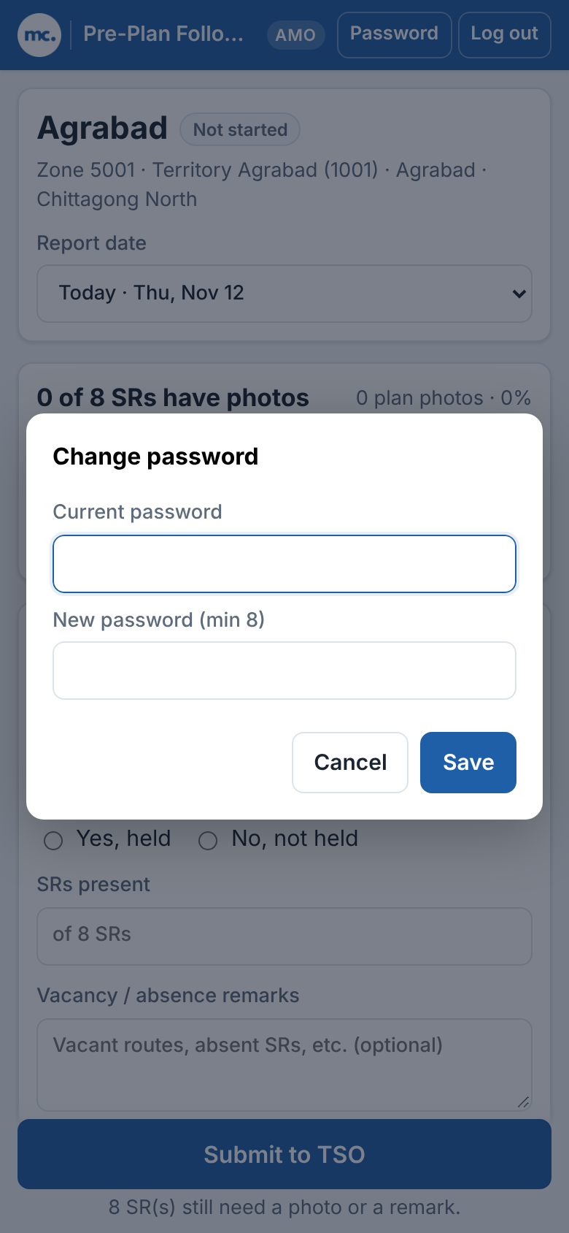

Change your password and keep it private
1
Tap Password
The button is at the top right of every page.
2
Type Current password
The password you use now.
Keep it private
Never share your password, not even with your TSO or SRs. Do not write it on your phone cover. Tap Log out on a shared phone.
3
Type New password
At least 8 characters. Make it hard to guess.
4
Tap Save
You see "Password changed".
Other phones sign out
After a password change, every other phone is signed out. Sign in there with the new password.
Password button, top right
Notes:
Ask everyone to change the first password they were given. The new password needs at least 8 characters. Everything uploaded is recorded under the username, so a shared password means someone else can submit in your name. Changing the password signs the account out on every other phone or browser, so if you think someone else knows your password, change it at once. Forgot password: only the admin can reset it.

Slide 7
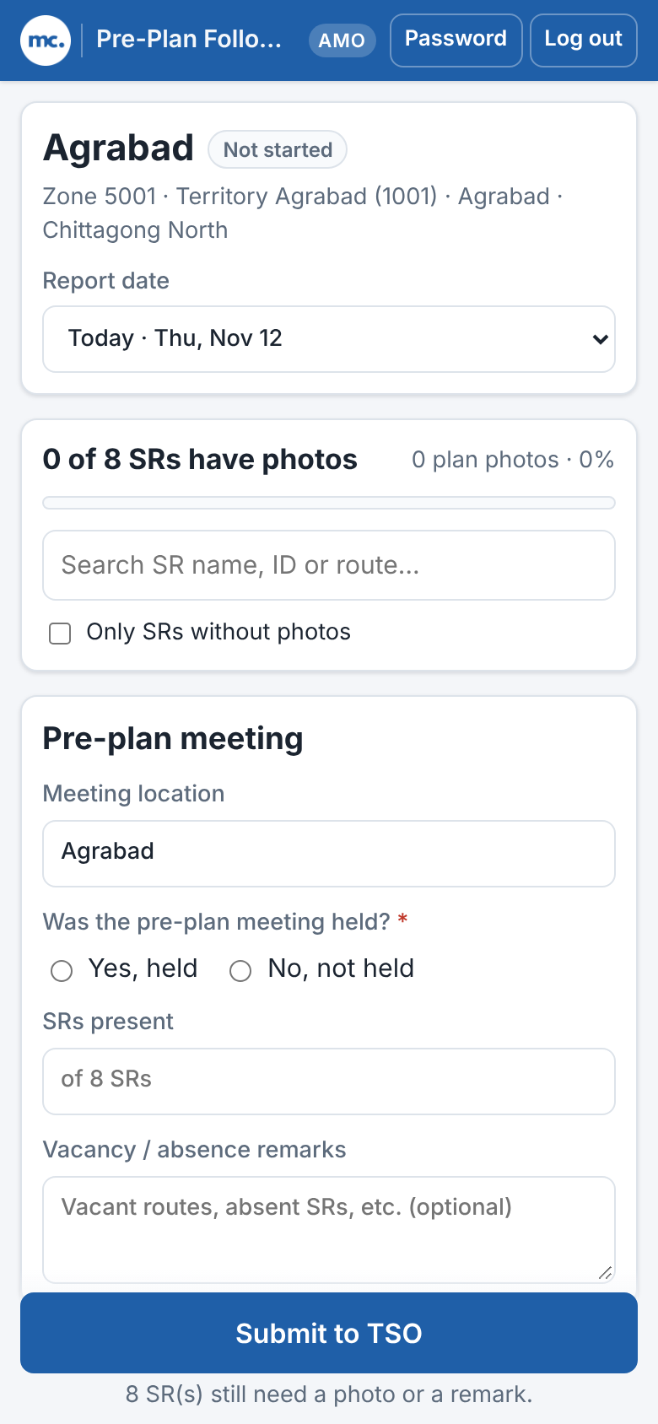
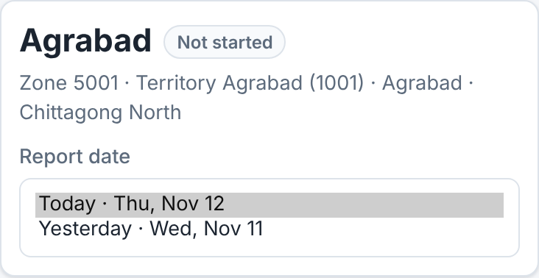
Your page and the report date
Status at the top
Not started
Draft
Submitted to TSO
Report date choices
Returned by TSO
1
Check your zone
Your zone name and status are at the top.
Check the date first
Only today and yesterday can be edited. Older days are closed.
2
Tap Report date
Choose Today, or Yesterday if you are finishing late.
3
Scroll down to work
Meeting first, then each SR, then Submit to TSO.
Your AMO page
Notes:
Walk through the page from top to bottom. The Report date list only offers today and yesterday. The status badge changes from Not started to Draft as soon as you start, Submitted to TSO after you submit, and Returned by TSO if the TSO sends it back. Always check the date before adding photos.

Slide 8
Pre-plan meeting
02
Tell us if the morning meeting was held

Slide 9
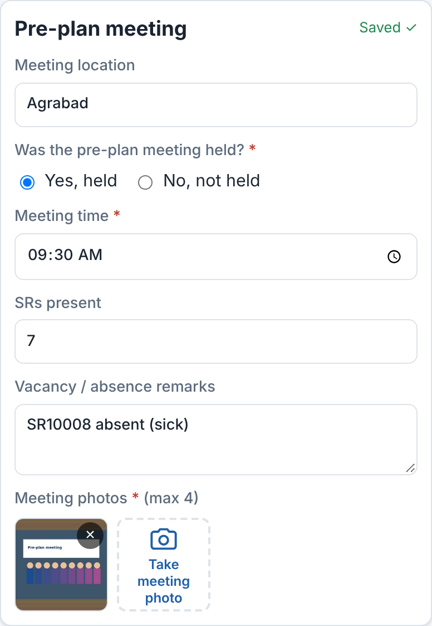
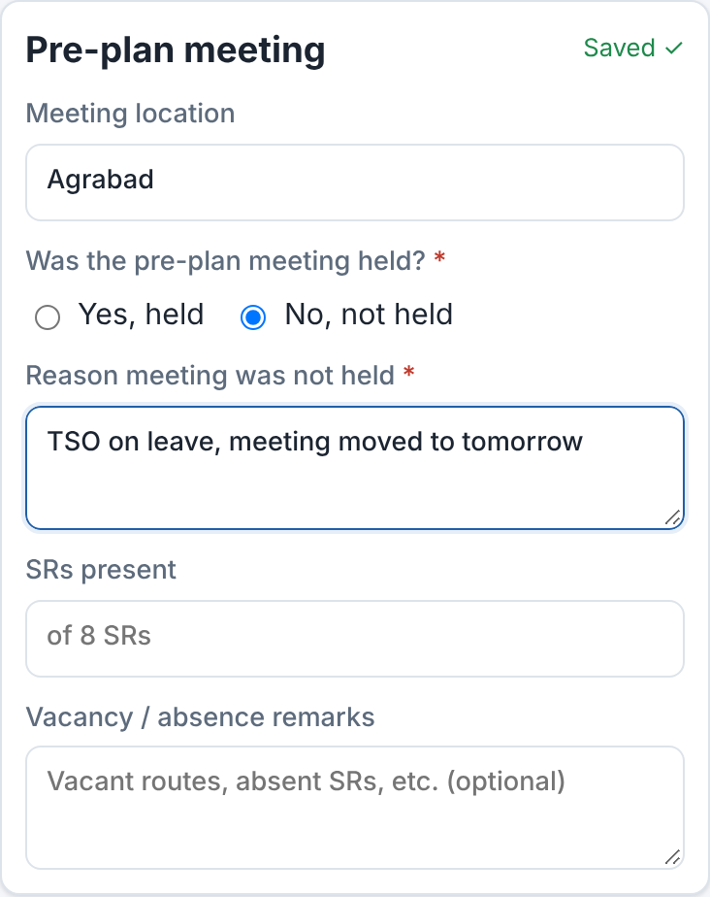

Fill in the pre-plan meeting
If Yes, held
Enter the Meeting time. Tap Take meeting photo and take at least 1 photo with the camera (max 4).
If No, not held
Write the reason the meeting was not held.
Saves by itself
Wait for "Saved ✓". SRs present and vacancy remarks are optional.
No, not held
Yes, held
Notes:
First answer "Was the pre-plan meeting held?". If yes, the meeting time and at least one meeting photo are required; up to 4 photos. The meeting photo is taken live: tap "Take meeting photo", the camera opens, take the photo of the meeting and tap Done. It works exactly like the SR plan photos in the next section. Photos cannot be picked from the gallery. If no, the reason box appears and is required. Location is pre-filled with the territory name. SRs present and Vacancy / absence remarks help the TSO but are optional. The form saves automatically - look for "Saved ✓" at the top right of the card.

Slide 10
SR plan photos
03
Take a live photo of the outlet-wise plan for every SR, with the phone camera

Slide 11
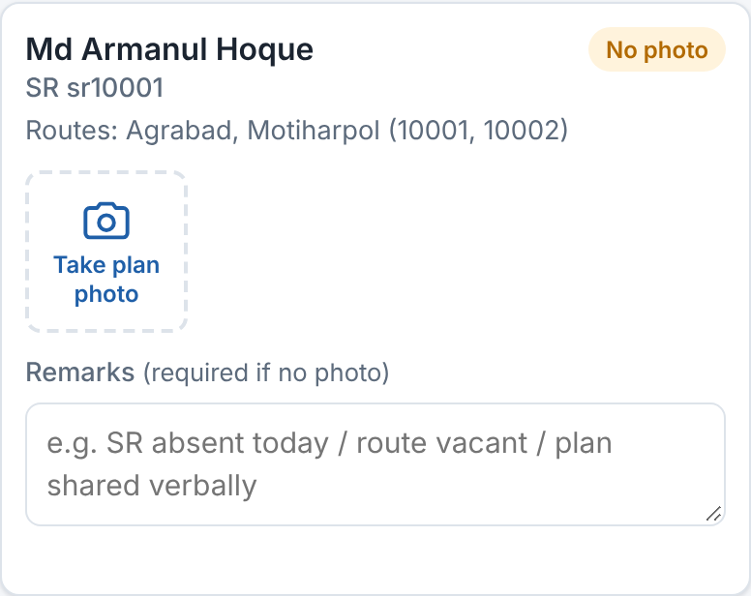
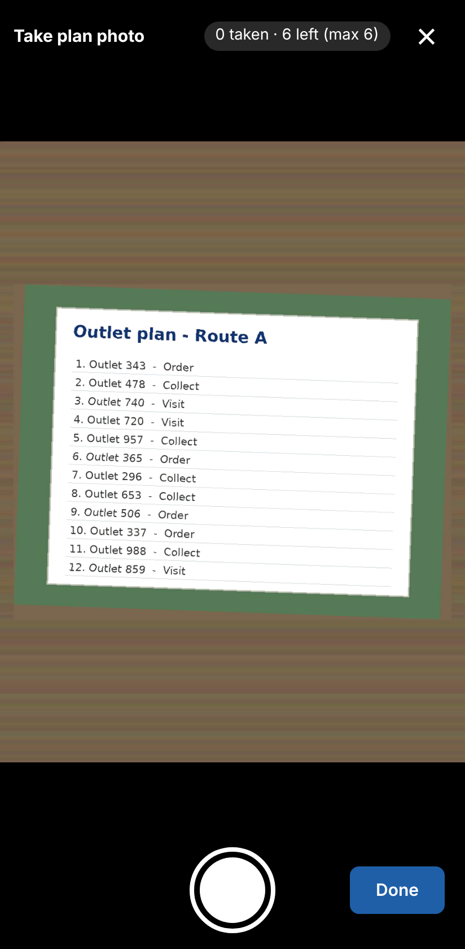
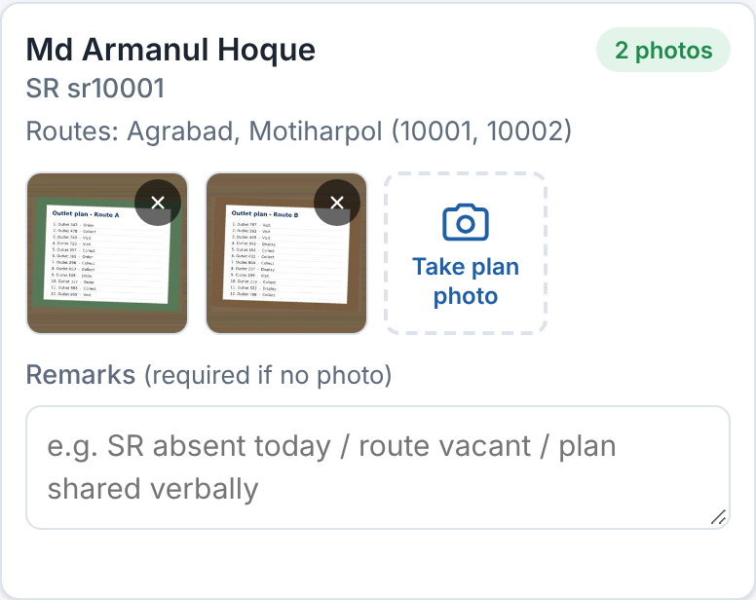
Take plan photos with the camera
1
Tap Take plan photo
The camera opens inside the page.
2
Point at the plan, tap the round button
The photo uploads at once. No extra step.
3
Need another photo?
Tap the round button again. Max 6 per SR.
1. Tap Take plan photo
4
Tap Done
The camera closes. The badge shows "2 photos".
No gallery
Photos must be taken live with the camera. You cannot choose a photo from the gallery.
3. Photos are on the SR card
2. The camera opens
Notes:
Each SR card has a "Take plan photo" tile with a camera icon. Tapping it opens the phone's back camera inside the page. Point it at the outlet-wise plan and tap the big round button: the photo is taken and starts uploading straight away - there is no separate upload step. The top of the camera shows how many photos are taken and how many are left, for example "1 taken · 5 left (max 6)". Take more if needed, then tap Done (or the × at the top) to close the camera. The badge on the SR card changes from "No photo" to "2 photos". There is no gallery option: old photos or screenshots saved on the phone cannot be added. The search box and the "Only SRs without photos" tick box still help with long lists.

Slide 12
First time only: allow the camera
1
Tap Take plan photo
Or Take meeting photo. Use Chrome on your Android phone.
Never tap Don't allow / Block
Then the camera cannot open and you cannot add photos. If it happened, see the next slide.
meetingchecker.com
2
Chrome asks about the camera
"meetingchecker.com wants to use your camera".
Allow this time?
That also works, but Chrome asks again next time.
meetingchecker.com
wants to use your camera
3
Tap Allow
Choose "Allow while visiting the site" if you see it.
Allow while visiting the site
Allow this time
4
The camera opens
Chrome remembers. Next time it opens at once.
Use the website in Chrome
Open meetingchecker.com in Chrome, not inside WhatsApp or Facebook.
Don't allow
Example. The words can differ a little by phone.
Notes:
The very first time an AMO taps "Take plan photo" or "Take meeting photo", Chrome on Android asks whether meetingchecker.com may use the camera. Tap Allow - on newer phones the choice is "Allow while visiting the site". "Allow this time" also works, but Chrome will ask again on the next visit. Do not tap "Don't allow" or "Block": the camera then stays blocked for this site until it is turned on again in Chrome's site settings (next slide). Always open the site in Chrome itself; links opened inside WhatsApp or Facebook may not be able to use the camera. The prompt on the slide is an example drawing; the exact words differ a little between Android and Chrome versions.

Slide 13
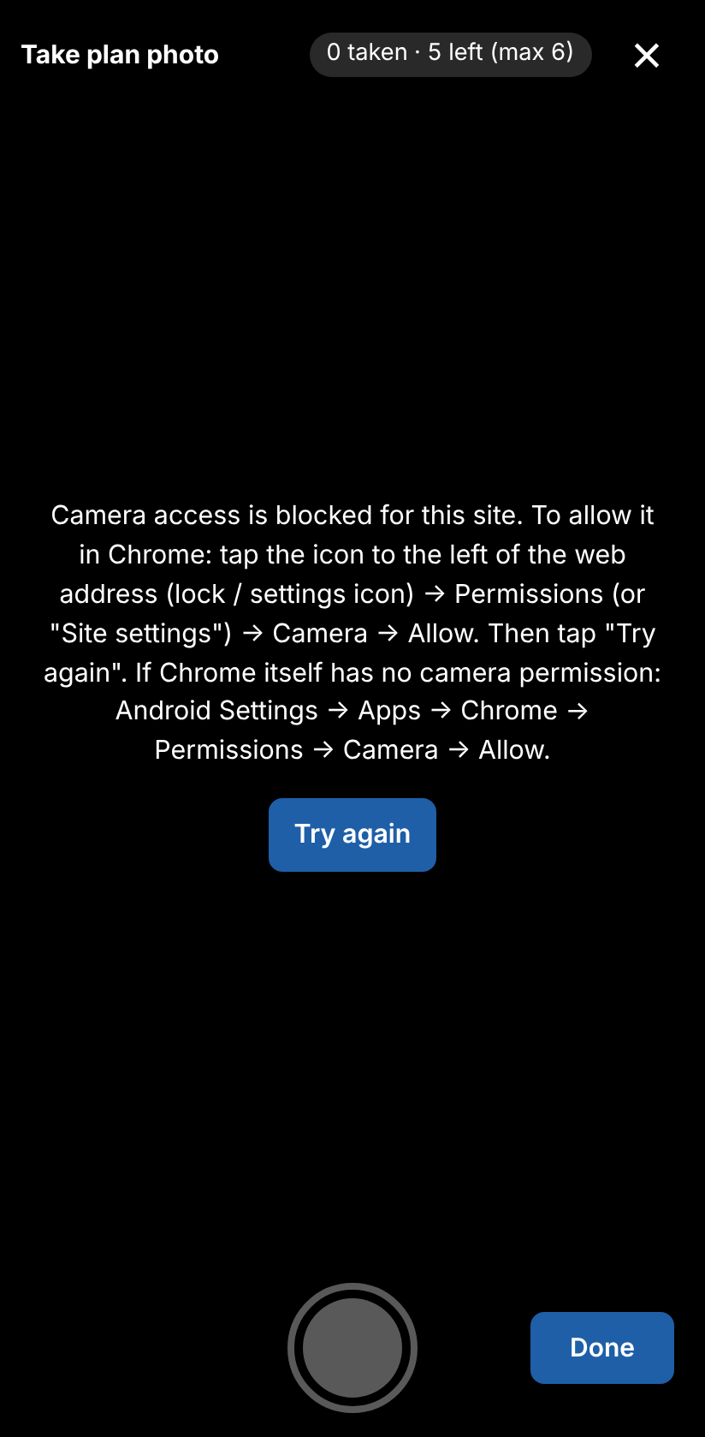
Camera blocked? Turn it back on
1
Tap the icon left of the web address
The lock or settings icon in Chrome's address bar.
Still blocked?
Android Settings > Apps > Chrome > Permissions > Camera > Allow.
2
Tap Permissions
On some phones it is called Site settings.
Camera busy?
Close WhatsApp or the Camera app, then tap Try again.
3
Tap Camera, then Allow
The camera is now allowed for meetingchecker.com.
4
Go back and tap Try again
The camera opens. Take your photo.
Still not working?
Restart the phone. Then call your admin.
Lock icon
›
Permissions
›
Camera
›
Allow
Message: camera access is blocked
Notes:
If camera access was refused, the camera screen shows "Camera access is blocked for this site" with the steps to fix it. In Chrome: tap the icon to the left of the web address (a lock or a settings icon), tap Permissions (on some phones "Site settings"), tap Camera and choose Allow. Go back to the page and tap "Try again". If Chrome itself is not allowed to use the camera, open the Android Settings app > Apps > Chrome > Permissions > Camera > Allow. If the message says the camera is busy, close other apps that use the camera, such as WhatsApp or the Camera app, and tap Try again. If nothing helps, restart the phone and then contact the admin. Photos cannot be added any other way - there is no gallery upload.

Slide 14
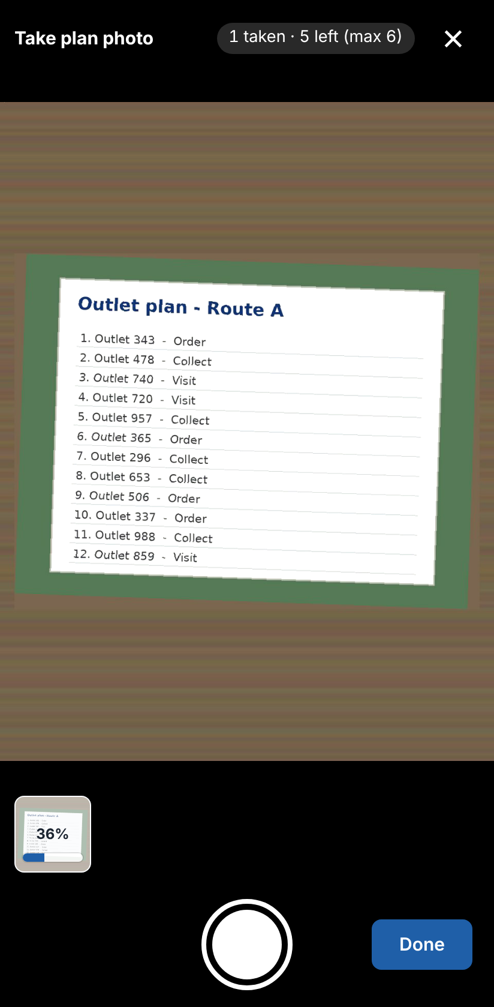
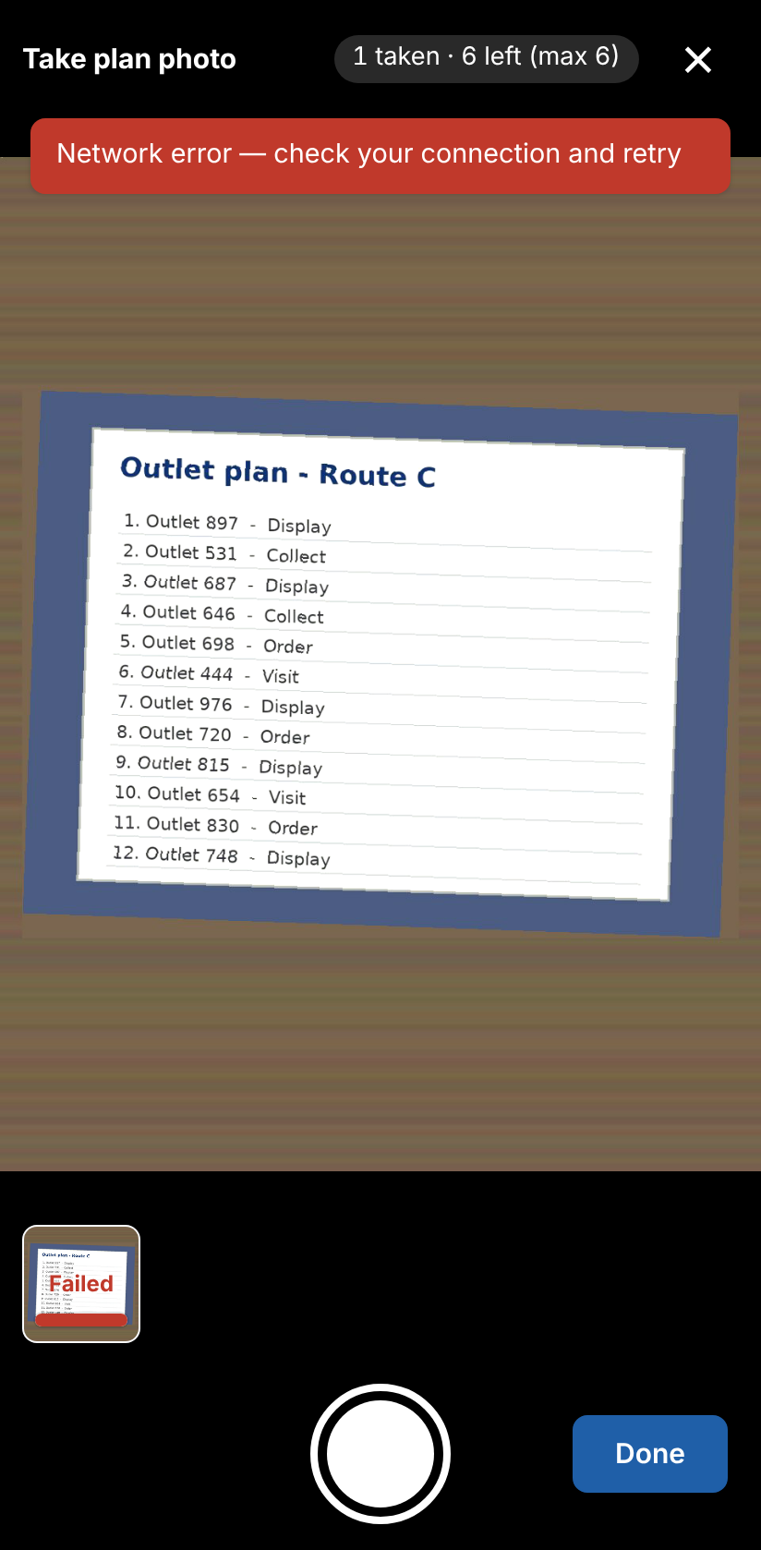



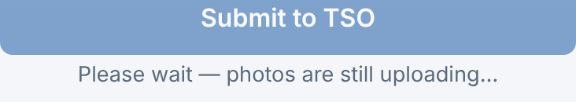
Each photo uploads at once
Preparing…, then 36%
The small photo at the bottom shows the upload. Keep the page open.
Uploaded (✓)
The photo is saved. Take the next one, or tap Done.
Failed
Tap Done, tap × on the failed photo, then take it again.
Submit waits until all uploads finish
Uploading: 36%
Failed: no network
Notes:
As soon as a photo is taken it starts uploading - you do not have to press an upload button. A small copy of the photo appears at the bottom of the camera with its own progress: Preparing…, then a percentage while it is sent, then a tick (✓) when it is saved. You can keep taking photos while earlier ones upload; they are sent one after the other. The same progress is also shown on the SR card. If a photo shows Failed (usually a weak network), a red message appears. Tap Done, tap the × on the failed tile, move to a better signal and take the photo again. While any photo is still uploading, the Submit to TSO button is grey and says "Please wait — photos are still uploading…". Do not close the page while photos are uploading.

Slide 15
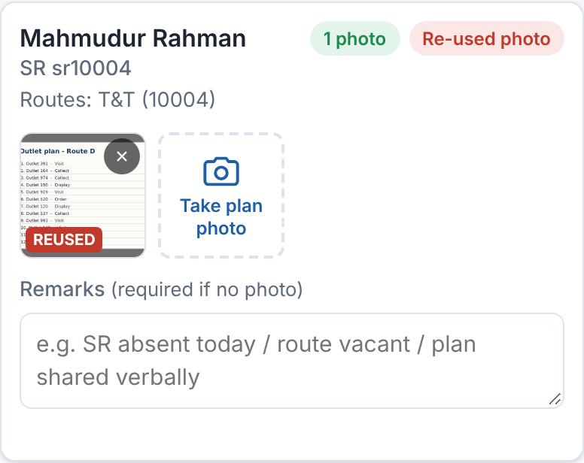
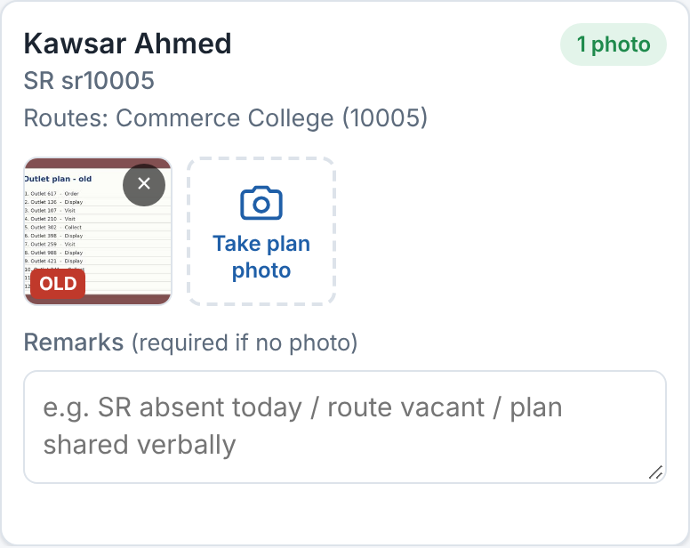



Photo rules
Live camera only
No gallery. Take the plan photo today, on the spot.
Up to 6 per SR
Up to 4 meeting photos.
Kept for 3 days
Photos older than 3 days are deleted.
REUSED flag
OLD flag
Flags are seen by your TSO and the Checker
REUSED = this exact photo was uploaded before. OLD = photo taken more than 2 days before the report date.
Wrong photo?
Tap × on it and take it again before you submit.
Notes:
Photos can only be taken live with the in-app camera; the gallery cannot be used, so take the plan photo on the spot every day. The portal still checks every photo. If the exact same photo was uploaded before (for any SR or any day), it shows REUSED and the SR gets a red "Re-used photo" badge. If the photo date is more than 2 days older than the report date, it shows OLD. You also get a red warning message. These flags are visible to the TSO and to the check-back team. Limits: 6 plan photos per SR, 4 meeting photos. Only the last 3 days are kept; older photos are deleted automatically.

Slide 16
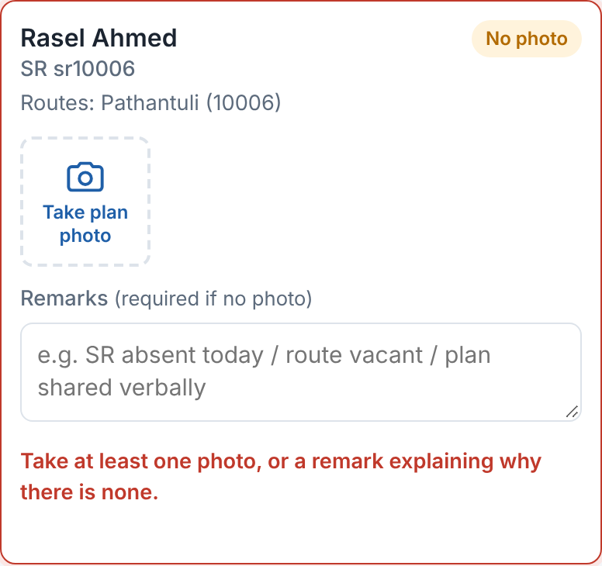
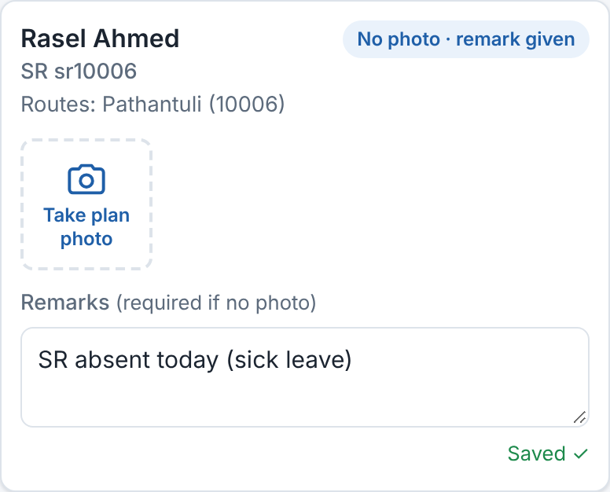
No photo? Write a remark
1
Tap the Remarks box
Under the photos of that SR.
2
Write the reason
e.g. SR absent today / route vacant.
3
Tap outside the box
Wait for "Saved ✓".
OK: remark given
Missing: no photo, no remark
Every SR needs at least one photo OR a remark. Otherwise you cannot submit.
Notes:
Sometimes there is no plan photo: the SR is absent, the route is vacant, or the plan was shared verbally. Then write a short, honest reason in Remarks. The badge changes to "No photo · remark given". A card with a red border and the red text "Take at least one photo, or a remark explaining why there is none" means the SR still needs a photo or a remark.

Slide 17
Submit to TSO
04
Send the report, fix errors, and handle returns

Slide 18
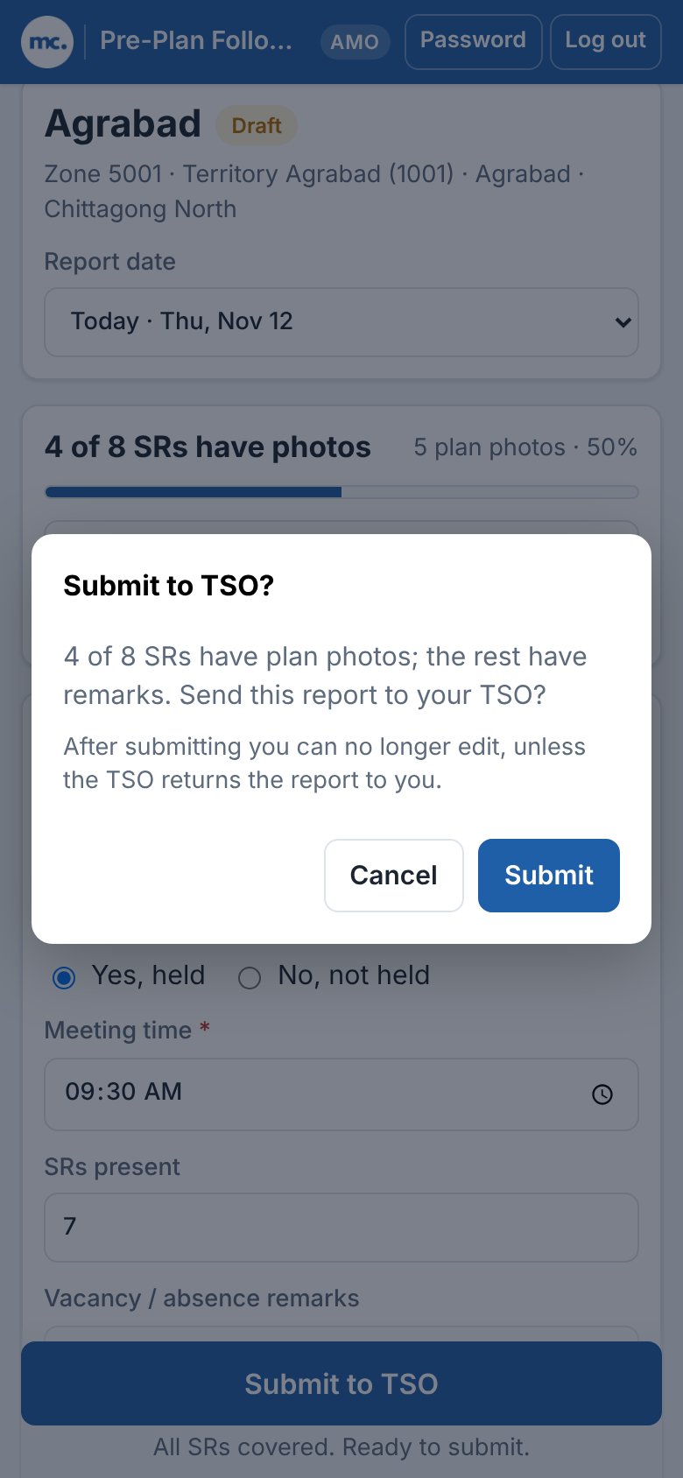

Submit your report
Ready to submit
Done!
You see "Report submitted to TSO". The report goes to your TSO.
1
Check the hint
"All SRs covered. Ready to submit."
2
Tap Submit to TSO
At the bottom of the page.
Before you tap Submit
After submitting you cannot edit any more, unless the TSO returns the report.
3
Read and tap Submit
Tap Cancel if you want to check again.
Confirm
Notes:
When every SR has a photo or remark and the meeting is filled in, the hint under the button says "All SRs covered. Ready to submit." Tapping Submit to TSO opens a confirmation box with a summary. Tap Submit to send it. A green message "Report submitted to TSO" confirms it.

Slide 19
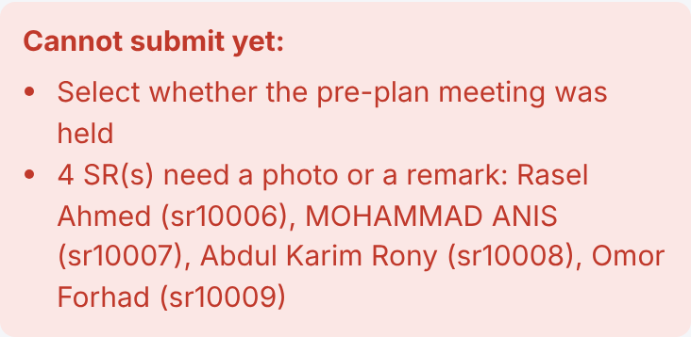
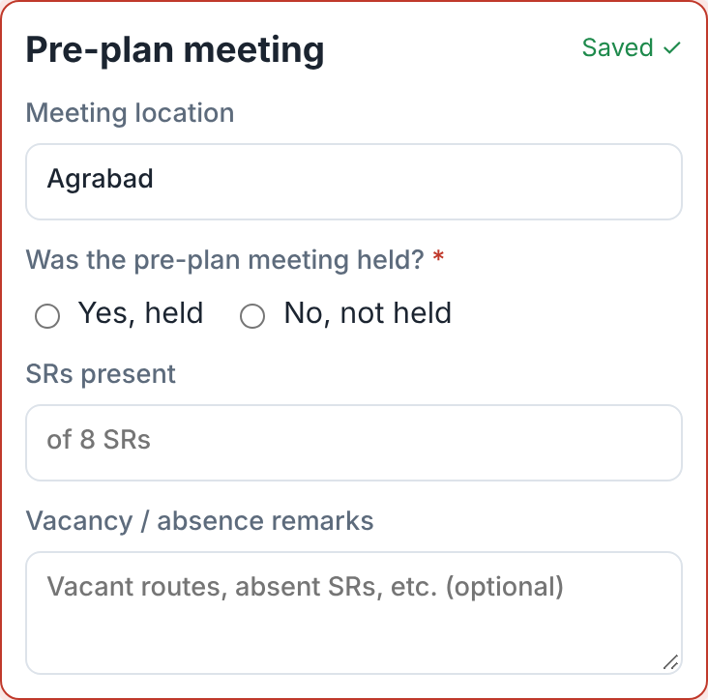
If you see "Cannot submit yet"
1
Read the list
It says exactly what is missing.
2
Find the red cards
The page jumps to the first one.
3
Fix and submit again
Take the photo, or add the remark or meeting answer.
Error list
Common errors
Meeting not answered, no meeting time or photo, SRs without photo or remark.
Red border = needs work
Notes:
If something is missing, a red box "Cannot submit yet:" lists every problem, and the cards that need work get a red border. Typical messages: "Select whether the pre-plan meeting was held", "Enter the meeting time", "Upload at least one meeting photo", "Enter the reason the meeting was not held", and "N SR(s) need a photo or a remark". Fix them and tap Submit to TSO again.

Slide 20
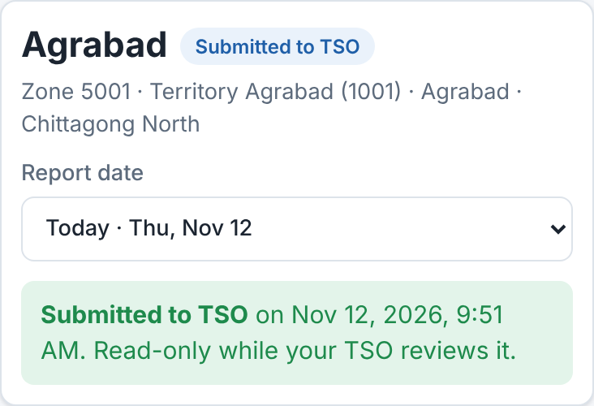
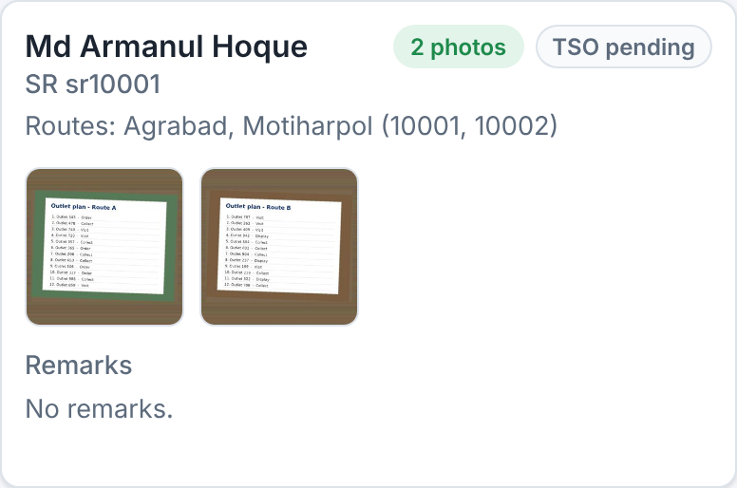

After you submit: the report is locked
Submitted to TSO
Read-only SR card
Read-only
You can look at the report, but not change it.
TSO pending / approved
Each SR shows what your TSO decided.
Final
When the TSO submits the territory, it is final.
Notes:
After submitting, a green banner shows "Submitted to TSO on <date and time>. Read-only while your TSO reviews it." The Take photo tiles and remark boxes disappear. Each SR shows "TSO pending" or "TSO approved ✓". When the TSO submits the whole territory the banner says "Final" and nothing can change any more.

Slide 21
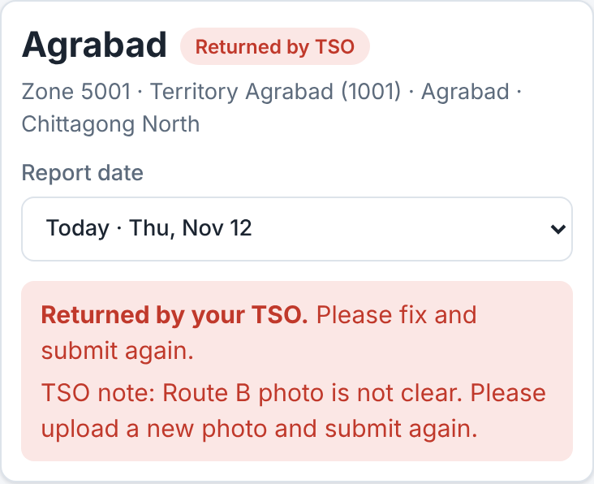
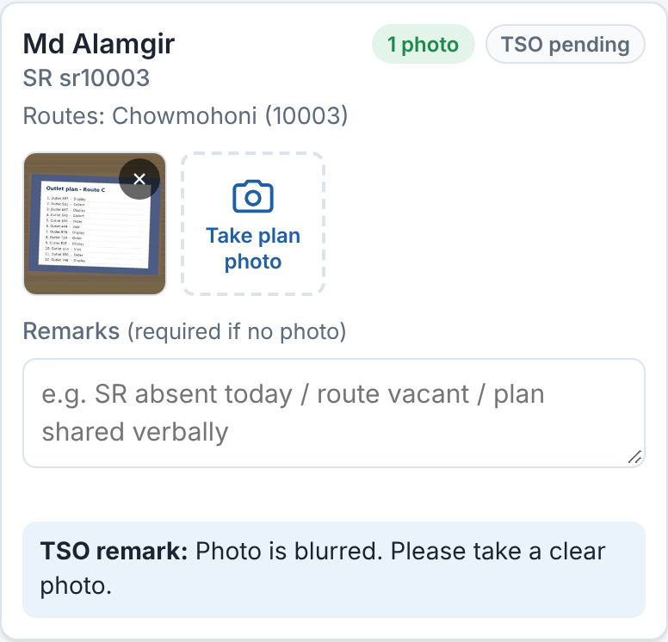

When the TSO returns your report
1
Read the TSO note
It is in the red box at the top.
2
Check SR remarks
Blue "TSO remark" boxes show what to fix.
3
Fix it
Take a new, clear photo or write a better remark.
Returned by TSO
TSO remark on an SR
4
Tap Re-submit to TSO
It goes back to your TSO.
The button now says Re-submit to TSO
Notes:
If the TSO is not satisfied, the status becomes "Returned by TSO" and a red banner says "Returned by your TSO. Please fix and submit again." with the TSO note. SRs can also carry a "TSO remark". The report is editable again. Fix the problems - for a blurred photo, tap × on it and take a new photo with the camera - and tap "Re-submit to TSO". Do this the same day if possible.

Slide 22
Checklist and help
05
Your daily routine, quick fixes, and who to ask

Slide 23
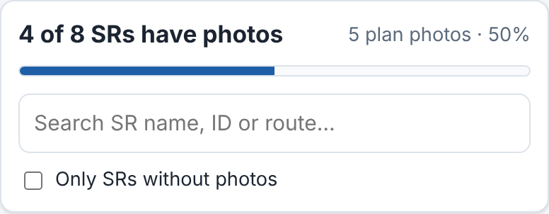
Daily checklist
✓
Sign in and check the Report date is Today
✓
Answer "Was the pre-plan meeting held?"
✓
Held: add meeting time, take meeting photo. Not held: reason
Progress bar
✓
Take live plan photos with the camera for every SR
Do it early
Submit soon after the meeting. Your TSO needs time to review before the day ends.
✓
No photo? Write a remark for that SR
✓
Wait until every photo shows ✓ (no upload running)
✓
Tap Submit to TSO and confirm
✓
Later: check if the TSO returned the report
Notes:
Hand this out or ask AMOs to take a photo of this slide. The progress bar at the top counts SRs that have photos; SRs with only a remark do not count as photos, but they are still accepted for submit.

Slide 24






Problems and quick fixes
Slow network
Move to a better signal. Wait for ✓ on each photo before you take many more.
Upload failed
Tap × on the failed photo, then take it again. Your other photos are safe.
Camera does not open
Chrome: lock icon > Permissions > Camera > Allow. Then tap Try again.
No gallery button
Correct. Photos can only be taken live with the camera.
Forgot password
Ask your admin to reset it. You get a new password. Then change it.
Wrong date
Change Report date at the top. If you already submitted, ask your TSO to return it.
Session expired?
Just sign in again. Your saved work is kept.
Notes:
Most problems are network problems. The message "Network error — check your connection and retry" means the photo did not arrive: tap Done, remove the failed tile and take the photo again. If the camera does not open, camera access is blocked for the site: in Chrome tap the lock icon left of the address > Permissions > Camera > Allow, then Try again (see the "Camera blocked" slide). There is no button to pick photos from the gallery - this is on purpose. Changing the date while photos are uploading is blocked ("Wait for uploads to finish first"). Forgotten passwords can only be reset by the admin; the admin gives a new password and the AMO should change it right away. A submitted report for the wrong day can only be reopened by the TSO returning it.

Slide 25

Need help?
meetingchecker.com
Admin: password reset
Contact your admin for sign-in problems and password resets. Ask your TSO about returned reports.
Notes:
Close by repeating: one report per day, every SR needs a photo or a remark, never share the password. Give AMOs the admin contact for their area and the site address meetingchecker.com.

