Slide 1
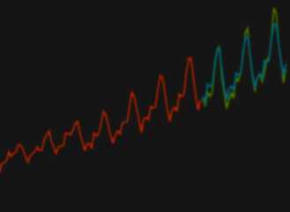
A Comprehensive Study of Deep Learning Techniques for Supply
Chain Demand Forecasting
IPE 4000
Submitted by, Asef Shahriar Roll no. 1611010 Department of IEM, KUET | Supervised by, Md. Al Amin Assistant Professor Department of IEM, KUET

Slide 2
Significance Overview
Demand forecast has always been a vital part of supply chain.
Accurate forecasts = More Response, Failure Resiliency, Profit
Forecasting error = Costs to the organization
Traditional methods have low accuracy.
Today's supply chain demand is more complex incorporating more variables, seasonal components, special days, e-commerce etc..
Deep Learning have the potential to address these problems.

Slide 3
Objectives
To study different deep learning techniques for supply chain demand forecasting.
To evaluate the performance of advanced deep learning techniques in forecasting demand with high variability and seasonal components.

Slide 4
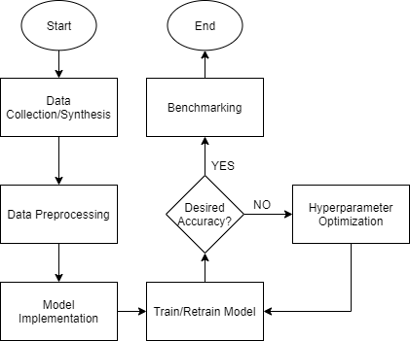
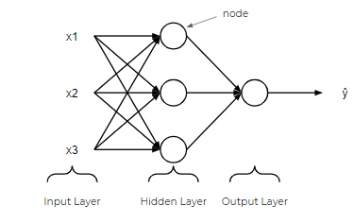


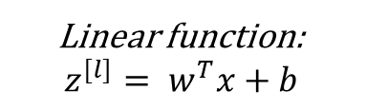
Methodology
Forecasting problem can be modeled as a supervised learning problem:
$$y=f\left(x\right)$$
Where, $x$ is previous demand data and $y$ is the forecast output.
Forward Propagation
Linear function:
$$z^{[l]}= w^{T}x+b$$
Activation function:
$$a^{[l]}=σ\left(z^{[l]}\right)$$
Cost
Function
Backpropagation

Slide 5
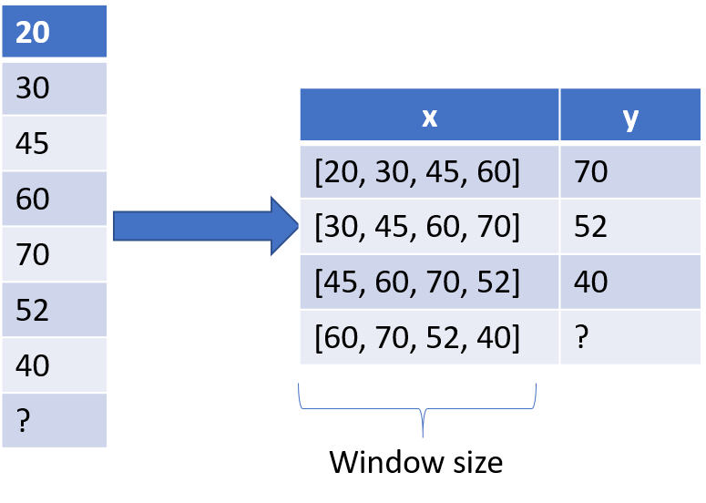
Methodology-Data
Two datasets:
Simulated Supply Chain
Real-world
Windowing

Slide 6
Methodology

Slide 7
Methodology-Models
State-of –the-art techniques | Hybrid-models | Other approaches
ANN CNN RNN LSTM | CNN-RNN CNN-LSTM | Decomposition-based model Auxiliary variable addition Transfer Learning
Model optimization
Number of hidden layers
Learning rate
Choice of activation function
Window size

Slide 8
Methodology

Slide 9

Methodology-Benchmarking
Three metrics:
$RMSE= \sqrt{\frac{\sum_{1}^{n}{\left(\hat{y}−y\right)2}}{n}}$
$MAPE=\frac{1}{n}\sum_{1}^{n}{\left|\frac{y−\hat{y}}{y}\right|}$
Data costs

Slide 10
Expected Results
Reduced RMSE and MAPE.
Low data and development costs.
Model feasibility considering costs and other challenges.

Slide 11
Timeframe
Literature Study – Already completed
Data Collection – by February 2020
Model Implementation and Benchmarking - by March 2020
Results and Discussion – by April 2020

Slide 12

Thank you!

