Slide 1

Chick-Fil-A Analysis

Slide 2
Agenda
Business Context
Issues
Dashboard
Data Governance

Slide 3
Business Context
Cleaned Data
Chick-Fil-A shared their data for us to find meaningful insight and trends
Cleaned the data by removing commas, quotation marks and special symbols from the csv file
Next we imported the file into SQL Server by specifying the data format for each column
Received Data
Imported into SQL Server
Exported tables to Tableau
Next, we created dimension and fact tables to help us query
Exported tables to tableau and created custom SQL queries to visualize data
Combined the individual graphs into a simple and interactive dashboard for Executives to use
Transformation
Created a dashboard
Business Context
Issues
Dashboard
Data Governance
Notes:
Add box adter “imported into sql server” to seperate transforming into dim and fact tables

Slide 4
Issues we ran into
Lack of Standardization
No employee ID, so compiling tables had to be done by parsing names and separating names in some cases
Shifts had to be standardized arbitrarily
Dates had different formats
Table 1
Table 2
Use of commas and quotations in raw data
Varchar data type also hindered joins
Lack of primary keys
Business Context
Issues
Dashboard
Data Governance
Notes:
Standardized data dictionary example job types
Standardized shift dimensions
Preset date format

Slide 5
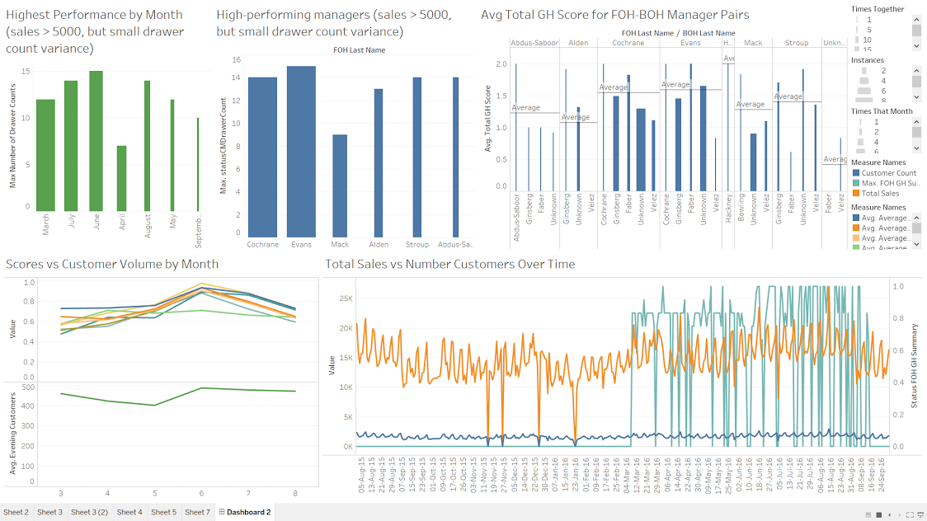
Dashboard
Business Context
Issues
Dashboard
Data Governance
Notes:
In making our dashboard we were interested in finding exceptional performance as well as exploring whether volume breaks systems. We did this by graphing manager and scorecard data. Here we have metrics detailing performance, sales, customer volume, and seasonality. By cross referencing metrics of both employees and the franchise as a whole, we can identify areas of improvement based on either individual performance or the total operation. This is a useful setup for preventing the finger from being pointed in the wrong direction, which could lower team morale or allow shirking.

Slide 6
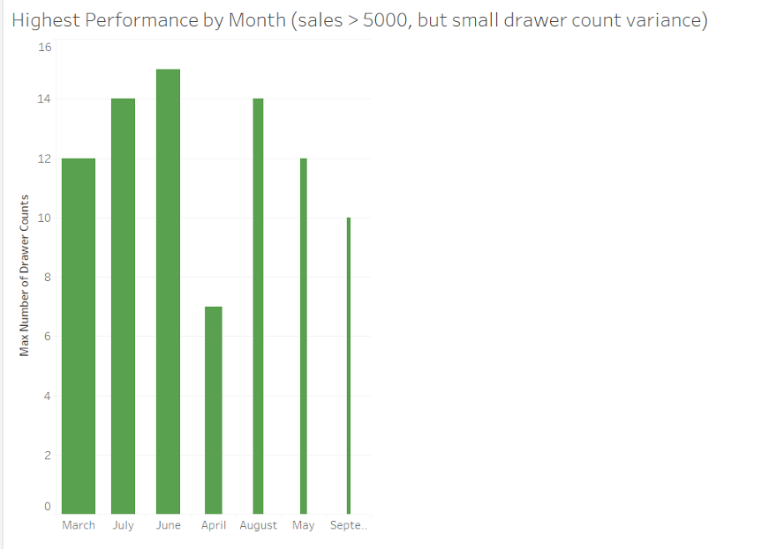
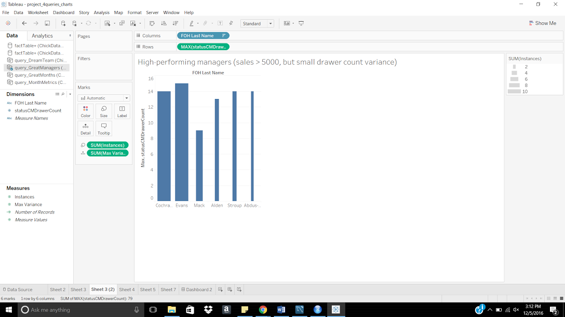
Dashboard
Business Context
Issues
Dashboard
Data Governance
Notes:
On the right is a chart displaying FOH managers who were working under busy conditions (sales > 5000) but completed at least one drawer count and had a low drawer count variance (less than $5.00 difference). The thickness of the columns illustrates how often the manager had such a high-performance day in the data we were given, while column height denotes the maximum number of drawer counts they performed on such a day. These are the managers you want working on the most important/ busy days of the year because they don’t appear to be prone to error even under pressure. To its left is a very similar chart, displaying the same performance metrics by month rather than by manager. Note that the columns are sorted by number of times there was such a high-performance day that month, rather than chronologically. Hiring patterns can be mapped to months based on the volume of sales to smooth the overall operations. This can also be used to investigate underperforming days ie July has had high volumes so far but today was much lower than expected. These dashboard elements might be skewed based on weekend days and so can be adjusted to account for day of week sales trends

Slide 7
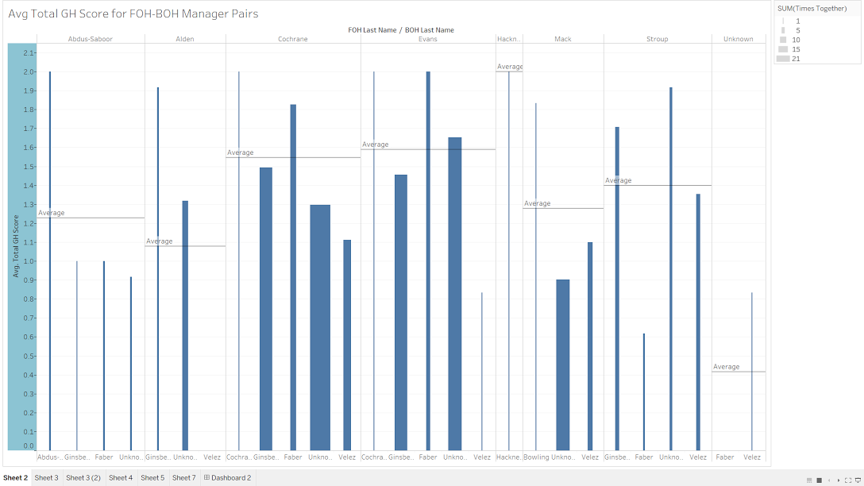
Dashboard
Business Context
Issues
Dashboard
Data Governance
Notes:
In this chart we investigated the possibility of there being ‘dream teams,’ or managers that work especially well together. Each column represents a FOH-BOH manager pair (FOH name on top), with the height telling us the average cumulative general health score when that pair is working and the width showing how often those manager pairs appeared in our data. Based on the results, we can identify managers who are generally higher performing with others and those who are less so. This chart doesn’t inform us of the underlying causes, but manager behavior can be observed

Slide 8
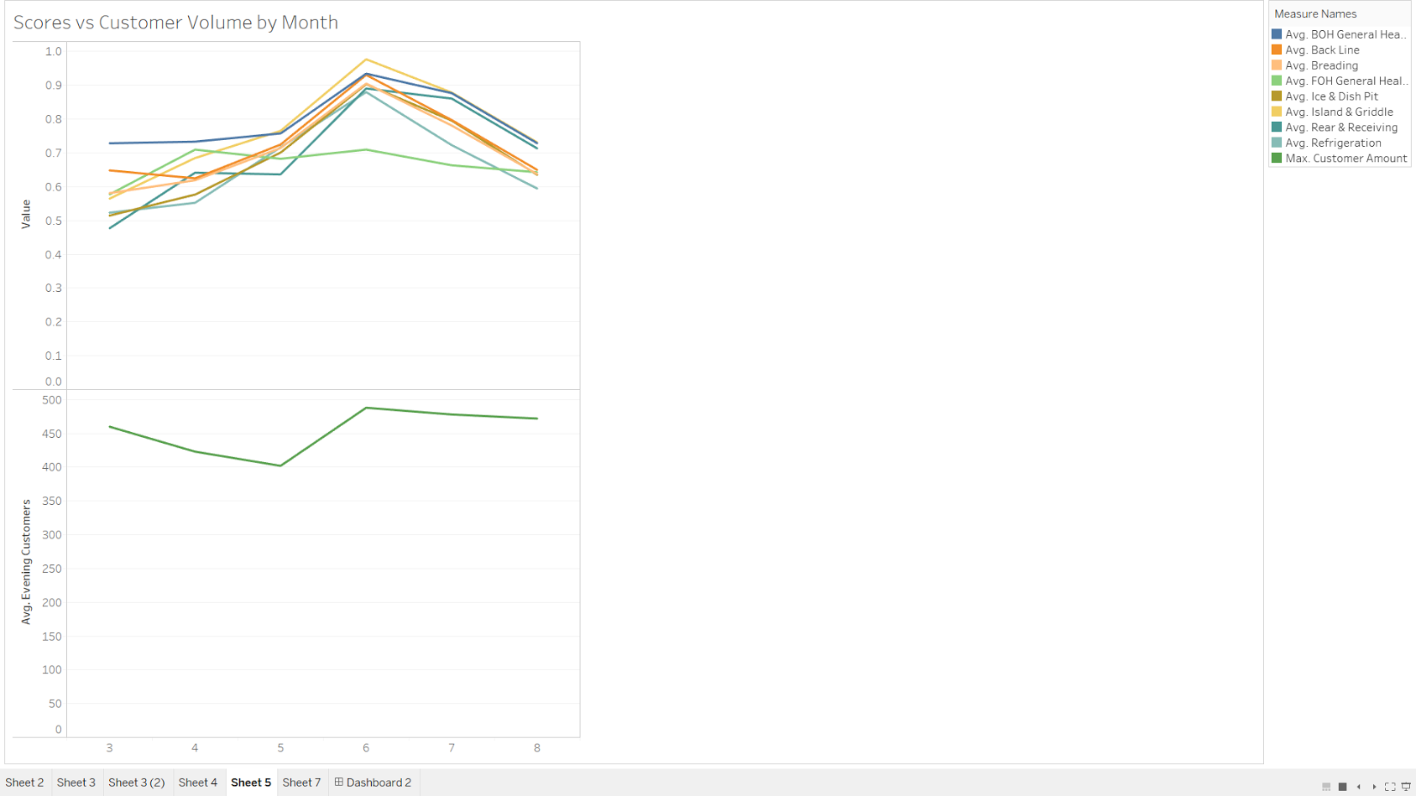
Dashboard
Business Context
Issues
Dashboard
Data Governance
Notes:
To see whether volume breaks systems, we included this chart contrasting the average scorecard metrics per month with the average number of customers per day that month all during dinner shift. We only used data from 2016 on days there were customers, but the monthly scores are still dragged low by days when the scorecard data wasn’t inputted and thus defaulted to 0. this highlights which scorecard metrics are affected, If volume does break systems, we will observe an inverse relationship between customer volume and scores. Findings may point to behavioral aspects of how customer volume affects performance or which steps have low capacity and may be at risk of causing a bottleneck ie is the breading or griddle quality compromised when there are too many people? One line here stands out --- FOH general health might be taxed by high volume

Slide 9
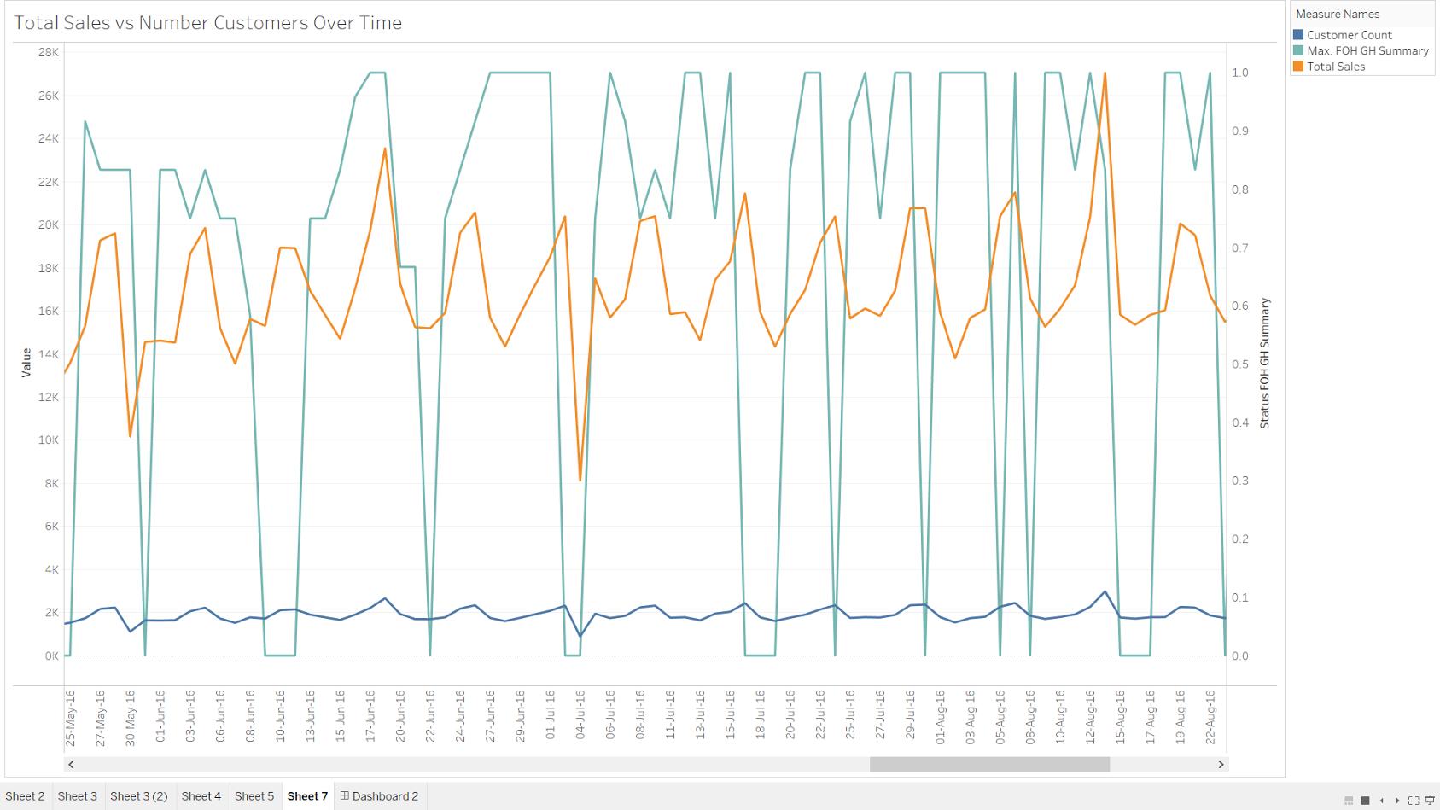
Dashboard
Business Context
Issues
Dashboard
Data Governance
Notes:
Here is a line graph displaying the daily number of customers and sales over time, as well as the FOH general health summary metric in order to see whether employees were unable to input the metric on high-volume days.
--point out the same volume with different health scores to argue that “volume breaks systems” isn’t the only determinant. It may vary based on staffing, misreporting, etc.
Blue --- customer count
Light green --- FOH general health
Orange --- total sales

Slide 10
Data Management Across the Enterprise
Corporate Standardization
Essential for maintaining smooth integration and lower cost
Implement standardized reporting process where all franchises complete and report to corporate on agreed upon regular time intervals
Franchise Flexibility
Franchise owners desire to track metrics that are important for their unique operations
Business Intelligence Developers
Data governance experts to manage the requirements of both corporate and franchise owners
Partition data to meet corporate’s standardized requirements and allow flexibility to collect data for individual franchises
Business Context
Issues
Dashboard
Data Governance
Notes:
For example, the data that we observed for managers isn’t very informational on a corporate level but interesting on a franchise level.

Slide 11




Trade-Offs
V.S.
Trade-off between vast amounts of data being provided to corporate at regular intervals and constantly trying to assimilate and analyze incoming data.
V.S.
Trade-off between franchise flexibility to add new metrics unique to their location and corporate flexibility in controlling which data to collect & analyze
Business Context
Issues
Dashboard
Data Governance

Slide 12
Questions to Explore
How can we ensure that tasks are completed up to standard?
Tracking the quality of maintenance via a survey (good, fair, poor metrics) reviewing tasks completed
How can we track our employee performance?
Gather employee data in employee dimension table to track tasks by shift, thereby enhancing granularity.
How can we improve our drive-thru and catering sales?
Gather sales data by separating out in-house sales versus catering versus drive-thru sales.
Additionally, franchise might find it useful to analyze data at a shift level, instead of on a day-to-day level; this could provide more insight into the data as a whole
Business Context
Issues
Dashboard
Data Governance

